Slide 1



ONLINE SALES ANALYSIS – POWER BI
BY ARDRA MOHAN

Slide 2

INTRODUCTION
Online Sales Analysis refers to the process of collecting, examining, and interpreting data from online sales channels.
This data can include information on product sales, customer demographics, purchasing patterns, and more.
The primary objective is to uncover trends and patterns that can inform strategic decisions and drive business growth.

Slide 3

About Dataset
It is a dummy dataset on online sales analysis published in Kaggle in the last week of October 2024.
It includes
Invoice No
Stock Code
Description
Quantity
Invoice Date
Unit Price
Customer ID
Country
Discount
Payment Method
Shipping Cost
Category
Sales Channel
Return Status
Shipment Provider
Warehouse Location
Order Priority

Slide 4

Relevance of Online Sales Analysis
E-Commerce Boom: With the rapid growth of online shopping, analyzing sales data is more relevant than ever.
Current Trends: Understanding sales patterns can help businesses adapt to changing consumer behavior and market trends.

Slide 5
Current Importance
Market Insights: Provides real-time data on consumer behavior, preferences, and trends, enabling businesses to adapt quickly to market changes.
Competitive Advantage: Helps identify strengths, weaknesses, opportunities, and threats, allowing businesses to stay ahead of competitors.
Operational Efficiency: Optimizes inventory management, supply chain operations, and workforce allocation based on sales data.
Customer Retention: Analyzes customer purchase patterns and feedback to improve customer experience and loyalty programs.
Revenue Growth: Identifies the most profitable products, services, and sales channels, helping to maximize revenue and profitability.
Marketing Effectiveness: Evaluates the impact of marketing campaigns and promotions, ensuring better allocation of marketing budgets.

Slide 6
Future Importance
Predictive Analytics: Uses historical sales data to predict future trends and consumer behaviors, aiding in proactive decision-making.
Personalization: Enhances customer experience through personalized recommendations and targeted marketing based on data-driven insights.
Global Expansion: Supports businesses in understanding and entering new markets with tailored strategies based on local sales analysis.
Sustainability: Provides insights into sustainable practices and products, aligning with the growing demand for eco-friendly options.
Technological Integration: Facilitates the integration of emerging technologies like AI and IoT to streamline sales processes and enhance data accuracy.
Adaptability: Prepares businesses to quickly adapt to future disruptions, such as economic shifts, technological advancements, and changing consumer behaviors.

Slide 7
INSIGHTS AND RECOMANDATIONS
Discounts provided by online markets have caused a potential decrease in total sales. The unavailability of cost of products has caused difficulty in calculating the profit or risks associated with the sales
- Adding the cost of products or profit margins to the dataset will be helpful in analyzing the financial health and efficiency of sales operations.
Accessories are sold the most and maximum orders are also from accessories and stationary items the least.
- Marketing the least sold items can add more customers thereby a rise in sales can also be expected

Slide 8
Overall Sales are most during the month of June/July.
- Analysing the trends of sales in respect of products or quantity of items sold in each country will help in analysing the pattern of buying and could be possible to allocate resources effectively.
High return rates can lead to a decrease in net sales and profits due to the cost of processing returns and potential losses on unsellable returned items.
Handling returns incurs additional costs related to shipping, restocking, and inspecting returned goods.
- Ensuring quality check of products as well as guidelines to shipment providers in handling the items can decrease the return rate.

Slide 9
High return rates might indicate dissatisfaction with product quality or customer service, potentially eroding customer trust and loyalty.
Affect brand image, business known for frequent returns may develop a negative reputation, impacting future sales.
- Analyzing return reasons can provide insights into product improvements, helping to address quality issues and better meet customer needs.

Slide 10
SUGGESTIONS
Enhance Product Descriptions: Provide detailed and accurate product information to align customer expectations with the actual product.
Quality Control: Implement strict quality control measures to ensure products meet high standards before shipping.
Customer Feedback: Collect and analyze customer feedback to identify and address common issues leading to returns.
Improved Customer Service: Offer excellent customer support to assist with product selection and address any issues promptly.
Flexible Return Policies: Balance generous return policies with measures to prevent abuse, such as restocking fees or return limits for certain customers.

Slide 11
Carrier Selection: Partner with reliable and reputable carriers that have a proven track record of timely and safe deliveries.
Multi-Carrier Strategy: Use multiple carriers to distribute risk and ensure capacity during peak times.
Secure Packaging: Ensure products are securely packaged to prevent damage during transit.
Forecast Demand: Use historical data to forecast demand during peak periods and plan resources accordingly.
Temporary Workforce: Hire temporary workers during busy seasons to handle increased volumes.

Slide 12

CONCLUSION
Informed Decision-Making: Businesses can make data-driven decisions, from inventory management to marketing strategies, ensuring resources are allocated effectively.
Customer Insights: Understanding customer demographics, purchasing habits, and preferences enables targeted marketing and personalized customer experiences.
Trend Identification: Analyzing sales data over time helps identify trends and seasonal patterns, allowing for proactive planning and forecasting.

Slide 13
Profitability Analysis: Evaluating the impact of discounts, return rates, and shipping costs on overall profitability helps in refining pricing strategies and operational processes.
Market Expansion: Geographic sales analysis provides a roadmap for exploring new markets and optimizing regional sales strategies.
Customer Satisfaction: By addressing pain points such as high return rates and delivery delays, businesses can enhance customer satisfaction and loyalty.

Slide 14
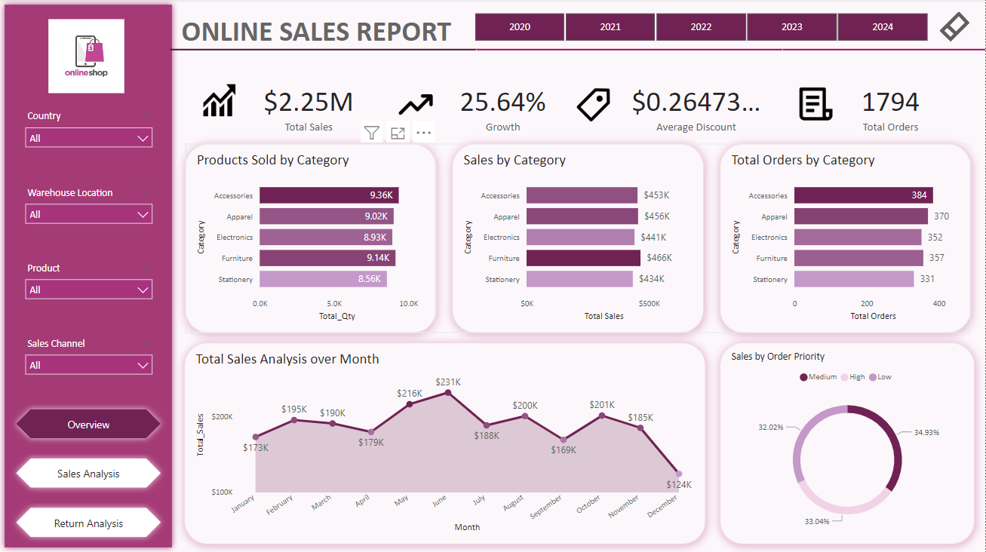

Slide 15
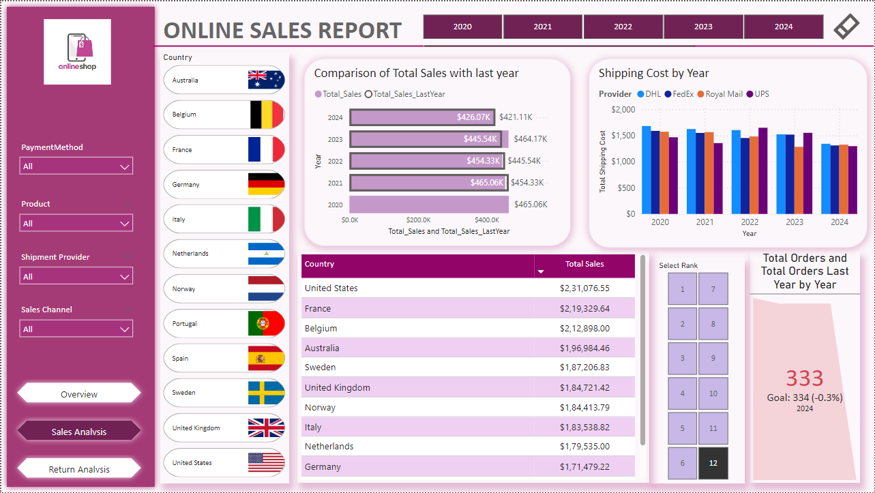

Slide 16
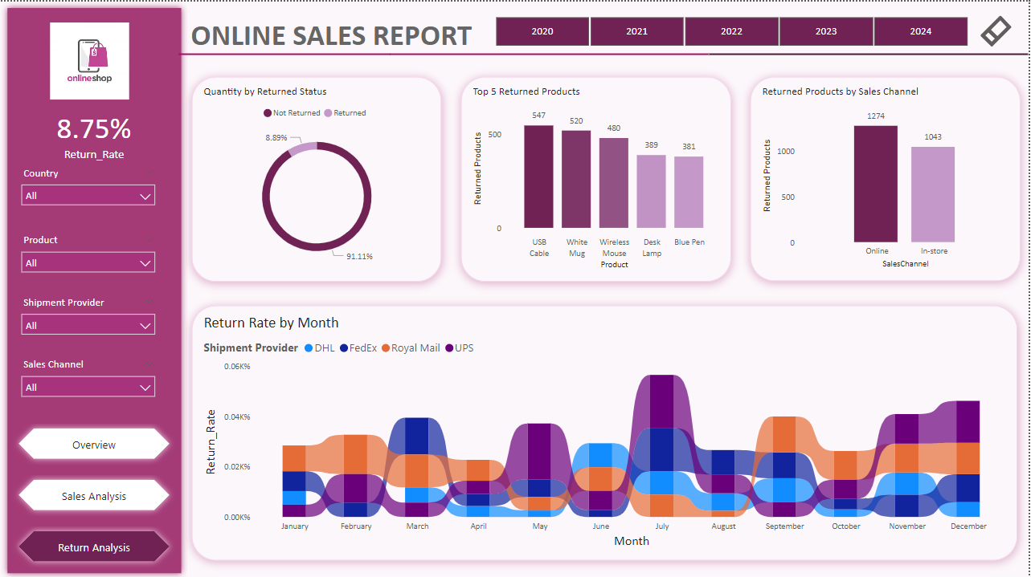

Slide 17
THANK YOU

