Slide 1
Project : Comprehensive Water Quality Assessment and Potability Prediction using Multi-parameter Analysis
Aim:
The objective of this machine learning problem is to predict whether a given set of water quality parameters meets the potability criteria or not based on the provided features
Submitted by : Ardra p

Slide 2
Steps Followed
Imported the data set using pd.read_csv function.
df.info() : used for getting the details of data frame like column name, non-null count and data type.
Data frame contains lot of object data type. Need to convert this to numeric columns.
df.describe() : Used for getting count, mean, std, min , max, etc.. Values of numeric column.
Plotted the scatter plot to get the distribution of data.
From scatter plot I found that data is having outliers.
Presence of non neumeric values need to remove

Slide 3
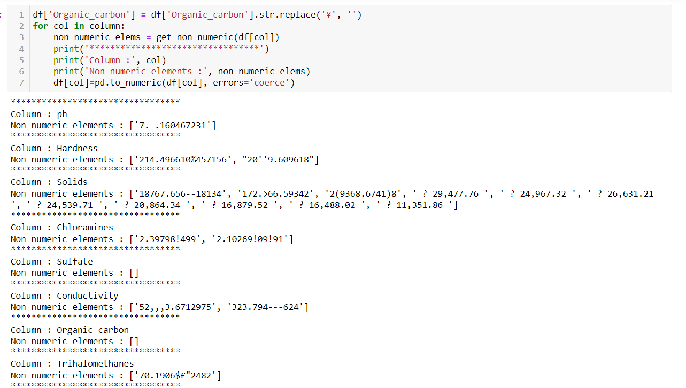
Steps Followed

Slide 4
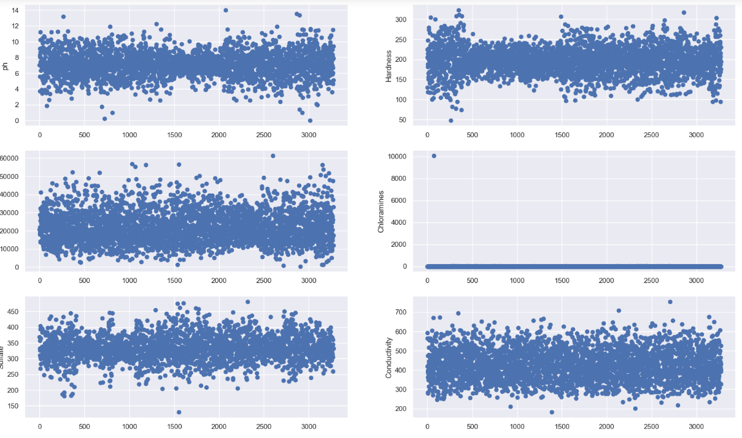
Steps Followed
Next need to do some EDA to get more idea about the data.

Slide 5
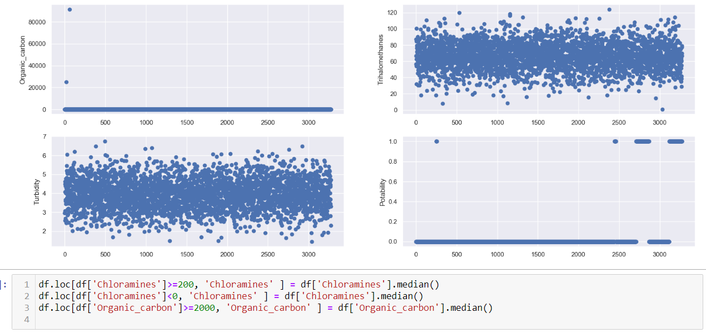
Steps Followed

Slide 6
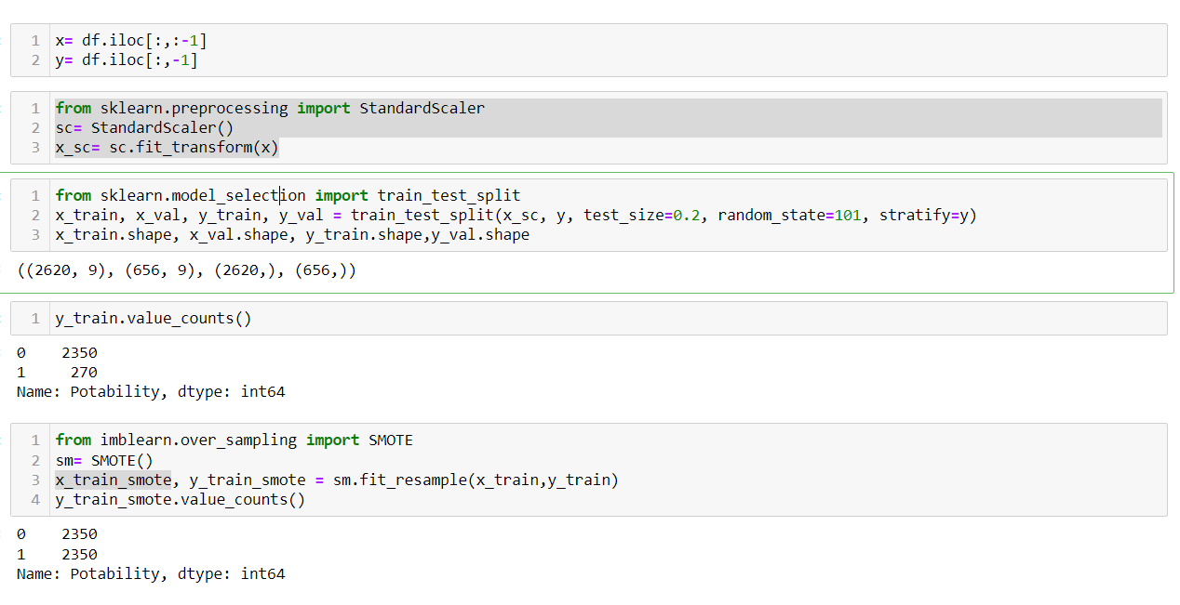
Steps Followed
After all this I have spitted the target and features.

Slide 7
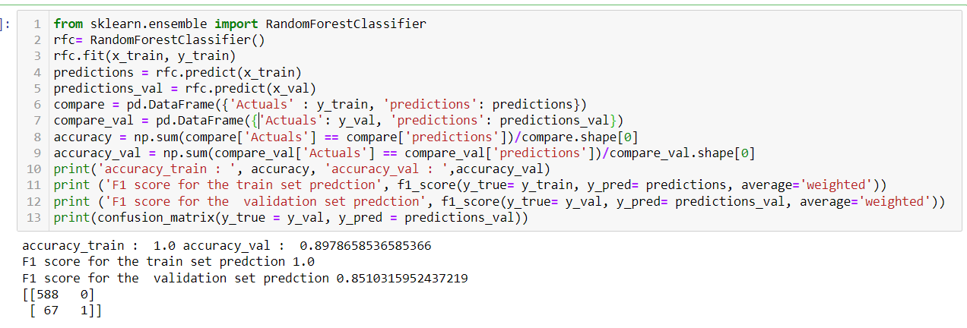
Steps Followed

Slide 8
Thank You

