Slide 1



Plant Disease Detection using Deep Learning
Ardra Padmakumar
Internship ID : INTERNSHIP_17513641056863b20937d78
Batch code: AUG_AIML_5

Slide 2

Learning Objectives
• Understand the importance of automated plant disease detection.
• Explore tools and technologies used in the project.
• Learn the methodology: dataset preparation, CNN model building, training, evaluation.
• Analyze results and evaluation metrics (accuracy, confusion matrix).
• Conclude with challenges, solutions, and future improvements.
GOAL
Source :
www.freepik.com/

Slide 3
Tools and Technology used
• Programming Language: Python
• Libraries:
• TensorFlow & Keras → Deep Learning (CNN)
• Matplotlib, Seaborn → Data Visualization
• scikit-learn → Classification report, Confusion matrix
• pandas, os → Data handling
• Environment: Google Colab
• Dataset: New Plant Diseases Dataset
https://www.kaggle.com/datasets/vipoooool/new-plant-diseases-dataset

Slide 4
Methodology
Data Preparation
• Dataset structured into train, validation, and test folders.
• Preprocessing:
• Images resized to 128×128
• RGB channels maintained
• Batch size = 32
• Labels auto-inferred from directory names
• Data generators created using image_dataset_from_directory

Slide 5
Methodology
CNN Model Design
• Convolutional Neural Network (CNN) with increasing filter depth:
• Conv2D + ReLU activation
• MaxPooling layers to reduce spatial size
• Dropout layers to avoid overfitting
• Dense Layer: 1500 units, ReLU activation
• Output Layer: 38 units (for 38 classes), Softmax activation

Slide 6
Methodology
Model Training & Evaluation
• Optimizer: Adam (lr = 0.0001)
• Loss Function: Categorical Crossentropy
• Metrics: Accuracy
• Training run for 3 epochs
• Performance evaluation:
• Training set accuracy/loss
• Validation set accuracy/loss
• Test set predictions

Slide 7
Problem Statement:
• Agriculture is one of the most important sectors of the economy, and plant health plays a crucial role in ensuring food security and farmer livelihoods.
• Plant diseases, if not detected at the right time, can spread rapidly and cause significant losses in crop yield and quality. This directly affects the income of farmers and can also lead to higher market prices and reduced food availability.
• Traditional disease detection methods rely on manual observation by farmers or agricultural experts, which is:
• Time-consuming – requires constant field monitoring
• Expensive – experts may not be available in remote regions
• Error-prone – different diseases can have similar visual symptoms, leading to misdiagnosis
• With the increasing scale of farming and climate-driven variations in diseases, there is a strong need for automated, scalable, and accurate solutions.
• The challenge is to design a system that can reliably identify plant diseases from leaf images and classify them into different categories, thereby assisting farmers in taking timely and correct preventive measures.

Slide 8
Visualisation and Metrics
• Training & Validation Accuracy
• Model accuracy steadily improved across epochs, showing effective learning.
• Validation accuracy closely followed training accuracy, indicating that the model generalized well to unseen data.
• Dropout layers helped minimize overfitting, keeping the gap between training and validation small.
• Loss Curves
• Training and validation loss decreased with each epoch, confirming that the model was successfully minimizing error.
• A balanced trend between training and validation loss shows the model avoided overfitting or underfitting.
• Confusion Matrix
• Provides a class-by-class performance view.
• Highlights which disease categories were classified with high accuracy and where misclassifications occurred.
• Useful in understanding model weaknesses — e.g., diseases with visually similar symptoms may have overlapping classifications.

Slide 9
• Classification Report
• Precision: Measures how many predicted positives were correct.
• Recall: Measures how many actual positives were correctly identified.
• F1-Score: Balances precision and recall, giving an overall measure of performance.
• Report confirmed that the model maintained consistent accuracy across multiple classes, not just the dominant ones.

Slide 10
Solution:
• Developed a deep learning-based CNN model capable of identifying and classifying plant diseases from leaf images into 38 distinct categories.
• The model can process raw input images and output predictions with high accuracy, making it practical for real-world deployment.
• Provides automated, accurate, faster detection than manual methods.
• Saves model (trained_model.keras) for reuse in real-world apps.
Github Repository Link: https://github.com/ardrapadmakumar/plant-disease-detection

Slide 11
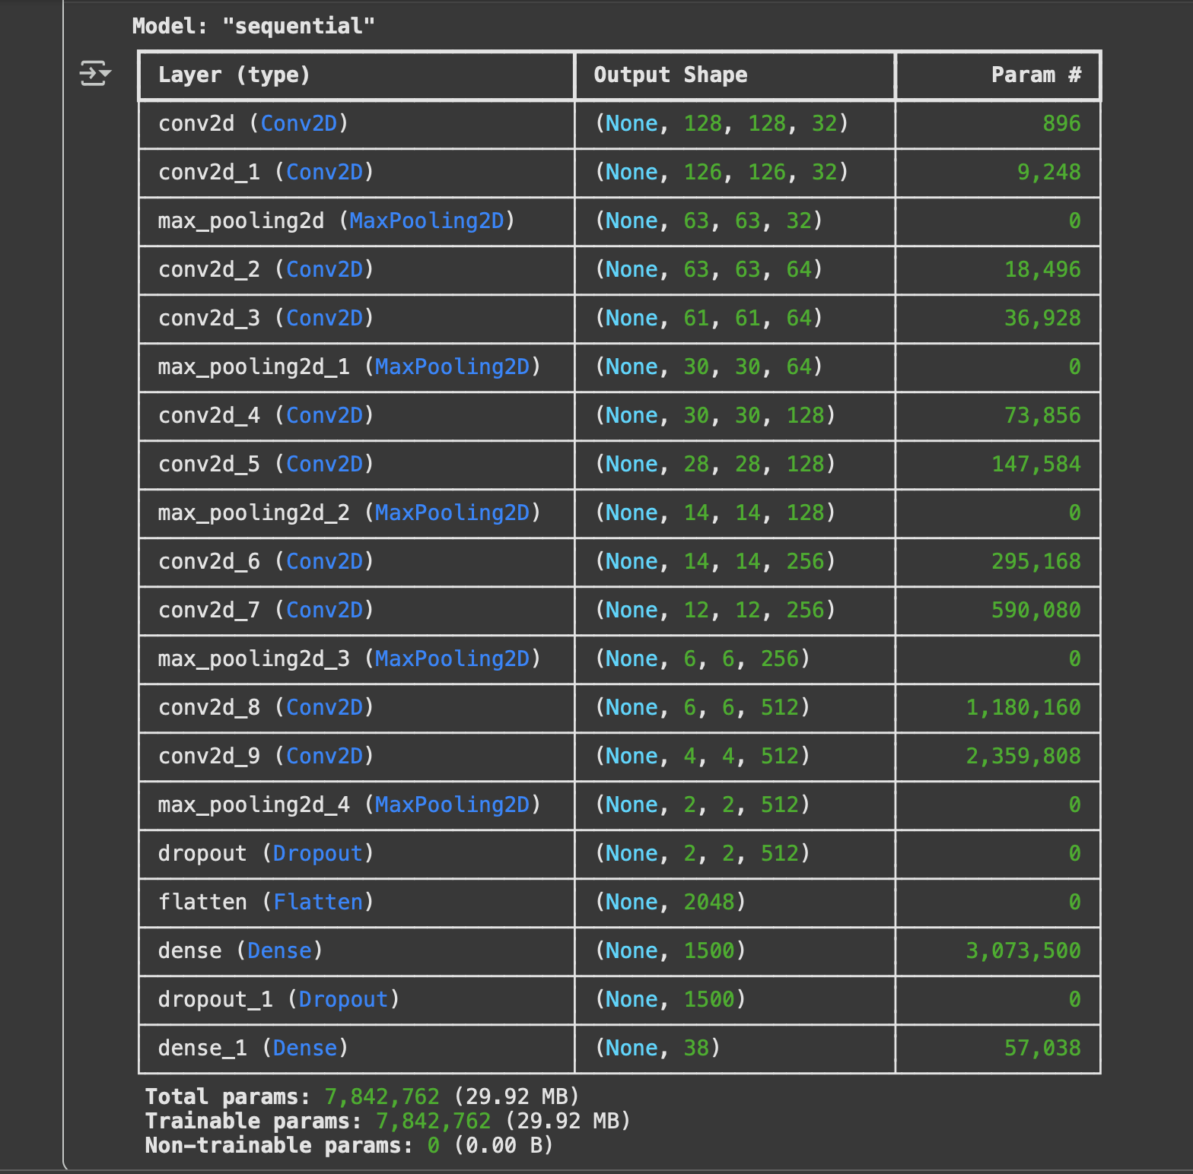
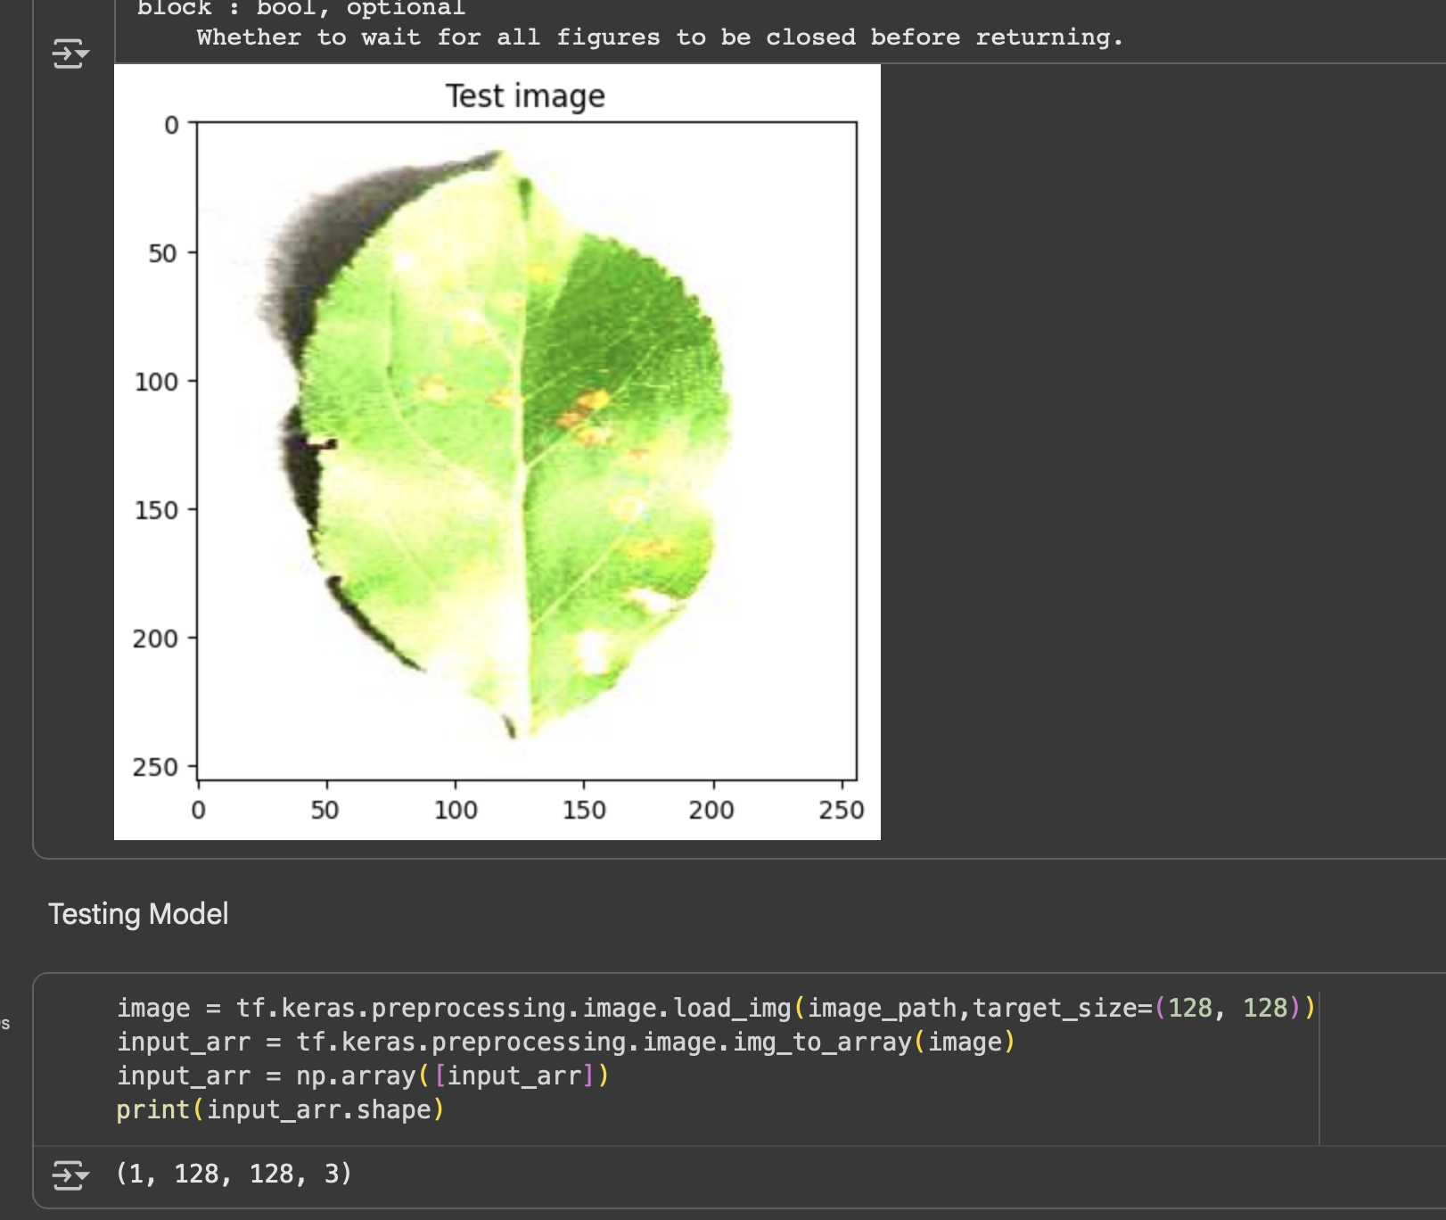
Screenshot of Output:

Slide 12
Conclusion:
• Achieved accurate classification of multiple plant diseases.
• Benefits:
• Helps farmers diagnose faster
• Reduces dependency on experts
• Potential for mobile/web deployment
• Limitations:
• Accuracy depends on dataset size & quality
• Similar-looking diseases may cause misclassification
• Future Work:
• Use transfer learning (ResNet, EfficientNet)
• Larger, more diverse datasets
• Deploy as a farmer-friendly mobile app

