Slide 1
$ Git & GitHub
$ git checkout -b “Nana Ofosu Budu”;
$ git add “Victor Munoz”;
$ git commit –m ”Aidan Henry”;
$git push origin “Muyiwa Coker”;

Slide 2

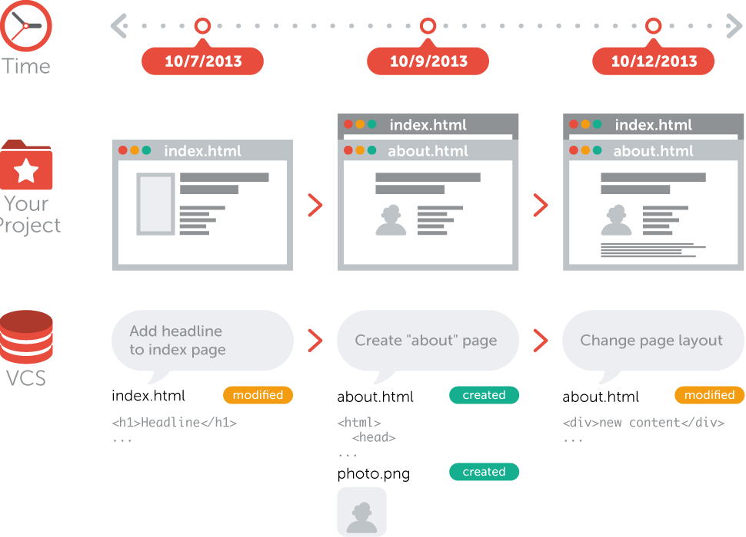



WHAT IS VERSION CONTROL?
the task of keeping a software system consisting of many versions and configurations well organized.

Slide 3
Everyday life of a developer:
Create something (code)
Save the code
Edit the code
Save the code again
What happens when you are on version 20 of your app and realize you would rather put out version 12?
It would be helpful to be able to see the changes you have made (committed) at each step in your development.

Slide 4
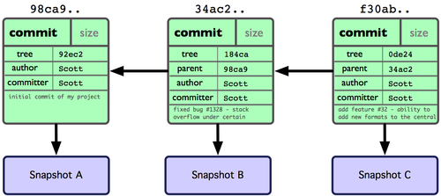
WHAT IS GIT?
Git is a fast and modern implementation of version control.
Git provides a history of document changes.
After a change is made a “snapshot” is taken
The “snapshots” are known as “COMMITS”
Git facilitates collaborative changes to files.

Slide 5
COMMIT OBJECT
Contains :
a snapshot of the content added
Author’s name and email address
Comments
Pointers to parent commits

Slide 6
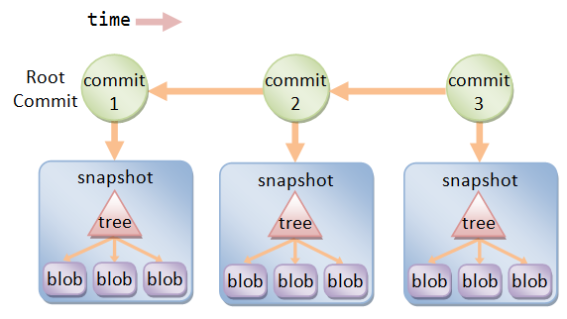
COMMIT GRAPH
Commits can be represented as a graph
Each commit has a record of the directory the files and the changes done

Slide 7
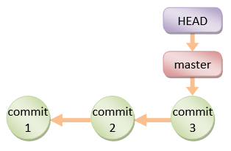
HEAD
HEAD points to a commit and a branch
The MASTER is the default branch created by git

Slide 8
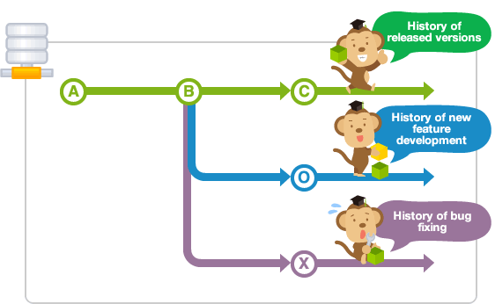
BRANCHES
Branches are used for new features or bug fixes
Keeps the main branch free from questionable code
Branches have can have their own directories and history
Branches can be used as “tasks” to be later merged into the main branch

Slide 9
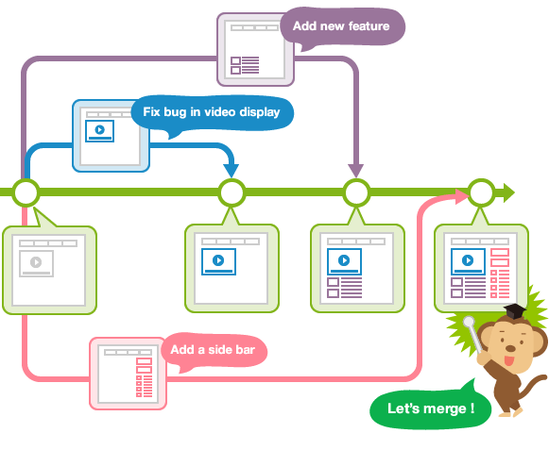
BRANCH MERGING
Once work is done on a branch it can then be merged into the main branch

Slide 10
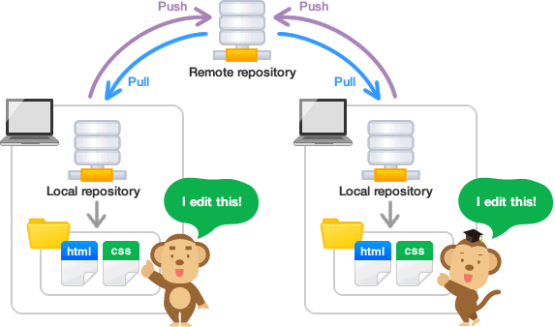
REPOSITORIES
Gitbucket , Gitlab, and Github offer remote repositories where project files are stores
Repositories can be copied by a collaborator to a local machine by “cloning” the repository
If changes are made to the remote repository collaborators can “pull” from the repository to get the most up to date version.

Slide 11
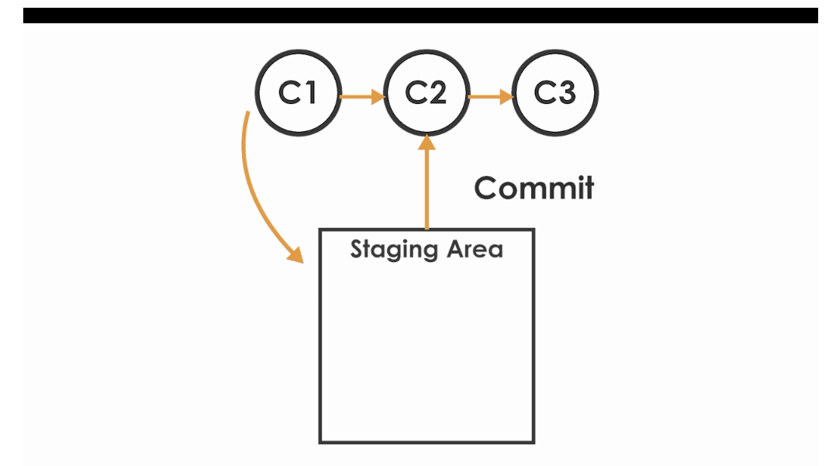
STAGING
Before committing a change the file must be placed in a staging area
C1 is placed in staging area
Changes are applied to the file and are committed to C2

Slide 12
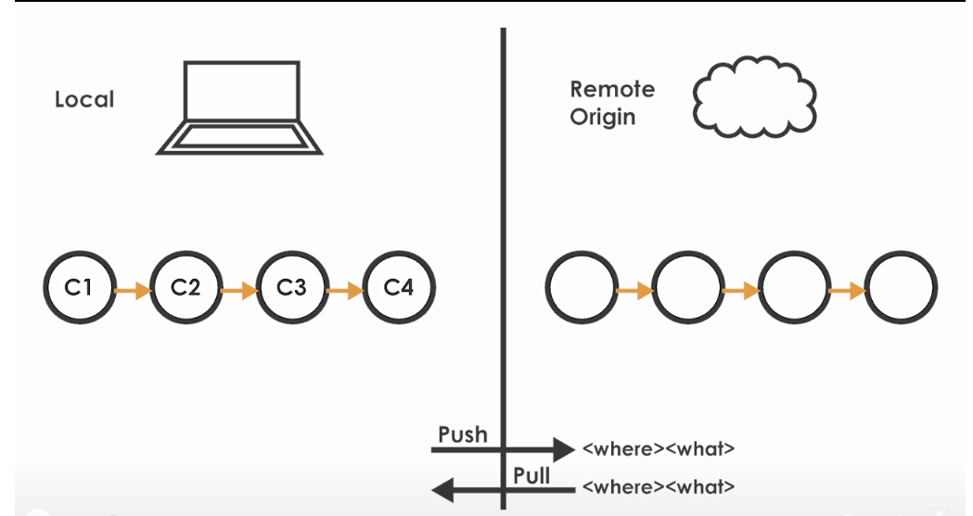
PUSHING
From the staging area a file and the changes applied can be committed on the local repository
A “push” is then required to update the remote repository

Slide 13
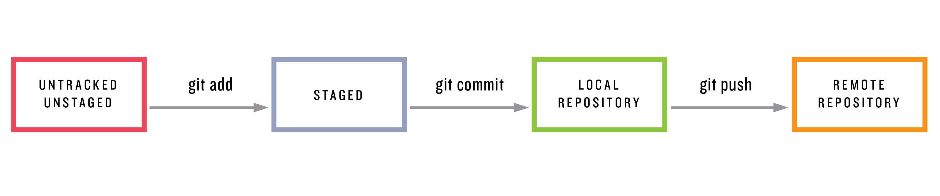
PROCESS
Various command prompt or shell commands are used in the process
Git add – to add to staging area
Git commit – to update local repo
Git push - to update remote repo

Slide 14
Git is locally enabled so you can version control items just on your desktop.
Team-centric: It allows teams to work in sequential or parallel fashion (using feature branches) and merge their code to complete the project.
History tracking: You can see a history of all your commits since the beginning of your project thanks to Git.

Slide 15
Git hands-on
Download and installer from: https://git-scm.com/downloads
Configure username and email address
git config --global user.name ”Big Poppa”
git config --global user.email bigpoppa@email.com
Create your first repository
git init myproject
cd myproject (change directories into the project folder)
Create a file index.php
git add index.php
Git commit –m “My very first commit”

Slide 16
GitHub
is a web-based hosting service for version control using Git.

Slide 17
REFERENCES
What is Version Control? (n.d.). Retrieved July 7, 2018, from https://www.git-tower.com/learn/git/videos/what-is-version- control
T. (2017, February 05). Git & GitHub Crash Course For Beginners. Retrieved January 7, 2018, from https://www.youtube.com/watch?v=SWYqp7iY_Tc
How to get started with GIT and work with GIT Remote Repo. (n.d.). Retrieved January 7, 2018, from https://www.ntu.edu.sg/home/ehchua/programming/howto/Git_H owTo.html
Atlassian. (n.d.). Git Branch | Atlassian Git Tutorial. Retrieved July 9, 2018, from https://www.atlassian.com/git/tutorials/using-branches
What's a branch? [branch] | Git Beginner's Guide for Dummies. (n.d.). Retrieved July 9, 2018, from https://backlog.com/git- tutorial/stepup/stepup1_1.html

