Slide 1


ANDROID HOME SCREEN EMERGENCY BUTTON WITH GPS MONITORING (YOUR URGENT WIDGET)
Ardy Jaya Putrasalim
001201400007
Information Technology 2014

Slide 2

1
Introduction
YourUrgentWidget

Slide 3
Background
The rises of crime index
The emergency situation people faces in daily life
Amount of time wasted to make a emergency phone call
Implement sharing location by using a single button on user’s home screen

Slide 4
Objective
Create an alternative way to contact public officer in an emergency situation. In which using only a single button to share real time location and user data.

Slide 5
Scope and Limitation
Cannot turn user device’s GPS on or off automatically
Cannot monitor turned off phone
Both party (transmitter and receiver) have to enable their GPS first.
Limited to only 3 kind of services (police, ambulance, fire fighter)
Cannot make more than 1 contact in one time

Slide 6



2
Literature Study

Slide 7
App Widgets Host
App Widgets
App Widget is miniature application view that can be embedded in the Home screen and receive periodic updates. An application component that is able to hold other App Widgets is called an App Widget host.
The app widget host provides the interaction with the AppWidget service for apps, like home screen, that want to embed app widgets on the UI

Slide 8
Google Maps
Google Maps is a Web-based service that has function of providing detailed information about geographical regions around the world.
Google Maps API (Application Programming Interface)
Used to help in the application development to display a Map on the application.

Slide 9
Firebase
Firebase is built on Google infrastructure. Firebase provides:
Firebase Realtime Database is a cloud-hosted NoSQL database that store and sync data between users in real time.
Firebase Authentication provides an end-to-end identity solution, supporting email and password accounts, phone authentication, and Google, Twitter, Facebook, and GitHub login, and more.
Firebase Cloud Storage is designed to help store and serve user-generated content quickly and easily, such as photos and videos.

Slide 10
Firebase
Asynchronous Listener
Data stored in a Firebase Realtime Database is retrieved by attaching an asynchronous listener to a database reference. The listener is triggered once for the initial state of the data and again anytime the data changes. An event listener may receive several different types of event. This data retrieval is supported in Java and Node.js Admin SDKs.
ref.addValueEventListener – not efficient but effective
ref.addChildEventListener – efficient but not effective

Slide 11
Firebase
Authentication
Firebase Authentication is a backend service provided by Firebase to help developers build a sign in and sign up system. Developers also able to choose either to use the ready mad UI libraries or use the SDKs (Software Development Kit). For the authentication option, there are:
Email and Password based
Federated Identity Provider (Google, Facebook, Twitter, GitHub)
Phone Number
Custom Authentication System
Anonymous Authentication

Slide 12
Firebase
Cloud Storage
Developers can use the Firebase SDKs for cloud storage to upload and download directly from the client. There is no requirement to migrate to any other provider. This cloud storage can store image, audio, and video. Firebase cloud storage is flexible since it does server-side processing such as image filtering or video transcoding

Slide 13
Tools
Hardware
Software
Personal Computer
Smartphone
Android Studio
Google Maps API
Firebase
Web Browser

Slide 14
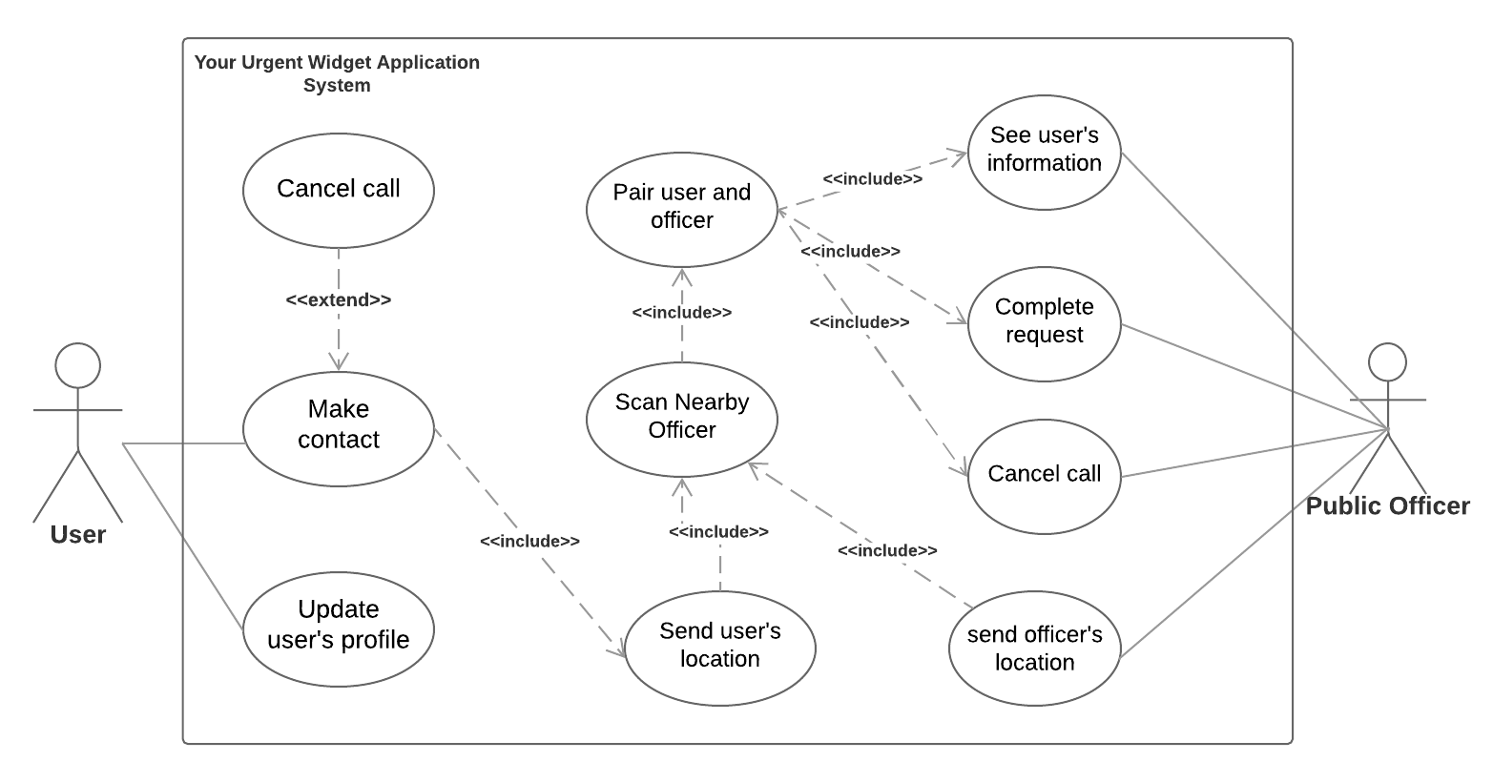
Use Case

Slide 15
DEMO

Slide 16

Conclusion
The application can be achieved from utilizing Google Maps API, Firebase, and app widget view on home screen
The accuracy of GPS also affected by the internet network intensity
Firebase is suitable for any application that needs online storage because of the easy development Firebase offers, since Android Studio support Firebase even has the Firebase Assistant to make it more efficient

Slide 17
Future Work
Improve the user interface of the application
Develop multi-platform application
Validate user’s ID card and Public Officer member ID by accessing government database
Call and message system
Heat map
Video call

Slide 18
Thank You

