Slide 1
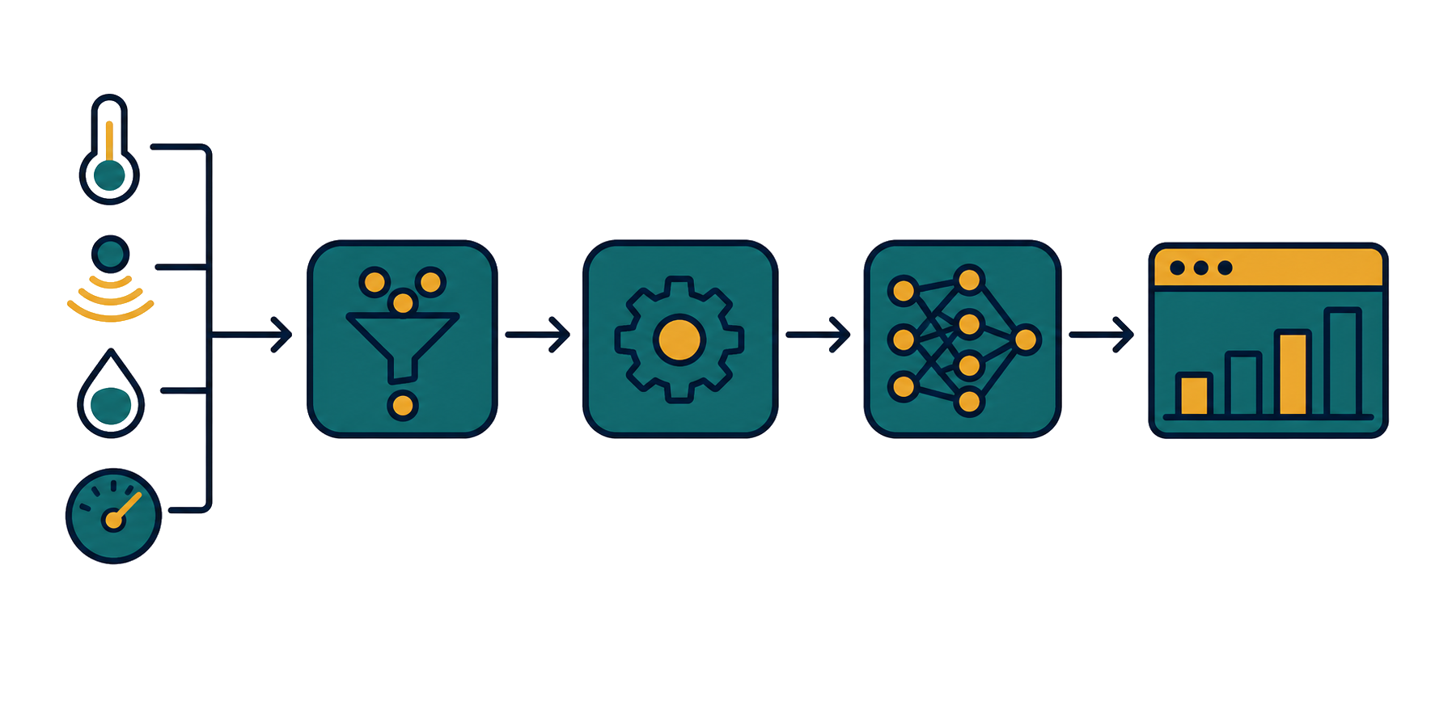
PDAM Pump Sentinel
Multivariate anomaly detection on pump sensors — SKAB surrogate, PCA T2/Q champion.
End-to-end anomaly-detection slice: sensors, multivariate detection, model lifecycle, operator dashboard.
SKAB water-circulation benchmark is used as surrogate academic data, not real PDAM field data.
Focus of this talk: how the system detects faults, and the honest evidence behind it.
40%
60%
DevOps + RouteMQ
AI/ML + MLOps
README.md; docs/plans/design.md
1/27

Slide 2
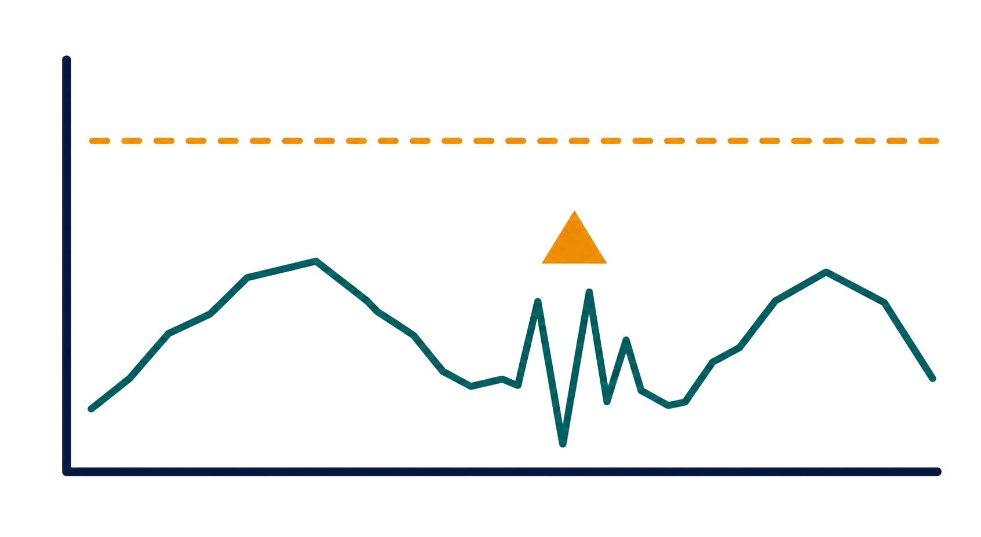
02
Why This Problem Matters
Pump faults are multivariate and gradual, and single-sensor limits miss them.
Centrifugal pumps are critical assets in water distribution operations.
Faults show up as cross-sensor pattern shifts, not one value crossing a line.
Goal: early multivariate condition monitoring, not just post-failure alarms.
docs/plans/design.md §2
2/27

Slide 3
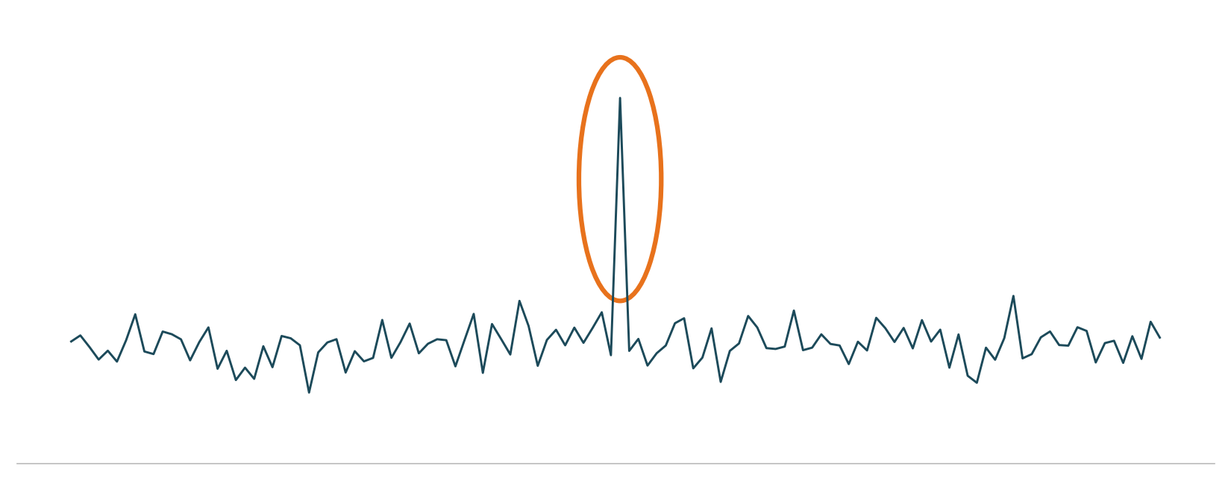
03
Anomaly 1: Point Anomaly
A single sensor reading spikes or drops sharply for an instant.
A momentary spike or drop in one sensor (general anomaly taxonomy, illustrative).
Min/max only catches it when the value crosses the static limit.
A short spike that stays inside the band still slips through.
docs/plans/design.md §2 (taxonomy is illustrative, not SKAB-defined)
3/27

Slide 4
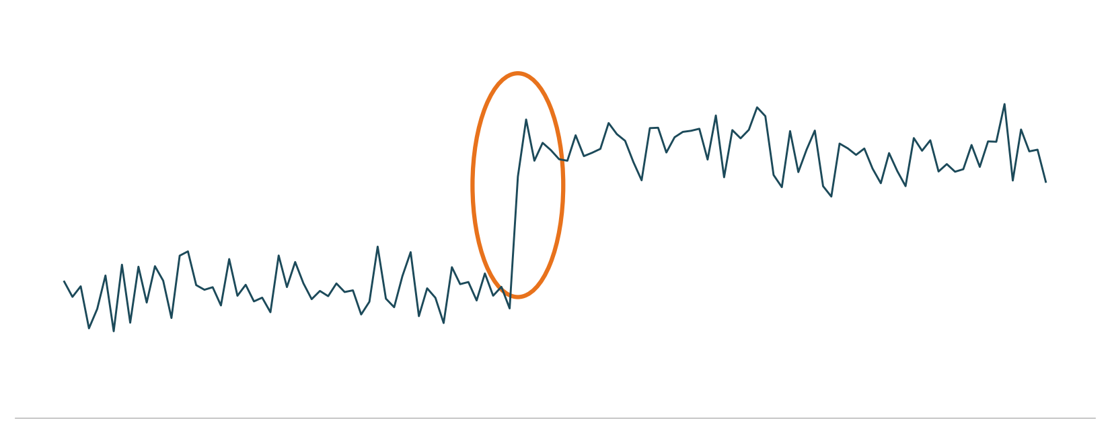
04
Anomaly 2: Context Anomaly / Change Point
Normal in another context, but abnormal for the current regime.
The level shifts to a new baseline without ever touching the static limit.
Min/max has no context memory, so this drift slips through.
SKAB labels separate outliers from change points and collective anomalies.
docs/plans/design.md §2; ml/features/windowing.py:54-59
4/27

Slide 5
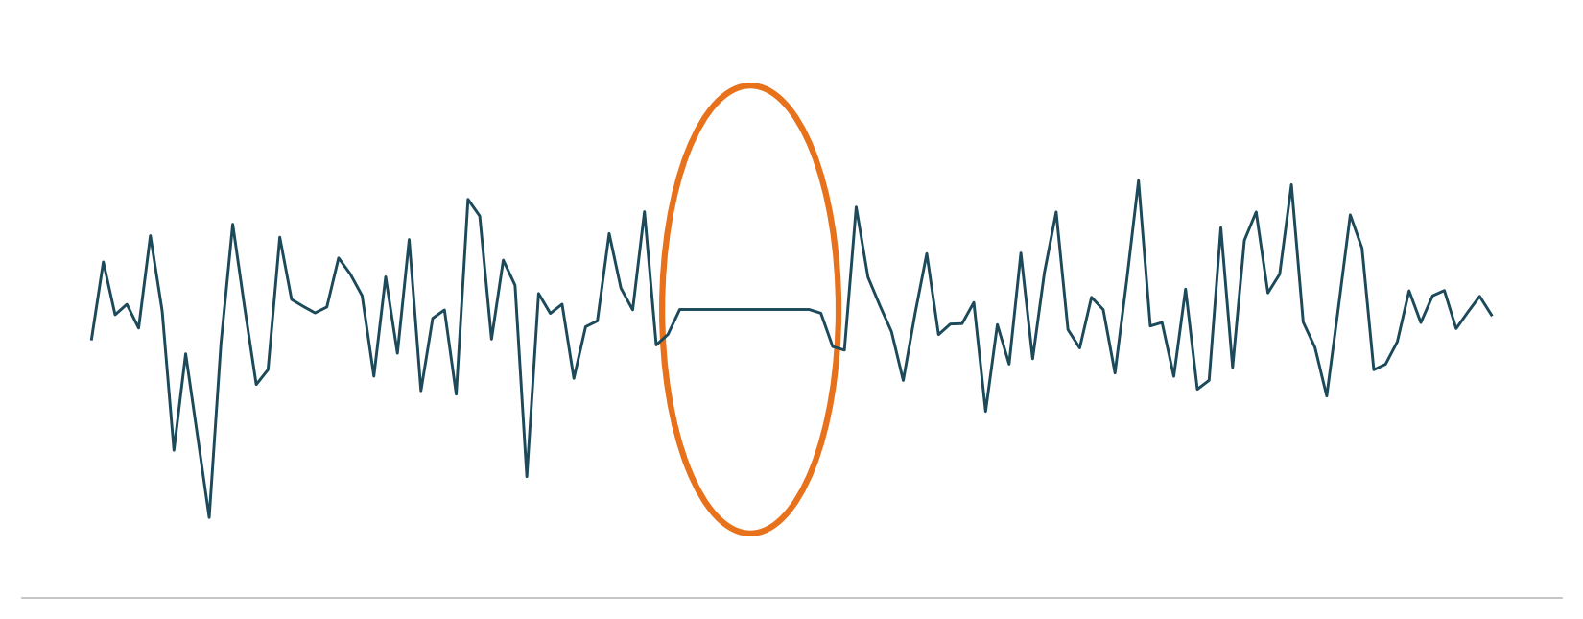
05
Anomaly 3: Pattern / Subsequence Anomaly
A run of points forms an odd shape, for example a stuck or flatline segment.
A frozen or repeating segment looks calm to min/max (illustrative taxonomy).
What breaks is the time-series shape, not the amplitude.
The 60-sample window makes this short episode visible to the model.
docs/plans/design.md §2; ml/features/windowing.py:54-59
5/27

Slide 6
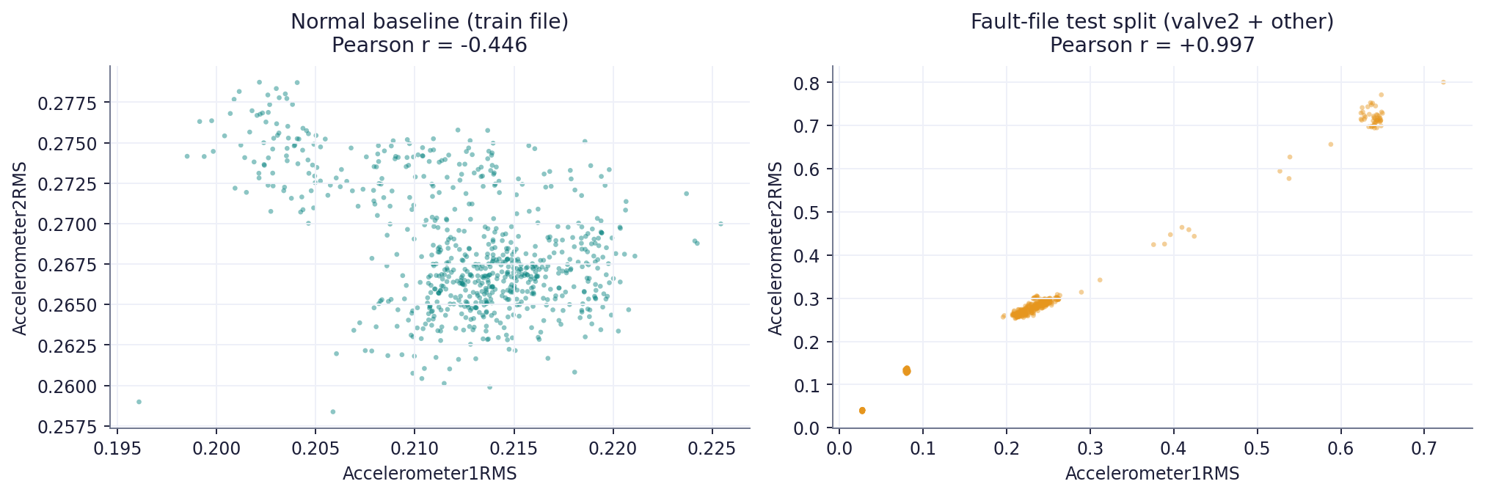
06
Anomaly 4: Multivariate Relationship Anomaly
Each channel looks fine, but the relationship between sensors breaks.
Real example: Accelerometer1 vs Accelerometer2 correlation goes from -0.45 (normal baseline) to +0.997 over the fault-file test split.
Per-sensor thresholds never see the relationship across sensors.
PCA T2/Q learns the joint structure of normal sensors and flags the break.
train/test correlation_matrix.csv; belajar-pca-t2-q-spectral-manual.md:58-67
6/27

Slide 7
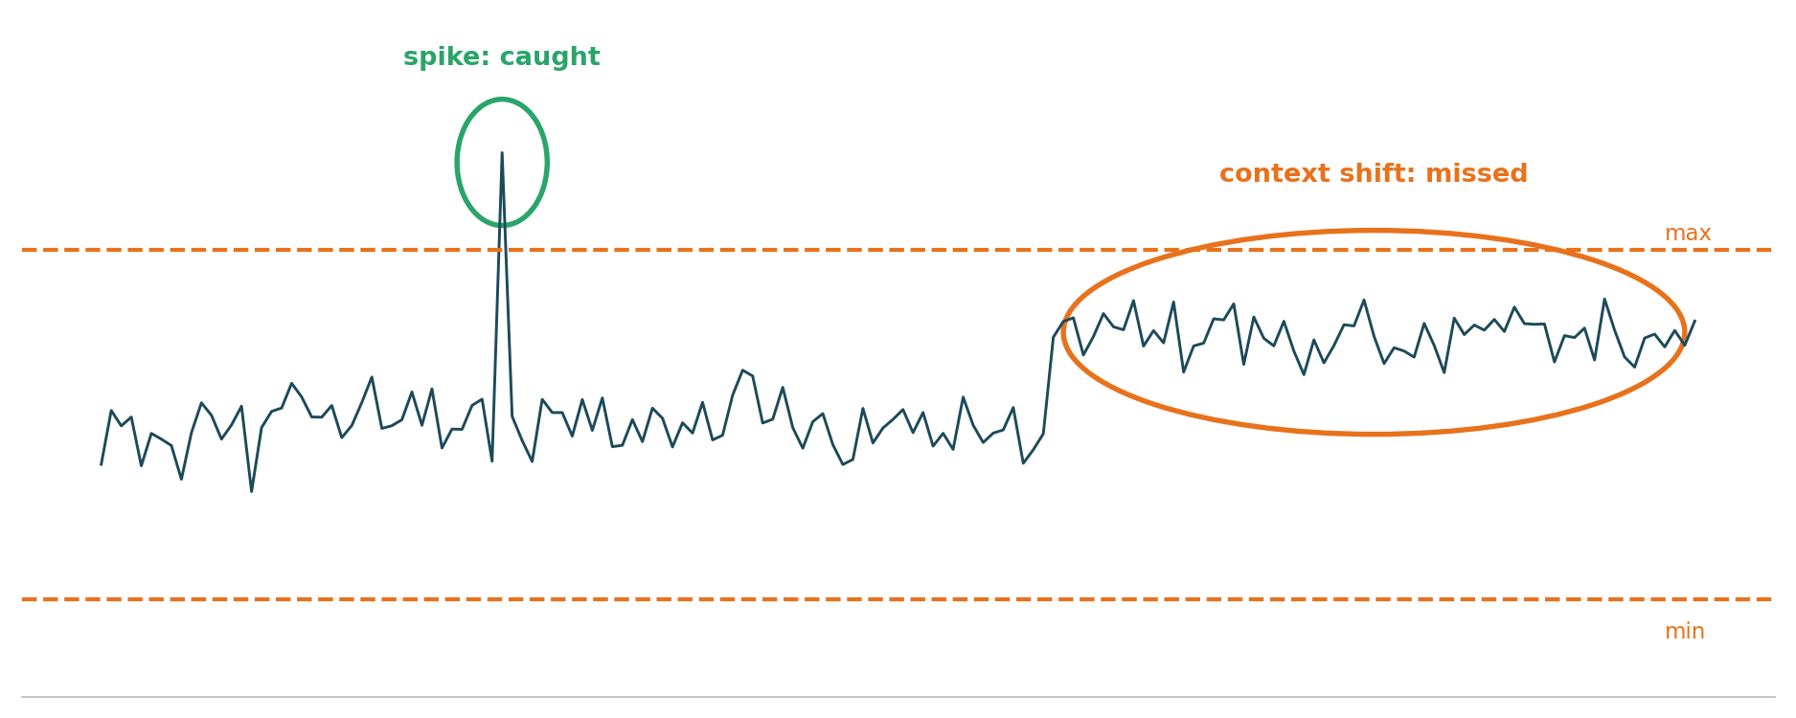
07
Why Min/Max Alone Is Not Enough
A static threshold only checks one sensor against one fixed limit.
A spike that crosses the limit is indeed caught.
A context shift rises to a new regime yet stays inside the min/max band, so it is missed.
Three of the four anomaly families are out of reach for a static limit.
docs/plans/design.md §2
7/27

Slide 8

08
EDA: What the Data Is
Structural facts about SKAB before any modeling.
EDA
8 sensors at ~1 Hz: 2 accelerometers (vibration), current, pressure, temperature, thermocouple, voltage, volume flow. Missing values: 0%.
No physical units are published with the dataset, so sensors are named by role.
Honest split (per file): train 1 file (anomaly-free, 9405 rows, all normal), validation 16 valve1 files, test 18 valve2+other files.
Windowed at 60 samples / stride 1: train 9346 normal windows; validation 9963 normal / 7253 anomaly; test 10527 / 7652.
The test files are concatenated, so the timeline is not one continuous 1 Hz stream.
skab_loader.py:6-15; data/skab_split_manifest.json; 02_pca_spectral/metrics.json
8/27

Slide 9
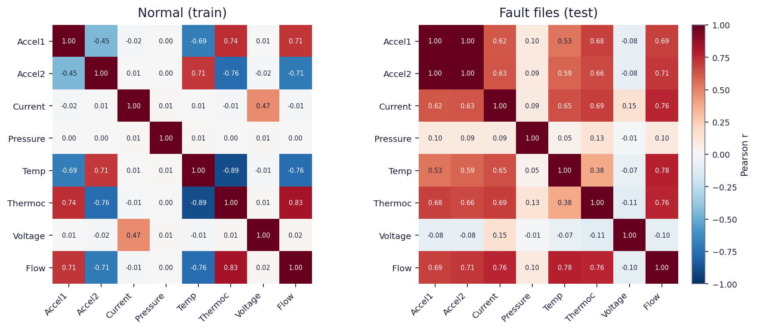
09
EDA: Sensors Move Together
Sensors are tightly coupled in normal operation; the joint structure shifts under fault.
Normal baseline shows strong couplings, e.g. Temperature-Thermocouple -0.89 and Thermocouple-Volume Flow +0.83; under fault these change sign or strength.
That coupling is exactly what PCA learns as normal, and what Q/SPE flags when it breaks.
Per-sensor ranges also drift in fault, e.g. Volume Flow p01 121 to 15, Thermocouple max 29.5 to 33.4.
train/test correlation_matrix.csv; sensor_distributions.csv
9/27

Slide 10
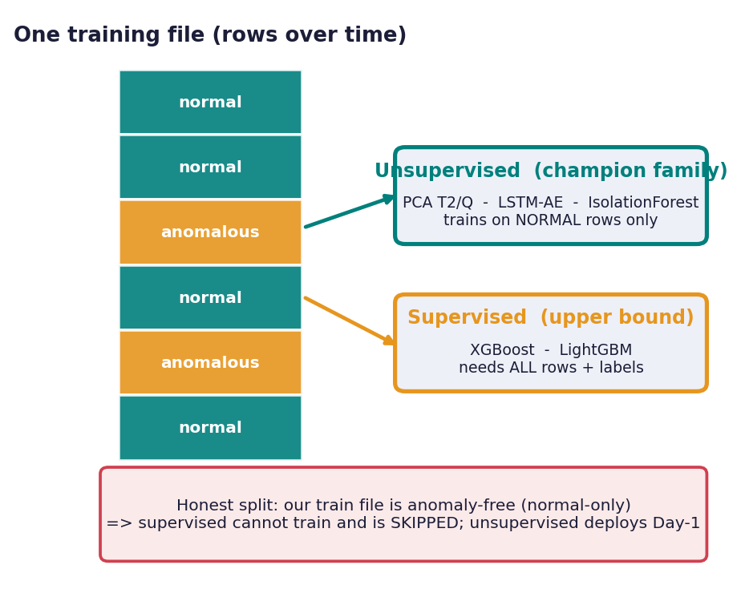
10
Candidate Models: Supervised vs Unsupervised
Same dataset, same split — the difference is what each model sees in training.
Modeling
Unsupervised — train on normal-only windows, can flag novel faults: PCA T2/Q (spectral champion, raw, feature-bagging), Isolation Forest (+ conformal), One-Class SVM, LSTM autoencoder (+ DBSCAN), plus forecasting-residual and distance-profile baselines.
Supervised — need labeled normal + fault rows, only recognize trained fault types: XGBoost and LightGBM.
Both families emit an identical AnomalyVerdict (anomaly 0/1, score, t2, q); the pipeline cannot tell which model produced it.
Honest Day-1 split has a normal-only train file, so XGBoost/LightGBM are SKIPPED (single class [0]); unsupervised is the only family that can train.
ml/inference/pca_inference.py:22-35; ml/inference/supervised_inference.py:29-42; summary.md:31-33
10/27

Slide 11
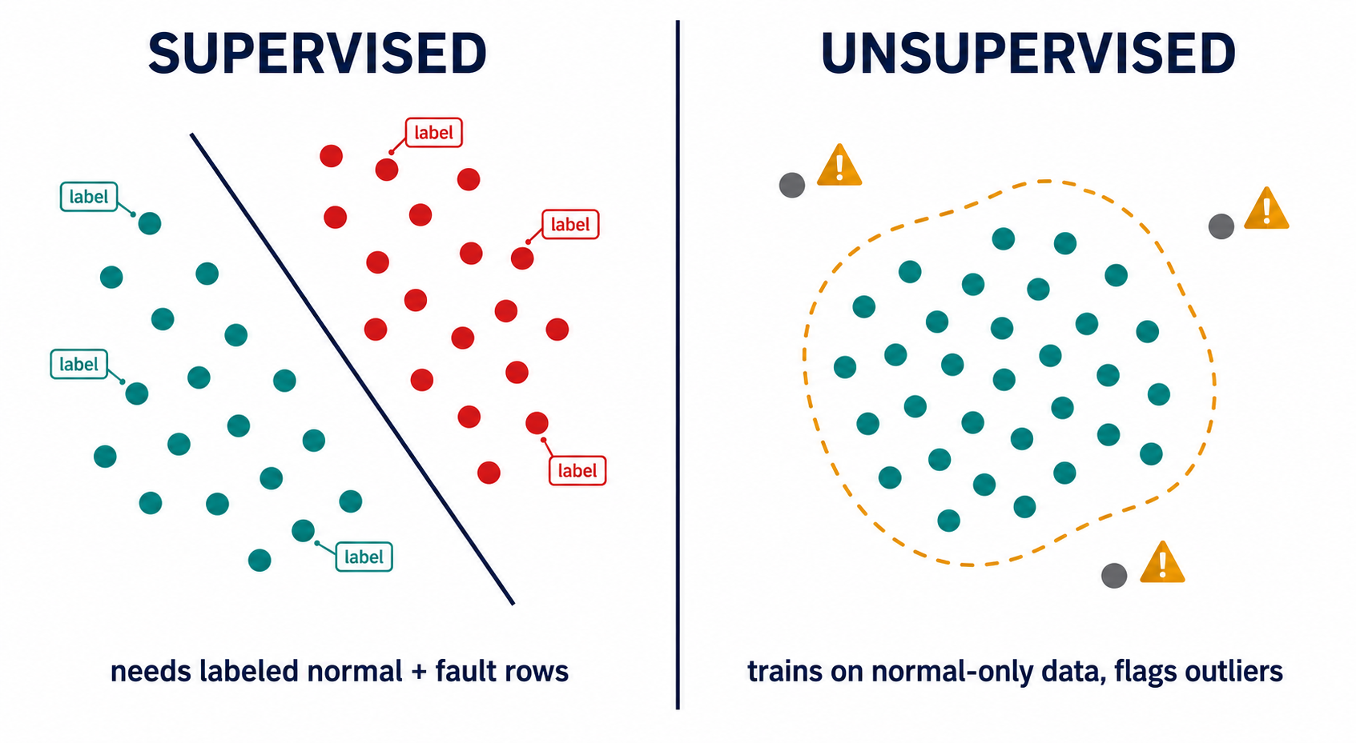
11
Model Inputs: Rows to Windows to Features
One shared contract feeds every candidate model.
Shared input: 60-sample windows (stride 1), raw or spectral FFT features — identical for every candidate.
What differs is data usage: supervised trains on labeled normal + fault rows; unsupervised (PCA champion, RobustScaler) trains on normal-only windows.
ml/features/windowing.py:20-61; ml/features/spectral.py:53-82; ml/training/pca_detector.py:30-35
11/27

Slide 12
12
Modeling Results: Honest F1 Spectrum
The same model looks very different depending on split honesty.
Modeling
Model | F1 | Family / note
02_pca_spectral | 0.558 | CHAMPION (deployed) — P 0.549 / R 0.568 — T2 1.0776, Q 6139.43
IsoForest-conformal | 0.519 | unsupervised
PCA-bagging | 0.519 | unsupervised
IsoForest-spectral | 0.493 | unsupervised
PCA-raw | 0.490 | unsupervised
distance-profile | 0.467 | unsupervised baseline
forecasting-naive | 0.443 | baseline
LSTM-AE | 0.260 | unsupervised (deep)
LSTM-DBSCAN | 0.225 | unsupervised (deep)
OneClassSVM | 0.000 | unsupervised (collapsed)
Context only — NOT the deployed model: supervised cross-group ~0.60 (AUC 0.937), in-distribution XGB 0.909 / LGBM 0.905, random-window 0.985 = leakage. Never present an in-distribution number as novel-fault readiness.
summary.md:22-33; docs/adr/0001-honest-eval-split-strategy.md; sprint-remaining.md
12/27

Slide 13
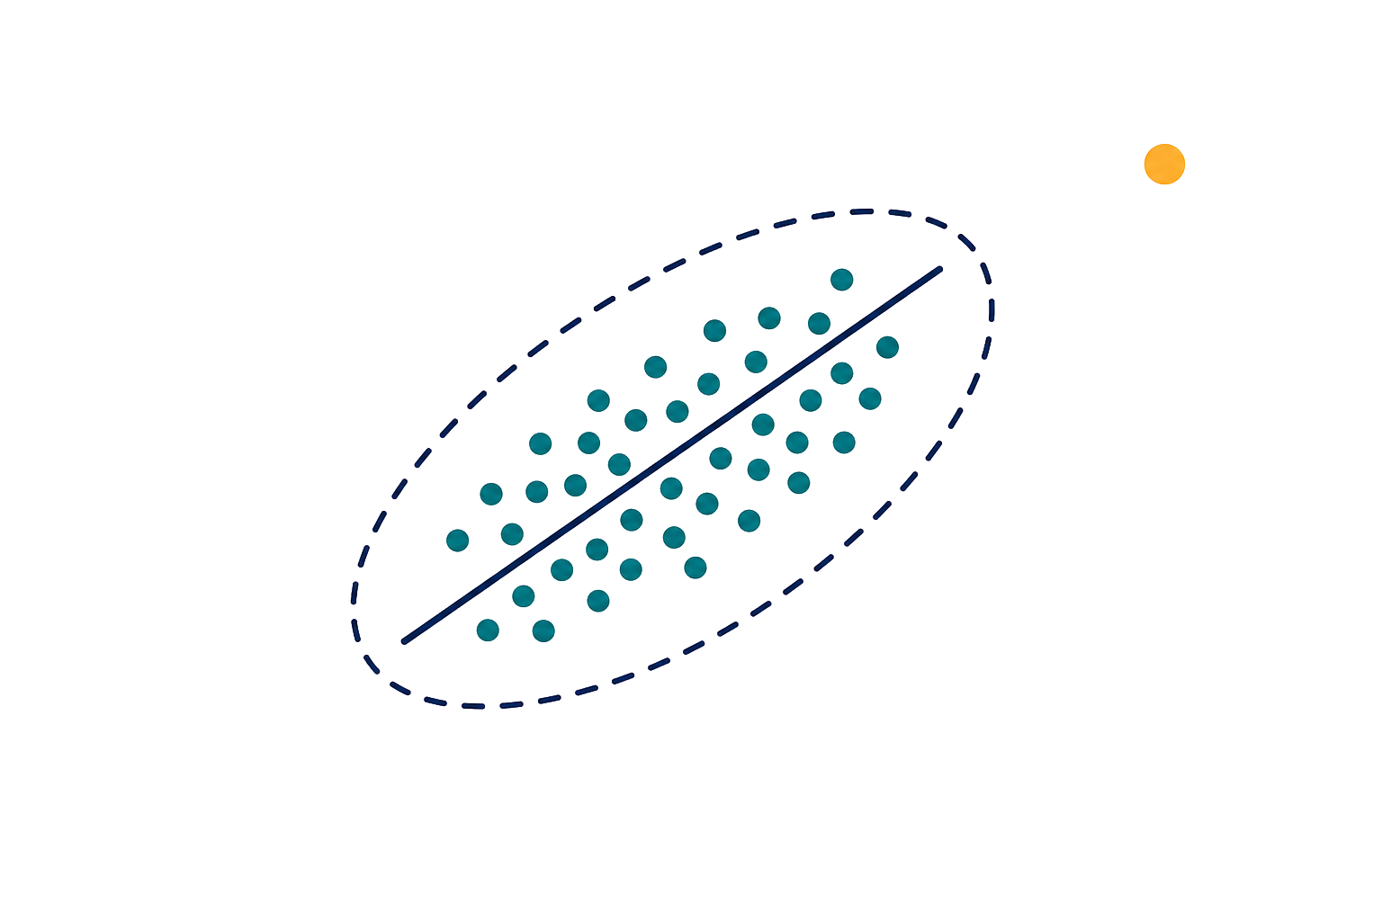
13
Why PCA-Spectral as Day-1 Champion
Chosen for a continuous-learning loop: cheap, deterministic retraining, not just F1.
Modeling
Industrial predictive maintenance retrains on a cadence (scheduled ~30 min + drift-triggered, PCA path), so the detector must be cheap and deterministic.
PCA retrains in a single full-SVD pass with closed-form thresholds: no epochs, no gradient descent, no hyperparameter search, reproducible for the champion-challenger gate.
It also deploys before a labeled fault inventory exists (normal-only cold start), where supervised XGBoost/LightGBM cannot even train.
Fast, decomposable, and operator-explainable; the mathematical proof of its low cost is on the next slide.
labeling-strategy-notes.md:5-8; docs/adr/0001-honest-eval-split-strategy.md:16-20; ml/monitoring/scheduler.py
13/27

Slide 14
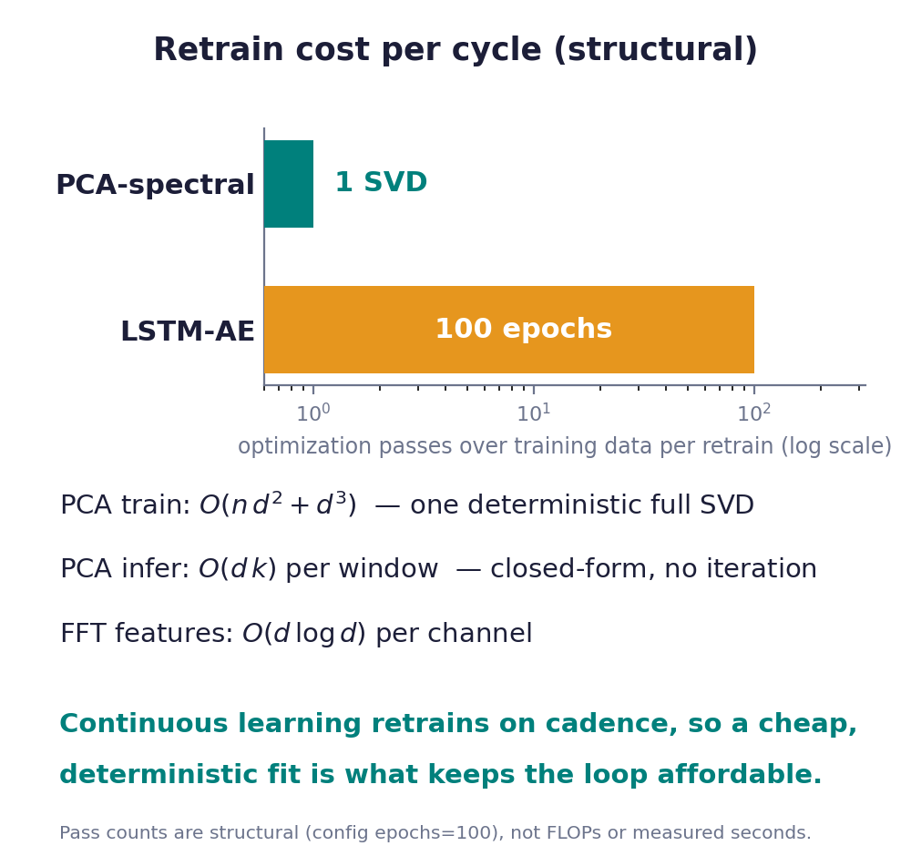
14
PCA Mechanics
One full SVD trains it; everything after is closed-form.
Modeling
Train once: fit RobustScaler, then a single full SVD on the normal windows (n=9346 rows, d=64 spectral features); keep components for 90% variance.
Training cost is that SVD: O(n*d^2 + d^3); thresholds are p95 empirical quantiles (one O(n log n) sort). No epochs, no backprop, no hyperparameter search.
Inference per window = project then reconstruct = O(d*k), where k is the kept components; deterministic and CPU-only.
Contrast: LSTM-AE trains ~100 epochs of backprop per retrain; PCA trains in one SVD, so retraining on cadence stays cheap.
ml/training/pca_detector.py:42-64; ml/training/train_lstm_ae.py:38; belajar-pca-t2-q-spectral-manual.md:103-117
14/27

Slide 15
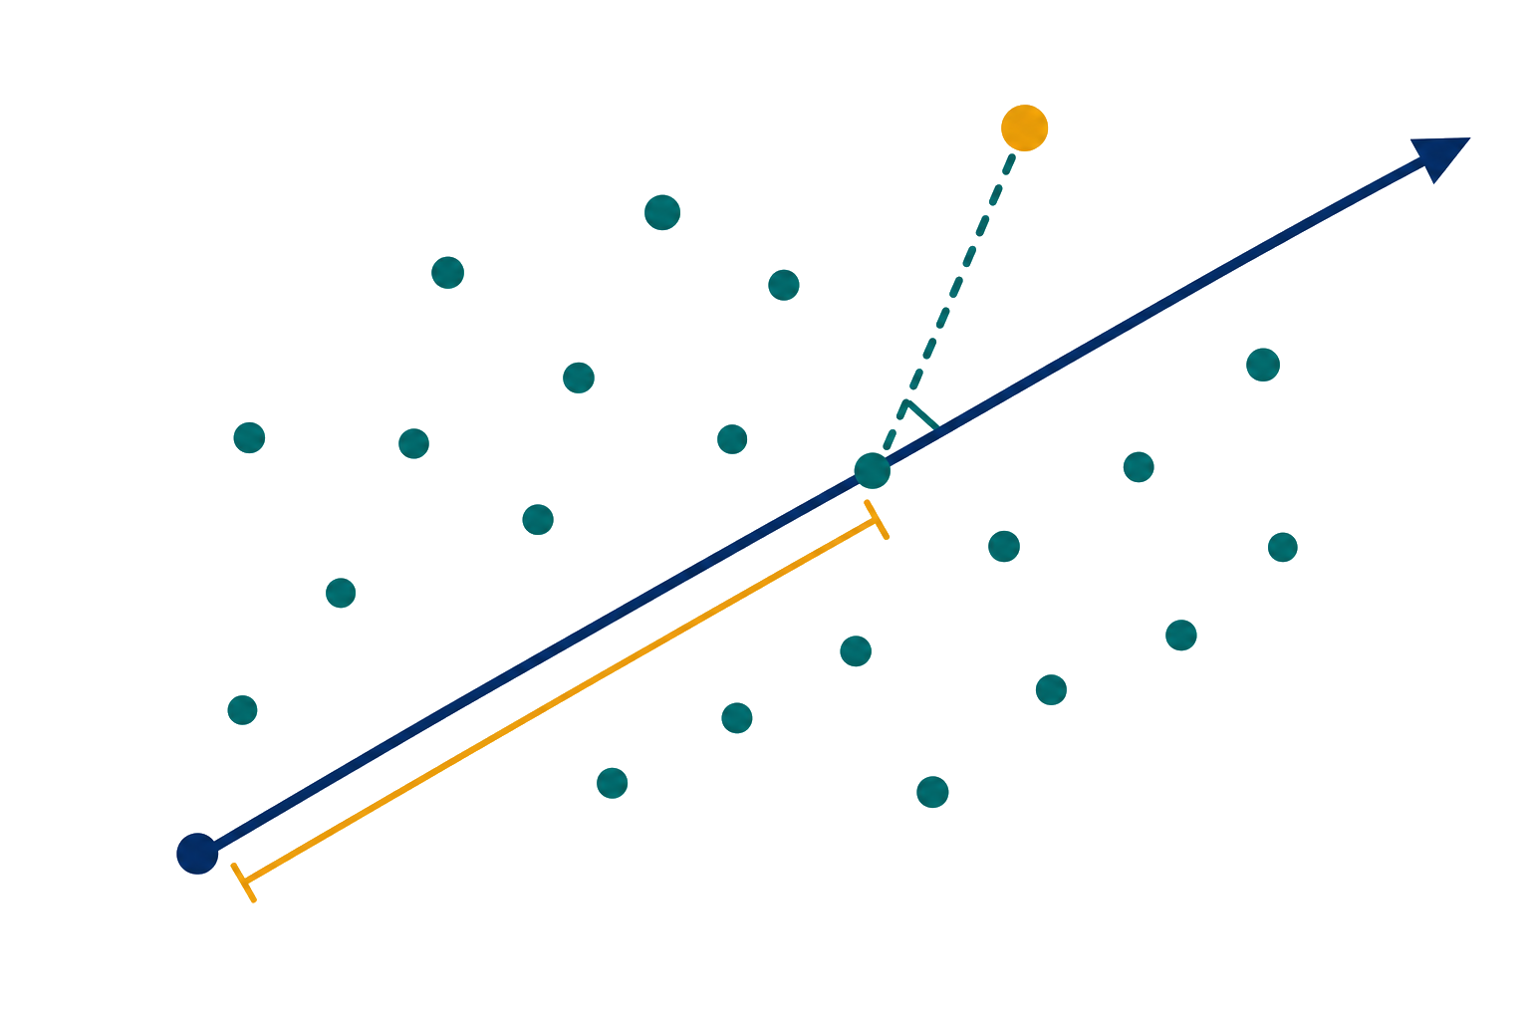
15
T2 vs Q/SPE
T2 = extreme along the normal road; Q/SPE = behavior that leaves the road.
Modeling
T2 = sum(score^2 / explained_variance): extreme, but still on a pattern PCA already knows.
Q/SPE = squared reconstruction residual: the relationship itself changed.
Decision is OR: anomaly if T2 > threshold OR Q > threshold; thresholds are p95 quantiles of normal.
Reported score = max(T2/T2_thr, Q/Q_thr); the top sensor is the largest residual contributor, not a proven root cause.
Both statistics reuse one projection, so scoring a window is O(d*k): live inference adds negligible cost at the ~1 Hz cadence.
ml/training/pca_detector.py:55-114; ml/inference/pca_inference.py:186-267
15/27

Slide 16

16
Spectral FFT Features
Spectral lets PCA see rhythm, not just level.
Modeling
Each window is mean-centered per sensor, then summarized by mean, std, range, FFT band energies, and spectral centroid.
Bands are equal splits of the FFT energy bins (not named Hz bands); feature count = sensors x (n_bands + 4) = 64.
Dominant frequency is taught as intuition only; it is not a live feature column.
Intuition: a rhythm shift can move band energy before the raw level moves (illustrative, not a measured lead time).
Feature build is cheap: the per-window FFT is O(d log d) per channel, so spectral awareness does not change the low-cost profile.
ml/features/spectral.py:53-82; ml/inference/pca_inference.py:270-284
16/27

Slide 17
17
What Is MLOps, and Why It Helps Us
Operationalizing the model lifecycle: train, deploy, monitor, retrain.
MLOps
MLOps keeps a model useful after the notebook: versioning, monitoring, drift, and safe updates.
In our case: deploy a champion on Day-1, watch for drift, retrain, and promote without downtime.
Tools: MLflow (registry), Evidently (drift), Prometheus + Grafana (signals), Streamlit (operator).
Operator actions (ack/mute/note) are captured as evidence, not yet as training labels.
README.md:13-15,39-42
17/27

Slide 18
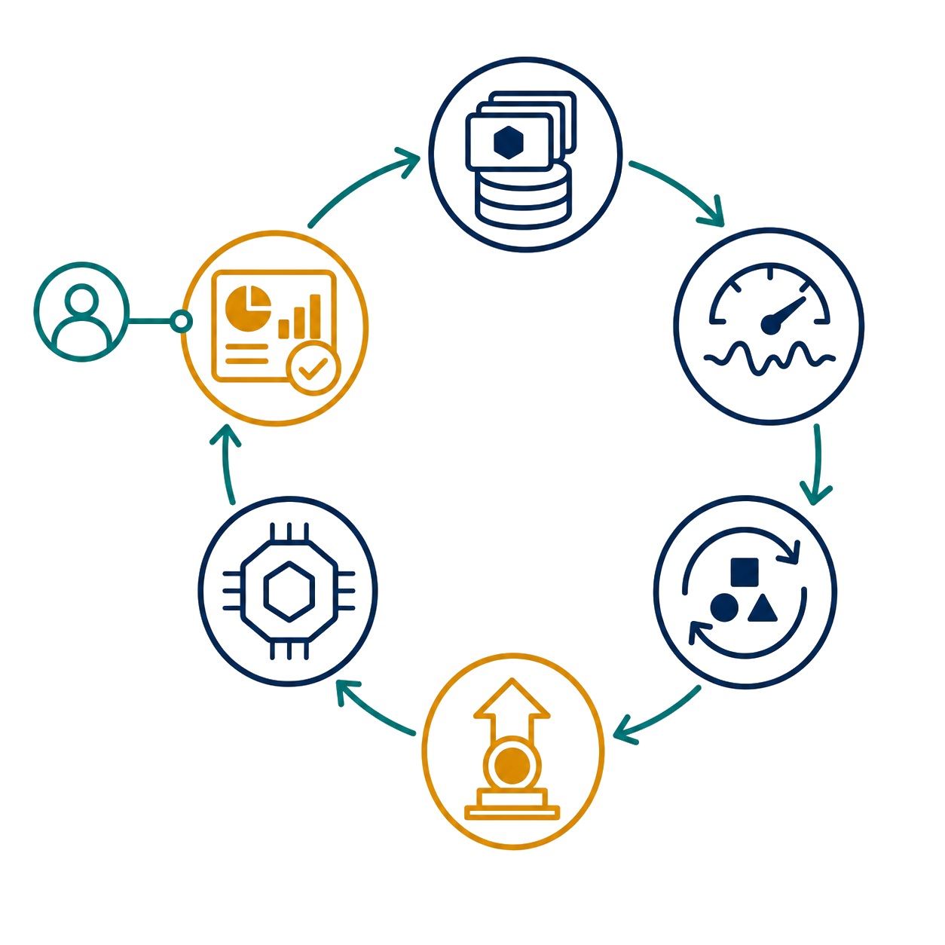
18
MLflow: Registry + Custom Promotion Gate
One managed registry, plus a custom gate that decides promotions.
MLOps
MLflow Model Registry: versioned models with a @champion alias; the app loads the champion and hot-swaps in-process.
A custom champion-challenger gate (project code, not an MLflow feature) makes the decision; MLflow then only moves the alias.
Gate: promote iff F1_challenger > F1_champion + 0.02 AND FAR_challenger <= FAR_champion x 1.05.
Schedulers (drift 15m, retrain 30m, refresh 5m) are off by default; hot-swap is process-local.
ml/monitoring/champion_challenger.py:8-32; docs/adr/0003-champion-challenger-promotion-gate.md:78-87; bootstrap/app.py:199-204
18/27

Slide 19
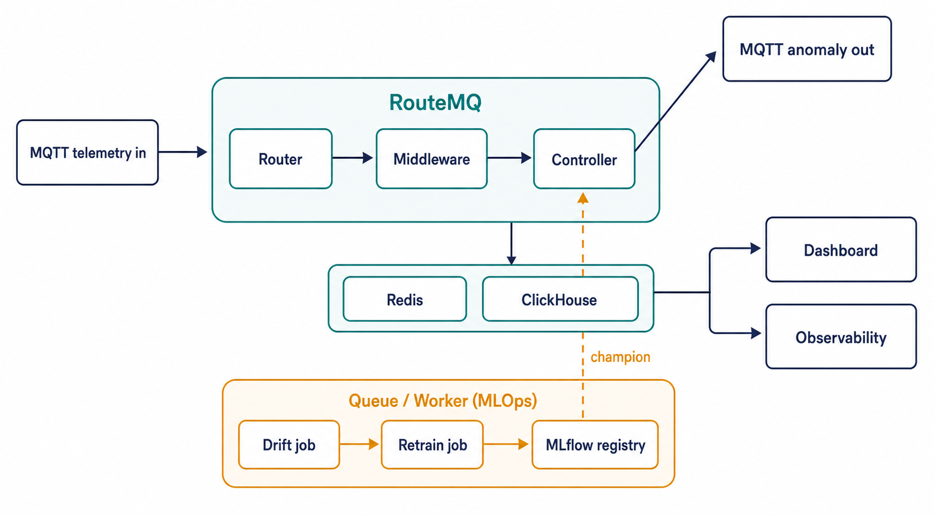
19
RouteMQ: Connect It All Together
One MQTT application framework wires ingest, ML, storage, and the operator view.
app/routers/telemetry.py; app/controllers/anomaly_controller.py; app/jobs/*; README.md:13-15
19/27

Slide 20
20
Layer 1 - Router: Ingest and Dispatch
The entry point of the synchronous path.
Platform
Subscribes the topic factory/skab/{station}/telemetry at QoS 1.
Routing is declarative: the matched topic dispatches to anomaly_controller.ingest.
A per-station wildcard keeps one route for every pump station.
Nothing heavy happens here; the Router only resolves topic to handler.
app/routers/telemetry.py:12-21
20/27

Slide 21
21
Layer 2 - Middleware: Validate, Rate-limit, Correlate
An ordered chain runs before the controller and protects inference.
Platform
ValidateTelemetryMiddleware: reject non-JSON payloads and empty sensor maps early.
InMemoryRateLimitMiddleware: cap 50 messages per second per station.
CorrelationLoggingMiddleware: attach a correlation id so a message is traceable end to end.
Order matters: bad or excess traffic is dropped before it reaches the model.
app/middleware/validate_payload.py:9; app/middleware/rate_limit.py:11; app/middleware/correlation.py:10
21/27

Slide 22
22
Layer 3 - Controller, Inference, Persistence
The synchronous core: decide, publish, store.
Platform
anomaly_controller calls the inference service, which loads the champion and scores the window (PCA T2/Q).
Inference is in-path and synchronous; it emits an AnomalyVerdict, not a queued job.
It publishes the result to factory/skab/{station}/anomaly at QoS 1.
Persistence is Redis latest-state first, then ClickHouse history for the timeline.
app/controllers/anomaly_controller.py:26-56; app/services/inference.py; app/services/persistence.py
22/27

Slide 23
23
Layer 4 - Queue/Worker: MLOps Jobs
The asynchronous lane where continuous learning lives.
Platform
DriftReportJob and RetrainingJob run off the queue, not in the anomaly inference path.
They read ClickHouse/SKAB data and write the MLflow registry plus Redis report keys.
The Controller picks up the new champion from MLflow; promotion is gated by the custom champion-challenger rule.
The scheduler is off by default (env flags), so the loop is opt-in, not always-on.
app/jobs/drift_report_job.py:26-29; app/jobs/retraining_job.py:47-50; ml/monitoring/scheduler.py
23/27

Slide 24
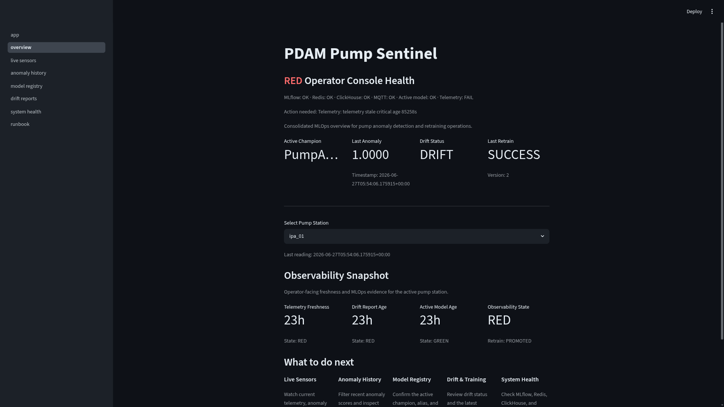
24
Operator Dashboard (Streamlit)
Seven operator pages over the same evidence.
Overview ("PDAM Pump Sentinel"): console-health banner, KPI tiles, station picker.
Live Sensor Monitoring: 5 s autorefresh, anomaly score, sensor status.
Anomaly History: timeline, severity buckets, drilldown.
Model Registry: active champion + version table.
Drift & Retrain Reports; System Health: 10 s autorefresh, probes.
Operator Runbook + actions ack/mute/note that write Redis keys (not yet training labels).
t9-observability-streamlit-observability-snapshot-20260628T0535Z.png
dashboard/pages/*; dashboard/data.py:213-312
24/27

Slide 25
25
What Is Observability
Asking arbitrary questions about a running system from the outside.
Platform
Three pillars: metrics (numbers over time), logs (events), traces (request paths).
Goal: understand system state and behavior without redeploying or guessing.
It turns "is it healthy?" into a question you can answer with data.
It is the basis for alerting, triage, and an operator runbook.
general concept; infra/README.md
25/27

Slide 26
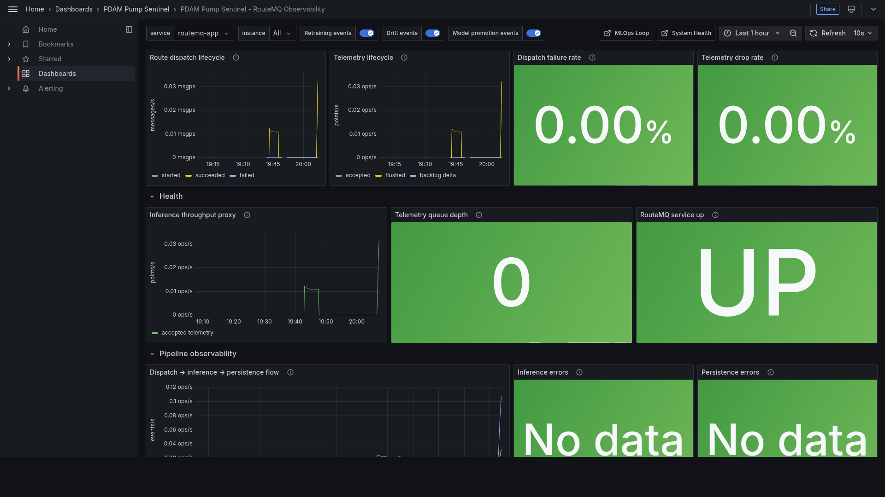
26
Observability in Our AIoT Case
What we actually implemented — local evidence, not production SRE.
Prometheus /metrics joins RouteMQ framework metrics with 15 pumpad_* application metrics.
Grafana dashboards: RouteMQ Observability, MLOps Loop, System Health, MQTT Broker.
Seven local alert rules: telemetry stale, inference/persistence errors, model age, high-severity anomalies.
This proves metrics + dashboards + local alerts; centralized logs/traces and incident routing are future.
All of it is local Docker Compose evidence, not a production cloud claim.
t9-observability-grafana-pipeline-observability-20260609T130723Z.png
app/observability/metrics.py:33-99; infra/prometheus/rules/pumpad-alerts.yml:1-65; infra/README.md:8
26/27

Slide 27
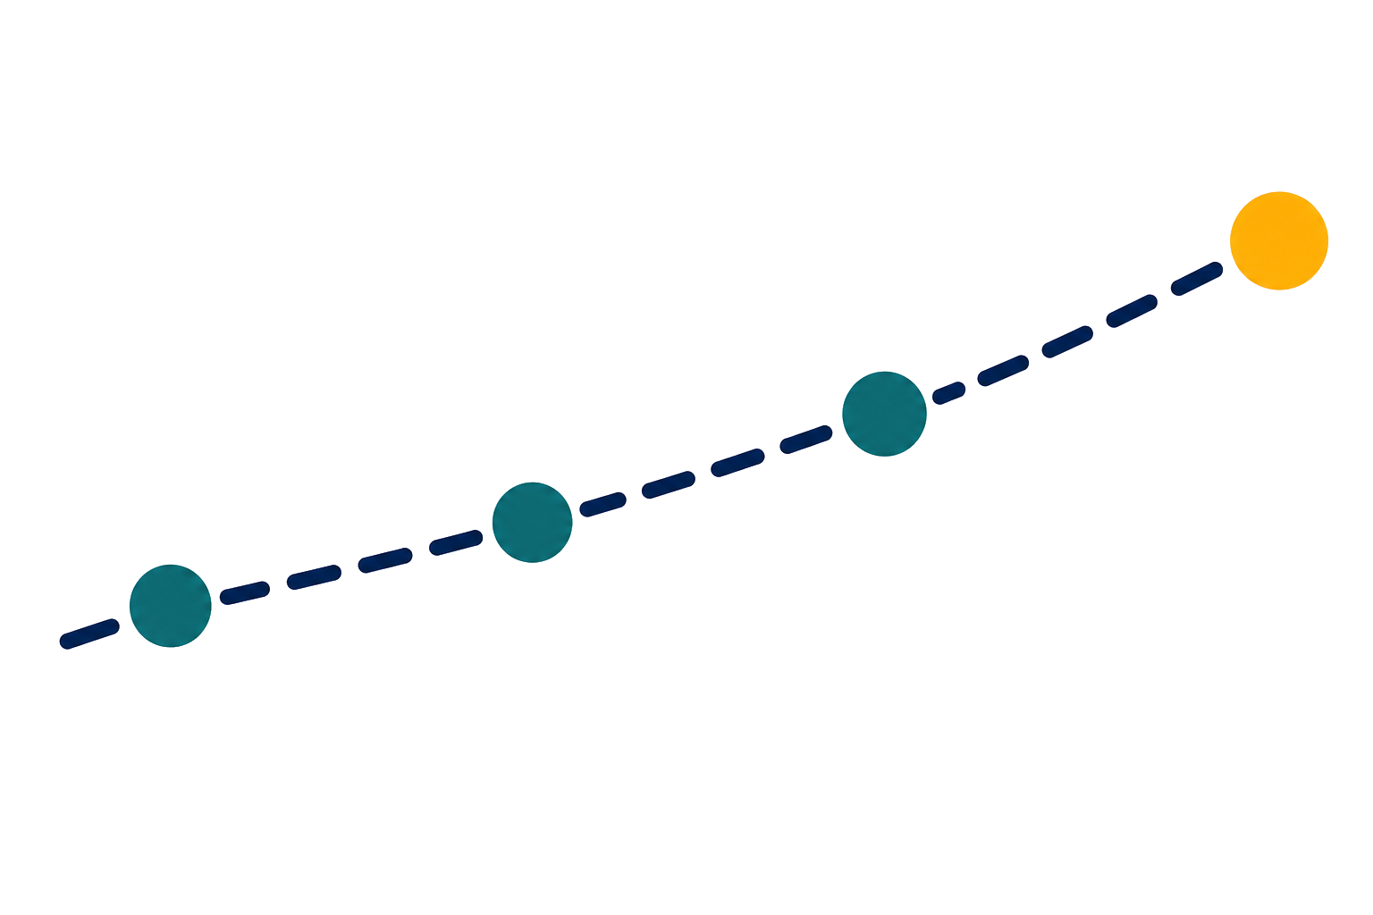
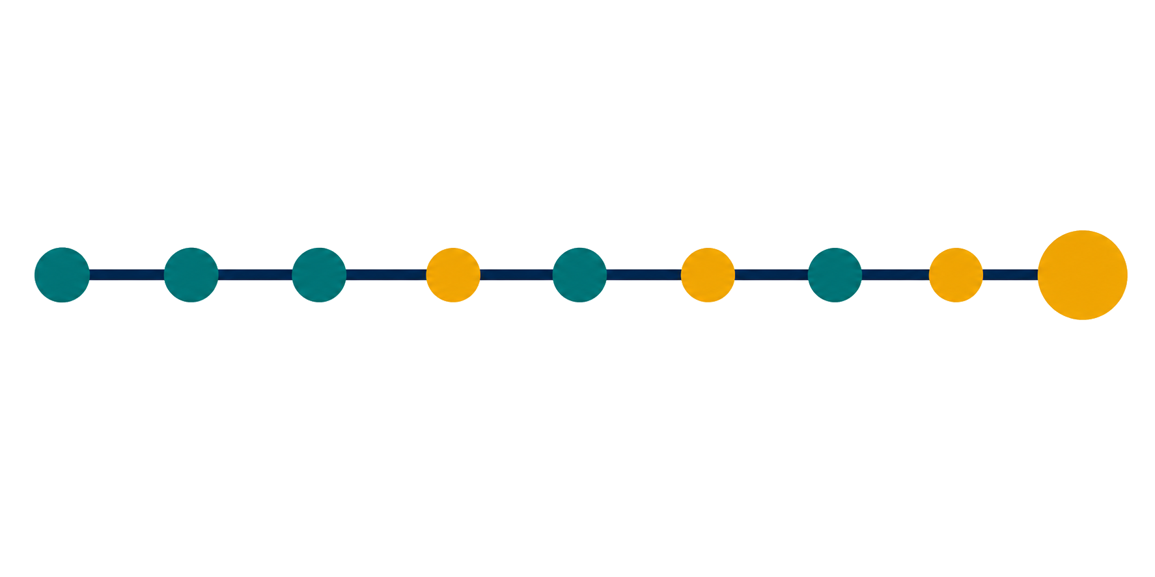
27
Limitations, Roadmap, Close
The MVP is demo-ready because its limits are explicit, not hidden.
Known limits: synchronous inference, schedulers off by default, scheduled retrain defaults to PCA, process-local hot-swap.
Roadmap: operator labels then supervised promotion, supervised alias setter, incident routing.
Closing thesis: an honest end-to-end anomaly-detection slice, not a standalone notebook.
Now
Next
Demo-ready local MLOps slice
Operator labels + supervised gates
End-to-end platform, not a standalone notebook
README.md §Known Limitations; sprint-remaining.md §Architectural follow-ups
27/27

