Slide 1
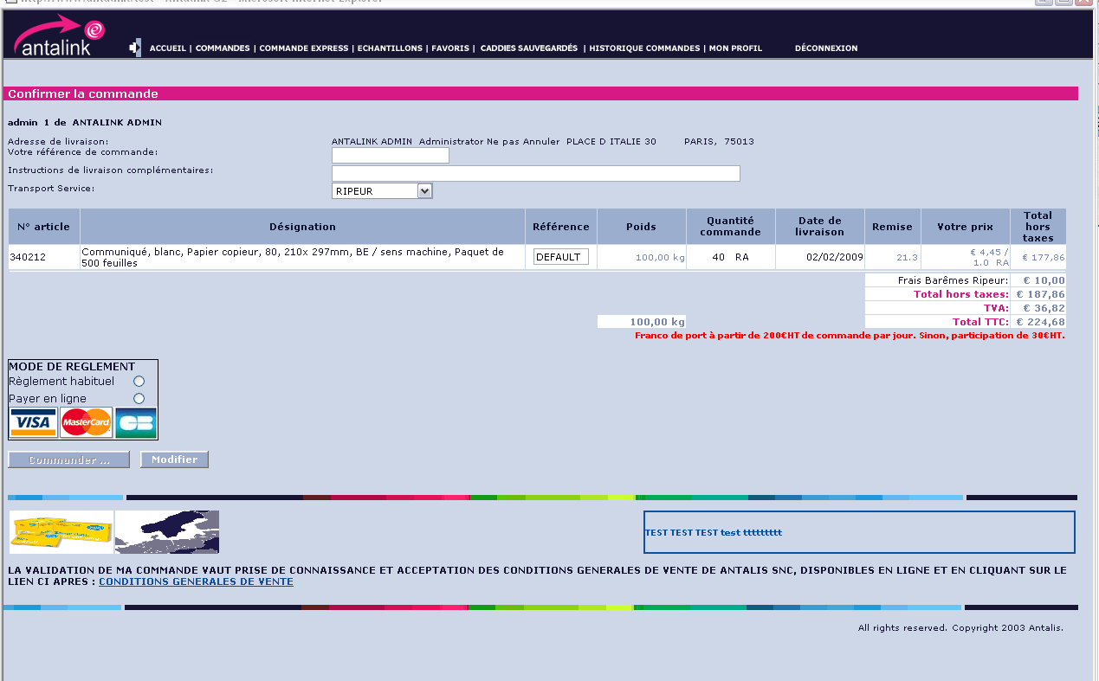
Pre-order screen : the user is about to validate the order
Delivery services
Delivery address
On line payment capability
cross-selling proposal zone
THIS NEEDS TO BE DRAMATICALLY ENHANCED !!

Slide 2
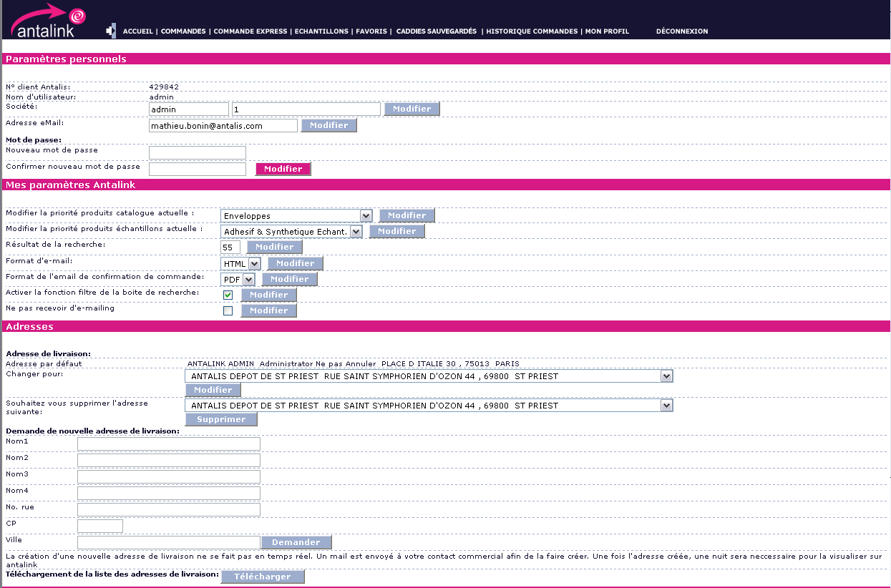
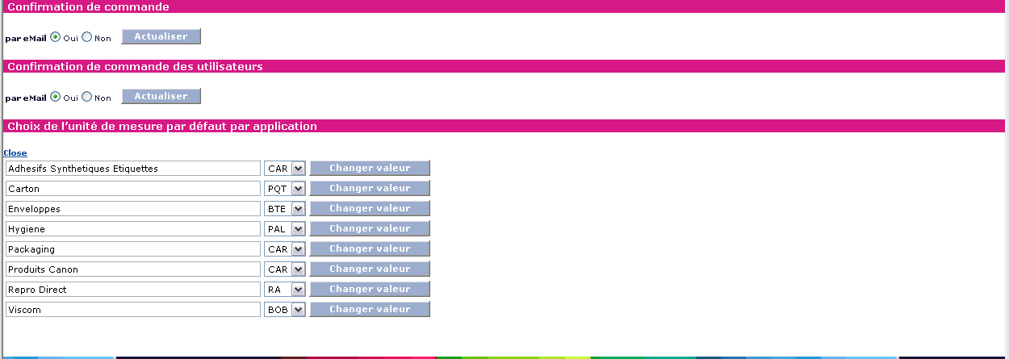
My profile- see Personal settings in xls

Slide 3
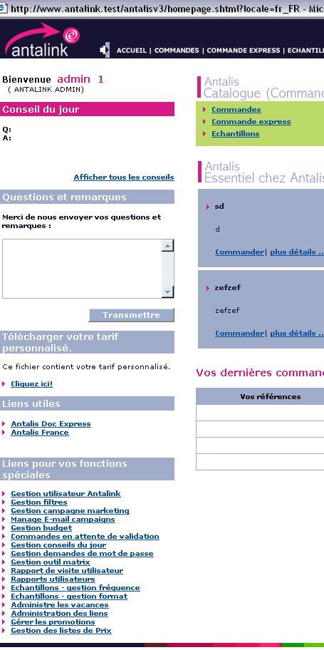
The functions shown in the following slides can be accessible via HP

Slide 4
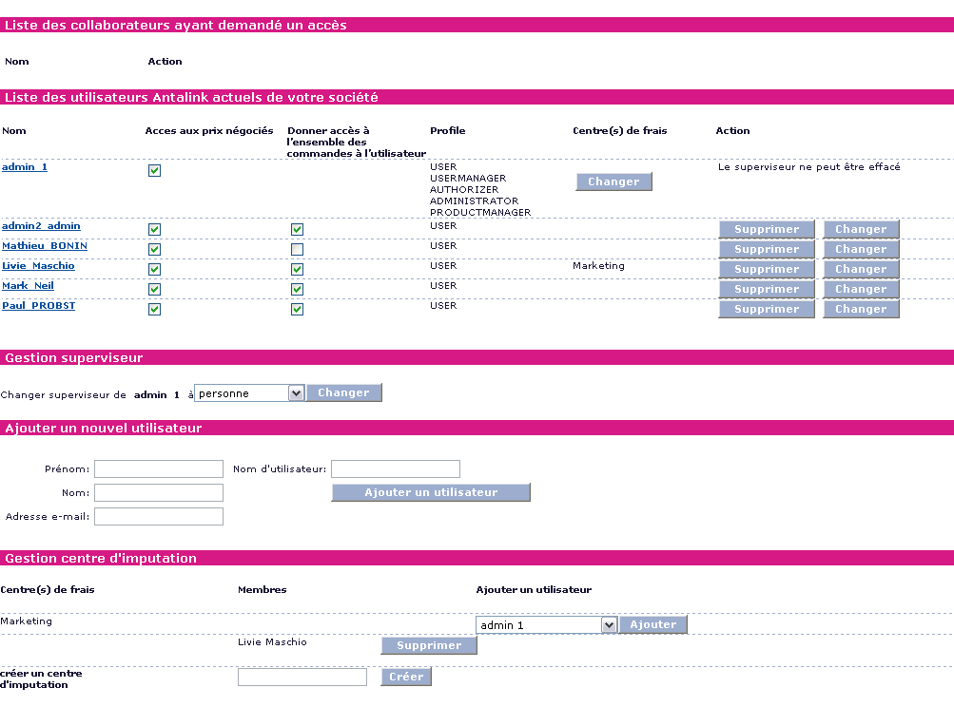
Manage users (available to Cust. User manager)

Slide 5
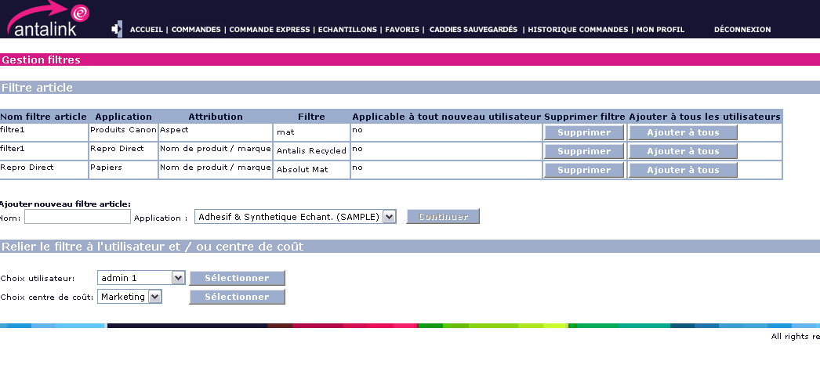
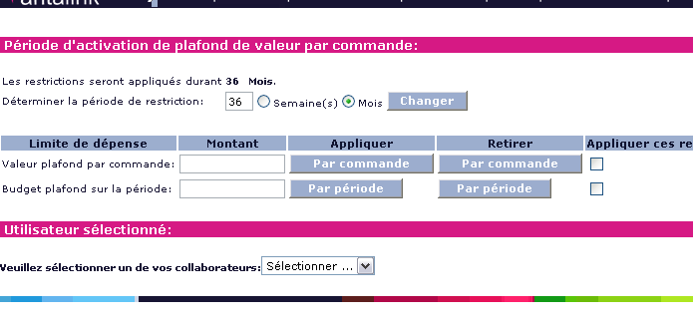
Manage product filters (available to Cust. User manager)
the behaviour will change in G3 (under discussion)
Manage spend limit (available to Cust. User manager if also authorizer)

Slide 6
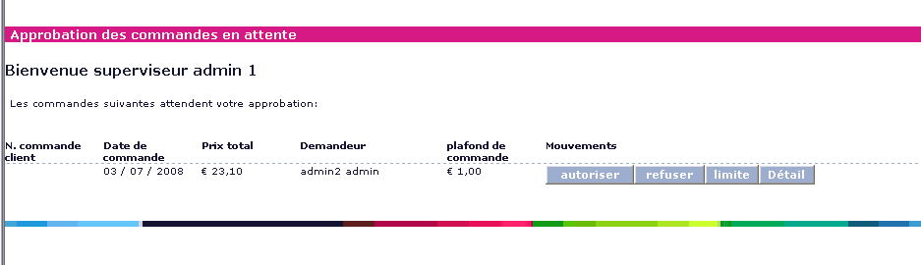
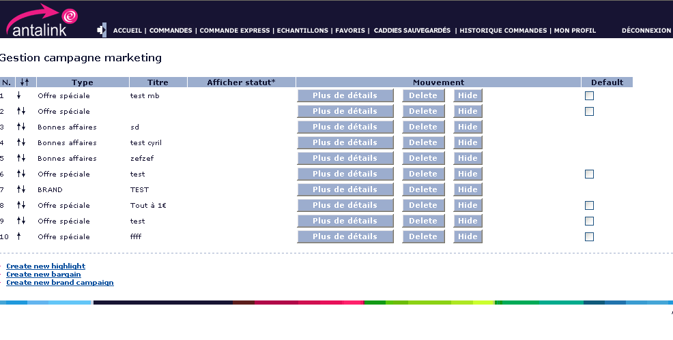
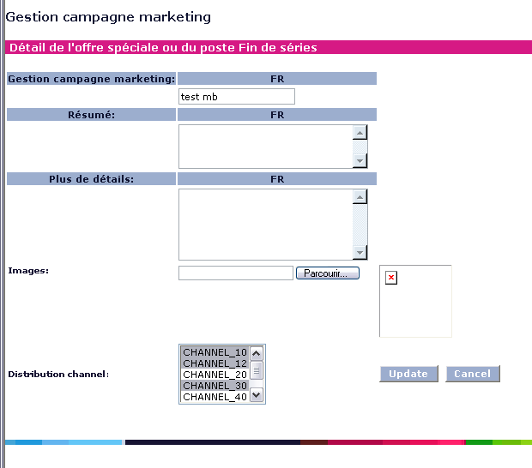
Pending orders approval process
-available to Cust. User manager if also authorizer
-available to Cust. user if also authorizer
Manage marketing campaign (antalis admin and antalis product manager)

Slide 7
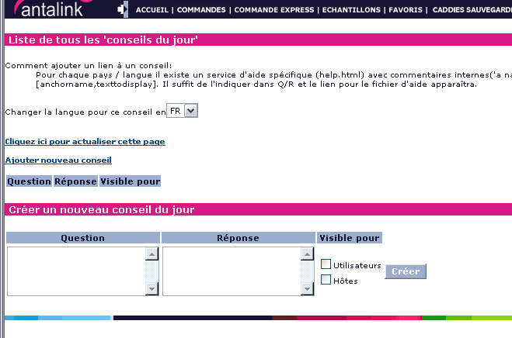
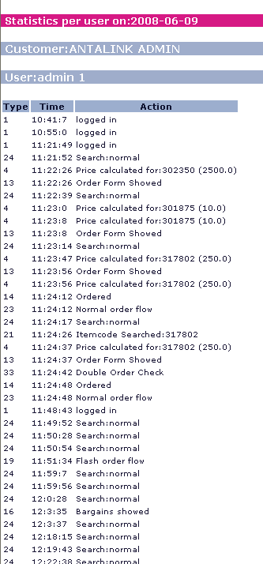
Tips of the day
(antalis admin)
Users visits statistics
(antalis admin)

Slide 8
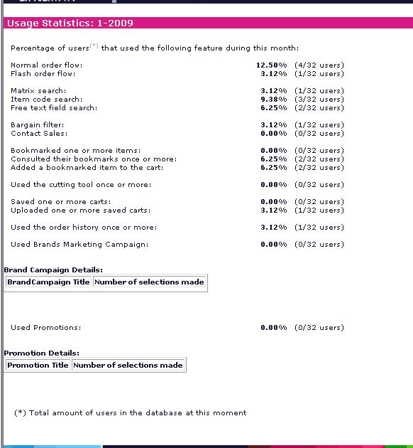
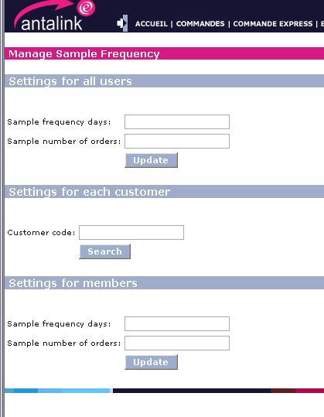
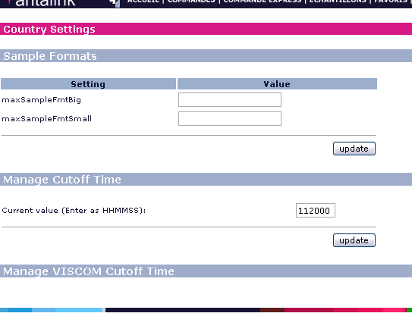
Browsing statistics
(antalis admin)
Manage sample frequency
(antalis admin)
Manage Samples format parameters
(antalis admin)

Slide 9
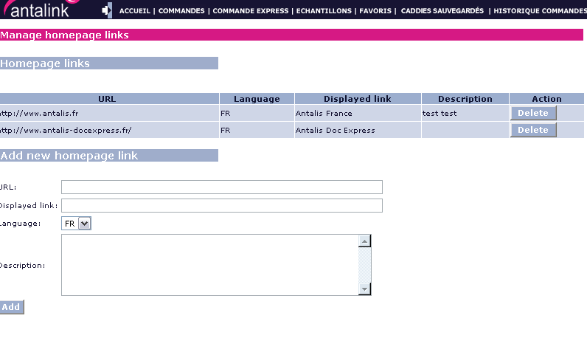
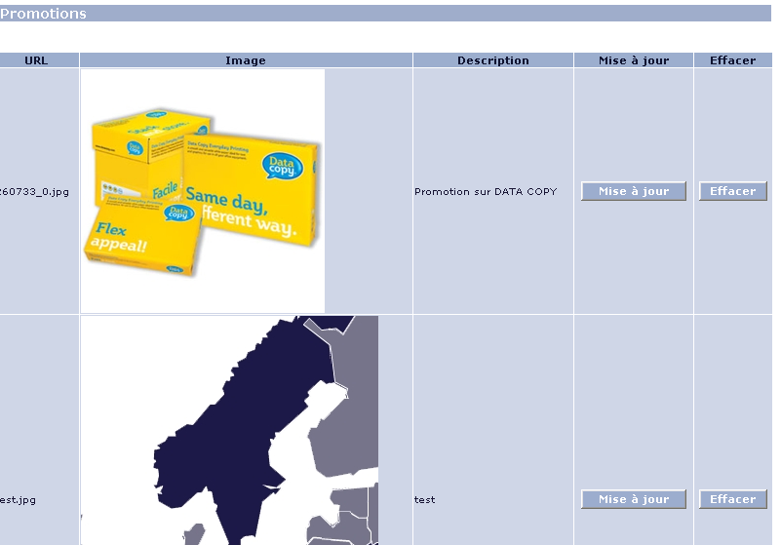
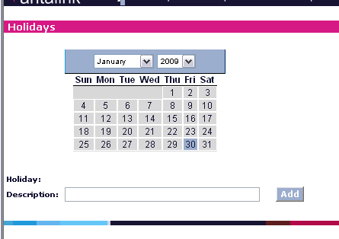
Manage display links on HP
(antalis admin)
Manage holidays
(antalis admin)
Manage cross selling promotion (antalis admin and antalis product manager)

Slide 10
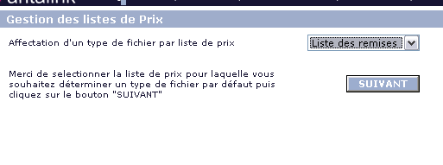
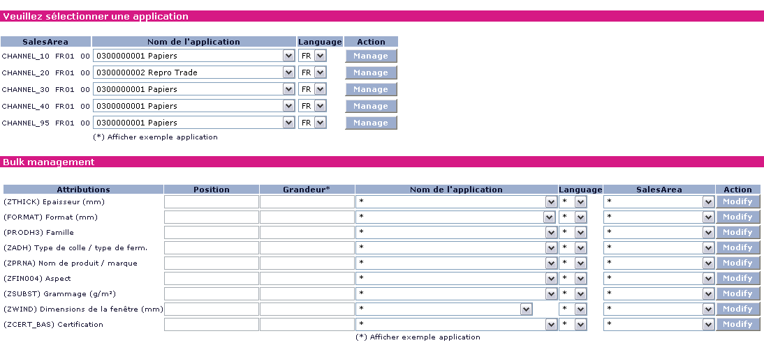
Manage pricelist available format
(antalis admin)
Manage search matrix windows
(antalis admin)

Slide 11
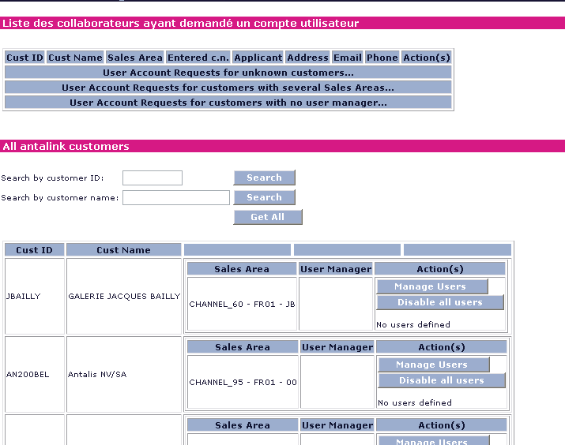
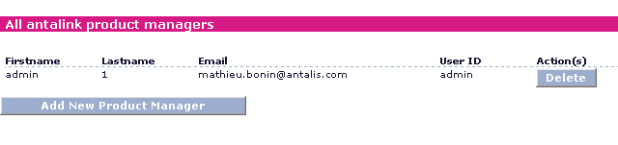
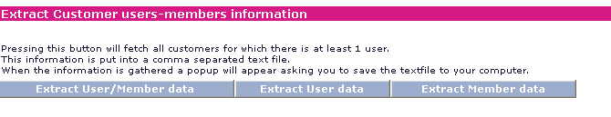
Manage password
(antalis admin)
Product manager role creation
(antalis admin)
Extract customer and member data (antalis admin)

