Slide 1
Laser/ Robot Remote Size Reduction
Nuclear Robotics Workshop
11/06/19

Slide 2
Background
Significant amount of post-operational items that require processing before disposal
Baseline methods (largely manual processing) are viewed as costly, slow and high risk
Considerable development of innovative techniques to process the waste
Remote size reduction viewed as meeting the three criteria of speed, cost and safety

Slide 3
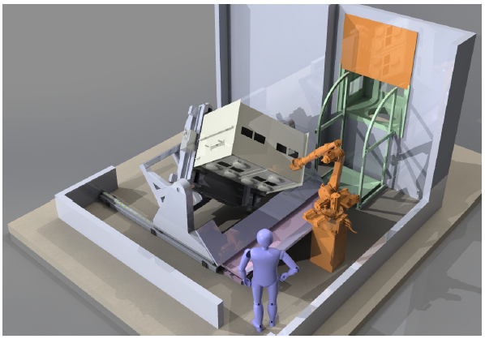
The Laser Cutting Demonstrator

Slide 4
Task / Environment
System is required to size reduce the item in line with the pre-determined cutting plan and to transfer the cut pieces into the waste drum without direct operator intervention
It needs to be able to cut significantly contaminated items
It is intended to decontaminate the containment and hardware after each operation, however the area is likely to become contaminated and operator entry carries some risk
Not intended to remove items for planned maintenance

Slide 5
Use of automation/ Technology
Item scanned prior to import to allow clamping to be optimised and cut path to be developed
From the scan a cut path is developed and verified, and uploaded to the main system.
Process is software controlled thereafter, through a set of sequences, various levels of automation possible from ‘press and go’ to step through of each sequence.
Laser safety system software based, uses a mixture of active and passive guarding

Slide 6
Key Hazards and Management Strategies
Radioactive material being released outside the facility
Managed through the provision of robust containment, and eliminating and managing the challenges to that containment (low reliance on software)
Conflict between operators and robots
Managed via the use of access control and robot maintenance modes (no access during normal operations)
Laser radiation hazard
Managed via the use of active and passive guarding systems (software based)

