Slide 1
S.2 LESSON
PHYSICS

Slide 2
OBJECTIVES
By the end of the lesson, learners should be able to;
Define pressure and state the S.I units
Explain the factors affecting pressure in solids
Calculate minimum and maximum pressure

Slide 3
KEY WORDS
Pressure
Force
Area
Maximum
minimum
SUCCESS CRITERIA
C/w define pressure and state the factors affecting pressure in solids
D/w Explain the factors affecting pressure in solids
Calculate minimum and maximum pressure

Slide 4
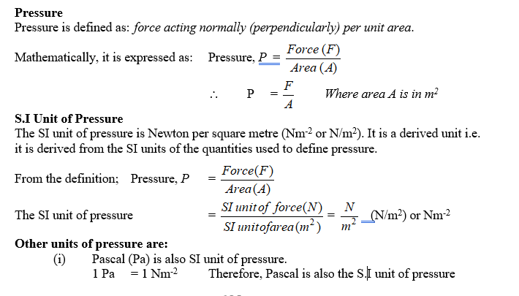

Slide 5
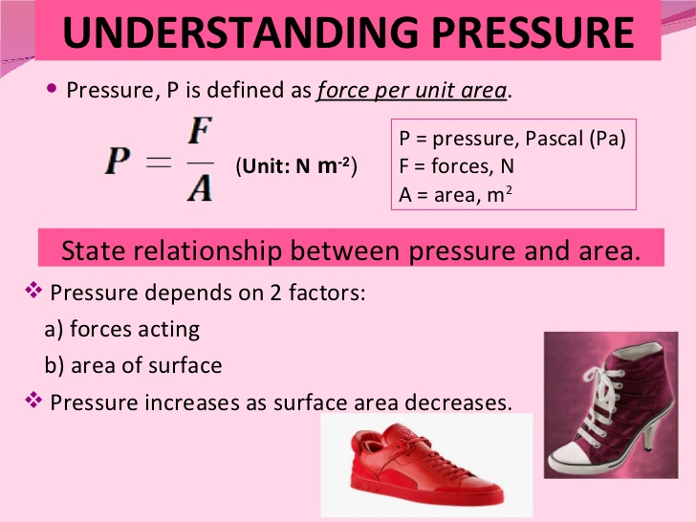

Slide 6
(ii) Atmosphere (atm).
(iii) Millimeter of mercury (mmHg)
1 atm = 101325 Pa or Nm⁻²
Also 1 atm = 760 mmHg
The larger units of pressure are:
- Kilo Pascal (kPa) 1 kPa = 1 000 Nm⁻²
- Mega Pascal (MPa) 1 MPa = 1 000 000 Nm⁻²

Slide 7
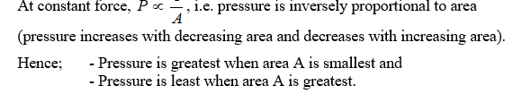
Factors affecting pressure in solids
force exerted
Area of contact

Slide 8
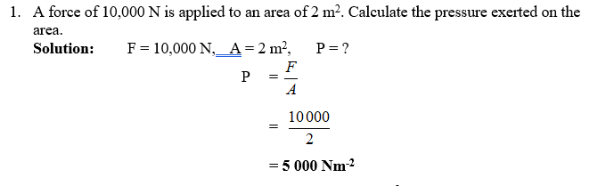
Worked examples

Slide 9
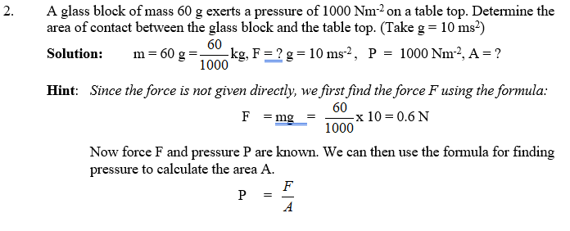
Example 2

Slide 10
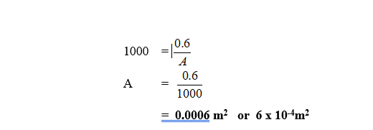

Slide 11
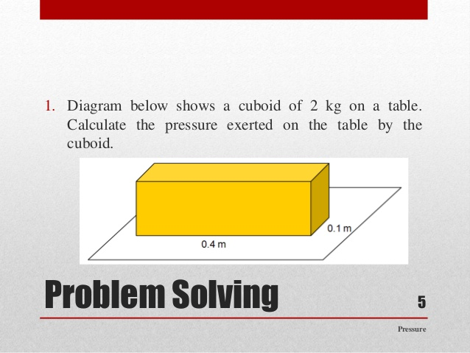
Question

Slide 12
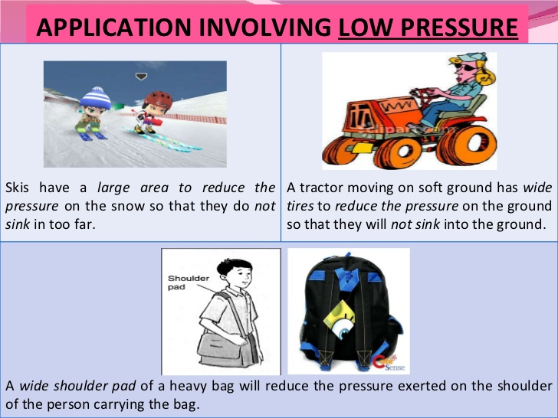

Slide 13
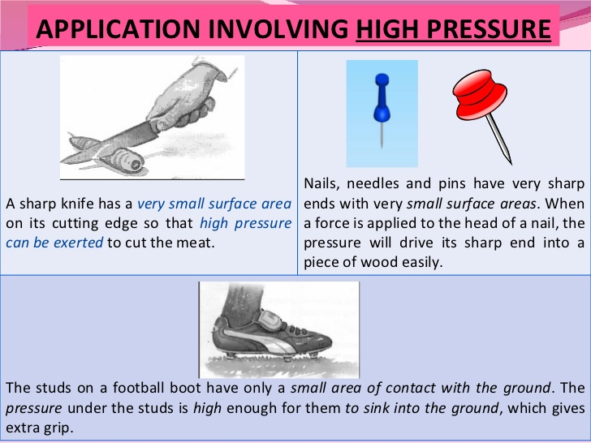

Slide 14

Minimum and maximum pressure
Pressure increases when the area decreases and decreases when the area increases

Slide 15
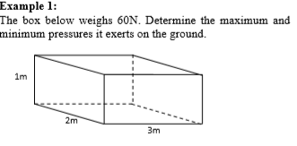
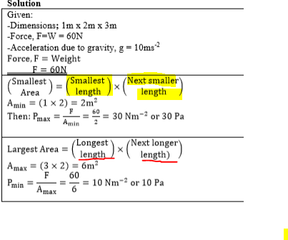

Slide 16
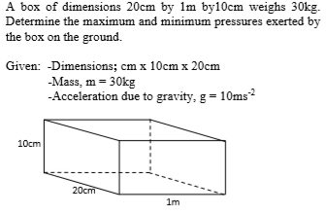
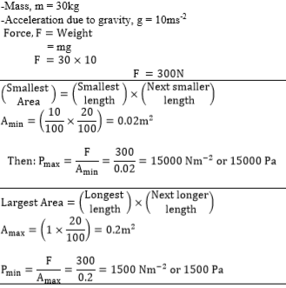

Slide 17
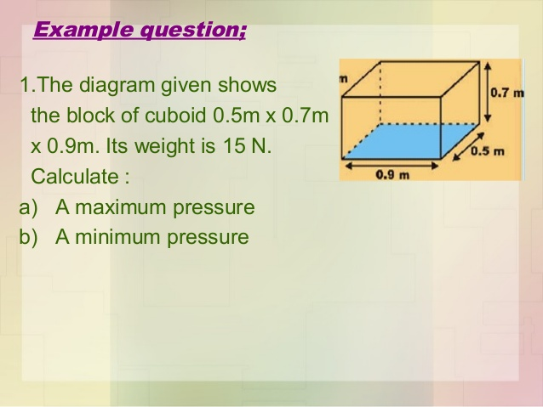
Trial questions

Slide 18
END

