Slide 1
UNIT TWO
Activity one

Slide 2


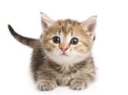
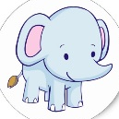



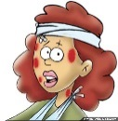

Agosto (August) 2019
Monday | Tuesday | Wednesday | Thursday | Friday | Friday | Sunday
 |  |  | 1 | 2 | 3 | 4
 |  |  | One | Two | Three | Four Golden gate
5 | 6 | 7 | 8 | 9 | 10 | 11
Five | Six | Seven | Eight he cat is carnivorous and domestic Body Mass: 3.6 - 4.5 kg (Adult) Height: 23 - 25 cm. Average life: 2 - 16 years | Nine International Day of the Indigenous Peoples | Ten | Eleven
12 | 13 | 14 | 15 | 16 | 17 | 18
Twelve -Day of the elephant Weight in female: 4 and 5 thousand kg of height 3m. Male weight: 6y7 thousand kg and height 3.2m | Thirteen | Fourteen | Fiveteen City hall | Sixteen | Seventeen | Eighteen
19 | 20 | 21 | 22 | 23 | 24 | 25
Nineteen World Day of Humanitarian Assistance | Twenty | Twenty One | Twenty Two | Twenty Three International Day of Remembrance of the Slave Trade and its Abolition | Twenty Four | Twenty Five
26 | 27 | 28 | 29 | 30 | 31
Twenty Six | Twenty Seven | Twenty Eight | Twenty Nine International Day against Nuclear Tests | Thirty International Day of Victims of Enforced Disappearances | Thirty One

Slide 3








Octubre (Octumber) 2019
Monday | Tuesday | Wednesday | Thursday | Friday | Friday | Sunday
 | 1 | 2 | 3 | 4 | 5 | 6
 | One International Day of the Elderly | Two International Day of Non violence | three | Four Day of the animal | Five World Teachers' Day | six
7 | 8 | 9 | 10 | 11 | 12 | 13
Seven World Habitat Day | Eight | Nine | ten World Mental Health Day | Eleven International Girl's Day | twelve World Day of migratory birds The Blue-winged Teal Body Mass: 5.5 kg (Adult) Height: 30 cm. Average life: 50 years | Thirteen
14 | 15 | 16 | 17 | 18 | 19 | 20
fourteen | fiveteen | Sixteen International Day of Rural Women | Seventeen | eighteen | nineteen | Twenty World Statistics Day
21 | 22 | 23 | 24 | 25 | 26 | 27
twenty one | twenty two | twenty three | twenty four | twenty five | twenty six | twenty seven
28 | 29 | 30 | 31
twenty eight | twenty nine | thirty | thirty one

Slide 4
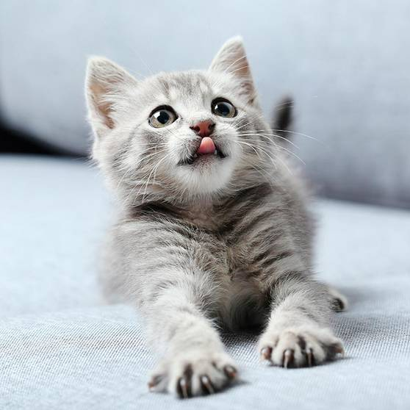
Hello my name is Nohora Velasco My favorite animal is cats (Thomas)
My favorite animal is cats, because they are very sweet, my cat is called Tomas is affectionate, playful and kind, there are different types of cats.
I love them all for being so special with the human being and they are always there for one to share a little bit of our time with them, they are special with people. The cat is my best friend that I can have in my house.
My cat Tomas is small, kind and he is fat, white, hairy and very sleeps short intervals of the day, because he likes to go out and get married and to share with his neighborhood friends. Tomas is a very beautiful and tender cat.

Slide 5

AUDIO

