Slide 1
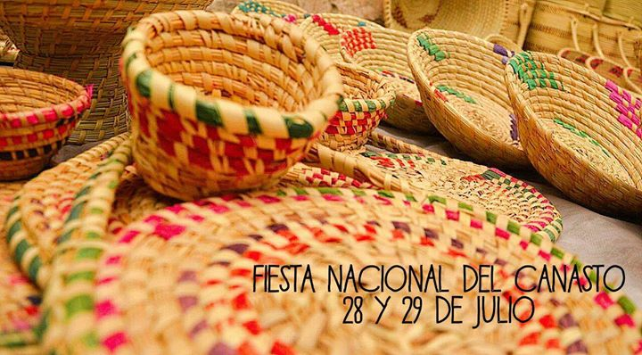
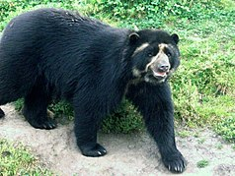
Julio 2019
This event, held on July 28 and 29, is a tribute to the artisans who, with their daily efforts, maintain the validity of an art based on the use of plant materials.
Sunday | Monday | Tuesday | Wednesday | Thursday | Friday | Saturday
 |  |  |  |  | 1 one | 2 two
3 three | 4 four | 5 five | 6 six | 7 seven | 8 eigth | 9 nine
10 ten | 11 eleven | 12 twelve | 13 thirteen | 14 fourteen | 15 fiveteen | 16 sixteen
17 seventeen | 18 eighteen | 19nineteen | 20 twenty | 21 twenty one | 22 twenty two | 23 twenty trhee
24 Tweny four | 25 twenty five | 26 twenty six | 27 twenty seven | 28 twenty eigth | 2 9 twenty nine | 30 Thirty
Valle del Cócora, is the cradle of the emblematic tree of Colombia; La Palma de Cera, and is considered a buffer zone of Los Nevados National Natural Park, that is, it delimits the space in order to prevent damage to its surroundings. This is the ideal destination for all those who enjoy the natural spaces and take pride in admiring the green of the mountains in their most active state.
The bear eyeglasses are medium sized and robust build It has length from 120 to 200 cm weigh between 100 and 200 kg is of mammal class lives approximately 50 years

Slide 2
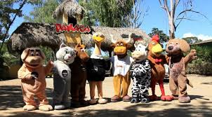
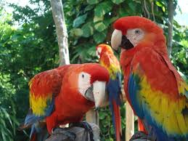
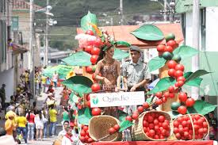
junio 2019
The beak is big and strong The legs have two fingers forward and two backwards, which allows the bird to use the fingers as if they were hands. it measures from 80 to 90 centimeters in length it's flying class
DOMINGO | LUNES | MARTES | MIÉRCOLES | JUEVES | VIERNES | SÁBADO
 |  |  |  |  | 1 one | 2 two
3 three | 4 four | 5 five | 6 six | 7 seven | 8 eigth | 9 nine
10 ten | 11 eleven | 12 twelve | 13 thirteen | 14 fourteen | 15 fiveteen | 16 sixteen
17 seventeen | 18 eighteen | 19nineteen | 20 twenty | 21 twenty one | 22 twenty two | 23 twenty trhee
24 Tweny four | 25 twenty five | 26 twenty six | 27 twenty seven | 28 twenty eigth | 2 9 twenty nine | 30 Thirty
In this celebration, the meeting of beauty of Colombian women, together with the tradition of coffee is held
This event takes place annually, during the last week of June
The National Agricultural Culture Park (PANACA) is an agricultural and livestock theme park located in Quimbaya, Colombia.
It is the first agricultural theme park in the world, offers several shows, theme stations and a collection of domestic zoology. It calls itself "A large farm", with 8 stations and more than 4 500 domestic animals, the park aims to get visitors to know the main activities of the agricultural sector and traditions of the countryside

Slide 3


MY FAVORITE ANIMAL
Hi my name is Paola
My favorite animal is the dog because they are very intelligent are good company The dog is very affectionate and faithful. Dogs protect us, take care of us when we are sad and stay by our side forever.
Thanks to the affection they are able to transmit, the sick get better, the elderly find company, the blind help and the children a sincere friendship.

