Slide 1
CALENDAR. SAN FRANSISQUITO. 2019.

Slide 2


Slide 3
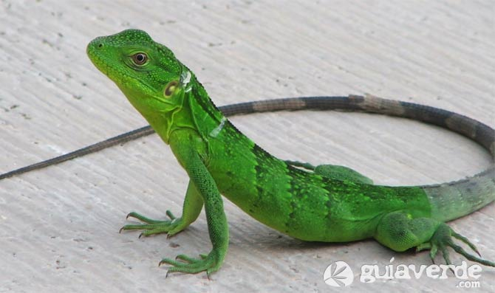
MAY 2019
REPTIBLE MONTH.
sunday | monday | tuesday | wednesday | thursday | friday | saturday
 |  |  | 1 | 2 | 3 | 4
5 | 6 | 7 | 8 | 9 | 10 | 11
12 | 13 | 14 | 15 | 16 | 17 | 18
19 | 20 | 21 | 22 | 23 | 24 | 25
26 | 27 | 28 | 29 | 30 | 31
Iguanas are reptilian animals, they have a life span between 10 and 20 years. They measure between 60 to 70 centimeters to 2 meters long from head to tail. They have a weight between 15 and 17 kilograms.

Slide 4


Slide 5
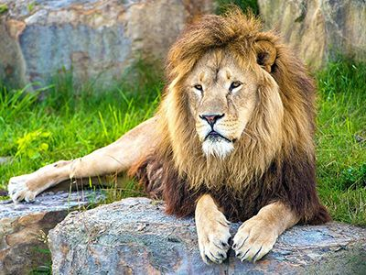
JUNE 2019
CARNIVOR MONTH.
sunday | monday | tuesday | wednesday | thursday | Friday | saturday
 |  |  |  |  |  | 1
2 | 3 | 4 | 5 | 6 | 7 | 8
9 | 10 | 11 | 12 | 13 | 14 | 15
16 | 17 | 18 | 19 | 20 | 21 | 22
23 | 24 | 25 | 26 | 27 | 28 | 29
In the will the lions live from 10 to 14 years, their weight varies betwwen 160-225 kilograms. Its size varies depending on the are of habitad this is betwwen 205 to 334 centimeters.

Slide 6
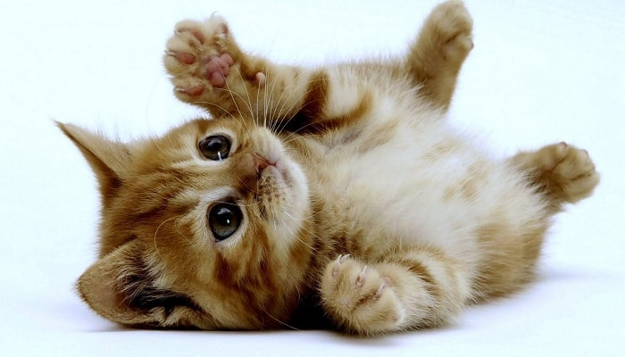

MY FAVORITE ANIMAL.
Hi my name is paola pesca.
My favorite animal is the Cat. Because they are very obedient, clean, they love to play with balls or wool. My cat is called felix is small White with black likes to share with children is friendly and loves lo slepp on my feet.

