Slide 1

Python Problems
Andrew Reddish
https://github.com/areddish/python_grids
Notes:
Quick intro

Slide 2
Agenda
What is a grid?
Topics:
Scanning
Spreadsheet
Navigation
Time to solve problem on own
Re-convene to discuss solution

Slide 3
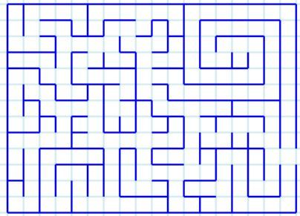
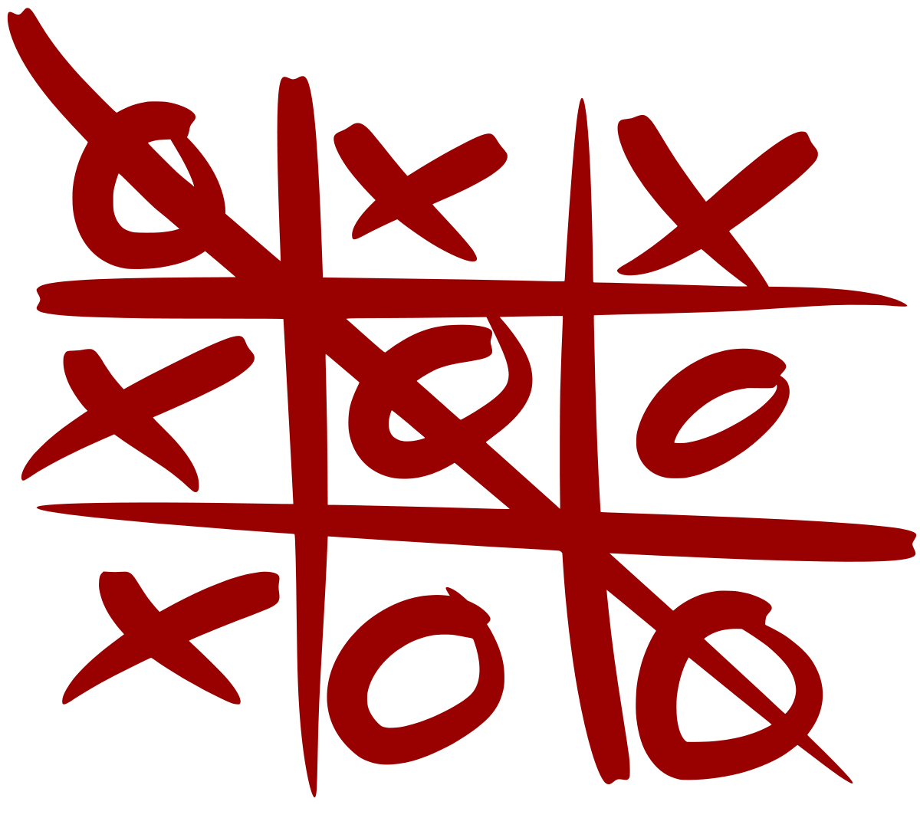
What is a grid?
Structured data:
Rows
Columns
Cells that are addressable (coordinates) and store data
We’ll only focus on 2D grids, with limited width and height
Phone | Part # | Qty | Price
555-1000 | 33AA56 | 3 | 25
555-4033 | 11AB11 | 5 | 30
555-1406 | 24CB13 | 100 | 1.25
555-4445 | 24CB15 | 2000 | 1
1
2
3
4
Notes:
Can be built on top of multiple data structures. We’ll use lists tonight but you could build a grid ontop of linked lists, graphs, etc.

Slide 4
Grids in Python
List of Lists (2D Array)
List (1D Array)
grid =[ [ 1, 2],
grid = [ 1, 2,
Logical Indexing:
grid[(y * width) + x]
[ 3, 4 ] ]
3, 4 ]
Direct indexing:
grid[2][1]
Notes:
1D is how screens used to do graphics, the entire screen was a giant frame buffer
Lots of work to make 1D faster, things like eliminating the multiplication by using bit shifting (power of two width)

Slide 5
Orientation
(0,0)
(0,0)
(0,0)
Good for problems with +/- values
Have to map the index from negative to positive
Good for positive only, mimics cartesian.
When printing top down, have to go from max Y to 0
Good for positive only, mimic’s screen space
Top down print would be
range(0,y)
Notes:
Negative indices in python operate from the back

Slide 6
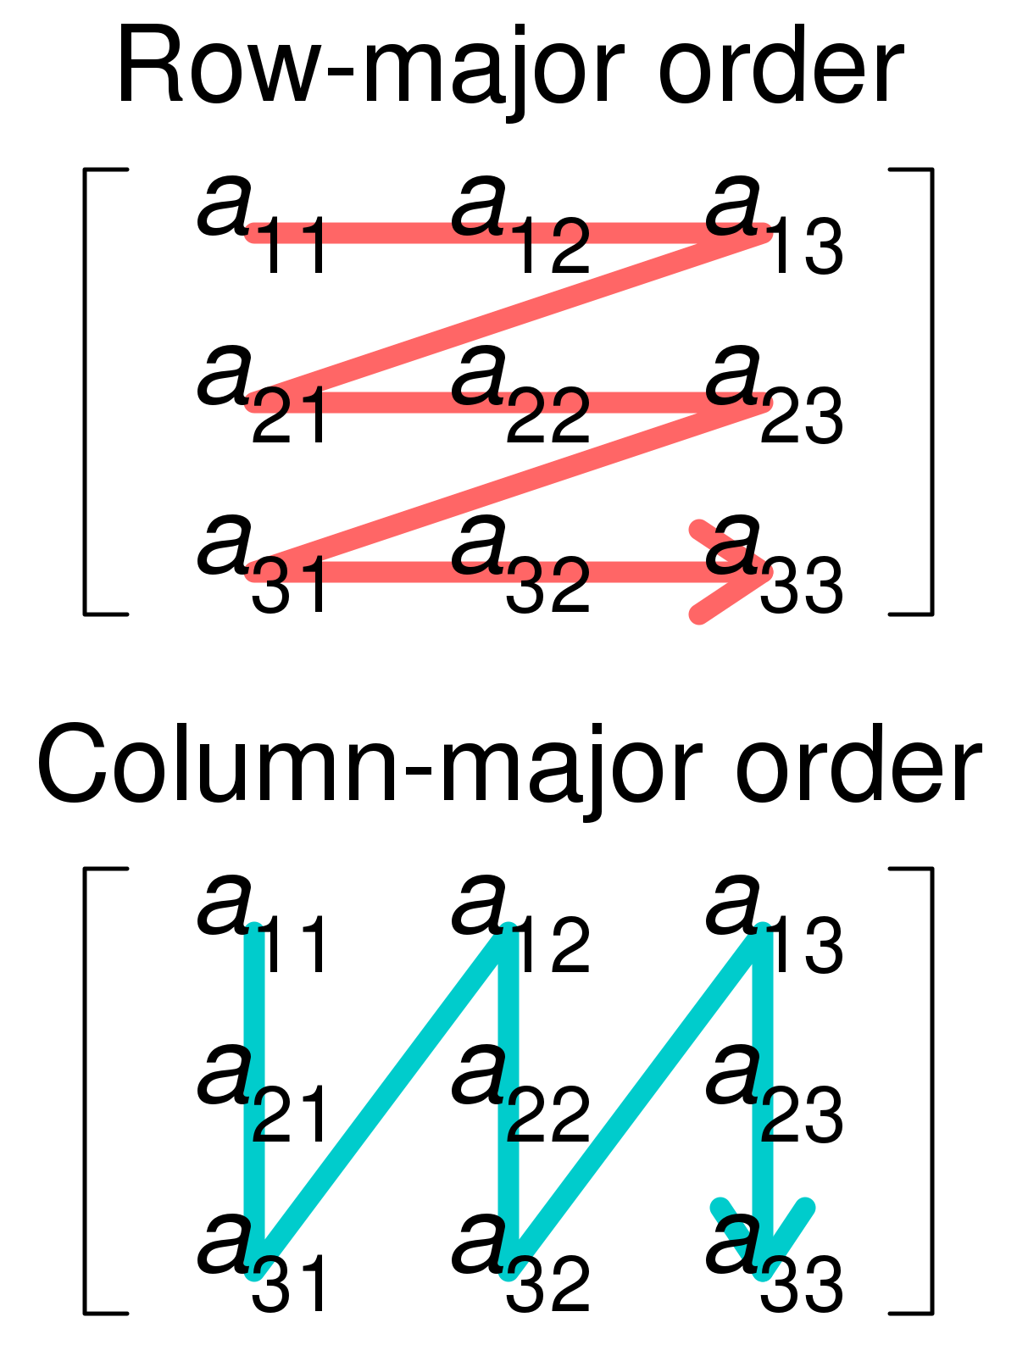
Iterating
Row-major
Column-major
FORTRAN, MatLab, …
Row Major
for x in range(width):
Python stores arrays this way as do many languages C/C++, C#, Java,…
for y in range(height):
Col Major
Iterating
for x in range(width):
for y in range(height):

Slide 7
For tonight’s solutions
Solutions will assume:
Upper, left is (0,0)
Iteration/Scanning will be top-to-bottom, left-to-right (book order)
2D array: grid[y][x]
Height of grid is then len(grid)
Width of grid is then len(grid[0])
Invariant: All rows are the same length
(0,0)
Top down print would be
range(0,y)

Slide 8

Scanning

Slide 9
Scanning
Looking for a value, or pattern on a grid
Involves iterating over the grid
Testing one or more values against another value or pattern
if grid[x][y] == "$":
print ("Player found cash!")
if grid[3][1] == ":" and grid[3][2] == ")":
print ("Smile!")

Slide 10
Problem #1
Tic-Tac-Toe
Given the contents of the tic-tac-toe board, determine the outcome:
X Wins
O Wins
Draw
Input:
X,O,X,O,O,X,O,O,X =
Result: X Wins!
X | O | X
O | X | X
O | O | X

Slide 11
Problem 1 – Cheat sheet
grid = [ ["X", "O", "X"],
["O", "X", "O"],
["O", "X", "X"] ]
# Prints out what’s at (1,2) print(grid[2][1]) # Prints X
# Prints out what’s at (2,1)
print(grid[1][2]) # Prints O
# To compare three things, you can pair-wise compare
a == b and a == c
# For static values, you can also chain ==‘s a == b == c

Slide 12
Solutions
Notes:
Brute Force: Use if statements to check for all conditions
Iterate in directions
Outward span

Slide 13
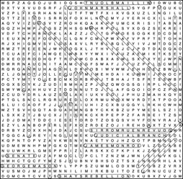
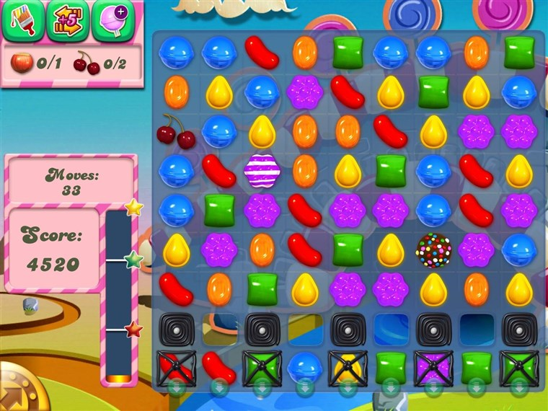
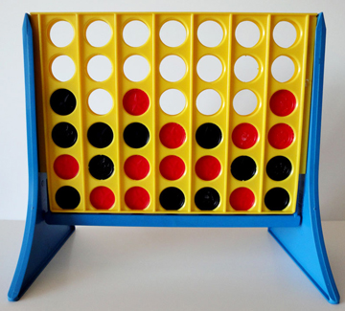
Solution - scan
Make use of the turn-based nature of games
Extensible for any size
Same solution works for anything matching

Slide 14
Scanning in a pattern
Matches are horizontal, vertical and optionally diagonal
Start from the location of the last piece placed
Expand out
Each direction is an offset, i.e (-1,0)= Left

Slide 15

Spreadsheets

Slide 16
Spreadsheets
Spreadsheets work on and are displayed on a gird
Finite vs infinite grid
Static data vs Formulas
i.e. Excel “=3” turns into grid[y][x] = 3
i.e. Excel “=C5 + 1” turns into grid[y][x] = grid[5][2] + 1
Heterogenous data
Cells can contain different data types: string ,int, date, etc.
Addressing multiple cells
Python has slicing syntax for extracting data from a list, useful for rows
Columns are harder, have to iterate over rows

Slide 17
Problem #2
Given a spreadsheet
Compute the formulas in the spreadsheet
Display the result:
Phone | Part # | Qty | Price | Profit
555-1000 | 33AA56 | 3 | 25 | *
555-4033 | 11AB11 | 5 | 30 | *
555-1406 | 24CB13 | 100 | 1.25 | *
555-4445 | 24CB15 | 2000 | 1 | *
 |  | + |  | +
Phone | Part # | Qty | Price | Profit
555-1000 | 33AA56 | 3 | 25 | 75
555-4033 | 11AB11 | 5 | 30 | 150
555-1406 | 24CB13 | 100 | 1.25 | 125
555-4445 | 24CB15 | 2000 | 1 | 2000
 |  | 2108 |  | 2350

Slide 18
Problem 2 Cheat Sheet
* = multiply previous two cells and replace value
+ = sum the column and replace with sum
# Row slice
grid[start:end]
# Column, list comprehension
[row[col] for row in grid[start:stop]]
# Column, function
def column(grid, start, stop, col):
result = []
for row in grid[start:stop]:
result.append(row[col])
return result
# Convert string to float
float("2.0")
# Convert float to string
str(2.0)

Slide 19
Solutions
Notes:
Brute Force: Use if statements to check for all conditions
Iterate in directions
Outward span

Slide 20
Things to think about
Operator precedence – what to do if more than one formula needs evaluating
Can look at each cell and walk dependencies
More extensive formulas
Address other cells, SUM(A1:A5) + SUM(B3:B8)
More operations, MOD, DIV, IF
This becomes a mini domain specific language

Slide 21

Navigation

Slide 22
Traversing a grid
Up, down, left, right, described as offsets (0,-1), (0,1), (-1,0), (1,0)
Adding diagonals, depends on problem. (+/-1, +/-1)
Wrap around vs clamp
Notes:
Orientation needs to match directional, sometimes it doesn’t matter though.
Left, right vs turning left, right.
Current position + offset = new position

Slide 23

Reachability
Grids are great for describing 2D space
Mark obstacles and goals
Traversing a grid is just like scanning
Solution determines if you can navigate to a point
Ways to do it:
Random movement
Explore all possibilities
Explore some possibilities

Slide 24
Backtracking
Make a move and see if you can solve from that location
If not, don’t go that way… ever again.
If so, that’s your solution
Gives a solution, not always best solution
Consider it a tree of moves, this is a depth first search
Recursion is often used, but not necessary
Pitfall: infinite navigation, circles
Notes:
General idea
have a goal condition
have constraints on what you can do
try one move
if hit goal, return!
if not, go back to where you came from and try a different move
(create a flow graphic)

Slide 25
Bookkeeping – ruling out paths
Rules out paths we took, avoids cycles
Directly in the grid
Good for reachability, no additional memory
Outside data structure
Good for giving back a path
Can store additional data like cost, desirability, total damage
Notes:
Sometimes referred to as visited or open/close lists.

Slide 26
Backtracking flow
Am I at goal?
Yes!
(we can get there)
Can I make a move?
No
(we can’t get there from here)
Get a move from possible moves
Two outcomes:
You find a path
You exhausted all moves and find your self back at the start with no where to go.
Make move & record
Start process over from new position

Slide 27
Problem 3
Navigate a maze
Given a grid with a start “S” and an end “E”, can you navigate from the start to the end and avoid the walls “#”
Bonus: can you generate the path?
▓▓▓▓▓▓▓▓▓▓▓▓▓▓▓▓▓▓▓▓▓▓▓
▓S▓ ▓ ▓ ▓ ▓ ▓
▓ ▓ ▓ ▓ ▓ ▓ ▓▓▓▓▓ ▓ ▓ ▓
▓ ▓ ▓ ▓ ▓ ▓ ▓
▓ ▓ ▓ ▓ ▓ ▓▓▓ ▓ ▓ ▓▓▓▓▓
▓ ▓ ▓ ▓ ▓ E▓
▓▓▓▓▓▓▓▓▓▓▓▓▓▓▓▓▓▓▓▓▓▓▓

Slide 28
Problem 3 Cheat Sheet
# Use Grid itself for bookkeeping, mark that we went this way
grid[y][x] = "#"
# Code to find other solution, goes here
# Didn't find a solution, unmark this path for other attempts
grid[y][x] = " "
# Tuples are great for coordinates
location = (x, y)
# However you can't add them with +
# Instead need to piecewise add them
a = (1, 0)
b = (0, 1)
# a+b will concat the tuple into (1,0,0,1)
# This will add (1,0) + (0,1) = (1,1)
a_plus_b = (a[0]+b[0], a[1]+b[1])
# You can check for tuples in a list or dict, if you use tracking
# outside grid
visited = [(1,2), (2,3)]
(2,3) in visited # returns True
(3,4) in visited # returns False

Slide 29
Solutions
Notes:
Brute Force: Use if statements to check for all conditions
Iterate in directions
Outward span

Slide 30
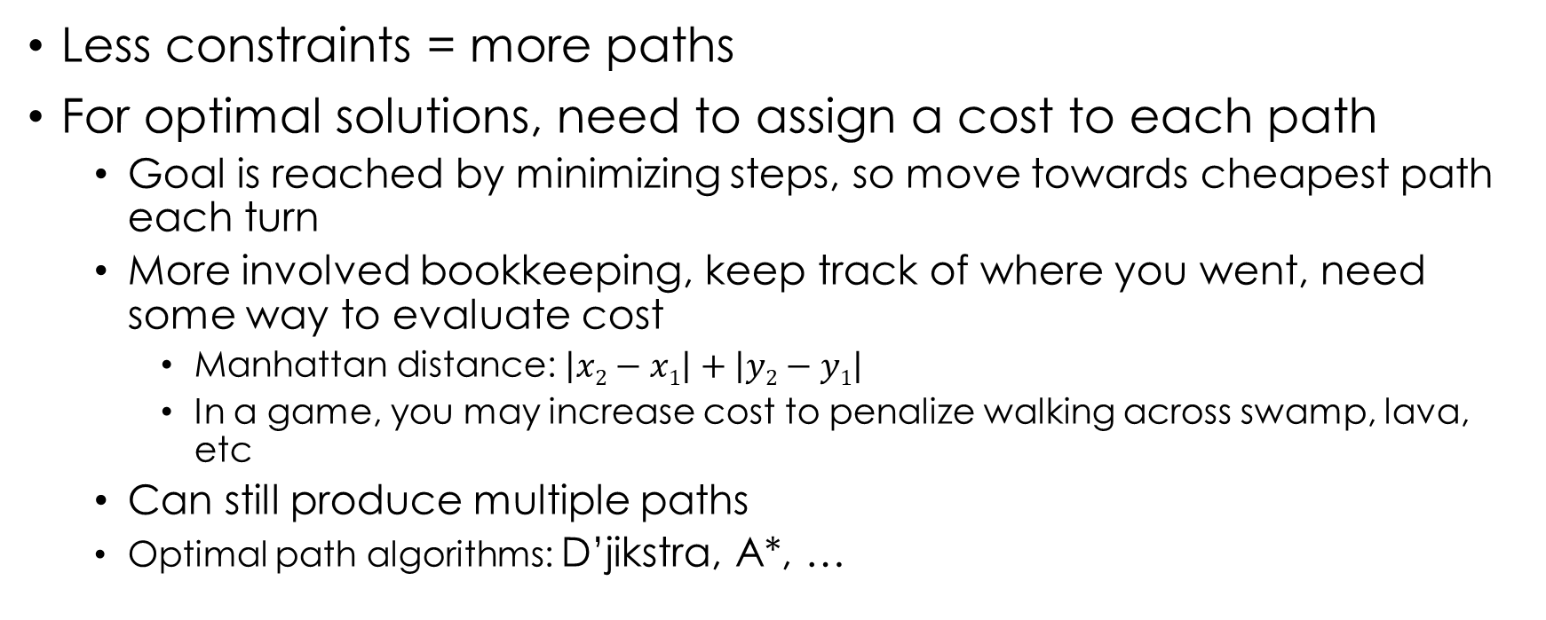
Pathfinding
Less constraints = more paths
For optimal solutions, need to assign a cost to each path
Goal is reached by minimizing steps, so move towards cheapest path each turn
More involved bookkeeping, keep track of where you went, need some way to evaluate cost
Manhattan distance: $\left|x2−x1\right|+\left|y2−y1\right|$
In a game, you may increase cost to penalize walking across swamp, lava, etc
Can still produce multiple paths
Optimal path algorithms: D’jikstra, A*, …

Slide 31
All Done!
Join our slack to keep in touch
Give us feedback, take the survey
Questions?

