Slide 1
Electron Diffraction
By Andrew and Michael

Slide 2
Outline
History
Theory
Procedure
Analysis
Questions

Slide 3
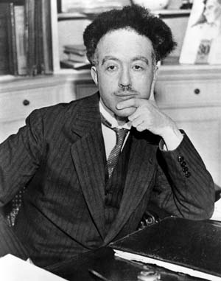
History
Can we reference particles in terms of their wave properties?
DeBroglie wavelength
Momentum is given by
Louis deBroglie
For a particle, wave properties can be described by

Slide 4
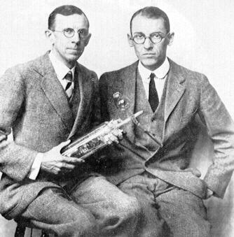
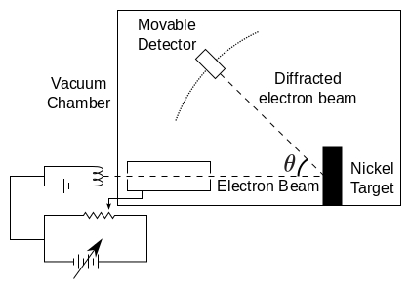
The Davison/Germer Experiment
Davison and Germer realized that electrons were being deflected by a lattice structure within their nickel target.
This was the first time anyone had observed deBroglie's theory that particles could act as both waves and particles.

Slide 5
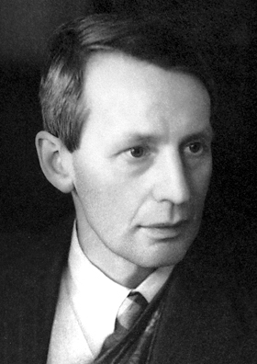
George Thomson
Observed wave-duality independently.
Designed an experiment using collimating slits
Different substances diffracted differently
Maximum electrons pass through at angles given by Bragg's law.

Slide 6
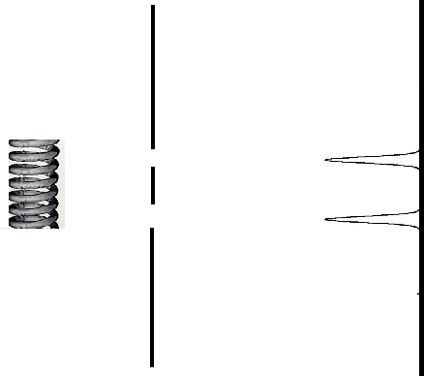
Classical Theory

Slide 7
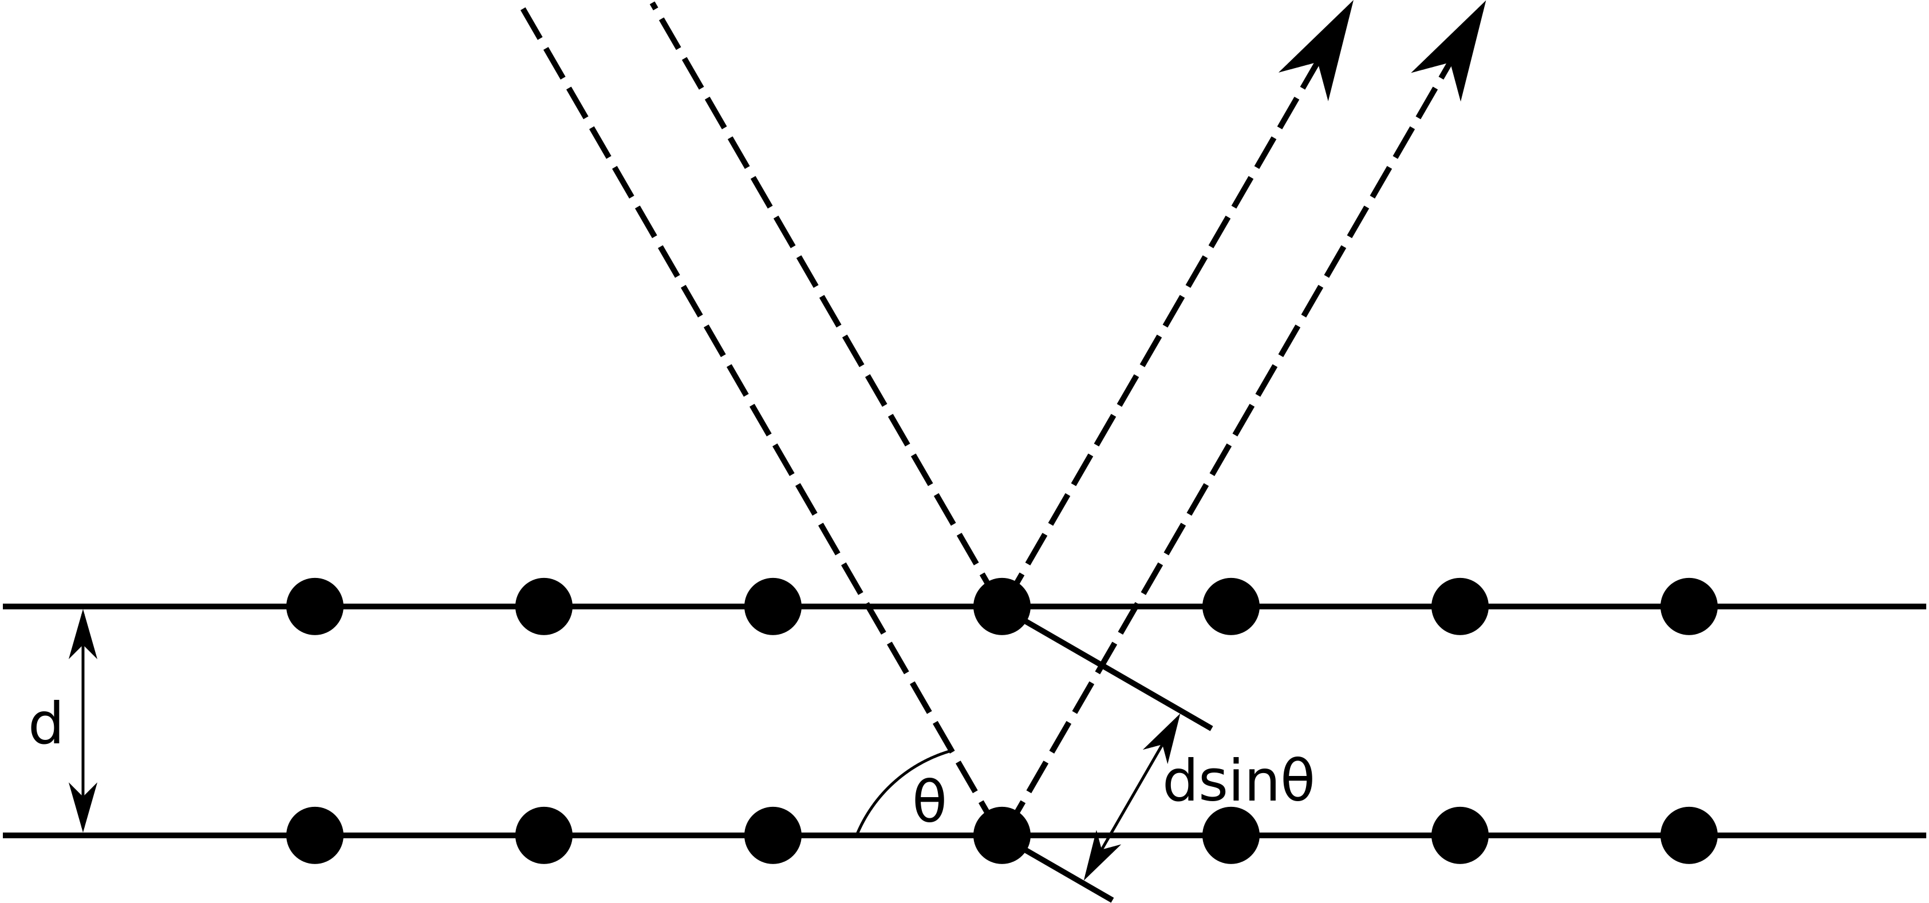
Theory
Bragg's Law
Constructive interference only occurs when deflected waves follow Bragg's Law. Otherwise Interference is negative.

Slide 8
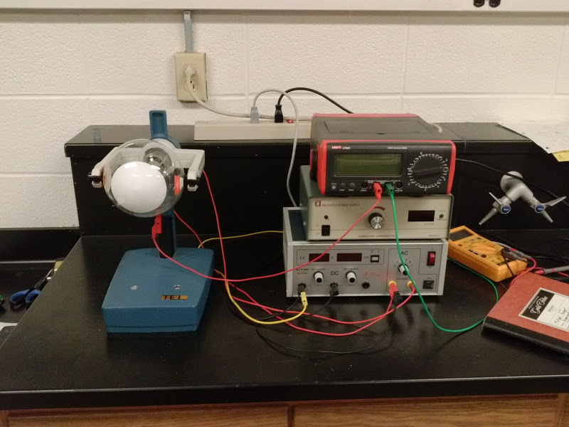

Slide 9
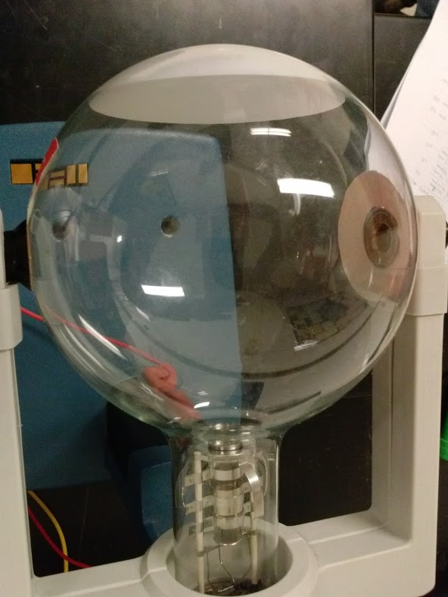
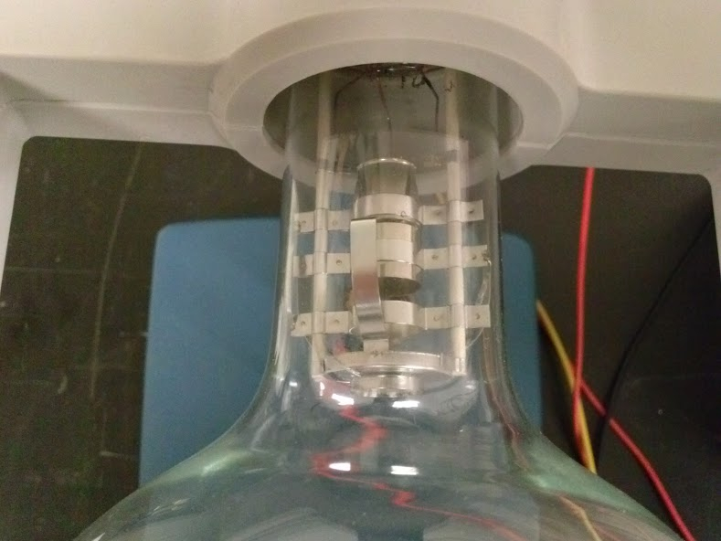

Slide 10
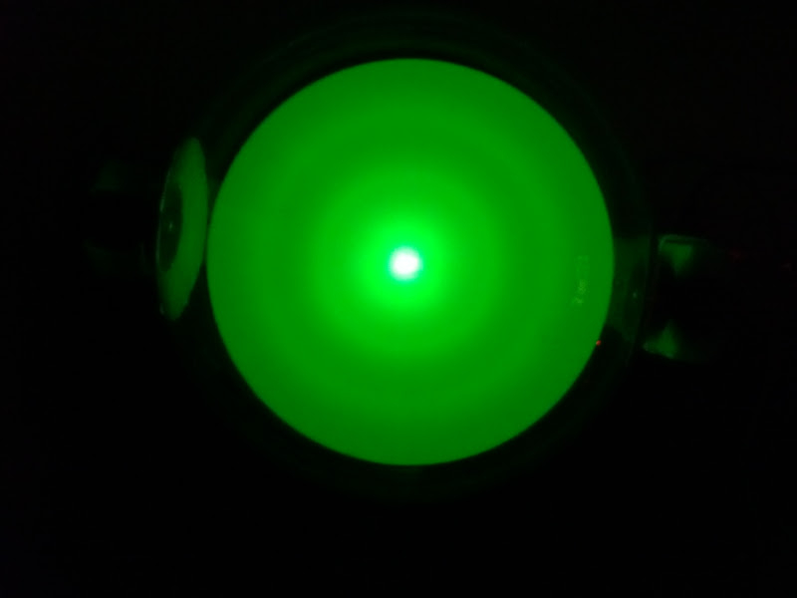

Slide 11
Works Cited
http://upload.wikimedia.org/wikipedia/commons/d/d2/Broglie_Big.jpg
http://en.wikipedia.org/wiki/Davisson%E2%80%93Germer_experiment#mediaviewer/File:Davisson-Germer_experiment.svg
http://upload.wikimedia.org/wikipedia/commons/4/4e/Davisson-Germer_experiment.svg
http://upload.wikimedia.org/wikipedia/commons/c/c2/George_Paget_Thomson.jpg
http://upload.wikimedia.org/wikipedia/commons/7/74/BraggPlaneDiffraction.svg
http://www.nyu.edu/classes/tuckerman/adv.chem/lectures/lecture_5/img5.png
http://upload.wikimedia.org/wikipedia/commons/9/99/Davisson_and_Germer.jpg

Slide 12
Questions?

