Slide 1
Electron Diffraction
By Andrew and Michael

Slide 2
Outline
History
Theory
Procedure
Analysis
Questions

Slide 3
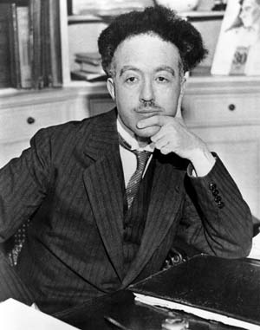
History
Louis deBroglie

