Slide 1

Film Script Analyzer
Luis Castro

Slide 2
‘The limits of my language mean the limits of my world.’ L. Wittgenstein
‘The most merciful thing in the world, I think, is the inability of the human mind to correlate all its contents.’ H.P. Lovecraft

Slide 3
Rationale
Films are a billion dollar industry.
Top creatives have to skim over many scripts.
Writers spend energy without an available tool to guide them.
We can do better.

Slide 4
Solution
“An application that extracts all relevant information from text so it can describe it, compare it, summarize it, rate it and recommend adequate or similar alternatives.”

Slide 5
Tools
Machine Learning
Recommendation Systems
Supervised/Unsupervised Learning
Natural Language Processing
Text mining/web scrapping
Summarization
API connections
IBM Watson
IMDB

Slide 6
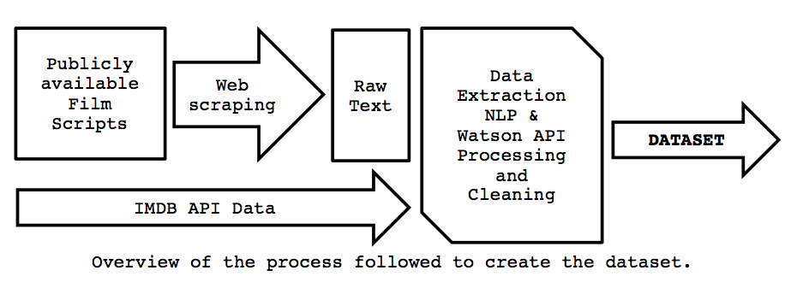
Dataset
Main dataset
Over 800 scripts scrapped
Over 500 scripts’ information contained in the dataset
30 personality insights features
13 text statistics features
19 film characteristics'’ features from IMDB
Recommendation matrix for the 500+ scripts.

Slide 7
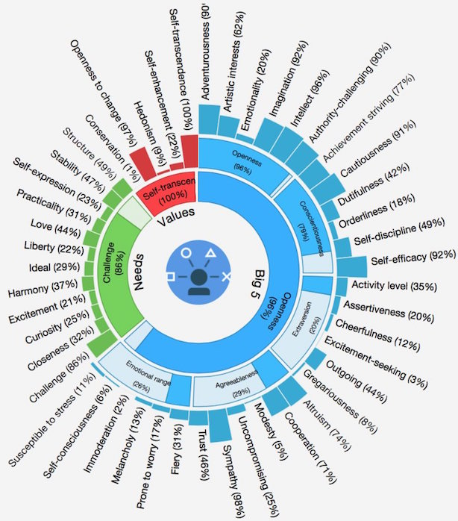
IBM Watson
"IBM Watson is a technology platform that uses natural language processing and machine learning to reveal insights from large amounts of unstructured data"

Slide 8
Main functions
Description
Recommendation
Classification
Summarization
Evaluation

Slide 9
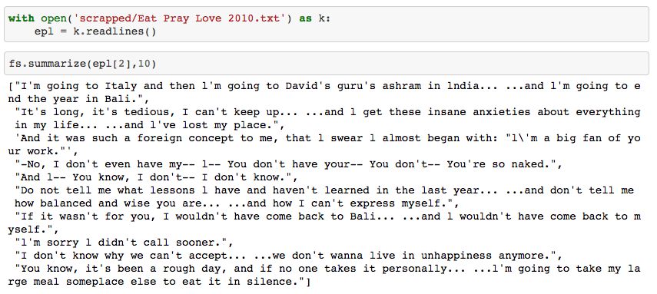
Summarize
Eat Pray Love

Slide 10
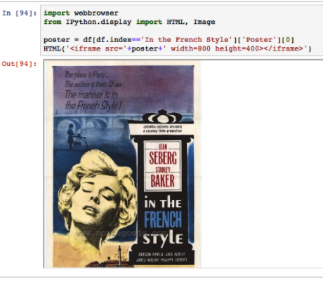
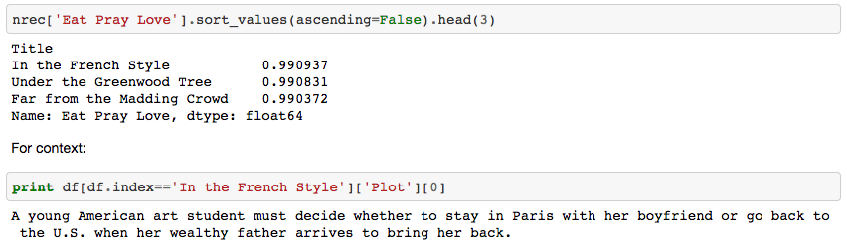
Recommend

Slide 11
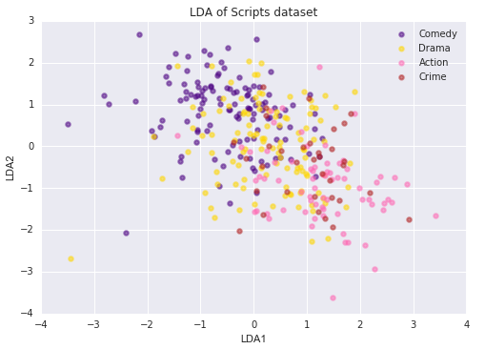
Classify
Current classification accuracy ~60%

Slide 12
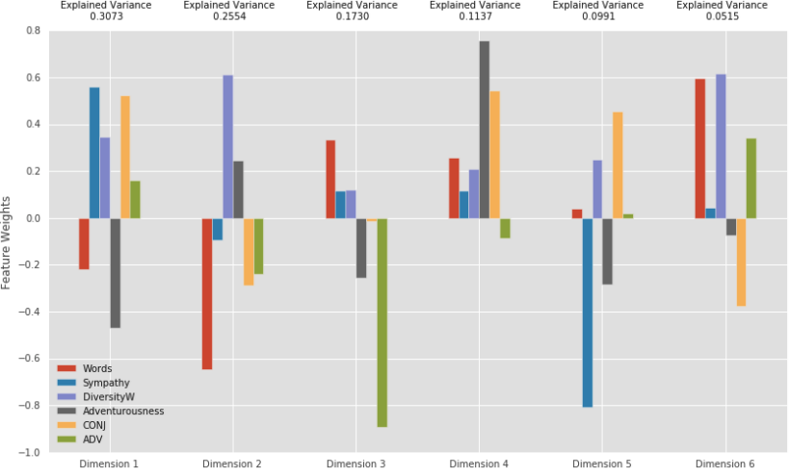

Describe
Importance as evaluated vs. ‘imdbRating’.

Slide 13
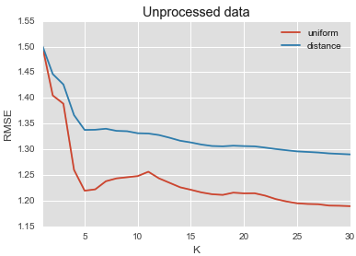
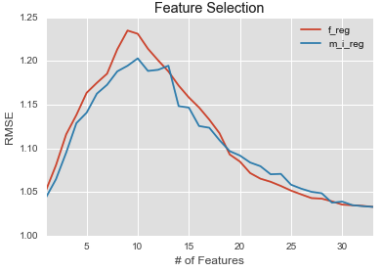
Evaluate

Slide 14
Why?
I have helped proofreading various scripts, one even sent to Cannes.
It may seem arrogant to qualify art, but we do it all the time, so lets be precise about it.
‘That is not art, that is a piece of…’ classification.
‘I guess it’s good, but doesn’t move me’ which is like 6 or 7, regression.
It can be expanded to literature “books”, speech to text, plagiarism detection, etc.

Slide 15
Next steps
Data mining (Keep increasing dataset):
Web crawling
API’s
Additional Books dataset
Machine Learning (classification/regression):
Tune KNN, SVM, RF, AdaBoost
Implement Keras NN, xgBoost
Develop web application:
User interface
Allow to submit text files
Allow to request for recommendation
Data visualization

Slide 16
Thank you.

