Slide 1
VIRTUAL
1
REALITY
LEARNING
KIDNEY VISUALIZATION
PRESENTED BY
ATIKA ABID (01-134222-032)
AREEBA AMIN (01-134222-028)
SUPERVISOR
DR. MUHAMMAD ASFAND-E-YAR

Slide 2
2
INTRODUCTION
→
linking anatomy to physiology matters for deeper learning and VR addresses that gap.
VIRTUAL
CHALLENGE
FOCUS
Traditional anatomy teaching methods such as cadavers and textbooks provide limited interactivity and do not effectively illustrate physiological processes.
VR-based anatomy learning system with an initial kidney module for 3D interactive visualization
OPPORTUNITY
VR enables immersive exploration linking structure and function.
explore, manipulate, and understand the human body in different ways
Next Slide

Slide 3
3
PROBLEM STATEMENT
How can virtual reality make anatomy learning more interactive and realistic?
PROBLEM DESCRIPTION
Traditional anatomy teaching methods that rely on cadavers, 2D diagrams, and textbooks are often expensive, limited, and less interactive, making it difficult for students to visualize 3D organ structures and understand physiological processes; therefore, there is a need for an engaging, interactive, and cost effective solution to enhance learning outcomes.
Next Slide
Next Slide

Slide 4
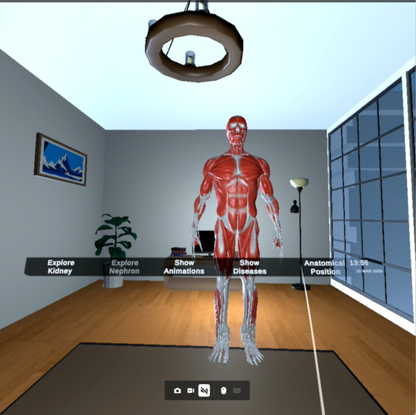
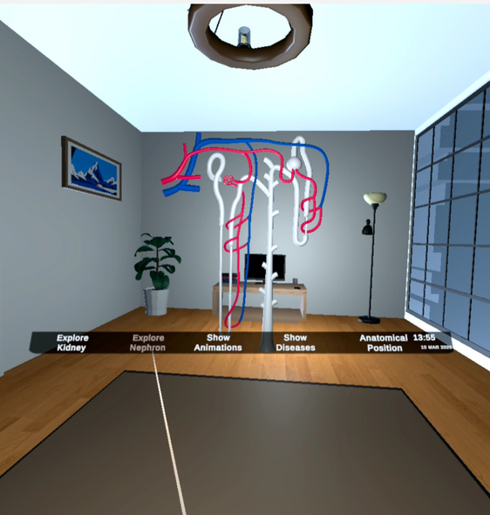
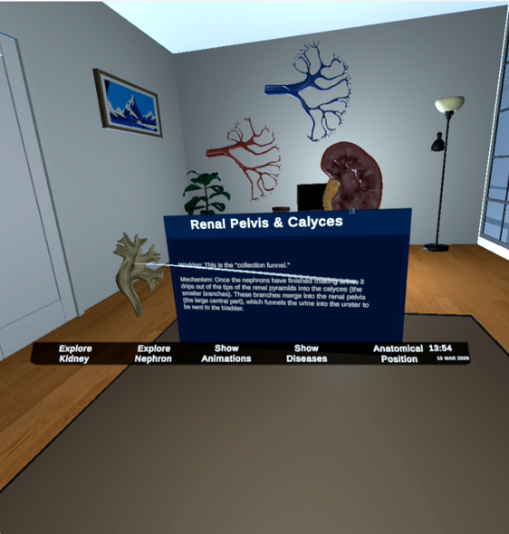
4
SOLUTION
We developed a VR Based Anatomy Learning System that:
Allows users to explore a 3D kidney model
Provides nephron visualization
Shows kidney function through animations
Includes disease simulation (Kidney Stones & PKD)
Displays anatomical position inside the human body
Next Slide

Slide 5
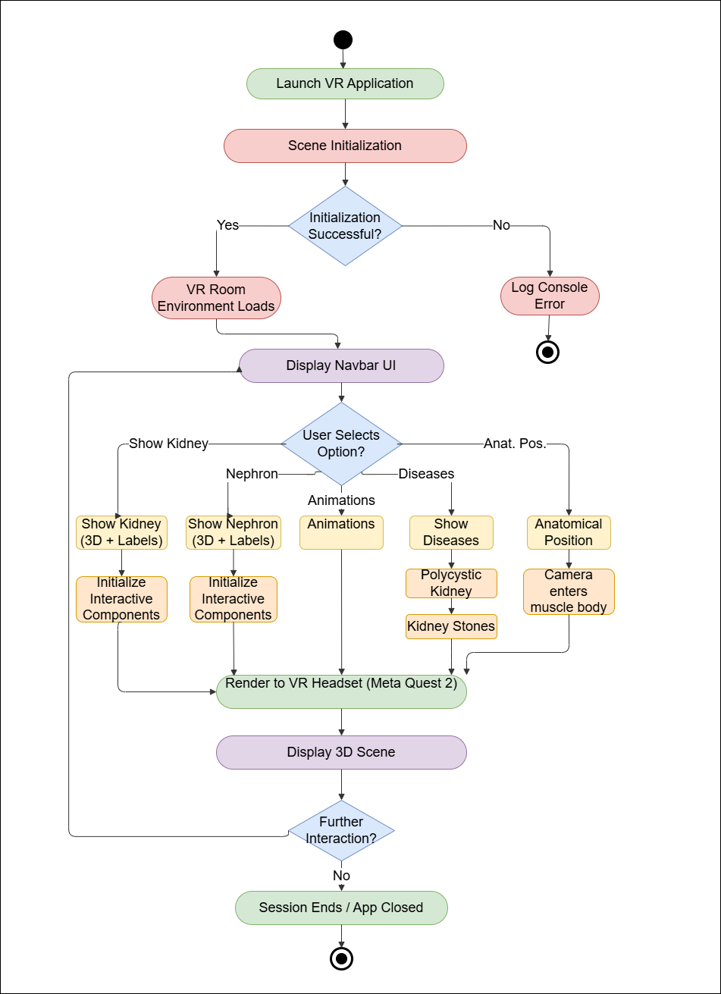
5
ACTIVITY
DIAGRAM
Next Slide

Slide 6
METHODOLOGY
6
System Design and Implementation: Unity(VR Room +Navbar), Blender(3D kidney and nephron models), Meta Quest 2 headset deployment.
Incremental Development Model: Structured delivery through 5 focused increments with feedback loops.
Requirement Analysis: Identify user needs for navigation, anatomy, animation, and disease modules.
3D Modeling and Animation: 3D kidney and Nephron models, Kidney filtration animation, PKD & Kidney stone Diseases.
Audio & Smart features: Narrated anatomy walkthroughs with audio delay sync & camera explorer integration.
Testing & Validation: Ensure usability, performance, and accuracy across all VR headset environments.
Next Slide

Slide 7


TOOLS AND TECHNOLOGY
7
HARDWARE
SOFTWARE
Unity 3D
XR Interaction Toolkit
Blender
C# Scripting
Sketchfab (Assets)
Meta Quest 2
VR Controllers
High-Performance
PC with Dedicated GPU
VR Anatomy Learning: Kidney Visualization
Next Slide

Slide 8
FUNCTIONAL REQUIREMENTS
8
Nephron Model Visualization
3D Anatomical Model Construction
VR Environment Navigation
Anatomical Labels and Descriptions
Kidney Function Animation
Kidney Model Visualization
Anatomical Position Visualization
Kidney Component Separation
Kidney disease Visualization
Next Slide

Slide 9
NONFUNCTIONAL REQUIREMENTS
9
The system has to display 3D models and anima-
tion smoothly at a minimum of 60 FPS without
lag.
Performance
The virtual reality interface should be user friendly
with simple navigation and clear labels.
Usability
The system should not crash during organ explo-
ration or interaction.
Reliability
Models, labels and animations of the kidney should
be scientifically right and justified by the experts.
Accuracy
The system must be able to accommodate the ad-
dition of new organs, layers, and functional anima-
tions.
Scalability
The system must be compatible with standard VR
headsets and high performance PCs with GPU in-
tegrated.
Compatibility
The system should be in a position to support left
and right handed users and minimize motion dis-
comfort in VR.
Accessibility
Next Slide

Slide 10
10
IMPACT
IMPACT & VALUE
COST/ACCESS ADVANTAGE
VIRTUAL
Improves conceptual clarity
Enhances spatial understanding
Reduces dependency on cadavers
Enables self-paced learning
One VR system can be reusable for unlimited students
No lab limitations
Works offline
Easily scalable for additional modules and organs
JMIE CHASTAIN
VR Expert
REALTY
Next Slide

Slide 11
11
FUTURE SCOPE
AI-based tutoring
Full human body system
Integration with medical curriculum
Next Slide

Slide 12
VIRTUAL
THANK YOU
12
REALITY
THANK YOU
LEARNING
THANK YOU
“THANK YOU”
THANK YOU
THANK YOU

