Slide 1
AIRHOP
Messaging that works
without the internet.
Nearby phones form a Bluetooth mesh and pass your messages along, up to seven hops, encrypted the whole way. No servers, no accounts, no tracking.
OFFLINE FIRST
NO ACCOUNTS
NO SERVERS
OPEN SOURCE
v1.0.0 Albatross · iOS and Android · MIT licensed · airhop.1mindlabs.org
Notes:
Open cold. Airhop is a messenger that works with no internet at all. Nearby phones relay for each other over Bluetooth. Shipped, on both stores, MIT licensed, no company behind it yet. One sentence if asked: it is what your phone does when the tower is gone.

Slide 2
THE PROBLEM
Every messenger on your phone
has the same point of failure.
Signal, WhatsApp and Telegram are very good at what they do. None of them is built to work without a network, and all of them go quiet when one disappears. Governments switch it off, wars take it out, and storms knock it down.
313
$19.7B
2.2B
SHUTDOWNS
LOST
PEOPLE
across 52 countries in 2025, with at least one running on any given day
to deliberate shutdowns in 2025, up 156% on the year before
have never been online at all, most of them rural and poor
Myanmar ordered 95 shutdowns last year. India ordered 65. Conflict caused another 125. Hurricane Helene took one Tennessee cell site in eight off the air.
Source: Access Now, Internet Shutdowns in 2025 · Top10VPN, Cost of Internet Shutdowns 2025 · ITU, Facts and Figures 2025 · FCC DIRS, 2024 hurricane reports
AIRHOP
02 / 10
Notes:
Land the single point of failure. Signal is excellent and stops when the network stops. That is a design boundary, not a criticism, and this is the product for the other side of it. The three numbers are 2025 and from primary sources, all linked on the slide. Do not round them up. The line at the bottom is there so nobody hears this as one country's politics. Sources: - Access Now and the #KeepItOn coalition, Internet Shutdowns in 2025, published 31 March 2026. https://www.accessnow.org/campaign/keepiton/ - Top10VPN, The Global Cost of Internet Shutdowns 2025. 120,095 hours of disruption, $19.7bn. https://www.top10vpn.com/research/cost-of-internet-shutdowns/ - ITU, Measuring Digital Development: Facts and Figures 2025, November 2025. 6.0bn online, 2.2bn offline. https://www.itu.int/itu-d/reports/statistics/facts-figures-2025/ - FCC Disaster Information Reporting System, Hurricane Helene and Milton communications status reports, 2024. https://www.fcc.gov/general/disaster-information-reporting-system-dirs-0

Slide 3
DEMAND
When it happens, people install
a mesh app the same day.
Nobody markets this category. There is no referral loop and no growth team. There are events, and the installs all arrive inside a day.
● BITCHAT INSTALLS IN NEPAL, SEPTEMBER 2025
360,000+
installs worldwide by late September 2025
3,500
→
48,781
BEFORE THE BAN
ON 8 SEPTEMBER, ONE DAY
53%
of installs came from India in the 30 days to July 2026
Roughly 39% of everything the app installed worldwide that day came from one country of 30 million people, four days after 26 platforms were blocked.
3 apps
pulled from the Indian stores at once, and their repositories with them
On 24 July 2026 India's I4C gave GitHub three hours to take the bitchat repositories down, naming the app's ability to work during a shutdown as the reason. A category is real once someone tries to remove it.
Source: BeInCrypto and Forbes, September 2025 · CoinDesk and MediaNama, July 2026
AIRHOP
03 / 10
Notes:
The slide investors care about. Demand is real, measurable and event driven. Nepal went from three and a half thousand installs to nearly forty nine thousand in a day. Then the takedown. A government moving to remove the whole category is the strongest signal that the category works. Sources: - BeInCrypto and Forbes, September 2025, on bitchat installs during Nepal's social media ban. 48,781 on 8 September against fewer than 3,500 before it. https://beincrypto.com/nepal-bitchat-downloads-protests-2025/ - CoinDesk and MediaNama, 24 July 2026, on the I4C notice covering bitchat, Briar and Bridgefy, and the GitHub takedown order. https://www.coindesk.com/tech/2026/07/24/india-orders-takedown-of-jack-dorsey-s-bitcoin-linked-messaging-app-bitchat

Slide 4
LANDSCAPE
Offline, hardware free and open
is a short list.
Every app here is good at something. Only some keep working when the network stops, and fewer still run on a phone with nothing extra plugged into it.
PROJECT
TRANSPORT
ENCRYPTION
OFFLINE
NO HARDWARE
OPEN
Signal
Centralized servers
Signal protocol
✕
✓
✓
Session
Onion routing
Session protocol
✕
✓
✓
Meshtastic
LoRa radio
AES-256 + Curve25519
✓
✕
✓
goTenna
Proprietary sub-GHz radio
AES-256 + ECC-384
✓
✕
✕
Bridgefy
Bluetooth + WiFi
Signal (libsignal)
✓
✓
✕
Briar
Bluetooth + WiFi + Tor
Bramble
✓
✓
✓
bitchat
Bluetooth + Nostr
Noise XX
✓
✓
✓
AIRHOP
Bluetooth + WiFi + Nostr
Noise XX + Double Ratchet
✓
✓
✓
Briar is Android and desktop only. Bridgefy is closed. bitchat is the one that is alive and growing, which is why Airhop joins its mesh instead of starting a second one.
AIRHOP
04 / 10
Notes:
Do not read the table row by row. Say the shape: internet-only apps stop when the internet stops, radio meshes need hardware nobody owns, and what is left is Bluetooth mesh on the phone people already carry. Every project name is a link if someone wants to check.

Slide 5
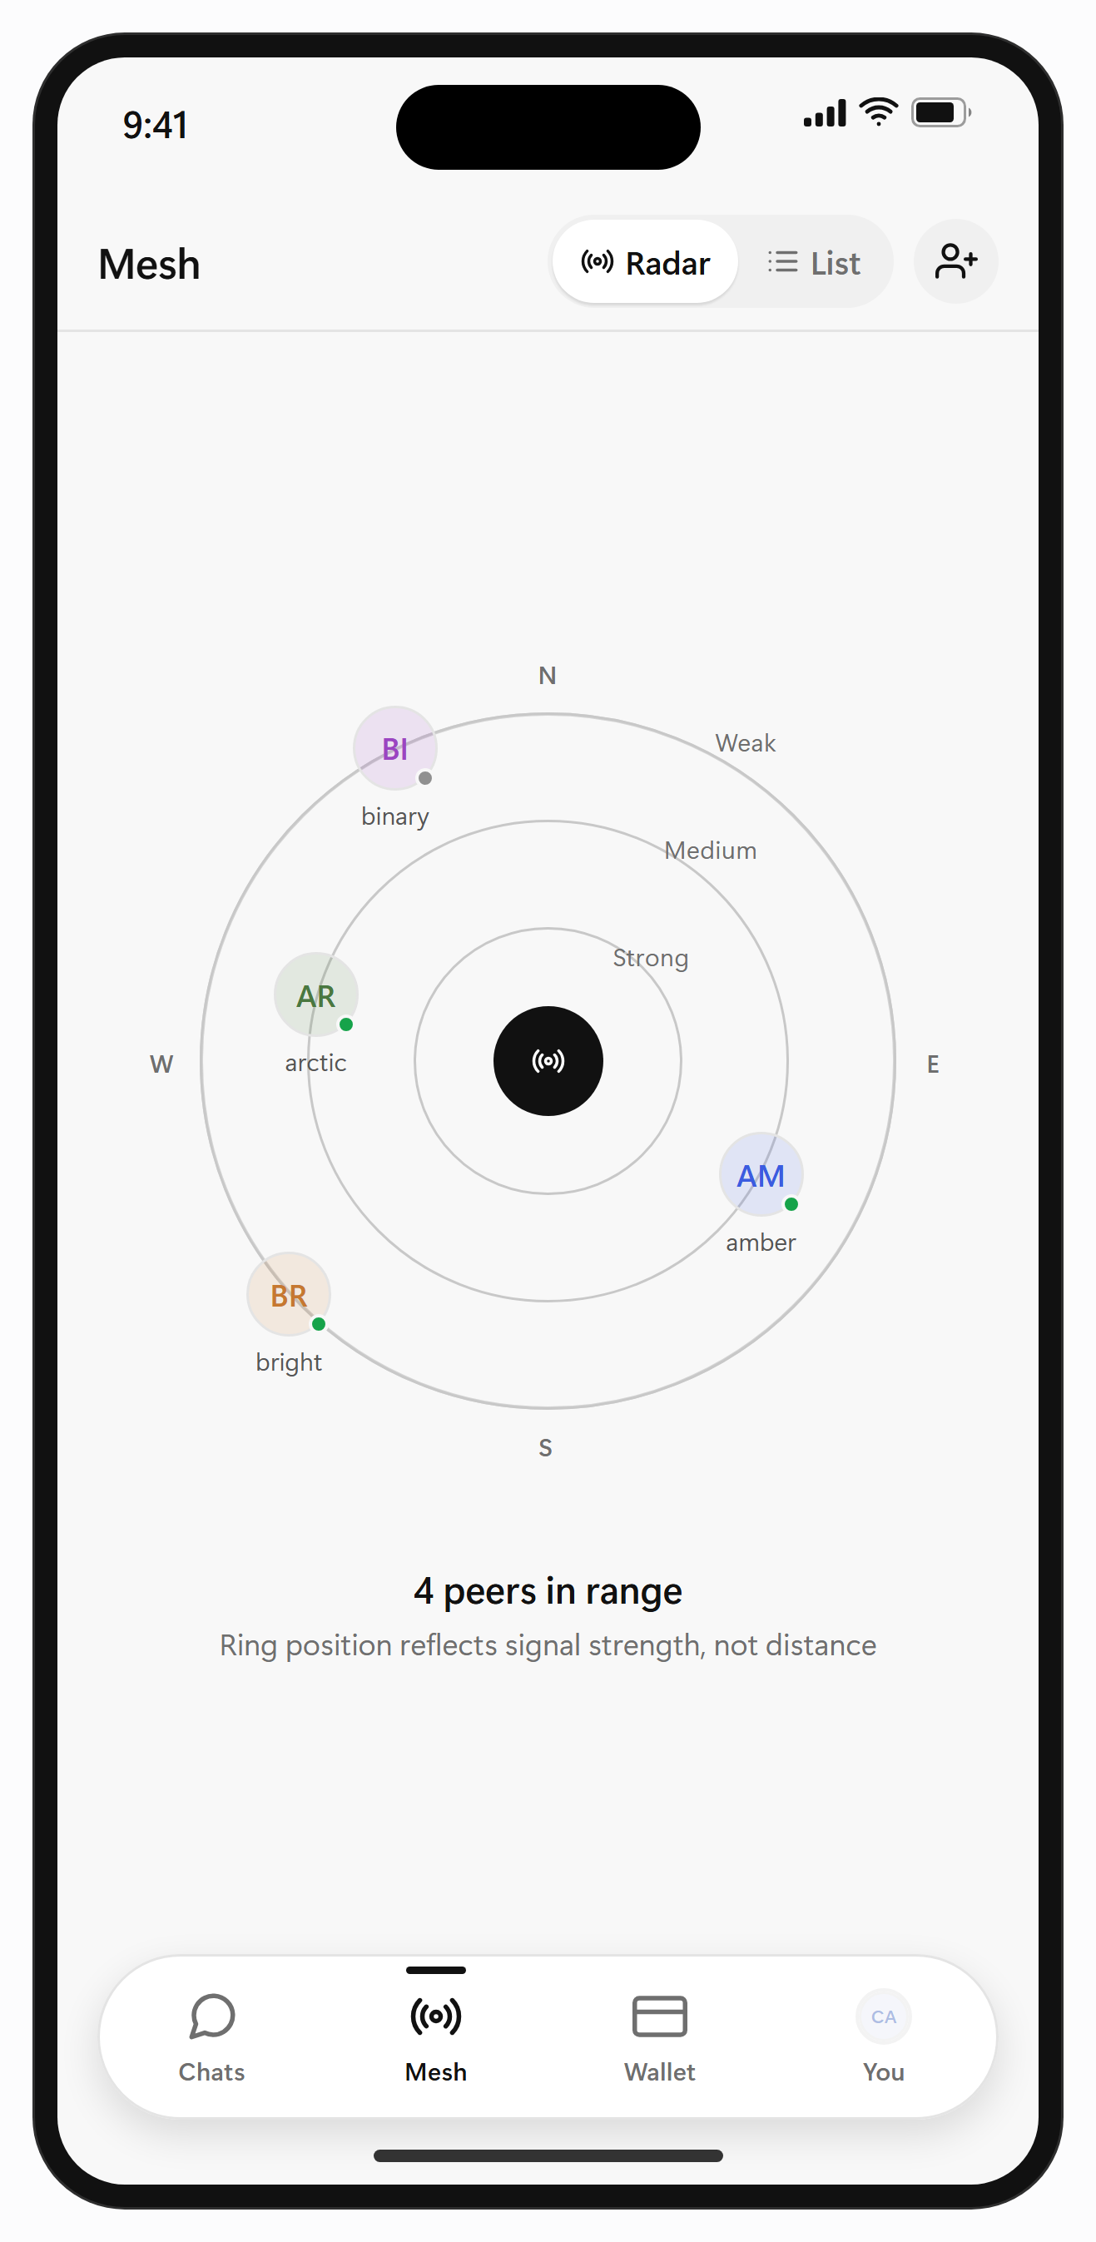
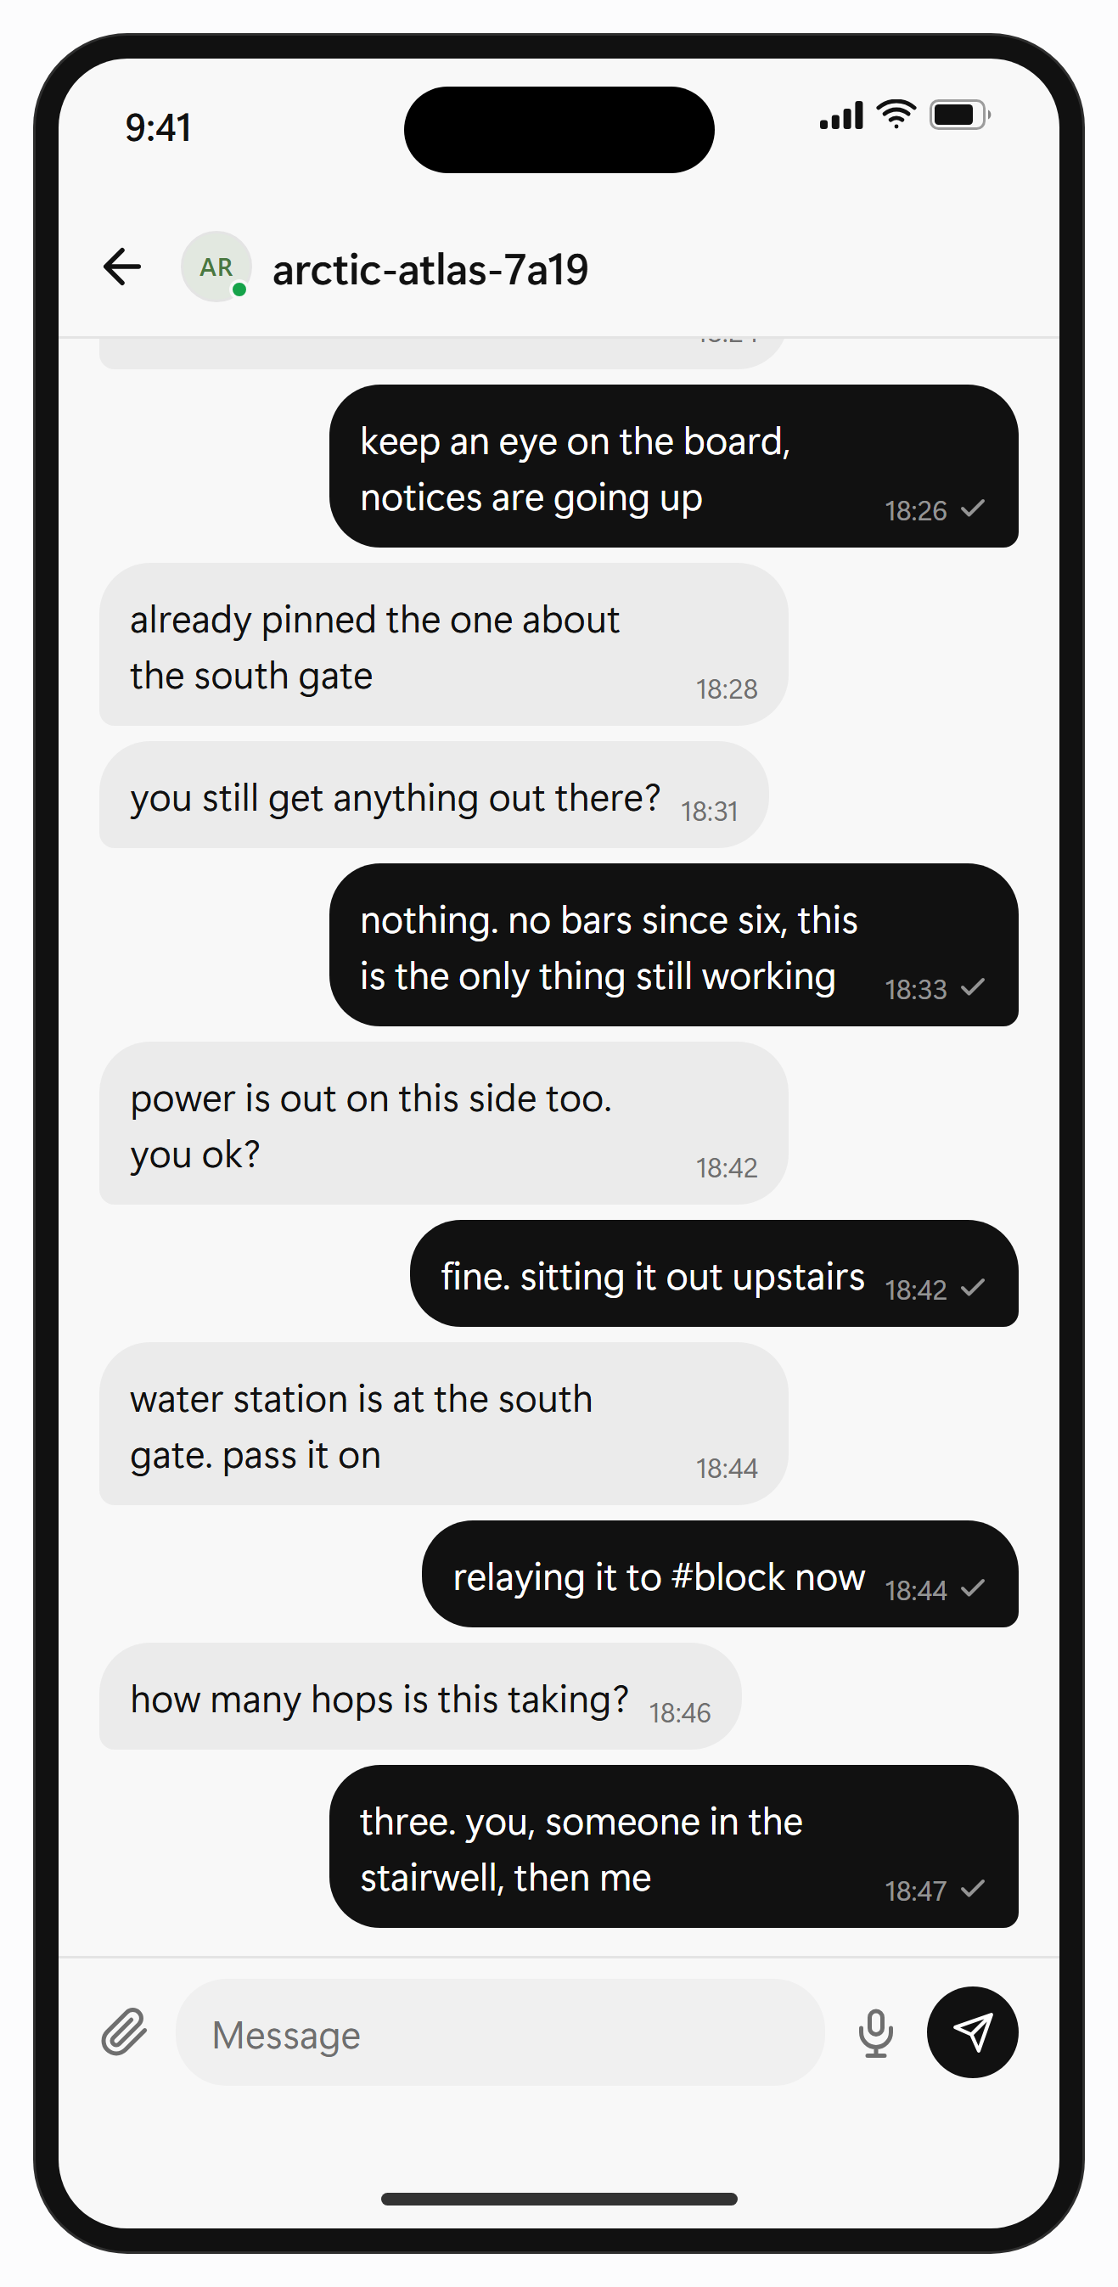
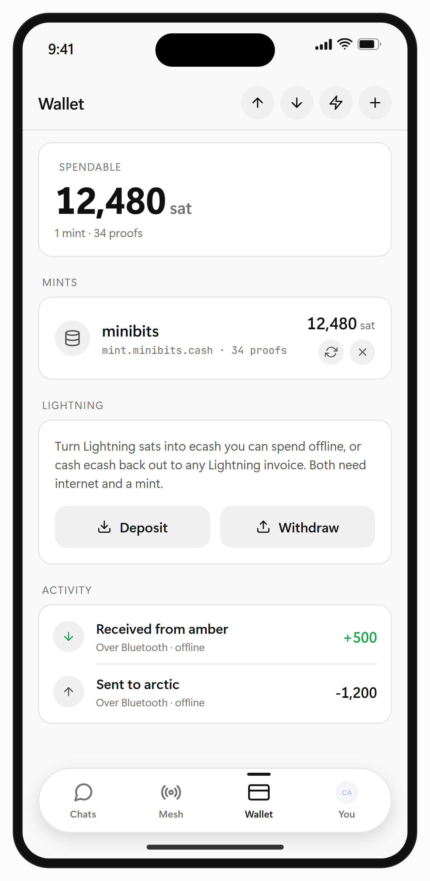
THE PRODUCT
Shipped, on both stores,
as an ordinary app.
Four tabs, no pairing screen, and no keys for anyone to get wrong. Install it and it is already looking for people.
MESH
DIRECT MESSAGE
WALLET
Who is in range right now, placed by signal rather than distance.
Encrypted by default. The phones relaying it carry it blind.
Hand ecash to the person beside you, neither phone online.
DOWNLOAD
App Store · Google Play · F-Droid · APK
Next: v1.1 offline AI · v1.8 SDK · v1.9 external audit
AIRHOP
05 / 10
Notes:
Hand the room something concrete after four slides of argument. These are real screens from the shipped build, and the download links work. If you have the app on your phone, open the Mesh tab now.

Slide 6
HOW IT WORKS
The mesh forms itself.
Phones nearby find each other and pass messages along. Where there is internet, public Nostr relays carry the same conversation further, and not one of those relays is ours.
01
DISCOVER
02
RELAY
03
REACH FURTHER
Phones running Airhop or bitchat find each other over Bluetooth. No pairing, no setup, no code to type.
A message hops phone to phone, up to seven times, 30 to 50 m a hop. The phones in between never see what they carry.
With internet the same conversation carries over public Nostr relays, through Tor if you want it to.
● BLE MESH · LOCAL PEER TO PEER NETWORK
BLE RELAY, UP TO 7 HOPS
Node 1
Node 2
Node 3
Nostr relay
Mesh node, offline
Multi-hop relay, Noise XX encrypted
bitchat on the same mesh
Nostr bridge, when online
One TypeScript protocol core with two thin native radios, so a fix lands on iOS and Android in the same commit. 189 source files, 125 test files, and no server anywhere in the delivery path.
AIRHOP
06 / 10
Notes:
Three steps and one picture. Discover, relay, reach further. Seven hops at thirty to fifty metres, so roughly three hundred and fifty metres through a crowd. The phones in between cannot read what they carry. That is the whole trust story in a sentence.

Slide 7
SECURITY
Written against an attacker
standing next to you.
Assume the stranger in range is hostile. They can forge any header, replay anything they captured, invent as many identities as they like, and quietly drop whatever passes through their phone. All of this is built for that.
Sessions
Messages
Identity
Seizure
Noise XX for mutual authentication and forward secrecy per session, the same handshake WireGuard uses.
Double Ratchet for forward secrecy per message, seeded from a secret only the two parties hold.
Every packet signed and checked before it is shown. A name comes from the key, so it cannot be taken.
Nothing readable on disk, keys in the OS keychain, and a panic wipe that clears the phone in under a second.
● TESTED BY ATTACKING IT
70+
scenarios across 11 tiers
Forged sender on a public channel
Refused
25
phones in one simulated room
Announce rebinding a known peer's key
Refused at three layers
Sybil flood of invented peers
Real neighbours never dropped
17
findings, 16 fixed, 1 accepted
Same ecash token spent twice
Refused by a real mint
No outside audit yet, and no simulation can prove how a real radio behaves on real silicon. Both are what the ask is for.
AIRHOP
07 / 10
Notes:
Say the threat model out loud: anyone in range can transmit anything. Then the four answers, then the evidence underneath them. Finish on the honest line. No outside audit yet. Never soften that in a room, it is exactly what the ask pays for.

Slide 8
DISTRIBUTION
The hard part of a mesh is the
first user. We skip it.
Airhop speaks bitchat's wire protocol in both directions: the same Bluetooth service UUID, the same packet frame, the same peer ID, the same handshake.
AIRHOP
SAME SERVICE UUID · SAME PACKET FRAME · SAME PEER ID
BITCHAT
● WHAT WE INHERIT
● WHAT WE ADD
The first Airhop install lands in a mesh that already has bitchat phones in it. It relays for them, they relay for it, and neither side is configured.
User experience
SHIPPED
Nielsen's heuristics, Fitts, Hick and Jakob, on Apple HIG and Material
Offline money
SHIPPED
Airhop's own packet types are ones bitchat forwards without reading, so a new feature never splits the network in two.
Cashu ecash phone to phone, with neither one online
Offline AI
V1.1.0
Fixes found here have gone back upstream. A bigger shared mesh beats a larger slice of a small one.
A small model on the device, no network call of any kind
Feature parity
SHIPPED
One core, so both platforms ship the same thing on the same day
Every other mesh messenger opens to an empty room. This one opens a door into a mesh that is already running.
AIRHOP
08 / 10
Notes:
The strategic slide, and the one they will remember. Every mesh app dies of the cold start. This one speaks bitchat's wire protocol, so install number one already has a network to join, and the right column is what it adds once it is in there. Live voice and the bulletin board are bitchat's work too. They are on the left for that reason, and saying so out loud is what makes the right column believable. On user experience, if pushed: a privacy tool nobody can use protects nobody. Names are words rather than hex, the mesh shows you who is in range and how strong the signal is, a payment says which route carried it and whether you can take it back, and delivery is never claimed without an acknowledgement. Nielsen's heuristics, Fitts, Hick and Jakob, checked against Apple's HIG and Material, with an accessibility pass in v1.0 and WCAG 2.1 AA scheduled for v2.0. If someone asks why not just contribute to bitchat: compatibility means we do not have to choose.

Slide 9
MARKET AND MODEL
Sized from events,
not from a percentage.
There is no incumbent revenue here to take a slice of. What there is: a trigger that keeps recurring, a hardware market next door that is already funded, and almost nothing it costs to serve a user.
NEXT DOOR, FUNDED
wireless mesh networking in 2026, reaching $27.0B by 2035 at 10.4% a year. Nearly all of it hardware. Airhop is the software half of the same problem.
● HOW IT PAYS FOR ITSELF
$11.1B
SDK and custom builds
V1.8.0
@airhop/core on npm, PyPI and crates.io, plus paid builds for groups that need their own profile
REACHABLE BY AN APP
people online, each already carrying the radio this needs. Nothing to buy, no plan to change, one install.
Resilience deployments
PILOT
6.0B
Response teams and municipalities, supported and configured rather than sold a licence
Sponsorship and grants
NOW
Digital rights and press freedom funders already pay for work in this space
TRIGGER, MEASURED
shutdowns across 52 countries in 2025, before counting disasters, crowds and dead zones where the same thing happens with nobody ordering it.
313
No ads, no data to sell, no KYC, no telemetry. There is no infrastructure bill either, so one user and a million cost the same to serve.
The straight answer: nobody is paying $50 a year for this. The value sits in the protocol layer, and in being the app already on the phone when the network drops.
Source: Research Nester, wireless mesh market · ITU, Facts and Figures 2025 · Access Now, Internet Shutdowns in 2025
AIRHOP
09 / 10
Notes:
Do not size this top down. Anchor on the mesh hardware market that is already funded, then point out the software half is unserved. Cost first on the right: no infrastructure bill, so runway is engineer time and an audit. Leave the straight answer at the bottom on screen, it buys more credibility than a bigger number would. Sources: - Research Nester and Business Research Insights, wireless mesh network market, 2026 to 2035. https://www.researchnester.com/reports/wireless-mesh-network-market/5024 - ITU, Measuring Digital Development: Facts and Figures 2025, November 2025. 6.0bn online, 2.2bn offline. https://www.itu.int/itu-d/reports/statistics/facts-figures-2025/ - Access Now and the #KeepItOn coalition, Internet Shutdowns in 2025, published 31 March 2026. https://www.accessnow.org/campaign/keepiton/

Slide 10
THE ASK
Fund the audit.
Open the distribution.
The product is shipped. What it needs next is the verification it cannot give itself, and reach that one person cannot buy.
01
TWO AUDITS
02
HARDWARE MATRIX
03
DISTRIBUTION
04
CONTRIBUTORS
Cure53 or equivalent on the crypto and the key handling, a second firm on the radio and the Nostr bridge. Findings published whatever they say.
A device lab across Pixel, Samsung and Xiaomi classes, plus iPhones, to prove on silicon what the simulation only models.
Response organizations, digital rights groups and press freedom funders already working in the 52 countries that went dark.
Ten language catalogs, the desktop and web targets, and the SDK. All of it scoped, none of it blocked.
When the network goes down, the mesh is still up.
airhop.1mindlabs.org · github.com/areebahmeddd/airhop
AIRHOP
10 / 10
Notes:
Be specific and short. Two audits, a device lab, distribution partners, contributors. Name the audit first because everything after it is blocked on it. Stop talking after the closing line. Leave the links up.

Slide 11
APPENDIX · ARCHITECTURE
docs/spec/ARCHITECTURE.md
One protocol core.
Two thin native radios.
bitchat runs two native codebases that drift apart. Airhop keeps the whole protocol in TypeScript and lets the native side own nothing but the hardware.
Screens
Chats · Mesh · Wallet · Profile
Hand-rolled four-tab shell, no navigation library
Message router
Both radios · Nostr · Courier
Picks the transport, names the one it used, never assumes delivery
Crypto engine
Noise XX · Double Ratchet · Ed25519 · HKDF
@noble primitives, Cure53 audited, pure TypeScript
Transports
BLE mesh · WiFi fast path · Nostr relays
Bluetooth is the only one that needs no internet and the only one that crosses iOS and Android
Native modules
BLE · Voice · WiFi Aware · Tor
Swift and Kotlin, hardware only. None of them knows what a packet is
189
source files outside tests
125
test files, the protocol runs in CI with no phone
0
servers, ours or anyone's, in the delivery path
AIRHOP
A1 / A3
Notes:
Appendix. Only open this if the room is technical or somebody asks how it is built. The point in one line: bitchat runs two native codebases that drift, this runs one TypeScript core, so a protocol fix reaches both platforms in the same commit.

Slide 12
APPENDIX · ROADMAP
docs/design/ROADMAP.md
Six versions done.
Ten written down.
The version targets have been in the repository since before the first line of code, and the audit at v1.9.0 is deliberately after the SDK, so the public API is inside its scope.
SHIPPED
V0.5 FOUNDATION
V0.6 MESSAGING
V0.7 NOSTR + VOICE
V0.8 RATCHET
V0.9 WALLET
V1.0 RELEASE
v1.1
v1.2
v1.3
v1.4
v1.5
Offline AI
Plugins
Ten languages
Web
CLI
On-device model, no network call
Bluesky, Mastodon, UPI, opt-in
Persian, Arabic, Hindi and more
Nostr-only browser companion
Headless relay on a Raspberry Pi
v1.6
v1.7
v1.8
v1.9
v2.0
Watch
Desktop
SDK
Audit
Flagship
watchOS and Wear OS, wipe on the wrist
macOS first, Windows after
@airhop/core published, API frozen
Two firms, separate scopes, published
Redesign, WCAG 2.1 AA, all public
1,526 catalog strings with none hardcoded, 398 bundled relays, 125 test files, every security finding published. One maintainer, no company, no funding.
AIRHOP
A2 / A3
Notes:
Appendix. Open it if someone asks what comes after v1.0. Point at v1.8 and v1.9 in that order. The SDK ships first so that the public API is inside the audit scope rather than after it.

Slide 13
APPENDIX · RISKS
docs/dev/PROGRESS.md
What could stop this,
and what is already done about it.
Written the way the repository writes them, plainly and with the mitigation attached.
RISK
WHAT IT IS
WHAT IS ALREADY DONE
Platform limits
A backgrounded iPhone is invisible to Android scanners. CoreBluetooth moves the service UUID into the advertisement overflow area and drops the name.
No app can fix that, so the UI says it rather than hiding it. Android keeps advertising through a foreground service, and links already open keep carrying traffic.
Regulatory pressure
Three mesh messengers were ordered off the Indian stores in July 2026, and the code repositories with them.
MIT source, F-Droid and a direct APK, and no company to serve a notice on. Delisting an app does not uninstall it, and it does not touch a mesh already running.
Unaudited crypto
The Noise state machine, the ratchet and the key boundaries have not been read by anyone outside this project.
Two independent audits scoped for v1.9.0, one for crypto and one for the radio and the bridge, with both reports published in full.
Density
A mesh with nobody else in it is an empty room, and that is the honest failure mode of every app in this category.
Wire compatibility with bitchat shares the installed base from the first day, and the Nostr bridge covers the case where nobody is nearby at all.
AIRHOP
A3 / A3
Notes:
Appendix, and the one worth volunteering unprompted in a diligence conversation. Lead with the platform limit nobody can fix. Volunteering that first is what makes the other three believable. Density is the real risk, and the answer is the wedge slide.

