Slide 1
GRAB ALL
BY-
Areeb Akhtar(01)
Shubham Patil(28)
Himanshu Wadekar(70)

Slide 2
Problem Statement
Lots of local vendors/ shopkeepers are suffering losses due to various online websites. The main constraint is that, the people are not aware about the offers on the desired products and their prices. Also, they are unaware about the places where they could get the product. Also, there is no such online platform to connect local vendors with people.

Slide 3
Abstract
The motivation for every location based information system is: “To assist with the exact information, at right place in real time with personalized setup and location sensitiveness”. In this era we are dealing with palmtops and Android, which are going to replace the bulky desktops even for computational purposes. We have vast number of applications and usage where a person sitting in a roadside café needs to get relevant data and information. Such needs can only be catered with the help of LBS. A very appealing application includes surveillance where instant information is needed to decide if the people being monitored are any real threat or an erroneous target. We need to Import them on mobile devices. We must ensure that a person when visiting places need not carry the travel guides with him. All the information must be available in his mobile device and also in user customized format.

Slide 4
INTRODUCTION
Location based service (LBS) is emerging as a killer application in mobile data services thanks to the rapid development in wireless communication and location positioning technologies. Users with location-aware wireless devices can query about their surroundings (e.g., finding the nearest restaurant, ATM, Hospitals or Medicals within 5 miles) at any place, anytime. While this ubiquitous computing paradigm brings great convenience for information access, the constraints of mobile environments, the spatial property of location-dependent data, and the mobility of mobile users pose a great challenge for the provision of location-based services to mobile users.

Slide 5
LBS have two major actions
1. Obtaining the location of user
2. Utilizing this information to provide a service.
These 2 actions are used to answer these 4 questions (below) for a mobile user in a new, fast, and
more accurate way, to form the basis for LBS:
Where am I…?
Where is the nearest ...?.
Where is my ...?,
How do I get there?

Slide 6
Challenges
Challenges in Determining User Location
Accurate coordinates of location sources
User movement
Varying accuracy

Slide 7
Function
Location Tracking
This component stores the location trace of individual users. This represents a fundamental component in next-generation LBS as it contains the data that allows a user’s route to be determined and potentially predicted. In particular, this component would typically support the following functionality:
Keep records on user’s current location.
Notify the user when a specific offer is detected, or when the user moves in or out of an area.
This supports location-based notifications being sent to users.
Determine which offers are within a defined location.

Slide 8
Scope of project
In our application, we have used Map Views as supported by Google APIs 10 or higher which would allow the use of app in devices starting from Gingerbread itself. We have used an .net Server with visual studio & MSSQL support for remote database use. The data transaction from or to the database occurs with the help of JavaScript and in the form of XML objects. The android end of the app handles this XML objects through HTTP clients. Onboard compass & map controllers are enabled. Locations are extracted from the device with the help of the GPS module available. A form of passive GPS use, the device decides on the best content with the information available from different providers. On touching the overlay on the map, options are asked ranging from extracting address to locating any other user on the same view.
The main objective is to detect the offers in the range set.

Slide 9
System Diagram
Backend
Webserver
Application
Database
Web Services

Slide 10
HARDWARE AND SOFTWARE REQUIREMENTS
Hardware Requirements
256 MB RAM.
8 GB HDD.
Intel 1.66 GHz Processor Pentium 4
GPRS enabled Mobile Phone with Android.
Software Requirements
Windows
SDK for Android
Visual Studio (asp.net and database)

Slide 11
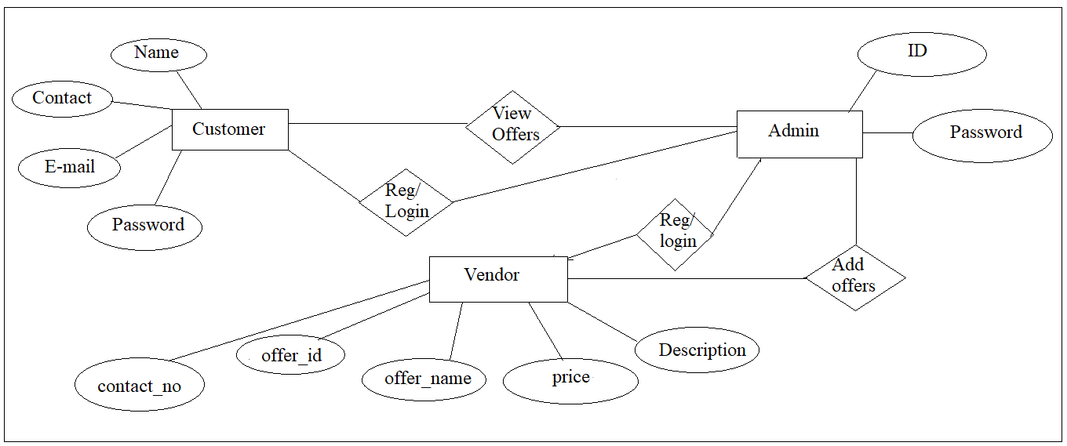
ER DIAGRAM

Slide 12
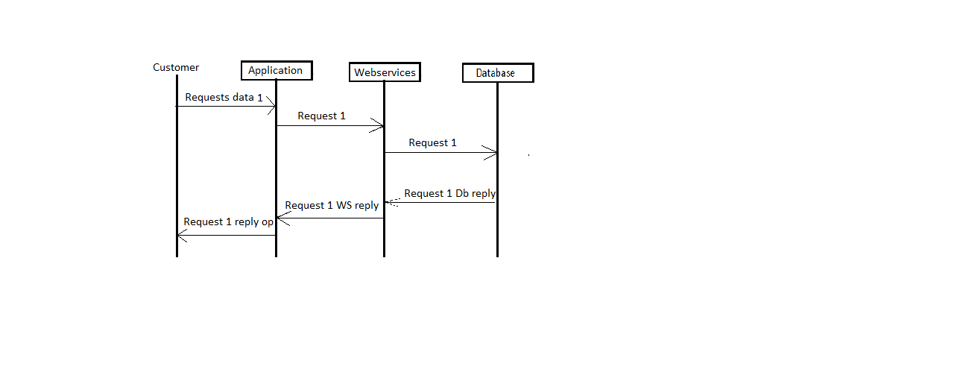
SEQUENCE DIAGRAM
CUSTOMER

Slide 13
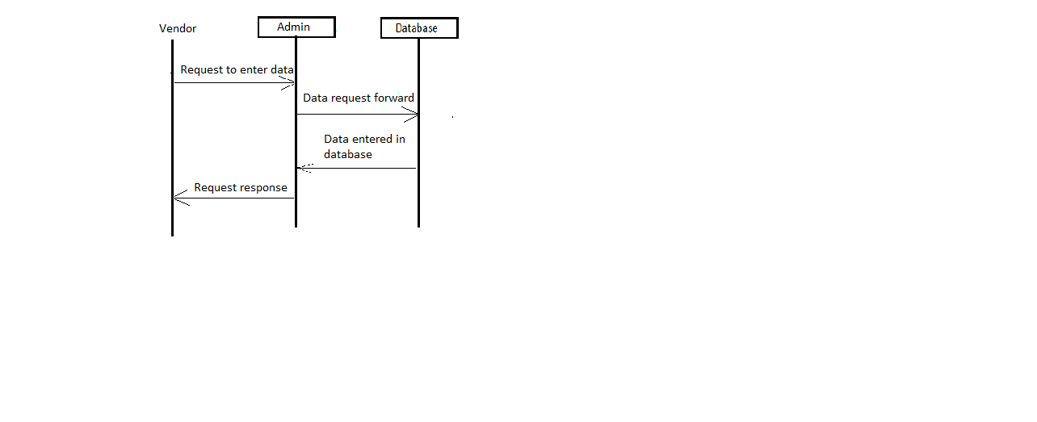
VENDOR

Slide 14
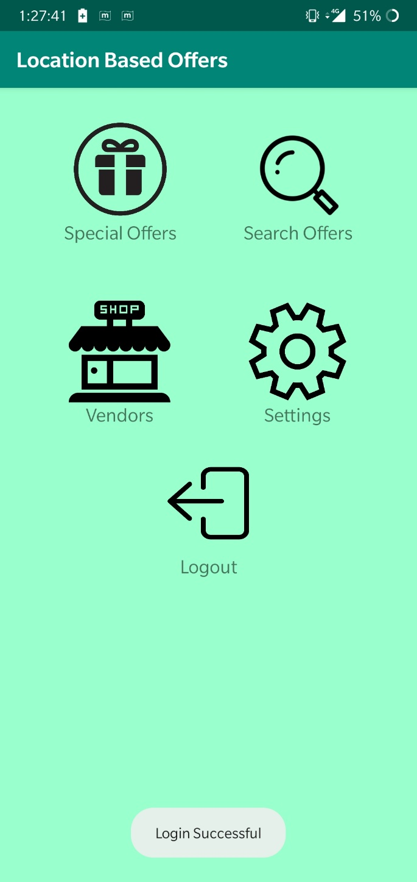
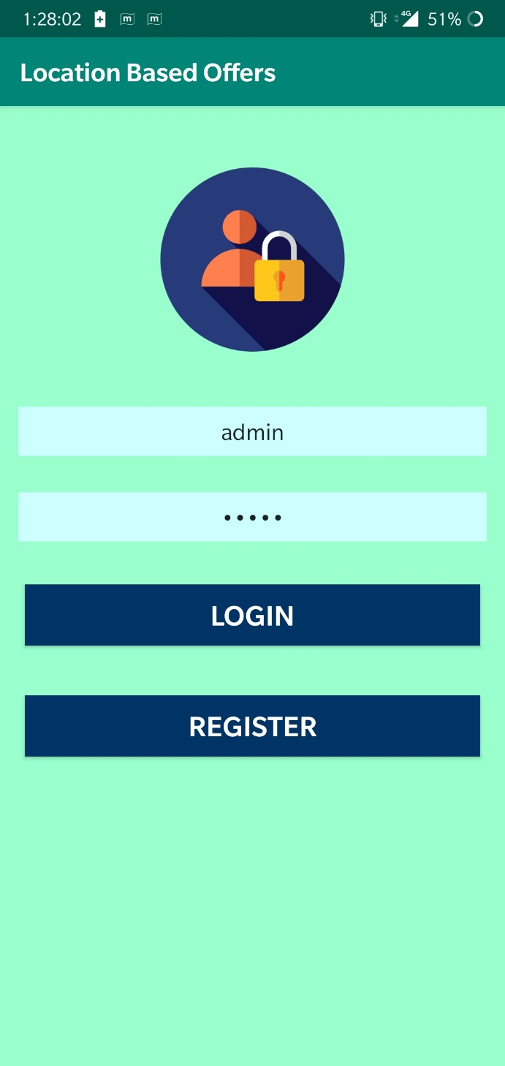

Slide 15
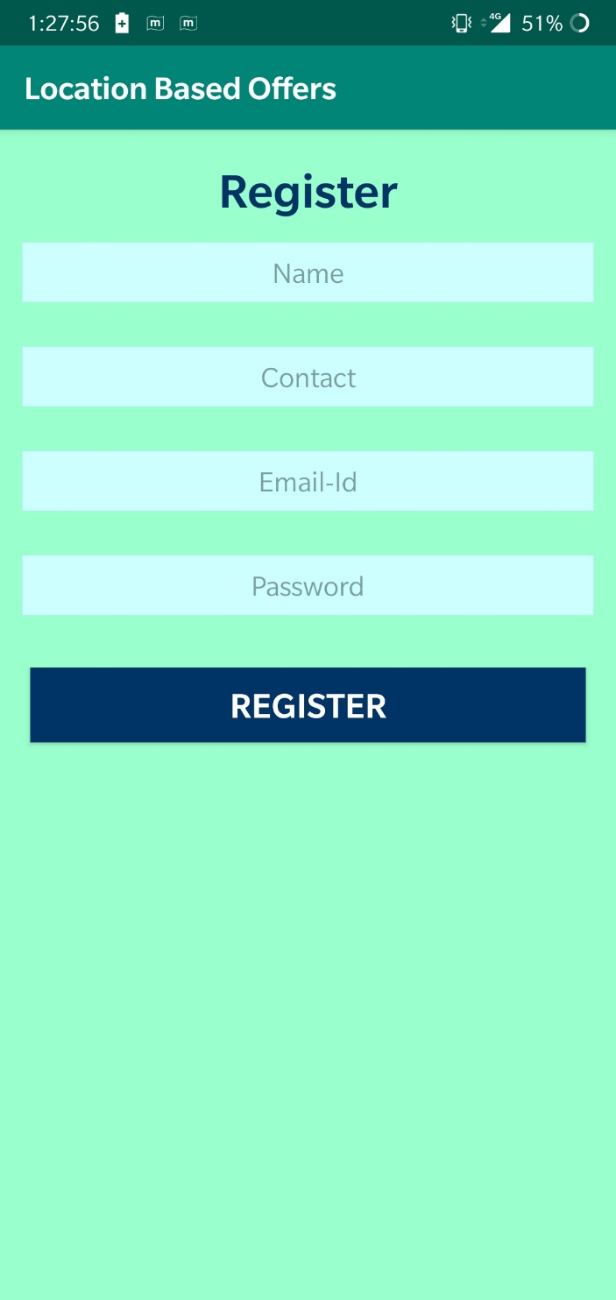

Slide 16
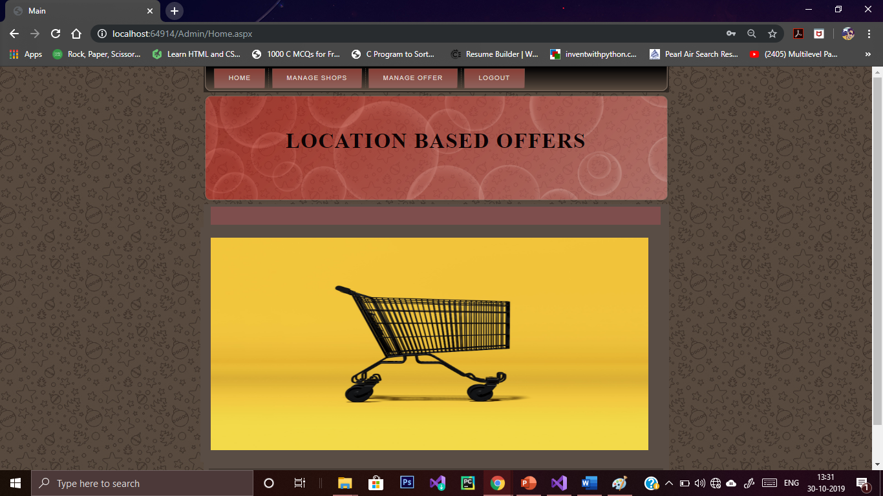

Slide 17
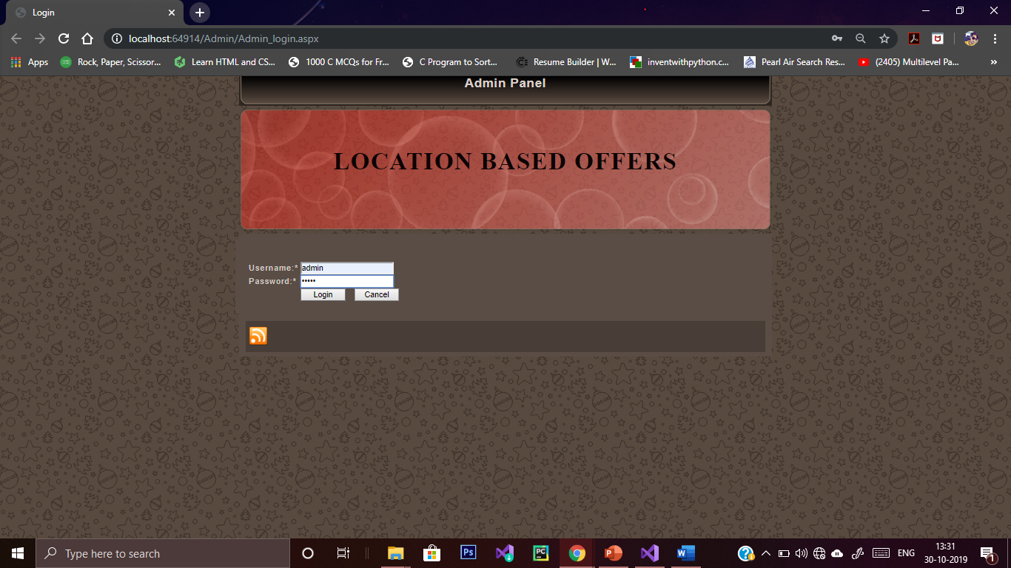

Slide 18
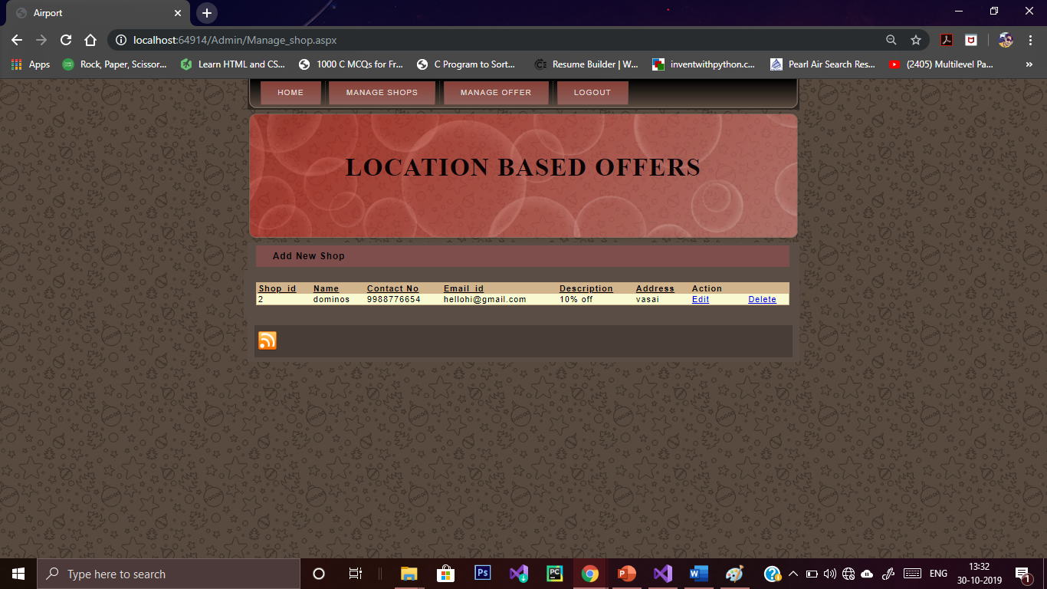

Slide 19
CONCLUSION
Initially mobile phones were developed only for voice communication but now days the scenario has changed, voice communication is just one aspect of a mobile phone. There are other aspects which are major focus of interest. Two such major factors are web browser and GPS services. Both of these functionalities are already implemented but are only in the hands of manufacturers not in the hand of users because of proprietary issues, the system does not allow the user to access the mobile hardware directly. But now, after the release of android based open source mobile phone a user can access the hardware directly and design customized native applications to develop Web and GPS enabled services and can program the other hardware components like camera etc. The LBS application can help user to find hospitals, school, gas filling station or any other facility of interest indicated by user within certain range. Just like a GPS device its location will also be updated as soon as user changes his/her position.

Slide 20
FUTURE SCOPE
After going through the surveying, it can be gathered that there is a huge scope of application development in our project. Following the same notion, we can also develop application that can tackle following issues of the project:
1) Location positioning technologies
2) Online Payment
3) Expanded Database (For large no. of users)
4) Data Security

Slide 21
REFERENCES
http://www.tutorialspoint.com
http://www.uml.org
http://www.smartdraw.com/resources/tutorials/uml-diagrams/
http://en.wikipedia.org/wiki/Software_maintenance
http://stackoverflow.com/

Slide 22
Thank You

