Slide 1
AI-023
National Smart Energy Grid
Intelligence & Demand
Forecasting Platform
An AI-powered platform for demand forecasting, renewable energy optimization,
failure prediction, and autonomous grid response
Ezitech Engineering Framework · Industry AI Case Study

Slide 2
The Challenge
Modern power grids are outgrowing static, reactive management
250
40
18
12
15M
Power Stations
Solar Farms
Wind Farms
Battery Facilities
Smart Meters
Consequences of static forecasting:
Goal
!
Power outages from unpredicted demand spikes
Build an AI platform that forecasts demand, optimizes renewable use, predicts failures, and responds to emergencies — before customers are affected.
!
Grid instability from renewable supply fluctuation
!
Energy wastage and high operational costs
!
No early-warning system for equipment failure

Slide 3
The Solution — 8 Core Modules
A complete, end-to-end AI platform covering every stage of grid intelligence
1
2
3
4
Smart Meter Data Processing
Demand Forecasting
Renewable Energy Forecasting
AI Grid Optimization
Collection, cleaning, aggregation, streaming
Hourly, daily, weekly, seasonal, residential, industrial
Solar, wind, battery, weather impact
Distribution, load balancing, battery strategy
5
6
7
8
Failure Prediction
Emergency Response Engine
Carbon Intelligence
Executive Dashboard
Transformer, voltage, frequency, overload risk
Load shedding, backup activation, dispatch
Emissions, efficiency score, sustainability report
Live grid health, forecasts, risk zones, carbon

Slide 4
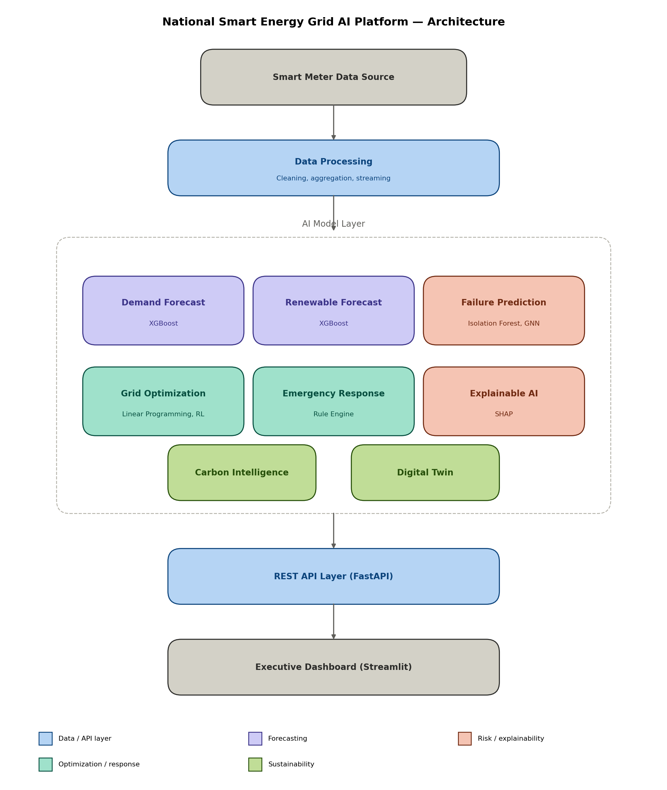
System Architecture
Data flows from smart meters through processing, AI models, and APIs to the dashboard

Slide 5
AI Components Used
All seven required AI techniques implemented end-to-end
TS
Time-Series Forecasting
GN
Graph Neural Networks
XGBoost models for demand, solar, wind
Grid topology-based failure risk
RL
Reinforcement Learning
AD
Anomaly Detection
PPO agent for battery charging strategy
Isolation Forest for equipment failures
XA
Explainable AI
OP
Optimization Algorithms
SHAP values for prediction transparency
Linear Programming for load distribution
DT
Digital Twin Simulation
Live what-if scenario simulator in dashboard

Slide 6
Model Results
Forecasting accuracy across the trained AI models (R² score)
99.9%
Failure prediction accuracy
83%
GNN grid-risk classification
7 / 7
AI components implemented
8 / 8
Core modules delivered

Slide 7
Technology Choices
Suggested technologies used as-is, with justified lightweight alternatives elsewhere
Suggested
Used
Rationale
Python, PyTorch, XGBoost, FastAPI
Used as suggested
Core ML stack and API framework
PostgreSQL / TimescaleDB
CSV (pandas)
Demo-scale data; documented migration path
Apache Kafka
Simulated Python stream
Demonstrates concept without broker overhead
Grafana / Prometheus
Streamlit
Equivalent dashboarding, faster to build in Python
Docker / Kubernetes
Dockerfile + docker-compose
Containerization defined; Kubernetes optional per spec

Slide 8
Executive Dashboard & Digital Twin
Live Streamlit dashboard with an interactive grid simulation mode
1
National Grid Health
Real-time KPI scorecard
REST API
2
Live Energy Flow
Demand vs. renewable supply, 7-day view
All models are also exposed via FastAPI endpoints — /forecast/demand, /predict/failure, /emergency/recommend, and more — documented at /docs.
3
Renewable Production
Solar & wind generation charts
4
High-Risk Zones & Incident Map
Equipment failure hotspots
5
Power Loss Analytics
Transmission loss estimation
6
Carbon Dashboard
Emissions & renewable usage tracking
7
Digital Twin Simulator
Adjust hour, weather, demand — see live AI predictions respond

Slide 9
Conclusion & Learnings
1
Built a complete AI pipeline: data simulation → forecasting → optimization → response → visualization
2
Combined classical ML (XGBoost), deep learning (GNN), and reinforcement learning (PPO) in one system
3
Applied explainability (SHAP) and a digital twin simulator to make AI decisions transparent and testable
4
Made and documented pragmatic engineering trade-offs (CSV vs. database, simulated vs. live streaming) under real time constraints
National Smart Energy Grid Intelligence & Demand Forecasting Platform · AI-023

