Slide 1

HOSPITAL PATIENT CARE OPERATIONS ANALYTICS
MySQL Business Analytics Project
Presented By : SYED AREEB
SYED ABDUL SATTAR

Slide 2
Team Overview
Team Member 1:- SYED AREEB
Background:- B.E. Computer Science Engineering
Muffakham Jah College of Engineering and Technology
Work Experience: Fresher
Why Data Science?
I want to build strong skills in data analysis and machine learning and use data to solve practical business problems.
LinkedIn:-
https://www.linkedin.com/in/syed-areeb-ds
GitHub:-
https://github.com/areebbaha
Team Member 2:- SYED ABDUL SATTAR
Background:- B.E. Computer Science Engineering
Muffakham Jah College of Engineering and Technology
Work Experience: Fresher
Why Data Science?
I want to develop practical data skills, understand real-world datasets and use analytics to support better decision-making.
LinkedIn:-
https://www.linkedin.com/in/syed-abdul-sattar-575589277
GitHub:-
https://github.com/syed-abdul-sattar

Slide 3
Agenda
Project Overview
Project Objective
ER Diagram & Database Structure
Data Understanding & SQL Analysis
Analytical Questions from the ER Model
Patient & Appointment Demand Analysis
Patient Appointment Behaviour Analysis
Treatment Performance Analysis
Doctor & Room Performance Analysis
Treatment & Appointment Problem Analysis
Key Insights & Business Recommendations
Challenges & Learning Experience
Conclusion

Slide 4
Project Overview :
This project focuses on analyzing hospital patient care operations using MySQL to understand how data can support better operational decision-making.
The database represents a multi-specialty hospital environment and contains interconnected information about patients, appointments, treatments, doctors, and rooms.
The analysis covers major operational areas such as patient demand, appointment behavior, treatment outcomes, doctor workload, and room utilization.
SQL is used to connect and analyze data across multiple tables using JOINs, filtering, aggregation, GROUP BY, subqueries, CTEs, and window functions.
The project investigates important business questions such as which cities generate higher appointment demand, how patients use hospital services, and where treatment delays or repeated attempts occur.
Doctor and room activity is also analyzed to understand workload distribution, treatment duration, waiting time, and resource utilization.
The final objective is to transform raw hospital records into meaningful business insights that can support resource planning, operational improvement, and better patient service management.

Slide 5
Project Objective
Understand Patient & Appointment Demand
Analyze appointment volume across cities, service types, priorities, dates, patient types, and booking channels.
Analyze Patient Appointment Behavior
Identify frequent patients, appointment patterns, patient segments, and differences in booking activity.
Evaluate Treatment Performance
Study treatment outcomes, completion rates, waiting time, treatment duration, repeated attempts, and performance trends.
Measure Doctor & Room Performance
Analyze doctor workload, treatment outcomes, treatment duration, room utilization, and resource usage.
Identify Treatment & Appointment Problems
Detect cancellations, no-shows, rescheduled appointments, repeated treatment attempts, and areas with higher waiting or problem rates.
Generate Business Insights
Convert SQL analysis into practical insights that can help the hospital understand demand, improve resource allocation, and identify operational areas requiring attention.

Slide 6
Database Structure :
The hospital database consists of five interconnected relational tables.
Patients
Stores patient details such as patient ID, name, age, gender, city, patient type, preferred time slot, and registration date.
Appointments
Records appointment details including appointment date, patient, doctor, service type, priority, estimated cost, and booking channel.
Treatments
Stores treatment information such as treatment date, doctor, room, status, treatment attempts, duration, waiting time, and treatment cost.
Doctors
Contains doctor details including speciality, hire date, rating, employment type, and active status.
Rooms
Stores room information such as room type, floor, equipment type, capacity, maintenance date, and availability.
Primary keys and foreign keys connect the tables and maintain relationships between the hospital's operational records.
These relationships allow analysis across the complete flow of patients → appointments → treatments, while also connecting doctors and rooms to treatment activities.

Slide 7
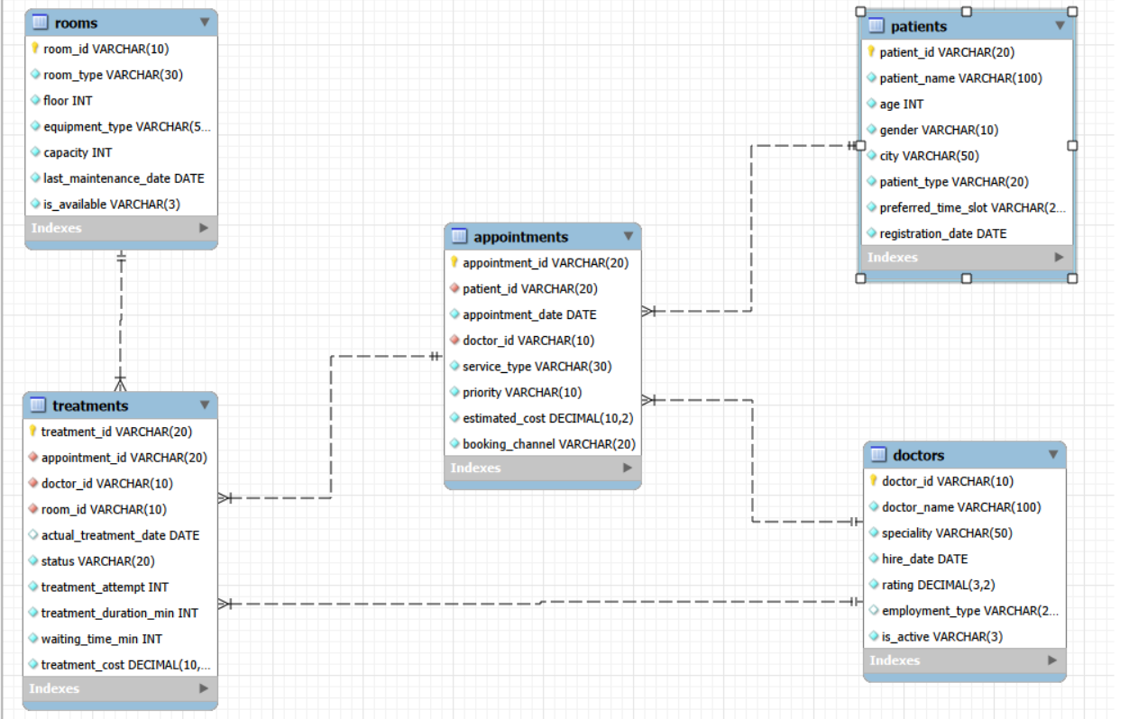
ER Diagram
Relationships: Patients are connected to Appointments, Appointments are connected to Treatments, while Doctors and Rooms are linked to treatment activities through foreign keys.

Slide 8
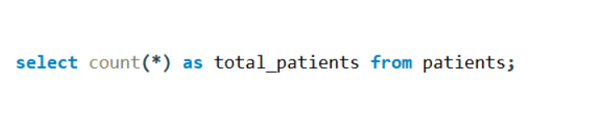
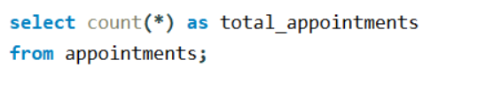
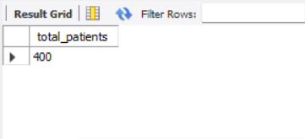
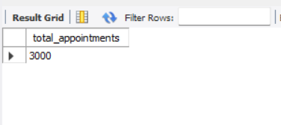
Section 1 — Basic SQL Analysis
1. What is the total number of patients?
2. What is the total number of appointments?
What it does:
Counts all records in the appointments table to measure the total appointment volume in the hospital database.
What it does:
Counts all records in the patients table to determine the total number of registered patients.

Slide 9
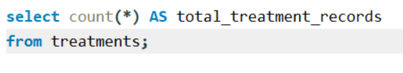

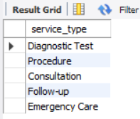
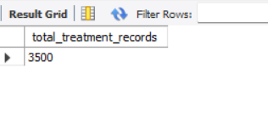
Section 1 — Basic SQL Analysis
3. What is the total number of treatment records?
4. What are the different medical service types?
What it does:
Uses DISTINCT to display each unique service type available in the appointments table without repeating duplicate values.
What it does:
Counts all records in the treatments table to determine the total number of treatment records stored in the database.

Slide 10


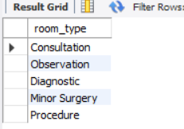
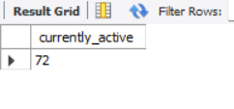
Section 1 — Basic SQL Analysis
5. How many doctors are currently active?
6. What are the different room types?
What it does:
Counts the doctors whose is_active status is set to yes to determine the number of currently active doctors in the database.
What it does:
Uses DISTINCT to identify each unique room type available in the hospital without displaying duplicate values.

Slide 11


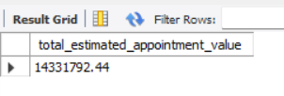
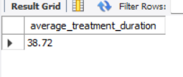
Section 1 — Basic SQL Analysis
7. What is the total estimated appointment value?
8. What is the average treatment duration?
What it does:
Calculates the total estimated value of all appointments by adding the estimated_cost of every appointment.
What it does:
Calculates the average time taken to complete treatments using the treatment_duration_min column.

Slide 12
Section 2 — Objective-Based Analysis
The analysis is organized around five key business objectives:
Patient & Appointment Demand
Understand appointment volume, service demand, patient types, and booking channels.
Patient Appointment Behaviour
Identify frequent patients, appointment patterns, patient segments, and booking activity.
Treatment Performance
Evaluate treatment outcomes, waiting time, treatment duration, and repeated attempts.
Doctor & Room Performance
Analyze doctor workload, treatment activity, room utilization, and resource usage.
Treatment & Appointment Problems
Identify cancellations, no-shows, rescheduling, repeated attempts, and higher waiting/problem areas.

Slide 13

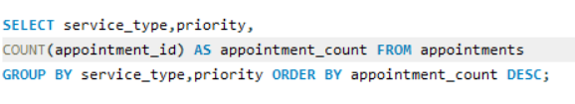
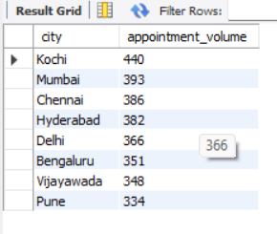
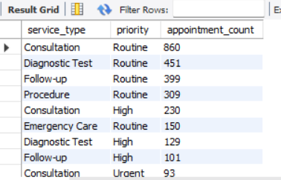
OBJECTIVE 4.1 — Patient & Appointment Demand
1. Compare appointment volume across cities.
2. Compare appointments across service types and priorities.
What it does:
Groups appointments by service type and priority to show which combinations have the highest appointment demand.
What it does:
Counts appointments for each city by joining the Patients and Appointments tables, helping compare appointment demand across cities

Slide 14
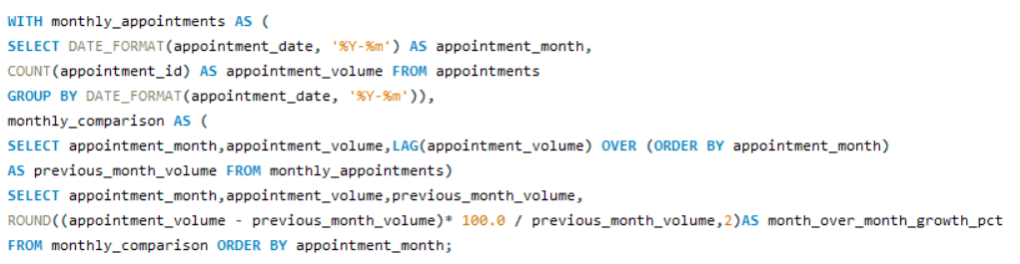
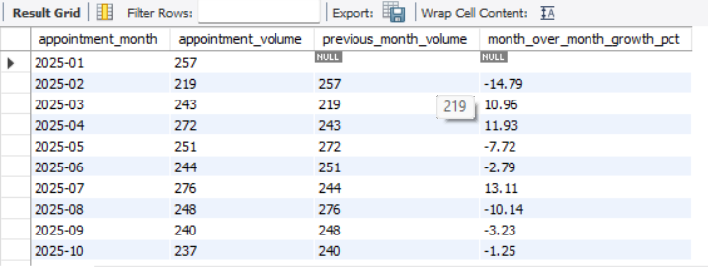
OBJECTIVE 4.1 — Patient & Appointment Demand
Student-Developed Advanced Analysis
Advanced Q3: Calculate monthly appointment volume and month-over-month percentage change.
What it does:
Calculates monthly appointment volume and uses LAG() to compare each month with the previous month.
It helps identify periods of increasing or declining appointment demand.

Slide 15
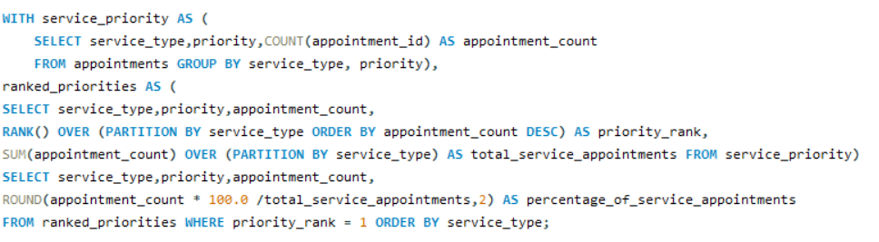
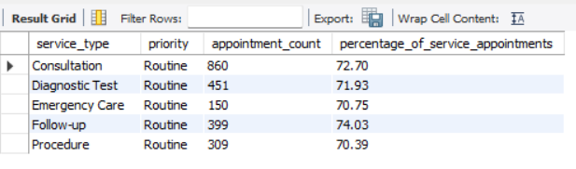
OBJECTIVE 4.1 — Patient & Appointment Demand
Advanced Q4: Identify the dominant priority for each service type and calculate its percentage of that service's appointments.
What it does:
Identifies the most common priority level for each service type using ranking within each service. It also calculates what percentage of that service’s appointments belong to the dominant priority

Slide 16


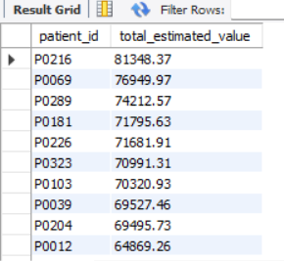
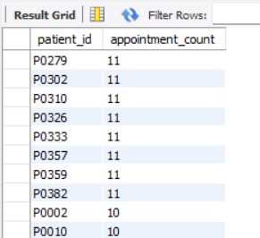
OBJECTIVE 4.2 — Patient Appointment Behaviour
1. Compare patients by number of appointments.
2. Identify patients with higher cumulative estimated appointment value.
What it does:
Calculates the cumulative estimated appointment value for each patient and sorts the results to identify patients with higher estimated value.
What it does:
Counts the number of appointments for each patient and sorts the results to identify patients with the highest appointment activity.

Slide 17
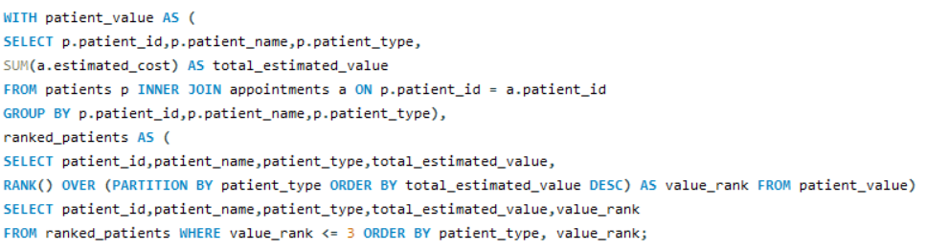
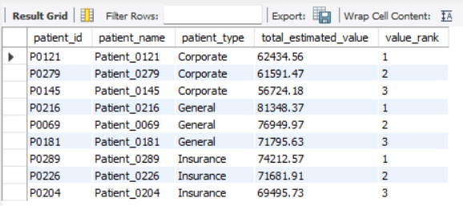
OBJECTIVE 4.2 — Patient Appointment Behaviour
Student-Developed Advanced Analysis
Advanced Q3: Rank patients by cumulative estimated appointment value within each patient type
What it does:
Calculates each patient's total estimated appointment value and ranks patients separately within General, Corporate, and Insurance groups to identify the top 3 patients in each group. This helps compare how appointment value is distributed across different patient segments.

Slide 18
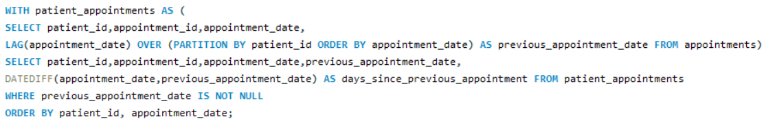
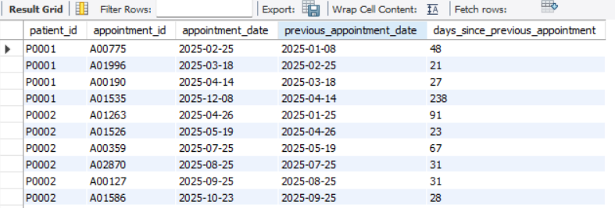
OBJECTIVE 4.2 — Patient Appointment Behaviour
Advanced Q4: Calculate the number of days between consecutive appointments for each patient
What it does:
Uses LAG() to find each patient's previous appointment date and DATEDIFF() to calculate the number of days between consecutive appointments.
This helps identify how frequently patients return for appointments.

Slide 19
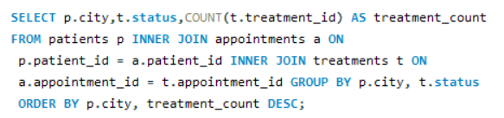
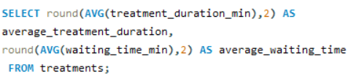
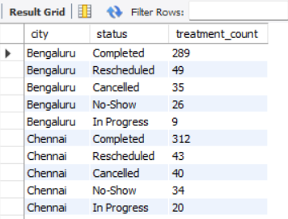

OBJECTIVE 4.3 — Evaluate Treatment Performance
1. Compare treatment outcomes across cities.
2. Examine treatment duration and waiting time.
What it does:
Calculates the overall average treatment duration and average waiting time across all treatment records.
What it does:
Groups treatment records by city and treatment status to compare how many treatments were Completed, Cancelled, No-Show, Rescheduled, or In Progress in each city.

Slide 20
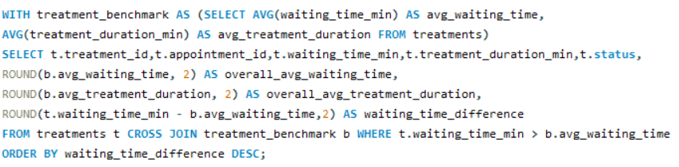
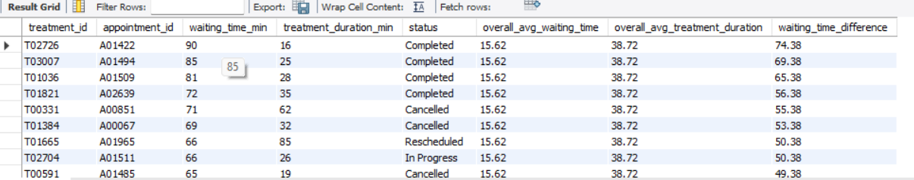
OBJECTIVE 4.3 — Evaluate Treatment Performance
Advanced Q5 : Which treatments had waiting times higher than the overall average and how did their treatment duration compare with the overall average?
What it does: Compares each treatment's waiting time with the overall average and identifies treatments above that benchmark. It also compares their treatment duration with the overall average duration.

Slide 21
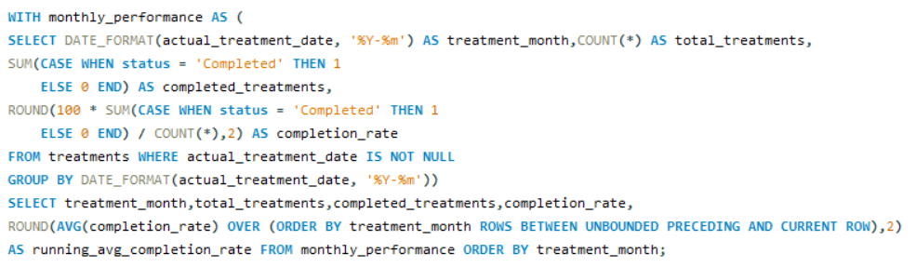
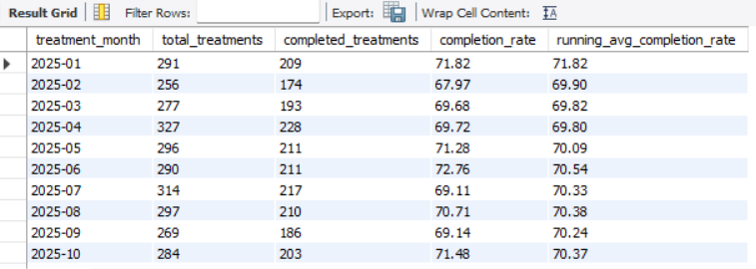
OBJECTIVE 4.3 — Evaluate Treatment Performance
Student-Developed Advanced Analysis
Advanced Q1: How does the monthly treatment completion rate change over time, and what is the running average completion rate?
What it does:
Calculates the monthly treatment completion rate and uses a window function to track the running average over time. This helps identify how treatment completion performance changes across months.

Slide 22
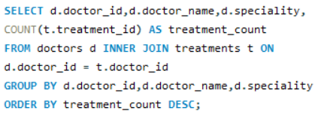
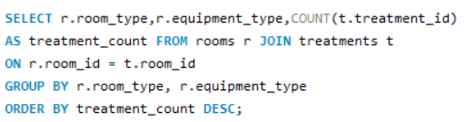
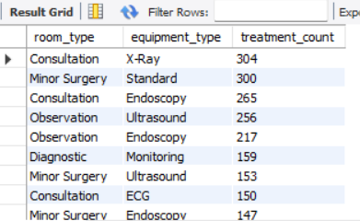
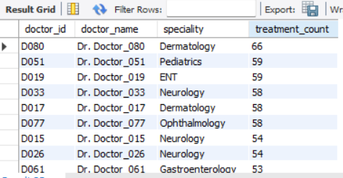
OBJECTIVE 4.4 — Doctor & Room Performance
1. Compare the number of treatments handled by doctors.
2. Compare room usage across room types and equipment types.
What it does: Counts treatments for each combination of room type and equipment type. This helps identify which room and equipment combinations are used most frequently.
What it does:
Counts the number of treatments handled by each doctor and groups the results by doctor and speciality. This helps identify doctors with higher treatment workloads.

Slide 23
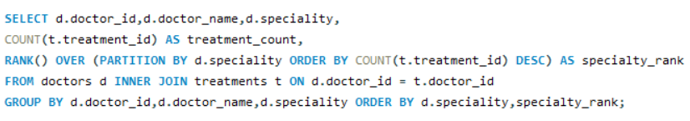
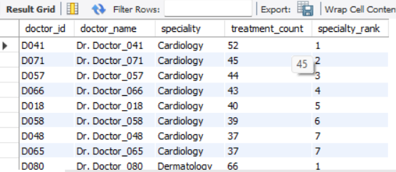
OBJECTIVE 4.4 — Doctor & Room Performance
Student-Developed Advanced Analysis
Advanced Q1:How do doctors rank within their respective specialties based on the number of treatments they handle?
What it does:
Counts the treatments handled by each doctor and uses RANK() within each speciality to compare doctors based on their treatment workload.

Slide 24
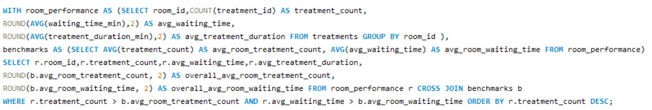
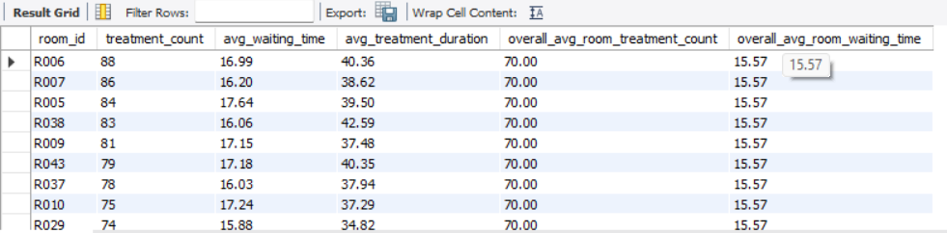
OBJECTIVE 4.4 — Doctor & Room Performance
Advanced Q4 : Which rooms have both a high treatment workload and above-average patient waiting time?
What it does: Calculates treatment workload and average waiting time for each room, then compares them with overall room averages to identify rooms that have both high workload and above-average waiting time.

Slide 25

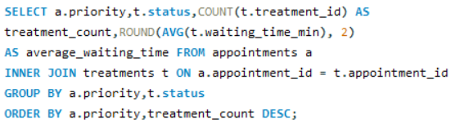
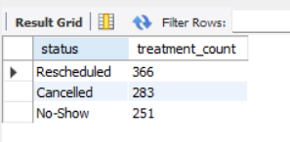
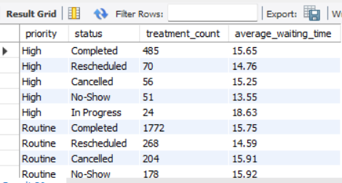
OBJECTIVE 4.5 — This helps identify patients experiencing both repeated treatment activity and higher waiting times.
2. Compare treatment outcomes and waiting time across priority levels.
1. Find common problem statuses and patterns.
What it does:
Counts cancelled, no-show, and rescheduled treatments by status to identify the most common treatment problems in the hospital.
What it does: Groups treatments by priority and treatment status to compare treatment outcomes and average waiting time across different priority levels.

Slide 26
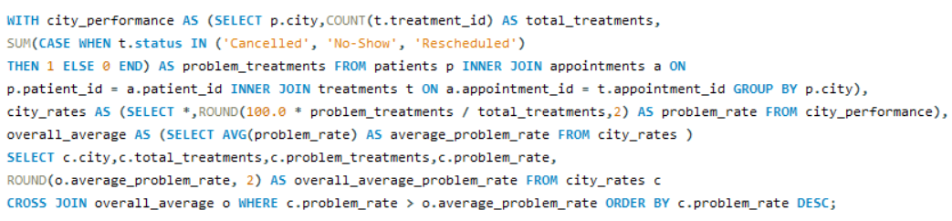
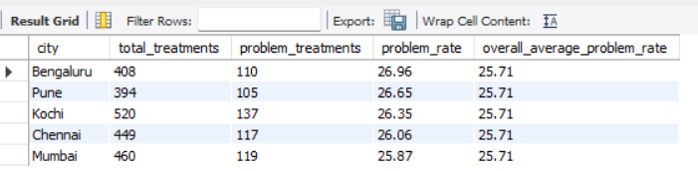
OBJECTIVE 4.5— Treatment and Appointment Problems
Student-Developed Advanced Analysis
Advanced Q1:Which cities have an above-average problem rate?
What it does: Calculates the problem rate for each city and compares it with the overall average problem rate to identify cities with higher-than-average treatment problems.

Slide 27
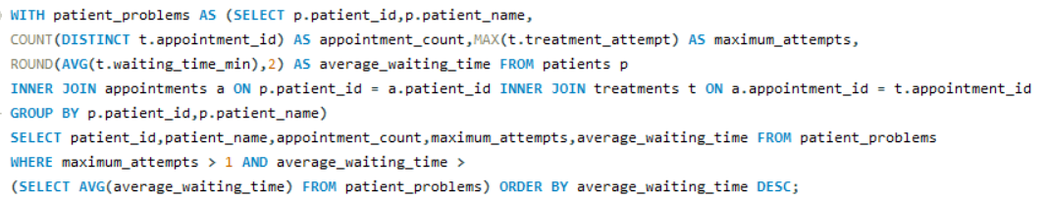
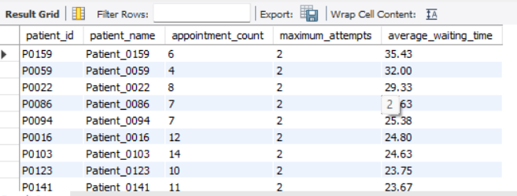
OBJECTIVE 4.5 — Treatment and Appointment Problems
Advanced Q4 : Find patients who have both repeated treatment attempts and high waiting time
What it does: Identifies patients with repeated treatment attempts and average waiting times above the overall patient average. This helps identify patients experiencing both repeated treatment activity and higher waiting times.

Slide 28
KEY INSIGHTS AND FINDINGS
Appointment Demand: Kochi recorded the highest appointment volume, followed by Mumbai and Chennai, showing differences in patient demand across cities.
Booking Behavior: A small group of patients had considerably higher appointment activity and estimated appointment value than others.
Treatment Performance: Completed treatments were the largest outcome category, while cancellations, no-shows, and rescheduling represented important operational issues.
Doctor & Room Utilization: Treatment workload varied across doctors, while certain rooms showed both high treatment workload and above-average waiting time.
Operational Problems: Some cities had problem rates above the overall average, and certain patients experienced both repeated treatment attempts and higher waiting times.
Advanced Analysis: Window functions, CTEs, ranking, LAG(), and benchmark comparisons were used to identify patterns that basic aggregation alone would not reveal.

Slide 29
CHALLENGES & LEARNING EXPERIENCE
Relational Database Understanding: Learned how multiple hospital tables are connected through primary keys and foreign keys.
Complex SQL Joins: Worked with multiple JOIN operations to combine patient, appointment, treatment, doctor, and room information.
Data Aggregation: Practiced COUNT(), SUM(), AVG(), GROUP BY, and CASE to answer business questions.
Advanced SQL: Applied CTEs, window functions, RANK(), LAG(), and date functions for deeper analysis.
Business Problem Solving: Converted real-world hospital operational requirements into measurable analytical questions.
Data Interpretation: Learned to move beyond SQL output and translate results into meaningful business findings and operational insights.
Presentation & Documentation: Improved the ability to explain SQL logic, analytical results, and their practical business relevance.

Slide 30
CONCLUSION & RECOMMENDATIONS
Operational Understanding: The project provided a structured view of hospital patient care operations using a relational MySQL database.
Patient & Appointment Insights: SQL analysis helped identify differences in appointment demand, patient activity, booking patterns, and service priorities.
Treatment Performance: Treatment outcomes, waiting time, treatment duration, and repeated attempts were analyzed to identify operational patterns.
Resource Utilization: Doctor workload and room usage were examined to understand how hospital resources are being utilized.
Problem Identification: Cancellations, no-shows, rescheduled treatments, repeated treatment attempts, and higher problem-rate areas were identified.
Data-Driven Recommendations: The findings can support better appointment planning, workload balancing, resource allocation, and monitoring of treatment delays.
Overall Learning: The project strengthened practical skills in MySQL, relational databases, advanced SQL, data analysis, and business problem solving.

Slide 31

THANK YOU

