Slide 1


EXCELLENCE QUOTIENT 2021
Team: Golden Arrows
Team Members:
Shivank Rastogi(shivank189738@st.jmi.ac.in)
Areeb Bashir Lone(areeb1810195@st.jmi.ac.in)
Faculty of Engineering, Jamia Millia Islamia, New Delhi

Slide 2

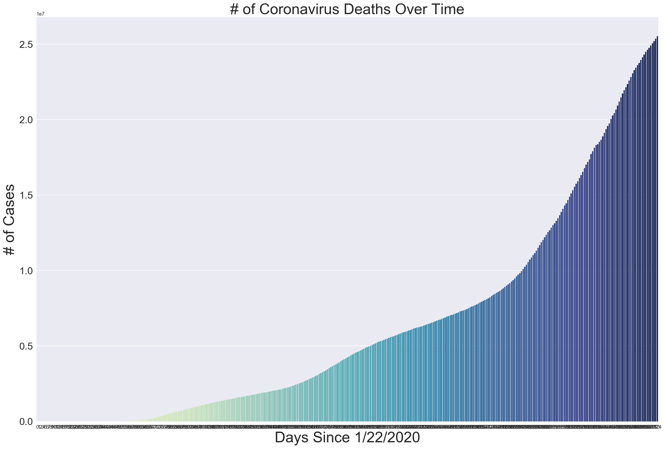

Understanding the Problem
Insights From the Dataset
Forecasting Model
The dataset contains daily Covid-19 Cases, Deaths due to Covid-19 in counties of all the states of USA.
Dataset contains Google Mobility Index, Apple Mobility Index for various categories of places like Grocery stores, Recreational places, Transit Station etc. for all counties of all the states.
Mobility Index: This shows the movement trends by region across different categories of places. It show the changes in 2 different ways:
Headline number: Compares mobility for the report
date to baseline day.
Trend Graph: The percent changes in the 6 weeks
before the report date.
4. Dataset also stores the Electricity Consumption,
Population Demography, Medical Infrastructure,
Workforce Demography etc. for each County.
5. Using these information we have to build a Forecasting
that will predict daily new Covid-19 cases at County
level.

Slide 3

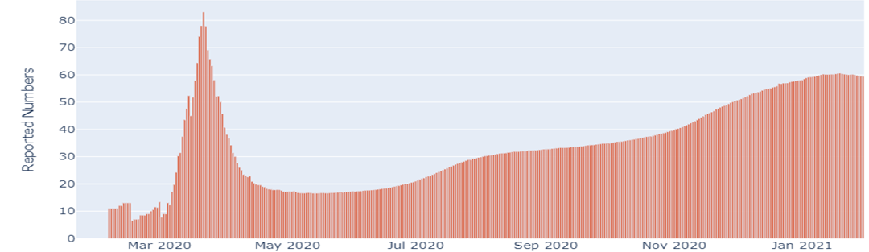
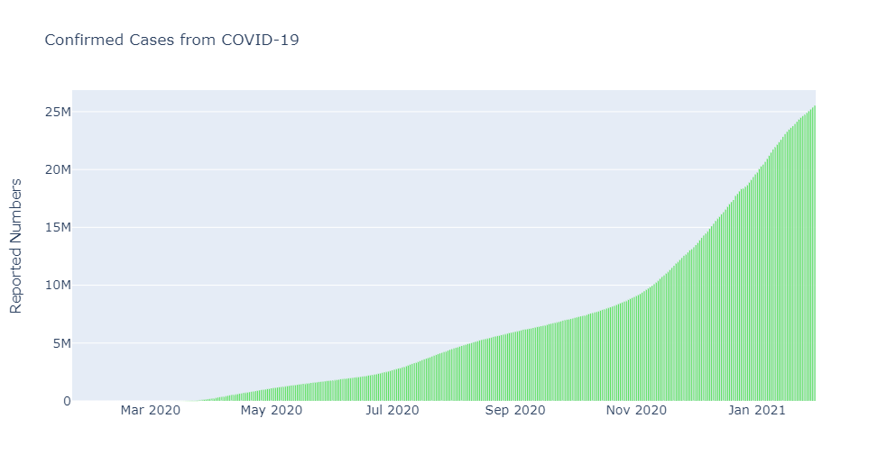
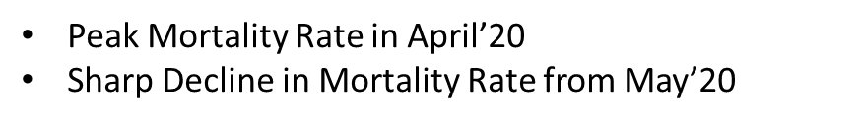
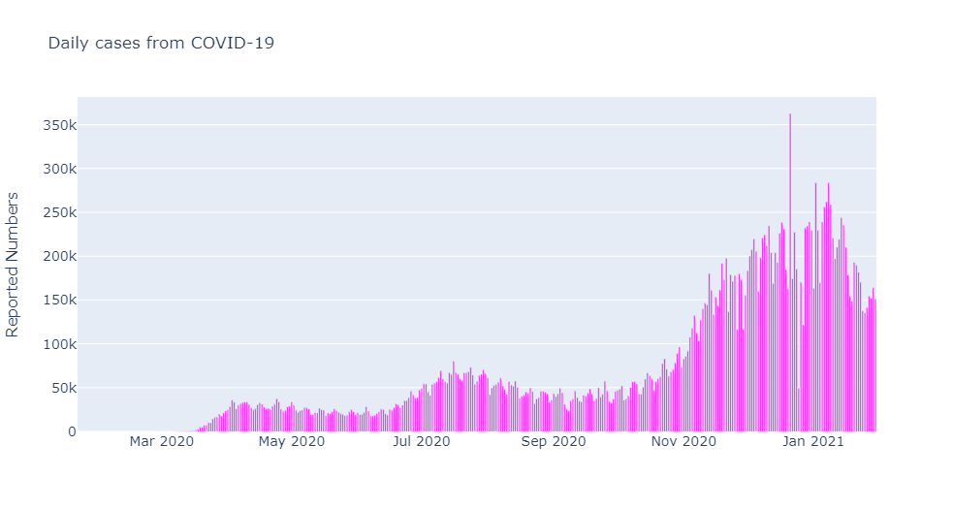
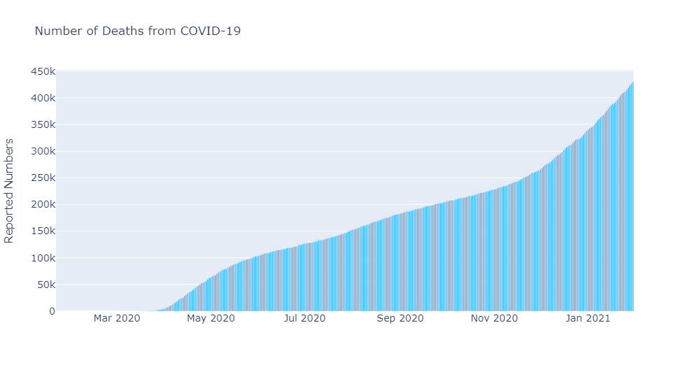
Understanding the Problem
Insights From the Dataset
Forecasting Model
Visualizing Growth Trajectory of Covid-19
Coivd-19 Cases in USA
Daily New Covid-19 Cases
Mortalities due to Covid-19:
Spikes in Daily New cases in Month of August and December.
Three Waves of Covid-19 can be inferred from Daily New cases
Increase in Mortality rate in month of December.
There is dip in Mortality rate from June.

Slide 4
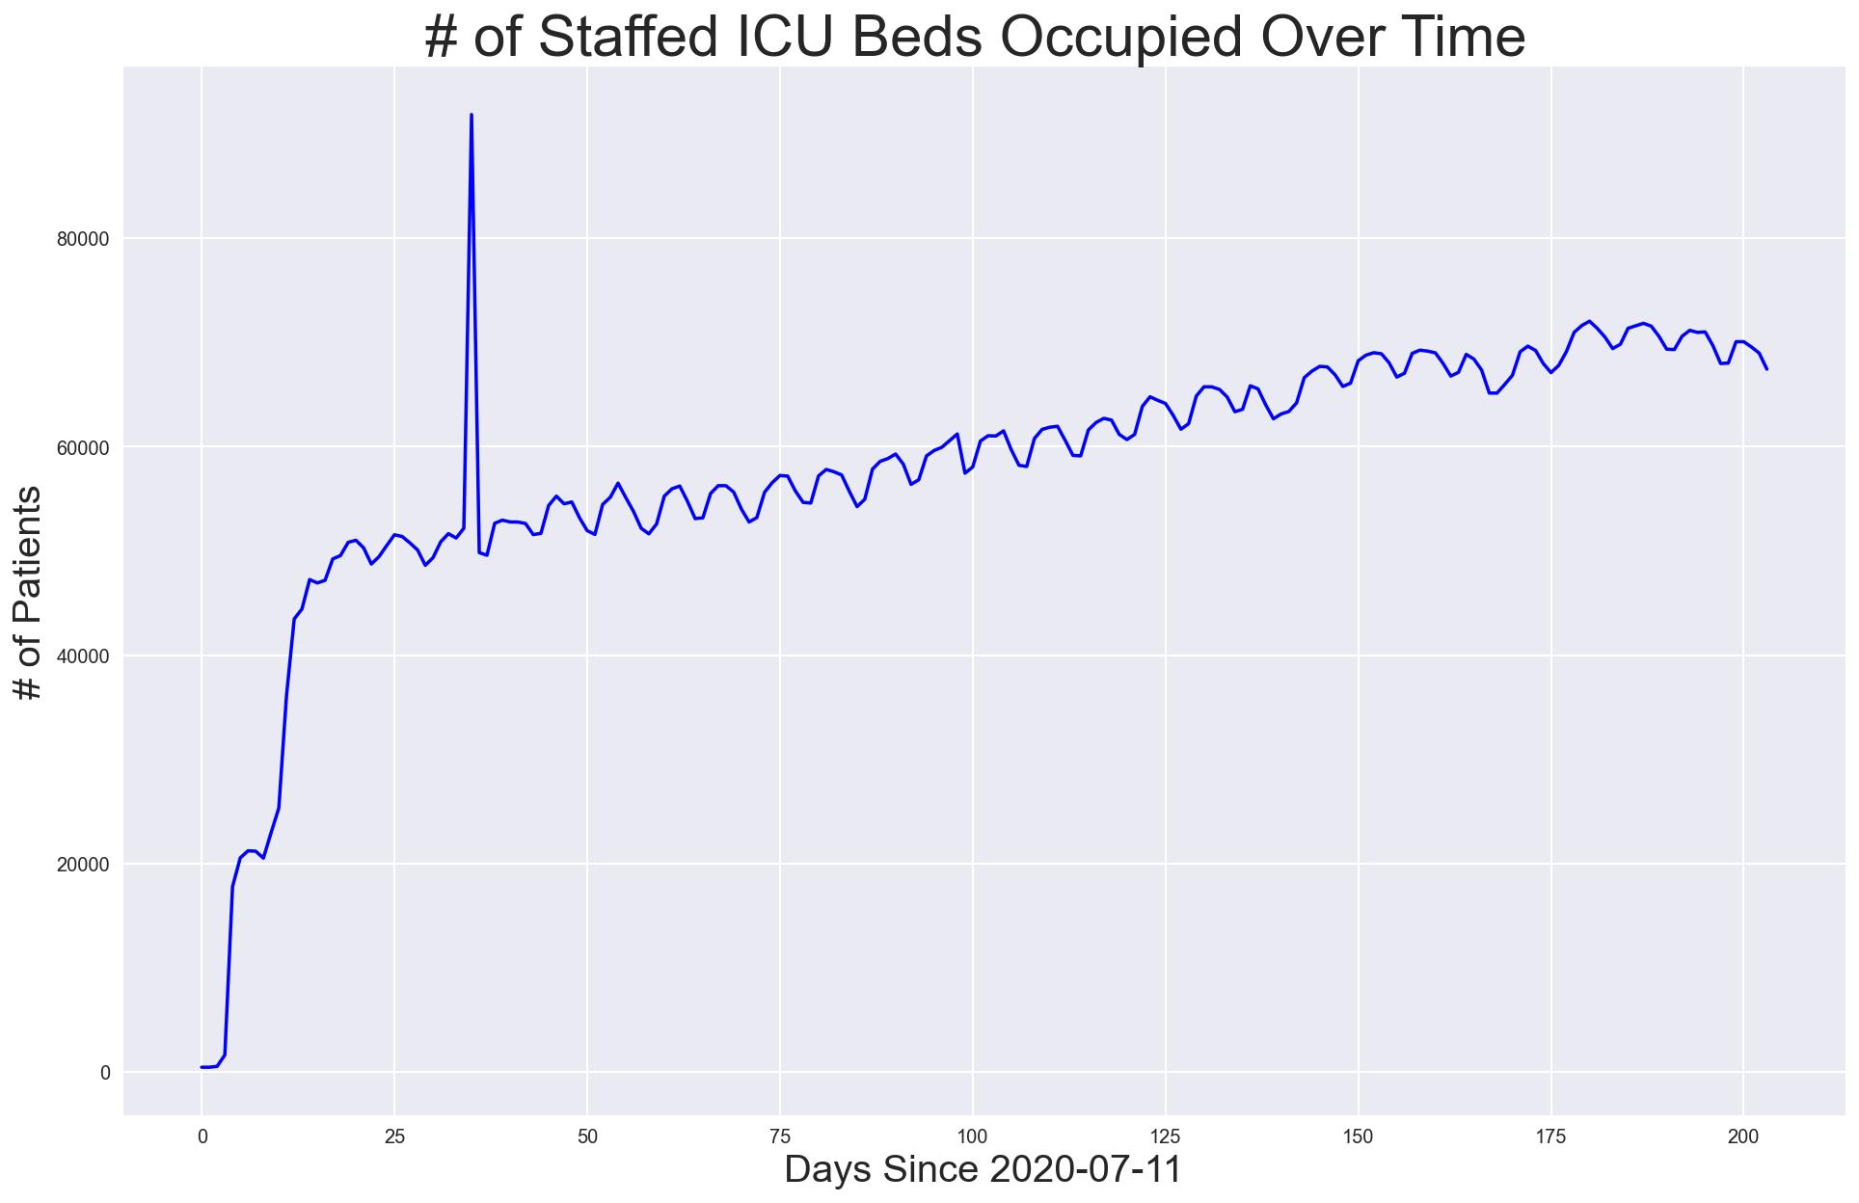
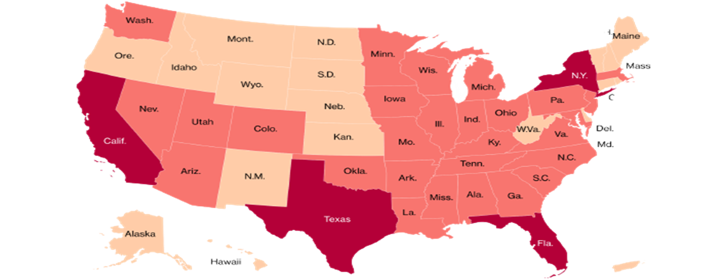
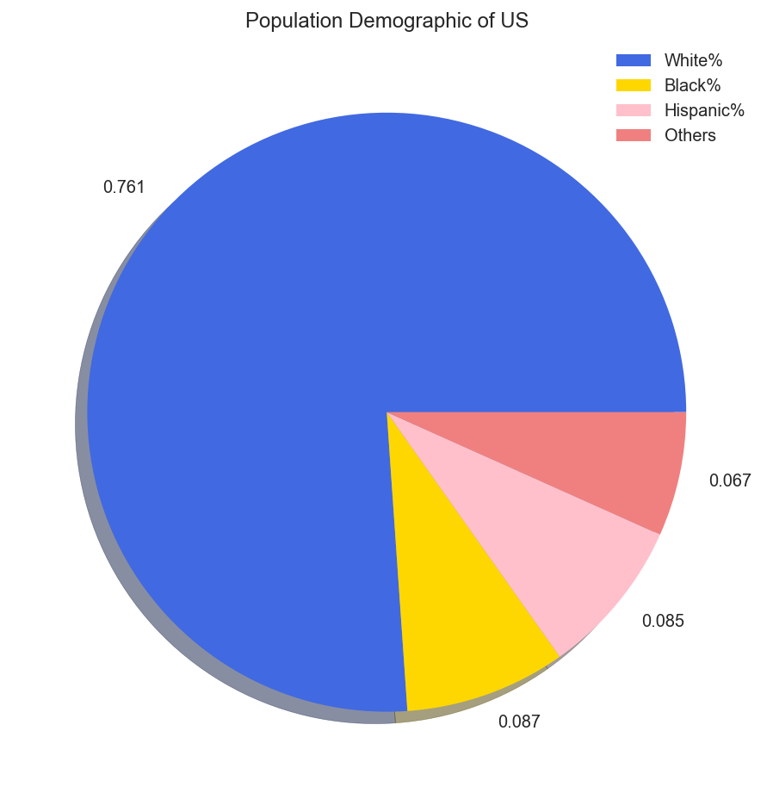
Understanding the Problem
Insights From the Dataset
Forecasting Model
Impact of Covid-19 in USA
Number of ICU Beds Occupied
Covid-19 Cases in States of USA:
Maximum number of ICU beds occupied in Aug’20
Population Demography
76.1% are White
8.7% are Black
8.5% are Hispanic
6.7% are Others
Texas, California, New York, Florida are worst effected states in USA

Slide 5
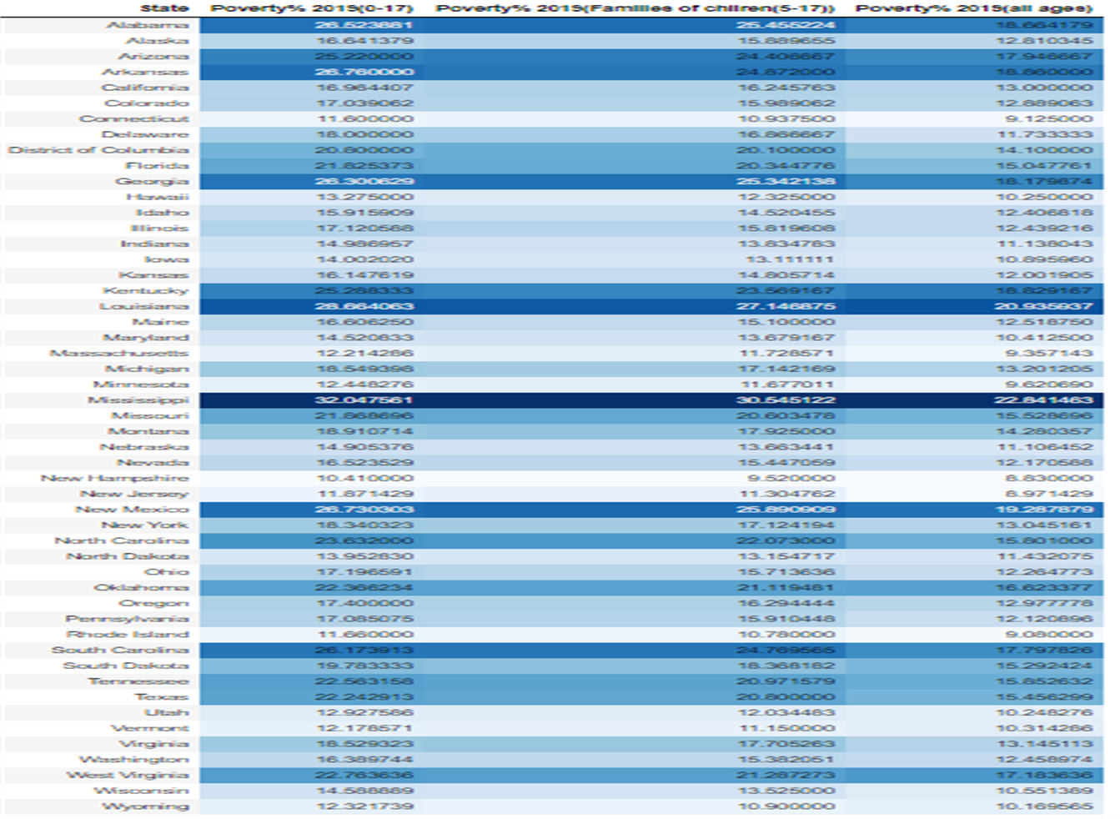
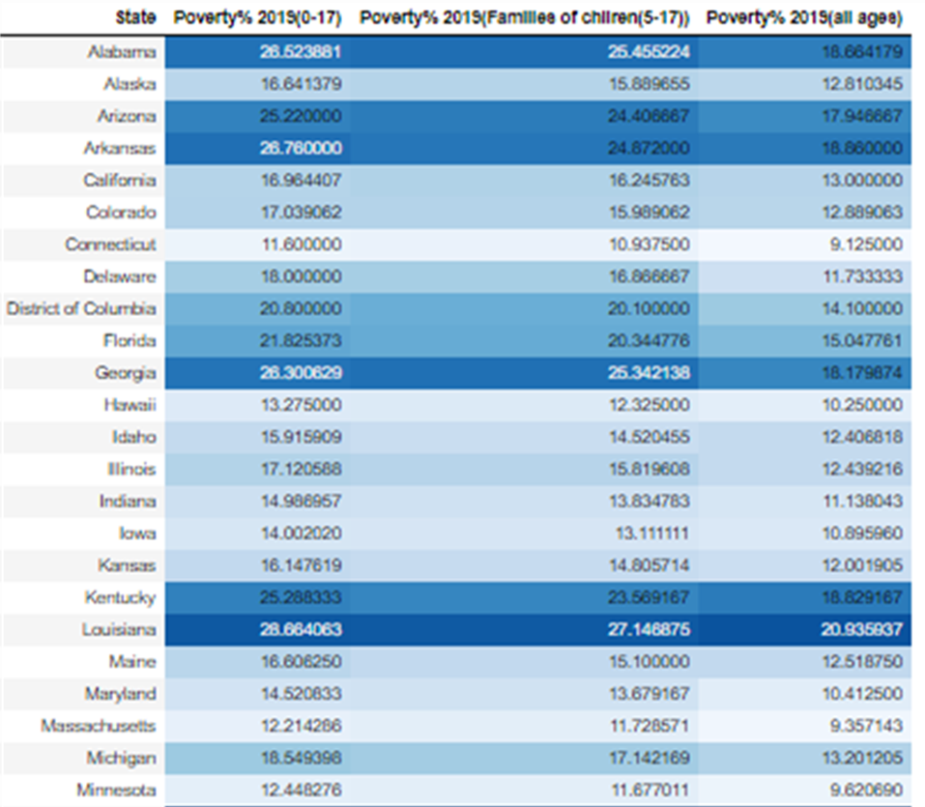
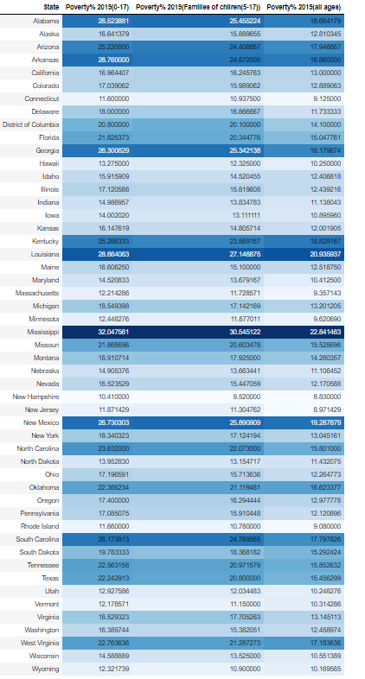
Understanding the Problem
Insights From the Dataset
Forecasting Model
Poverty Breakdown by States
Poverty in age group from 0-17 is highest Mississippi.
Poverty in Families of children(5-17 yr old) is highest in Mississippi.
Poverty in all age group is highest in Mississippi.
Mississippi has the highest poverty

Slide 6
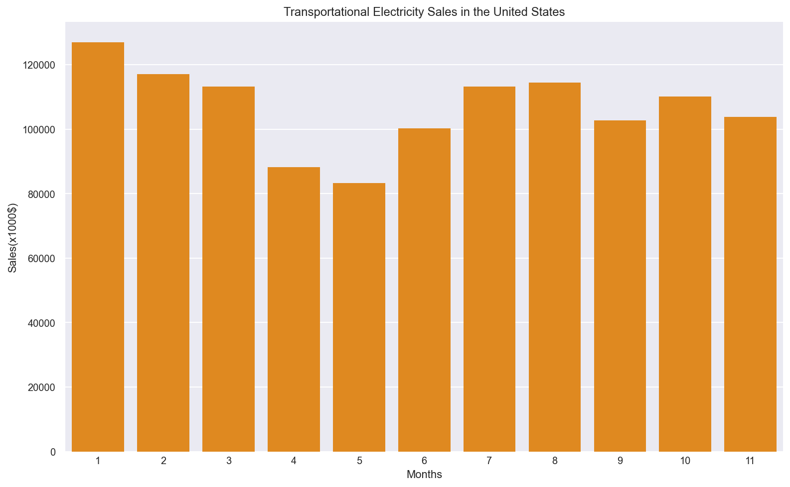

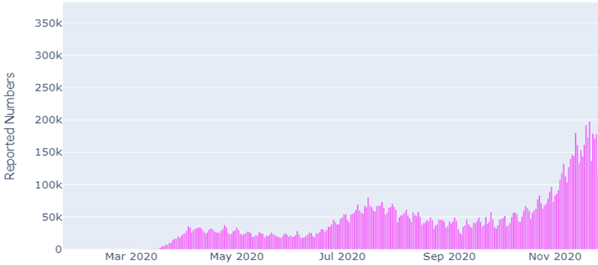
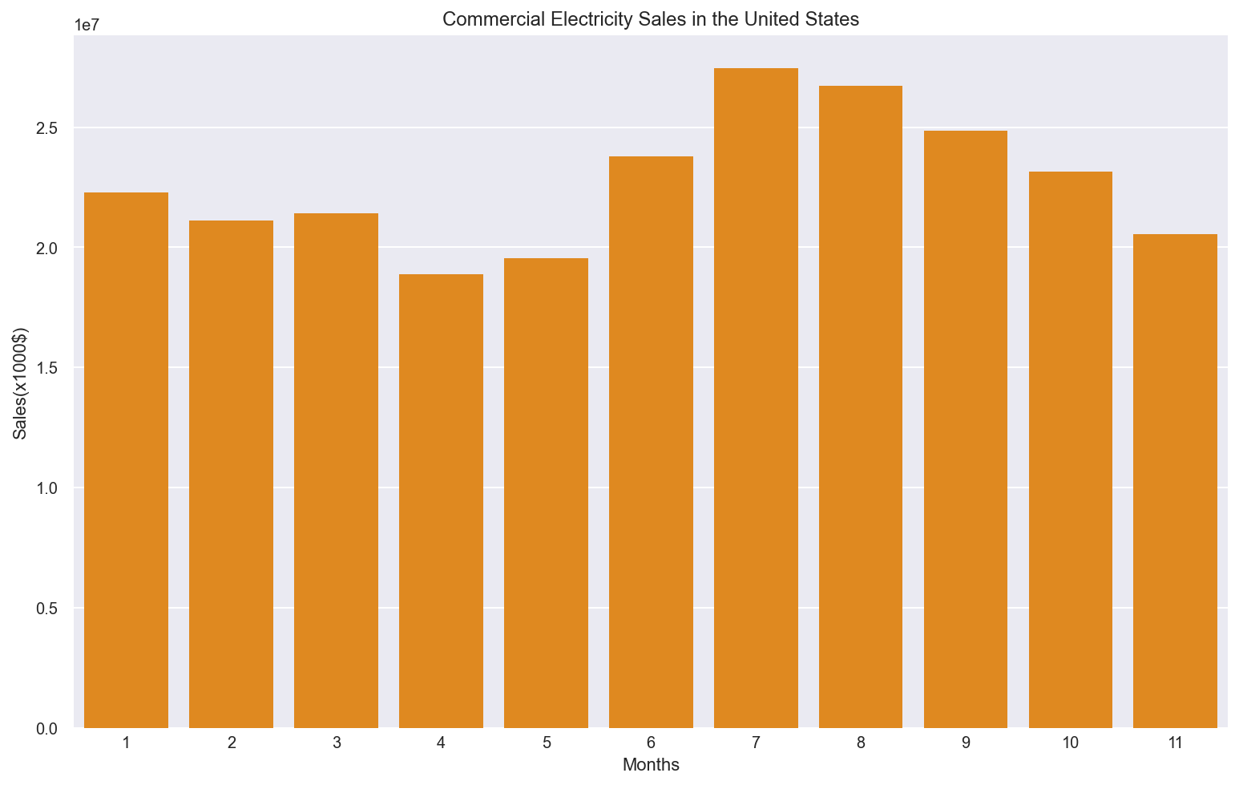
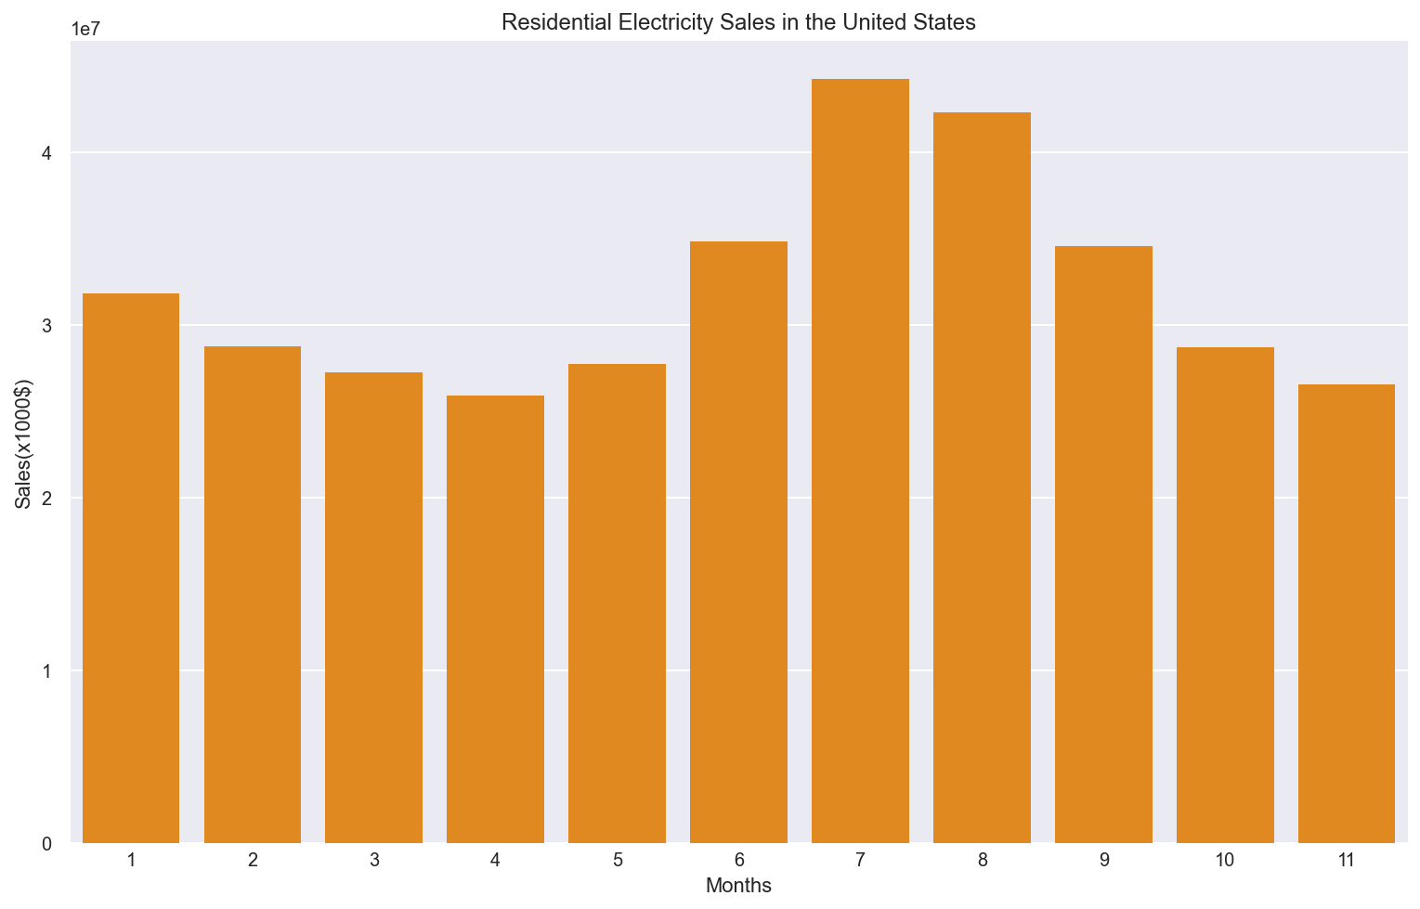
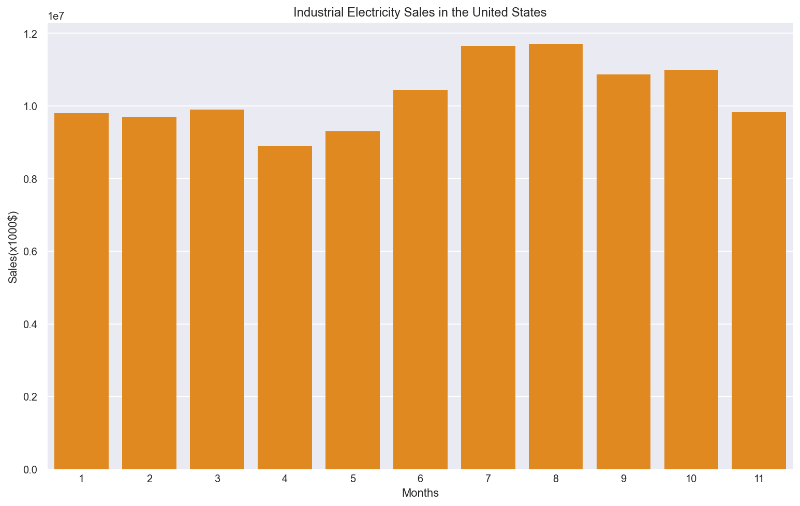
Understanding the Problem
Insights From the Dataset
Forecasting Model
Inferences from Electricity Consumption
Transportation Electricity Sales
Commercial Electricity Sales
Daily New Covid-19 Cases
Residential Electricity Sales
Industrial Electricity Sales
Majority of States in USA had lockdowns from March’20-May’20.
Transportation Electricity Sales: Due to lockdown, consumption/sales in month of April’20 have significantly gone down.
As Transportation Elec. Sales increases corona cases also increases in month of July’20 to Sept.’20
2. Commercial Electricity Sales: Due to lockdown consumption/sales
of commercial electricity decreased
From Jun’20-Sept’20 Both Covid-19 Cases and Commercial elec. Consumption/sales increases.
3. Residential Electricity Sales: No major change in residential
electricity consumption/sales during lockdown period.
From Jun’20 to Sept’20 as Covid-19 cases increases residential electricity consumption/sales also increases because of more people staying indoor.
Industrial Electricity Sales: There is no significant change in Industrial
electricity consumption. We can conclude industry operations was not
affected by covid-19.
1e7

Slide 7
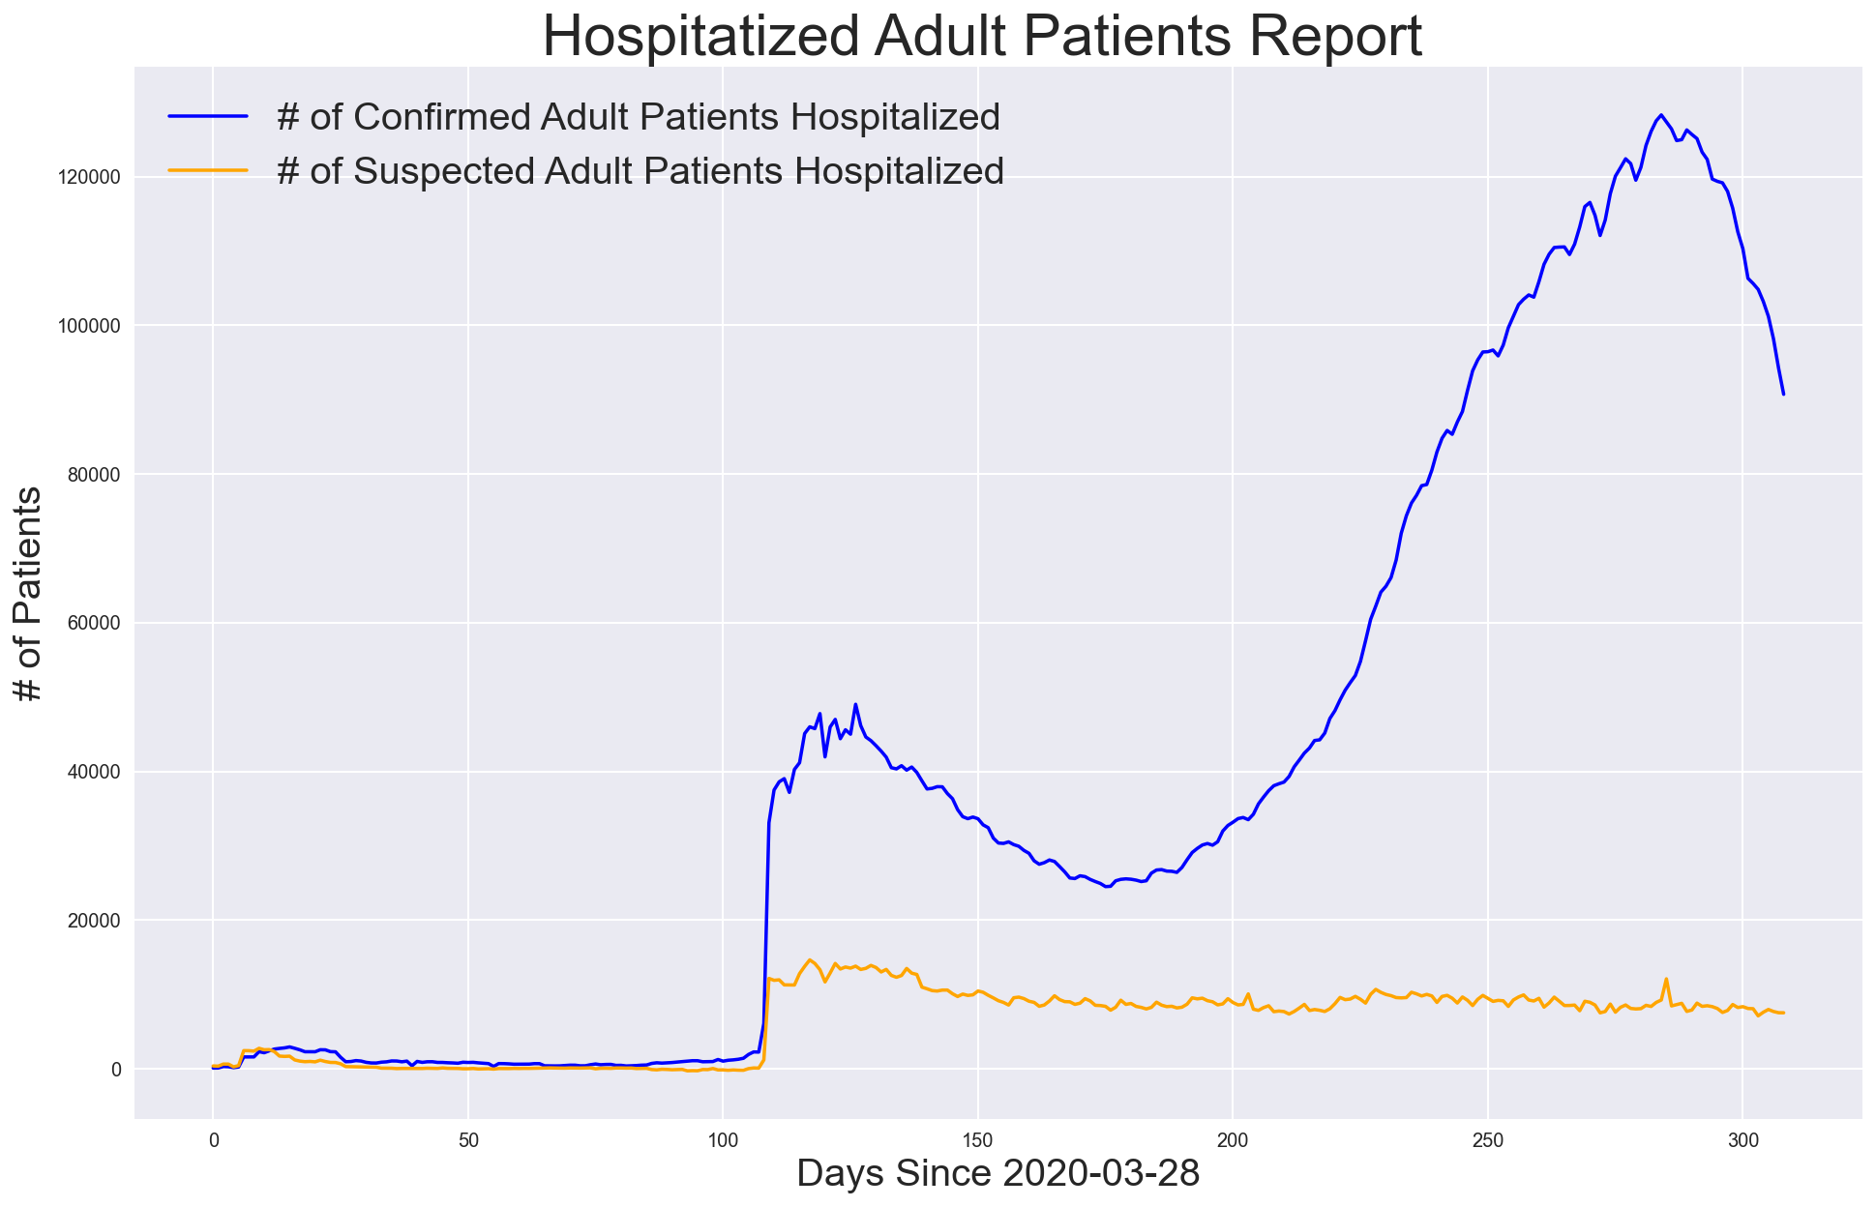
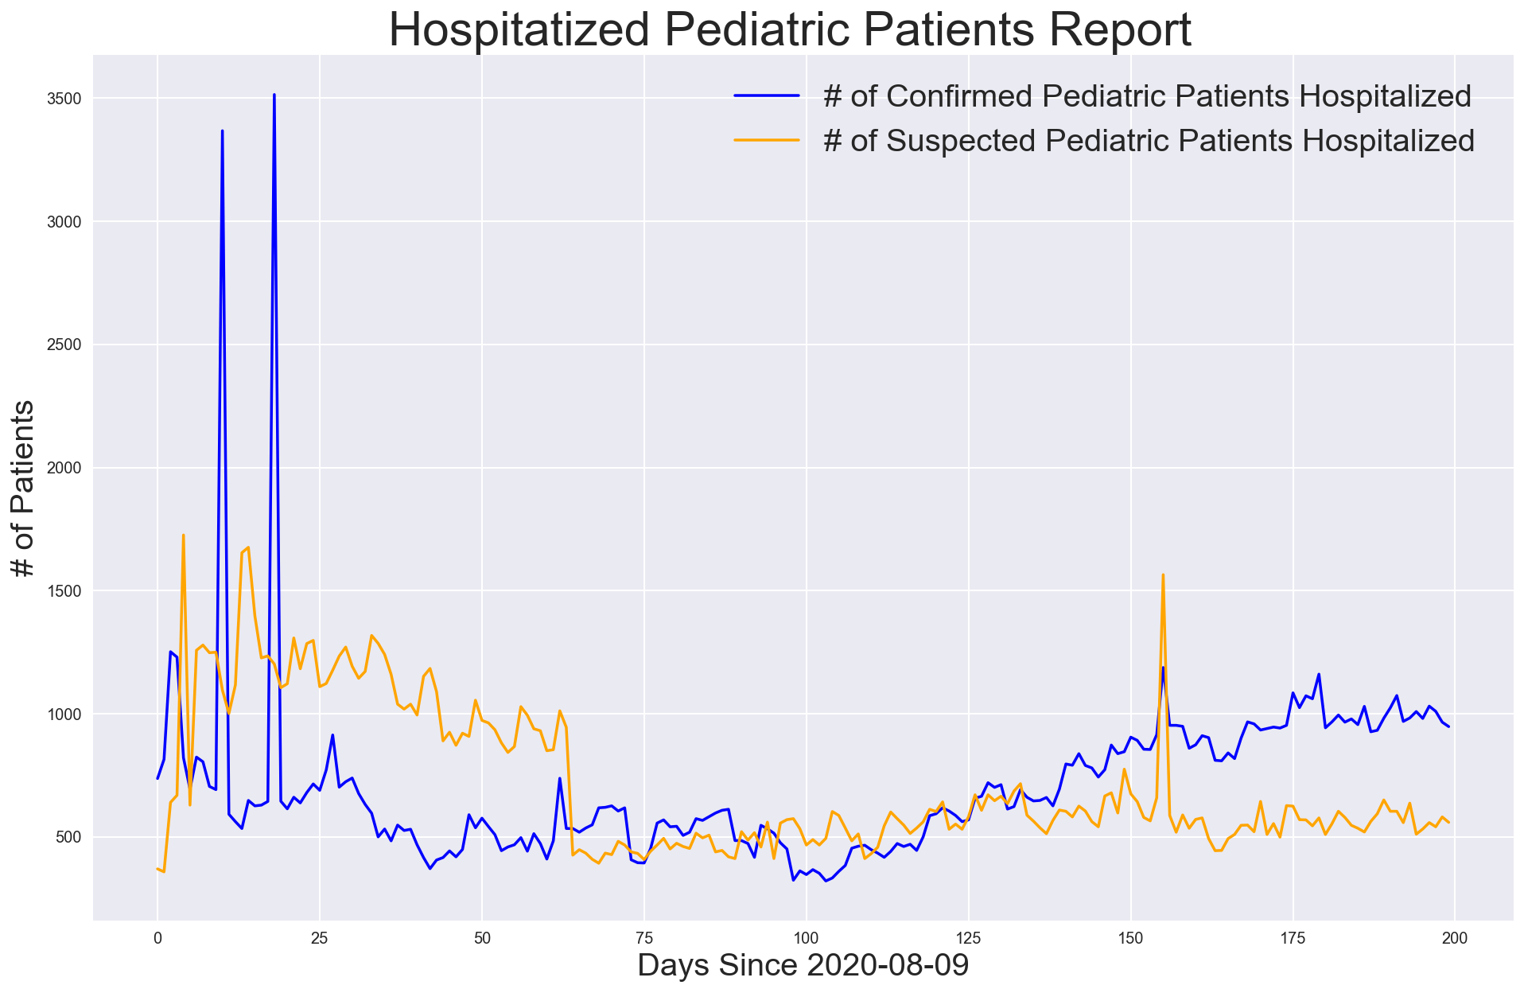
Understanding the Problem
Insights From the Dataset
Forecasting Model
Medical Infrastructure Utilized
Adult Patients Hospitalized
Pediatric Patients Hospitalized
From the graph “ Adults Patients Hospitalized”: There is steep increment in Number of Adults patients hospitalized in July’20 which began to decrease from Sep’20.
From Nov’20 We can see Second Wave.
Number of Suspected pediatric patients hospitalized is comparable to
number of confirmed pediatric patient hospitalized where as in case of Adult patients
number of suspected patient hospitalized is quite smaller than confirmed patients
hospitalized.

Slide 8

Data
Processing
Feature
Engineering
Machine Learning Model
Predictions
Understanding the Problem
Insights From the Dataset
Forecasting Model
Our Forecasting Model
Auto ARIMA is used for building this forecasting model that will predict number of confirmed covid-19 cases for first 15 days of Feb’21.
ARIMA stands for Auto-Regressive Integrated Moving Averages.
Preprocess the data removing NaN value and assign numerical values to categorical features.
Data was modified to obtain a Data Frame similar to submission template so that it is compatible with Auto ARIMA model
Predicts the number of Covid-19 cases for the first 15 days of Feb’21.

Slide 9
Understanding the Problem
Insights From the Dataset
Forecasting Model
Stationary Identification
Auto-ARIMA Model:
Stationary Treatment
Model
Identification
Hyperparameter
Estimation
White Noise Test
Forecasting
Yes
No
Model Improvement
Problem Identification : We identified the problem as a time series forecasting problem. It observes the values of cases in each county at equal intervals of time and predicts future values based on past values.
Model : Our model is an Automatic ARIMA model, One of the time forecasting models used for forecasting contagions. Unlike the basic ARIMA model, where we need to provide the values of Hyperparameters(p, d and q) and use statistical techniques to generate these values by performing the difference to eliminate the non-stationarity, In Auto ARIMA, the model itself will generate the optimal values of Hyperparameters(p, d and q)which would be suitable for the data set to provide better forecasting. Auto ARIMA was applied to every single county and hyperparameters were calculated separately and chosen according to the lowest Akaike information criterion(AIC) score.
Working : The model studies the values of cases from each county, generates the Hyperparameters for every county and then predicts the number of Covid-19 cases in every county of USA for the first 15 days of February’21.

Slide 10
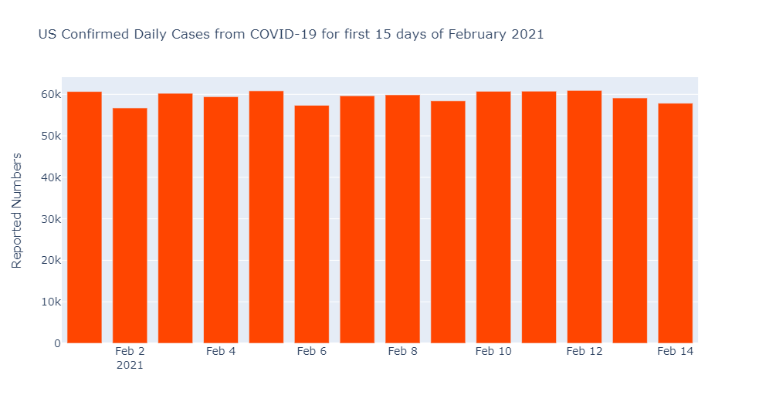
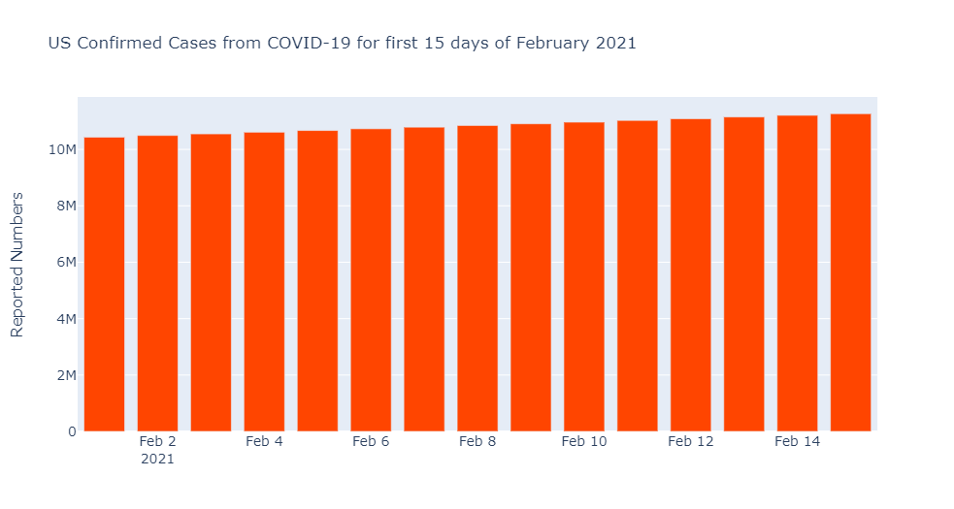
Understanding the Problem
Insights From the Dataset
Forecasting Model
Predictions
Predicted Daily New Covid-19 Cases in USA
Predicted Total Covid-19 Cases in USA
Our model is an Automatic ARIMA, one of the predictive models used for forecasting contagions to predict the number of confirmed cases for next 15 days in all of the counties in USA.
The model gave satisfactory results with accuracy of 80-83%.The confirmed cases for the counties show an increasing trend in the first 15 days of February 2021
Auto ARIMA was applied to every single county and hyperparameters were calculated separately and chosen according to the lowest Akaike information criterion(AIC) score.
(The model was affected due limited processing power which may have reduced the accuracy)

Slide 11
Thank You!
Submitted By:
Shivank Rastogi(shivank189738@st.jmi.ac.in)
Areeb Bashir Lone(areeb1810195@st.jmi.ac.in)
Faculty of Engineering, Jamia Millia Islamia New Delhi

