Slide 1
Encryption

Slide 2
Symmetric vs Asymmetric Encryptions
Asymmetric encryption holds one key that both the client and the server hold
Symmetric - For all a, b in X if a is related to b then b is related to a.
Asymmetric - For every a, b pair in X if a is related to b then b is not related to a.

Slide 3
Block vs Stream Encryption
Block Encryption- When the data being encrypted is placed into blocks of a declared size and padded to fill the room left available.
Stream Encryption- When the data being encrypted is in a one to one relation with with the output encrypted text.

Slide 4
Modes of Operation
Electronic Code Book ( ECB )
Cipher Block Chaining ( CBC )
Cipher Feedback ( CFB )
Output Feedback ( OFB )
Counter ( CTR )

Slide 5
AES
The Basics

Slide 6
Advanced Encryption Standard ( AES )
Background
Encryption Type: Symmetric
Original Name: Rijndael
Forms of AES include
AES-128 ( 10 Rounds Keys )
AES-192 ( 12 Rounds keys )
AES-256 ( 14 Rounds Keys )
Notes:
5 modes of encryption were standardized in 2001

Slide 7
AES
Encryption

Slide 8
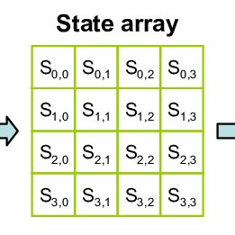
State Array
Derived from block data
Holds state of encryption throughout the process
Center focus of the encryption

Slide 9
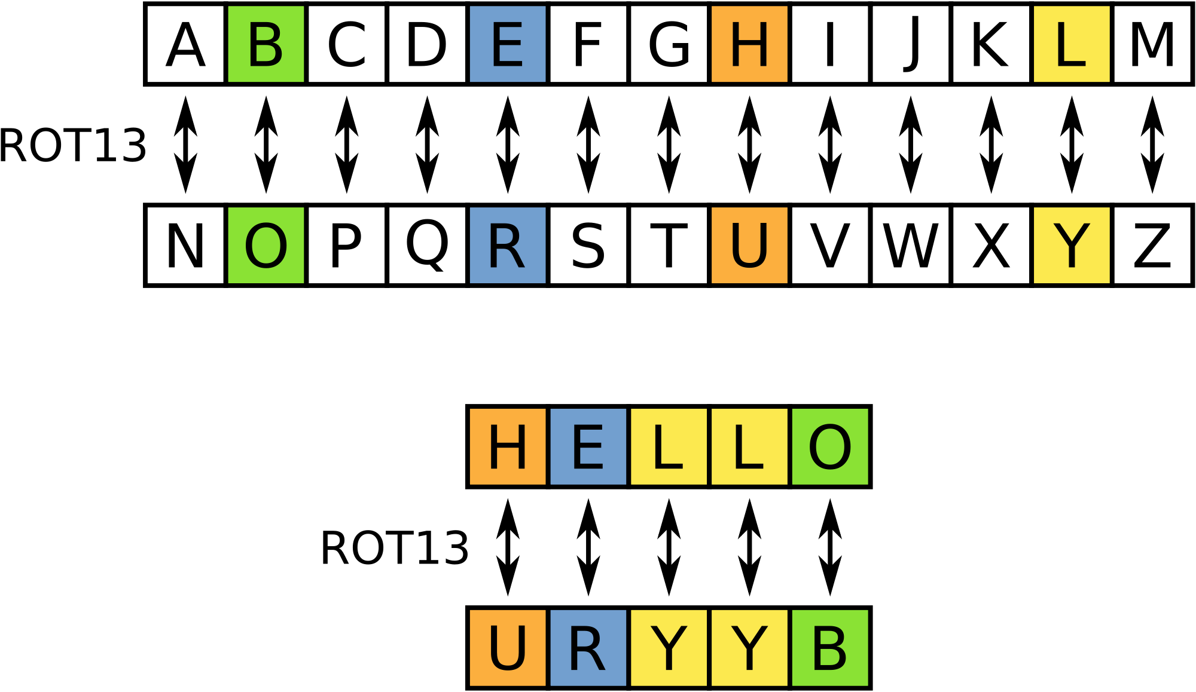
Substitution box (S-Box)
Notes:
ROT- number ( number of letters shifted )

Slide 10
Round constant (Rcon)
1 -> 2
2 -> 4
3 -> 8
4 -> 16
5 -> 32
6 -> 64
7 -> 128
8 -> 27
9 -> 54
10 -> 108
Notes:
128 ->27 is due to finite field overflow

Slide 11
Round Key
X keys that are derived from the original key, the first round being the key itself,
Each Key is derived from the last
Each key contains 4 32 bits words (W)
Formulas:
R(x) =
x rotated right 8 bits
Key(i):W(0)=
Key(i-1):W(0) XOR R(Key(i-1):W3) XOR Rcon[i]
Key(i): W(i) =
Key(i-1):W(i) XOR Key(i):W(i-1)

Slide 12
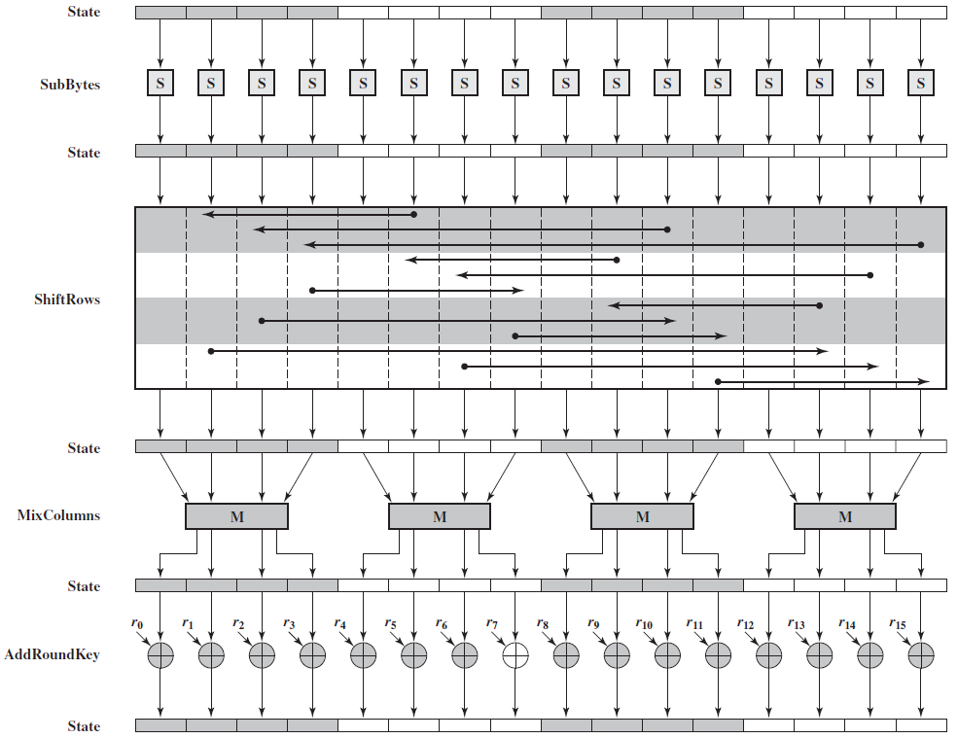
The Process

Slide 13
The Process

Slide 14
The Process

Slide 15
The Process

Slide 16
The Process

Slide 17
The Process

Slide 18
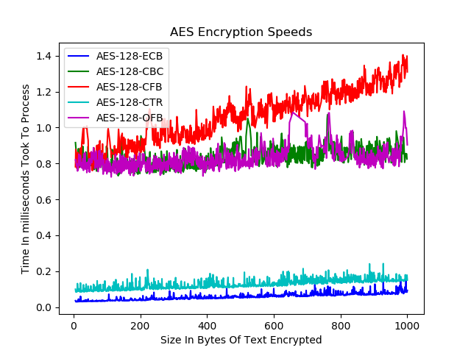

Slide 19
AES
Decryption

Slide 20
Advanced Encryption Standard Decryption
Methods/ Functions Required
Inverse Substitute Bytes
Inverse Shift Rows
Inverse Mix Columns
Apply all the rules in reverse, since everything is XORed we can use XOR to return to the previous state

Slide 21
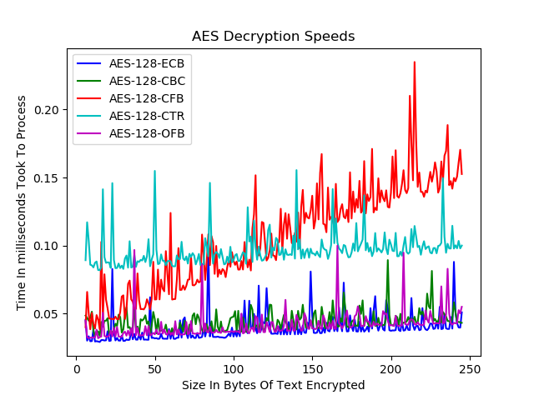

Slide 22
RSA
The Basics

Slide 23
Rivest, Shamir, Adleman ( RSA)
Background
Named after its founders;
Ron Rivest,
Adi Shamir
Leonard Adlema
Important Details:
Encryption Type: Asymmetric
Stream Encryption
Main focus of RSA is in the modulus and the exponent
Math oriented
Limited to 245 bytes at a time
Notes:
5 modes of encryption were standardized in 2001

Slide 24
Key Generation - How does it work
Private Key:
Two prime numbers are picked at random, p and q
The modulus is then found
Length is founda
List all integers from 2 to length
Choose one that is a coprime with both the length and the modulus
That number is now the exponent
Equations:
modulus = p * q
Length(Euler's Totient) = ( q - 1 ) * ( p - 1 )

Slide 25
Key Generation - How does it work
Public Key:
Retrieve the private key’s modulus and exponent
Using the exponent from the private key we can solve for d, there will be multiple answers for this where the range is infinit. Any of the possibilities may be chosen.
Choose one at random, at that becomes the exponent
The modulus will match that of the private key’s
The Rule:
(D * exponent) % length = 1

Slide 26
RSA Encryption
The public key is obtained
Each byte(b) is then put into the following equation where e is its encrypted value
b^(exponent) % modulus = e
All the bytes are then placed together again and form a new byte array

Slide 27
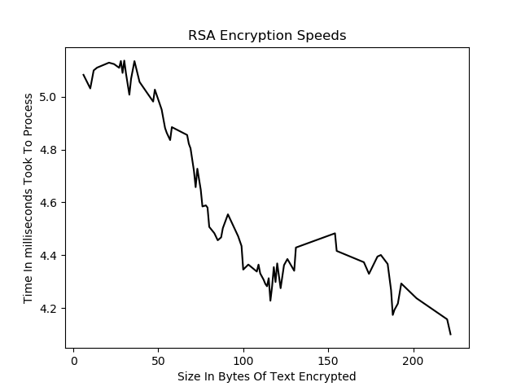

Slide 28
RSA Decryption
The private key is obtained
The bytes(b) given in the encrypted text are put through the following equation just as before, where d is the decrypted byte
b^(exponent) % modulus = d
All the bytes are then placed together again and form a new byte array that can then be turned turned into a decrypted string

Slide 29
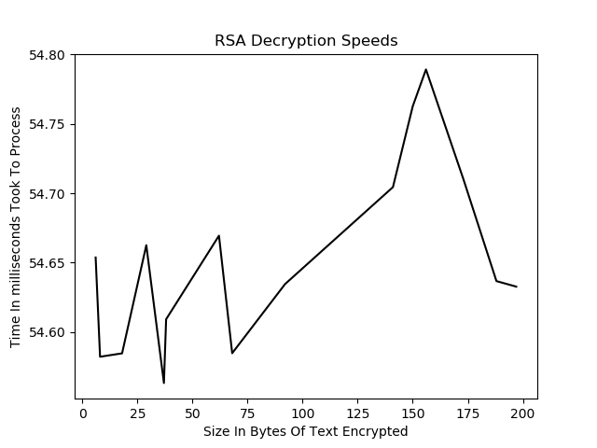

Slide 30
Data Encryption Standard
Outdated
Key with the size of 64 bits
8 of the bits from the key are reserved and unused during encryption, due to this DES is considered to have 56 bit keys
Considered easy to break using a brute force attack

Slide 31
Triple Data Encryption Standard
The same algorithm that Single Data Encryption Standard uses
3 unique keys adding up to a total of 168-bits for a key
Saved DES from being removed from the eyes of the world

Slide 32
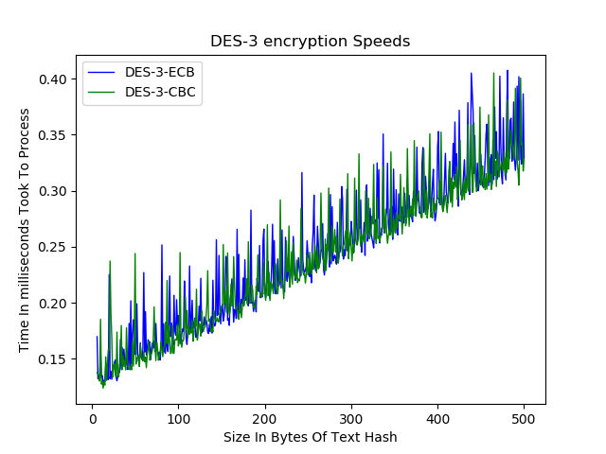

Slide 33
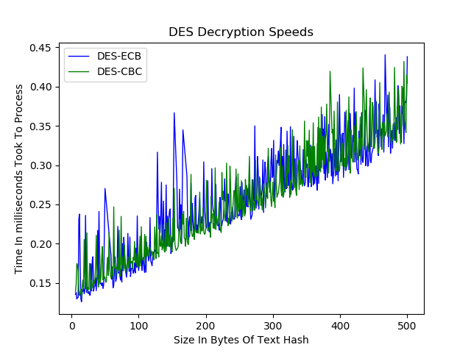

Slide 34
Blowfish Encryption
Said to be the fastest algorithm, however it all depends on what mode is used at the time of encryption
Discovered in 1993 in an attempt to replace DES
Rated inferior to AES

Slide 35
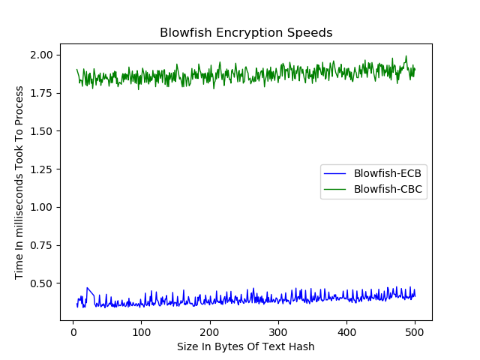

Slide 36
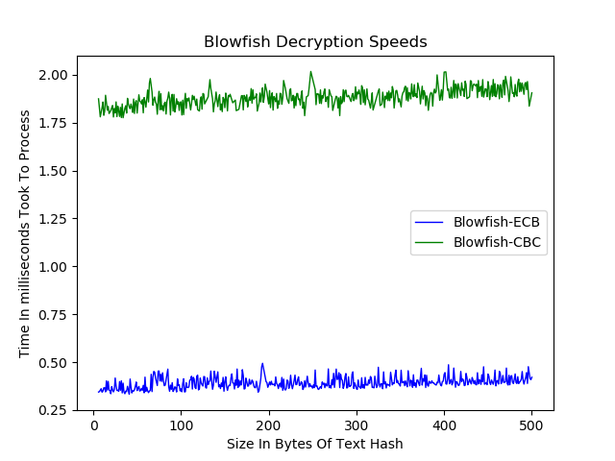

Slide 37
Comparing Encryption Method speeds

Slide 38
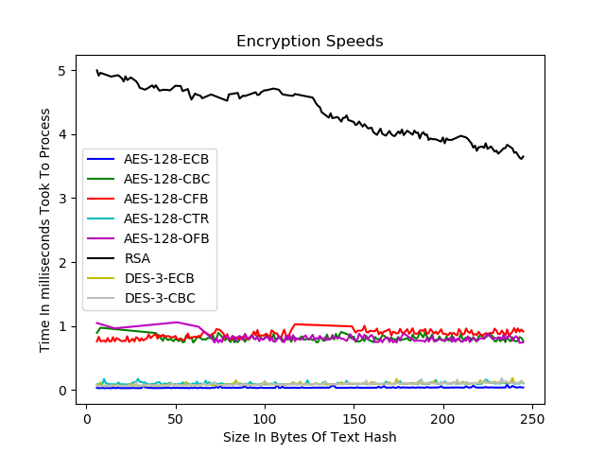

Slide 39
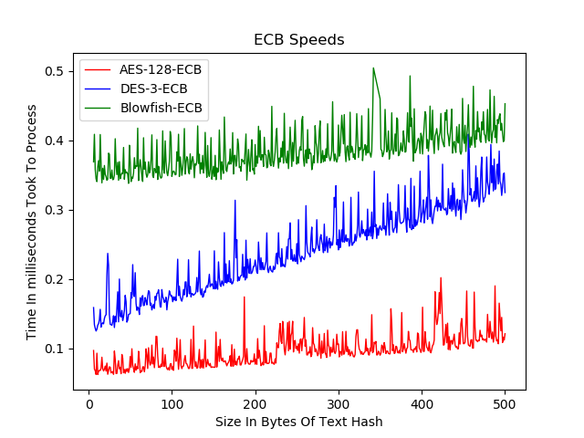

Slide 40
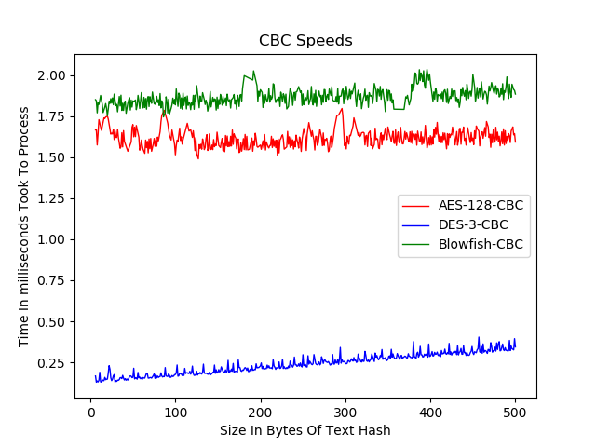

Slide 41
Hashing

Slide 42
Message Digest
Output: 128 bits
Breaks words down into blocks
Designed by Rivest, who also played a role in creating RSA

Slide 43
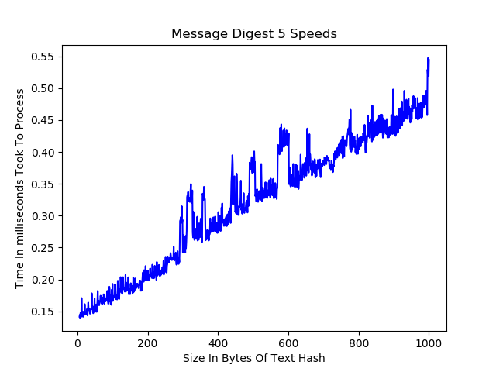

Slide 44
Secure Hashing Algorithms
Works in the form of blocks
Sha Forms are broken into groups called SHA-0, SHA-1, SHA-2, SHA-3
SHA-0 contains only SHA-0
SHA-1 contains only SHA-1
SHA-2 contains SHA-224, SHA-256, SHA-384, SHA-512, SHA-512/224, SHA-512/256
SHA-3 contains SHA-224, SHA-256, SHA-384, SHA-512, SHAKE128, SHAKE256

Slide 45
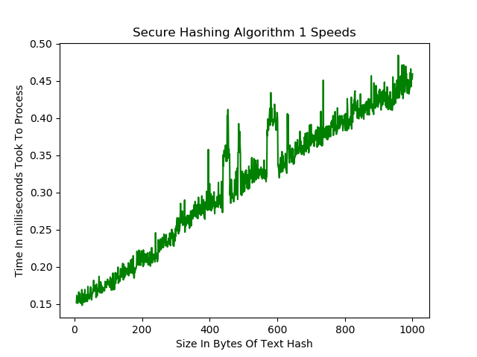

Slide 46
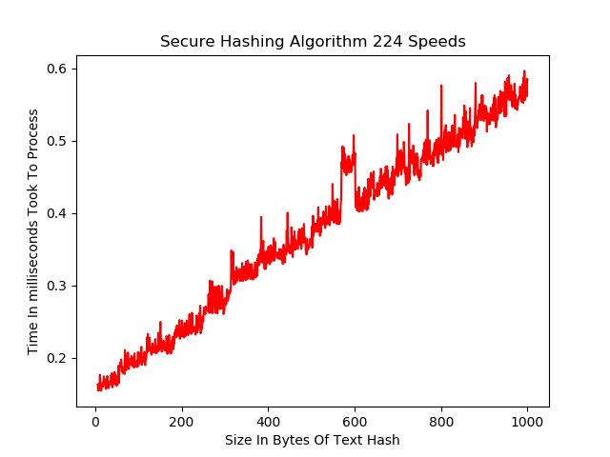

Slide 47
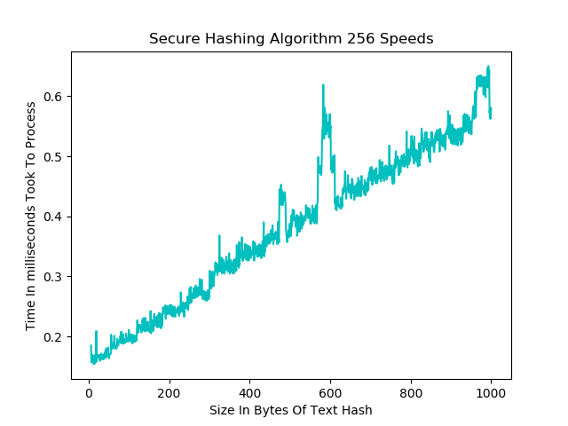

Slide 48
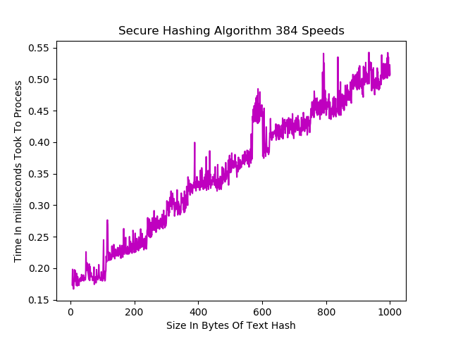

Slide 49
