Slide 1

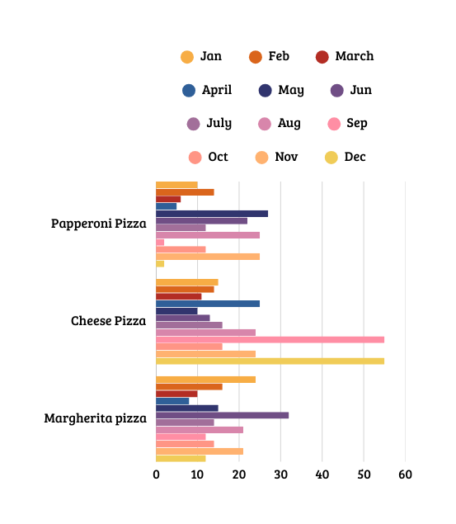


PIZZA HUT
PIZZA SALES
IN 1 YEAR
DATA ANALYSIS-
SQL
AREEJ BADAR

Slide 2
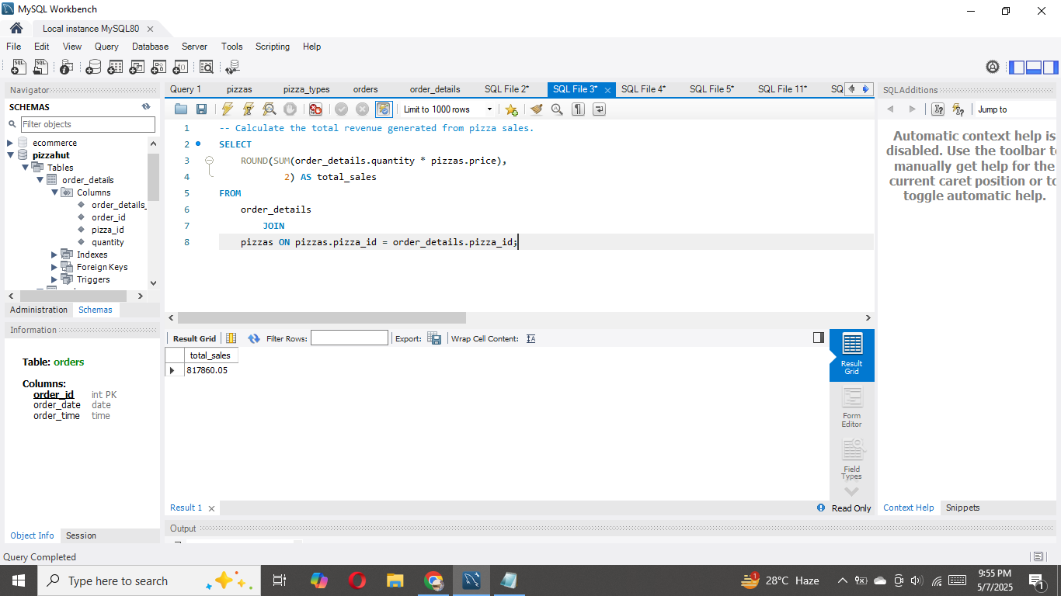
Calculate the total revenue generated from pizza sales.

Slide 3
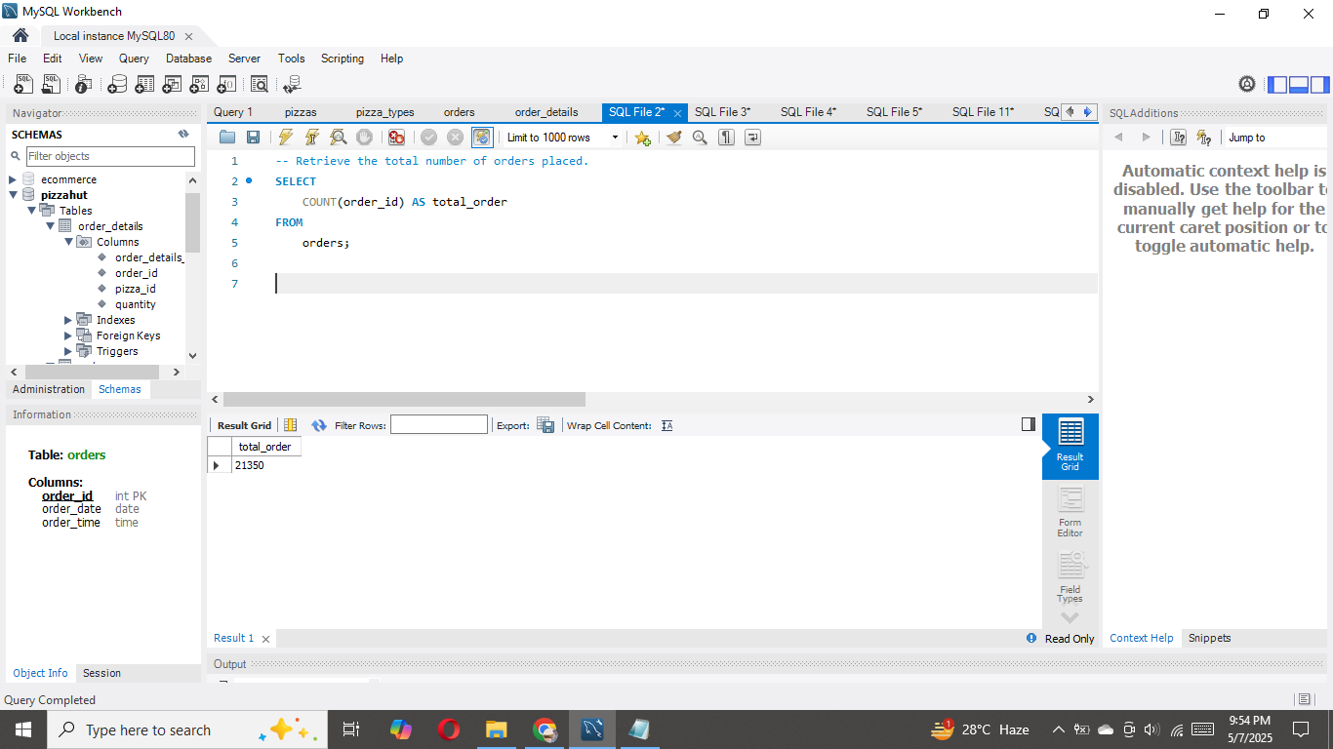
Retrieve the total number of orders placed.

Slide 4
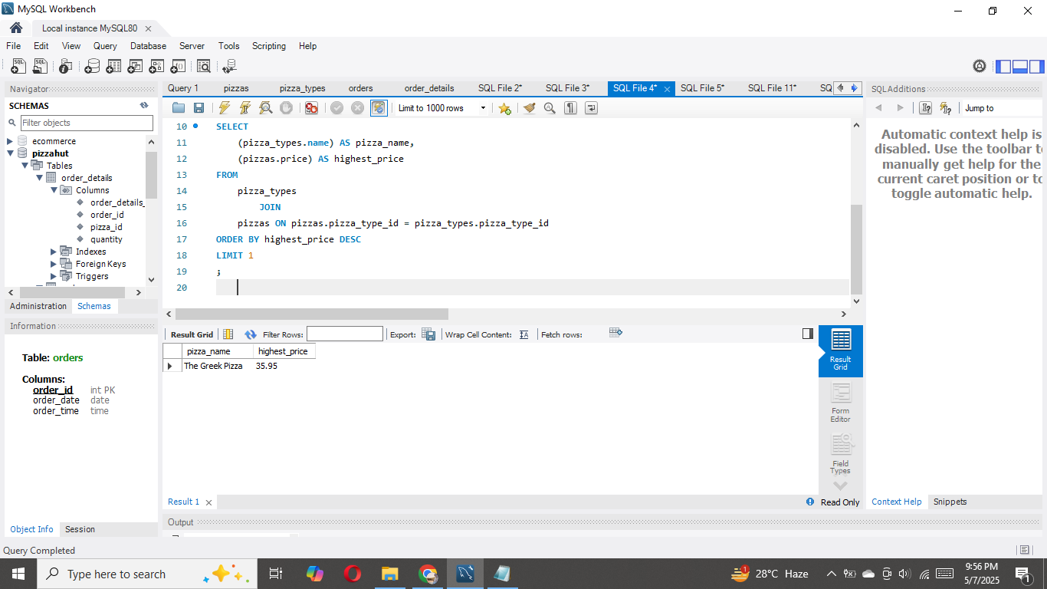
Identify the highest-priced pizza.

Slide 5
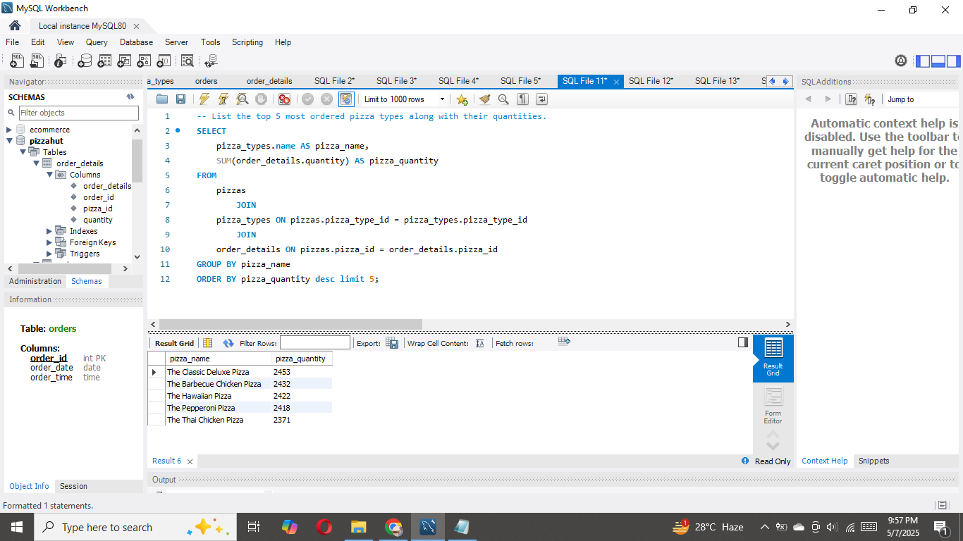
List the top 5 most ordered pizza types along with
their quantities.

Slide 6
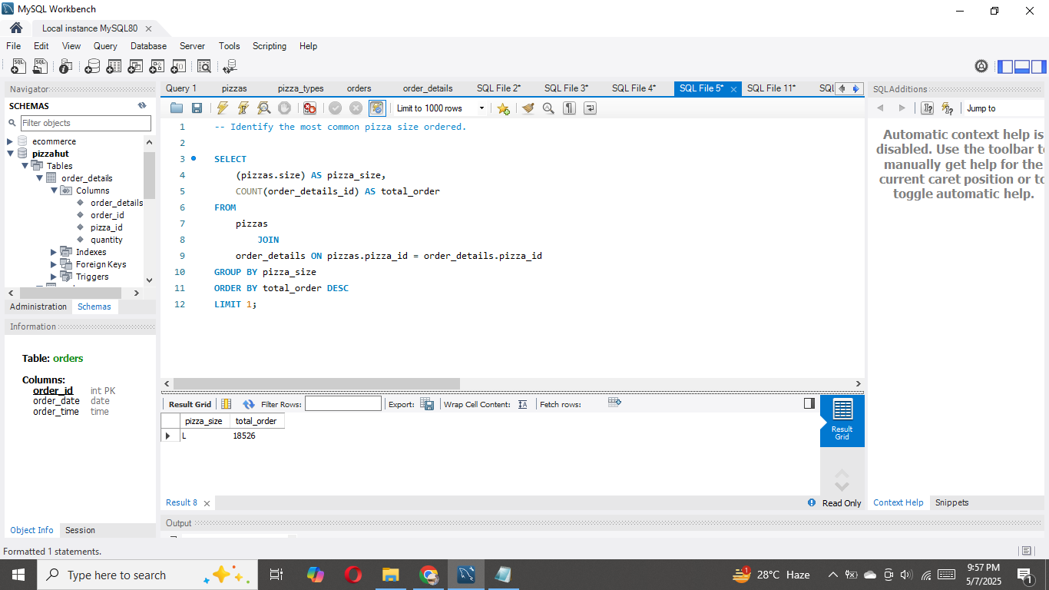
Identify the most common pizza size ordered.

Slide 7
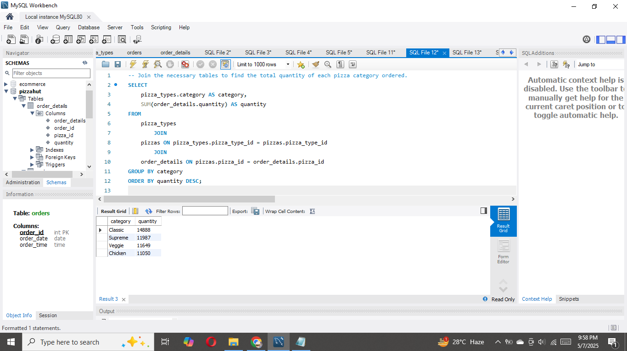
Join the necessary tables to find the total quantity of each pizza category ordered.

Slide 8
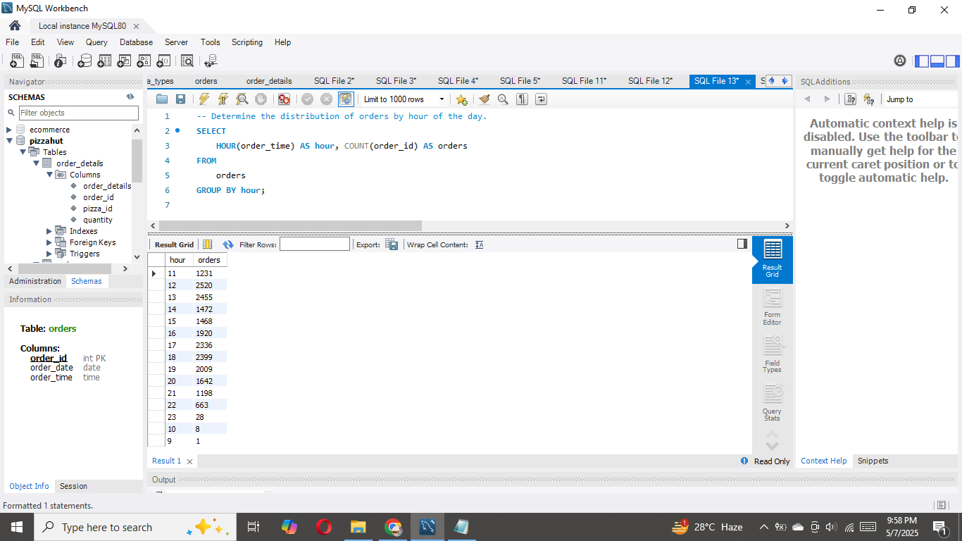
Determine the distribution of orders by hour of the day.

Slide 9
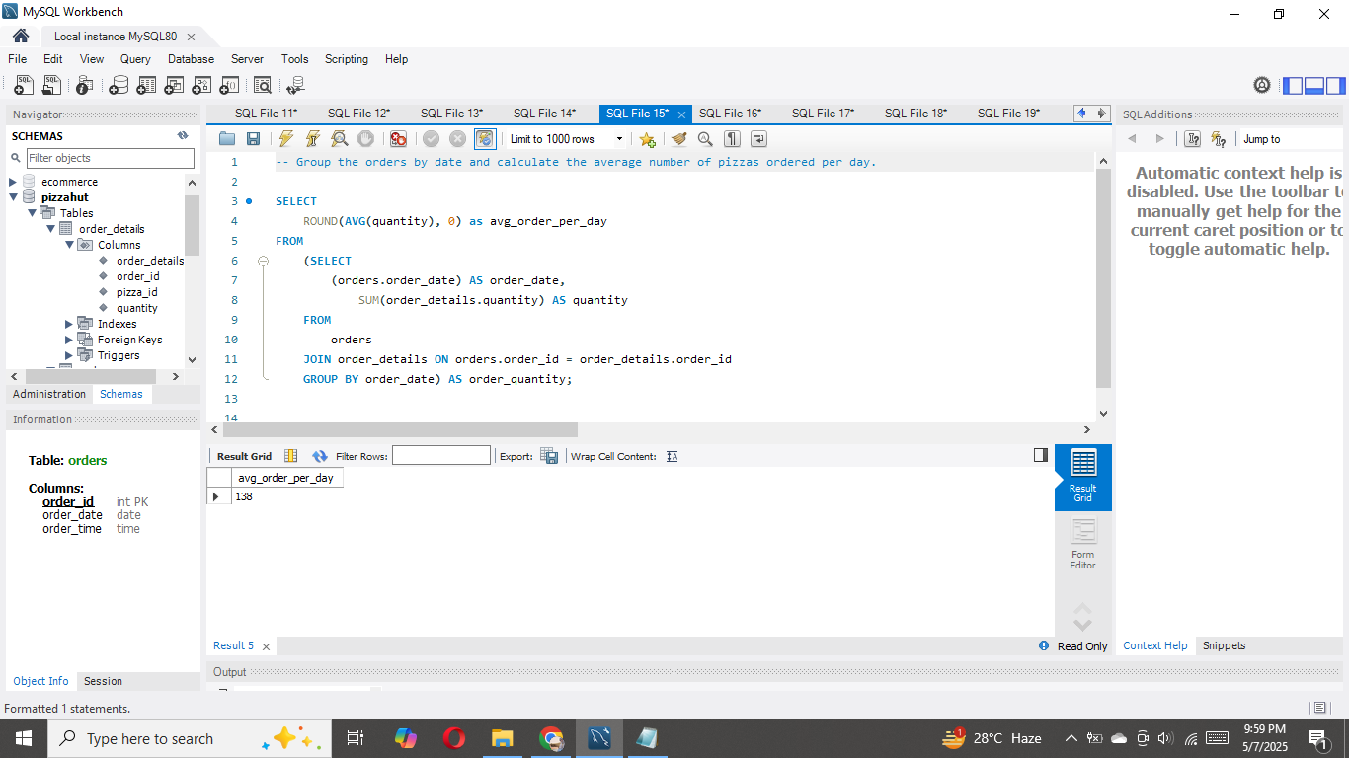
Group the orders by date and calculate the average number of pizzas ordered per day.

Slide 10
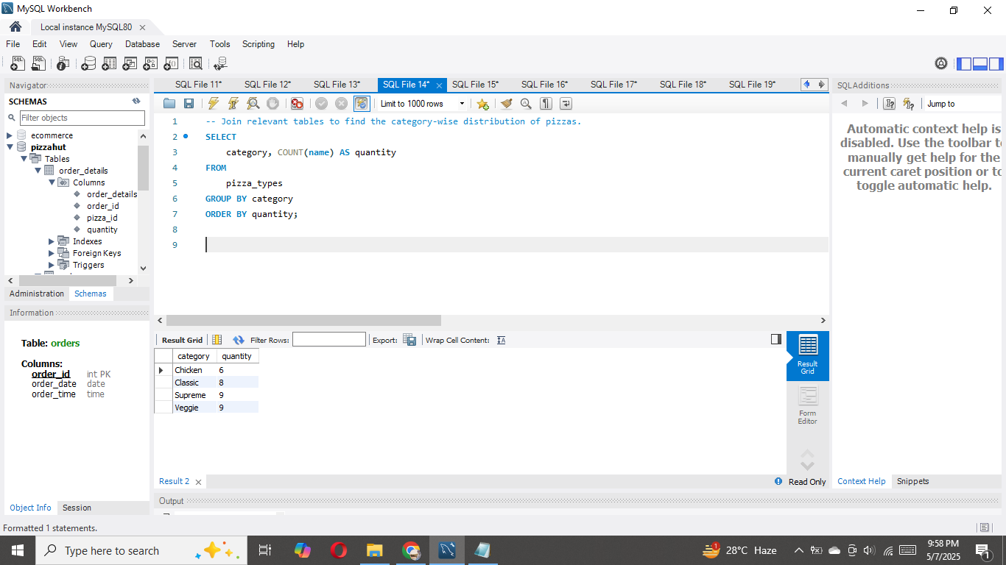
Join relevant tables to find the category-wise distribution of pizzas.

Slide 11
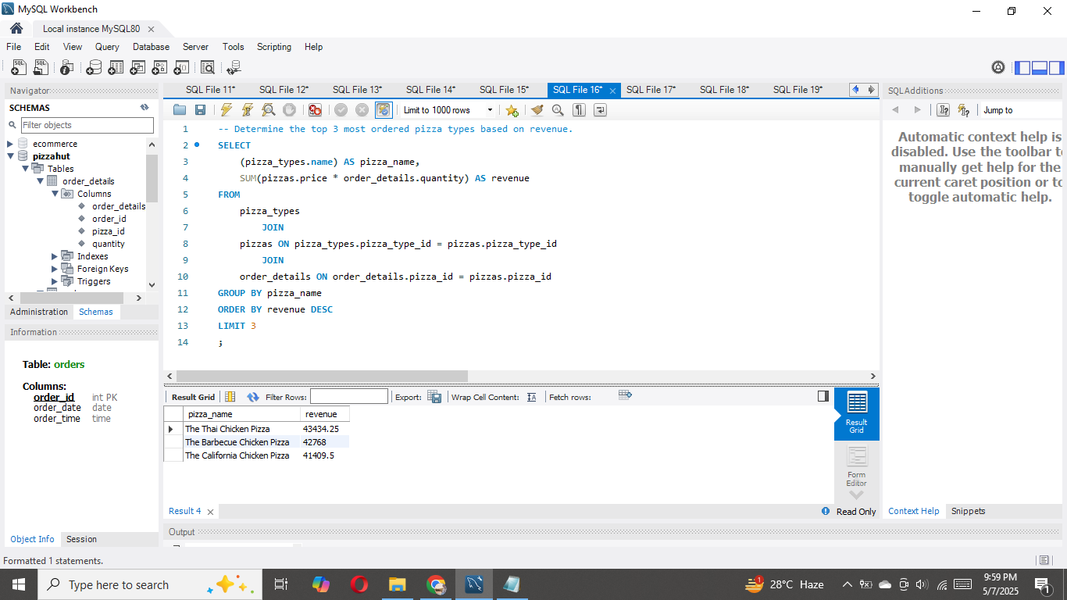
Determine the top 3 most ordered pizza types based on revenue.

Slide 12
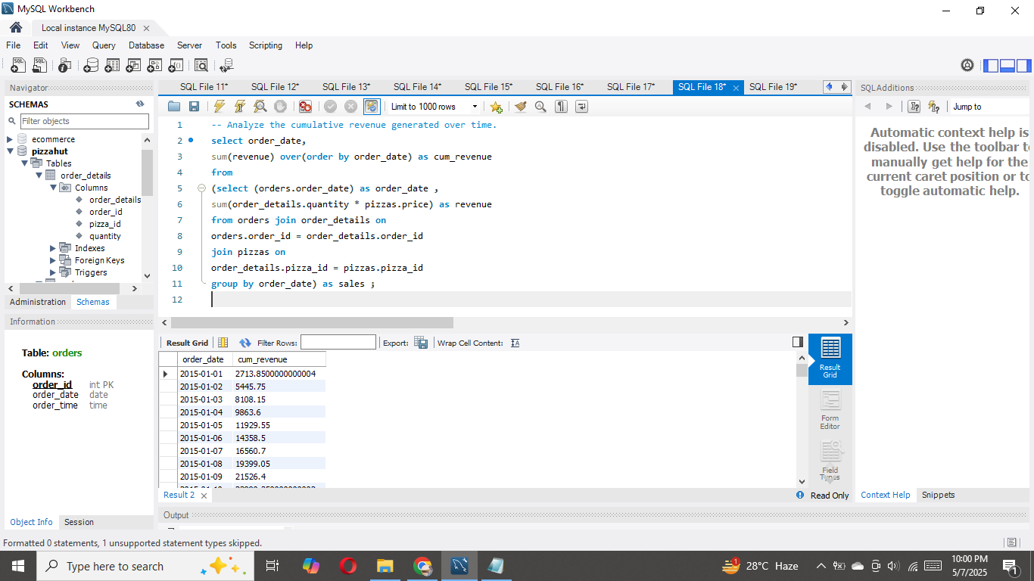
Analyze the cumulative revenue generated over time.

Slide 13
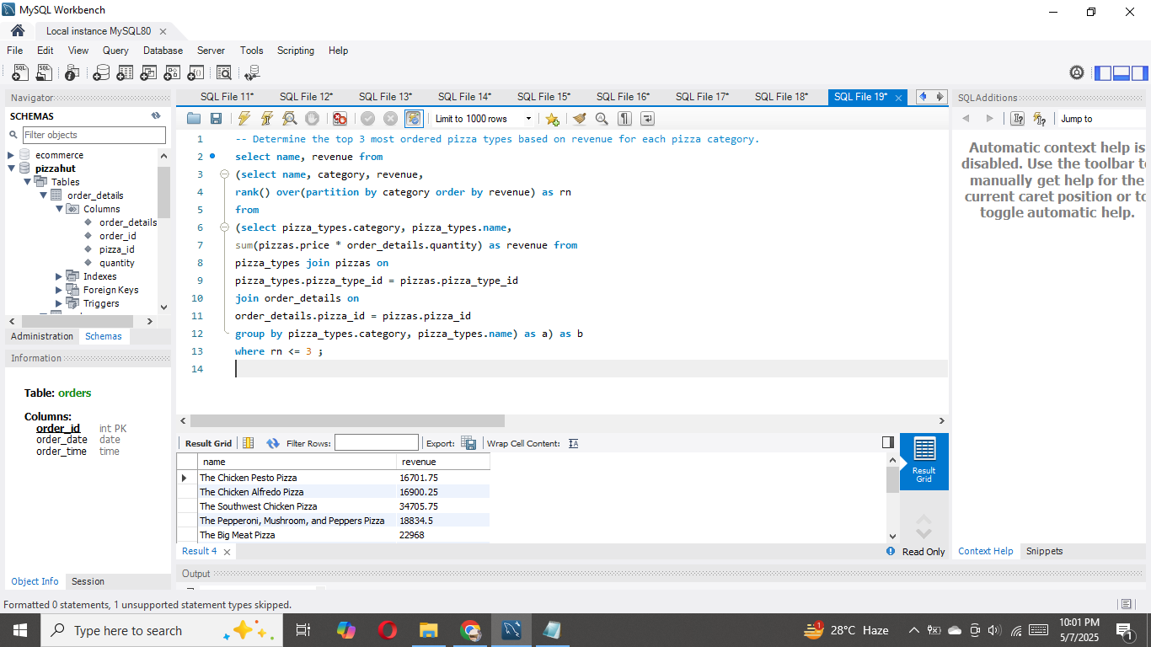
Determine the top 3 most ordered pizza types based on revenue for each pizza category.

Slide 14
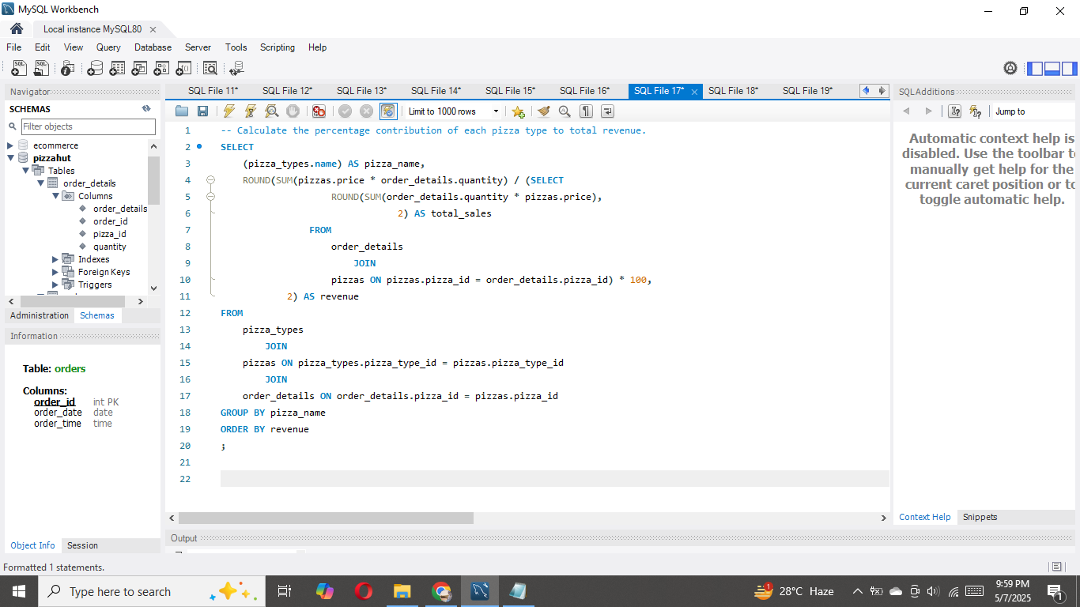
Calculate the percentage contribution of each pizza type to total revenue.

Slide 15
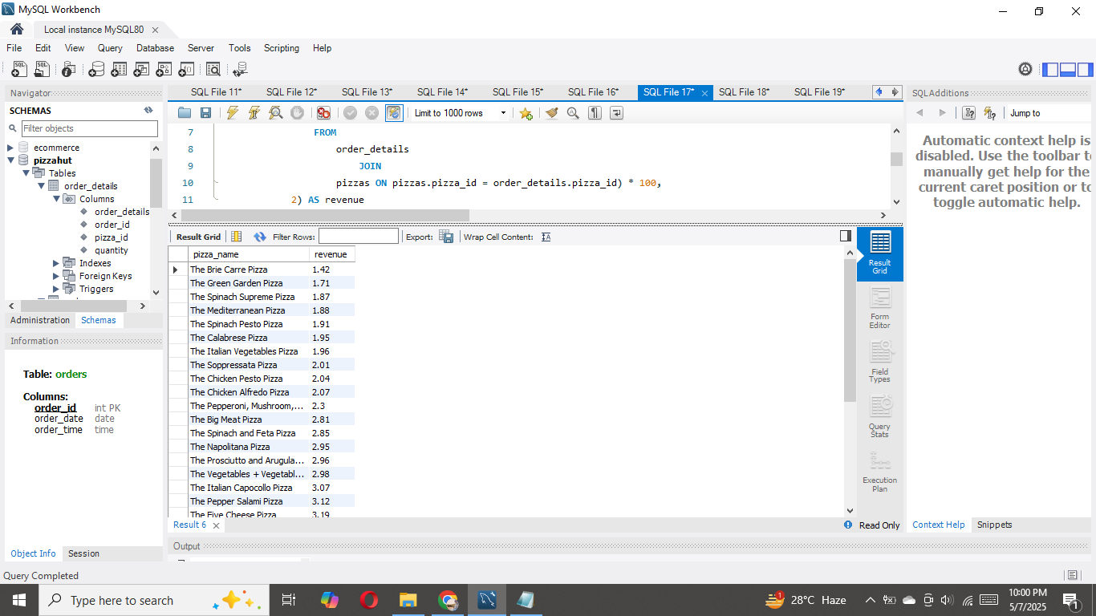
Calculate the percentage contribution of each pizza type to total revenue.

Slide 16

Project Summary
Pizza Hut Sales Analysis using SQL
What I Did:
Analyzed Pizza Hut's sales dataset using SQL to extract business insights.
Used basic to advanced SQL queries involving aggregation, filtering, joins, grouping, and window functions.
Explored sales performance by orders, revenue, product type, time trends, and category-wise breakdowns.
Key Learnings:
Applied real-world SQL skills such as:
Data retrieval & aggregation (SUM, COUNT, AVG)
Table relationships through joins
Time-based analysis using DATE & TIME functions
Advanced techniques like cumulative totals and percentage revenue share
Developed the ability to transform raw data into actionable insights for business decision-making.
How This Project Supports My Career:
Strengthens my profile as an aspiring Data Analyst with hands-on project experience.
Demonstrates my ability to perform data-driven storytelling using SQL.
Prepares me for real-world scenarios in industries like retail, food services, and e-commerce.
Enhances my portfolio with a practical project showing problem-solving, logic, and analytics.
"This project marks a strong step in my data analytics journey, turning raw data into real insights with SQL."

