Slide 1


Heatwave Risk Prediction & Climate Intelligence System
H A C K I N S I G H T 2 0 2 6
Aata Jaata koch nhi
Data Science & AI Risk Intelligence | Hack Insight 2026

Slide 2



Problem Statement
1. Who is affected?
High-risk urban populations, disaster management authorities, and healthcare planners in climate-vulnerable Pakistani cities (Karachi, Jacobabad, Lahore, Multan).
T H E P R O B L E M
Extreme heat events pose severe threats to public health and urban infrastructure in Pakistan. Standard weather forecasts only provide point predictions (e.g., “38°C”), failing to quantify prediction uncertainty required for emergency health decision-making.
2. Why does it matter?
Unpredictable heat spikes lead to heatstroke casualties, power grid overload, and delayed civic response due to a lack of calibrated risk interval bounds.
C L I M A T E - V U L N E RA B L E C I T I E S
3. Our goal
To build an end-to-end Machine Learning pipeline providing calibrated 80% prediction intervals (via Conformal Prediction) combined with a RAG-powered Climate Intelligence Agent.
Karachi
Jacobabad
Lahore
Multan
HackInsight 2026 | Heatwave Risk Prediction & Climate Intelligence
2

Slide 3



Dataset Declaration
K E Y S T A T S
Dataset name | Open-Meteo & NASA POWER Historical Weather Ingestion
Source / link | Open-Meteo API & NASA POWER Global Surface Meteorology
Size | Multi-year hourly time-series records across 4 Pakistani cities
Time period | 2024 - 2026
Format & license | Parquet / Warehouse Tables (Open Data)
Key features / target | Temperature, humidity, wind, pressure, lag features, and rolling metrics | Target: Next-day maximum Heat Index (HI_max).
~70,400+
Hourly records
13+
Engineered weather features & lags
~15 MB
Dataset size (Parquet format)
HackInsight 2026 | Heatwave Risk Prediction & Climate Intelligence
3

Slide 4





Pipeline Used
1
2
3
4
5
Data Collection
Data Cleaning
Analysis / EDA
Modeling
Dashboard / App
Automated API ingestion from
Open-Meteo & NASA
POWER.
Automated pipeline handling missing values & quality logging.
13 engineered features capturing temporal lags, rolling statistics, and atmospheric changes.
Quantile LightGBM Regressors with Split Conformal Prediction calibration.
Interactive Streamlit app featuring RAG-based advice and operational risk cards.
O N E L I N E S U M M A R Y
Raw API weather data in → Calibrated uncertainty bounds and evidence-cited emergency guidance out.
HackInsight 2026 | Heatwave Risk Prediction & Climate Intelligence
4

Slide 5
Pipeline Details & Tools
Stage | Tools / Libraries | What we did
Collection | Python, HTTPX, Open-Meteo API, NASA POWER | Ingested hourly historical and recent climate parameters for the four cities, with retries, raw JSON storage and a SHA-256 manifest.
Preprocessing | Pandas, PyArrow, Parquet, Pandera | Validated and cleaned the data, converted timestamps to Pakistan time, and logged every Data Quality Agent decision.
Analysis / EDA | NumPy, Pandas, DuckDB | Calculated the heat index and engineered features (temporal lags, atmospheric changes, city codes). Stored results in a DuckDB warehouse.
Modeling | LightGBM, HistGradientBoosting, GradientBoosting (scikit-learn), split conformal prediction | Compared three algorithms against a persistence baseline on a time-based validation split. LightGBM (quantile models) was selected, and its 80% prediction interval was calibrated with split conformal prediction.
Dashboard / App | Streamlit, Scikit-Learn (TF-IDF), pypdf, RAG | Built an interactive forecaster, performance slices, and a RAG advisory agent that cites its source documents.
HackInsight 2026 | Heatwave Risk Prediction & Climate Intelligence
5

Slide 6
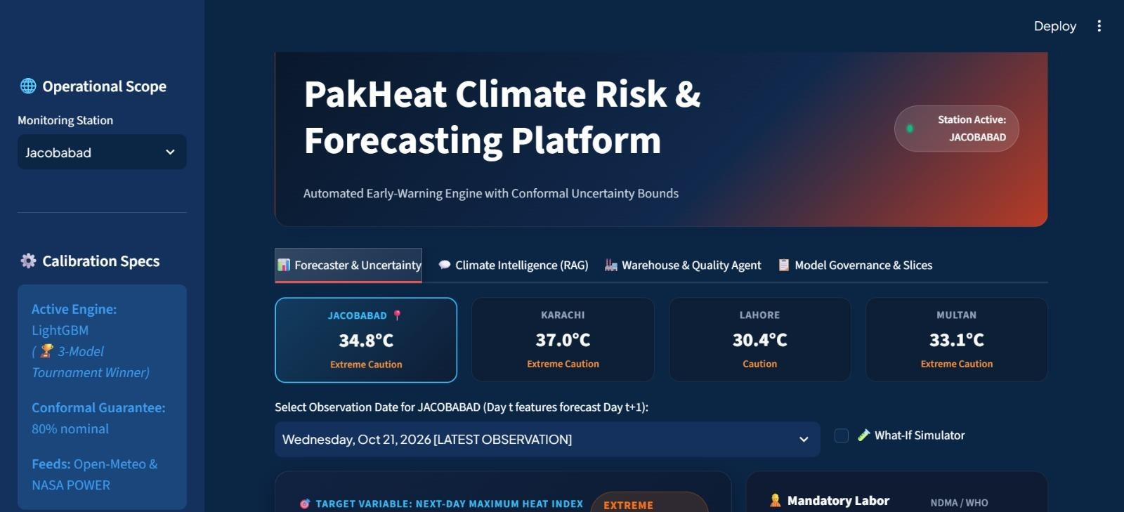
Risk & Uncertainty Forecaster

Slide 7
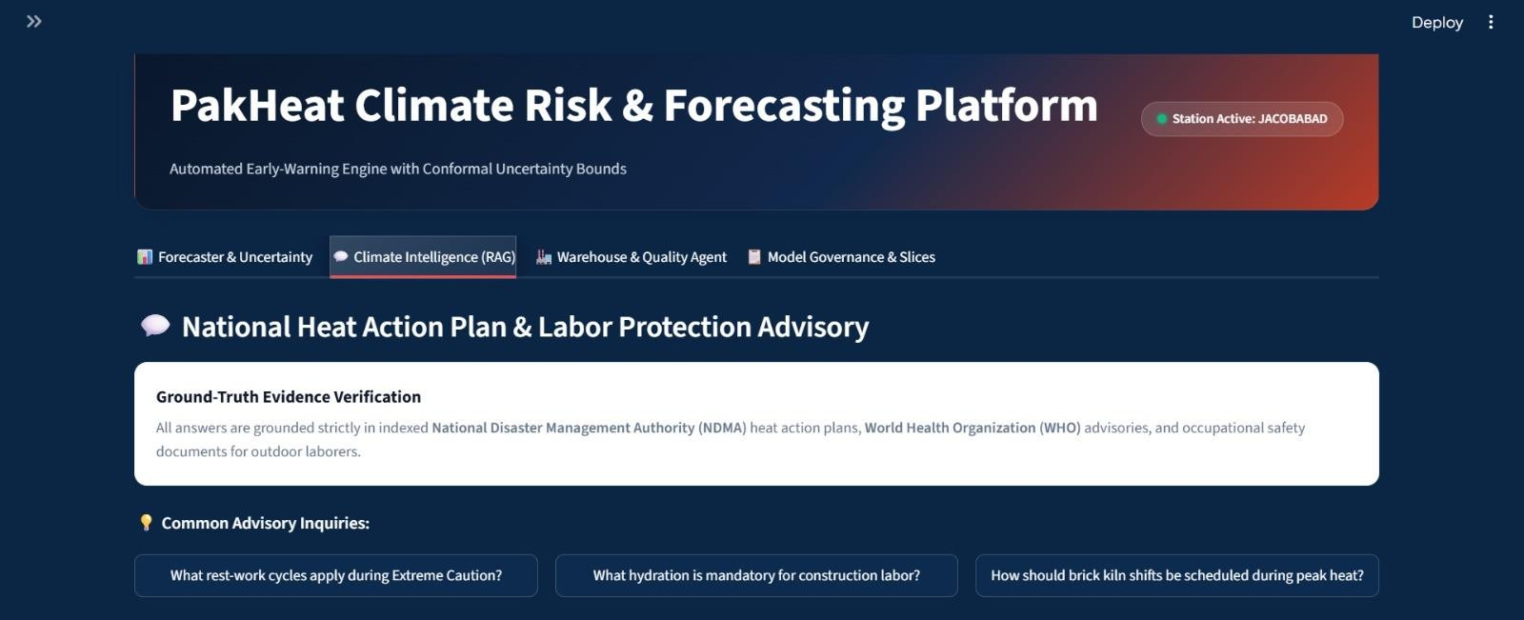
Climate Intelligence (RAG Agent)

Slide 8
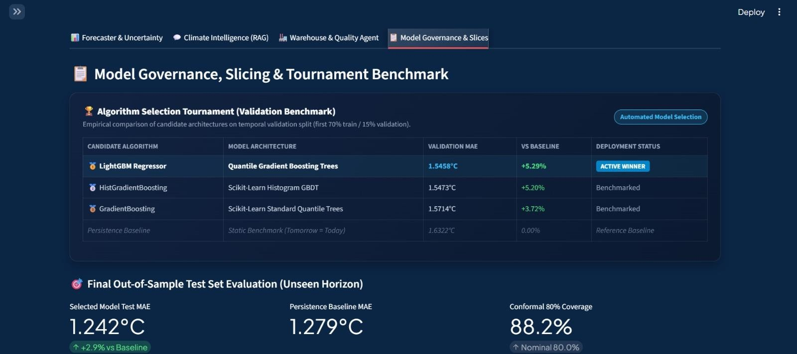
Model Card & Performance Slices
HackInsight 2026 | Heatwave Risk Prediction & Climate Intelligence

Slide 9


Conclusion
K E Y F I N D I N G 1
1.24°C MAE
The model achieved a test MAE of 1.2418°C, outperforming the persistence baseline of 1.2788°C.
K E Y F I N D I N G 2
88.2%
Conformal prediction achieved 88.2% test interval coverage, exceeding the 80% target.
K E Y F I N D I N G 3
RAG agent
Successfully integrated RAG agent to provide instant evidence-cited action plans for extreme heat warnings.
I M P A C T
F U T U R E W O R K
Empowers emergency response teams and citizens in Karachi, Jacobabad, Lahore, and Multan with reliable risk bounds and actionable emergency protocols.
Real-time lag generation pipeline for zero-lag live forecasts and incorporation of Urban Heat Island (UHI) / satellite vegetation metrics.
HackInsight 2026 | Heatwave Risk Prediction & Climate Intelligence
9

Slide 10



[Aata Jaata koch nhi
Member 1: ume e hani
AI & Frontend Developer | Dt-23006
Member 2: Areena Sheikh
Data Engineer & Pipeline Lead| Dt-23004
M E N T O R / S U P E R V I S O R
Member 3: Hassan munir
Machine Learning & Uncertainty Specialist: | 000.
Member 4: [Member Name]
[Role | Roll No.]
C O N T A C T
[email / GitHub link]
Thank you!

