Slide 1
Storytelling with Data
From showing numbers to moving people
Areena Arora · Editorial Coder, The Hindu
Notes:
Intro, 30 seconds. "I'm an editorial coder on the data team at The Hindu: I turn spreadsheets into things people actually read. Election results, trade numbers, health surveys. My readers owe me nothing. If the first ten seconds don't make sense, they scroll away. Your audience in a review meeting is not that different. They're just more polite about it." Optional 20-second story from your own work: a moment where the real story was buried in the data. Set expectations: there will be hands, shouting and pair work. Then go straight to the 10-second test.

Slide 2
Q3 Chargeback Analysis
Payments Ops · Internal · v3 FINAL (2)
Data source: disputes system export, Jul 1 to Sep 30, 2026; excludes test accounts and reversed disputes; reason codes mapped per network guidelines v4.2; USD at transaction-date FX
Q3 total chargebacks 1,656 vs 1,200 in Q2 (QoQ +38.00%); avg dispute value $287.40; blended win rate 33.12%; see tabs 4 to 9
Reason code | Jul | Aug | Sep | Q3 | QoQ % | Share %
10.4 Fraud CNP | 118 | 122 | 120 | 360 | 12.50% | 21.74%
13.3 NAD | 110 | 118 | 117 | 345 | 15.00% | 20.83%
13.1 INR (other) | 85 | 92 | 93 | 270 | 22.73% | 16.30%
13.1 INR (>$250, NSR) | 120 | 170 | 190 | 480 | 166.67% | 28.99%
12.6 Duplicate | 36 | 37 | 37 | 110 | 10.00% | 6.64%
Misc. | 29 | 31 | 31 | 91 | 13.75% | 5.50%
Total | 498 | 570 | 588 | 1,656 | 38.00% | 100.00%
Notes:
THE 10-SECOND TEST. Say: "I'm going to show you a slide for ten seconds. Your only job is to work out what it wants you to do." Count ten seconds silently, then go to the next slide. Ask: "Hands up if you know what the main point was." (Usually a few hands.) "Keep it up if you know what action it was asking for." (Usually almost none.) If many hands go up, flip it: "Great. Tell me the action in one sentence." They usually can't. Don't apologise for this slide or explain it. The confusion is the point. We fix it at slide 20.

Slide 3
Every number was there.
The story wasn't.
Today: from showing data to communicating with it.
What changed?
So what?
Now what?
3
Notes:
"That slide had every number you'd need. Nothing was wrong with the data. What it was missing was a story. And most of us have made that slide. I certainly have." "Today is about one shift: from showing data to communicating with it. You'll leave with a three-question framework: What changed? So what? Now what? You'll use it once before you leave this room. And we'll come back to that slide and fix it together." Transition: "So why do smart people make slides like that? It almost always comes down to one habit."

Slide 4
We present in the order we worked
How we work
How they listen
Data
Recommendation
Cleaning
Why it matters
Analysis
Evidence
Findings
Method: appendix
Recommendation (a much later slide)
4
Notes:
"When we present, we tell the story of our work. First I pulled the data, then I cleaned it, then I built a pivot, and on slide 14 here's what I found. That's the order we lived it. It is the exact opposite of what the audience needs." "Newspapers solved this a hundred years ago. It's called the inverted pyramid. The most important fact goes in the first line, because a reader can stop at any paragraph. Your VP is that reader. They might get called away after two minutes. What did they leave with?" For the curious: also called BLUF (bottom line up front) in the military, and the Pyramid Principle in consulting.

Slide 5
For today, let’s imagine we’re working with chargeback data
Chargeback is a reversal of a credit or debit transaction initiated by the cardholder’s bank on customer’s request to return funds to the customer.
4
Notes:
"When we present, we tell the story of our work. First I pulled the data, then I cleaned it, then I built a pivot, and on slide 14 here's what I found. That's the order we lived it. It is the exact opposite of what the audience needs." "Newspapers solved this a hundred years ago. It's called the inverted pyramid. The most important fact goes in the first line, because a reader can stop at any paragraph. Your VP is that reader. They might get called away after two minutes. What did they leave with?" For the curious: also called BLUF (bottom line up front) in the military, and the Pyramid Principle in consulting.

Slide 6
Keep asking until there is no more “so what” possible
SO WHAT?
Signatures could halve it
so what?
Costs more than all the rest
so what?
'Not received' grew fastest
so what?
Split by reason and order value
so what?
We pulled 18 months of data
5
Notes:
Set it up: "I'm going to read you some opening lines. Every time 'so what?' appears, the whole room shouts it." Practise once. Make them do it loudly. Click by click: each step appears, then "so what?" appears and the room shouts, then the next step. Say each step as a full sentence: 1. "We pulled 18 months of chargeback data from the disputes system." 2. "We broke it down by reason code and by order value." 3. "'Item not received' claims grew the fastest." 4. "They now cost us more each month than every other reason combined." 5. "Signature confirmation on high-value orders could cut them by about half." After the top step: "Notice where the room went quiet. That top step is where your presentation should START. The bottom step isn't wrong. It's just an answer to a question nobody has asked yet." Use "so what?" as a callback for the rest of the session.

Slide 7



Method earns its place when someone asks
WHERE DOES THE METHOD GO
One line up front
The rest: appendix
Unless it changes the answer
Enough for credibility
Ready when asked
Then say it first
Write the email subject line first.
6
Notes:
One line of credibility up front is fine: "Based on 18 months of disputes data." Everything else goes in a footnote, the appendix or your back pocket. Method earns its place when someone asks for it. The exception: when the method changes the conclusion, say so early. "These numbers exclude the outage week, which would otherwise double the spike." Practical trick: before building any slides, write the email subject line you'd send if you only had one line. That sentence is your first slide. Transition: "Easy to say 'lead with the insight'. But before you can lead with an insight, you need to know it's actually true."

Slide 8
How to spot what’s the message in the data?
FINDING THE MESSAGE
1
2
Is it real?
What's driving it?
Signal or noise
Rate or volume
Small numbers
Contribution
Regression to the mean
Mix shift
7
Notes:
"Everyone in this room can see that a number went up. That's not the skill. The skill is answering two questions before it goes on a slide." IS IT REAL? - Signal or noise: every metric wobbles. Look at the last 12 periods: inside the usual range is probably noise. Ops formalises this as a control chart (Shewhart): limits at roughly mean plus or minus 3 standard deviations. - Small numbers lie loudly. A category with 40 orders can swing from 2% to 5% by chance. Kahneman: the US counties with the lowest kidney cancer rates are mostly small and rural. So are the highest. - Regression to the mean. Last month's worst team will probably look better next month whatever you do. Ask what would have happened without the intervention. WHAT'S DRIVING IT? - Rate or volume? More orders, or a larger share going bad? Different stories, different owners. Count = orders x rate. - Contribution, not growth. Up 200% from a tiny base can matter less than up 5% from a large one. Rank by share of the total change. - Mix shift. An average can move when no segment changes. In the extreme, every segment improves while the total gets worse. Next slide. Say these briskly: about two and a half minutes. If short of time, drop regression to the mean.

Slide 9
Which week would you escalate?
Outside: investigate
8
Upper limit
7
6
Average
5
Inside the band: noise
Lower limit
Week 1
Week 7
Week 17
Week 20
7 ·
Notes:
TIME: 0:10:30 to 0:12:30 (about 2 minutes).
PURPOSE: Show the tool behind "Is it real?" from slide 6. A control chart separates normal wobble (noise) from real change (signal).
ON THE SLIDE (starts with just the black line): one number, chargebacks per 1,000 orders, every week for 20 weeks. The y-axis runs from 5 to 8. Most weeks sit around 6. Two weeks jump: week 7 (to about 7.1) and week 17 (to about 8.6). There are 3 clicks.
SETUP (black line only):
"This is one number: chargebacks per 1,000 orders, every week for 20 weeks. Week 7 jumped. Week 17 jumped. Hands up: who would escalate week 7 to their manager? Week 17? Both?"
Expect a split: week 7's jump, from about 5.4 to 7.1, looks dramatic.
CLICK 1 (a grey dashed average line appears, labelled "Average"):
"First, draw the average. Over these 20 weeks it's about 6 chargebacks per 1,000 orders. Every week sits a bit above or below it. That wobble is normal."
CLICK 2 (a shaded blue band appears, with "Upper limit", "Lower limit" and "Inside the band: noise"):
"Now draw a band showing how far this number normally wobbles. Anything inside the band is the ordinary ups and downs of the process. Look at week 7. It looked alarming, but it's inside the band. It's noise. If you'd escalated it, someone would have spent a week hunting for a cause that doesn't exist."
CLICK 3 (week 17 turns orange, with "Outside: investigate"):
"Week 17 is outside the band. That's news. Something has actually changed, and that's the one to investigate."
THE RULE TO LEAVE THEM WITH: "Inside the band, don't explain it. Outside the band, investigate it."
HOW THE BAND IS CALCULATED (for you, and for technical questions):
- First measure the "typical wobble": roughly how far a normal week sits from the average. Statisticians call this the standard deviation, or sigma. Here it's about 0.5 per 1,000.
- The limits go three times that wobble above and below the average: 6 plus or minus 1.5, so the band runs from 4.5 to 7.5.
- Why three? If nothing has changed, a week falls outside three-sigma limits only about 3 times in 1,000. So when one does, it's very unlikely to be chance.
- Technical aside: proper control charts estimate the wobble from week-to-week differences (an "XmR" chart), so one extreme week doesn't widen the band.
ONE EXTRA SIGNAL (optional, for technical people): even inside the band, a long run of points on one side of the average, for example eight weeks in a row above it, suggests something has shifted. That's one of the "Western Electric rules", from a 1956 factory quality handbook.
REAL-LIFE EXAMPLE 1, WHERE IT CAME FROM: Walter Shewhart, an engineer at Bell Labs, invented the control chart in 1924 to improve the quality of telephone equipment made by Western Electric. His insight: there are two kinds of variation. The everyday wobble built into any process, and unusual events with a real cause. Treating the first as if it were the second makes things worse. W. Edwards Deming later called that mistake "tampering": adjusting a machine after every slightly bad batch adds variation instead of removing it.
REAL-LIFE EXAMPLE 2, A MODERN ONE: the NHS in England. Hospital board reports used to colour every monthly number red, amber or green against a target, and boards demanded an explanation for every red. NHS England's "Making Data Count" programme pushed boards to use control charts instead, so they react to genuine signals and stop asking managers to explain normal monthly wobble.
BRING IT HOME: "Think about your own dashboards. How many alerts fire on a fixed rule like 'up 10% week on week'? A control chart sets the alert at the edge of what's normal for that particular number. Fewer false alarms, and the real ones stand out."
IF SHORT ON TIME: skip the Western Electric rule and example 1. Keep the vote, the three clicks and the NHS example.
NEXT: "That's 'is it real?'. Now the second question, 'what's driving it?', and the trap I find most surprising." Click.

Slide 10
Win rate fell from 52% to 33%.
Retrain the disputes team?
Dispute type | Q2 disputes | Q2 win rate | Q3 disputes | Q3 win rate
Fraud claims (hard to win) | 200 | 20% | 800 | 25%
Item not received (easier) | 800 | 60% | 200 | 65%
All disputes | 1,000 | 52% | 1,000 | 33%
Better at both types. The mix flipped: four times as many fraud claims.
8 ·
Notes:
Show only the headline first. "Our dispute win rate fell from 52% to 33%. Hands up if we should retrain the disputes team." Expect lots of hands. Click: reveal the table. "The team got better at both types, by five points each. The overall rate collapsed because the mix flipped: four times as many fraud claims, which are hard to win. Retraining would have punished a team that improved. The real question: why did fraud claims quadruple?" Maths: Q2 wins 40 + 480 = 520 of 1,000. Q3 wins 200 + 130 = 330 of 1,000. Line to leave them with: "Before you report a change in an average, check whether the mix underneath it changed." It comes back in the exercise. Don't let anyone feel foolish: "This catches statisticians too. Berkeley's 1973 graduate admissions looked biased against women overall, yet most departments admitted women at similar or higher rates. Women had applied mostly to the most competitive departments." (Bickel, Hammel and O'Connell, Science, 1975.) Technical follow-up for Q&A: a rate-mix decomposition splits a change in a total into the part due to rates and the part due to mix.

Slide 11
Write your main point in one sentence
Does it change a decision?
Is it big enough to matter?
Is it new to this room?
INTERESTING IS NOT THE SAME AS IMPORTANT
[What] [rose or fell] by [how much] [compared with what], driven by [rate, volume or mix] in [which segment].
9
Notes:
Three filters before a finding earns the headline: does it change a decision, is it big enough to matter (in money, customers or hours), and is it new to this audience? Telling the payments team that chargebacks hurt is not news. Then the template. Leave it on screen for a beat. Transition: "So you know what your sentence says, and that it's true. Which picture proves it? There's real perception science behind that choice."

Slide 12
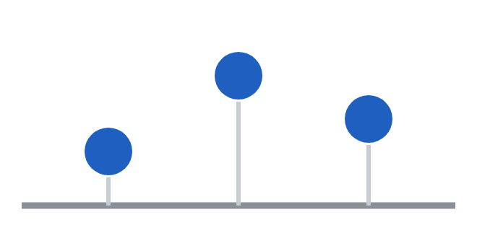
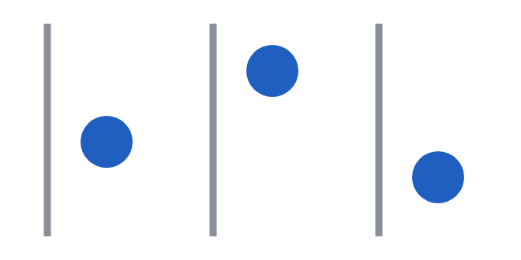

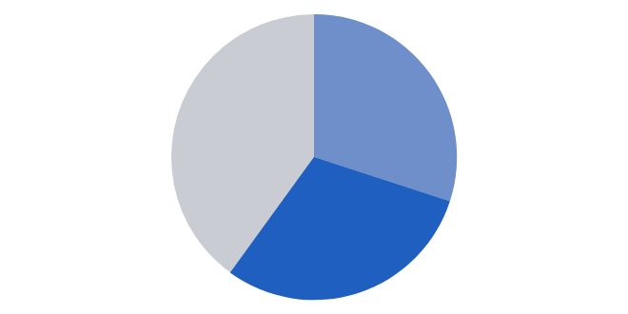



The eye reads position best, colour worst
Position
Aligned scales
Length
Angle
Area
Colour shade
You found the blue dot before you read this.
10 ·
Notes:
"In 1984, two statisticians at Bell Labs, William Cleveland and Robert McGill, ran experiments on how accurately people read quantities from different visual encodings. Almost every piece of chart advice you've heard falls out of their ranking." Walk left to right along the strip. "So pies aren't bad because designers dislike them. They ask the eye to compare angles, which it does badly. Bubbles are worse: people consistently underestimate differences in area, so a bubble twice as big doesn't feel twice as big. Heatmaps are great for spotting where the pattern is, poor for reading values." Point at the dots: "How long did it take you to find the blue one? That's a pre-attentive attribute: colour, size, orientation and position are processed in about a quarter of a second, before conscious attention. 'Grey everything, then colour the story' works because it spends that quarter-second on the one thing you want seen."

Slide 13
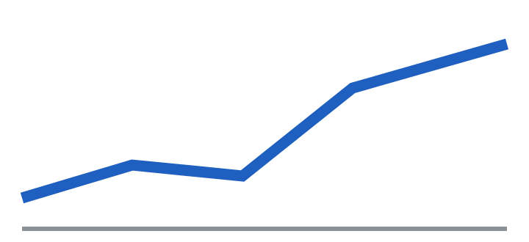

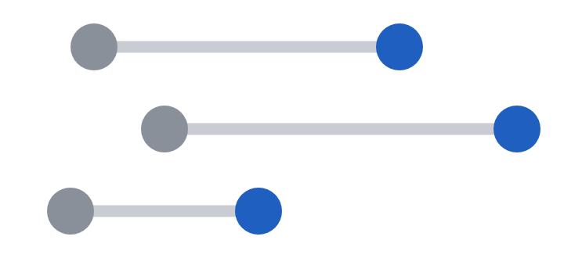


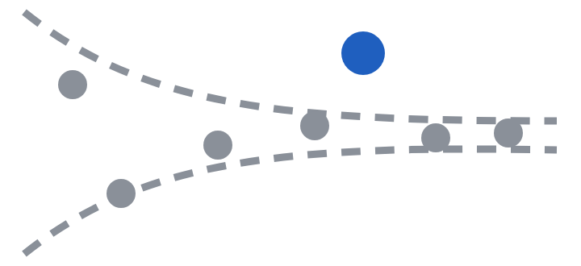
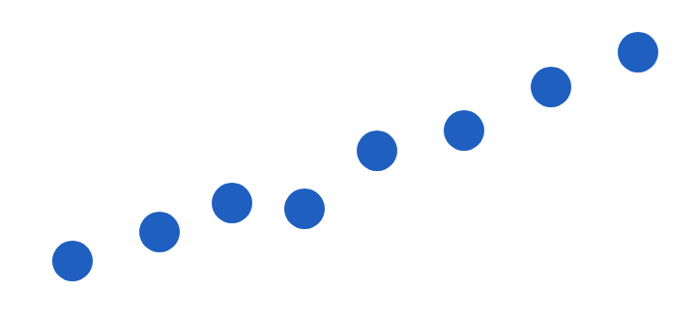
Start from the question
CHOOSING THE RIGHT CHART
Over time?
Which is biggest?
What shifted?
How did A become B?
Line
Sorted bar
Dumbbell or slope
Waterfall
1,656
What's typical?
A real outlier?
Related?
Just one number?
Histogram
Funnel plot
Scatter
No chart. Big number.
11
Notes:
Walk the grid quickly. The point: start from the analytical question, not from a chart you like. - Over time: line (position on a common scale). - Which is biggest: sorted bar or dot plot; sorting does the ranking for the reader. - What shifted between two points, across many categories: dumbbell or slope chart. - How did total A become total B: waterfall, showing each driver's signed contribution. - What's typical: histogram or box plot; shows the shape, not just the centre. - A real outlier among groups of very different sizes: funnel plot (coming up in the quiz). - Are two measures related: scatter. - Just one number: no chart. One big number with a comparison. One permission: tables are fine when people need to look up exact values. Charts are for patterns; tables are for lookups.

Slide 14
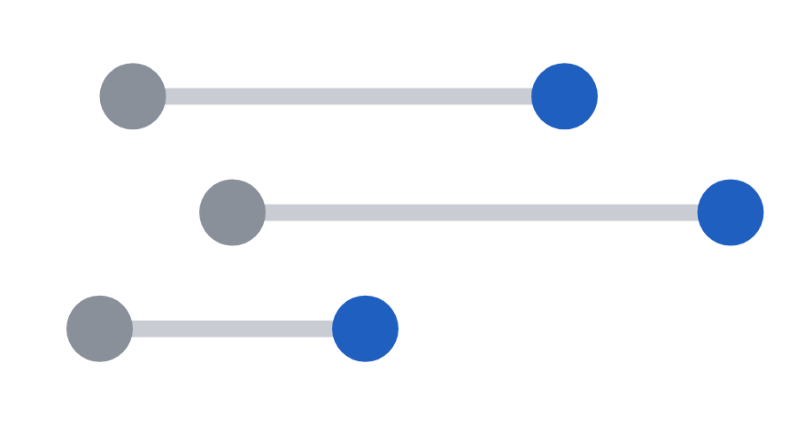

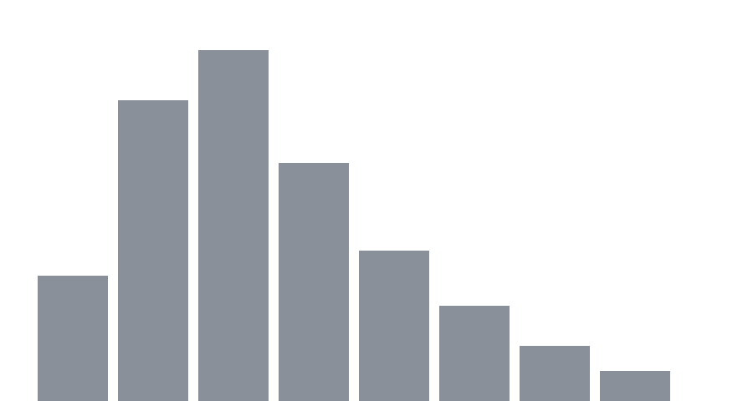
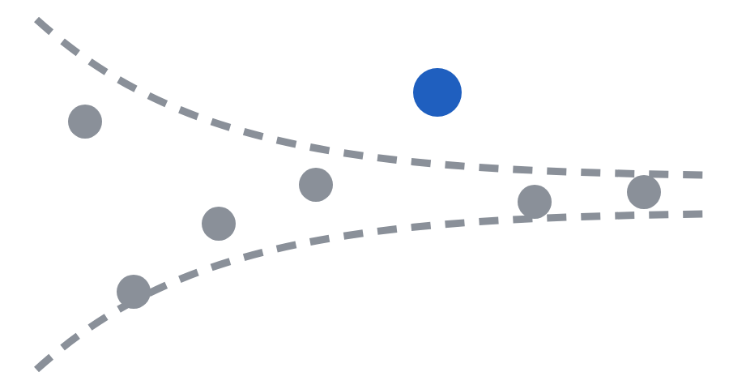
Which chart?
1
2
3
4
Dumbbell
Waterfall
Histogram
Funnel plot
A Before vs after, 8 reason codes
B $1.2M → $1.5M: what made the gap?
C Typical time, if some take a week?
D Which of 40 groups is truly unusual?
12
Notes:
"I'll read a question. Hold up fingers for the chart. Three, two, one, show me." Point at A, B, C, D in turn and say the full question. A. "Win rate for eight dispute reason codes, before and after the new evidence template." ANSWER 1, dumbbell. Two dots per row joined by a line; sort by size of improvement. B. "Chargeback losses went from $1.2M in Q2 to $1.5M in Q3. What made up the difference?" ANSWER 2, waterfall. Start bar, one step per driver, end bar. Steps must sum to the gap: an honesty check in itself. C. "What does resolution time typically look like? The average is 18 hours, but some tickets take a week." ANSWER 3, histogram. Report the median and 90th percentile, not the mean. In right-skewed data the long tail drags the mean up. D. "Which of our 40 seller categories has an unusually high chargeback rate, when some have 50 orders and others 50,000?" ANSWER 4, funnel plot. Volume on x, rate on y, control limits that narrow as volume grows. Only points outside the funnel are real outliers. Spiegelhalter popularised these for comparing surgical outcomes across UK hospitals. Link it to "small numbers lie loudly". BONUS: "How many chargebacks did we have last quarter?" None of the above: one big number. "1,656, up 38% on Q2." If behind, cut B.

Slide 15
The stretched gap
SPOT THE PROBLEM · 1 OF 4
96%
98%
98%
96%
95%
0%
Team A
Team B
Team A
Team B
13 ·
Notes:
Format for slides 13 to 16: show the chart for about 20 seconds. Pairs: what's wrong, and how would you fix it? Take one answer, then click to reveal the fix. Opening line for the segment: "Some chart mistakes make you squint. Others make you believe something false. In journalism, once readers catch one misleading chart, they stop trusting every chart after it. Your CFO works the same way." Problem: a bar encodes value as length (Cleveland and McGill again). Cut the baseline and the length lies. Fix: bars start at zero. If a two-point gap genuinely matters, use a dot plot, which encodes position rather than length and can legitimately zoom in. The rule isn't "always start at zero"; it's "start at zero whenever length carries the meaning".

Slide 16
The cumulative trap
SPOT THE PROBLEM · 2 OF 4
Year to date growth
Monthly: it doubled in August
3,000
600
2,000
400
1,000
200
0
0
Jan
Feb
Mar
Apr
May
Jun
Jul
Aug
Sep
Jan
Feb
Mar
Apr
May
Jun
Jul
Aug
Sep
Total chargebacks since January
Chargebacks added each month
14 ·
Notes:
Problem: a cumulative series almost always goes up, so it hides whether things are accelerating or slowing. Here, monthly chargebacks doubled in August, which shows only as a slightly steeper slope on the left. Fix: chart the flow, not the stock. Plot the monthly count, or better, the monthly rate per 1,000 orders. Ask the room: where else do we see cumulative charts? (Year-to-date revenue, total signups, total disputes resolved.)

Slide 17
Every map of totals is a population map
SPOT THE PROBLEM · 3 OF 4
Per 1,000 orders
Chargebacks by state (count)
Nevada
14.2
California
410
Florida
11.8
Texas
290
Arizona
10.9
Florida
260
Georgia
9.7
New York
230
Texas
8.1
Illinois
120
15 ·
Notes:
Describe it as a map: "Imagine a US map shaded by chargeback count. California, Texas and Florida are darkest." The left panel is the same thing as bars. Problem: that's where the orders are. Every map of raw totals is mostly a map of where people live. Fix: normalise. Chargebacks per 1,000 orders, by state. The leaders usually change, and the new ones are the real story. Then apply the funnel-plot logic: high rates on tiny volume are often noise. If behind, this is the one to drop. Keep the statistical list on slide 16's notes.

Slide 18
The dual axis: the crossing means nothing
SPOT THE PROBLEM · 4 OF 4
Chargebacks
Revenue
Index (Jan = 100)
550
$12M
140
500
$11M
130
120
$10M
450
110
$9M
100
400
Jan
Mar
May
Jul
Sep
Jan
Mar
May
Jul
Sep
16 ·
Notes:
Problem: whoever picks the two scales controls where the lines cross. The crossing means nothing, but it reads as a story. Fix: index both series to 100 at a common start and put them on one axis, or chart the ratio directly (chargebacks per $1,000 of revenue). THE STATISTICAL ONES (one line each, briskly, no slide needed): - Per cent vs percentage points: 0.6% to 0.9% is up 0.3 percentage points, or up 50 per cent. Both true. Say which. - Relative vs absolute risk: "Fraud is 3x higher on new accounts" might mean 1 in 10,000 became 3 in 10,000. Give the absolute figure. - Average of averages: averaging five teams' win rates weights a 50-dispute team like a 5,000-dispute team. Pool the counts. - Mean on skewed data: report median and 90th percentile. - Censoring: chargebacks arrive months after the order, so last month's rate always looks better than it will end up. Compare cohorts at the same age. (This lands hard with a payments team; pause and ask if anyone has been caught by it.) - Survivorship: analysing only closed disputes leaves out the hardest ones. Transition: "So the sentence is true and the chart is honest. Now: how do you sequence it so the room follows?"

Slide 19
Q3 Chargeback Analysis
Payments Ops · Internal · v3 FINAL (2)
Data source: disputes system export, Jul 1 to Sep 30, 2026; excludes test accounts and reversed disputes; reason codes mapped per network guidelines v4.2; USD at transaction-date FX
Q3 total chargebacks 1,656 vs 1,200 in Q2 (QoQ +38.00%); avg dispute value $287.40; blended win rate 33.12%; see tabs 4 to 9
Reason code | Jul | Aug | Sep | Q3 | QoQ % | Share %
10.4 Fraud CNP | 118 | 122 | 120 | 360 | 12.50% | 21.74%
13.3 NAD | 110 | 118 | 117 | 345 | 15.00% | 20.83%
13.1 INR (other) | 85 | 92 | 93 | 270 | 22.73% | 16.30%
13.1 INR (>$250, NSR) | 120 | 170 | 190 | 480 | 166.67% | 28.99%
12.6 Duplicate | 36 | 37 | 37 | 110 | 10.00% | 6.64%
Misc. | 29 | 31 | 31 | 91 | 13.75% | 5.50%
Total | 498 | 570 | 588 | 1,656 | 38.00% | 100.00%
Notes:
THE 10-SECOND TEST. Say: "I'm going to show you a slide for ten seconds. Your only job is to work out what it wants you to do." Count ten seconds silently, then go to the next slide. Ask: "Hands up if you know what the main point was." (Usually a few hands.) "Keep it up if you know what action it was asking for." (Usually almost none.) If many hands go up, flip it: "Great. Tell me the action in one sentence." They usually can't. Don't apologise for this slide or explain it. The confusion is the point. We fix it at slide 20.

Slide 20
Chargebacks rose 38% in Q3.
Two-thirds of the rise came from one fixable gap.
Increase in chargebacks by reason, Q2 to Q3 (count)
SO WHAT
Not received, >$250, unsigned
+300 (66% of the rise)
≈ $96,000 a quarter in extra losses, still rising in September.
Not received, other
+50
Not as described
+45
Unauthorised or fraud
+40
NOW WHAT
Other
+11
Approve a six-week signature pilot on orders over $250. Decision today.
Duplicate or processing
+10
18 ·
Notes:
AFTER. All numbers are invented and add up: Q2 1,200, Q3 1,656 (up 456, or 38%), and 300 of the 456 came from one category. 1. Flip between before and after: "Which would you act on?" 2. Re-run the 10-second test on this slide alone, then ask what action it wants. Most hands should go up this time. Point that out. 3. Name the five changes in one breath: "The title says the point. One chart, one colour. The so what is in dollars. The ask is explicit, with a deadline. The method moved to the footer." 4. Land it: "Same data. Nothing was deleted, only moved. The table and the daily chart live in the appendix for anyone who asks." Pushback "My manager wants the full table": agree; appendix or next slide. The first slide's job is the decision. Expect "Is this just order volume?": have a backup slide with chargebacks per 1,000 orders for Q2 and Q3. That's the decomposition idea in action. Domain challenge ("we'd never get signature on that"): "You'd know far better than me. Swap in the real fix. The structure holds." Transition: "Enough watching me do it. Your turn."

Slide 21
Find the story
1 Headline: one sentence, with a number
2 Chart: type, axes, what to highlight
3 Ask: Make a recommendation - who does what, by when
Month | Tickets | Avg resolution time (hrs) | Weekday avg resolution time (hrs) | Weekend avg resolution time (hrs) | Weekend share | First-contact resolution | Consumer satisfaction overall | Consumer satisfaction weekend
Jan | 11,800 | 18.4 | 22 | 10 | 30% | 62% | 4.3 | 4.4
Feb | 11,200 | 18.4 | 22 | 10 | 30% | 61% | 4.3 | 4.4
Mar | 12,100 | 18.0 | 18 | 18 | 30% | 63% | 4.2 | 4.1
Apr | 12,400 | 18.4 | 16 | 24 | 30% | 62% | 4.2 | 3.7
May | 12,000 | 18.9 | 15 | 28 | 30% | 62% | 4.1 | 3.4
Jun | 12,300 | 19.1 | 14 | 31 | 30% | 63% | 4.1 | 3.2
19 ·
Notes:
Brief (30 seconds): "You're on the payments support team. Your manager gets two minutes in Monday's leadership review. In pairs, write three things. One: a headline, one sentence, with a number. Two: the one chart you'd show, and what you'd highlight. Three: the ask. Who should do what, by when. Three minutes. Go." The design is deliberate: the average resolution column is almost flat. Tickets and first-contact resolution are distractors. The story is in the weekday and weekend split; the clue is the ops note in small print. Walk the room. Hints, one at a time: "What's the average hiding?" / "Compare the two columns in the middle." / "Read the small print." Early finishers: "Write the first sentence you'd say out loud." Stretch for strong pairs: "What would you check before presenting?" (Did weekend ticket type change after March? Is the CSAT fall concentrated in the slowest tickets? Would weekday gains reverse?) Read-outs (2 minutes): take three pairs: one who fell for the average, one who found the weekend story, one with a strong ask. To "resolution time is stable": "That's exactly what the dashboard would tell leadership. It's true. And it would have hidden a problem affecting nearly a third of your customers." Arithmetic: overall = 0.7 x weekday + 0.3 x weekend. Jan: 22 x 0.7 + 10 x 0.3 = 18.4. Jun: 14 x 0.7 + 31 x 0.3 = 19.1.

Slide 22
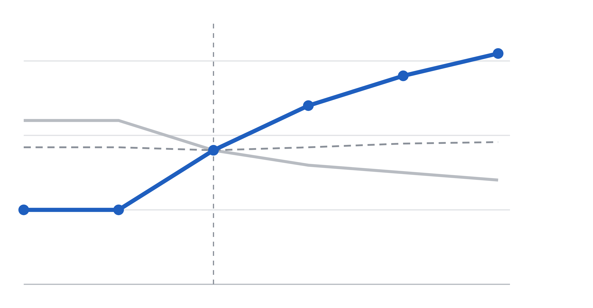
Weekend tickets now take 3× as long
WHAT
hrs
1 Mar: weekend shift cut, 6 → 2 agents
31 hours, up from 10
30
Weekend: 31 hrs
SO WHAT
1 in 3 customers waits over a day
20
All tickets: 19.1 hrs
Weekday: 14 hrs
NOW WHAT
10
Two agents back on weekends
10 hrs
0
Jan
Feb
Mar
Apr
May
Jun
20 ·
Notes:
Reveal last, after read-outs. NAME THE CONCEPTS (30 seconds): "Two ideas from earlier did the work here. First, a mix effect: the overall average stayed flat because weekdays got faster while weekends got slower, and weekdays carry 70 per cent of the weight. Same family as the Simpson's paradox vote. Second, signal versus noise: weekend times sat flat at 10 hours for two months, so a move to 31 is far outside any normal wobble. That's how you know it's real before it goes on a slide." Then point at the last line of the ask: "Naming the trade-off yourself is what makes leadership trust the rest. Good data stories are honest about the cost."

Slide 23
What changed?
So what?
Now what?
TAKE THIS WITH YOU
Rewrite every slide title in your next deck as a sentence that says the point.
21 ·
Notes:
"If you remember one thing from today, make it these three questions. What changed? So what? Now what? Lead with the answer, back it with one honest chart, and end with a decision. And before you present, run the three checks: can someone get the story from the titles alone, can a stranger read the chart in ten seconds, and would someone outside your team understand every word?" Monday action: "Open the next deck or dashboard you have to present. Don't touch the charts. Just rewrite every slide title as a sentence that says the point. That one change will do more than anything else we covered." If running behind, shorten the recap, not the Monday action.

Slide 24
Questions?
Data doesn't speak for itself. You speak for it.
Areena Arora · Editorial Coder, The Hindu
Notes:
Closing line: "Data doesn't speak for itself. You speak for it. Next time you present, imagine this room shouting 'so what?' at your first slide, and make sure you've already answered." About two and a half minutes. Repeat each question into the mic. Seed if quiet: "A question I get a lot: what if my manager wants to see all the data?" Answer: give it to them, second. Lead slide with the point, full table next or in the appendix. Other likely questions: no clear insight ("nothing changed, no action needed" is a valid headline); uncertainty (ranges, say how confident you are); is storytelling spin (a story chooses emphasis, spin hides what's inconvenient: would you be comfortable if they later saw the full data?); AI tools (good for drafting and jargon checks, verify every number, follow policy on internal data). Hard stop at 0:40. Offer to stay a few minutes afterwards.

