Slide 1

Accessibility
Guest Lecture, UW, Spring 2022
axle-lab.com
Data Visualization
Frank Elavsky, PhD student at Carnegie Mellon University

Slide 2
What you will learn today
What is accessibility?
How do you know a visualization is inaccessible?
How can you make a a visualization more accessible?
What are challenges in this space?

Slide 3
Today’s google doc
tinyurl.com/visA11yClass

Slide 4
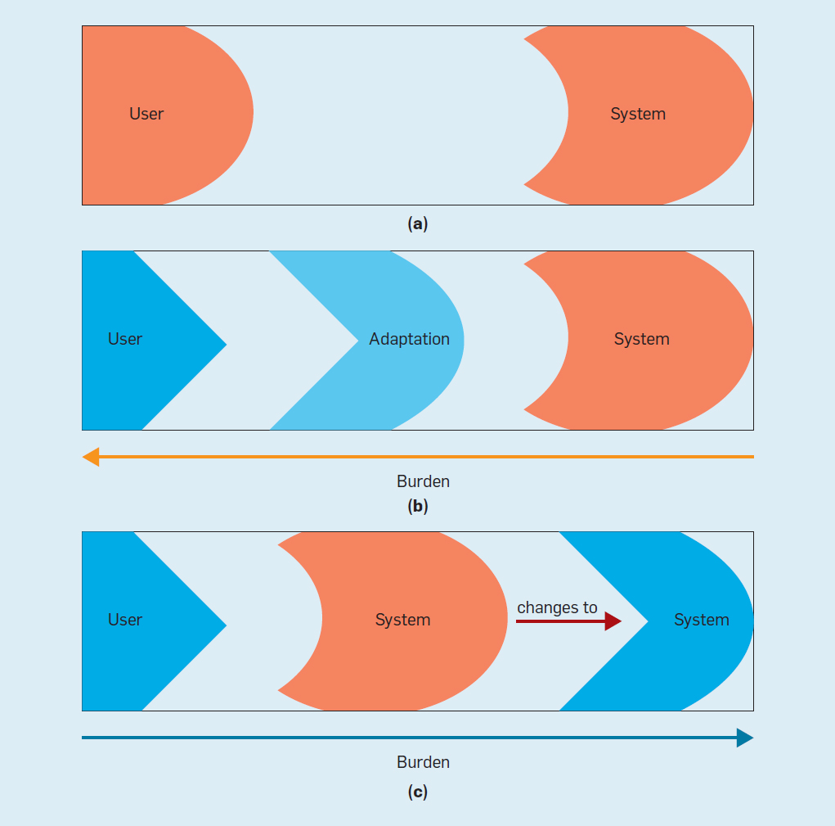
Exercise: Ability Assumptions
(Wobbrock et al) https://cacm.acm.org/magazines/2018/6/228034-ability-based-design/fulltext
User abilities and a system's ability assumptions:
(a) user abilities match a system's ability assumptions;
(b) in assistive technology, the user acquires an adaptation to remedy a mismatch; and
(c) in ability-based design, user abilities drive changes in the system.

Slide 5
Discuss: What is accessibility?
Bonus discussion:
What is “Inclusive Design” and how is it different from accessibility?

Slide 6
Discuss: Why do people do this work?

Slide 7

Human Rights: The correct argument.
https://www.un.org/development/desa/disabilities/convention-on-the-rights-of-persons-with-disabilities/article-9-accessibility.html
https://www.un.org/development/desa/disabilities/convention-on-the-rights-of-persons-with-disabilities/article-10-right-to-life.html
Accessibility is an internationally recognized human right.
It is the right thing to do.

Slide 8
15-26: The cold-blooded argument.
CDC: https://www.cdc.gov/ncbddd/disabilityandhealth/infographic-disability-impacts-all.html
In my own interviews with designers and developers who understand accessibility, they report that about 15% of their work overall is specific to accessibility.
In the United States alone, 26% of people report living with at least one disability that affects their daily life.
15% work to capture the needs of 26% of people sounds like good business.

Slide 9
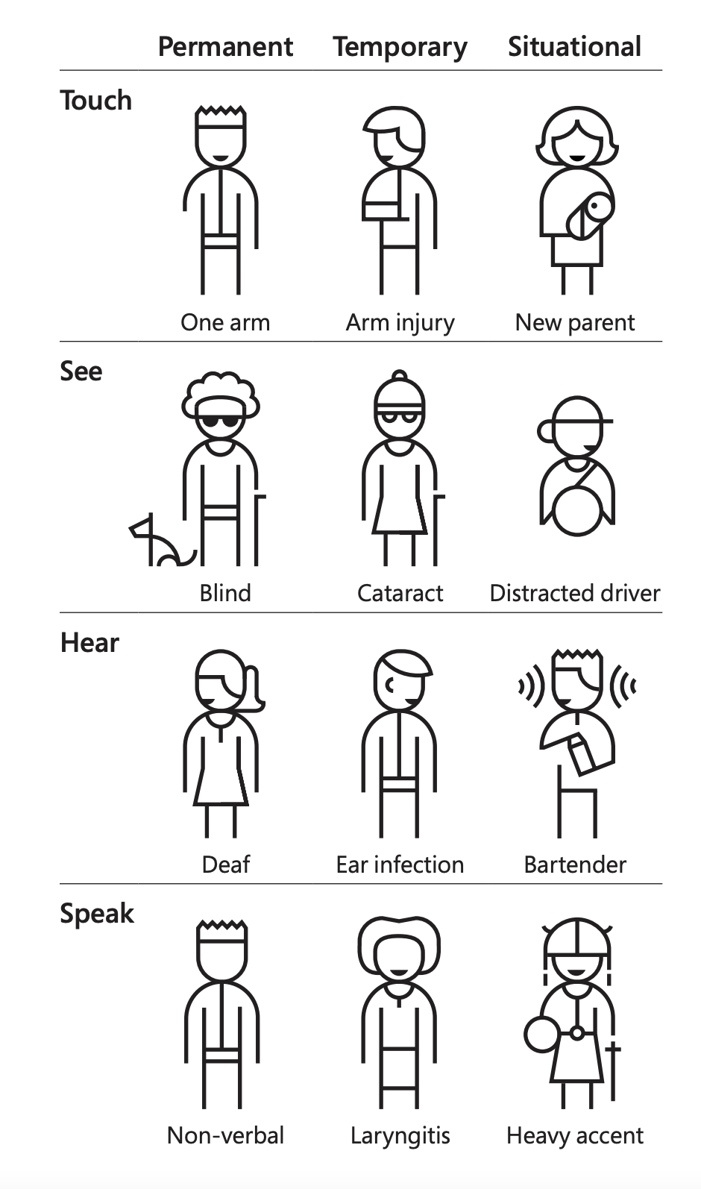
Design for One, Extend to All:
The Inclusive Argument
Exclusions, impairments, and disability actually affects everyone because these have a temporal dimension.
At some point in all of our lives we find ourselves in a situation where we experience barriers in our environment or as a result of a temporary or permanent impairment.
Inclusive design is for everyone.
Microsoft’s Inclusive Design 101 Toolkit: https://download.microsoft.com/download/b/0/d/b0d4bf87-09ce-4417-8f28-d60703d672ed/inclusive_toolkit_manual_final.pdf

Slide 10
Colorblindness: ~4.5% of those with Eur. Ancestry
Uncorrected/Low vision: ~25% of all people
Vision correction (broadly): ~75% of all people

Slide 11
Severe Disability: ~8.5% of all people
Functional Impairment: ~17.5% of all people
Situational impairment: 100% of us at some point

Slide 12
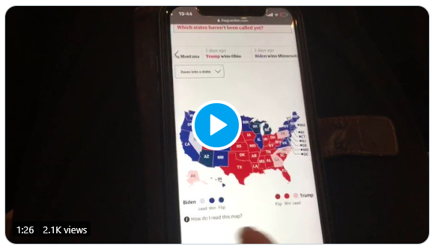
What is an inaccessible experience like?
Credit: Sarah Fossheim on twitter

Slide 13
Your turn: Using a Screen reader
Mac users: VoiceOver
Windows users: NVDA (requires download)

Slide 14
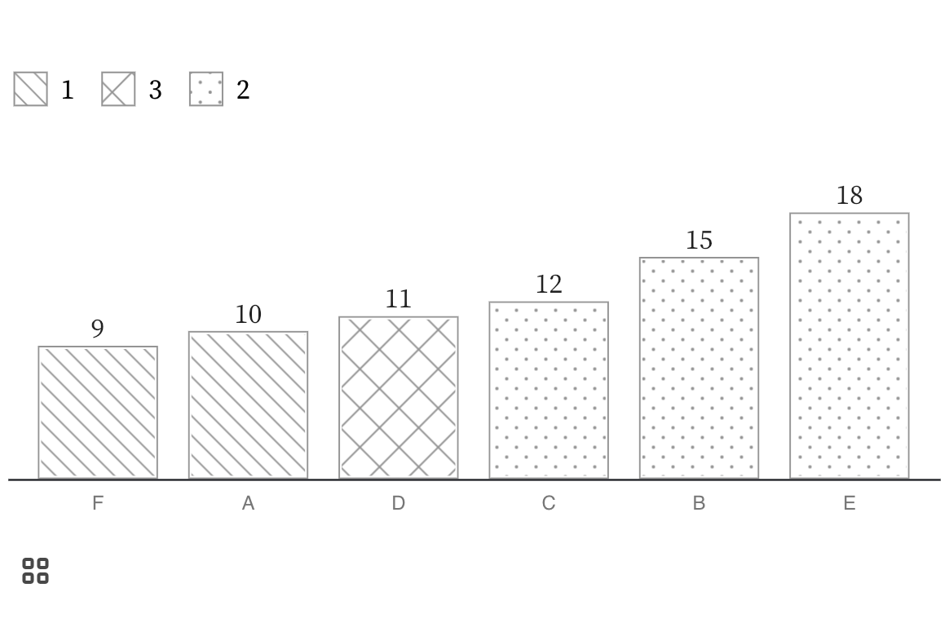
Ex. 1: Visa Chart Components Bar Chart
https://observablehq.com/@frankelavsky/chartability-contrast-series

Slide 15
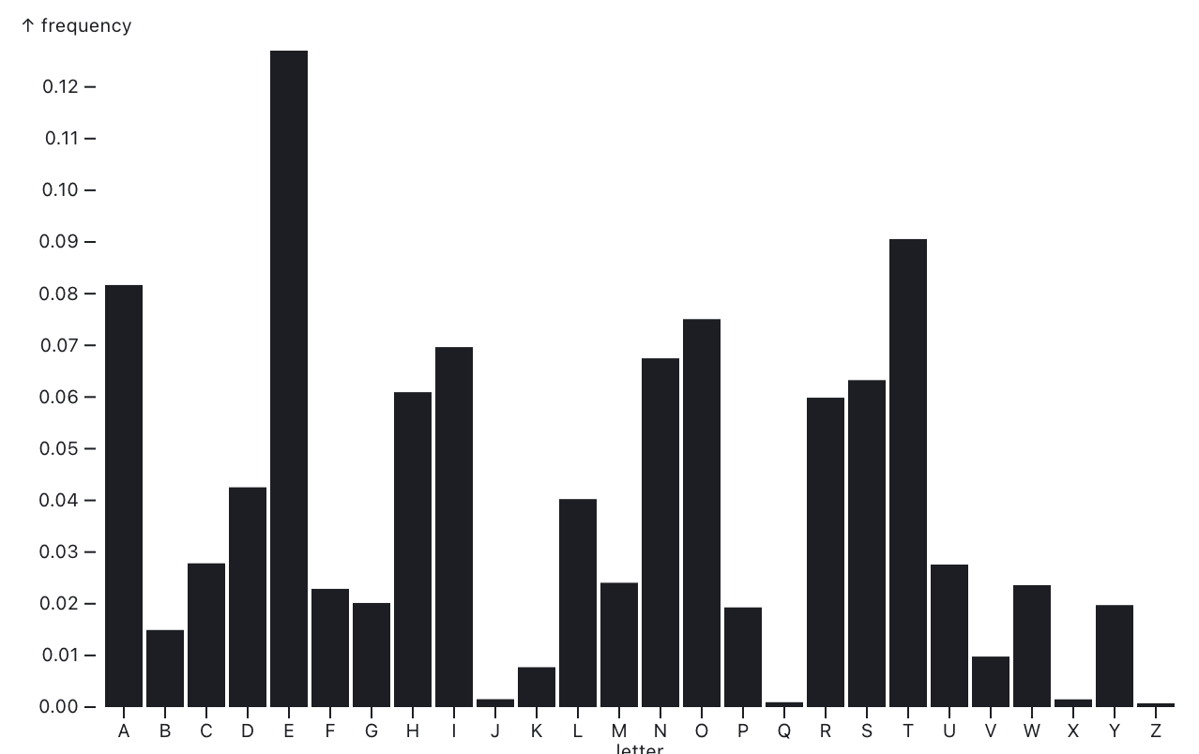
Ex. 2: Plot bar-chart
https://observablehq.com/@observablehq/plot-bar

Slide 16
Discuss!
What was it like to use a screen reader?
What are some difference between the two charts?
Why did one chart work and another not work?

Slide 17
Listen to People with Disabilities (PWD)
There are a lot of ways to listen to PWD:
Actually ask them!
Find where they are already speaking
Find where they have already spoken:
Research
Blog posts
Accessibility Standards

Slide 18
How do you make a visualization accessible?
a short set of heuristics!
Perceivable: Contrast, color, alt
Operable: Keyboard and SR access
Understandable: Textual descriptions and simplicity

Slide 19
Perceivable
Can someone perceive this in multiple ways? Is each way easy?

Slide 20
Perceivable Checklist:
High Contrast
CVD-Safe + Redundant Encoding
Alt Text

Slide 21
Design with high contrast
Colorblindness Disproportionately Overrepresented in A11y Resources
Colorblindness Disproportionately Overrepresented in A11y Resources
Colorblindness: % of People
Colorblindness: % of People
4%
4%
Low Vision: % of People
Low Vision: % of People
25%
25%
Colorblindness: # of Resources
Colorblindness: # of Resources
51
51
Low Vision: # of Resources
Low Vision: # of Resources
5
5
Notes:
https://projects.susielu.com/viz-palette

Slide 22
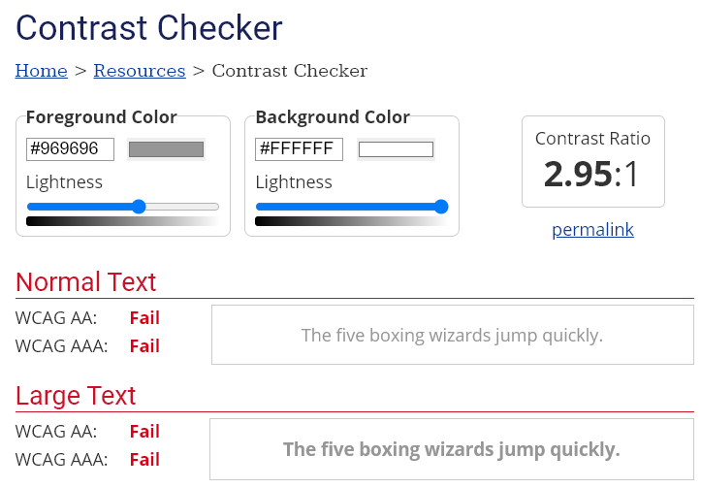
Use High Contrast Text
Text needs at least 4.5:1 contrast against its background.
Large text (bold and 16pt or larger) can be 3:1 or higher.

Slide 23
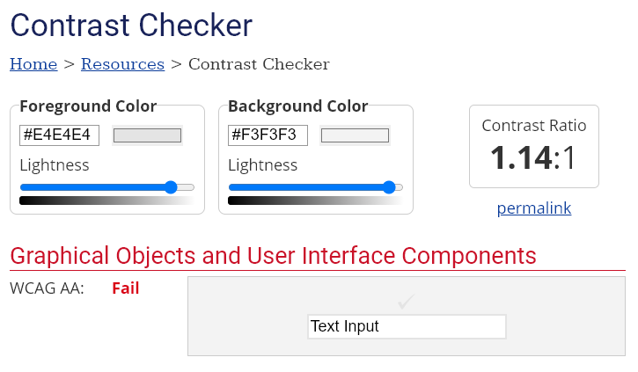
Use High Contrast Geometries
Chart elements need at least 3:1 contrast against their background.

Slide 24
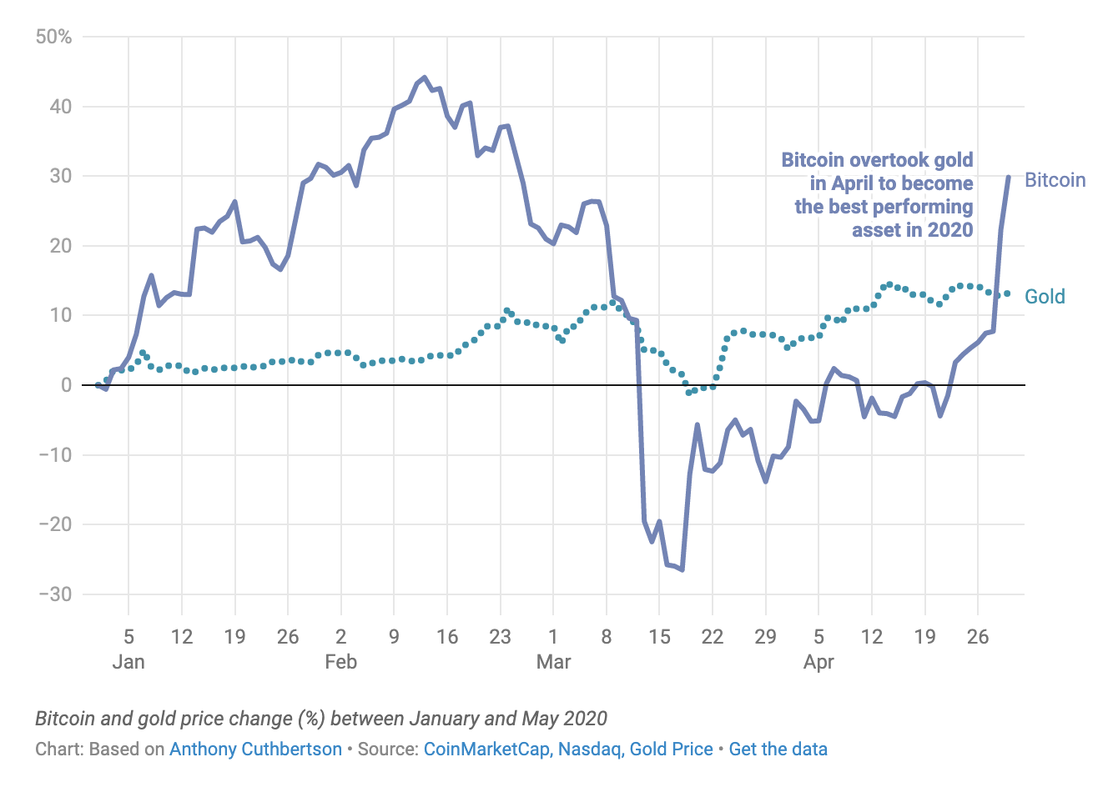
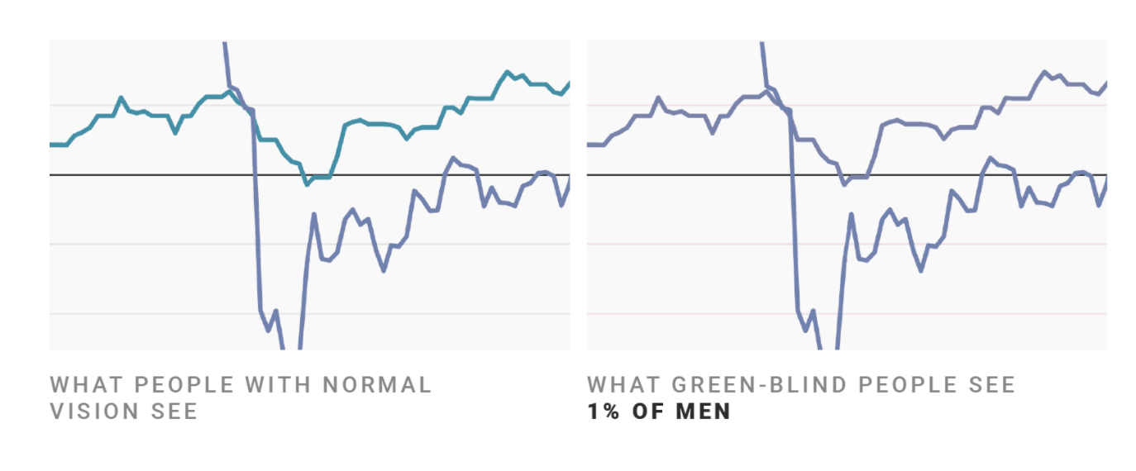
Don’t rely on color alone!
(Muth) https://blog.datawrapper.de/colorblindness-part2/

Slide 25
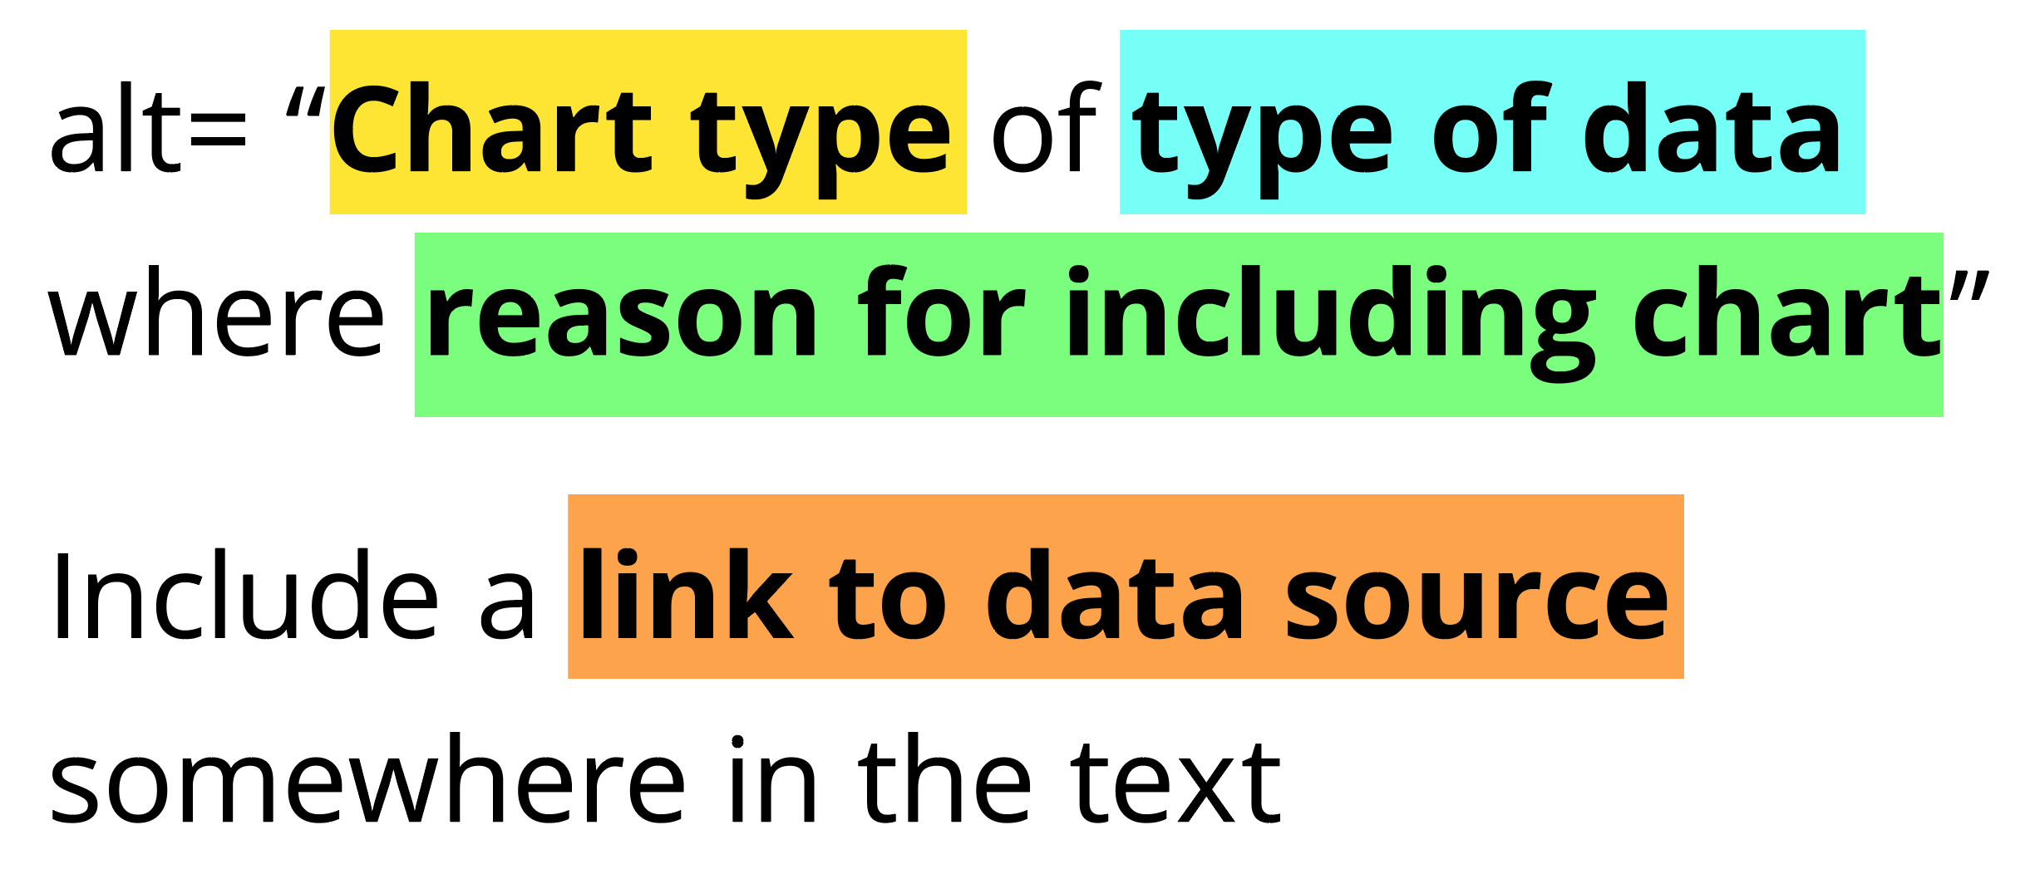
Add alt text
There is great research on alt text, but the most important thing to know is that you should add it to every image you post online (including twitter), in a document, or presentation.
Guidance: https://medium.com/nightingale/writing-alt-text-for-data-visualization-2a218ef43f81

Slide 26
Perceivable Evaluation Toolkit:
Contrast Checker
Safe color design
CVD Checker
Redundant encoding design ideas
Alt Text

Slide 27
Operable
Can someone operate this in multiple ways? Is each way easy?

Slide 28
Operable Checklist:
Mouse
Keyboard-only
Screen Reader

Slide 29
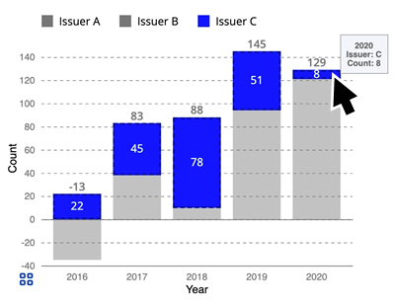
Ensure Keyboard Access (if interactive)

Slide 30
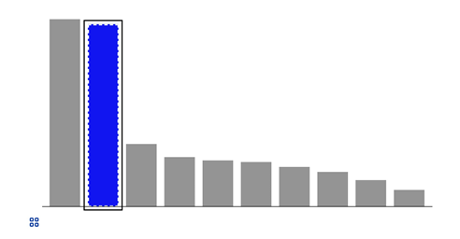
Indicate keyboard focus, use multi-modal style
This is a keyboard focus indicator (outer border) with the same styling effect applied on mouse hover (inner dashed white lines and blue fill)

Slide 31
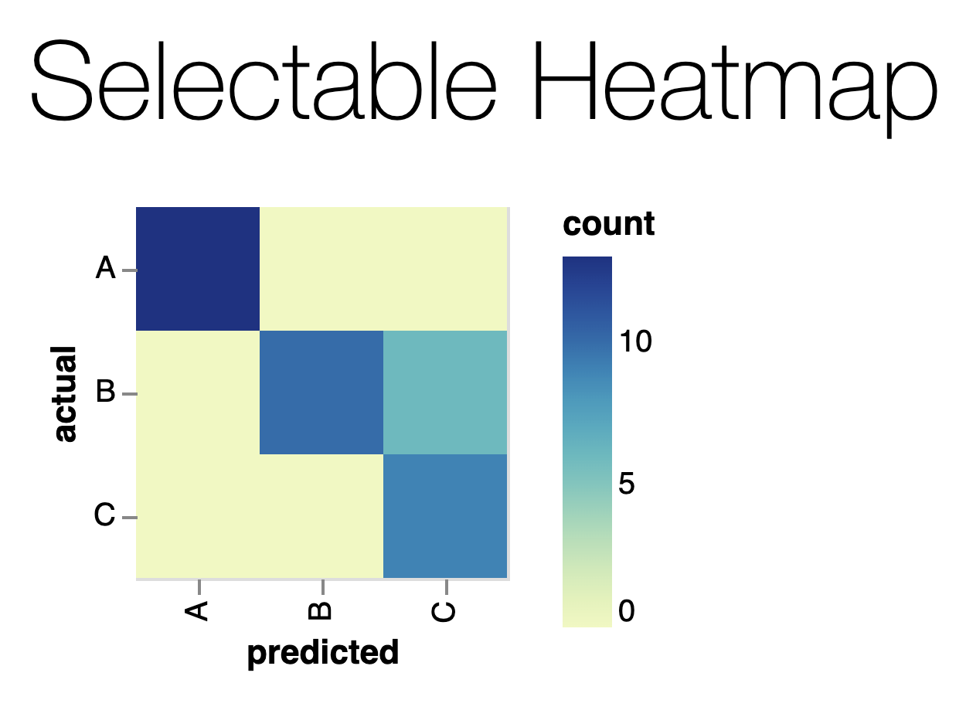
Why Keyboard-only?
Some things work for screen readers but not for keyboard-only users!
https://vega.github.io/vega-lite/examples/selection_heatmap.html

Slide 32
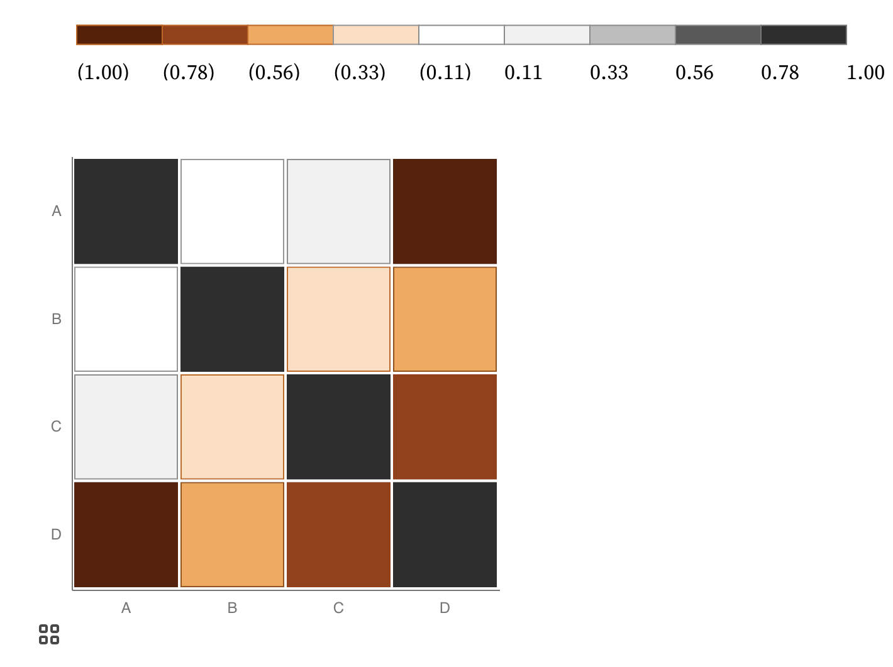
Keyboard only example:
https://observablehq.com/@frankelavsky/experimental-color-scale-textures

Slide 33
Operable Evaluation Toolkit:
Use your mouse: can it do something meaningful? (tooltip, click event, etc) If so:
Test using a keyboard-only: can you navigate and use keyboard activation (spacebar/enter) on the visualization?
Test using a screen reader: Can you use a screen reader to navigate and use keyboard activation on the visualization?

Slide 34
Understandable
Can someone understand this in multiple ways? Is each way easy?

Slide 35
Understandable Checklist:
Descriptive title, summary, or caption
Data table or data download
Reading level

Slide 36
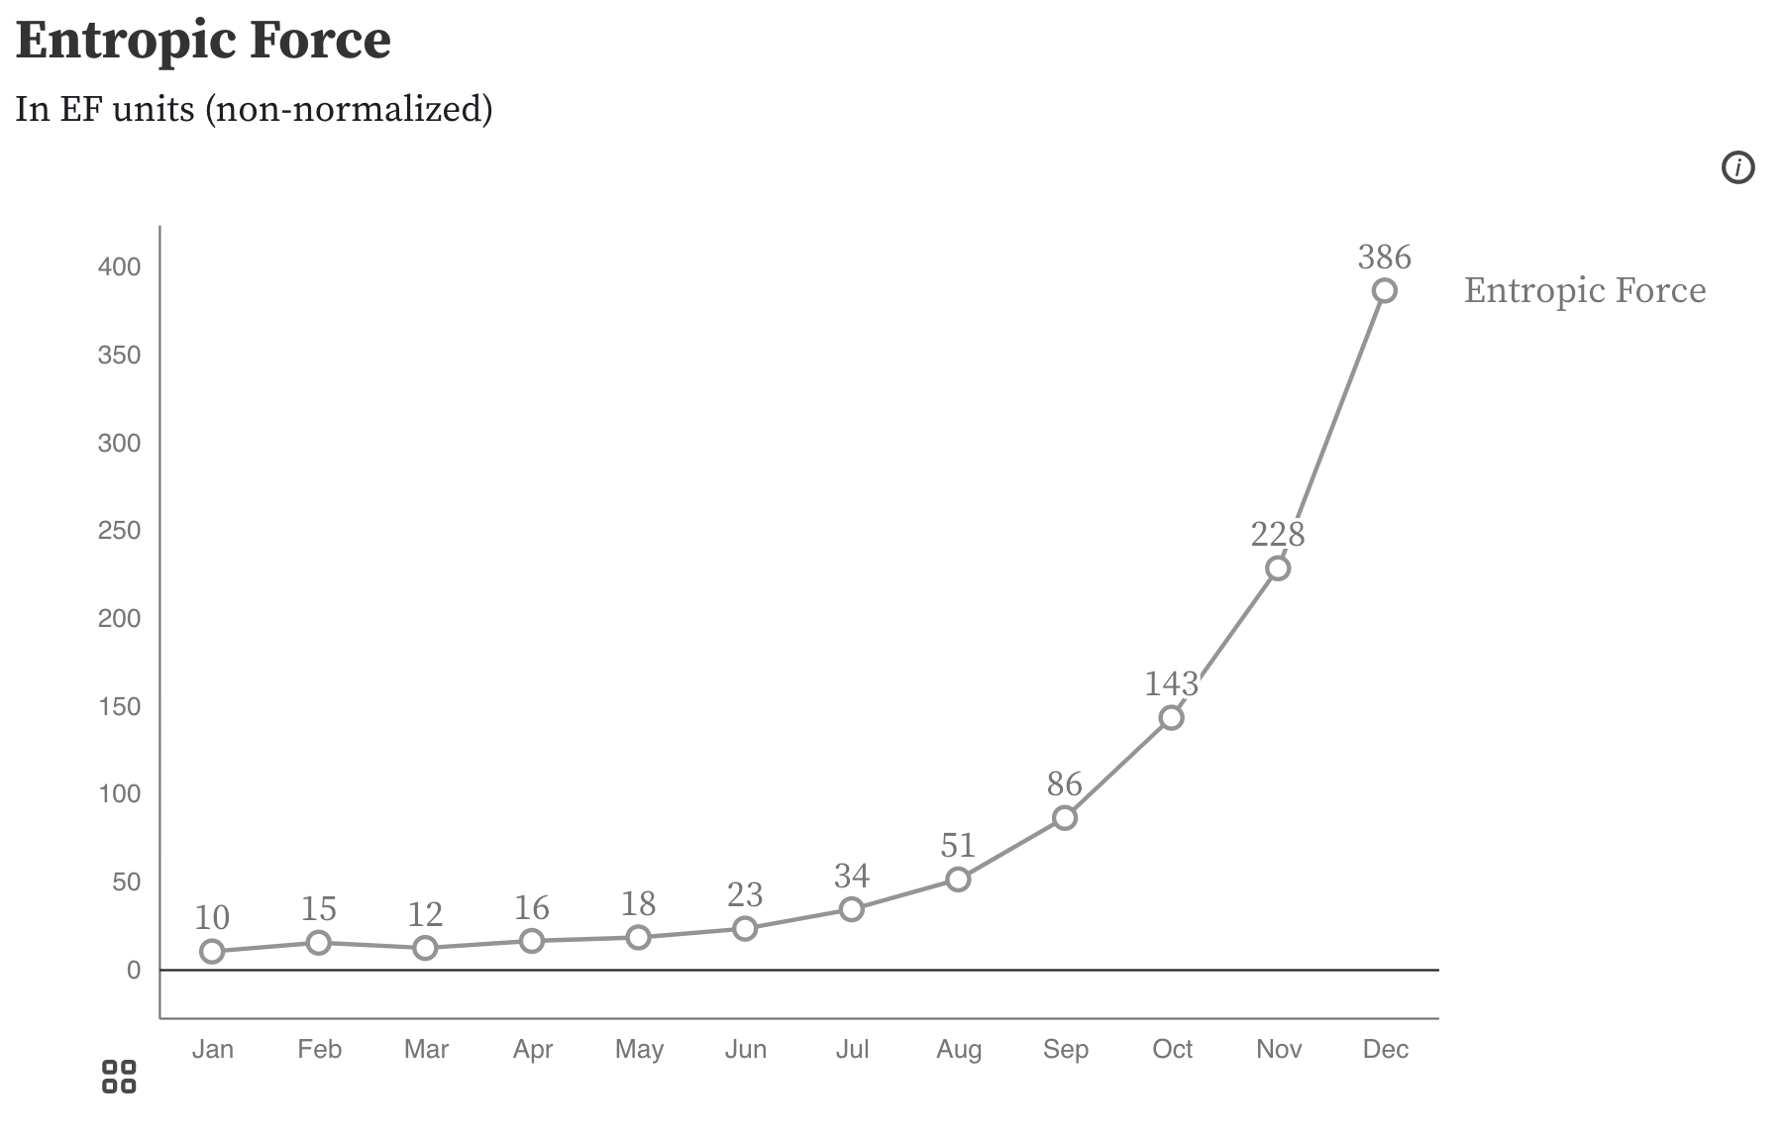
Non-descriptive Titles are Inaccessible!

Slide 37
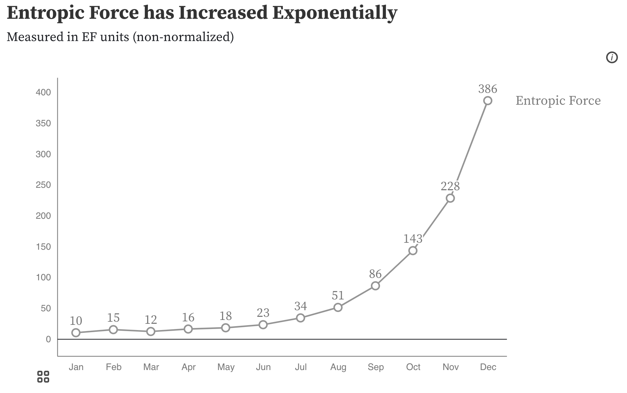
Descriptive Titles have Summaries/Takeaways

Slide 38
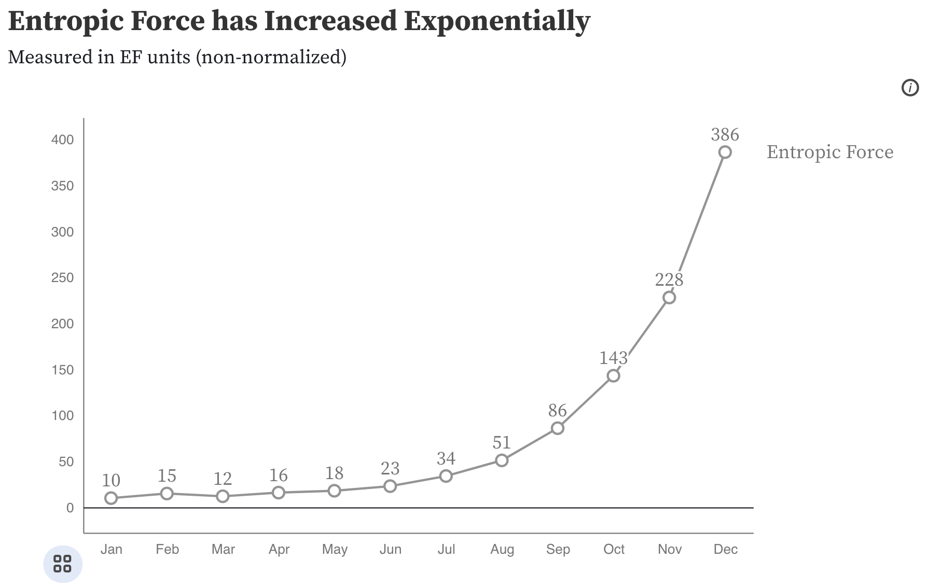
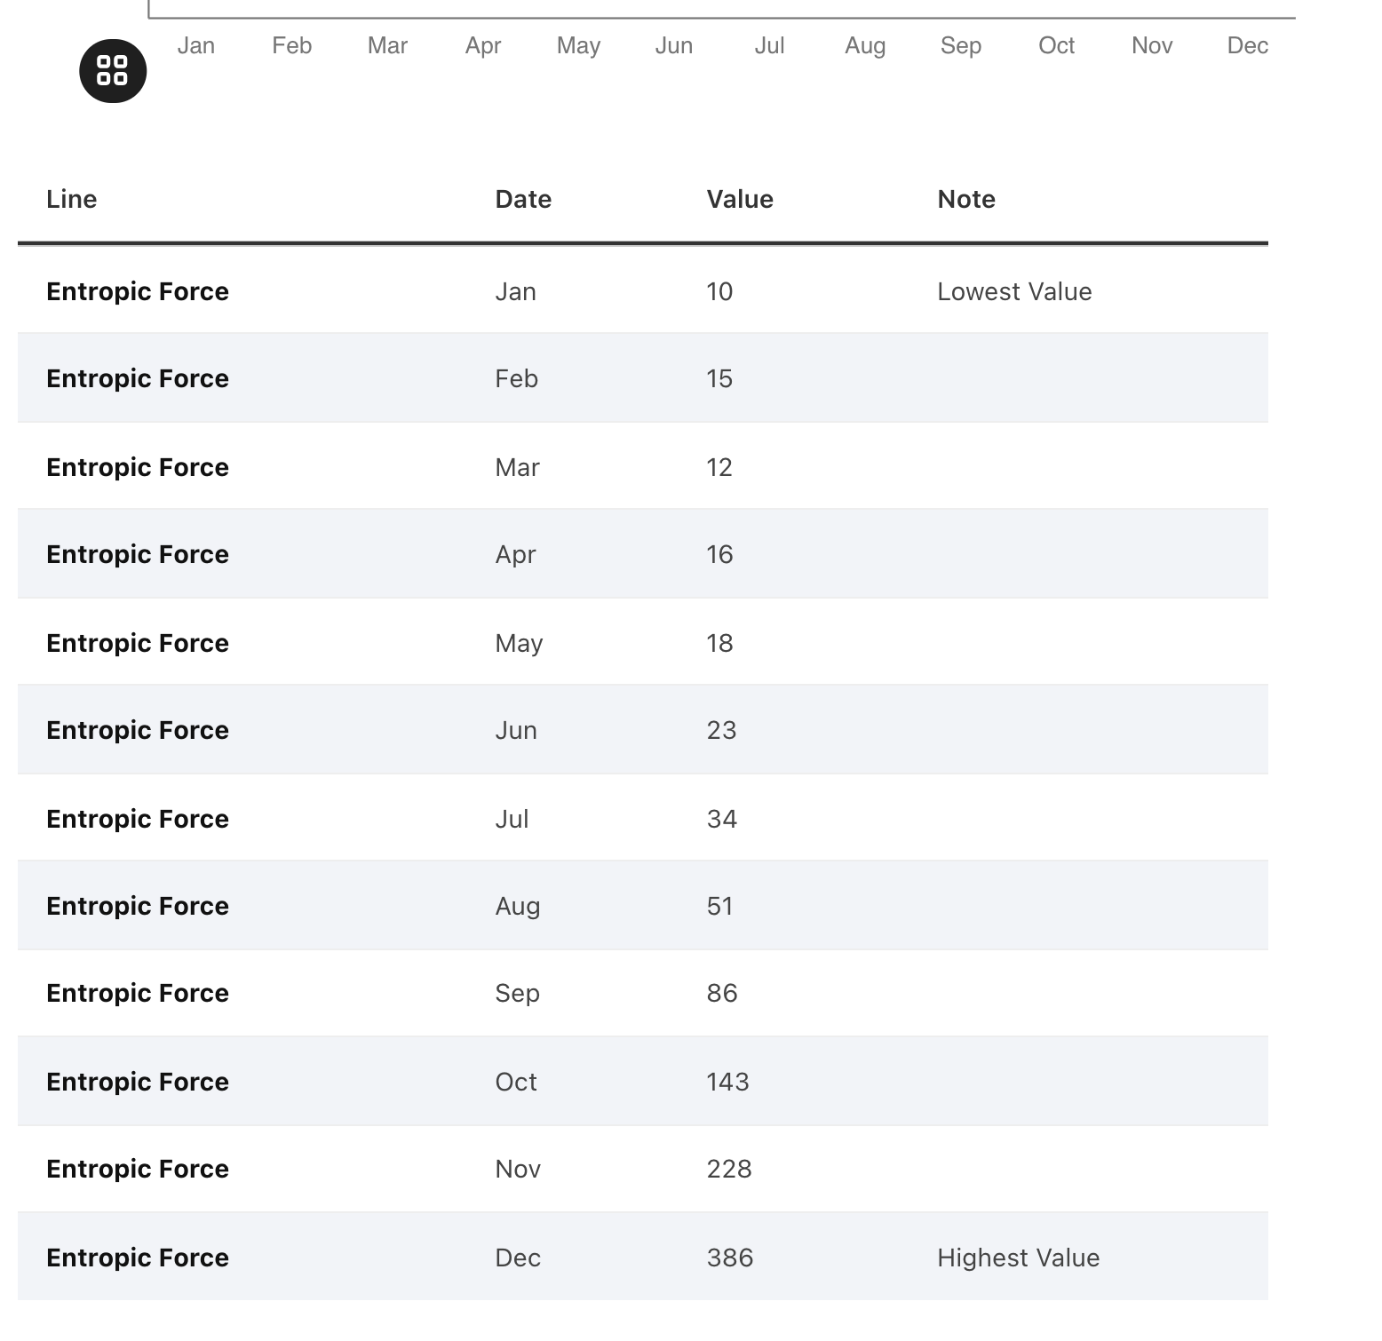
All charts should have data available!

Slide 39
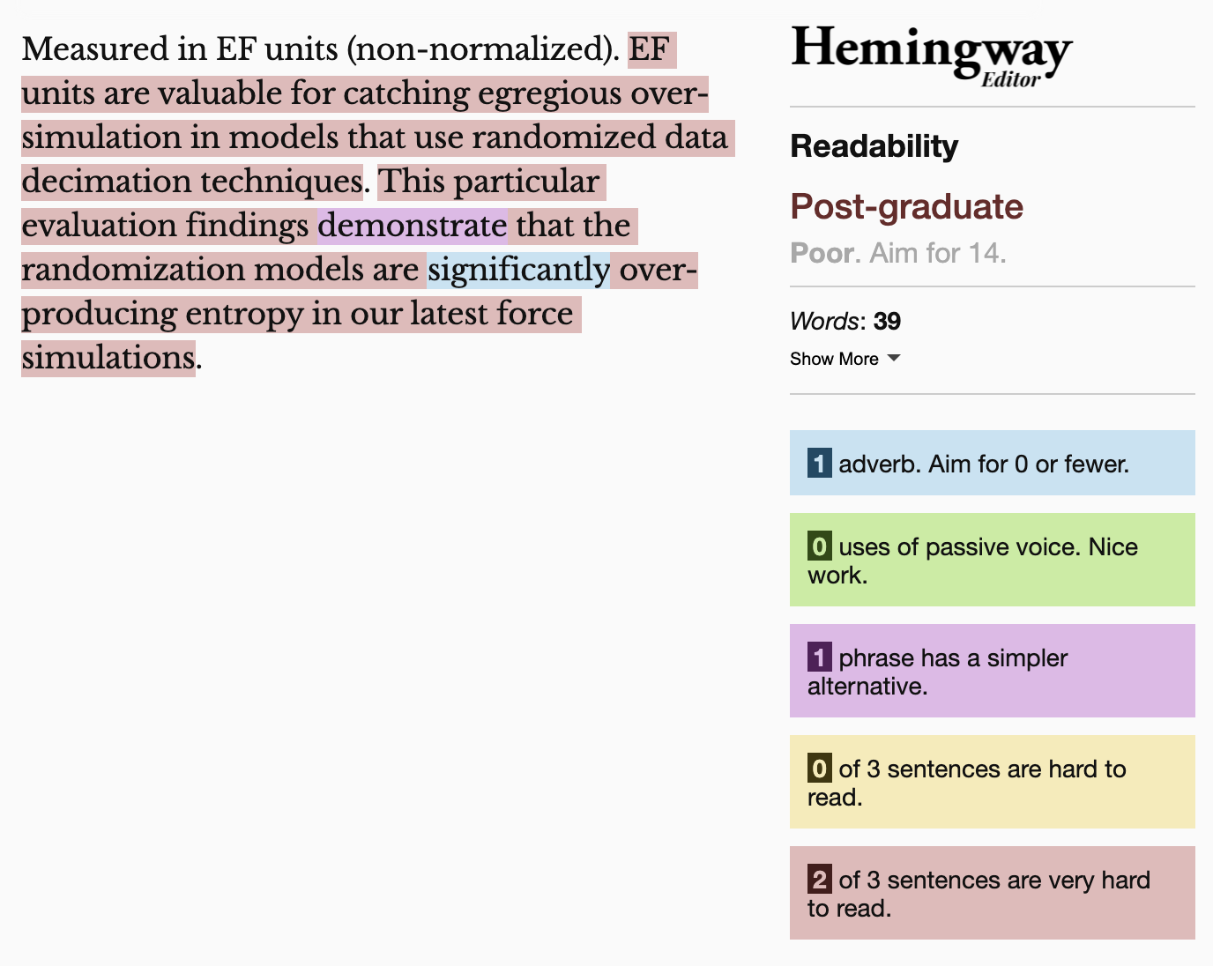
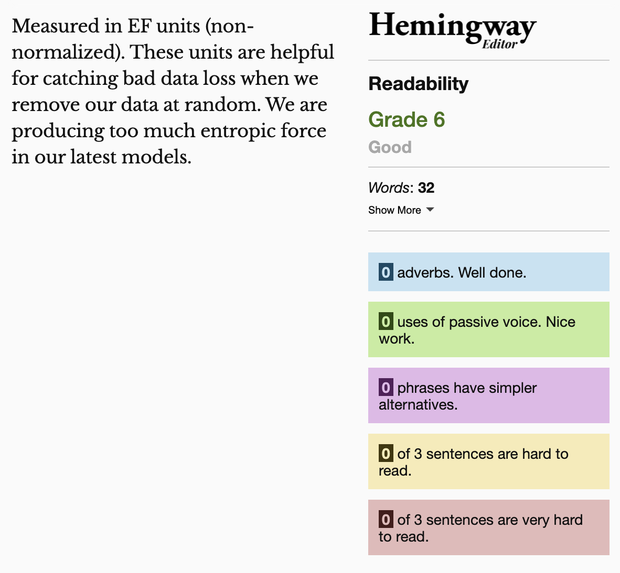
Keep summaries as non-technical as possible
If the topic is technical, provide a “plain language” summary somewhere close by that is easy to find (either in the same location or with by providing a link).

Slide 40
Understandable Evaluation Toolkit:
Is there a descriptive title, summary, or caption?
Is there a scoped HTML table or downloadable data file provided?
Is the descriptive text supporting the visualization presented at a reading level at grade 9 or below?

Slide 41
Exercise: Evaluate a visualization
Pick: Perceivable, Operable, or Understandable, try all tests

Slide 42
Discuss: What did you find?
Perceivable?
Operable?
Understandable?

Slide 43
The cone of infinite (inaccessible) evil.
Tools
Creators
Future things
(there will be many more!)
Created Things (now)

Slide 44
The future looks rough.
(This is pretty bad!)
Tools
Creators
Future things
(there will be many more!)
Created Things (now)

Slide 45
Discuss: Where do we intervene?
Tools
Creators
Future things
(there will be many more!)
Created Things (now)

Slide 46
Intervening on the final environment
Tools
Creators
Future things
(there will be many more!)
Created Things (now)

Slide 47
Intervening on the creators
Tools
Creators
Future things
(there will be many more!)
Created Things (now)

Slide 48
Intervening on the means of production
Tools
Creators
Future things
(there will be many more!)
Created Things (now)

Slide 49
What you can do now
Name ability assumptions in something you encounter
Use a screen reader
Evaluate the accessibility of a data visualization
Come up with a strategy for intervening on inaccessibility

Slide 50
Q/A
Happy to answer questions about how to do this work professionally (design, engineering, research, education)
as well as any questions about data visualization and accessibility more broadly (including tools, challenges, what lies in the future)

Slide 51
Resources
A resources repository!
My twitter (@FrankElavsky)
Chartability

