Slide 1

Data Visualization Accessibility
Invited Talk, UC, Fall 2022
axle-lab.com
Thinking about data visualization for people with disabilities.
Frank Elavsky, PhD student at Carnegie Mellon University

Slide 2
Who am I? A data visualization + accessibility researcher and engineer
Research: Carnegie Mellon and Apple.
Organize: DataVizA11y.
Contribute: W3C’s ARIA Working Group as an invited expert.
Create: Tools for designers and engineers who want to make accessible visualizations.

Slide 3
What you will learn today
What is accessibility?
How do you know a visualization is inaccessible?
How can you make a a visualization more accessible?

Slide 4
Discuss: What is accessibility?
Bonus discussion:
What is “Inclusive Design” and how is it different from accessibility?

Slide 5
Accessibility (some working definitions):
1. The qualities that make an experience open or usable to all.
2. The qualities that make an experience open or usable specifically for people with disabilities.

Slide 6
Colorblindness: ~4.5% of those with Eur. ancestry
Uncorrected/low vision: ~25% of all people
Vision correction (broadly): ~75% of all people

Slide 7
Severe disability: ~8.5% of all people
Functional impairment: ~17.5% of all people
Situational impairment: 100% of us at some point

Slide 8
Discuss: Why do people do this work?

Slide 9

1. Access is a human right
Accessibility is an internationally recognized human right.
It is the morally and ethically correct thing to do.
https://www.un.org/development/desa/disabilities/convention-on-the-rights-of-persons-with-disabilities/article-9-accessibility.html
https://www.un.org/development/desa/disabilities/convention-on-the-rights-of-persons-with-disabilities/article-10-right-to-life.html

Slide 10
2. It is expensive to exclude

Slide 11
15% of time spent on accessibility…
… for 26% of all people

Slide 12
Fixing inaccessibility takes 1.5 – 10x more time if done after something is built.

Slide 13
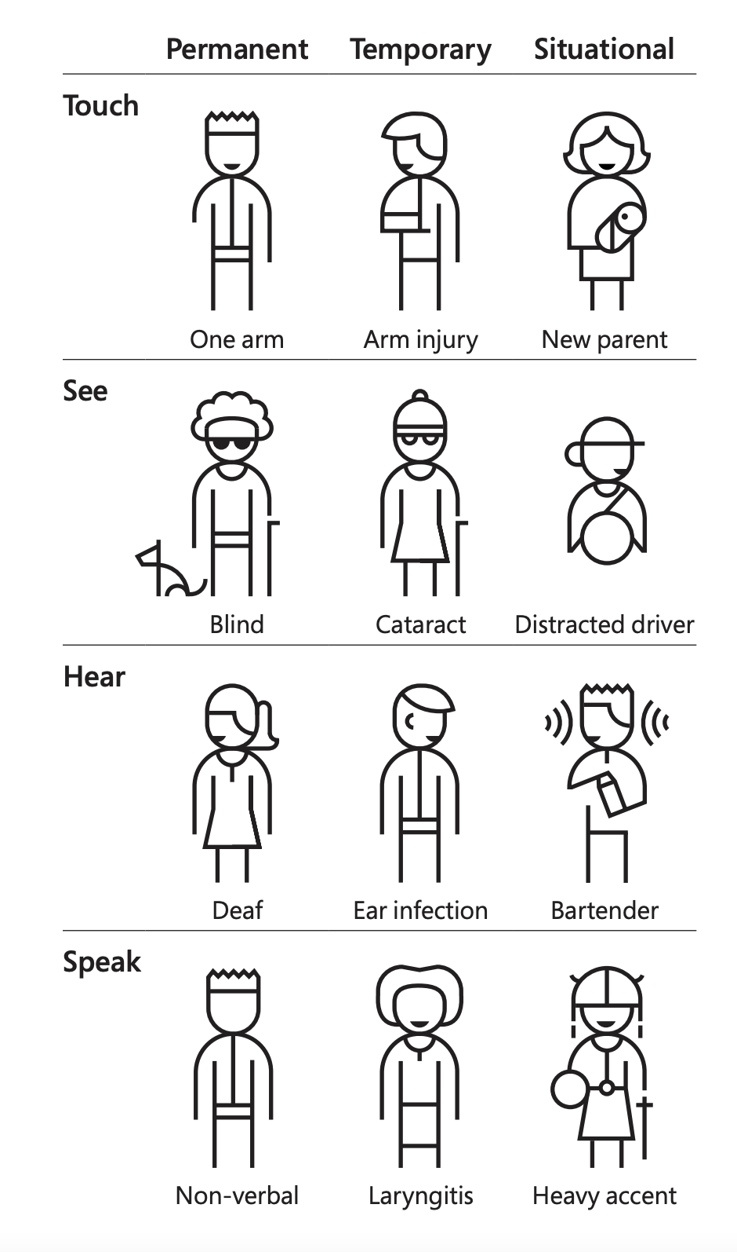
3. “Design for One, Extend to All” is better design work
Microsoft’s Inclusive Design 101 Toolkit: https://download.microsoft.com/download/b/0/d/b0d4bf87-09ce-4417-8f28-d60703d672ed/inclusive_toolkit_manual_final.pdf

Slide 14
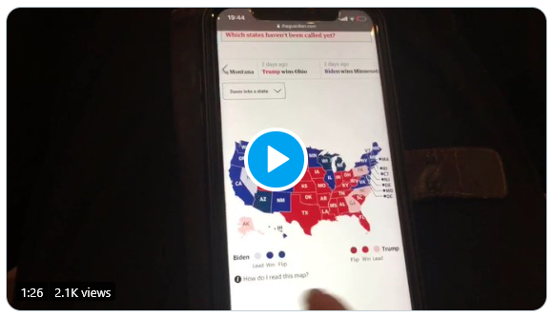
What is an inaccessible experience like?
Credit: Sarah Fossheim on twitter

Slide 15
Demo: Using a screen reader
Mac users: VoiceOver
Windows users: NVDA (requires download)

Slide 16
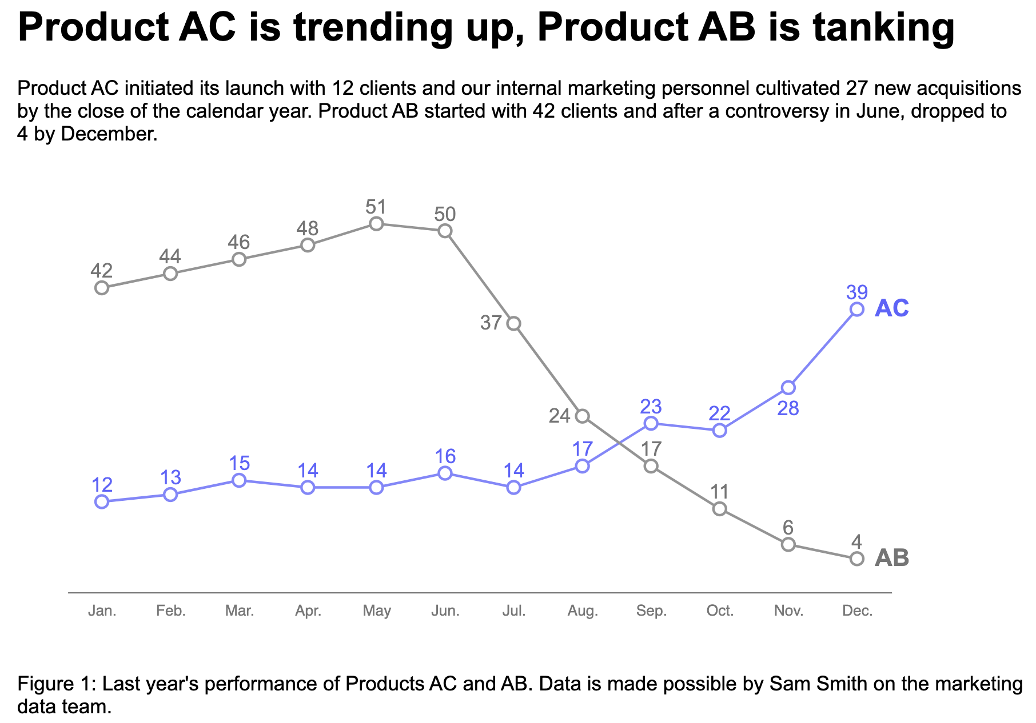
Explore: An interactive bar chart
https://frankelavsky.github.io/assessing_chart_interactivity/

Slide 17
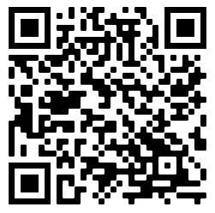
Exercise: Using a screen reader (your turn!)
https://frankelavsky.github.io/assessing_chart_interactivity/
Mac users: VoiceOver
Windows users: NVDA (requires download)

Slide 18
Discuss!
What was it like to use a screen reader?
What are some differences between the chart and the “inaccessible” version?
Why did one chart work and another not work?

Slide 19
A methods question: How do you know something is inaccessible?

Slide 20
Listen to people with disabilities.

Slide 21
There are a lot of ways to listen to PWD:
Actually ask them!
Find where they are already speaking
Find where they have already spoken:
Research
Blog posts
Accessibility standards

Slide 22
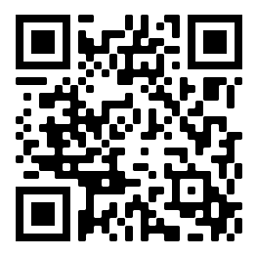
How do you make a visualization accessible?
Let’s vote on which principle we go over today!
bit.ly/viz_a11y_UC_poll
1. Perceivable: Contrast, color, alt
2. Operable: Keyboard and SR access
3. Understandable: Textual descriptions and simplicity

Slide 23
Perceivable
Can someone perceive this in multiple ways? Is each way easy?

Slide 24
Perceivable Checklist:
High Contrast
CVD-Safe + Redundant Encoding
Alt Text

Slide 25
Design with high contrast
Colorblindness Disproportionately Overrepresented in A11y Resources
Colorblindness Disproportionately Overrepresented in A11y Resources
Colorblindness: % of People
Colorblindness: % of People
4%
4%
Low Vision: % of People
Low Vision: % of People
25%
25%
Colorblindness: # of Resources
Colorblindness: # of Resources
51
51
Low Vision: # of Resources
Low Vision: # of Resources
5
5
Notes:
https://projects.susielu.com/viz-palette

Slide 26
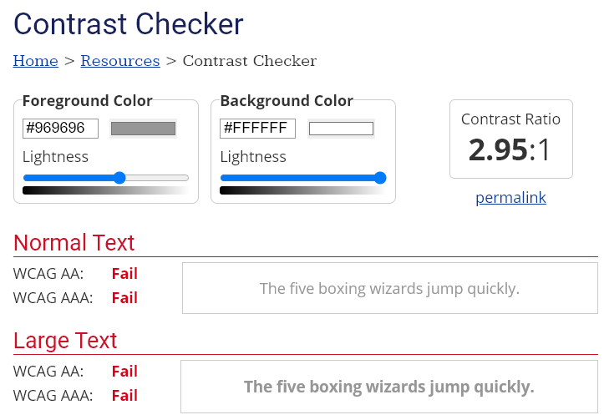
Use High Contrast Text
Text needs at least 4.5:1 contrast against its background.
Large text (bold and 16pt or larger) can be 3:1 or higher.

Slide 27
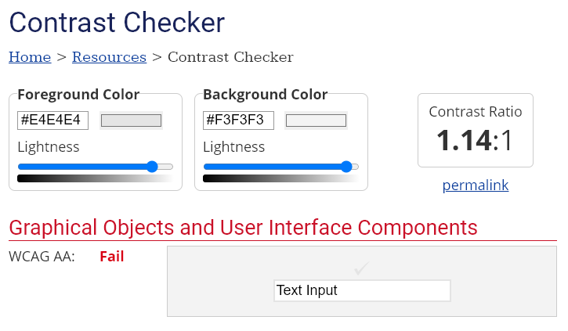
Use High Contrast Geometries
Chart elements need at least 3:1 contrast against their background.

Slide 28
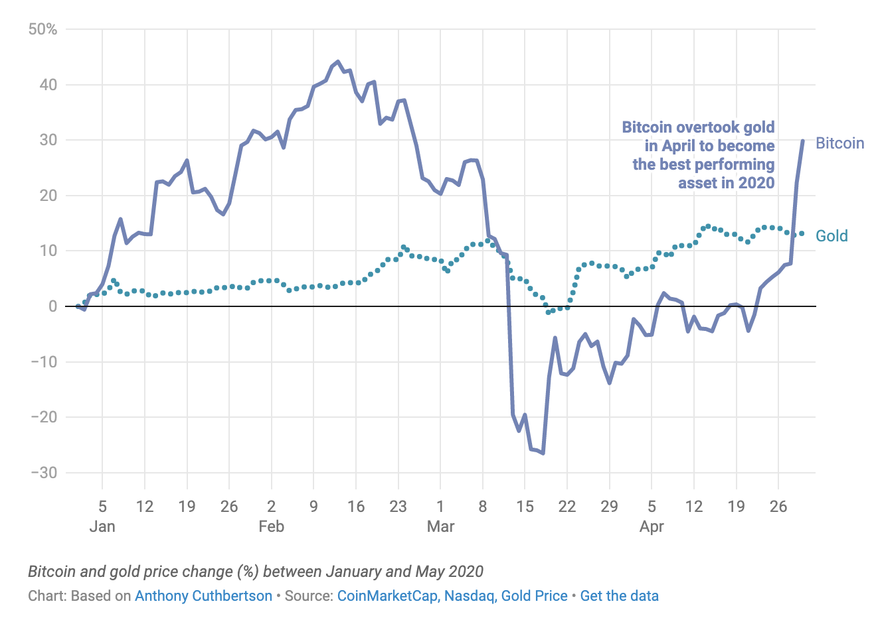
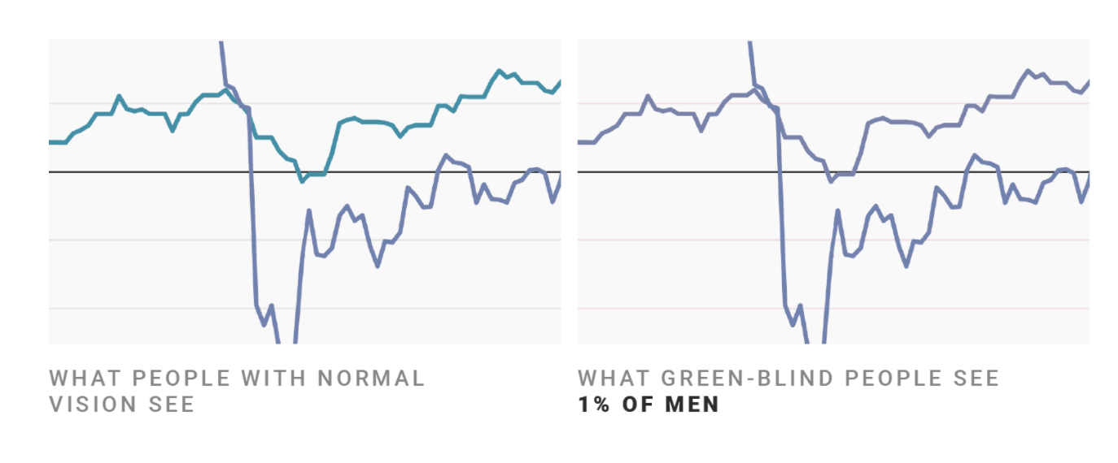
Don’t rely on color alone!
(Muth) https://blog.datawrapper.de/colorblindness-part2/

Slide 29
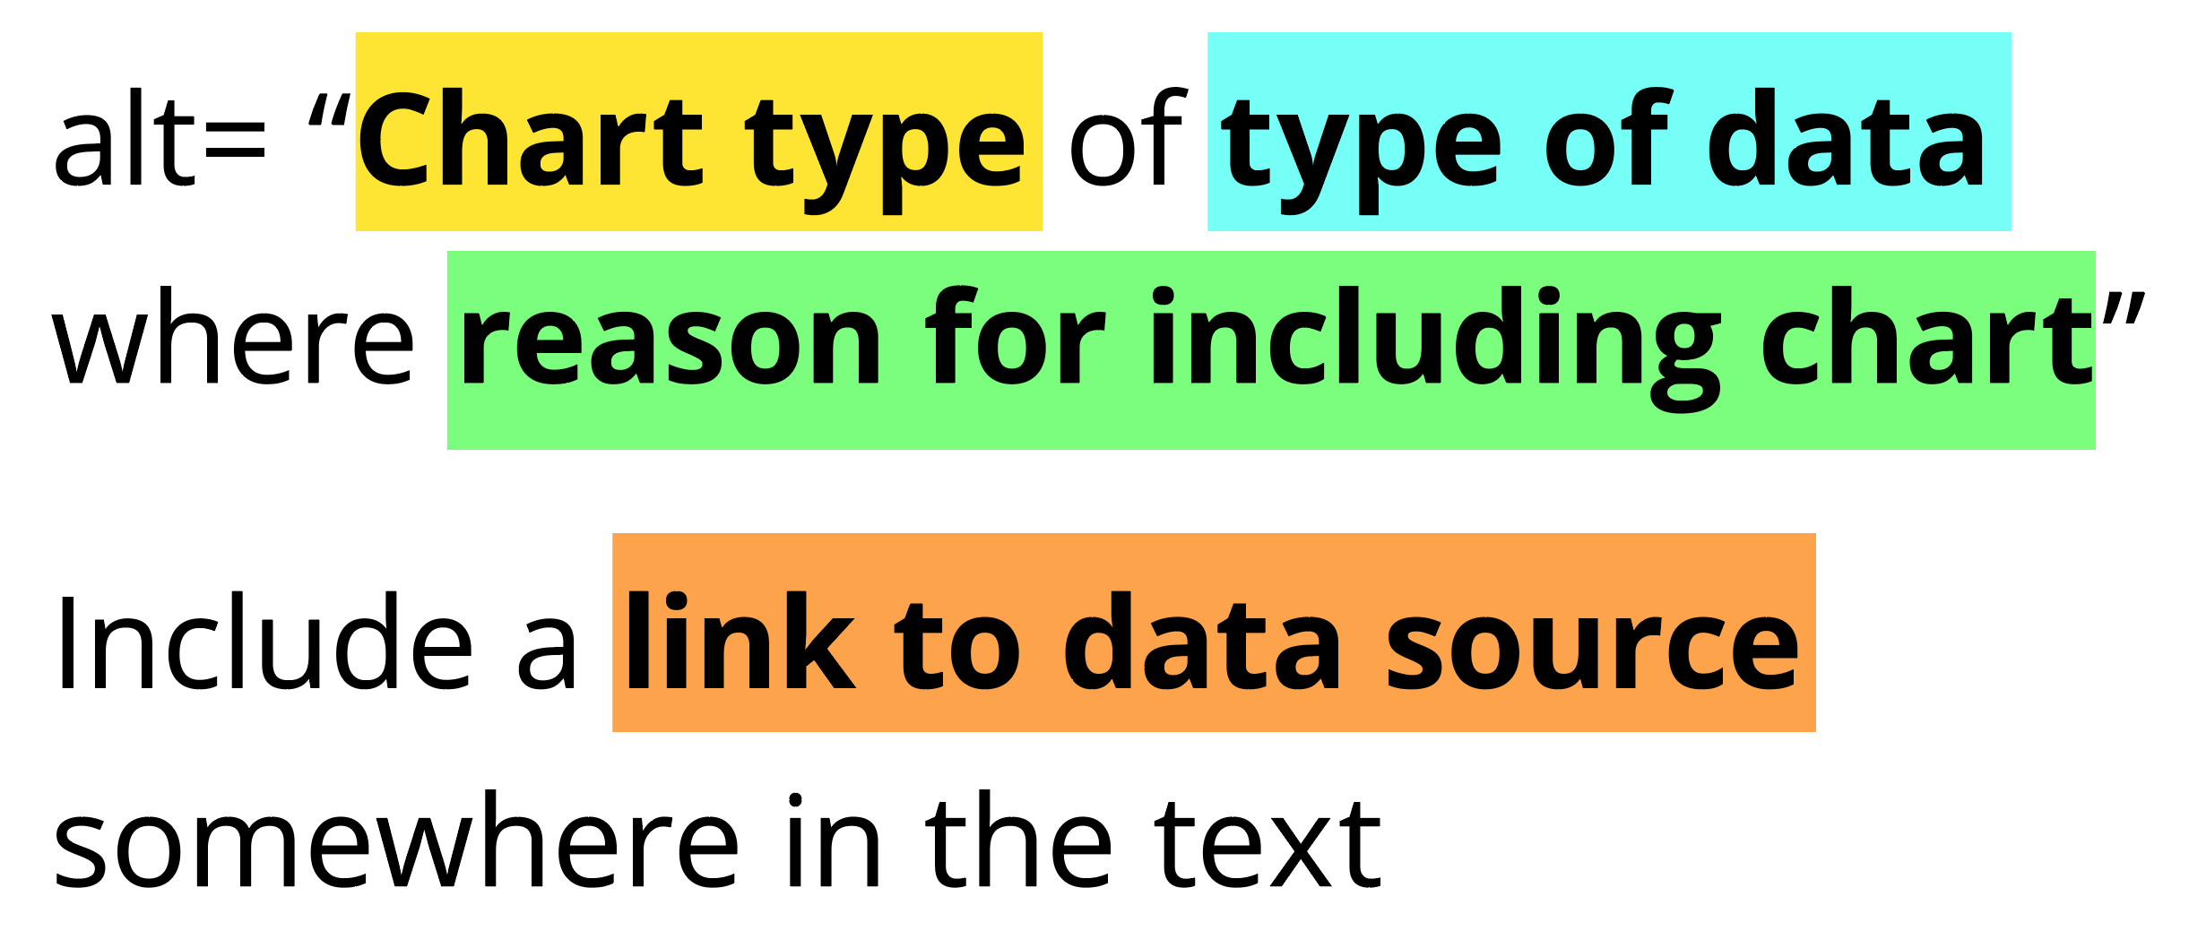
Add alt text
There is great research on alt text, but the most important thing to know is that you should add it to every image you post online (including twitter), in a document, or presentation.
Guidance: https://medium.com/nightingale/writing-alt-text-for-data-visualization-2a218ef43f81

Slide 30
Perceivable Evaluation Toolkit:
Contrast Checker
Safe color design
CVD Checker
Redundant encoding design ideas
Alt Text

Slide 31
Operable
Can someone operate this in multiple ways? Is each way easy?

Slide 32
Operable Checklist:
Mouse
Keyboard-only
Screen Reader

Slide 33
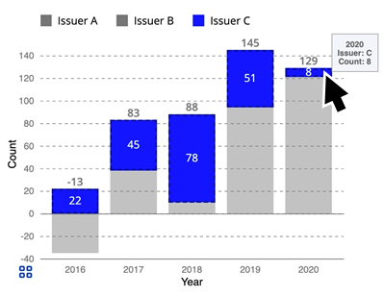
Ensure Keyboard Access (if interactive)

Slide 34
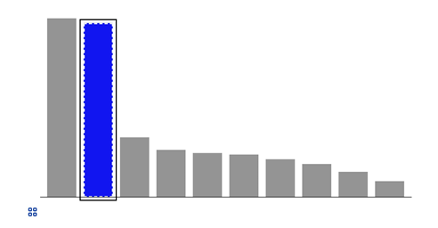
Indicate keyboard focus, use multi-modal style
This is a keyboard focus indicator (outer border) with the same styling effect applied on mouse hover (inner dashed white lines and blue fill)

Slide 35
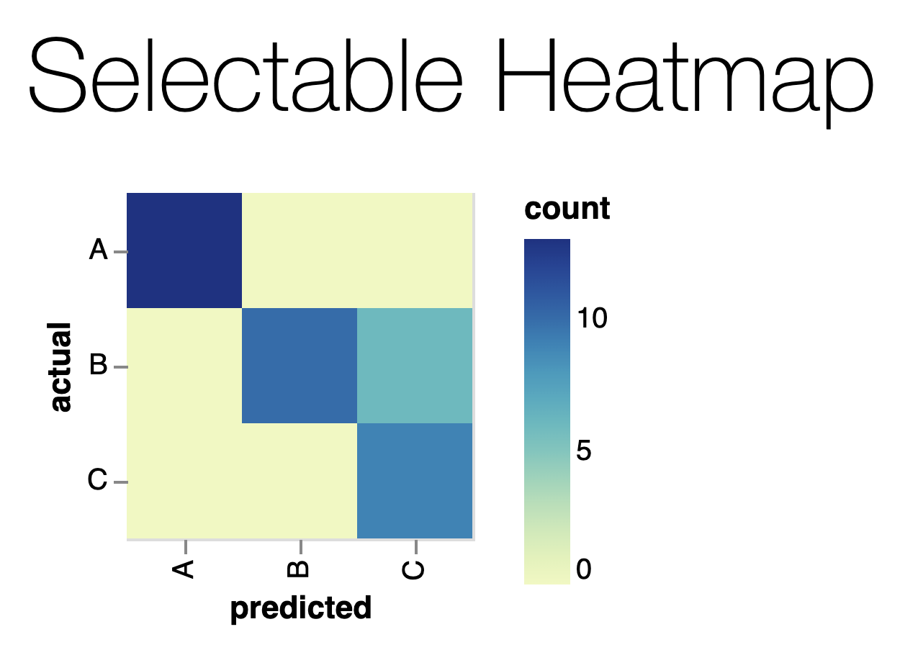
Why Keyboard-only?
Some things work for screen readers but not for keyboard-only users!
https://vega.github.io/vega-lite/examples/selection_heatmap.html

Slide 36
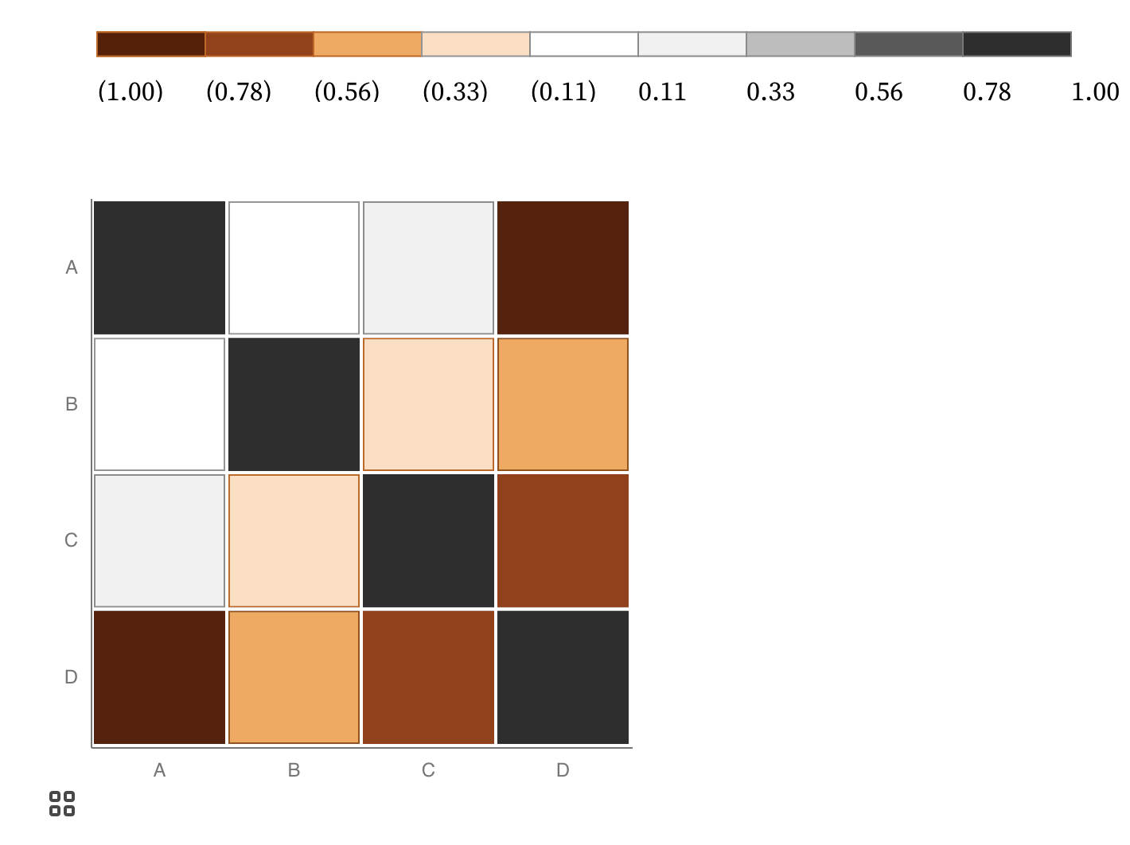
Keyboard only example:
https://observablehq.com/@frankelavsky/experimental-color-scale-textures

Slide 37
Operable Evaluation Toolkit:
Use your mouse: can it do something meaningful? (tooltip, click event, etc) If so:
Test using a keyboard-only: can you navigate and use keyboard activation (spacebar/enter) on the visualization?
Test using a screen reader: Can you use a screen reader to navigate and use keyboard activation on the visualization?

Slide 38
Understandable
Can someone understand this in multiple ways? Is each way easy?

Slide 39
Understandable Checklist:
Descriptive title, summary, or caption
Data table or data download
Reading level

Slide 40
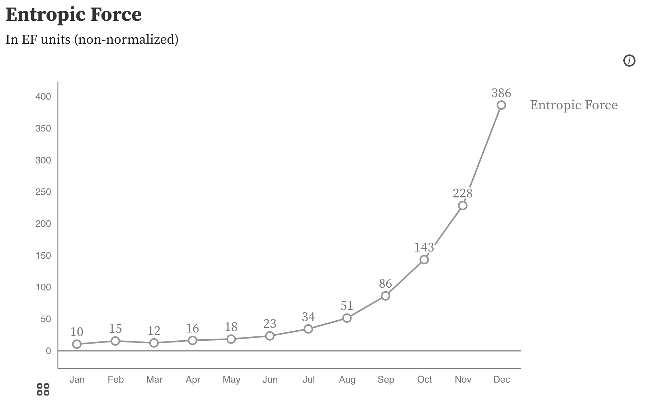
Non-descriptive titles are inaccessible

Slide 41
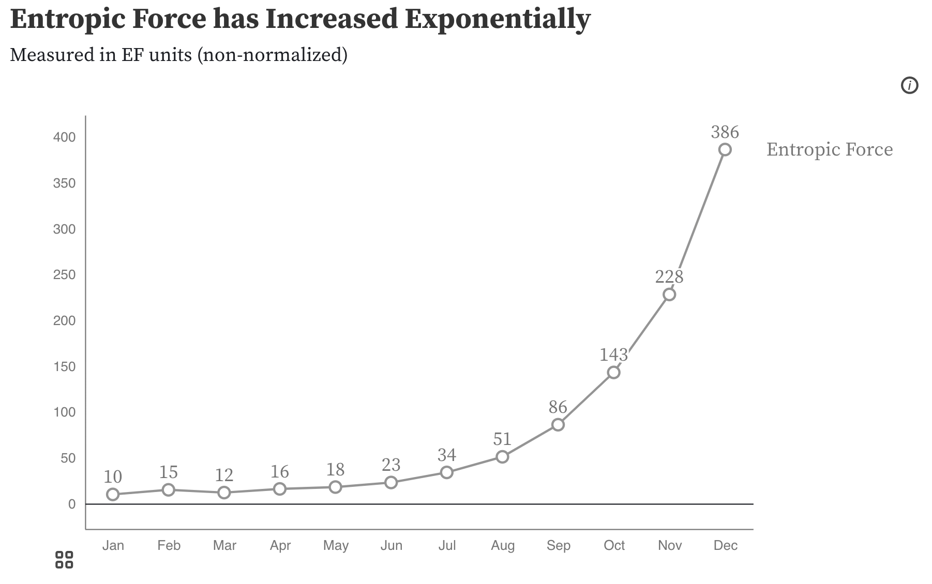
Descriptive titles have summaries/takeaways

Slide 42
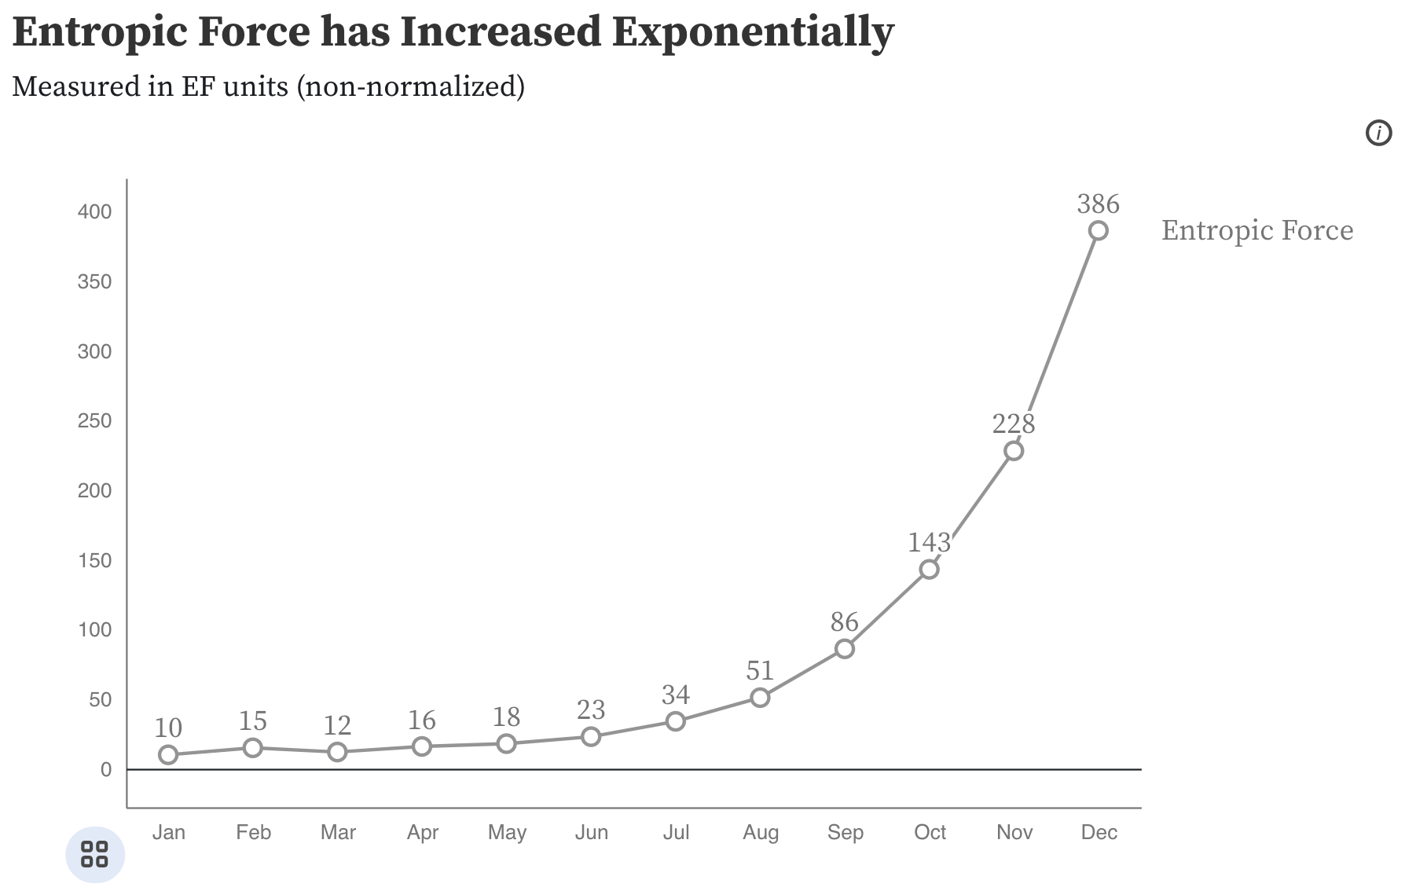
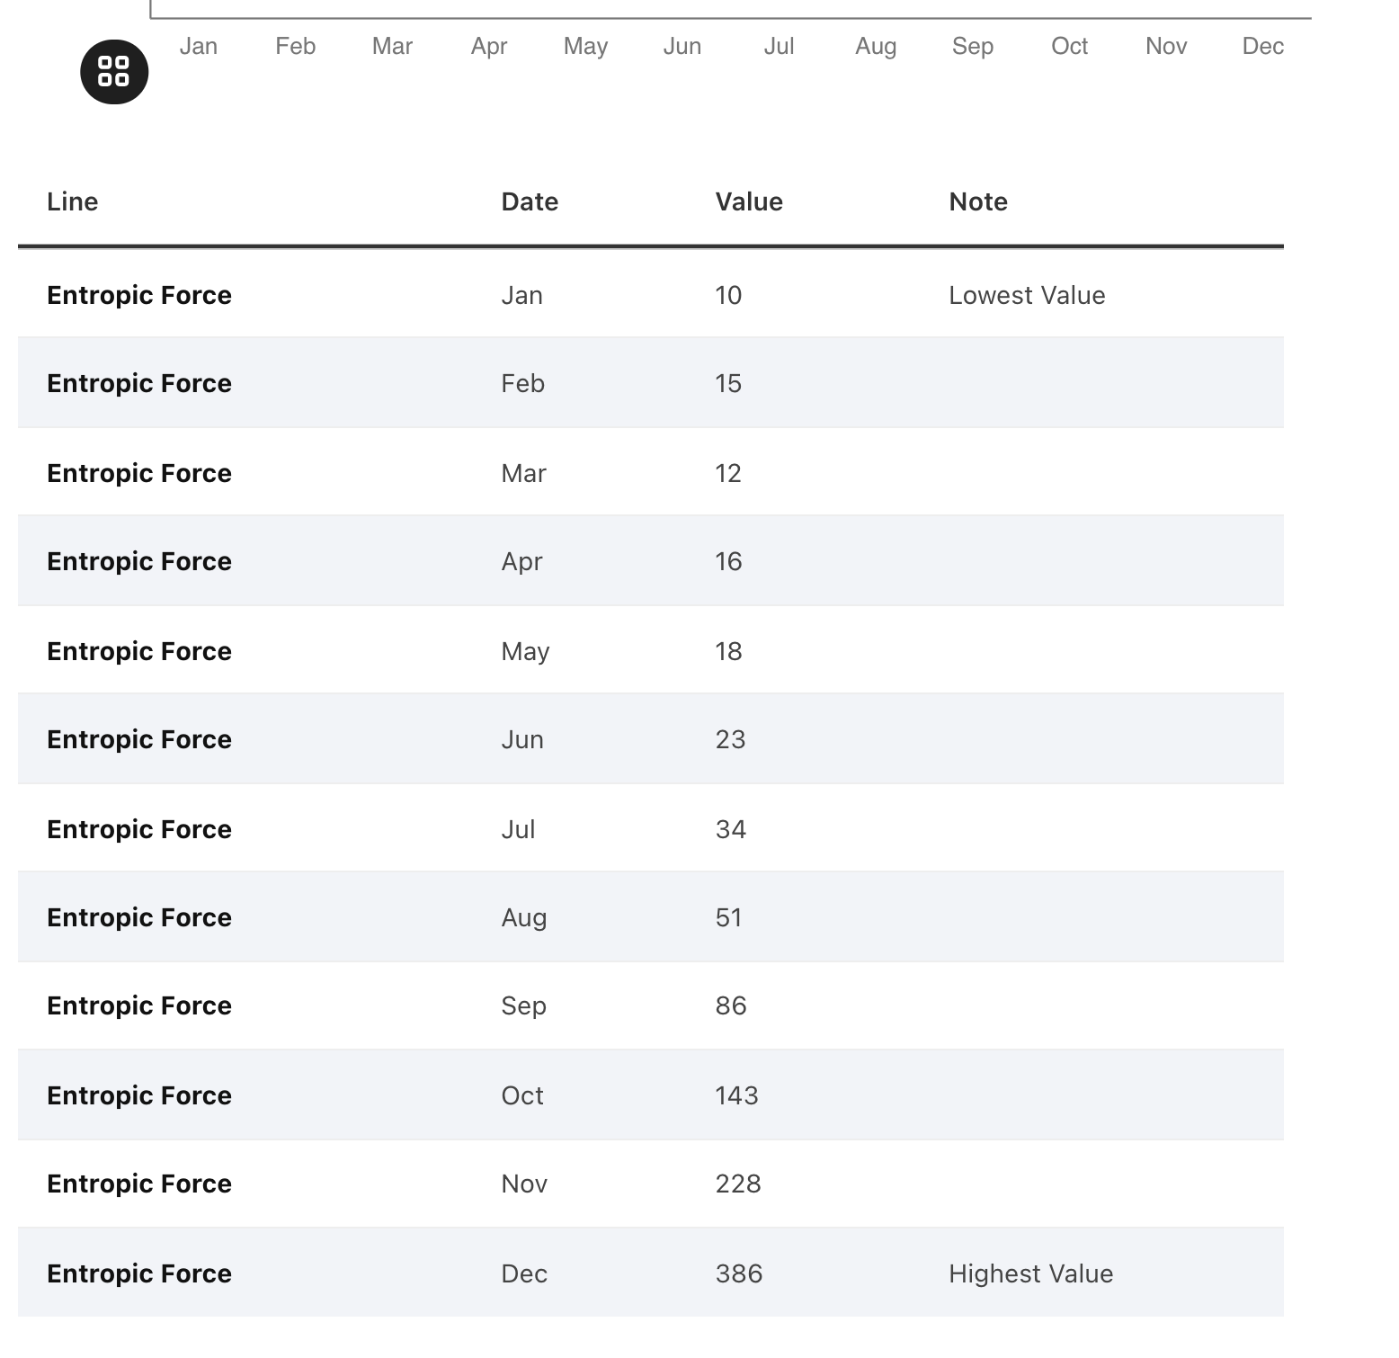
All charts should have data available!

Slide 43
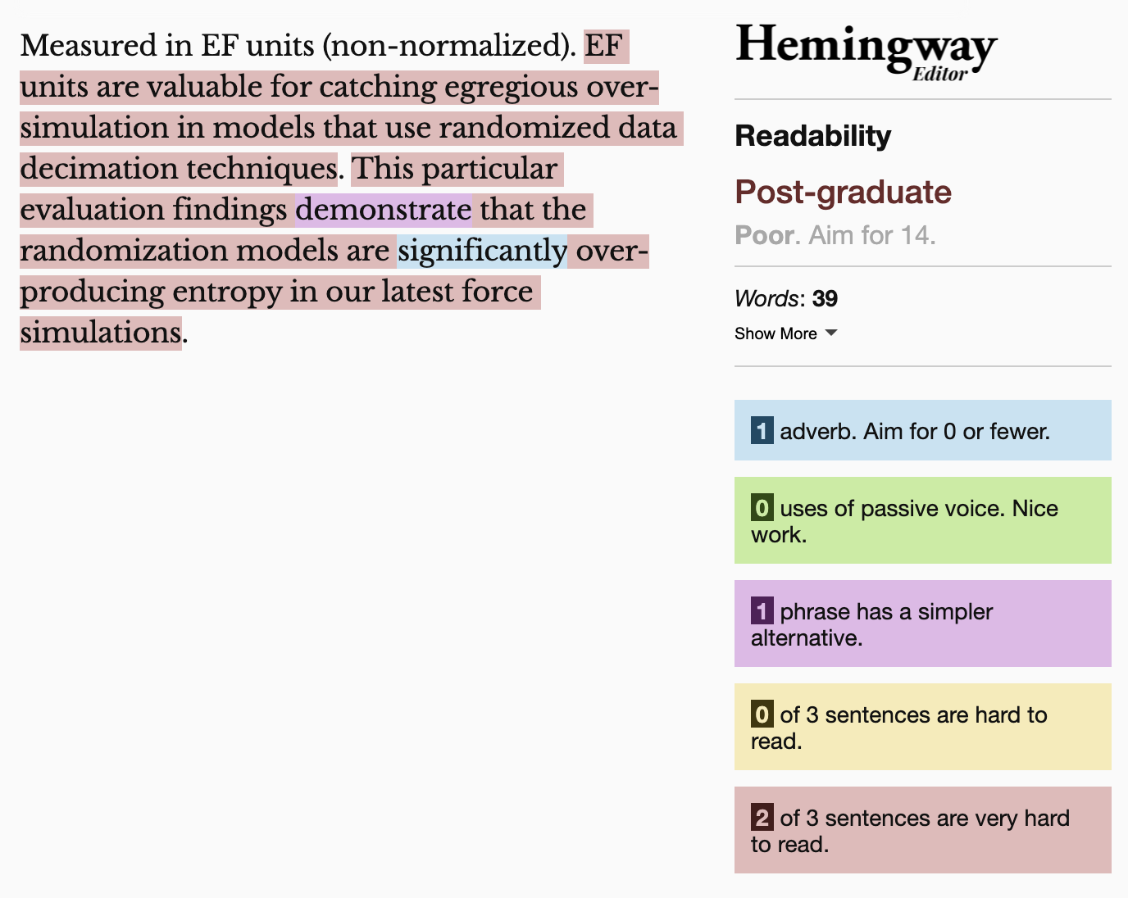
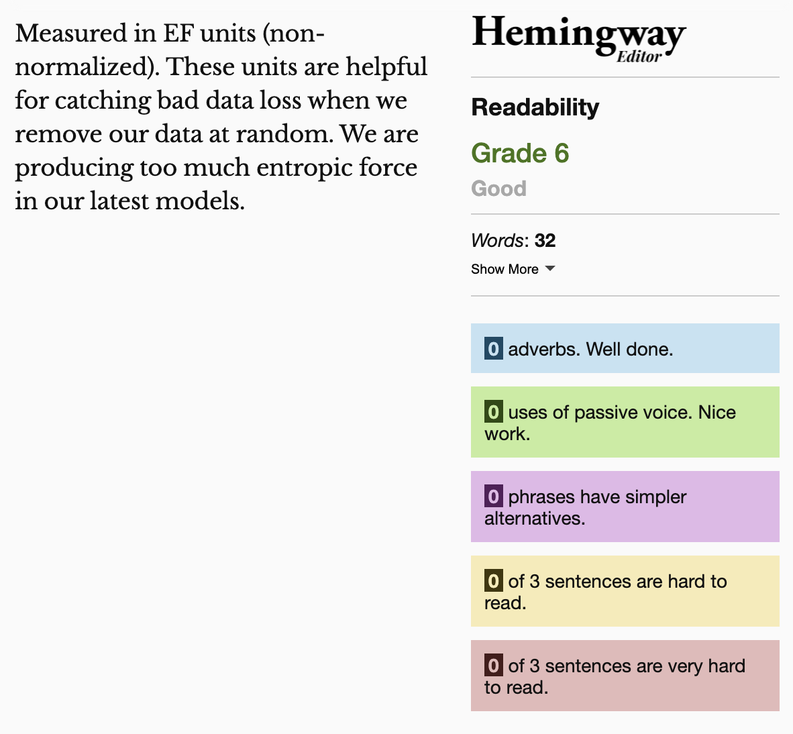
Keep summaries as non-technical as possible
If the topic is technical, provide a “plain language” summary somewhere close by that is easy to find (either in the same location or with by providing a link).

Slide 44
Understandable Evaluation Toolkit:
Is there a descriptive title, summary, or caption?
Is there an accessible table or downloadable data file provided?
Is the descriptive text supporting the visualization presented at a reading level at grade 9 or below?

Slide 45
Exercise: Group improve!
Try to give feedback on a visualization in the wild using what you just learned.

Slide 46
What you can do now
Define accessibility
Explain why people do accessibility work
Use a screen reader
Identify inaccessibility
Come up with feedback for improving accessibility

Slide 47
Q/A
Happy to answer questions about how to do this work professionally (design, engineering, research, education)
as well as any questions about data visualization and accessibility more broadly (including tools, challenges, what lies in the future)

Slide 48
Resources
A resources repository!
My twitter (@FrankElavsky)
Chartability

