Slide 1

Data Visualization and Accessibility on the Web
Frank Elavsky (He/Him/His)
Staff Data Visualization Engineer and Designer, Data Visualization Team

Slide 2
Content Disclaimer
This presentation contains no real data and examples are not based on actual events or statistics. Case studies, comparisons, statistics, research and recommendations are provided “AS IS” and intended for informational purposes only and should not be relied upon for operational, marketing, legal, technical, tax, financial or other advice. Visa Inc. neither makes any warranty or representation as to the completeness or accuracy of the information within this document, nor assumes any liability or responsibility that may result from reliance on such information.

Slide 3
Section 1: a bit of CONTEXT
Me.
My work.
My context.
Our mission.

Slide 4



Who am I?
Dog Lover: My wife Shelby and I have a 1 year old samoyed pup, Pizzelle.
Writer: In my spare time I write a tabletop rpg that I play with friends.
Vizzer: I love creating data experiences (which is how I talk about my job to others).

Slide 5
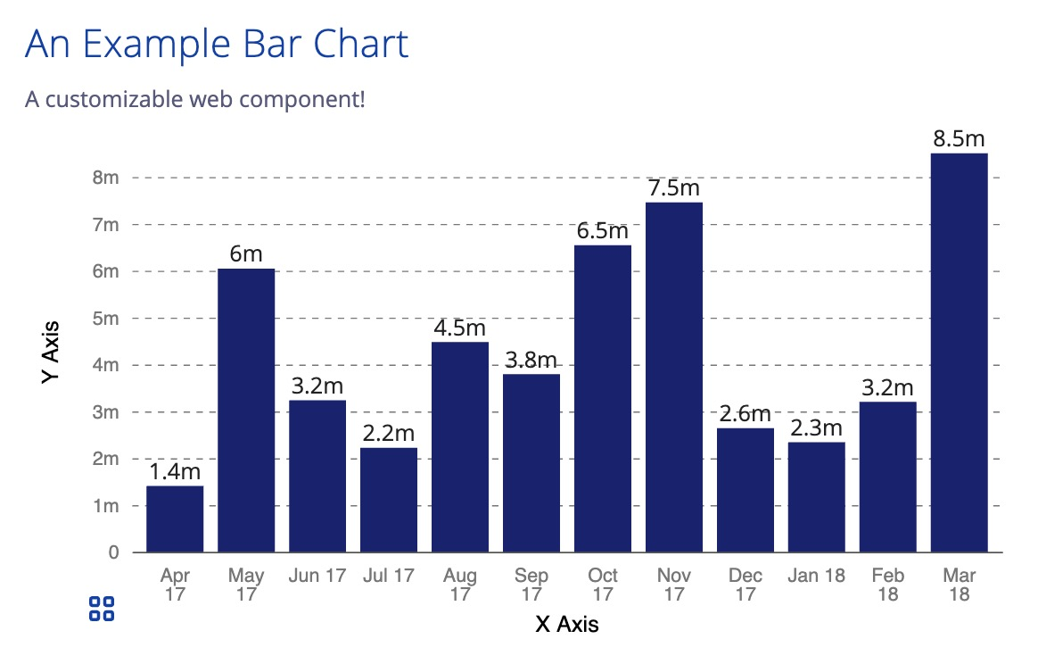
What do I do?
I am a Staff Data Visualization Engineer and Designer on Visa’s AWESOME Data Viz team.
Our Stack:
Data Visualization (D3.js).
Web Components (Stencil).
Visa Design Systems (VDS).
I previously worked in Federal and Academic research spaces, related to data visualization.

Slide 6
I’m still learning
Hopefully, my findings and process are useful to all of you, even though I am still learning.
But (selfishly) the real value that I get out of this is the chance to receive feedback and grow.

Slide 7
So why Design Systems?

Slide 8
Design Systems as Infrastructure
When you create a component, it is used all across your organization. “Design once, use everywhere.”
With a design system, you get:
Scale
Efficiency
Consistency
Design systems are a good approach for large companies.
More reading: https://uxdesign.cc/design-systems-62f648c6dccf
Notes:
3min target time

Slide 9
Why Web Components?

Slide 10
Our team’s first users: Developers
Web Components are framework-agnostic. React, Angular, and even stuff in the future can consume our code. They're part of the web now! (Polyfills help older browsers use them too.)
“Develop once, use everywhere.”
Web Components work well with design systems at a large company. We can support older systems (jQuery, etc) and empower our company to pivot to new web tech too.

Slide 11
So why make our stuff “accessible”?
I believe that data visualization is (at its core) already an attempt to make data more accessible.
However, data visualization privileges visual accessibility, which can cause serious accessibility issues! This work is needed.

Slide 12
Accessibility only at the end is too expensive
Big debt awaits those who add accessibility too late.
Late accessibility:
Has expensive retrofitting.
Sees minimal opportunities for research.
Can’t afford many iterations (if any) and isn’t very agile.
Assumes expertise isn’t part of the team and must be brought in.
Typically ends up with a result which is rushed and lackluster.

Slide 13
Accessibility is the infrastructure of Usability
Nice.
Accessibility is not a feature.
It is as low-level and important as the web page itself, as databases, data pipelines, servers, and any other critical technology.
Accessibility is necessary for the user’s experience to even exist.
Proficiency
Is it efficient?
Reliance
Is it trusted and forgivable?
Infrastructure
Can it be accessed? Does it function?

Slide 14
Section 2: a bit of THEORY
Assumptions and Hypotheses.
Going beyond the table.
Data is painful.

Slide 15
Data Visualization Accessibility Basics: not covered here.
Between WCAG, VGAR, and Section 508, our team has nearly 100 different design considerations we’ve worked on (and are still working on).
But going through all of those is outside the scope of our time today. Perhaps in a 3+ hour workshop someday (wink wink Access U folks), we could touch on the fundamentals more thoroughly.
(Not even joking, I could give a talk about accessible color strategies in data viz for an hour and a half.)

Slide 16
on Assumptions and Hypotheses
We (our team and the field at large) are still learning.
Our team operates on a combination of existing literature as well as our own hypotheses (considering what the literature lacks or is still exploring).
So you could say that we are entering uncharted territory (pun intended).
(If any researchers want to collaborate, please get in touch!)

Slide 17
Going beyond the table
Many analytical, dashboard-building tools will give the user access to a table and call it good.
This is considered “providing equal access to the chart’s information” by a lot of companies.
I want to challenge that.

Slide 18
If a data table is considered “equal access,” why do we even visualize at all?

Slide 19
But really, why do we visualize data?

Slide 20
Data is painful.
We visualize because it increases ease, efficiency, and joy when gathering insights that are based on information.
Data can be massive, complex, and/or rapidly changing. Dealing with data like this is daunting.
Visualization helps make all of that bearable (and I’d even argue enjoyable too).
https://nuitrcs.github.io/intro_to_viz_workshop/#/22

Slide 21
In analytical apps: Visualization is a delivery vehicle for tools
It helps us get to insights faster and carries a lot of our burdens for us.
Think of it as a literal delivery truck, carrying insights and features. It drops these items off at your work site as a convenience to you, so you can continue to do your work as efficiently as possible.

Slide 22
Giving your users a table is telling them to walk: “get it yourself.”

Slide 23
Still: why are charts less painful? How and what do they “deliver”?
I’ll argue 4 things are relevant for this talk.

Slide 24
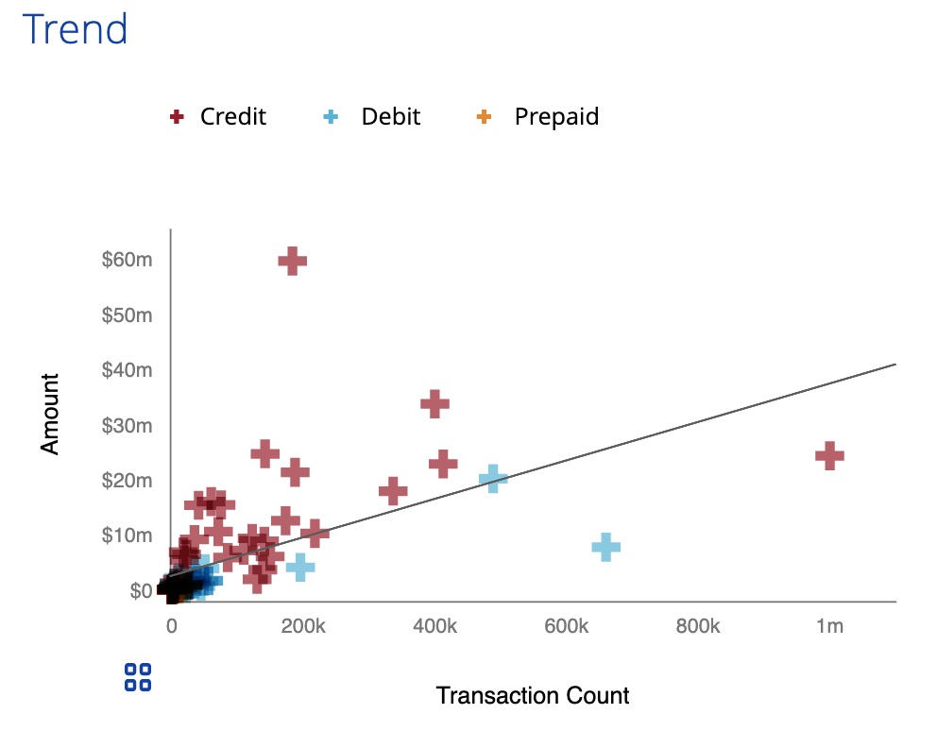

1. What is “visually apparent”
Charts can quickly reveal (through sighted means) summary information within the chart space, such as trends or outliers. This is called “visual statistics.”
The context of the chart also helps determine its purpose, message, and relevance.

Slide 25
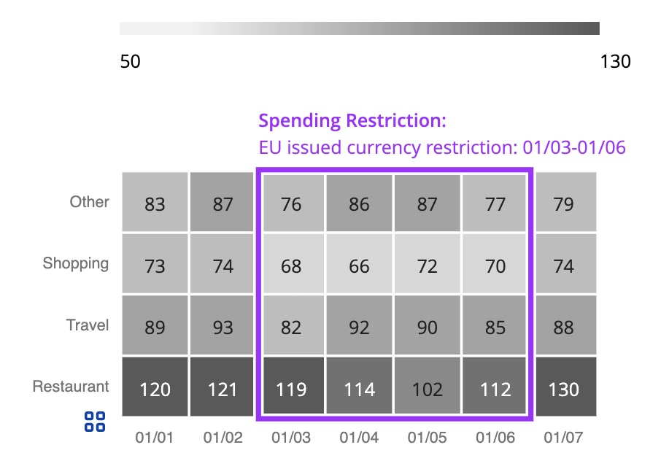
2. Annotations can guide interpretation
Some charts need a little help.
Annotations (as higher-order marks than the geometries of the chart) make it easier to know where to start, what visual features are insightful, or what supplementary context can help explain the data.
(You get to have annotations.)
(Who annotates a table?!)

Slide 26

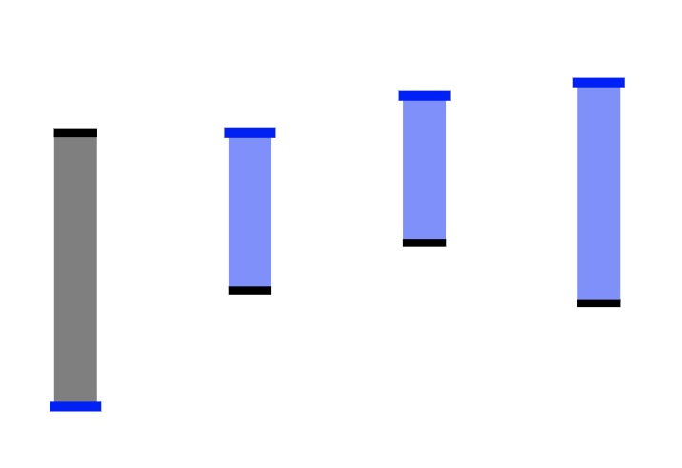
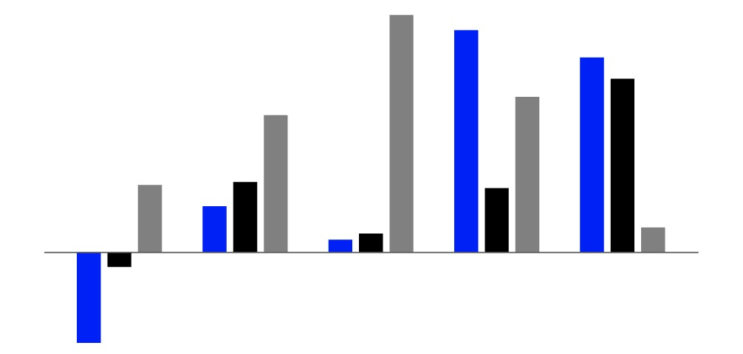
3a. Arranging the geometry improves the information
Not all insights that we visualize are tabular:
Hierarchical relationships.
Paired/difference metrics.
And nested/grouped categories.
Insights from these structures are different than insights from a tabular structure.

Slide 27
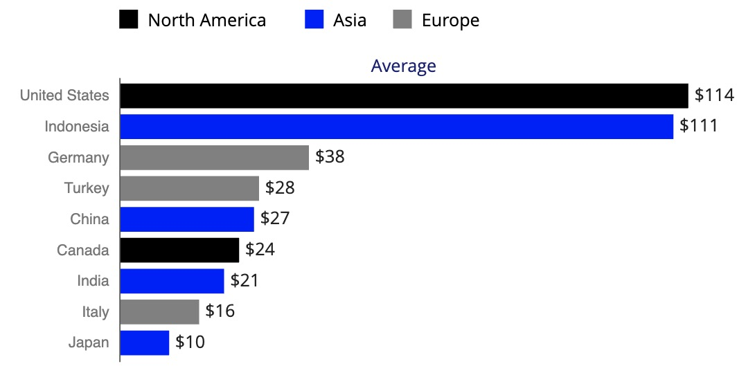
3b. Navigating a chart made from tabular data can be more seamless than the table
What about tabular data with non-serial grouping? You could sort the table below by region, but you would lose the sorting by value. Color (in the chart) allows visual grouping in addition to sorting by value.
Tables would need to have a “next sibling in category” navigation (or equivalent) in order to expose the access sighted users have.
Region | Country | Value
North America | United States | $114
Asia | Indonesia | $111
Europe | Germany | $38
Europe | Turkey | $28
Asia | China | $27
… | … | …

Slide 28
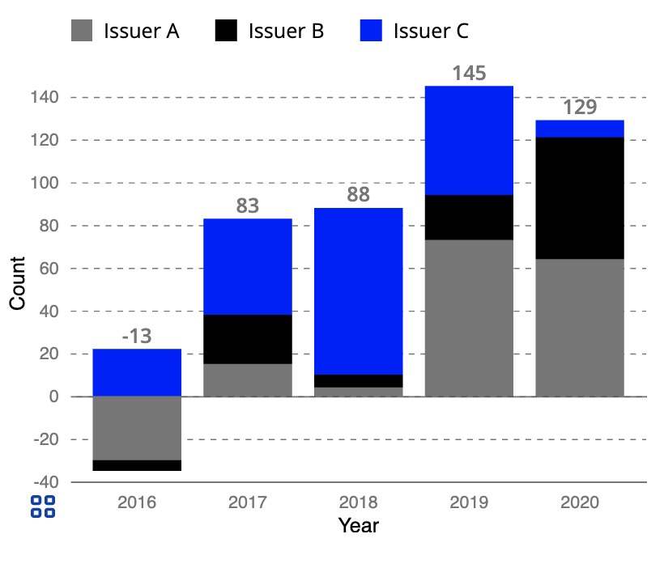
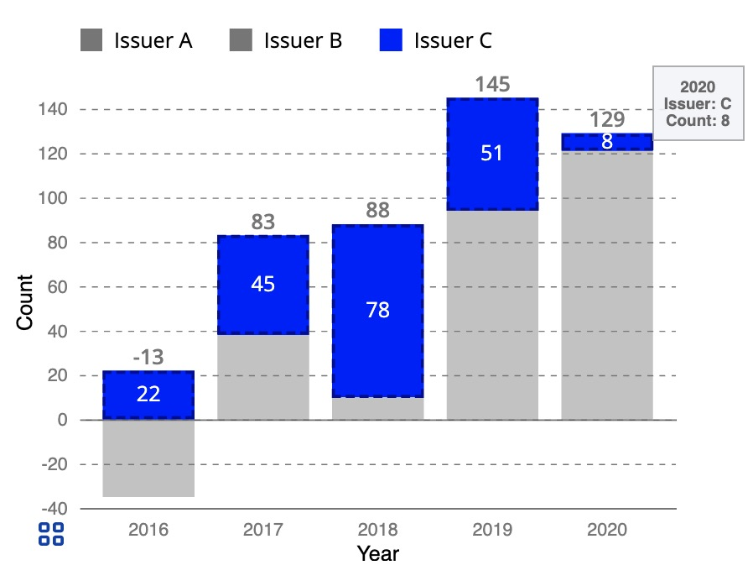
4. Filtering the visual space is often dynamic
Sometimes charts can perform some powerful filtering actions as the user is parsing the chart.
These dynamic and convenient visual-filtering (or visual re-arranging) actions are often not easy to do in a table because they would require re-drawing or re-filtering the table constantly.
In the example on the right, we are de-emphasizing Issuer A and B geometries while adding labels to Issuer C all in a single mouseover operation.

Slide 29
Section 3: a bit of PRACTICE
Props.
ARIA (advanced).
Interactivity.

Slide 30
Robust + Flexible Props
We create pretty darn accessible chart components by default.
But we use a props methodology that allows developers to finish the job: only they are the true authors of their content. They are the ones who really know what each chart is for.

Slide 31
Props: Validation
Our components have a prop: accessibility.disableValidation, which is set to FALSE by default.
This means that all of our charts will put warnings in the JavaScript console if any props have not been supplied, are invalid, or have too little or too much information supplied.

Slide 32
Props: Why validate?
Requiring robust descriptions can encourage content authors to think more about the story they are telling.
Designers and developers should practice the art of captioning and providing universal descriptions for their artifacts. It’s a good skill to have!

Slide 33
Props: Flexible Descriptions
Our charts expose props that allow developers to supply the following information, which will be read by screen readers when the chart area receives focus:
accessibility.title (if not supplied to the chart)
accessibility.executiveSummary
accessibility.purpose
accessibility.longDescription
accessibility.context
accessibility.statisticalNotes
accessibility.structureNotes

Slide 34
Props: the executiveSummary
If a busy person were to see this chart, what would the one to two-sentence conclusion or outcome be?

Slide 35
Props: the purpose
Why was this chart included at all? What job or question does it help the user tackle

Slide 36
Props: the longDescription
What further information can be summarized about this chart, beyond the findings? Anything caveats, captions, or credits worth mentioning?

Slide 37
Props: the context
What other elements of the application affect this chart (or does this chart affect)? Examples can include: filters, data tables, other charts, etc.

Slide 38
Props: the statisticalNotes
Is there anything about the metrics, stats, or data that are worth mentioning? Anything that is visually apparent about the statistics, such as regions of clustering, outliers, trends, or other noteworthy statistical findings?

Slide 39
Props: the structureNotes
Is there anything else visually apparent in this chart that isn’t mentioned in any of the other sections?

Slide 40
Props: Example Descriptions (visually hidden)
(h2) Chart Title: Example Bar Chart
(h3) Chart subtitle: This bar chart is an example in our demo and documentation application.
(h3) Long description
(p) This is a chart template that was made to showcase some of the capabilities of Visa Charts Library
(p) This chart's current data can be changed by using the Change Data button (before this chart). The props used by this chart are set in the props control panel below.
(h3) Executive summary
(p) This chart is simply an example chart.
(h3) Purpose
(p) The purpose of this chart template is to provide an example of what props are required for a basic bar chart.
(h3) Structure
(h4) Statistical Explanation
(p) This chart is using dummy data.
[programmatically generated] (h4) Chart description
[programmatically generated] (p) This is a bar-chart with 12 bars.
[programmatically generated] (p) The chart has a horizontal X Axis, titled X Axis with a range that starts with Apr 17 and ends with Mar 18.
[programmatically generated] (p) The chart has a vertical Y axis, titled Y Axis with a range that starts with 0 and ends with 8m.
(h4) Notes about visual structure
(p) The chart shows each month's performance, in millions (abbreviated).

Slide 41
Props: sometimes data is rough
If we included the key names of data by default, our aria-labels might look like this:
“PROFIT_CALC_VALID: 8.5m. JSON_DATE_OBJECT_FORMATTED: Mar 18. Bar 12 of 12.”

Slide 42
Props: keeping labels brief by default
By default the aria-label is:
“8.5m. Mar 18. Bar 12 of 12.”

Slide 43
Props: adding more robust aria-labels
When includeDataKeyNames is set true, and the keys are made human readable:
“Profit: 8.5m. Month: Mar 18. Bar 12 of 12.”

Slide 44
Props: What if a single element has a visually apparent feature?
If accessibility.elementDescriptionAccessor is set to a certain string value, elements can have custom, data-driven insights.

Slide 45
Props: Custom label example
Setting accessibility.elementDescriptionAccessor to “Note” will add to each element’s label if the element’s data object contained a value for the property “Note”:
“Profit: 8.5m. Month: Mar 18. Note: This month is a significant outlier, with more than six times any other month’s profit. Bar 12 of 12.”

Slide 46
Props: Annotations
Every annotation added to our chart is required to have a note prop supplied, whether it is visual or hidden, in order to explain the annotation to non-sighted users.

Slide 47
Order of information: High to low
We believe keyboard navigation should follow the same drill-down pattern our visual system follows when closely examining a chart:
High level purpose/descriptions/context, "visual statistics," and immediate features are learned first.
Annotations are examined next.
Lastly, the chart area itself is slowly parsed element by element.

Slide 48
Dynamic ARIA
Labels.
Roles.
Browser considerations, lack of SVG support.

Slide 49
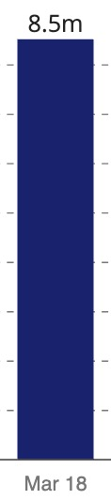
Chart labels = ARIA labels = table cells
Data for this bar looks like this:
{
value: 8500000,
month: Thu Mar 01 2018 00:00:00 GMT-0700
}
The aria labels and table cells must also show “8.5m” and “Mar 18” – not the raw data values, which are painful to see and hear!

Slide 50
ARIA roles?
Charts geometries can play multiple roles on the web.
We argue that they are not always just role=img!
Some charts are interactive and affect the content and logic of an application, as if they were a collection of UI elements.
We are interested in the expansion of aria support for more roles on SVG elements, such as button, menuitem, treeitem, and more.

Slide 51
Browser support for SVG and ARIA
It isn’t good.
HTML Validator (with w3c) can get pretty mad at us!
Props to Amcharts for this one:
Charts as role=menu and geometries as role=menuitem is a workaround to force certain screen reader+browser combinations to work.
Targeting browsers and/or using feature detection is advised.
Sometimes invalid ARIA is still parsed as-intended by screen readers, but the goal is to have fully valid markup.

Slide 52
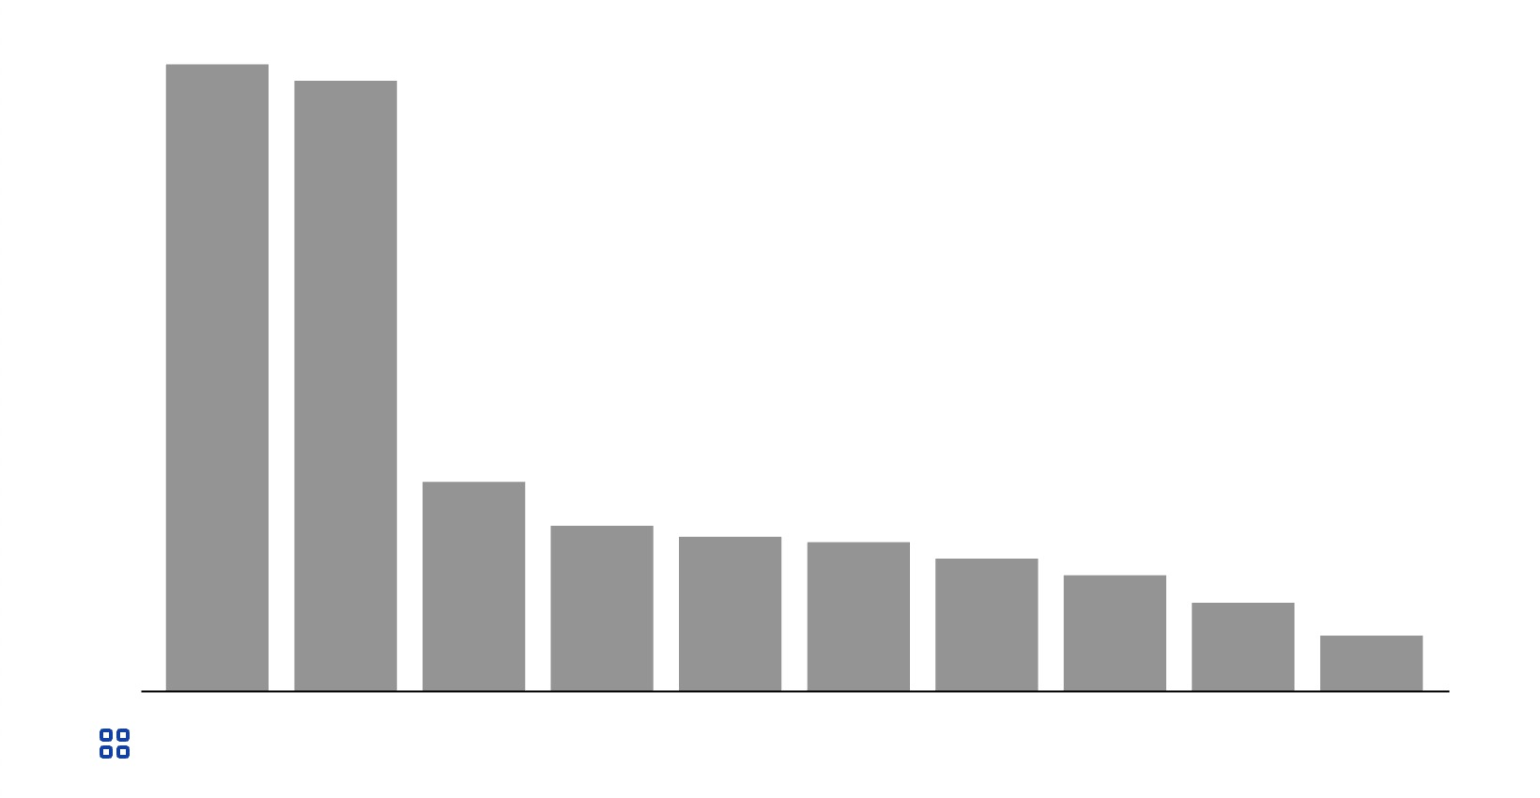
Keyboard Navigation Pattern
The following keys are available to all charts:
UP, DOWN, LEFT, and RIGHT ARROW,
TAB and SHIFT+TAB,
ENTER and SPACEBAR,
And ESC.
Some charts also have:
COMMA and PERIOD.

Slide 53
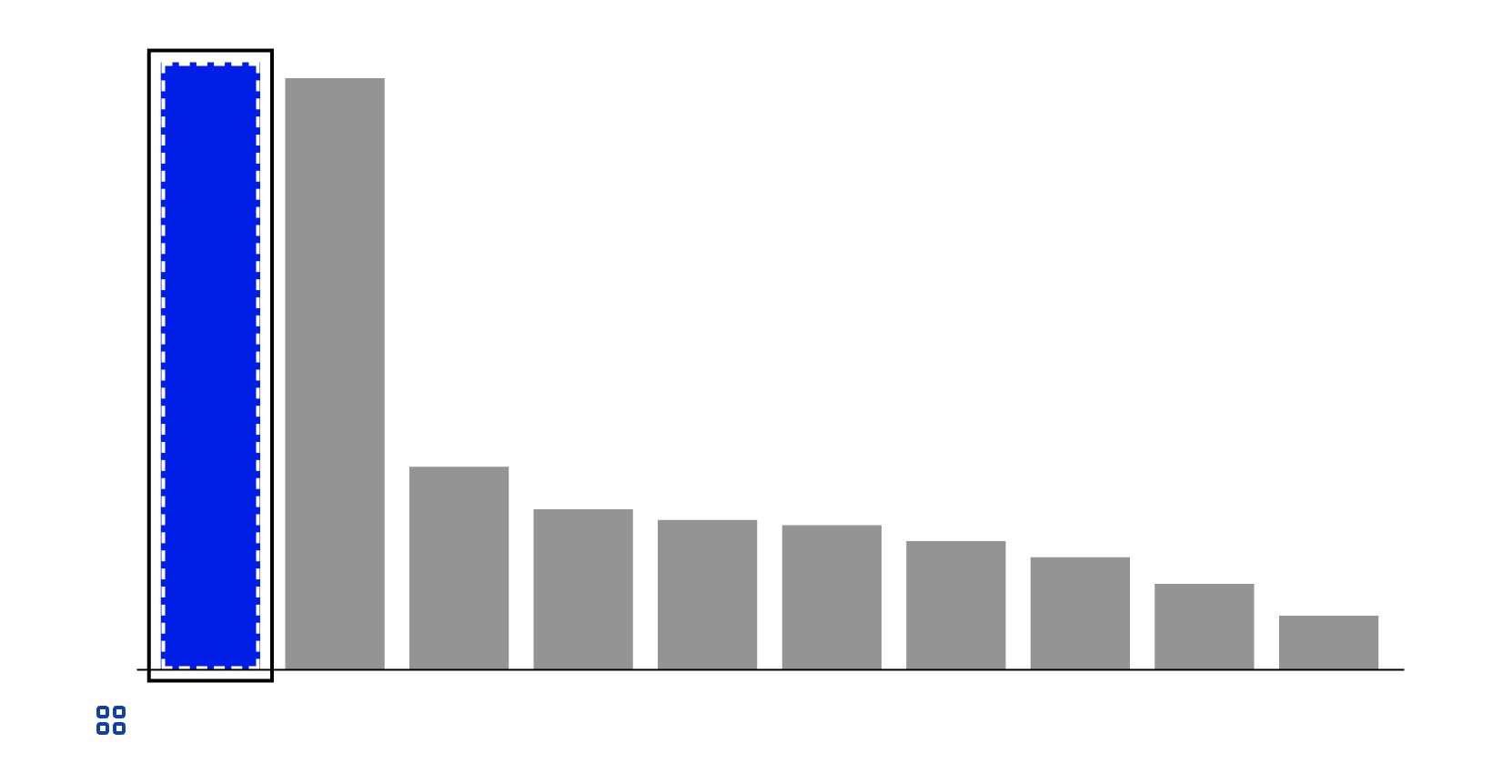
Custom Visual-Focus Indicator
Due to differences in browser focus indication and concerns for contrast across any chart content, a custom focus indicator was built.
The indicator has a white halo with a black stroke and can be placed around any <svg>, <g>, or chart element upon being focused.

Slide 54
Mirroring Event Listeners
Depending on the keys that are pressed or actions that happen, we use JavaScript to create a corresponding mouse event on the SVG chart element.
Mirrored keyboard-to-mouse events are as follows:
Focused: triggers an onMouseOver event.
Blurred: triggers an onMouseOut event.
Selected (ENTER or SPACEBAR): triggers an onClick event.
This ensures keyboard and mouse have equal access.

Slide 55
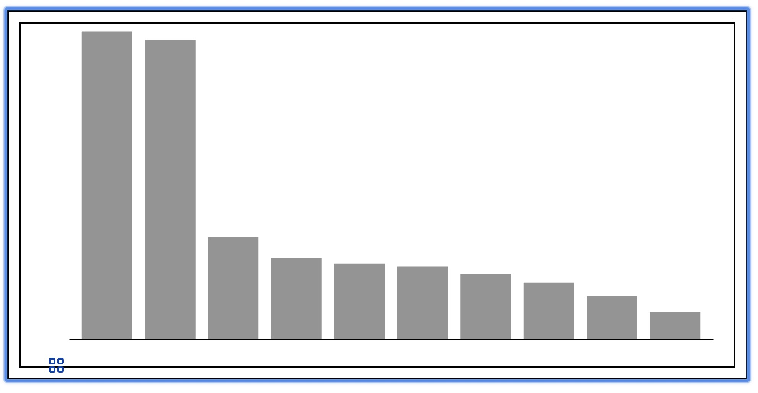
Focusing the Chart area
When the user presses TAB to the chart area and focuses it, a visual focus indication will appear around the chart.
1. User focus is elsewhere.
2. User presses TAB.
3. User focus is now here.

Slide 56
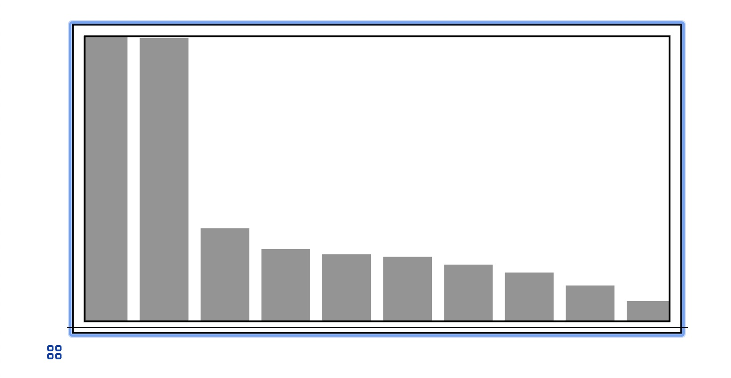
Entering the Chart area
When the user is focusing the chart area, they may press DOWN ARROW, ENTER, or SPACEBAR to focus the chart’s first group.
2. User presses DOWN ARROW, ENTER, or SPACEBAR.
1. User focus is here.
3. User focus is now here.

Slide 57
Group-level: TAB
When the user is focusing a group, they may press TAB to move forward to a sibling group. If no forward sibling group exists (like with our example below), the user will exit the chart area.
3. The user has now moved their focus to the data table button, beyond the chart.
1. User focus is here.
2. User presses TAB.

Slide 58
Group-level: LEFT and RIGHT ARROW
When the user is focusing a group, they may press LEFT or RIGHT ARROW to move to a sibling group. If no sibling group exists (like with our example below), the user will not move.
2. User presses LEFT or RIGHT ARROW.
1. User focus is here.
3. User focus doesn’t move.

Slide 59
Group-level: Shift + TAB
When the user is focusing a group, they may press SHIFT + TAB to move back to a sibling group. If no backward sibling group exists (like with our example below), the user will move to the chart root.
2. User presses SHIFT + TAB.
1. User focus is here.
3. User focus is now here.

Slide 60
Group-level: Drill Out
When the user is focusing a group, they may press UP ARROW or ESC to move back to the chart root.
2. User presses UP ARROW or ESC.
1. User focus is here.
3. User focus is now here.

Slide 61
Group-level: Drill Down
When the user is focusing a group, they may press DOWN ARROW, ENTER, or SPACEBAR to move to the first child element of that group.
2. User presses DOWN ARROW, ENTER, or SPACEBAR.
1. User focus is here.
3. User focus is now here.

Slide 62
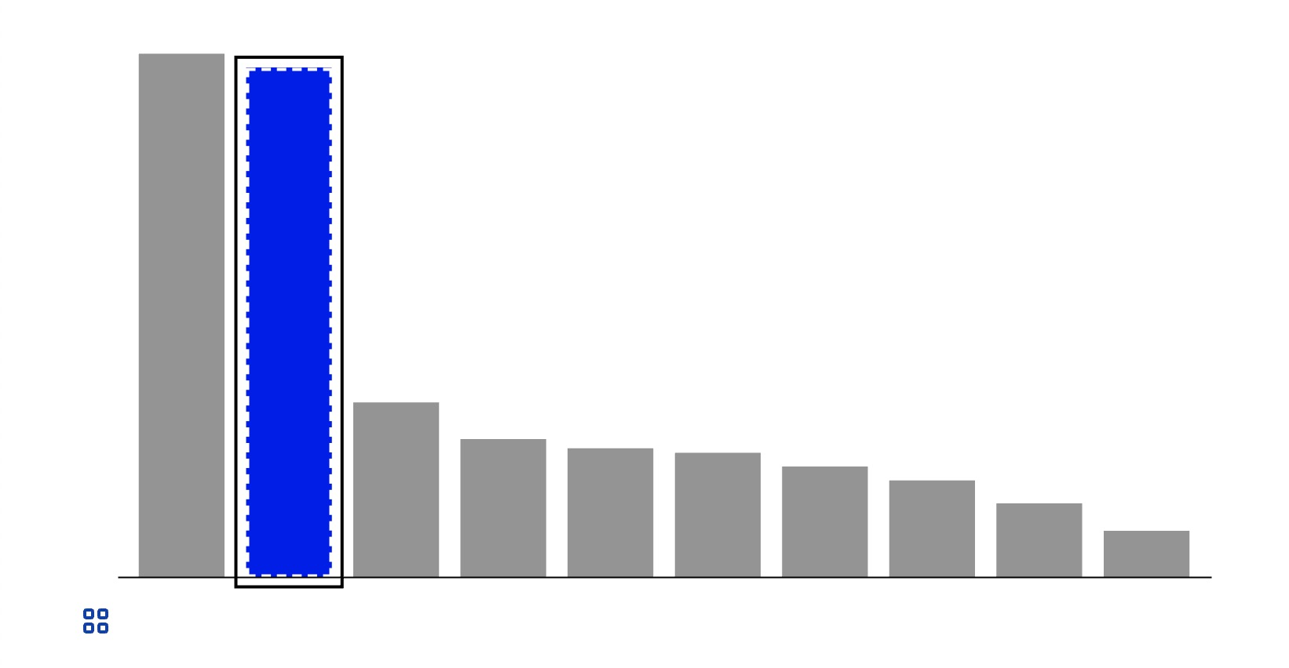
Element-level: Move Forward
When the user is focusing a chart element, they may press RIGHT ARROW or TAB to move to the next child element of that group.
2. User presses RIGHT ARROW or TAB.
1. User focus is here.
3. User focus is now here.

Slide 63
Element-level: Move Backward
When the user is focusing a chart element, they may press LEFT ARROW or SHIFT + TAB to move to the previous child element of that group.
2. User presses LEFT ARROW or SHIFT + TAB.
1. User focus is here.
3. User focus is now here.

Slide 64
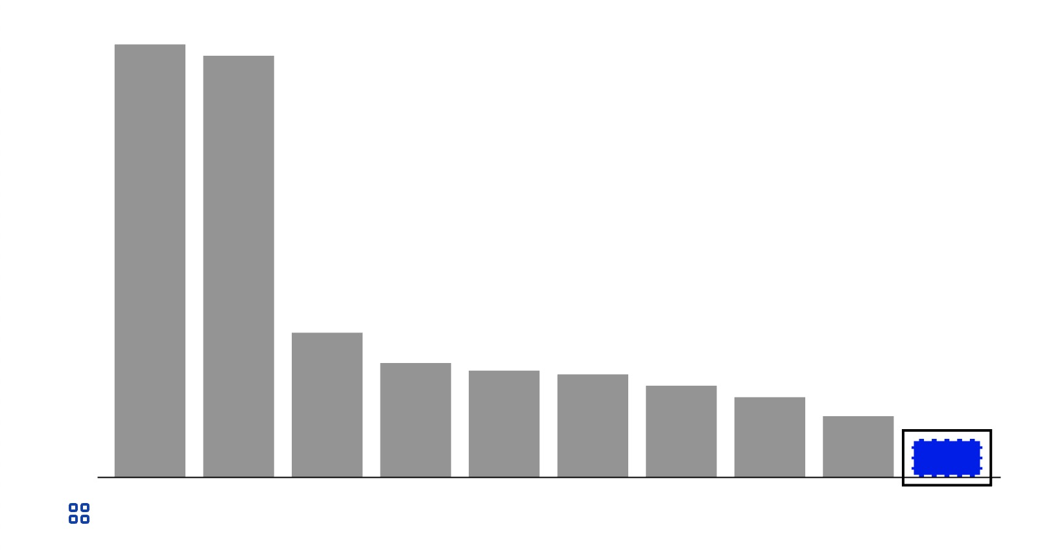
Element-level: Loop to End
When the user is focusing the first chart element of a group and they press LEFT ARROW, they will move to the last element of that group.
2. User presses LEFT ARROW.
1. User focus is here.
3. User focus is now here.

Slide 65
Element-level: Loop to Start
When the user is focusing the last chart element of a group and they press RIGHT ARROW, they will move back to the first element of that group.
2. User presses RIGHT ARROW.
1. User focus is here.
3. User focus is now here.

Slide 66
Element-level: Tab Exit
When the user is focusing the last chart element of a group and they press TAB, they will move to the forward sibling of their current (parent) group. If no forward sibling of the parent exists (like with our example below), the user will exit the chart area.
3. The user has now moved their focus to the data table button, beyond the chart.
1. User focus is here.
2. User presses TAB.

Slide 67
Element-level: Drill Out
When the user is focusing an element, they may press UP ARROW or ESC to move back to their parent group.
2. User presses UP ARROW or ESC.
1. User focus is here.
3. User focus is now here.

Slide 68
Element-level: Shift + Tab (Drill Out)
When the user is focusing the first element of a group and they press SHIFT + TAB, they will move back to their parent group.
2. User presses UP ARROW or ESC.
1. User focus is here.
3. User focus is now here.

Slide 69
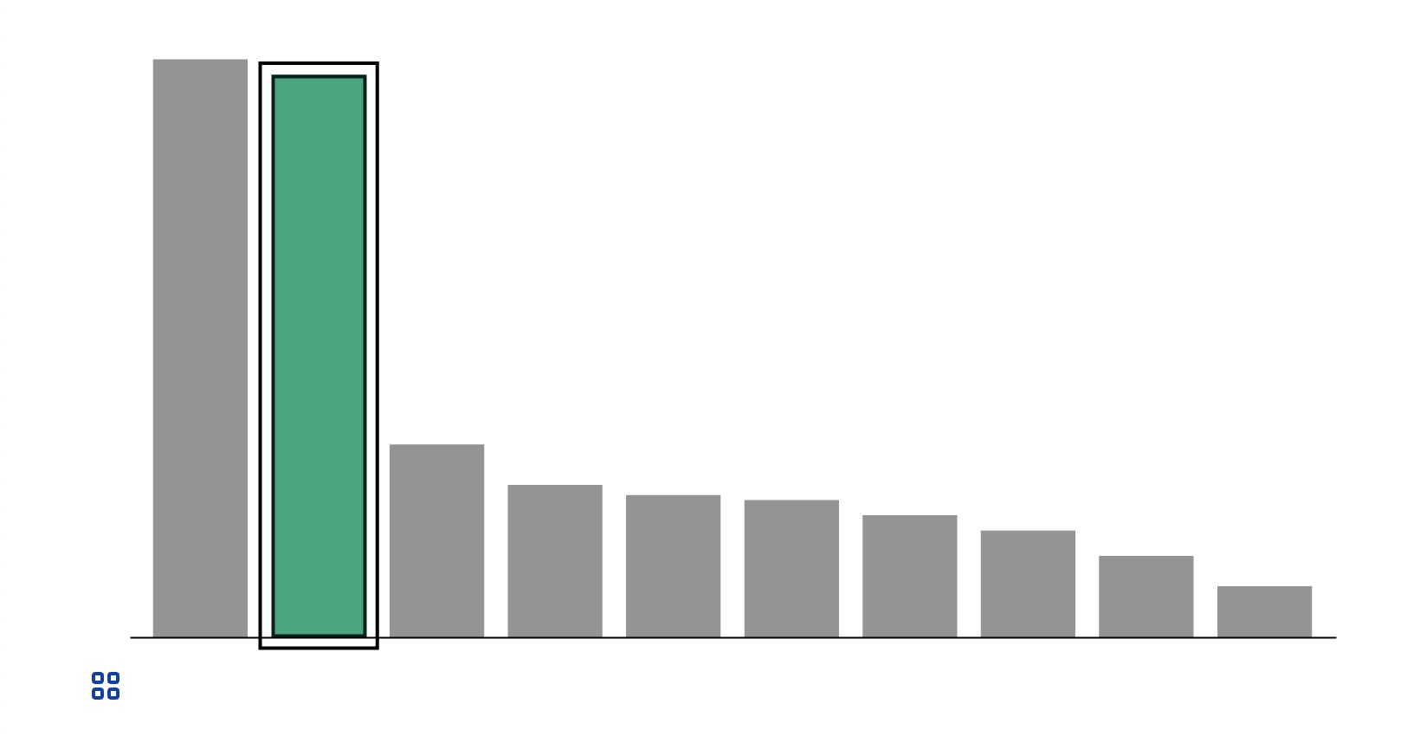
Element-level: Select
If the application has added logic to the onClick Event() on a chart and the user is focusing an element, they may press ENTER or SPACEBAR to activate or de-activate an element.
2. User presses ENTER or SPACEBAR.
3. User focus stays here, bar receives new styling (from application logic).
1. User focus is here.

Slide 70
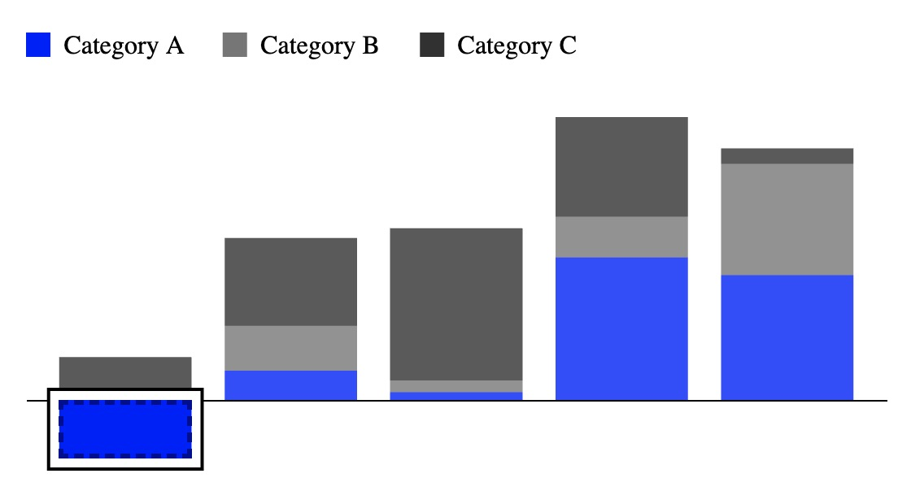
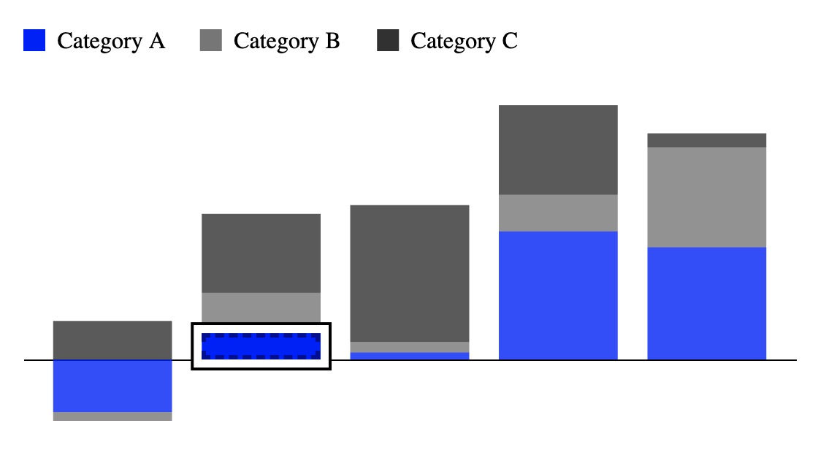
Cross-Group Element: Next Cousin
When the user is focusing an element and the chart contains cross-group categories, they may press PERIOD to leave their group and move to the next group’s corresponding child element of the same category.
2. User presses PERIOD.
1. User focus is here.
3. User focus is now here.

Slide 71
Cross-Group Element: Previous Cousin
When the user is focusing an element and the chart contains cross-group categories, they may press COMMA to leave their group and move to the previous group’s corresponding child element of the same category.
2. User presses COMMA.
1. User focus is here.
3. User focus is now here.

Slide 72
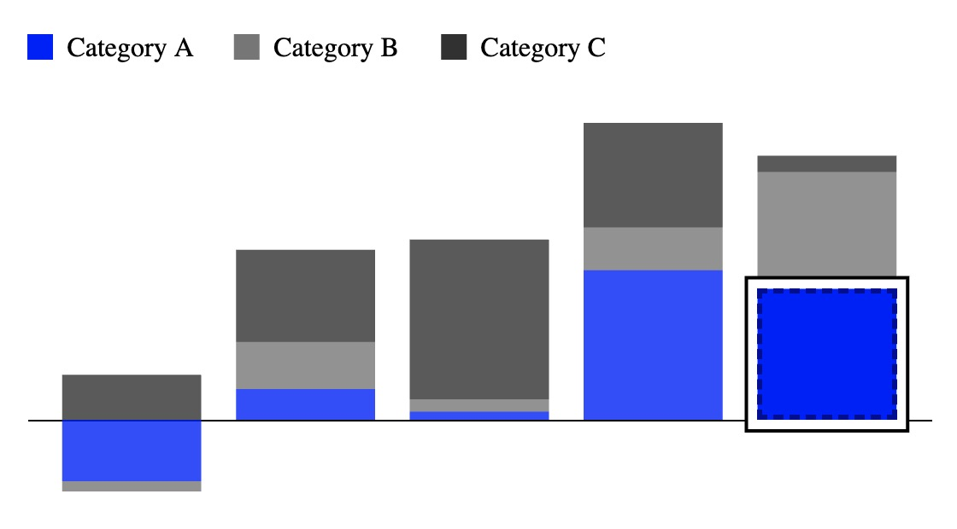
Cross-Group Element: Loop to Last Cousin
When the user is focusing an element in the chart’s first group and the chart contains cross-group categories, they may press COMMA to leave their group and move to the last group’s corresponding child element of the same category.
2. User presses COMMA.
1. User focus is here.
3. User focus is now here.

Slide 73
Cross-Group Element: Loop back to First Cousin
When the user is focusing an element in the chart’s last group and the chart contains cross-group categories, they may press PERIOD to leave their group and move to the first group’s corresponding child element of the same category.
2. User presses PERIOD.
1. User focus is here.
3. User focus is now here.

Slide 74
Browser support for SVG keyboard interactivity and aria-labels
Navigating SVG with a keyboard isn’t something every screen reader and browser can do well. Some can be tricky!
Internet Explorer 11 (IE 11) struggles especially (I tested with NVDA) and does not support the aria-label attribute on SVG.
We need an approach that takes everything we have applied until now, but works even on older browsers!

Slide 75
A cross-browser solution: the Controller
Controller
Controller mirrors the interactivity of the chart, but only has up to 3 elements at a time (charts can have many).
Made of only HTML (IE safe!).
The controller is invisible and keyboard discoverable instead of the chart space.
If using a controller, chart’s aria and tabindex should be disabled.

Slide 76
Controller “Nodes”
At any given moment, the controller retains up to 3 “nodes”.
A “node” is a <div> that contains a <p> element. Each <p> has tabindex = 0.
The <p> element contains text that matches a chart element’s aria-label:
“Profit: 8.5m. Month: Mar 18. Bar 12 of 12.”
A node:
< div class = ‘hidden’ >
< p tabindex = 0 >
Profit: 8.5m. Month: Mar 18. Bar 12 of 12.
</ p >
</ div >

Slide 77
Why 3 nodes?
One node is the user’s current focus. Then there is one more node each for TAB and SHIFT + TAB elements.
Note: Intercepting TAB doesn’t always work, so the forward and backward TAB elements must be made ready (if they exist).
We render other nodes as-needed (for other keyboard commands).
Controller
Current Focus
SHIFT+TAB
TAB

Slide 78
Controller Pattern
When the user is focusing a node, all of the previously mentioned interactivity rules apply to it, based on the kind of chart element it represents.
When the user takes a keyboard action on that node, we simulate as though that action took place in the chart space.

Slide 79
On-demand rendering: Controller only renders what is necessary for focus + tabs
Navigation causes a new focus Node to be drawn and its corresponding next SHIFT + TAB and TAB nodes (only up to one each) to be drawn as well (if they exist). The user’s focus is then moved to the new Node and the old Nodes are removed from the controller.

Slide 80
On-demand rendering: Why though?
This progressive, lean approach avoids memory concerns. Imagine if we simply imitated the chart space with <div>and <p> elements and had a data table. That would be bad news! (Lots of elements that aren’t necessary.)
Some charts have over 1000 elements! But the user only really needs to access one at a time.

Slide 81
Controller: On-Demand Render Example
3. User presses DOWN and focuses first child.
1st Child
Parent Group
2nd Child
1. User TABs to the chart area root.
4. User presses TAB and focuses second child.
Root SVG
2nd Child
1st Child
3rd Child
2. User presses DOWN and focuses first group.
4. User presses UP and focuses first group.
Parent Group
Parent Group
Root SVG
Root SVG

Slide 82
Next steps?
Moving towards the controller by default (for proper ARIA support)
Fixes and regular maintenance
Developer feedback
Usability testing (I’m really looking forward to this)
Search-to-focus functionality for non-sighted users
Mobile approaches, using the controller method
Non-SVG approaches, using the controller method
Automating text-based insights?
felavsky@visa.com, Twitter: @FrankElavsky, linkedin.com/in/elavsky

