Slide 1

Data Visualization Accessibility
Invited Talk, UC, Fall 2022
axle-lab.com
Thinking about data visualization for people with disabilities.
Frank Elavsky, PhD student at Carnegie Mellon University

Slide 2
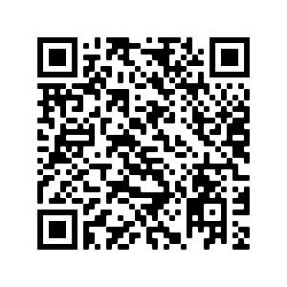
Today’s slides:
bit.ly/viz_a11y_uc

Slide 3
Who am I? A data visualization + accessibility researcher and engineer
Research: Carnegie Mellon and Apple.
Organize: DataVizA11y.
Contribute: W3C’s ARIA Working Group as an invited expert.
Create: Tools for designers and engineers who want to make accessible visualizations.

Slide 4
What you will learn today
What is accessibility?
How do you know a visualization is inaccessible?
How can you make a a visualization more accessible?

Slide 5
Discuss: What is accessibility?
Bonus discussion:
What is “Inclusive Design” and how is it different from accessibility?

Slide 6
Accessibility (some working definitions):
1. The qualities that make an experience open or usable to all.
2. The qualities that make an experience open or usable specifically for people with disabilities.

Slide 7
Colorblindness: ~4.5% of those with Eur. ancestry
Uncorrected/low vision: ~25% of all people
Vision correction (broadly): ~75% of all people

Slide 8
Severe disability: ~8.5% of all people
Functional impairment: ~17.5% of all people
Situational impairment: 100% of us at some point

Slide 9
Discuss: Why do people do this work?

Slide 10

1. Access is a human right
Accessibility is an internationally recognized human right.
It is the morally and ethically correct thing to do.
https://www.un.org/development/desa/disabilities/convention-on-the-rights-of-persons-with-disabilities/article-9-accessibility.html
https://www.un.org/development/desa/disabilities/convention-on-the-rights-of-persons-with-disabilities/article-10-right-to-life.html

Slide 11
2. It is expensive to exclude

Slide 12
15% of time spent on accessibility…
… for 26% of all people

Slide 13
Fixing inaccessibility takes 1.5 – 10x more time if done after something is built.

Slide 14
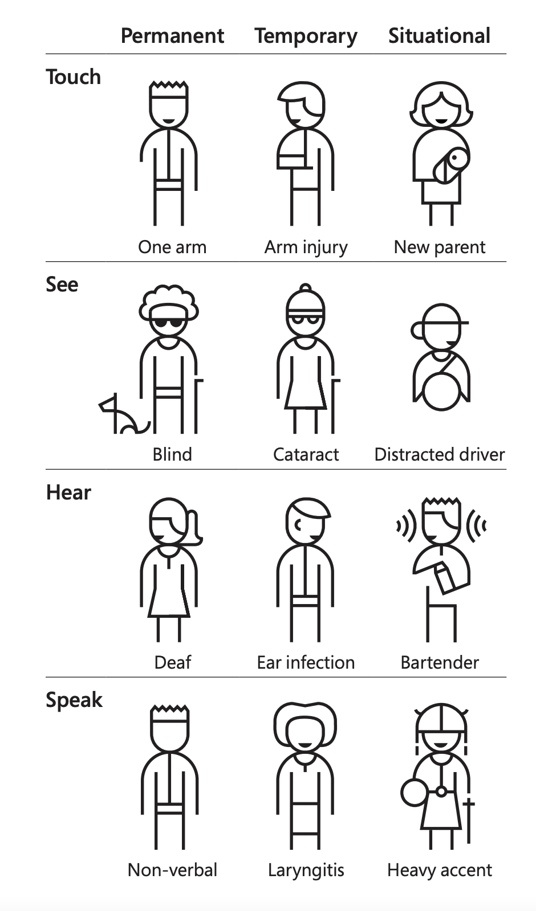
3. “Design for One, Extend to All” is better design work
Microsoft’s Inclusive Design 101 Toolkit: https://download.microsoft.com/download/b/0/d/b0d4bf87-09ce-4417-8f28-d60703d672ed/inclusive_toolkit_manual_final.pdf

Slide 15
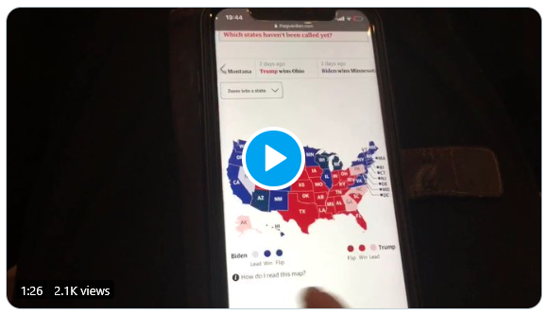
What is an inaccessible experience like?
Credit: Sarah Fossheim on twitter

Slide 16
Demo: Using a screen reader
Mac users: VoiceOver
Windows users: NVDA (requires download)

Slide 17
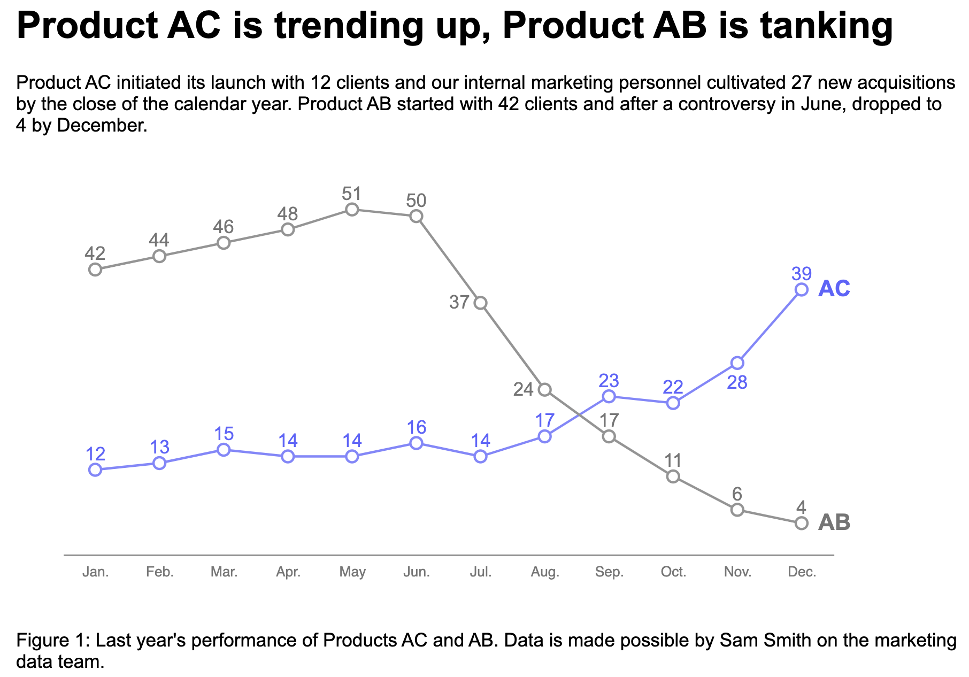
Explore: An interactive bar chart
https://frankelavsky.github.io/assessing_chart_interactivity/

Slide 18
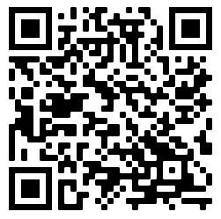
Exercise: Using a screen reader (your turn!)
https://frankelavsky.github.io/assessing_chart_interactivity/
Mac users: VoiceOver
Windows users: NVDA (requires download)

Slide 19
Discuss!
What was it like to use a screen reader?
What are some differences between the chart and the “inaccessible” version?
Why did one chart work and another not work?

Slide 20
A methods question: How do you know something is inaccessible?

Slide 21
Listen to people with disabilities.

Slide 22
There are a lot of ways to listen to PWD:
Actually ask them!
Find where they are already speaking
Find where they have already spoken:
Research
Blog posts
Accessibility standards

Slide 23
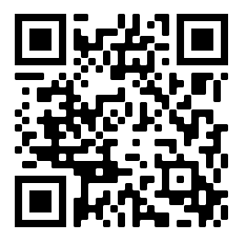
How do you make a visualization accessible?
Let’s vote on which principle we go over today!
bit.ly/viz_a11y_uc_poll
1. Perceivable: Contrast, color, alt
2. Operable: Keyboard and SR access
3. Understandable: Textual descriptions and simplicity

Slide 24
Perceivable
Can someone perceive this in multiple ways? Is each way easy?

Slide 25
Perceivable Checklist:
High Contrast
CVD-Safe + Redundant Encoding
Alt Text

Slide 26
Design with high contrast
Colorblindness Disproportionately Overrepresented in A11y Resources
Colorblindness Disproportionately Overrepresented in A11y Resources
Colorblindness: % of People
Colorblindness: % of People
4%
4%
Low Vision: % of People
Low Vision: % of People
25%
25%
Colorblindness: # of Resources
Colorblindness: # of Resources
51
51
Low Vision: # of Resources
Low Vision: # of Resources
5
5
Notes:
https://projects.susielu.com/viz-palette

Slide 27
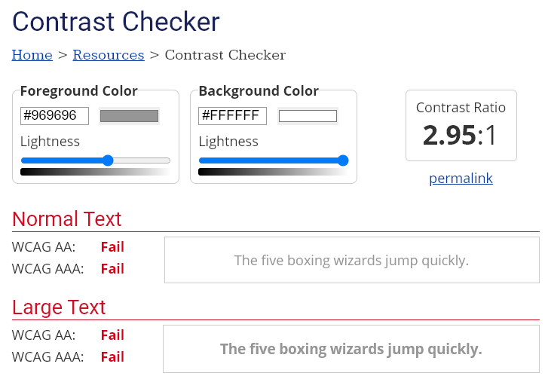
Use High Contrast Text
Text needs at least 4.5:1 contrast against its background.
Large text (bold and 16pt or larger) can be 3:1 or higher.

Slide 28
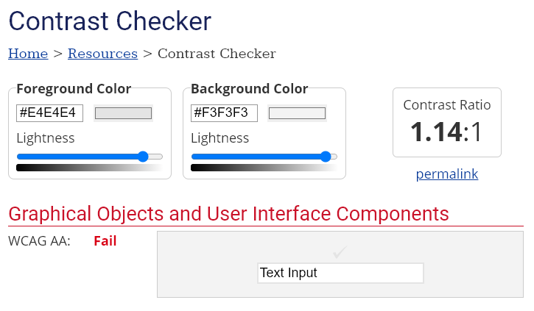
Use High Contrast Geometries
Chart elements need at least 3:1 contrast against their background.

Slide 29
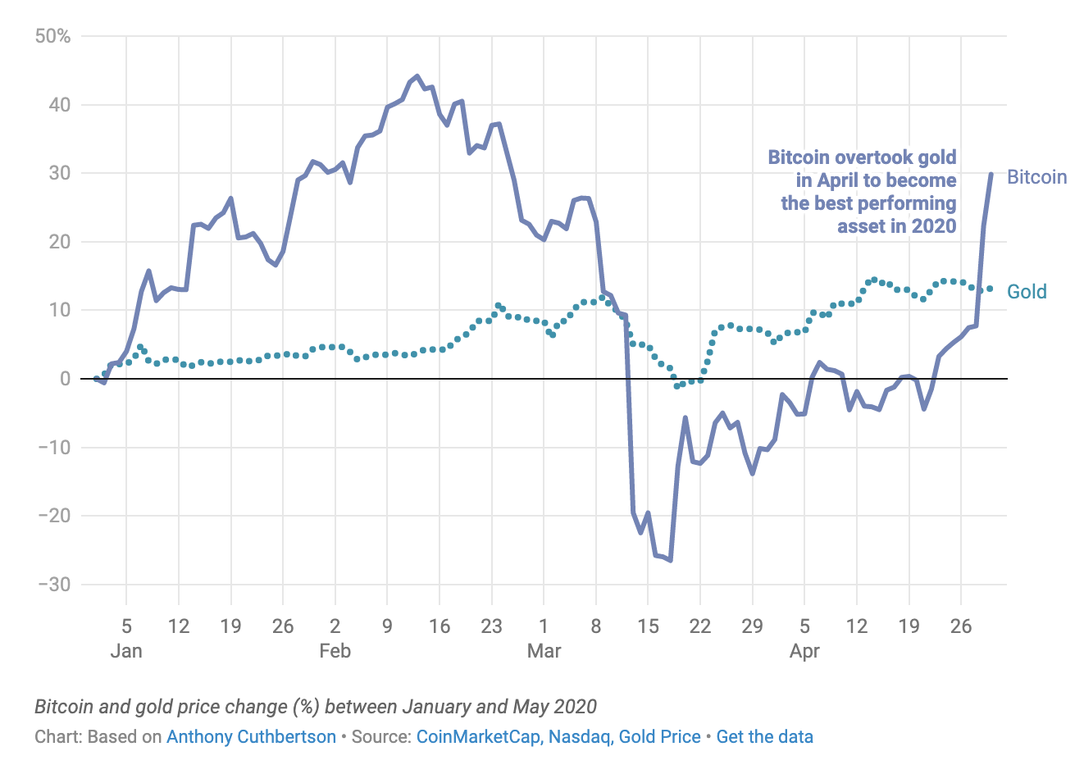
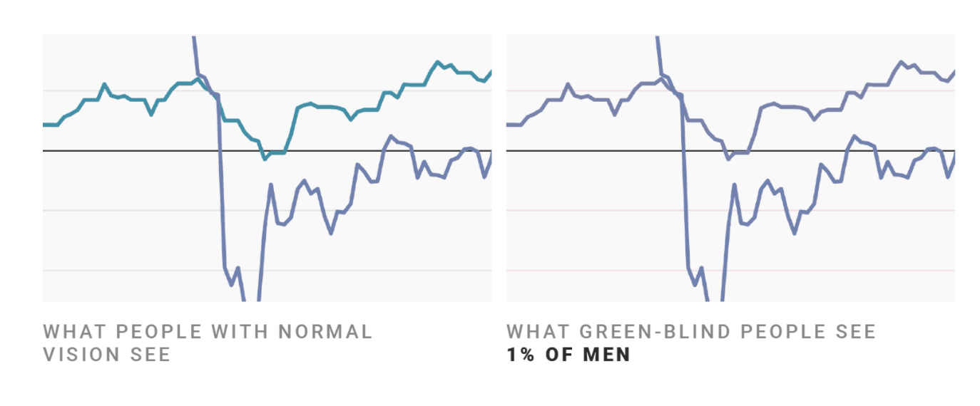
Don’t rely on color alone!
(Muth) https://blog.datawrapper.de/colorblindness-part2/

Slide 30
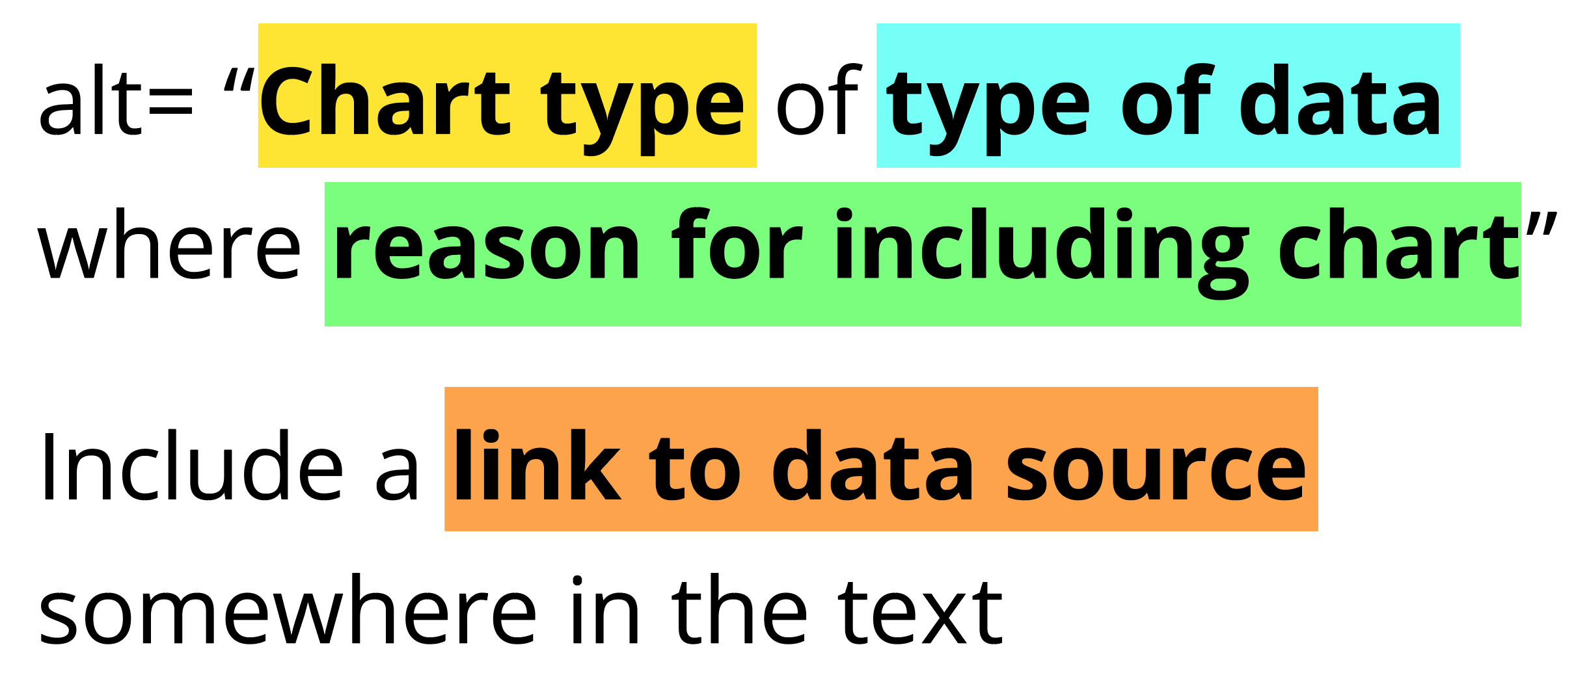
Add alt text
There is great research on alt text, but the most important thing to know is that you should add it to every image you post online (including twitter), in a document, or presentation.
Guidance: https://medium.com/nightingale/writing-alt-text-for-data-visualization-2a218ef43f81

Slide 31
Perceivable Evaluation Toolkit:
Contrast Checker
Safe color design
CVD Checker
Redundant encoding design ideas
Alt Text

Slide 32
Operable
Can someone operate this in multiple ways? Is each way easy?

Slide 33
Operable Checklist:
Mouse
Keyboard-only
Screen Reader

Slide 34
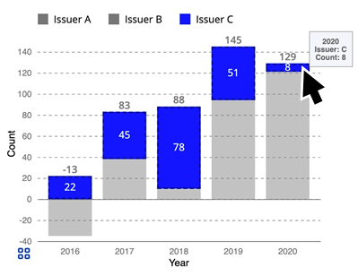
Ensure Keyboard Access (if interactive)

Slide 35
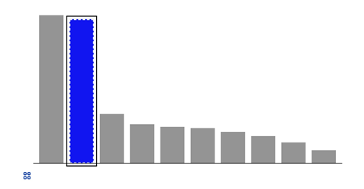
Indicate keyboard focus, use multi-modal style
This is a keyboard focus indicator (outer border) with the same styling effect applied on mouse hover (inner dashed white lines and blue fill)

Slide 36
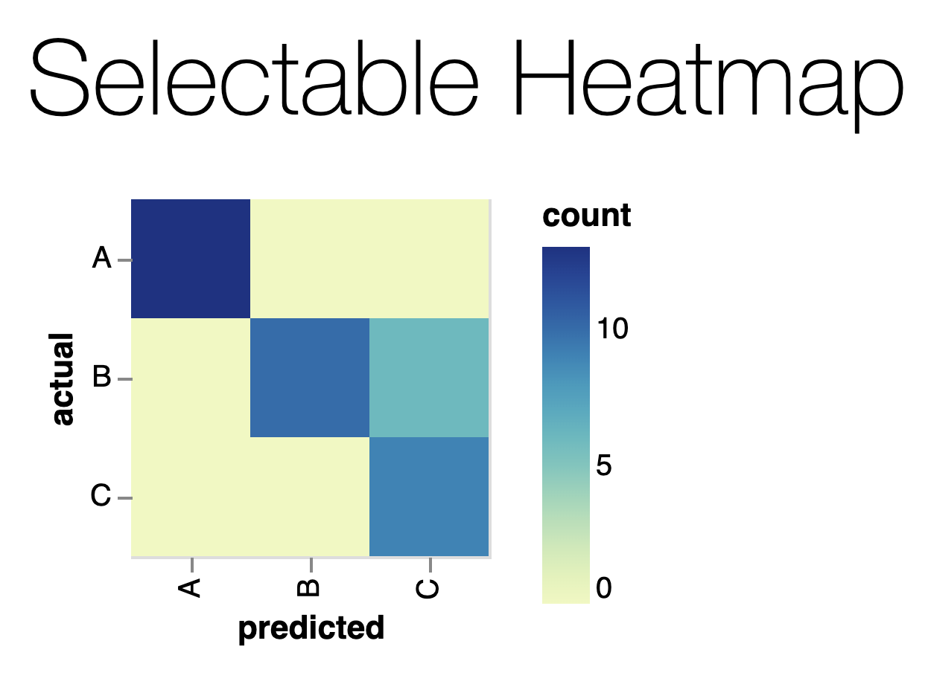
Why Keyboard-only?
Some things work for screen readers but not for keyboard-only users!
https://vega.github.io/vega-lite/examples/selection_heatmap.html

Slide 37
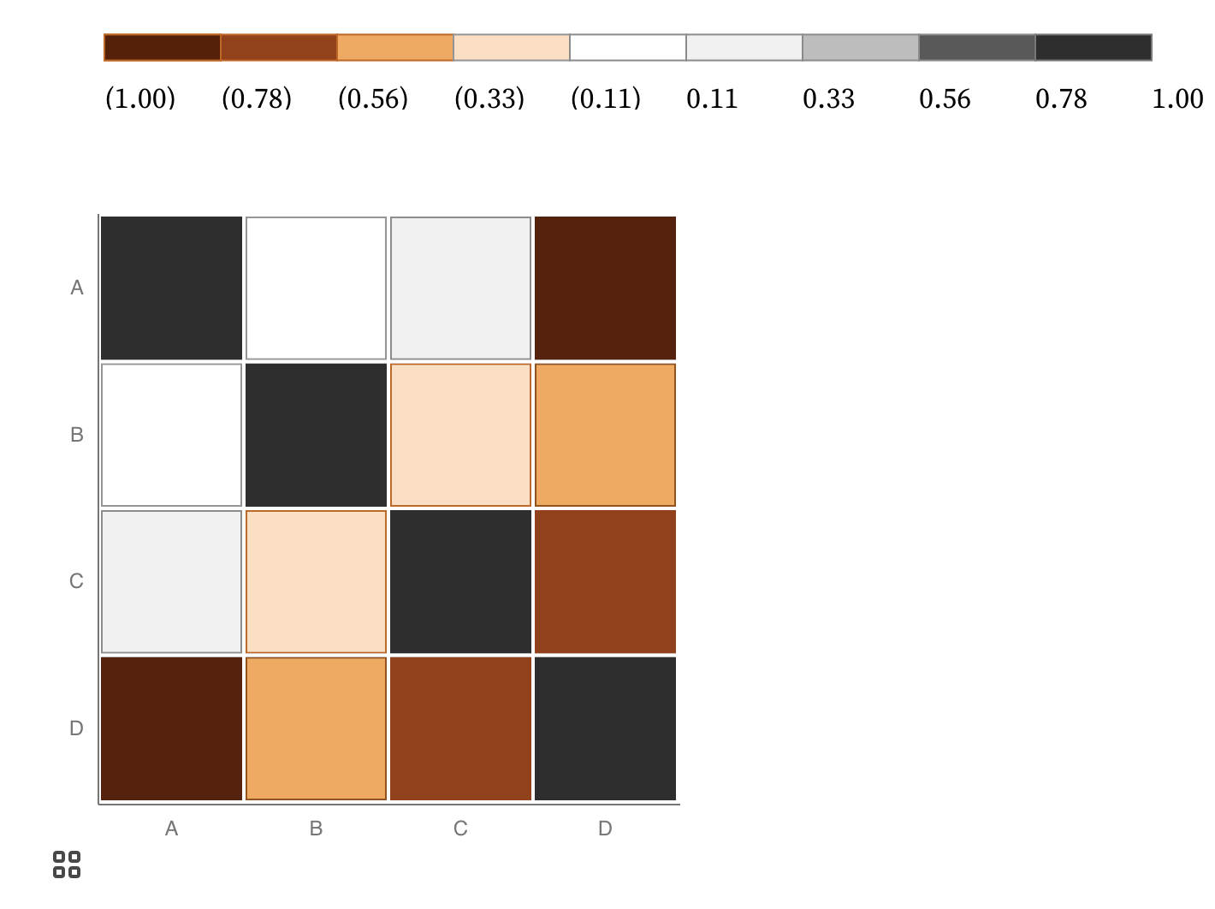
Keyboard only example:
https://observablehq.com/@frankelavsky/experimental-color-scale-textures

Slide 38
Operable Evaluation Toolkit:
Use your mouse: can it do something meaningful? (tooltip, click event, etc) If so:
Test using a keyboard-only: can you navigate and use keyboard activation (spacebar/enter) on the visualization?
Test using a screen reader: Can you use a screen reader to navigate and use keyboard activation on the visualization?

Slide 39
Understandable
Can someone understand this in multiple ways? Is each way easy?

Slide 40
Understandable Checklist:
Descriptive title, summary, or caption
Data table or data download
Reading level

Slide 41
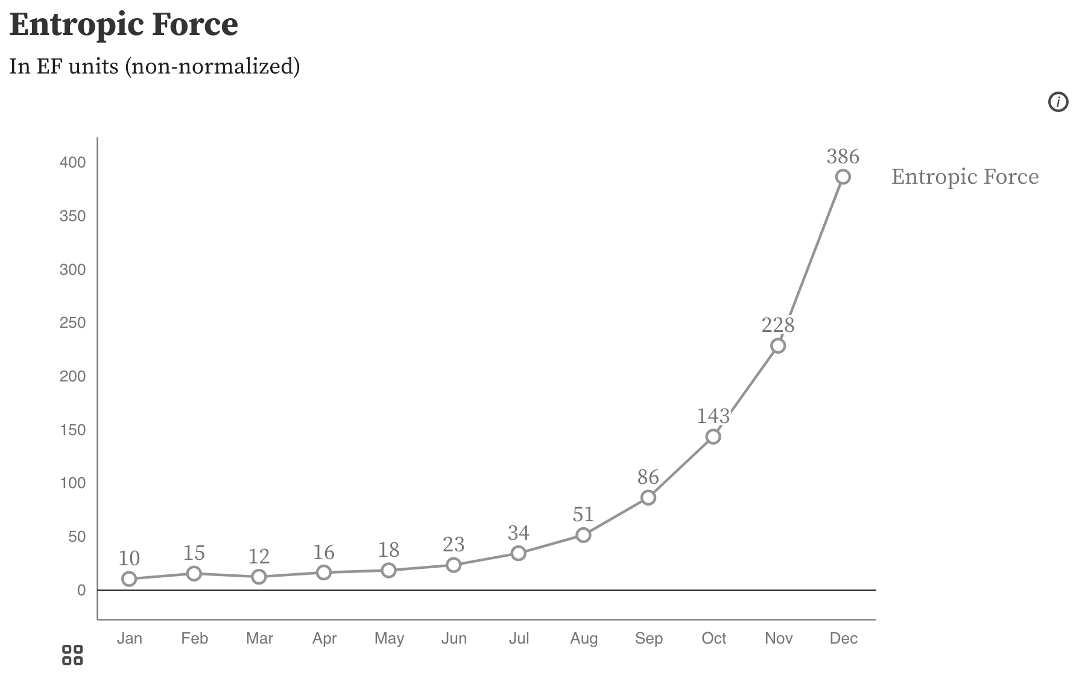
Non-descriptive titles are inaccessible

Slide 42
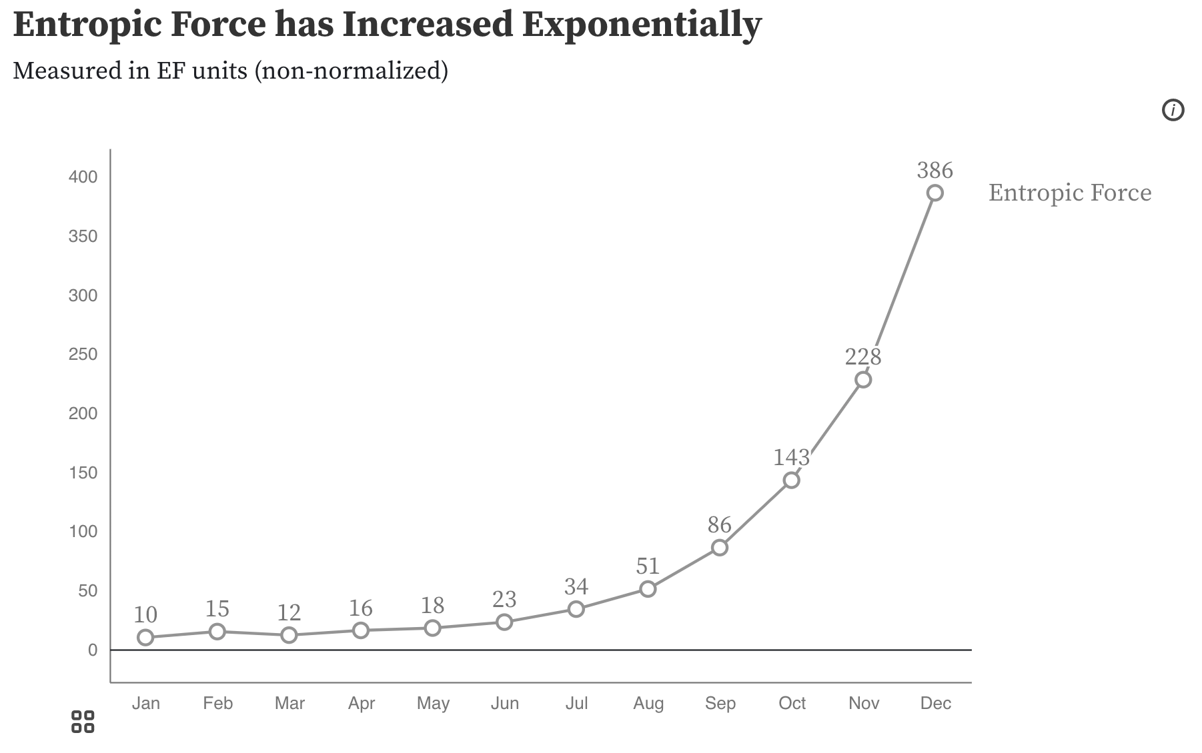
Descriptive titles have summaries/takeaways

Slide 43
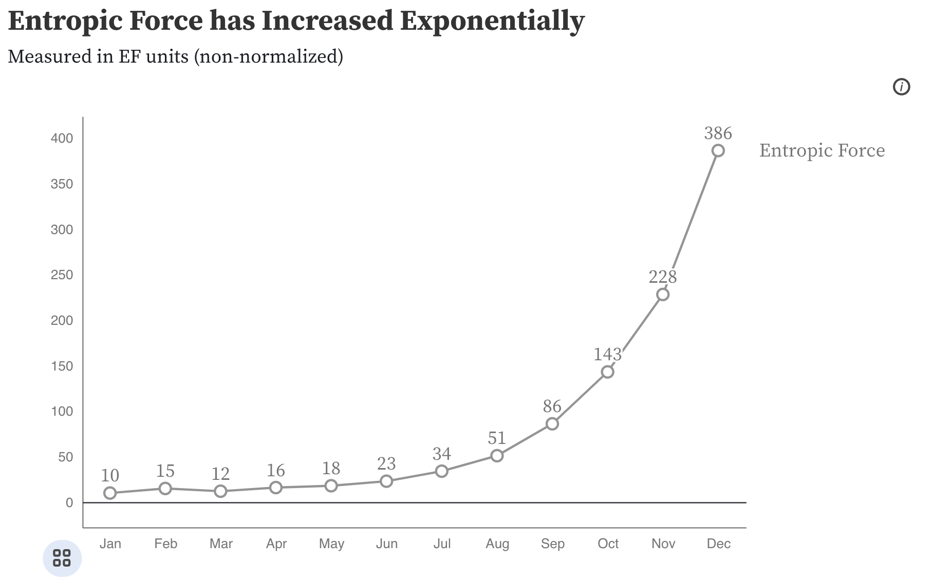
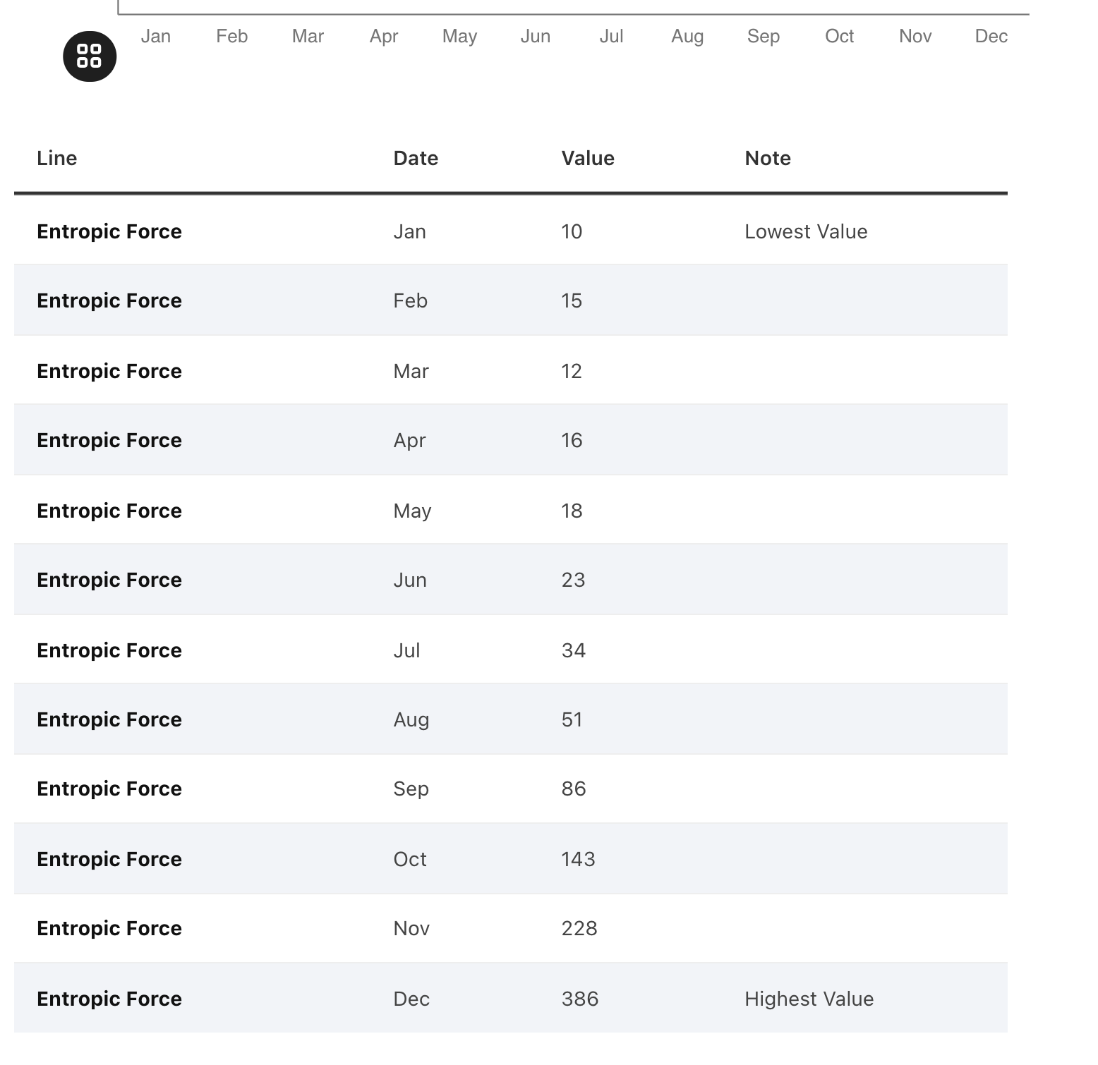
All charts should have data available!

Slide 44
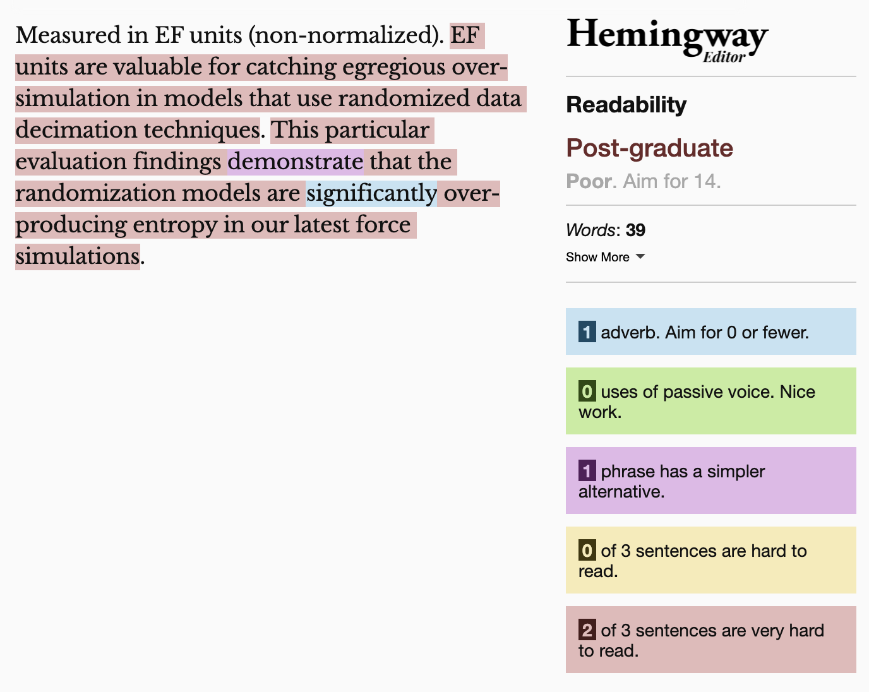
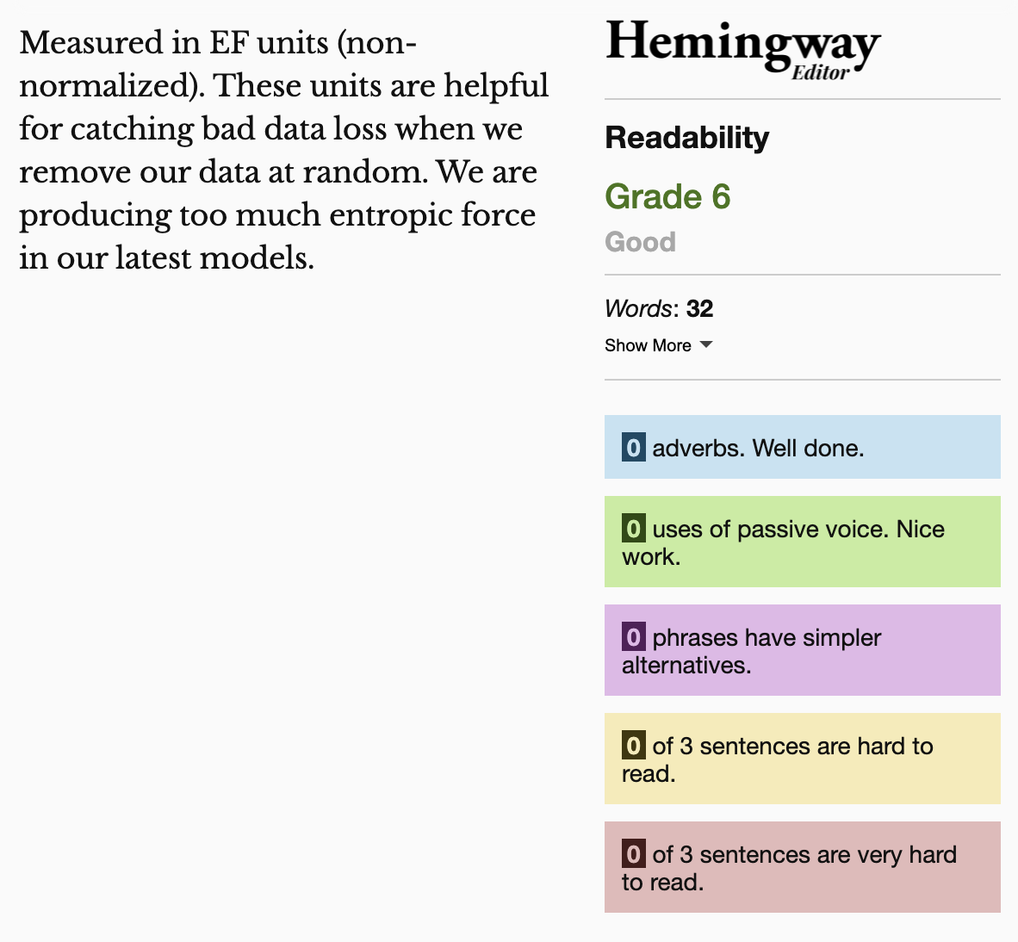
Keep summaries as non-technical as possible
If the topic is technical, provide a “plain language” summary somewhere close by that is easy to find (either in the same location or with by providing a link).

Slide 45
Understandable Evaluation Toolkit:
Is there a descriptive title, summary, or caption?
Is there an accessible table or downloadable data file provided?
Is the descriptive text supporting the visualization presented at a reading level at grade 9 or below?

Slide 46
Exercise: Group improve!
Try to give feedback on a visualization in the wild using what you just learned.

Slide 47
What you can do now
Define accessibility
Explain why people do accessibility work
Use a screen reader
Identify inaccessibility
Come up with feedback for improving accessibility

Slide 48
Q/A
Happy to answer questions about how to do this work professionally (design, engineering, research, education)
as well as any questions about data visualization and accessibility more broadly (including tools, challenges, what lies in the future)

Slide 49
Resources
A resources repository!
My twitter (@FrankElavsky)
Chartability

