Slide 1




Data Navigator
hcii.cmu.edu
axle-lab.com
dig.cmu.edu
Towards improved building materials for accessible data interaction experiences.
Frank Elavsky

Slide 2
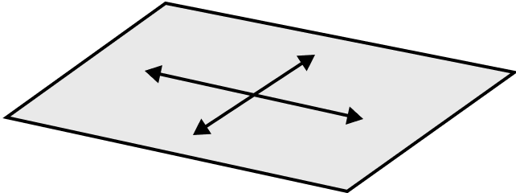
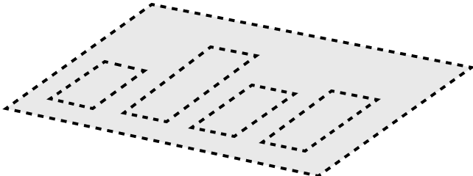
To-do: - Pick 3 case studies - Clarify how touch (and other modalities) fit in - Talk about plan + prep for Vis Problem, consequences, solution, consequences
2

Slide 3
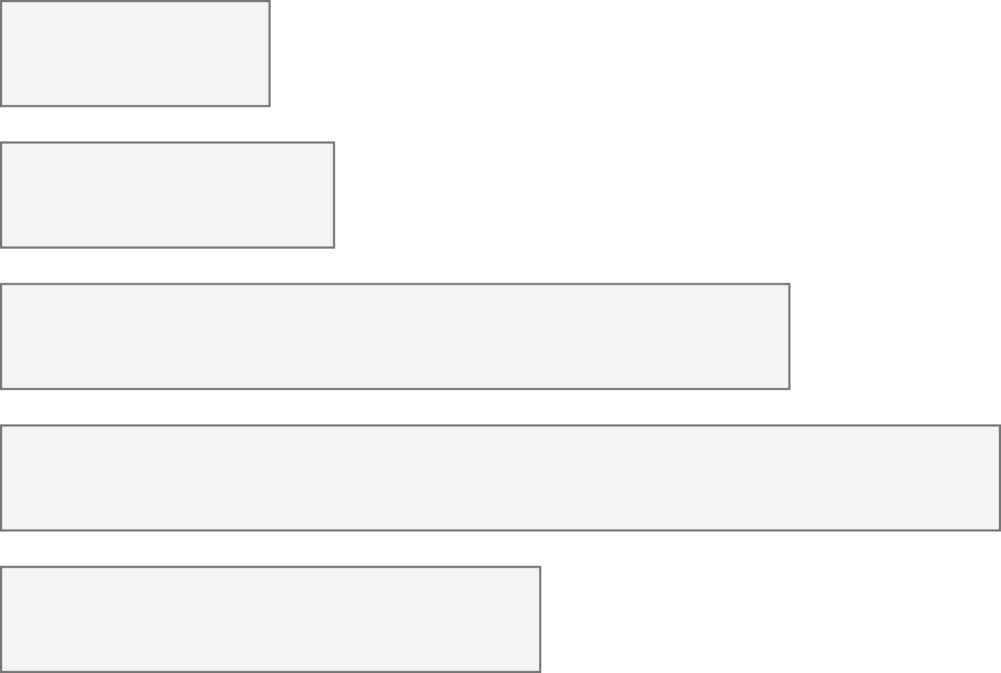
26% of people living in the United States self-report living with a disability that affects their daily life.
3.7%
Color Vision Deficiency
4.5%
Blindness, Low Vision
10.8%
Cognitive, Neurological
13.7%
Motor, Dexterity
7.4%
Vestibular, Motion
Source: Okoro et al. “Prevalence of Disabilities and Health Care Access by Disability Status and Type Among Adults”

Slide 4
4.5% blind, low vision, or visually impaired.
4.5%
Blindness, Low Vision
Source: Okoro et al. “Prevalence of Disabilities and Health Care Access by Disability Status and Type Among Adults”

Slide 5
13.7% with motor or dexterity disabilities.
13.7%
Motor, Dexterity
Source: Okoro et al. “Prevalence of Disabilities and Health Care Access by Disability Status and Type Among Adults”

Slide 6
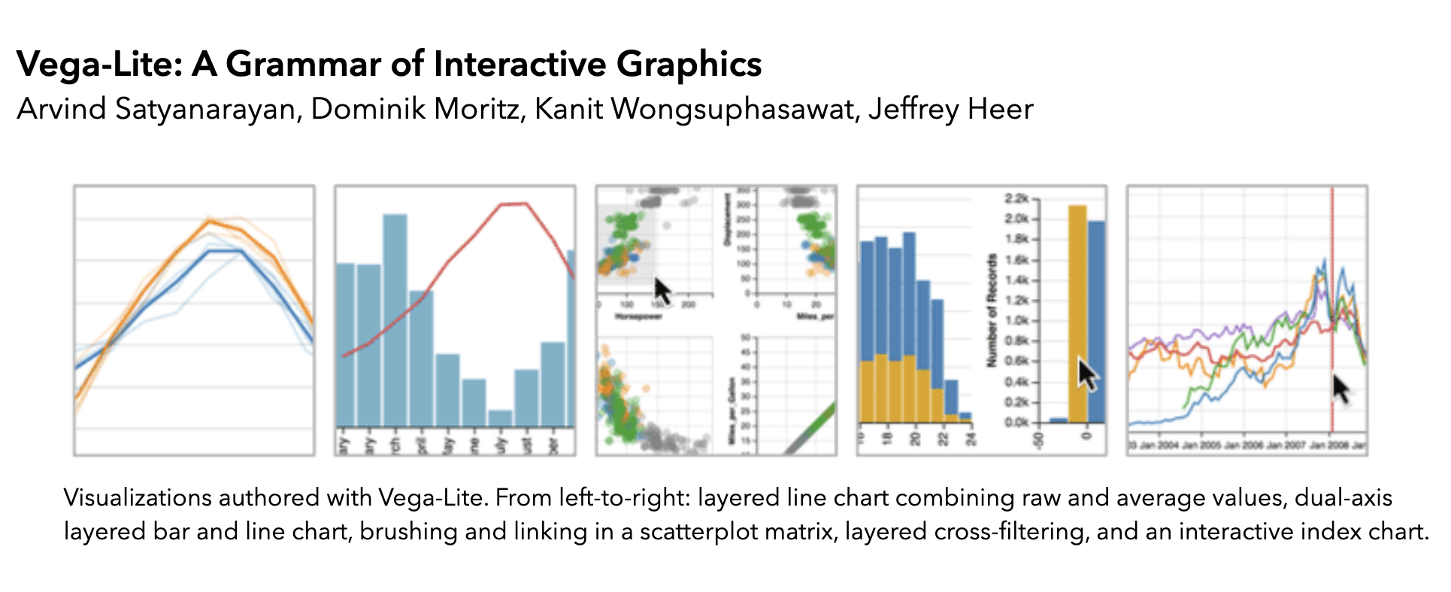
6

Slide 7
7

Slide 8
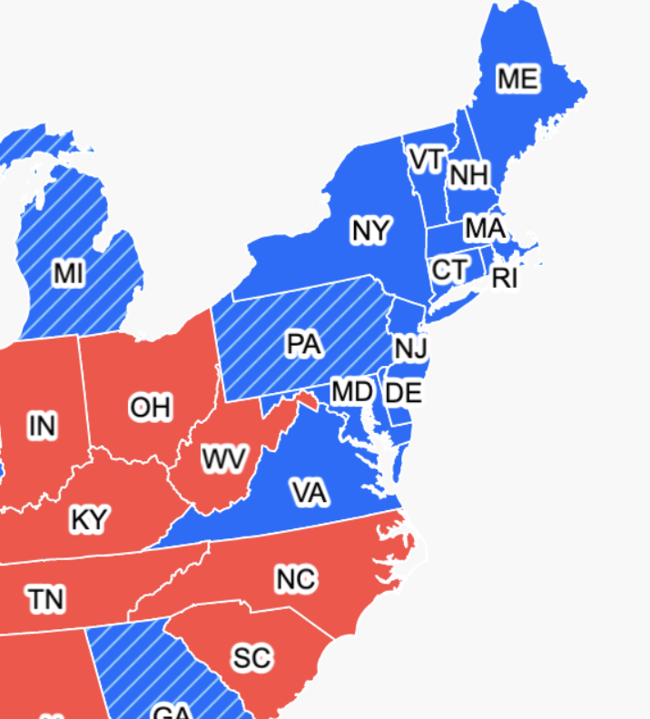


But precision-based pointer interaction excludes people with dexterity and fine motor disabilities.
8

Slide 9
As well as folks using precision-based touch and gesture input.
9

Slide 10
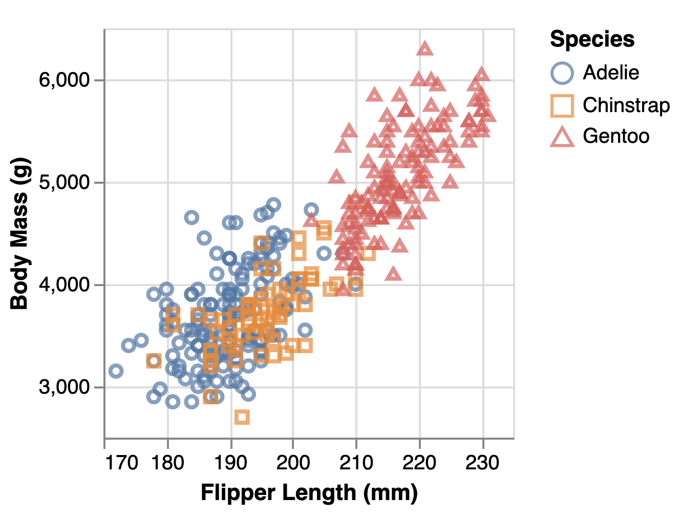
10

Slide 11
So what do we do currently to address this?
11

Slide 12
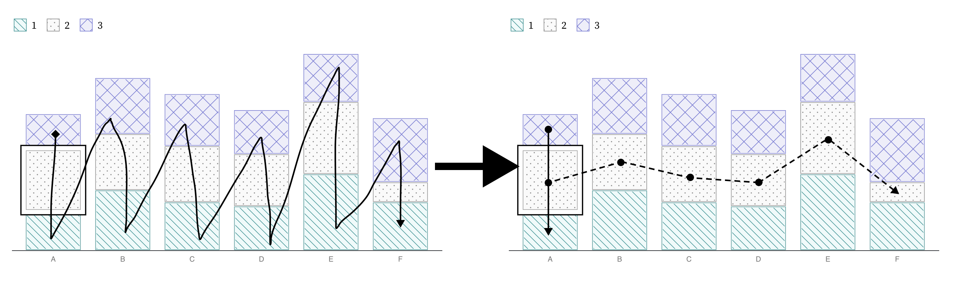

Navigating data experiences is typically done in a linear fashion (forward or backward through a list)
12

Slide 13
Up, down, left, right navigation is the current state of the art.
13

Slide 14
What about touch?
14

Slide 15
And what about visualizations that would be tedious to navigate?
15

Slide 16
Sketching ideas
“What navigation experience could you imagine for this scatterplot?”
16

Slide 17
What is the first “thing” you would want to navigate to? Then what?
17

Slide 18
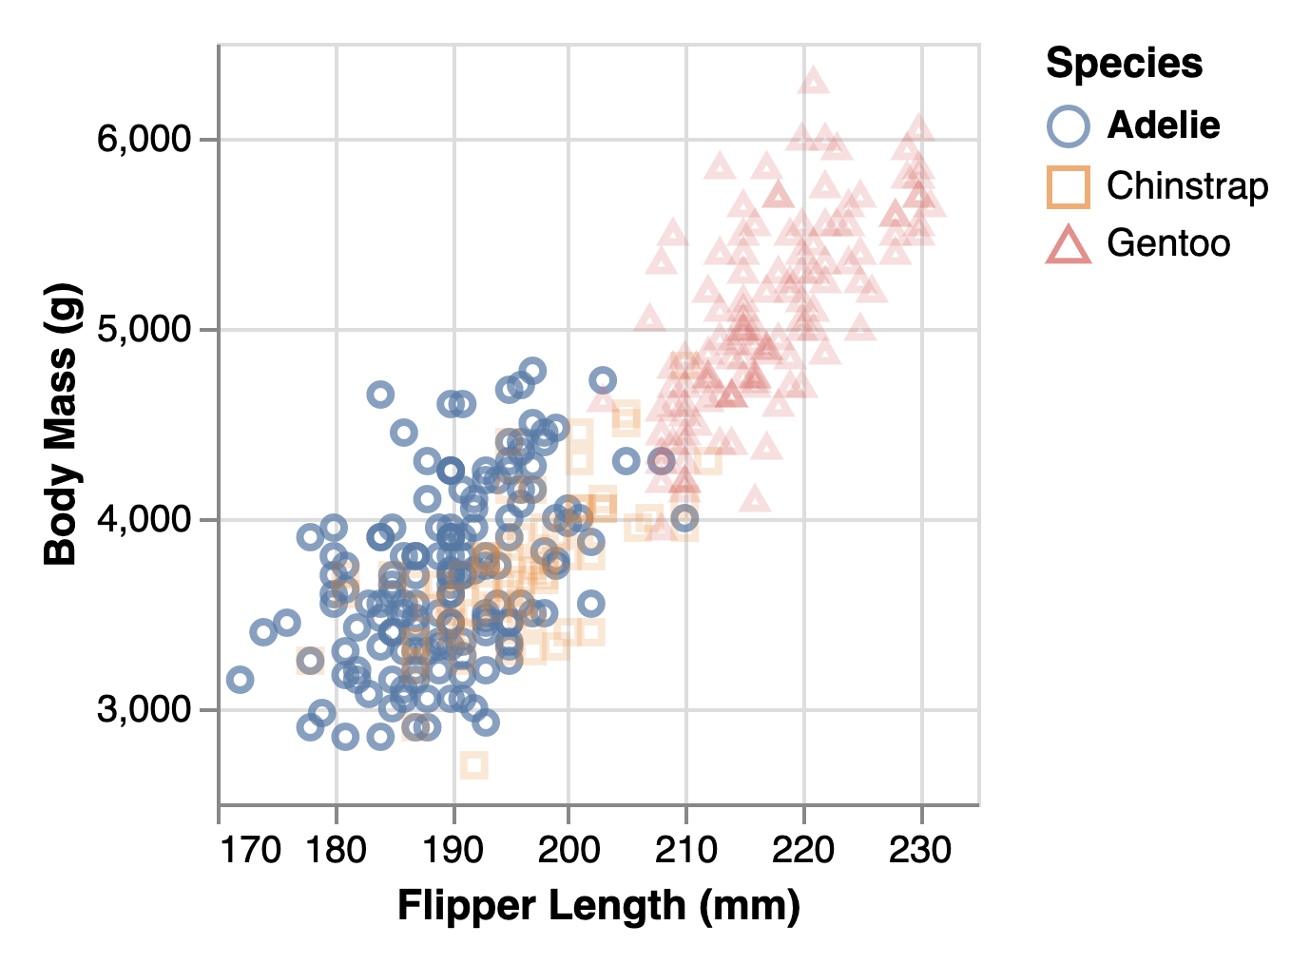
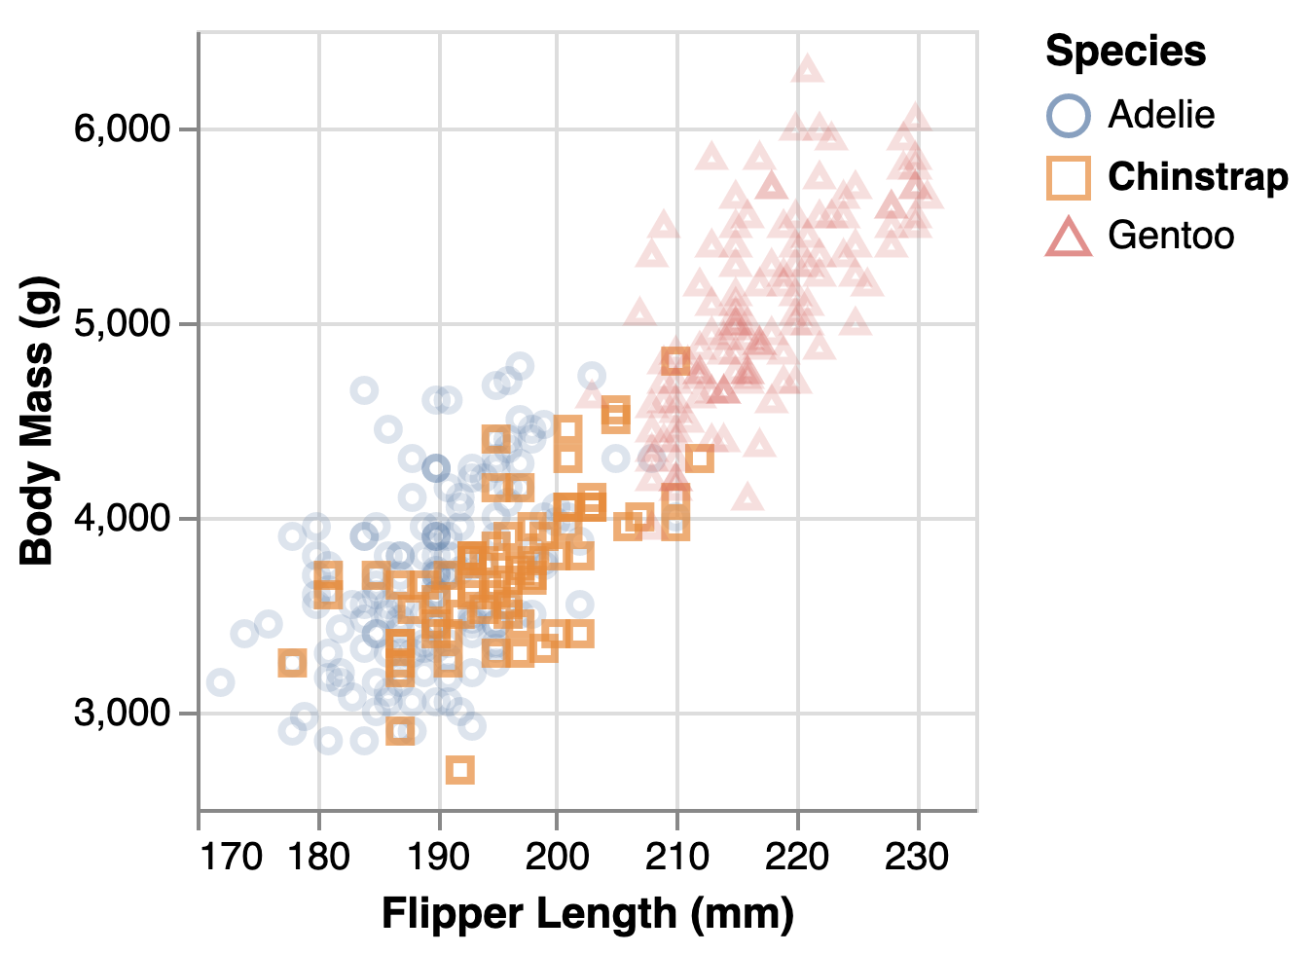
3 approaches
Default, mark to mark navigation, ordered based on render order
“MIT” method, cell-to-cell navigation, ordered based on axis cells starting with cell with lowest x value
Semantic, group navigation, ordered based on legend order
18

Slide 19
Even a single visualization may benefit from many different navigation schemes, depending on the context.
19

Slide 20
But trying out different schemes is very slow. Each must be hand crafted after a visualization is made.
20

Slide 21
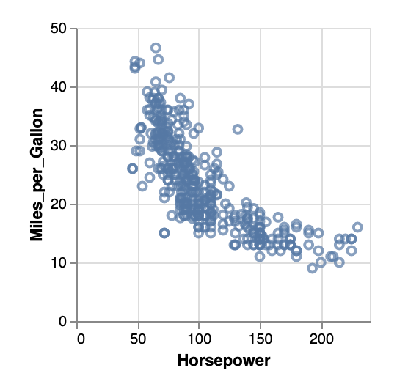
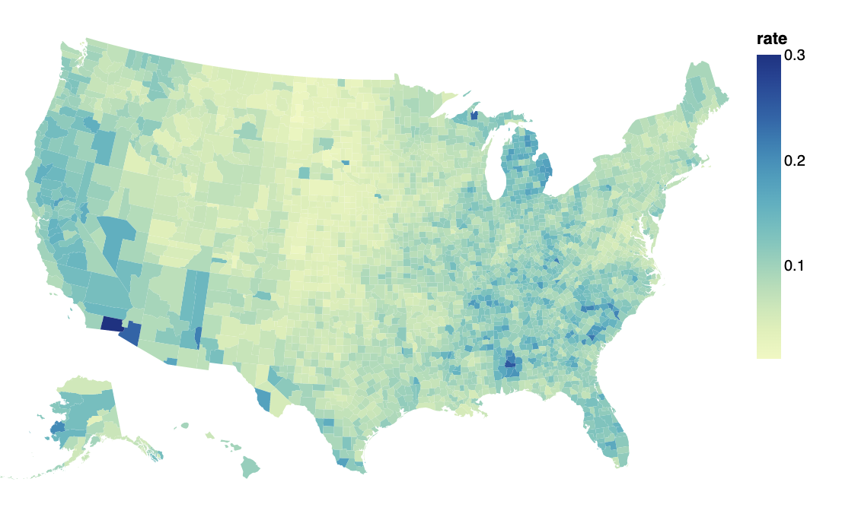
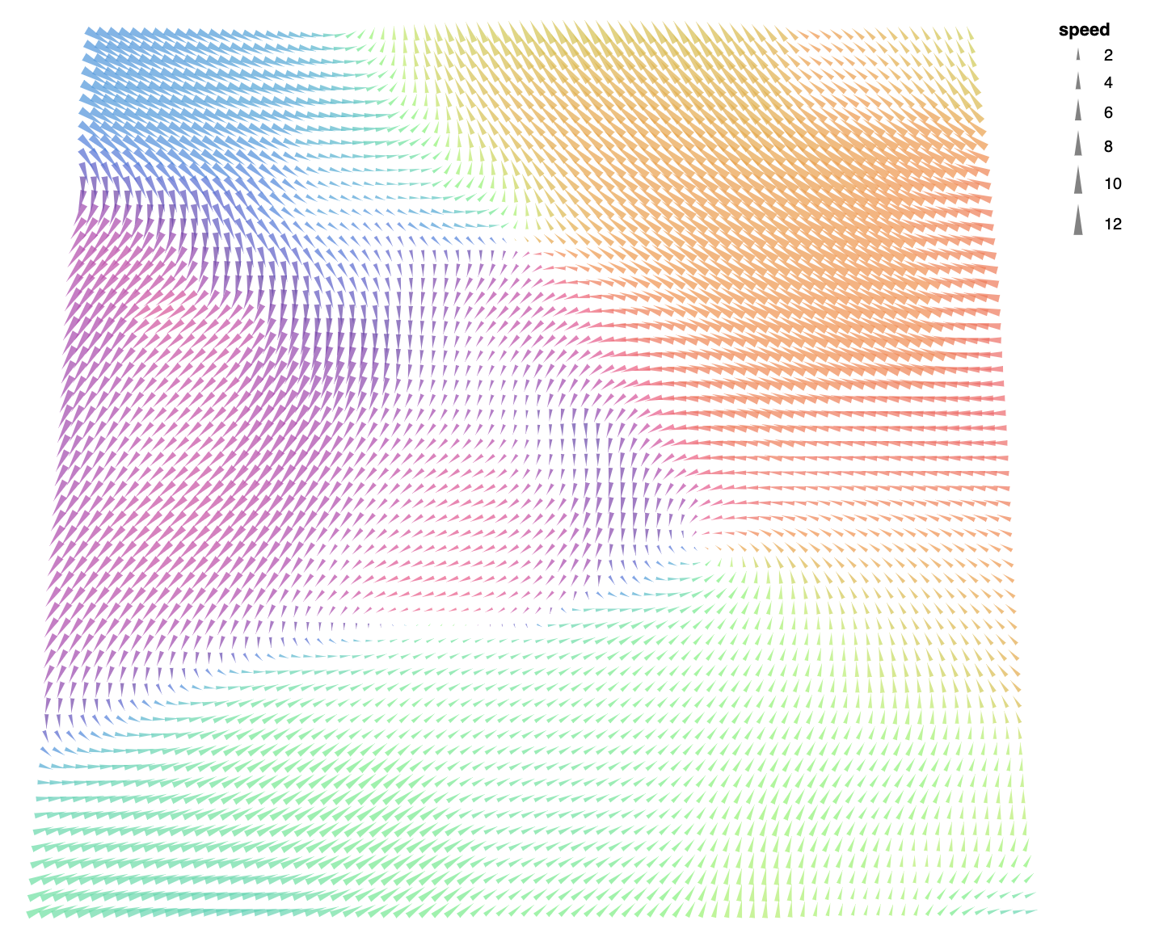
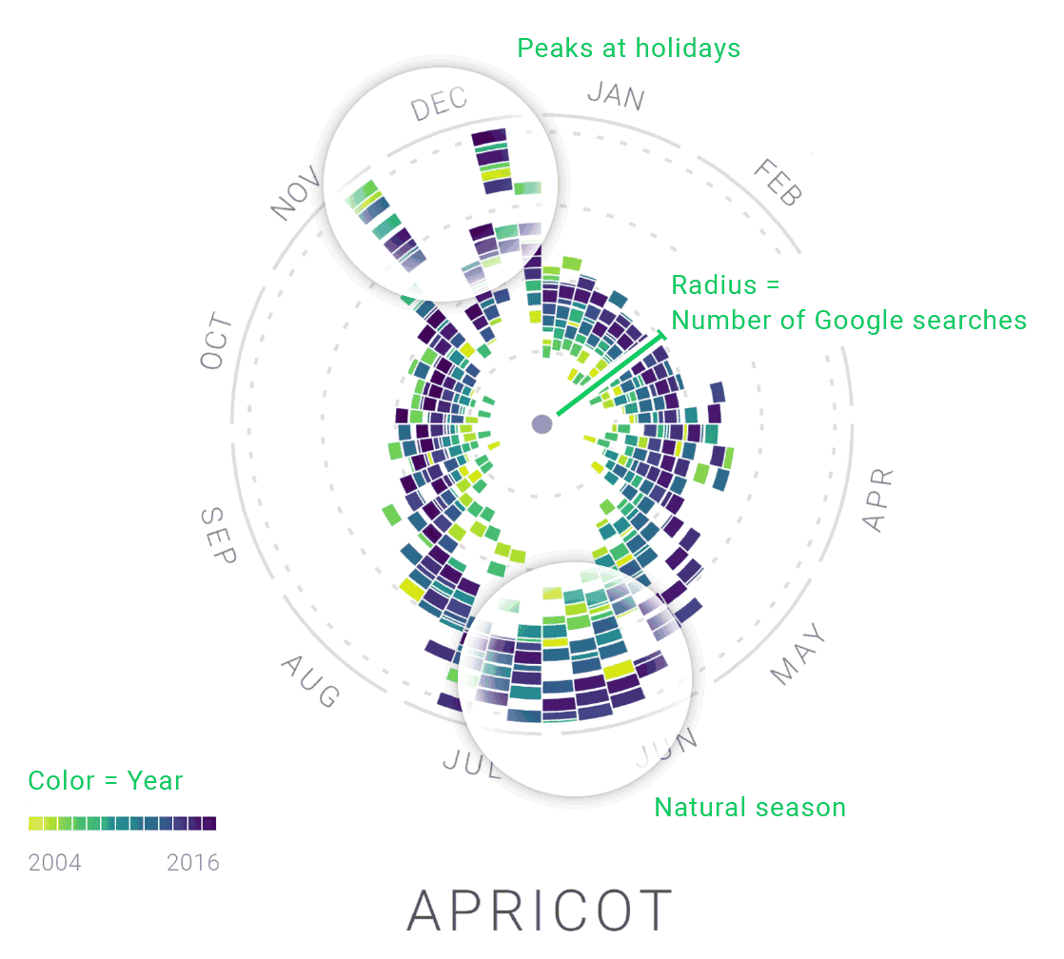
Primary Research Question: What data structures and input modalities do designers and developers need to be able to specify and express that are impossible or very difficult using current methods?
21

Slide 22
Co-designing the tool’s potential
22

Slide 23
Evaluating these co-designed artifacts in semi-structured interviews with users
23

Slide 24
Implications For the long term: - We believe that data navigator shows promise for speeding up research growth in this area - We believe that this tool can also be used to make documents, games, and even AR/VR/XR applications more accessible
24

Slide 25
Implications For the long term: - We believe that data navigator shows promise for speeding up research growth in this area - We see an opportunity for computational methods to automatically infer and build navigation experiences based on the known input data, context, and analytical tasks of the user - We believe that this tool can also be used to make documents, games, and even AR/VR/XR applications more accessible
25

Slide 26
Implications For the long term: - We believe that data navigator shows promise for speeding up research growth in this area - We believe that this tool can also be used to make documents, games, and even AR/VR/XR applications more accessible
26

Slide 27
Secondary Research Questions: In what ways does a lower-level data navigation API enable designers and researchers to iterate more effectively on research and design problems? What are the needs and challenges faced by visualization practitioners when using a tool for expressing more robust data interaction experiences, such as touch and sequential navigation? When screen reader users interact with the prototypes that were built by others using our system, what are their thoughts, experiences, and needs?
27

Slide 28
Secondary Research Questions: In what ways does a lower-level data navigation API enable designers and researchers to iterate more effectively on research and design problems? What are the needs and challenges faced by visualization practitioners when using a tool for expressing more robust data interaction experiences, such as touch and sequential navigation? When screen reader users interact with the prototypes that were built by others using our system, what are their thoughts, experiences, and needs?
28

Slide 29
Secondary Research Questions: In what ways does a lower-level data navigation API enable designers and researchers to iterate more effectively on research and design problems? What are the needs and challenges faced by visualization practitioners when using a tool for expressing more robust data interaction experiences, such as touch and sequential navigation? When screen reader users interact with the prototypes that were built by others using our system, what are their thoughts, experiences, and needs?
29

Slide 30
Ideal Pilot Results
“What navigation experience would you like for this scatterplot?”
30

Slide 31
Ideal Pilot Results
Default, mark to mark navigation, ordered based on render order
“tedious,” “exhausting,” “confusing,” “I’m lost”
“MIT” method, cell-to-cell navigation, ordered based on x/y data appearance
“really empty,” “disorienting,” “detailed,” “structured”
Semantic, group navigation, ordered based on legend order
“interesting,” “simple,” “easy,” “seems useful but not very detailed”
31

Slide 32
Ideal Pilot Results
Default, mark to mark navigation, ordered based on render order
“tedious,” “exhausting,” “confusing,” “I’m lost”
“MIT” method, cell-to-cell navigation, ordered based on x/y data appearance
“really empty,” “disorienting,” “detailed,” “structured”
Semantic, group navigation, ordered based on legend order
“interesting,” “simple,” “easy,” “seems useful but not very detailed”
32

Slide 33
Ideal Pilot Results
Default, mark to mark navigation, ordered based on render order
“tedious,” “exhausting,” “confusing,” “I’m lost”
“Zong” method, cell-to-cell navigation, ordered based on axis grid
“really empty,” “disorienting,” “detailed,” “structured”
Semantic, group navigation, ordered based on legend order
“interesting,” “simple,” “easy,” “seems useful but not very detailed”
33

Slide 34
Ideal Pilot Results
Default, mark to mark navigation, ordered based on render order
“tedious,” “exhausting,” “confusing,” “I’m lost”
“Zong” method, cell-to-cell navigation, ordered based on axis grid
“really empty,” “disorienting,” “detailed,” “structured”
Semantic, group navigation, ordered based on legend order
“interesting,” “simple,” “easy,” “seems useful but not very detailed”
34

Slide 35
Ideal Pilot Results
Default, mark to mark navigation, ordered based on render order
“tedious,” “exhausting,” “confusing,” “I’m lost”
“MIT” method, cell-to-cell navigation, ordered based on axis cells
“really empty,” “disorienting,” “detailed,” “structured”
Semantic, group navigation, ordered based on legend order
“interesting,” “simple,” “easy,” “seems useful but not very detailed”
35

Slide 36
Evaluation Method We worked with visualization practitioners currently working on real-world projects and co-designed data navigation experiences with them using our tool. We then evaluated the end experiences we built together through semi-structured interviews with screen reader users and sighted users with touch devices.
36

Slide 37
Results We found that not only did data navigator help practitioners express a wider range of experience possibilities they previously had not considered, but their designs also felt faster, easier to understand, and more natural than existing accessible data representation techniques for their users.
37

Slide 38
Implications We believe that Data Navigator enables not only practitioners to build more robust and accessible data experiences, which is our primary motivation for this work, but also enables much more rapid research exploration into accessible data interaction design. As a secondary contribution to this paper, we are submitting over 100 additional navigable data structure examples that may inspire future research, design, and progress in this space.
38

Slide 39
Problem Designing and developing data visualizations that are accessible for input devices and modalities such as screen readers, keyboards, non-direct touch, gestures, and voice is an under-addressed space. Most attempts to make data visualizations accessible either rely on a shared infrastructure with a visualization’s visual marks and elements or create a separate data representation, such as a table. Both of these approaches can create overly-complex and cumbersome data navigation experiences for users of serial and sequential input devices.
39

Slide 40
Technical Method To address these design and development difficulties, we present Data Navigator. Data Navigator is a tool that allows data practitioners to create navigable and interactive data experiences that can be loosely coupled or entirely uncoupled from visual experiences, allowing a much broader range of data structures.
40

Slide 41
Evaluation Method We worked with visualization practitioners currently working on real-world projects and co-designed data navigation experiences with them using our tool. We then evaluated the end experiences we built together through semi-structured interviews with screen reader users and sighted users with touch devices.
41

Slide 42
Results We found that not only did data navigator help practitioners express a wider range of experience possibilities they previously had not considered, but their designs also felt faster, easier to understand, and more natural than existing accessible data representation techniques for their users.
42

Slide 43
Implications We believe that Data Navigator enables not only practitioners to build more robust and accessible data experiences, which is our primary motivation for this work, but also enables much more rapid research exploration into accessible data interaction design. As a secondary contribution to this paper, we are submitting over 100 additional navigable data structure examples that may inspire future research, design, and progress in this space.
43

Slide 44
Problems unaddressed in current work 99.9% of data visualizations I have evaluated are inaccessible. 98% shared on twitter don’t even have alt text added. So among the small majority where work IS being done, it looks like this: [show vega lite scatterplot] Some attempts have been made to understand ideal user experiences, but this work is slow and iterations are expensive. A single design idea is expressed in an entire paper’s work [Zong’s].
44

Slide 45
Methods [show technical methods diagram] [make a diagram for evaluation method]
45

Slide 46
Highlights of findings [show example built using VCC prototype]
46

Slide 47
Implications Our prototype shows that our system currently needs more work I order to be easy and powerful for practitioners to use, however we are excited about the preliminary reception it received from our pilot screen reader test.
47

