Slide 1
IS-API v0.3.0
A RESTful Statistics API for Cross-Study
Immune Repertoire Analysis
COVID-19 BCR Repertoire Use Case
System Immunology Lab

Slide 2
The Challenge
🧬
Data Heterogeneity
AIRR-seq studies use different metadata schemas, disease labels, and tissue types across repositories
🔍
No Cross-Study Statistics
Existing tools (iReceptor, VDJServer) focus on sequence storage and retrieval, not comparative analysis
📊
Manual Harmonization
Researchers must manually reconcile metadata before any cross-study comparison is possible
⏱️
Reproducibility Gap
Ad-hoc analysis pipelines make it difficult to replicate findings across different cohorts

Slide 3
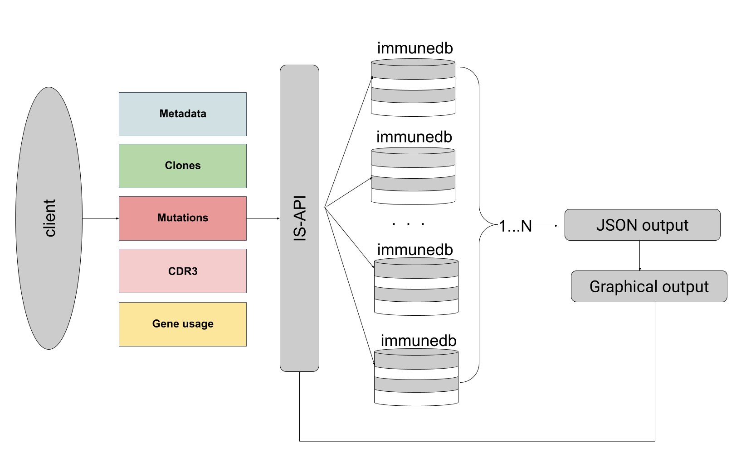
IS-API: The Solution
A RESTful API built on ImmuneDB that enables standardized cross-study BCR analysis
Metadata-Driven Filtering
Query by disease stage, tissue, sex, age across all databases
5 Statistical Endpoints
Clone count, clone size, CDR3 length, somatic mutations, Top-X analysis
7 ImmuneDB Instances
COVID-19, vaccine, healthy, and transplant cohorts unified
JSON Output
Structured responses for programmatic downstream analysis

Slide 4
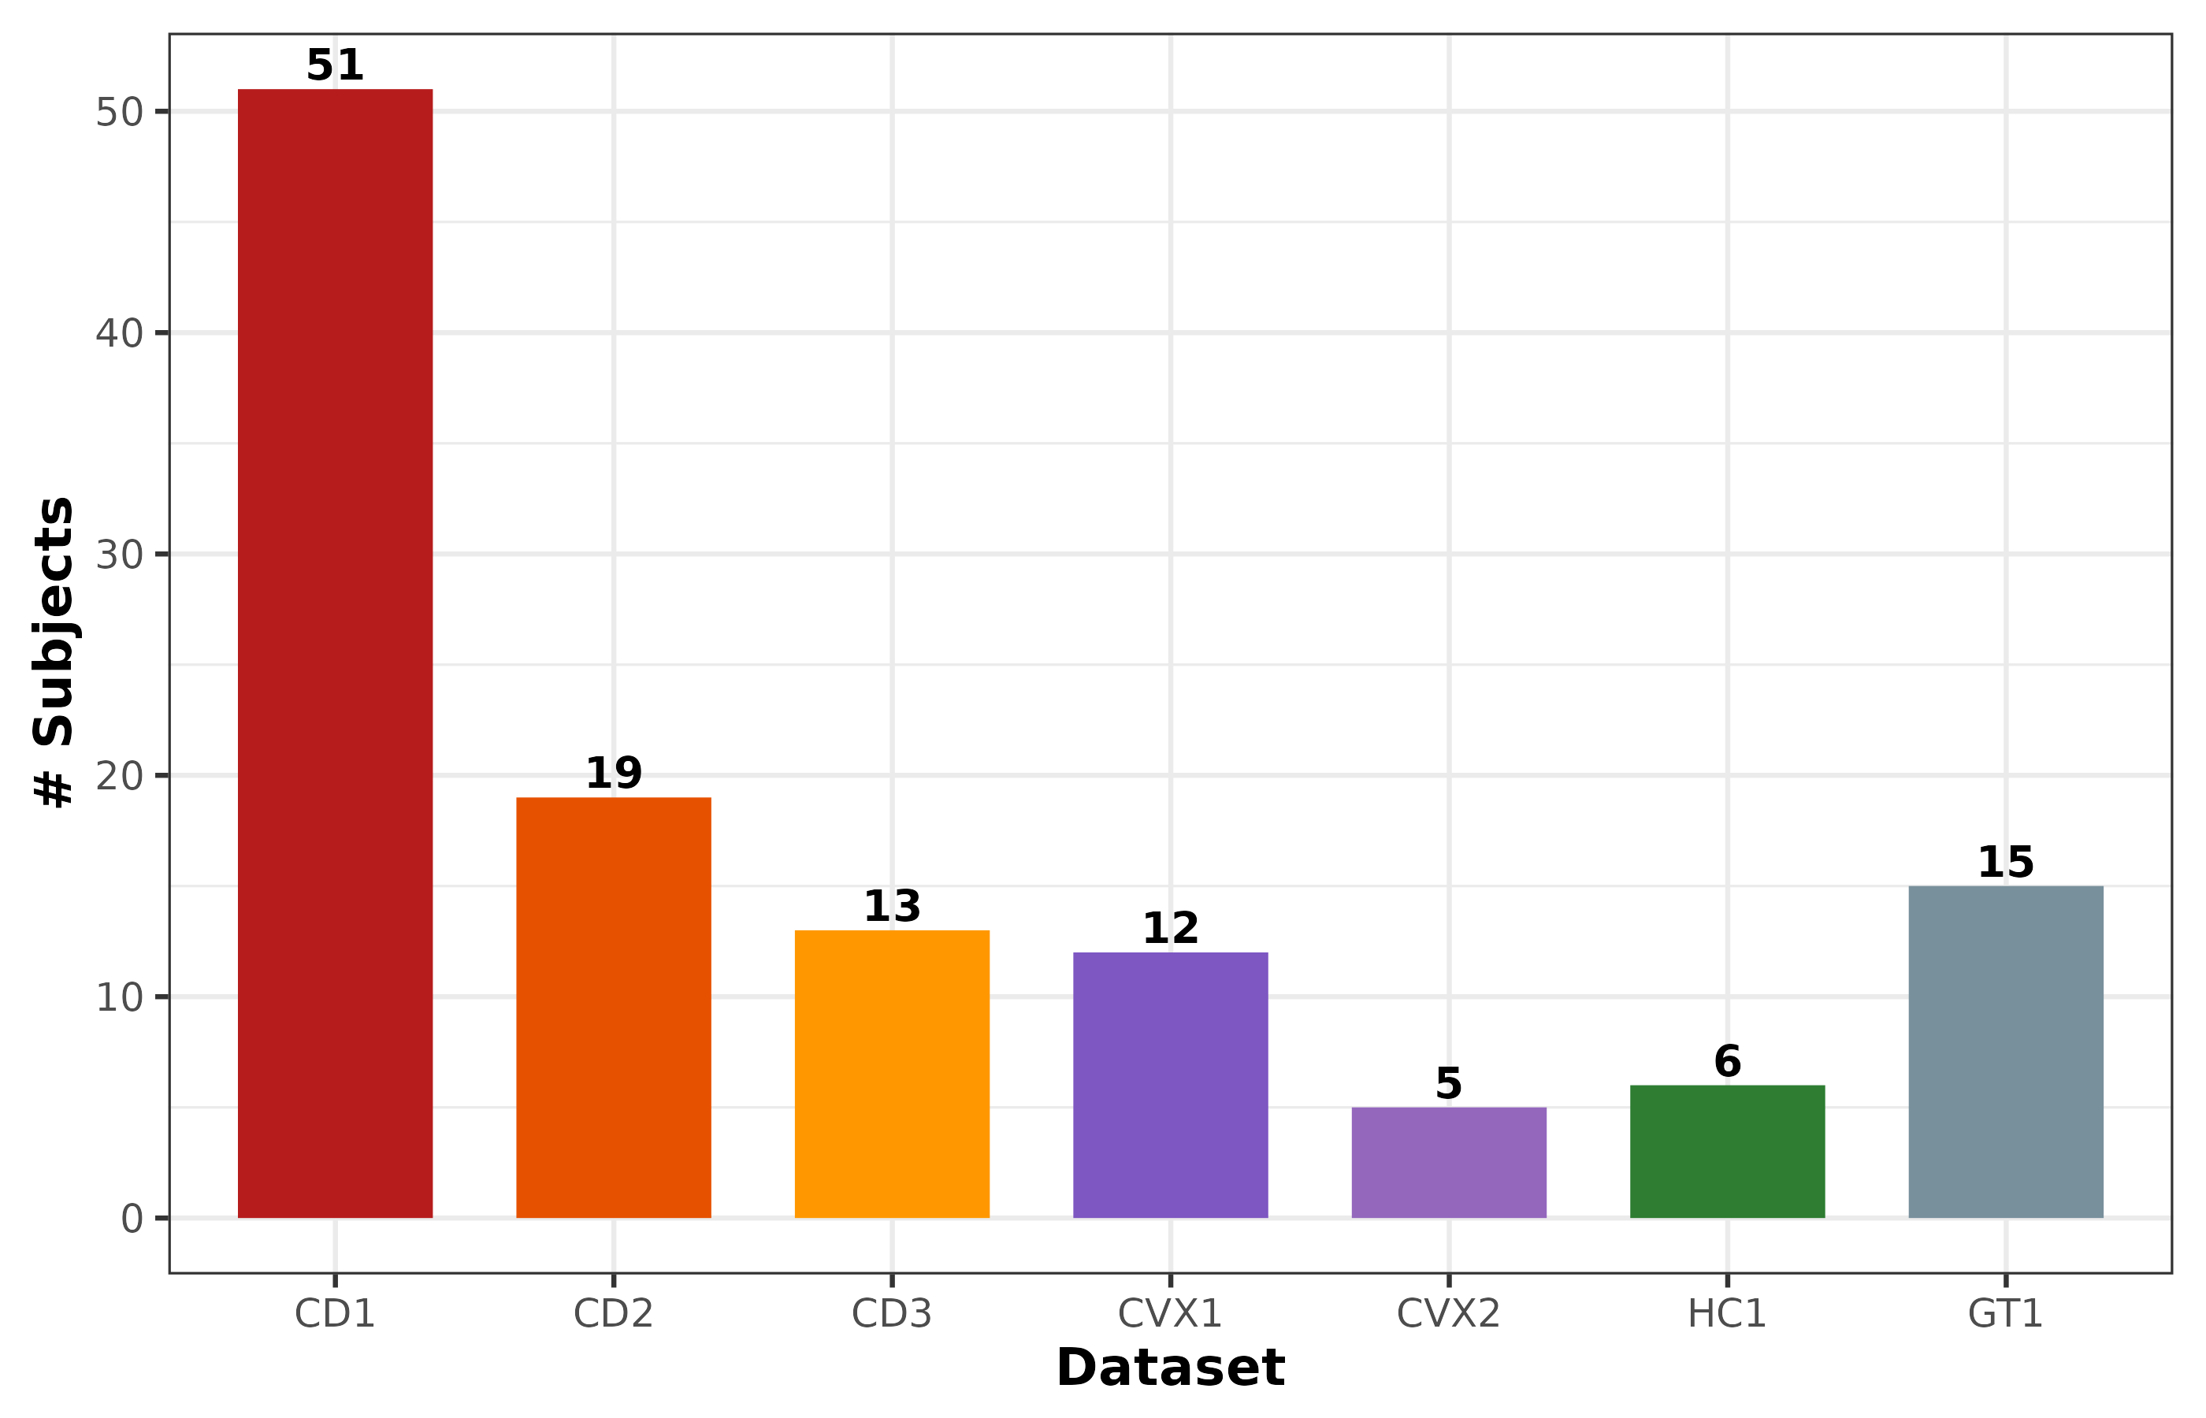
Study Cohort
103
7
6
5
Subjects
Databases
Disease
Categories
Statistical
Endpoints
Dataset
Study
n
Disease
CD1
Covid19_db3
51
Mild, Severe
CD2
covid_db2
19
Severe, Moderate, Recovered
CD3
covid19
13
Mild, Severe, Healthy
CVX1
vaccine2
12
COVID Naive, Recovered
CVX2
covid_vaccine_new
5
Recovered
HC1
lp16_Igblast
6
Healthy
GT1
sykesIgblast2020
15
Transplant (excluded)

Slide 5
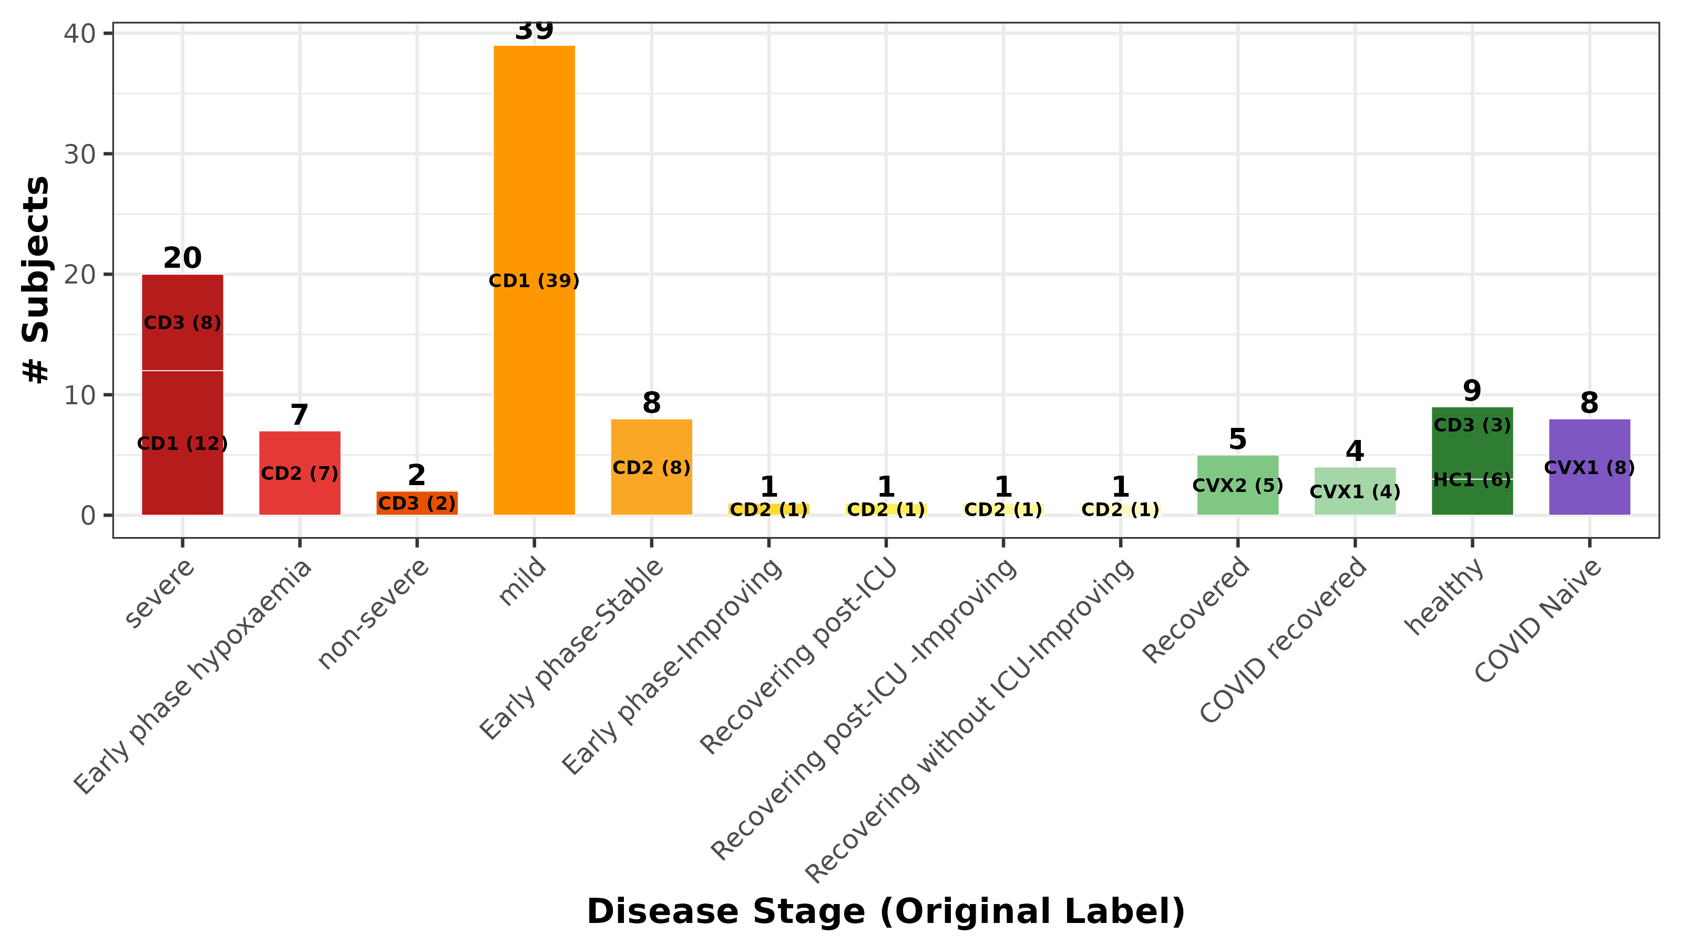
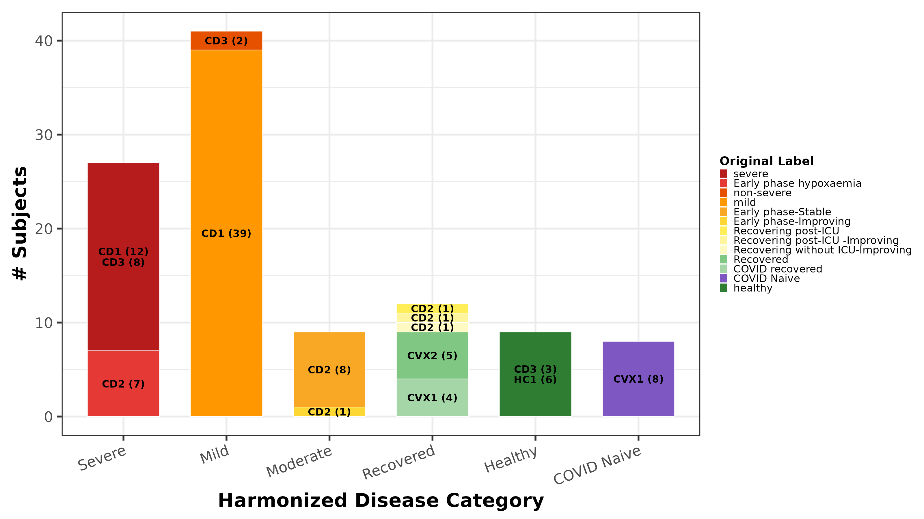
Disease Stage Harmonization
13 original disease labels → 6 harmonized categories
Original Disease Labels by Dataset
Harmonized Categories with Original Label Breakdown
Exclusions: 3 HC1 subjects (no age/sex), 2 CVX2 controls, GT1 transplant cohort. Blood/PBL tissue only.

Slide 6
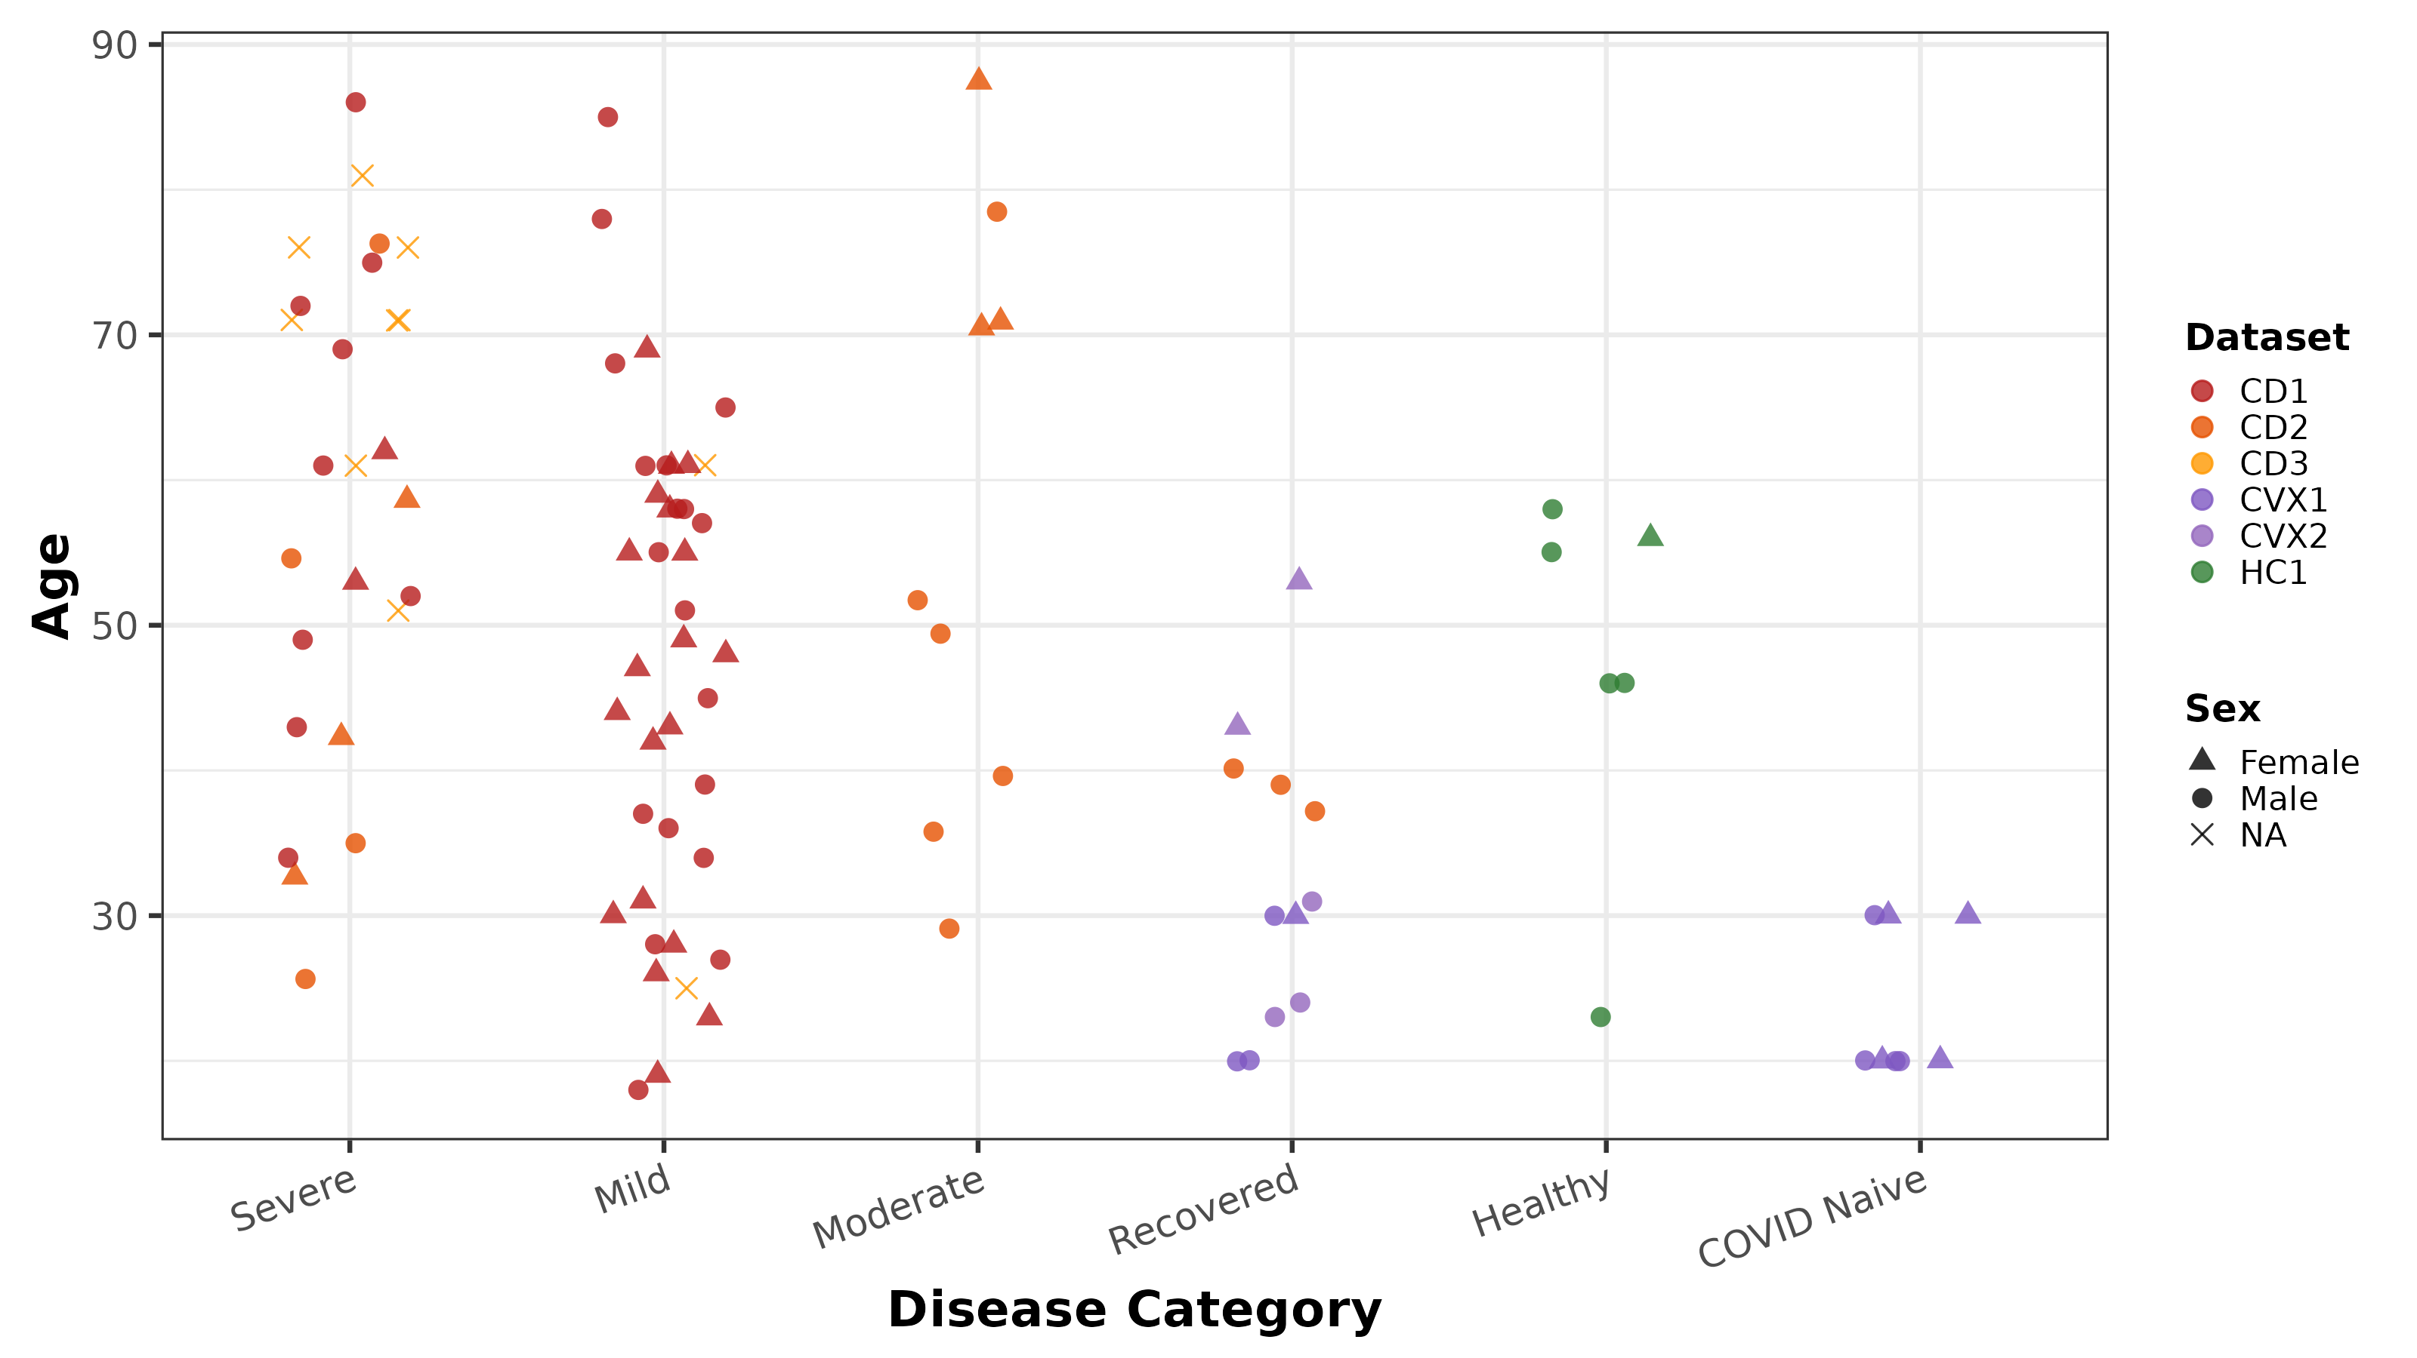
Participant Demographics
Key Demographics
Age range: 18–87 years
52 Male, 34 Female, 14 NA
Median age: 48 years
CD1 dominates Severe & Mild
CVX1 = all COVID Naive
HC1 = all Healthy controls

Slide 7
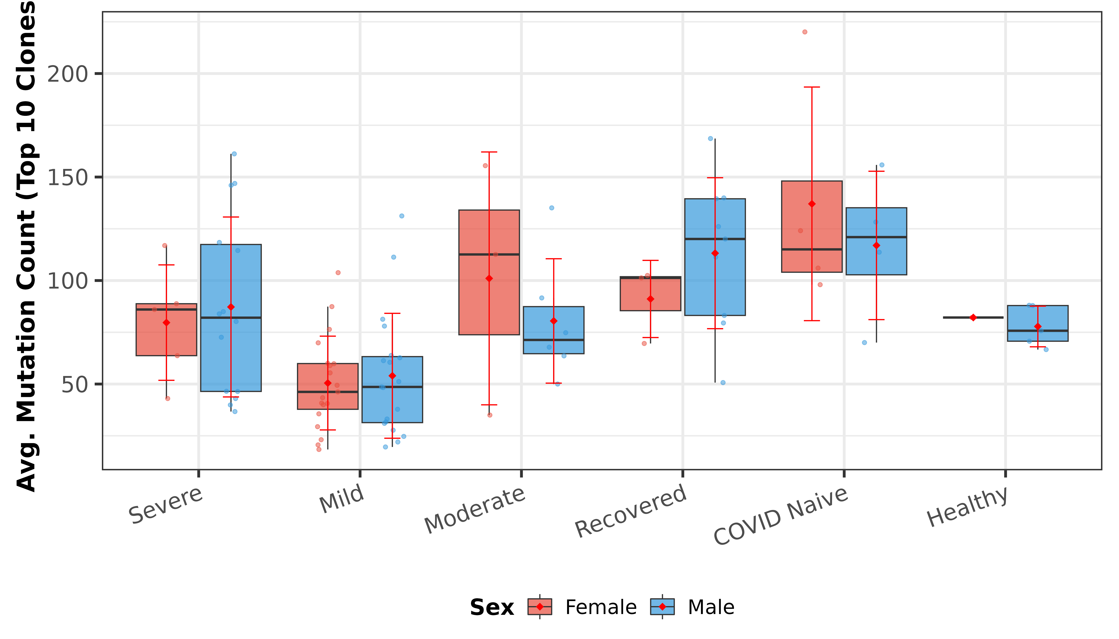
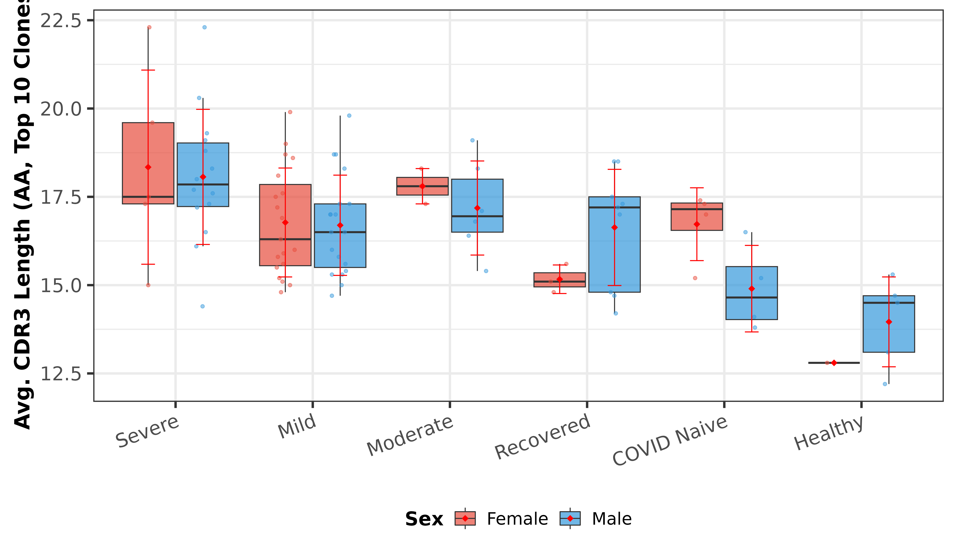
Clonal Analysis by Sex & Disease
Mutation Count by Sex & Disease (Top 10 Clones)
CDR3 Length by Sex & Disease (Top 10 Clones)
Sex-stratified analysis of top 10 expanded clones reveals subtle differences in mutation burden and CDR3 length across disease categories. These patterns suggest that sex may modulate the BCR repertoire response to COVID-19, though larger cohorts are needed to confirm significance.

Slide 8
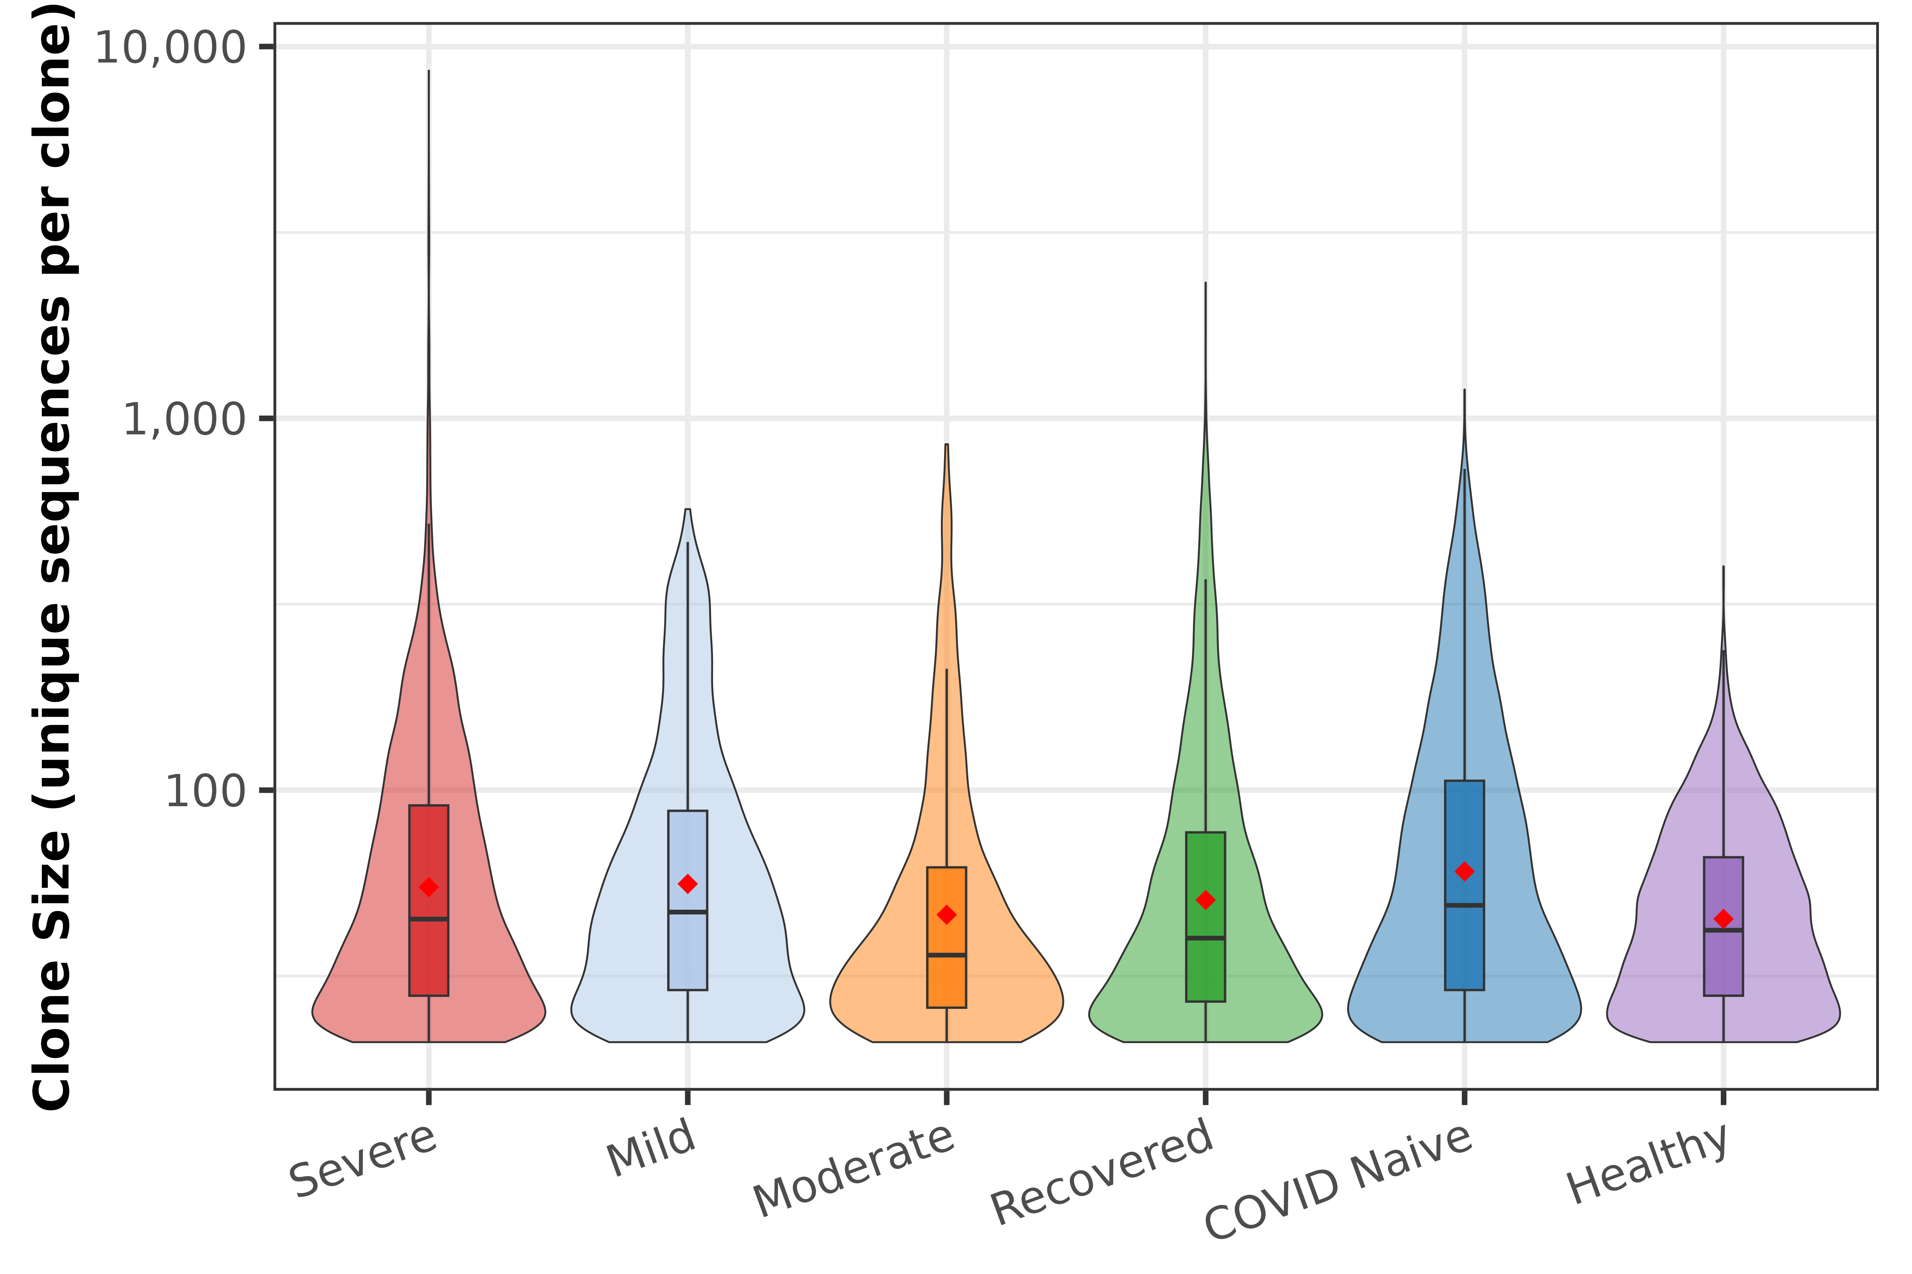
Clone Size Distribution
Unique sequences per clone (clones with ≥20 unique sequences)
Key Findings
COVID Naive shows highest median clone size and widest distribution
Severe has the heaviest upper tail (max ~8,600 unique sequences)
Mild shows most heterogeneous pattern across subjects
Healthy (HC1) has compact distribution, consistent with diverse unexpanded repertoire
All groups show right-skewed distributions on log scale

Slide 9
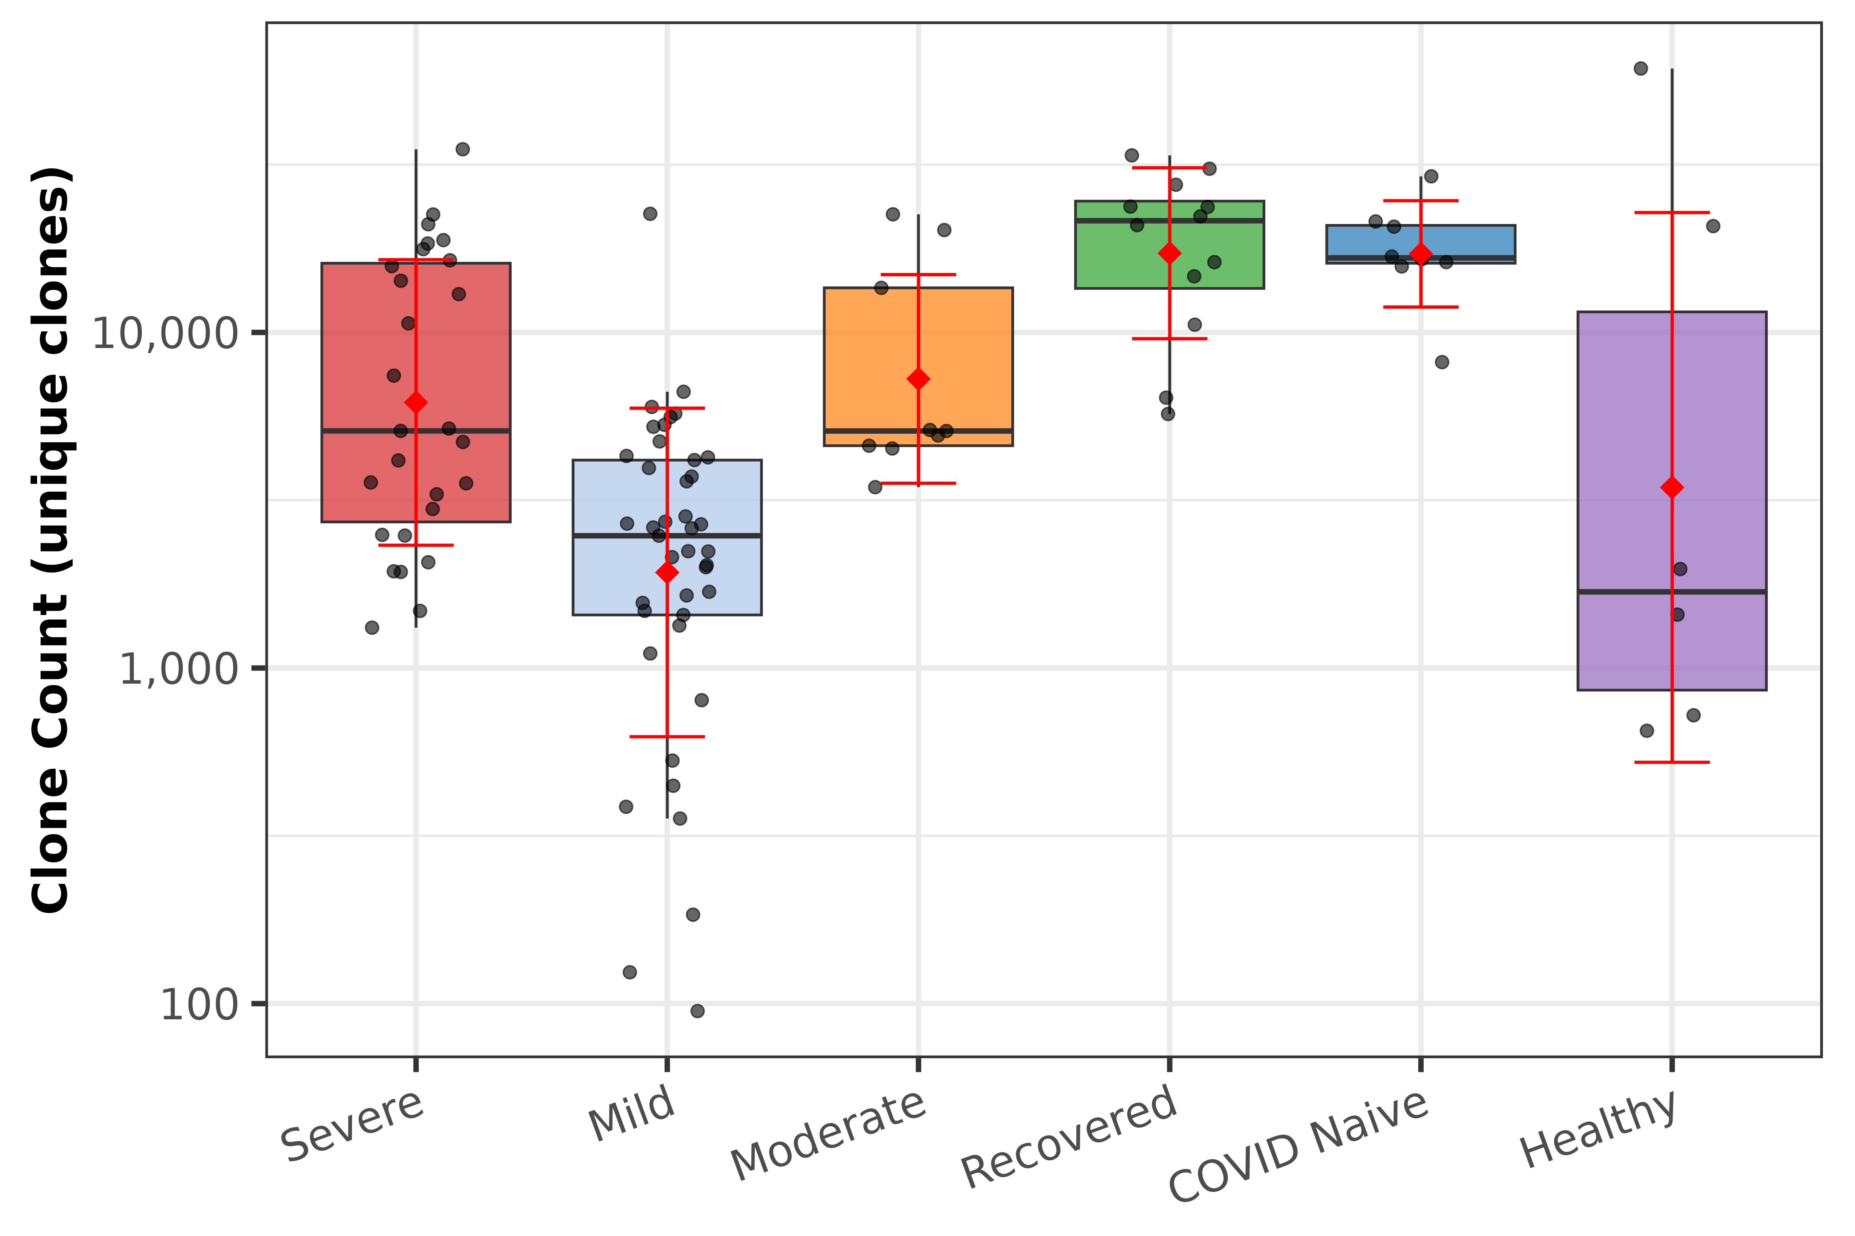
Clone Count by Disease Category
Number of distinct clones per subject across disease severities
Key Findings
Clone count reflects B cell diversity within each subject's repertoire
Severe COVID patients show variable clone counts, reflecting heterogeneous immune responses
Healthy controls (HC1) show consistently lower clone counts
Higher clone counts in Mild/Recovered may indicate broader polyclonal activation

Slide 10
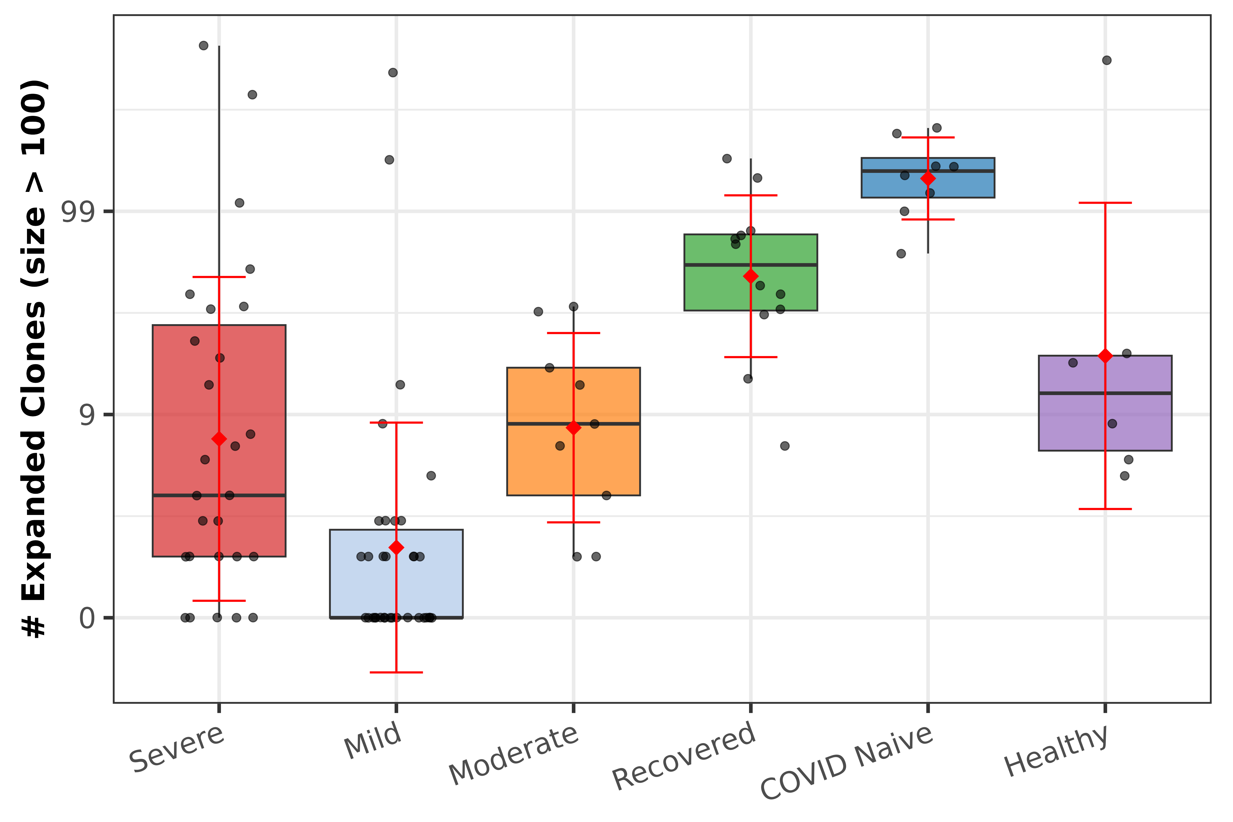
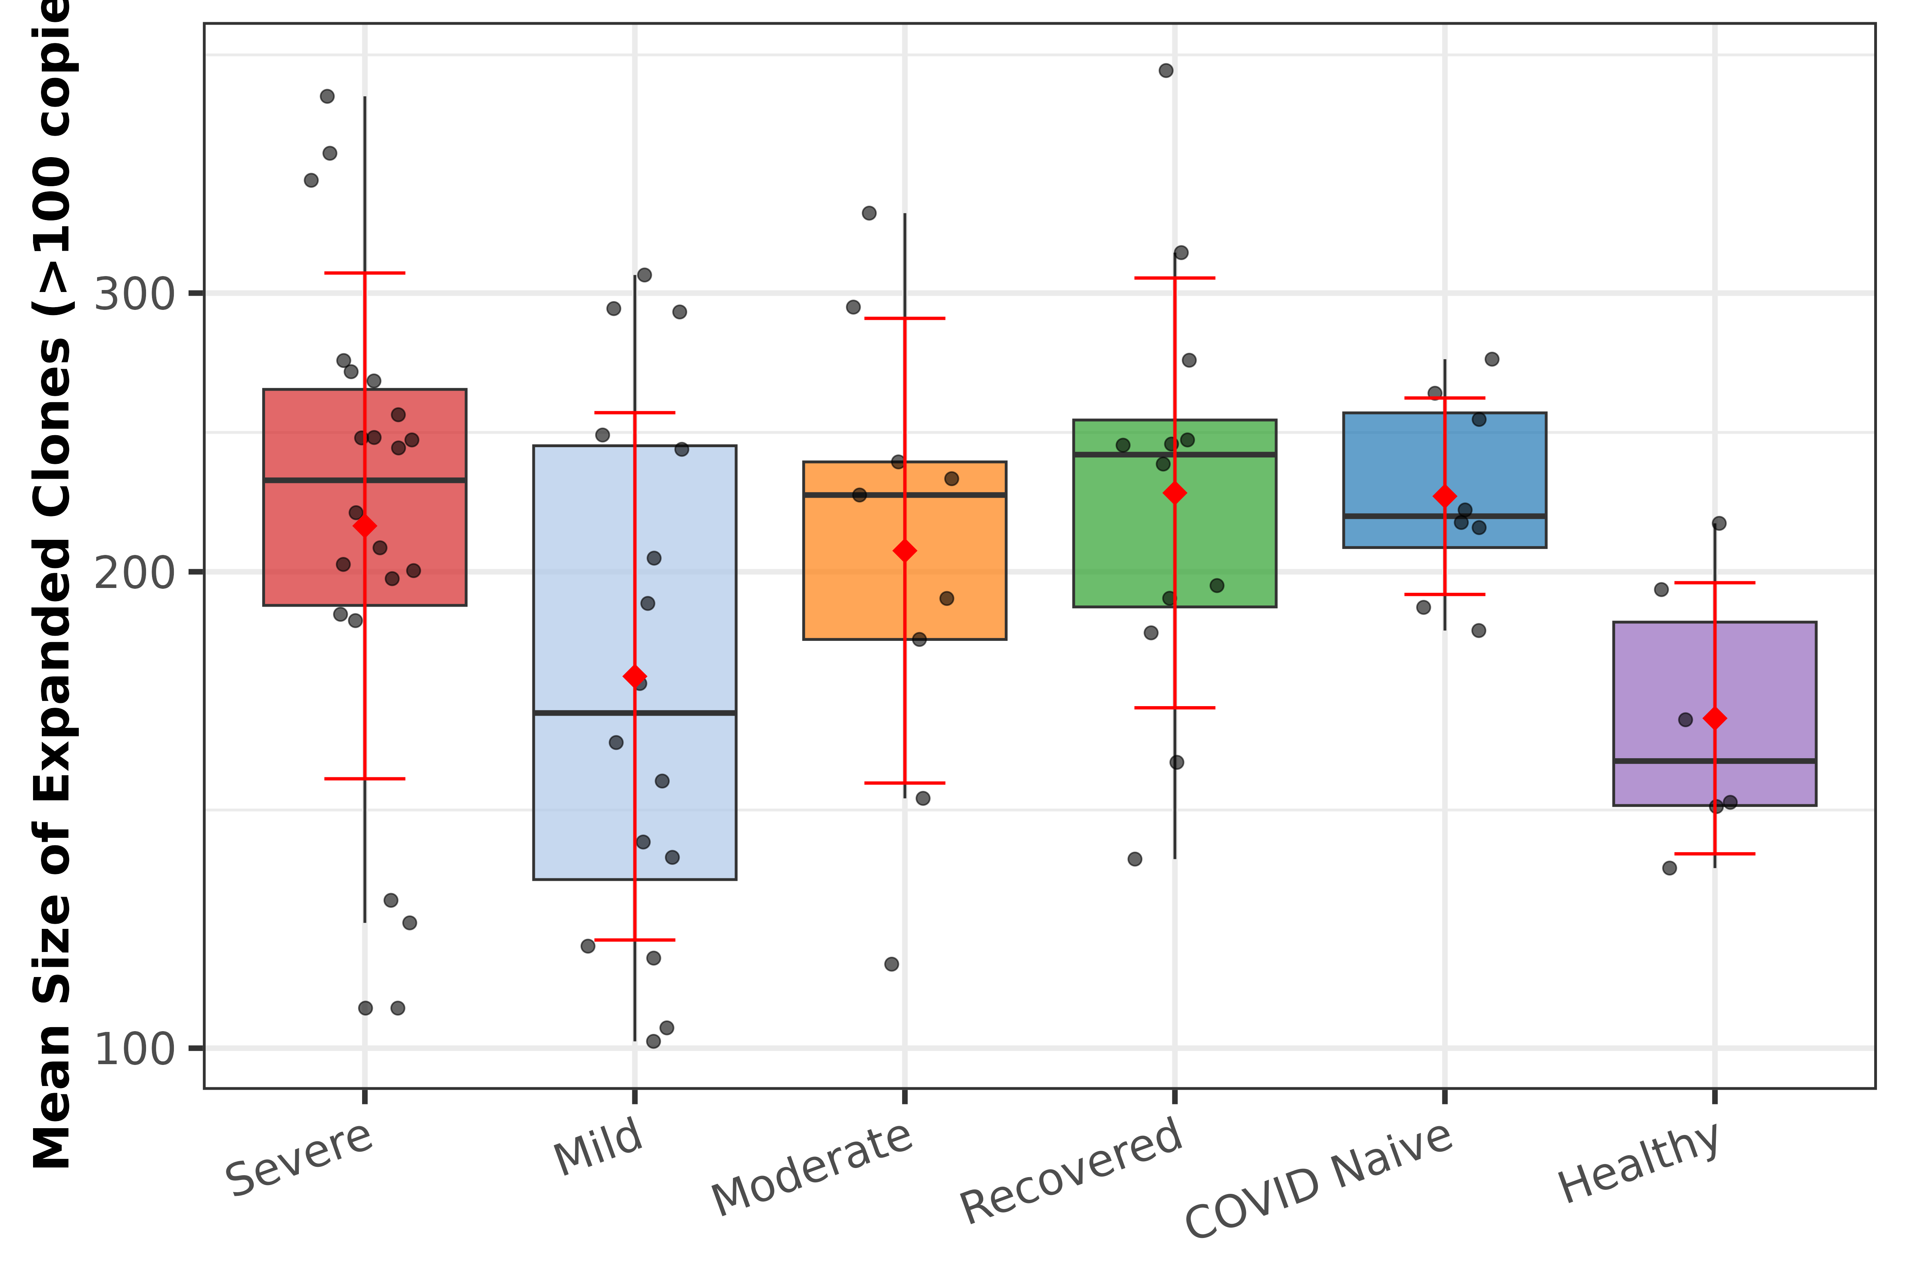
Expanded Clones Analysis
Count of Expanded Clones (>100 unique seqs)
Mean Size of Expanded Clones
Expanded clones (>100 unique sequences) represent antigen-driven clonal expansion. Severe and COVID Naive groups show the highest expansion counts, while expanded clone size reveals the magnitude of individual clonal responses.

Slide 11
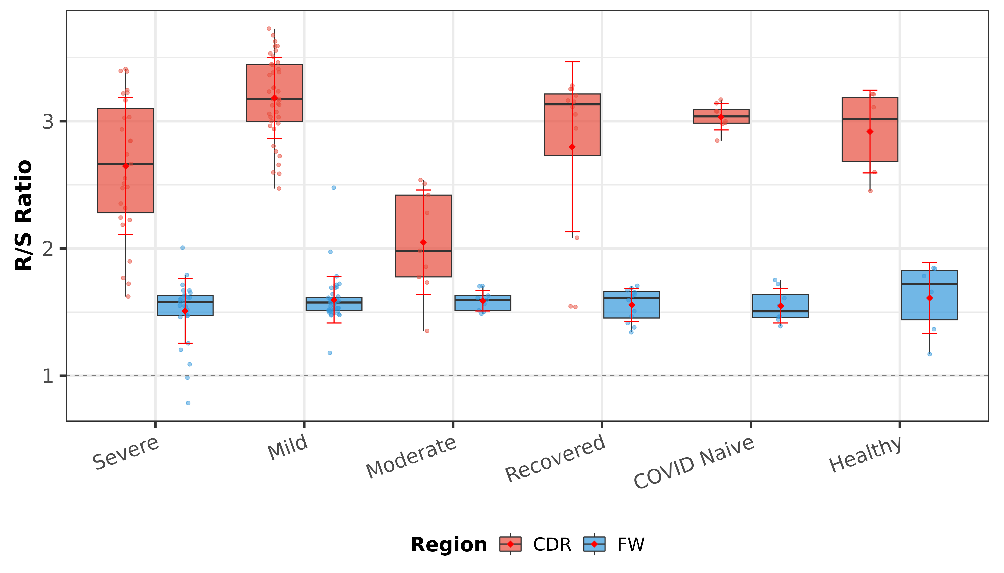
Replacement/Silent Mutation Ratio
R/S ratio as a measure of antigen-driven selection pressure
Key Findings
R/S ratio > 1 indicates positive selection — replacement mutations are favored over silent ones
Higher R/S in CDR regions vs framework reflects antigen-driven selection in binding sites
COVID Naive and Recovered groups show elevated R/S ratios consistent with affinity maturation
Healthy controls show baseline R/S levels expected for unselected repertoires

Slide 12
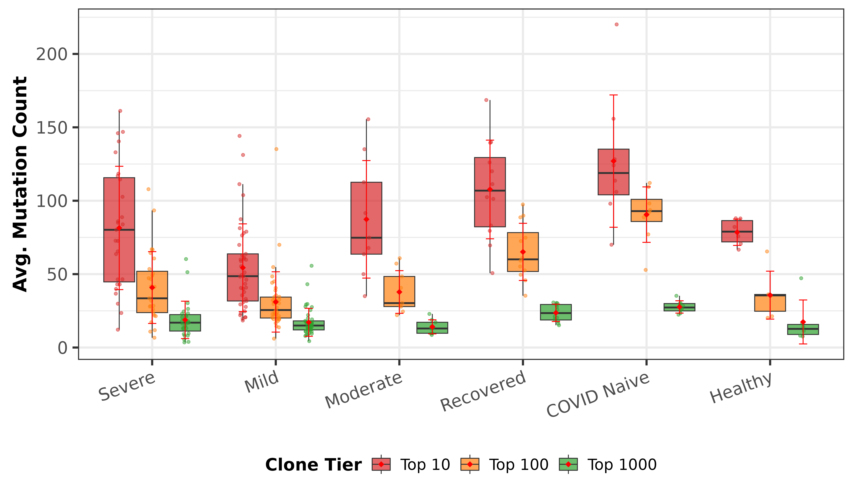
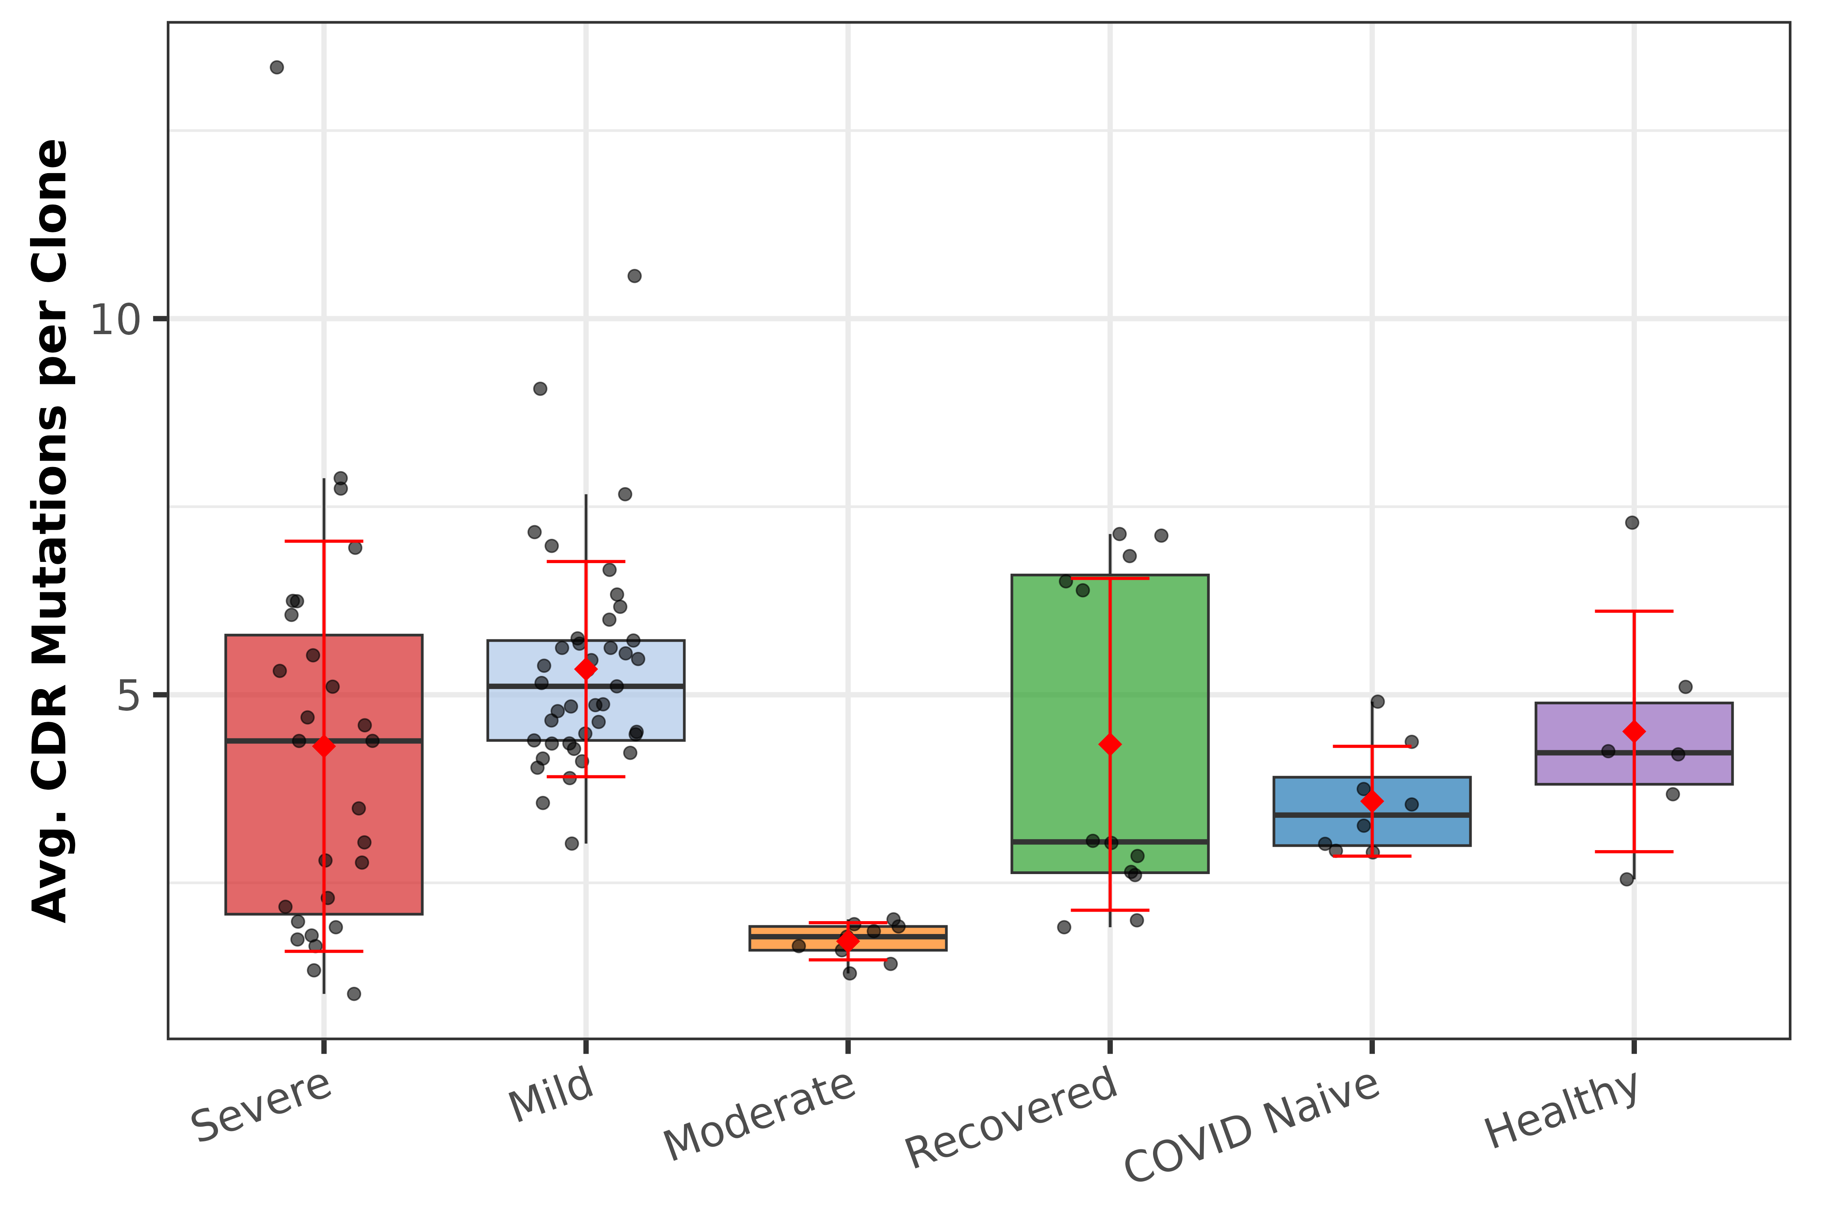
Somatic Hypermutation Analysis
Mutation Count (Top 10 Clones)
CDR Region Mutations
Mutation counts represent unique nucleotide positions differing from germline. Higher mutation in COVID Naive and Recovered groups suggests mature, affinity-selected B cell responses. CDR mutations indicate antigen-driven selection.

Slide 13
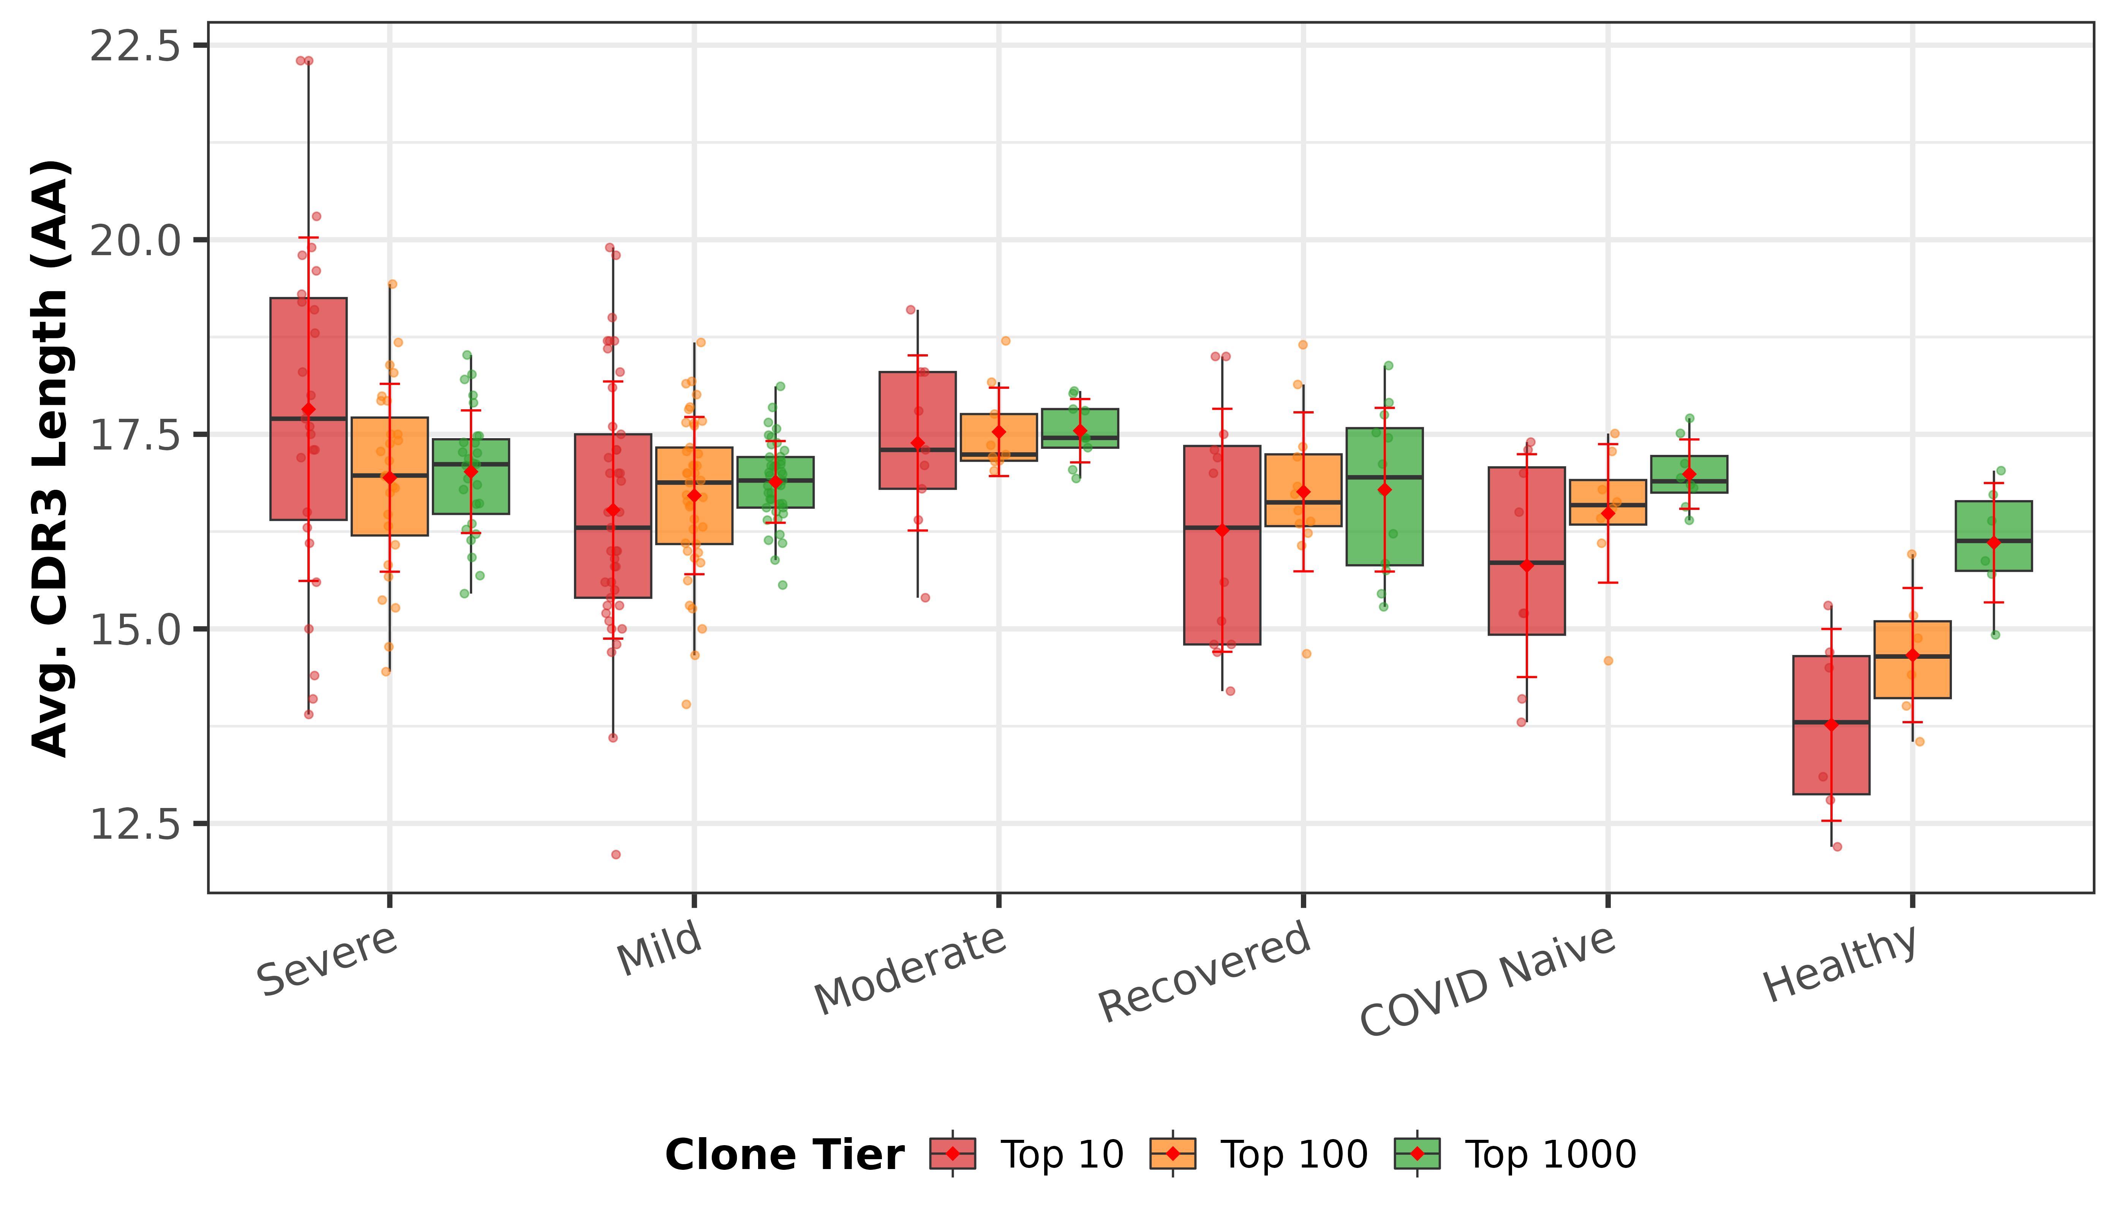
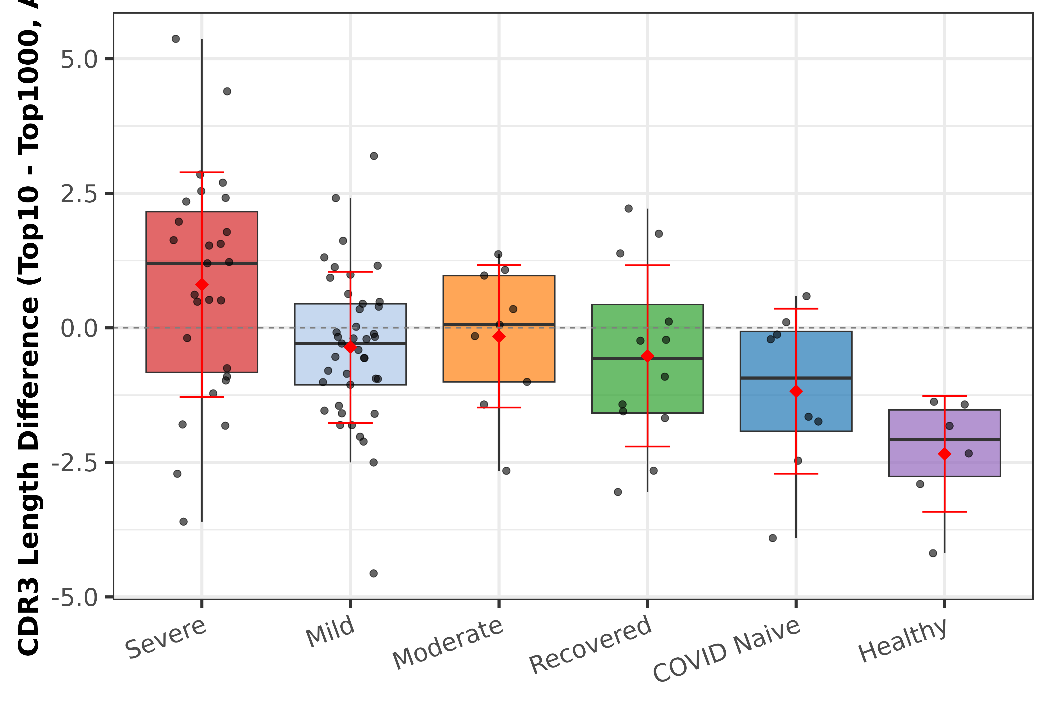
CDR3 Length Analysis
CDR3 Length (Top 10 Clones, AA)
CDR3 Length Range per Subject
CDR3 lengths are relatively consistent across disease categories (~15–16 AA for top clones), suggesting the overall structural constraints on antigen binding are preserved. Greater CDR3 range diversity is observed in COVID Naive and Recovered groups.

Slide 14
Summary & Conclusions
IS-API enables cross-study analysis
Successfully harmonized 103 subjects across 7 databases with 6 disease categories through metadata-driven filtering
Disease severity shapes BCR repertoire
Systematic differences in clone size, mutation burden, and CDR3 diversity across COVID-19 severity groups
COVID Naive shows distinct expansion
Highest clonal expansion and mutation counts, suggesting pre-existing mature memory B cell responses
Standardized API reduces barriers
Reproducible analysis pipeline replacing manual harmonization, enabling broader immunological studies
IS-API v0.3.0 | System Immunology Lab

