Slide 1
Solving Linear Programming Models Using Pyomo
Areesh Mittal
areeshmittal@utexas.edu
Sept 4, 2018

Slide 2
Installation Steps
Step1: Install Python 3.6
NOT Python 2.7
I recommend Anaconda distribution (in Windows)
https://www.anaconda.com/download/

Slide 3
Step 2: Install Pyomo
http://www.pyomo.org/installation/

Slide 4
Step 3: Download a Solver
Free academic license:
Gurobi
Google “Gurobi academic license” and follow the instructions
Cplex
Same steps as gurobi
Open Source (Slower, but you might need this after graduation):
Cbc
Click here for solver specific instructions on how to make Pyomo recognize the solvers

Slide 5
Additional Installation Tips
While installing either Anaconda or Solvers, if asked whether to “Add directory to PATH” (or something similar), ALWAYS say yes.
You have to be connected to UT network while installing solvers with academic license. After installing you can use them anywhere.

Slide 6
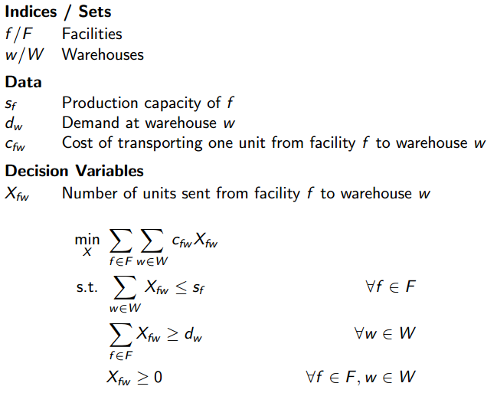
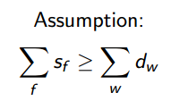
Transportation problem

Slide 7
Thank You!!!

