Slide 1
C-means
Examples and comparison to k-means
Yazd University
Dr. Derhami
Aref Akbari
2022

Slide 2
Steps
What has been done in this work
Definitions
c-means on image
k-means on image
c-means example on random generated dataset
c-means on bank transactions fraud dataset
k-means on bank transactions fraud dataset

Slide 3
Definitions

Slide 4
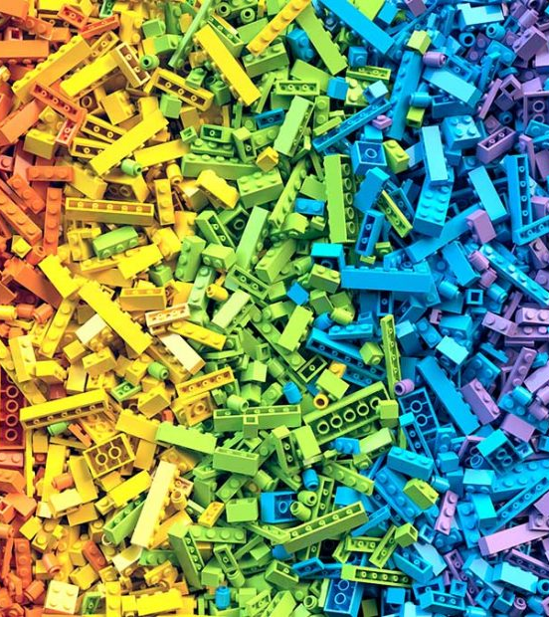
Clustering
Definition
Cluster analysis or clustering is the task of grouping a set of objects in such a way that objects in the same group are more similar to each other than to those in other groups.

Slide 5
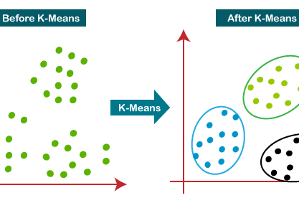
K-means
Definition
k-means clustering is a method of vector quantization, originally from signal processing, that aims to partition n observations into k clusters in which each observation belongs to the cluster with the nearest mean, serving as a prototype of the cluster.

Slide 6
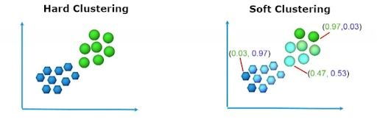
C-means
Definition
Fuzzy clustering is a form of clustering in which each data point can belong to more than one cluster. Clustering or cluster analysis involves assigning data points to clusters such that items in the same cluster are as similar as possible, while items belonging to different clusters are as dissimilar as possible.

Slide 7
C-means and k-means
Difference
C-means is fuzzy but k-means is hard (not fuzzy), each point is belonging to a centroid in K-means, but in fuzzy c-means each point can be belonging to two centroids but with different quality. each point either is a part of the first centroids, or the second centroids.

Slide 8
C-means on image

Slide 9

Implementation
Steps
I used a boilerplate code from github that already had implemented c-means image segmentation.
The cute cat image was used as input.
Same image was also used in k-means implementation.
Url: Github Repository

Slide 10
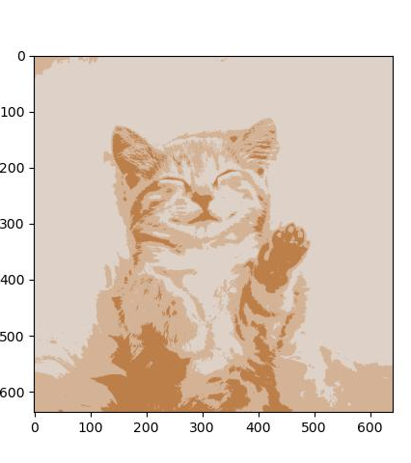
Results
Output
Segmented result is provided in output directory.
And also in this slide on right side.

Slide 11
k-means on image

Slide 12
Implementation
Steps
For implementation of k-means image segmentation I used a tutorial from web.
The cute cat image was used as input.
Same image was also used in c-means implementation.
Url: Website

Slide 13
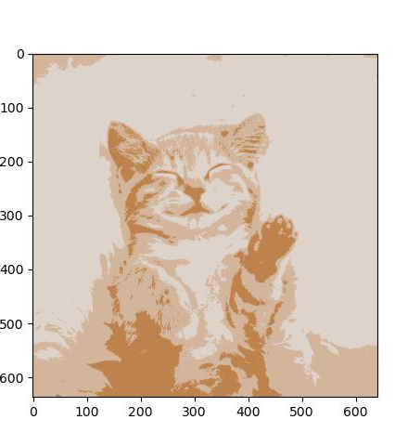
Results
Output
Segmented result is provided in output directory.
And also in this slide on right side.

Slide 14
C-means on generated dataset

Slide 15
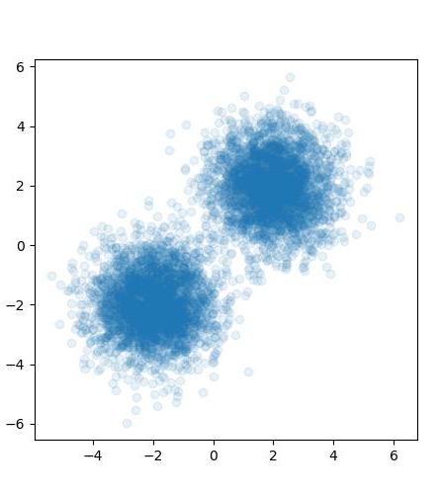
Implementation
Steps
This part was implemented from an example of fuzzy-c-means python module. Fuzzy-c-means is a simple implementation of Fuzzy C-means algorithm.
First step was generating random dataset using numpy library.
Url: Website

Slide 16
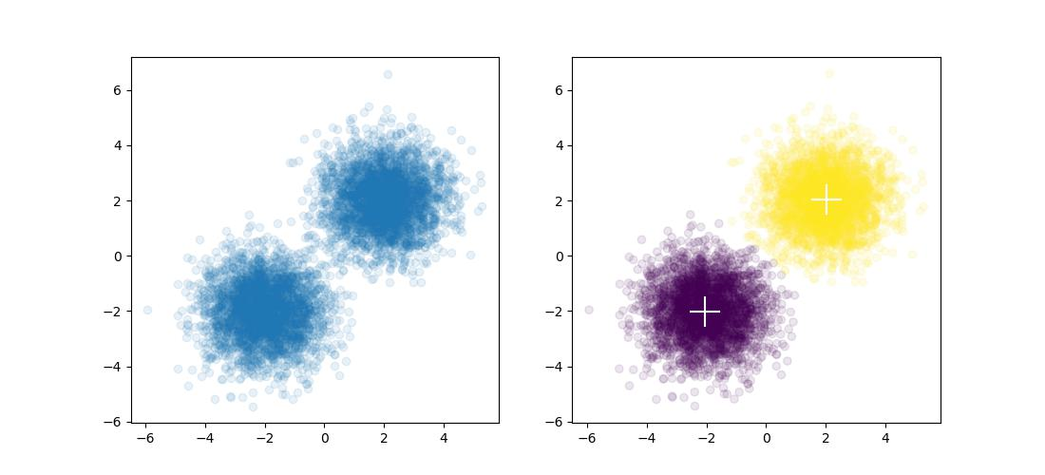
Results
Output
Clustering result is provided in output directory.
And also in this slide on right side.

Slide 17
C-means on real dataset

Slide 18
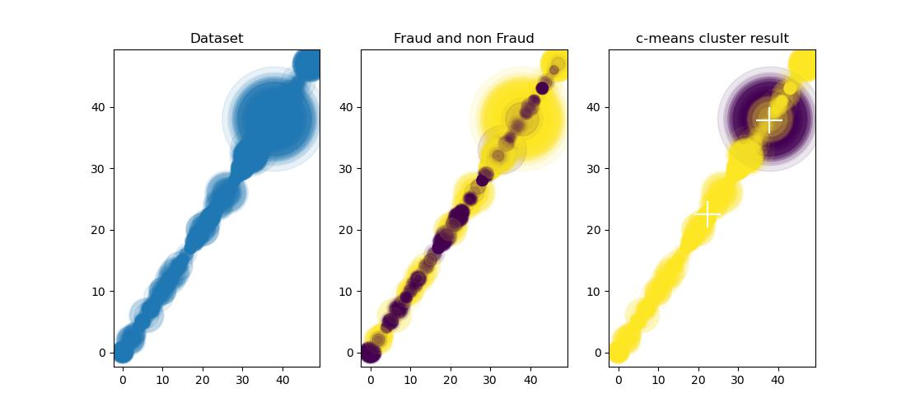
Implementation
Steps
Dataset was downloaded from kaggle website, titled “Synthetic Financial Datasets For Fraud Detection”.
For a lower resource usage (memory, cpu) only 20 percent of dataset was used.
Also labels on target and source of transactions was converted to numeric value using pandas library.
Url: Website

Slide 19
Results
Output
Clustering result is provided in output directory.
And also in this slide on right side.

Slide 20
k-means on real dataset

Slide 21
Implementation
Steps
Dataset used is same as last section.
Url: Website

Slide 22
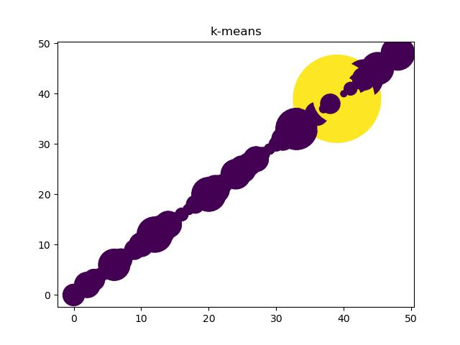
Results
Output
Clustering result is provided in output directory.
And also in this slide on right side.

Slide 23
“The Milky Way is
nothing else but a mass
of innumerable stars
planted together in
clusters.”
Galileo Galilei

