Slide 1
REINFORCEMENT LEARNING · CS 6999
Solving CVRP with
DQN and A2C
Arefeh Pourmohammadi
20 August 2026
Notes:
[Sources]
- User-provided presentation and DQN_parent.py
[/Sources]

Slide 2
How the solution is built
01
Problem
CVRP constraints and objective
02
Baseline
Clarke–Wright savings
03
Representation
GNN and Transformer encoders
04
Learning
DDQN, and A2C
05
Evaluation
Performance by graph size and fleet size
Notes:
[Sources]
- User-provided presentation and DQN_parent.py
[/Sources]

Slide 3
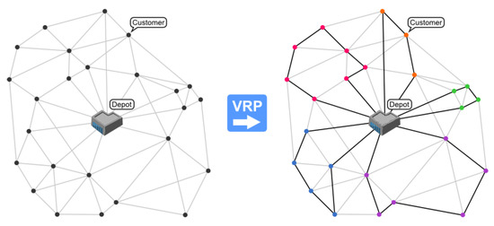
CVRP assigns every client to a feasible route
• N clients, each with a demand
• C vehicles with fixed capacity
• Every client is visited exactly once
• Each route starts and ends at the depot
• Objective: minimize total travel distance
Capacity constraints must remain satisfied for every vehicle.
Source: Ochelska-Mierzejewska et al., Electronics 2021, 10, 3147.
Notes:
[Sources]
- Ochelska-Mierzejewska et al., Electronics 2021, 10, 3147. https://doi.org/10.3390/electronics10243147
[/Sources]

Slide 4
The baseline greedily merges routes with the largest savings
1
Start with one depot–client–depot route per client
2
Compute s(i,j) = d(i,0) + d(0,j) − d(i,j)
3
Sort client pairs from largest to smallest saving
4
Merge routes only when capacity and routing constraints remain feasible
5
Stop when no additional feasible merge exists
Notes:
[Sources]
- Clarke and Wright savings method; diagram source in user-provided deck: Fikejz et al., Journal of Advanced Transportation (2024), 8753106.
[/Sources]

Slide 5
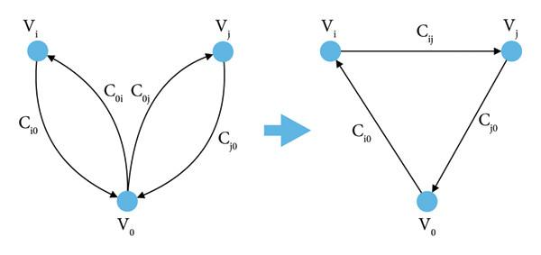
A route merge replaces four legs with three
Larger saving → more attractive feasible merge
Source: Fikejz et al., Journal of Advanced Transportation, 2024, 8753106.
Notes:
[Sources]
- Fikejz et al., Journal of Advanced Transportation (2024), 8753106.
[/Sources]

Slide 6
RL constructs the routes one decision at a time
STATE
ACTION
REWARD
Graph statistics, unvisited-client representation, and other routes
Choose a pair: (route, next client)
Negative normalized distance added by the selected move
Episode ends after all feasible client assignments are completed and routes return to the depot.
Notes:
[Sources]
- User-provided presentation and DQN_parent.py
[/Sources]

Slide 7
Four graph representations are compared
GNN
Learns node embeddings by message passing; graph embedding is the mean of node embeddings.
Transformer
Encodes node-pair tokens with self-attention; pair embeddings are pooled into nodes and the graph.
GNN + Transformer
The GNN produces node embeddings, then the Transformer models global embedding from the gnn embeddings.
Statistical features only
Uses normalized graph, route, client, and demand statistics without a learned graph encoder.
Notes:
[Sources]
- User-provided presentation and DQN_parent.py
[/Sources]

Slide 8
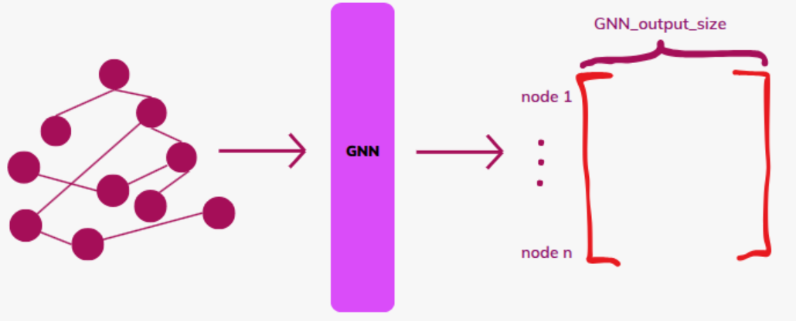
GNN message passing produces one embedding per node
Graph embedding = mean of all final node embeddings
Notes:
[Sources]
- User-provided presentation and DQN_parent.py
[/Sources]

Slide 9
Node and edge features describe local demand and geometry
NODE FEATURES
EDGE FEATURE
• Normalized client demand
• Average distance to other nodes
Normalized distance
between the connected nodes
Notes:
[Sources]
- User-provided presentation and DQN_parent.py
[/Sources]

Slide 10
Each edge creates a message for its connected nodes
mᵢⱼ = FFN([xᵢ ‖ xⱼ ‖ eᵢⱼ])
Node i
features
Node j
features
Edge i,j
feature
Feed-forward
network
→
→
→
The same learned function is applied to every connected pair.
Notes:
[Sources]
- User-provided presentation and DQN_parent.py
[/Sources]

Slide 11
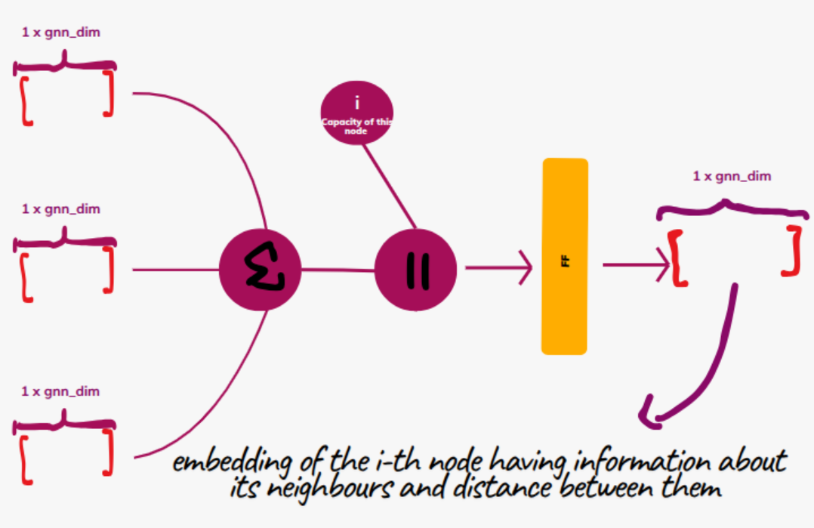
Neighbor messages are pooled to update each node
1
Aggregate messages from all neighbors
Concatenate the pooled message with the node’s own features
2
Apply an FFN to obtain the final node embedding
3
Notes:
[Sources]
- User-provided presentation and DQN_parent.py
[/Sources]

Slide 12
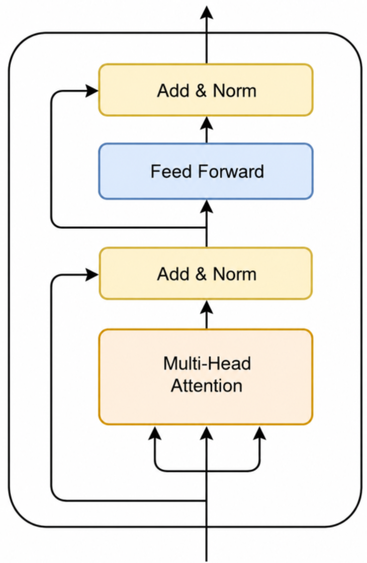
A Transformer layer mixes information across all tokens
MULTI-HEAD ATTENTION
Each token attends to every other token using learned query, key, and value projections.
FEED-FORWARD NETWORK
A nonlinear network independently refines every attended token.
Residual connections and LayerNorm stabilize both sublayers.
Image reference: h7w, ‘An Introduction to Transformers in Machine Learning,’ Medium.
Notes:
[Sources]
- https://medium.com/h7w/an-introduction-to-transformers-in-machine-learning-50c8a53af576
[/Sources]

Slide 13
The Transformer receives one token for every node pair
[ avgDistᵢ, demandᵢ, avgDistⱼ, demandⱼ, distanceᵢⱼ ]
Pair tokens
N(N−1)/2 × 5
Transformer
pair embeddings
Average incident pairs
node embeddings
Mean over nodes
graph embedding
→
→
→
Output shapes: node embedding [N, model_dim] · graph embedding [model_dim]
Notes:
[Sources]
- User-provided Transformer encoder code from the current conversation.
[/Sources]

Slide 14
DDQN learns the long-term value of each feasible action
Q(s,a) ≈ expected discounted return after taking action a in state s
y = r + γ Q_target(s′, argmaxₐ Q_online(s′,a))
• The online network predicts Q-values for all feasible (route, client) actions.
• ε-greedy exploration selects a random action with probability ε.
• Training minimizes SmoothL1Loss between Q_online(s,a) and target y.
Notes:
[Sources]
- DQN_parent.py supplied by the user. Formula reflects its Double-DQN-style target selection/evaluation.
[/Sources]

Slide 15
Separate encoders build the state and action representations
Raw state features
State encoder
Linear → SiLU → Linear
Concatenate
state + action
Online Q-network
Linear → SiLU → Linear
Scalar Q(s,a)
→
→
→
→
↗
Raw action features
Action encoder
Linear → SiLU → Linear
→
State features: graph + unvisited clients + other routes
Action features: next client + current route
Notes:
[Sources]
- DQN_parent.py supplied by the user.
[/Sources]

Slide 16
The training loop combines replay, target updates, and Double DQN
Generate feasible
CVRP episode
Store transition in
replay buffer
Sample a
mini-batch
Build Double-DQN
target
Backpropagate
SmoothL1Loss
→
→
→
→
Feasibility mask
Rejects actions that violate capacity or make the remaining demands impossible to pack.
Target network
Periodically copies weights from the online Q-network.
Stability
Gradient clipping, learning-rate decay, and epsilon decay are applied during training.
Notes:
[Sources]
- DQN_parent.py supplied by the user.
[/Sources]

Slide 17
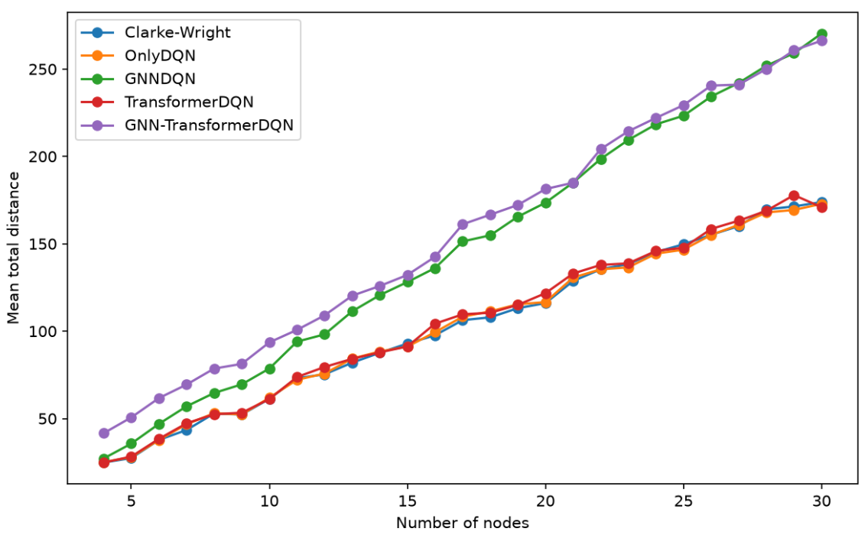
Simpler DDQN variants scale better as the graph grows
Only-DQN and Transformer-DQN remain close to the Clarke–Wright baseline.
The GNN-based variants produce much longer routes, and the gap increases with graph size.
Notes:
[Sources]
- Experimental plot supplied in the user-provided presentation.
[/Sources]

Slide 18
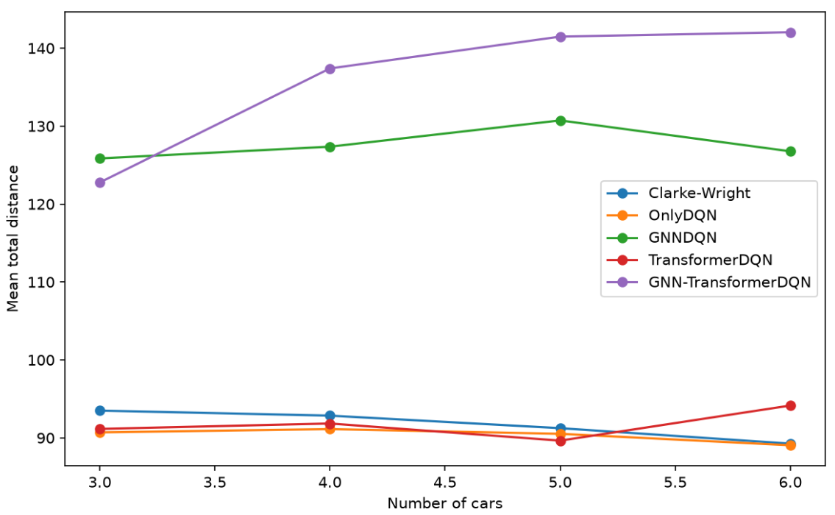
Only-DQN remains strongest across different fleet sizes
Only-DQN gives the lowest or near-lowest total distance for 3–6 vehicles.
Embedding-heavy variants remain substantially above the baseline across the tested fleet sizes.
Notes:
[Sources]
- Experimental plot supplied in the user-provided presentation.
[/Sources]

Slide 19
A2C learns a policy and value function together
ACTOR
CRITIC
Produces a probability distribution over feasible (route, client) actions.
Estimates V(s) and supplies an advantage signal to improve the actor.
The actor uses [state ‖ action]; the critic uses only the state representation.
Notes:
[Sources]
- A2C code supplied by the user in Pasted code.py.
[/Sources]

Slide 20
A2C updates both networks from one complete trajectory
Return
Advantage
Gₜ = rₜ + γrₜ₊₁ + γ²rₜ₊₂ + …
Aₜ = Gₜ − V(sₜ)
Total loss = Actor loss + value_coef × Critic loss − entropy_coef × Entropy
• Actor loss increases the probability of actions with positive detached advantage.
• Critic loss is the mean squared advantage: (Gₜ − V(sₜ))².
• Entropy encourages exploration; gradients are clipped and the learning rate decays.
Notes:
[Sources]
- A2C code supplied by the user in Pasted code.py.
[/Sources]

Slide 21
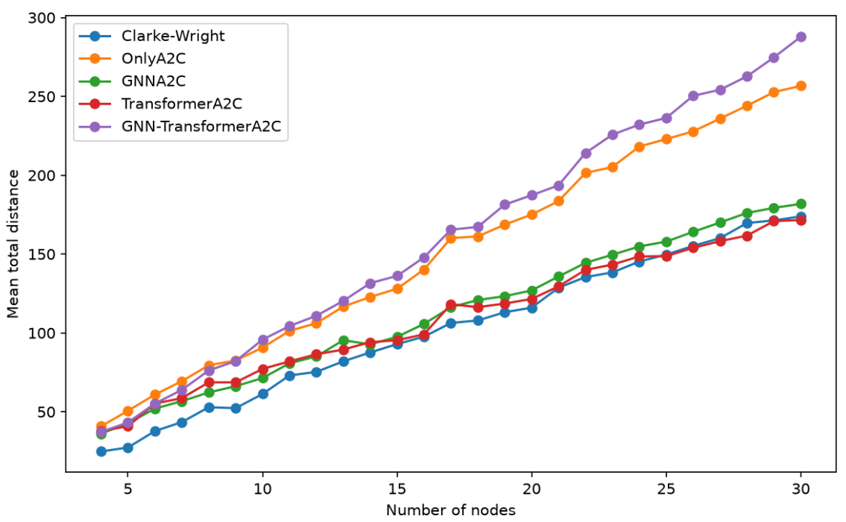
Transformer-A2C stays closest to the baseline as graphs grow
Clarke–Wright remains the strongest overall baseline.
Transformer-A2C and GNN-A2C track it most closely. Only-A2C and GNN–Transformer-A2C diverge as the number of nodes increases.
Notes:
[Sources]
- Experimental A2C plot supplied by the user.
[/Sources]

Slide 22
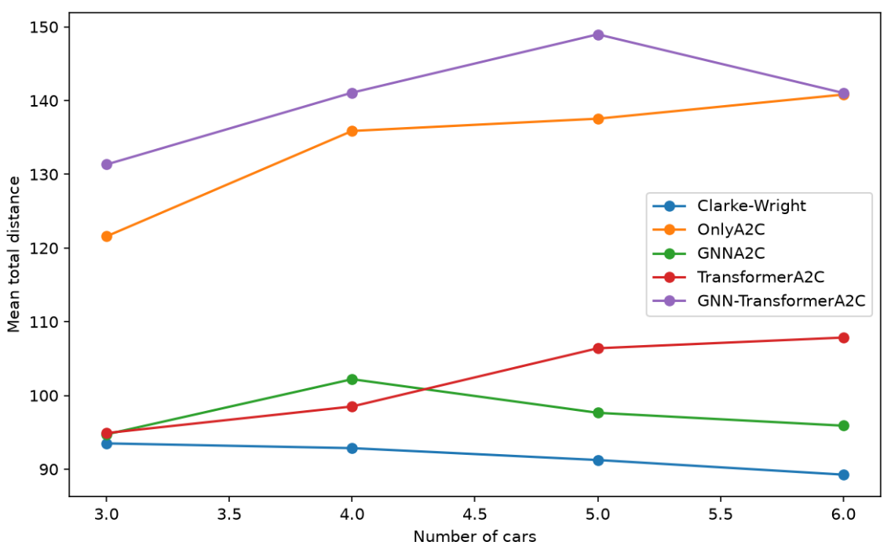
GNN-A2C is the strongest learned variant across fleet sizes
Clarke–Wright improves as more vehicles become available.
GNN-A2C is the closest learned method overall. Transformer-A2C degrades with more vehicles, while Only-A2C and the combined encoder remain much higher.
Notes:
[Sources]
- Experimental A2C plot supplied by the user.
[/Sources]

Slide 23
Results
1
Normalizing the inputs improved their performance heavily
The gap between the models and the heuristic approach before normalization was huge but normalizing inputs of all networks made them better performance
2
More representation is not always better
In the supplied experiments, Only-DQN is more competitive than GNN-based variants.
3
Different Networks for action and state is better in non-GNN models
While having different networks for action and state embedding made the non-GNN models better it worsen the GNN-based models in DDQN

