Slide 1
SCALE YOU!
Growing Your Career
Notes:
<WAIT TO START>
Hello again Everyone!
You have probably seen a job posting like this one...

Slide 2
Junior Software Engineer
at Aperture Science
Aperture Science is a scientific research company founded by Cave Johnson working with cutting edge AI technologies that will help power the future of all humanity.
1 to 2 years of experience
3 to 5 years working with the Poopact
3+ years experience with Poopvelte
1 years experience with Poopify
Excellent communication skills
Notes:
<GIVE TIME TO READ 15 COUNT>
Or like this one

Slide 3
Mid-Level Software Engineer
at Aperture Science
Aperture Science is a scientific research company founded by Cave Johnson working with cutting edge AI technologies that will help power the future of all humanity.
2 to 5 years of experience
3 to 5 years working with the Poopact
3+ years experience with Poopvelte
1 years experience with Poopify
Excellent communication skills
Notes:
Or like this one

Slide 4
Senior Software Engineer
at Aperture Science
Aperture Science is a scientific research company founded by Cave Johnson working with cutting edge AI technologies that will help power the future of all humanity.
5 to 10 years of experience
3 to 5 years working with the Poopact
3+ years experience with Poopvelte
1 years experience with Poopify
Excellent communication skills
Notes:
Or like this one

Slide 5
Principal Software Engineer
at Aperture Science
Aperture Science is a scientific research company founded by Cave Johnson working with cutting edge AI technologies that will help power the future of all humanity.
10 to 20 years of experience
3 to 5 years working with the Poopact
3+ years experience with Poopvelte
1 years experience with Poopify
Excellent communication skills
Notes:
The point is that these are all the same job.
The only differentiator

Slide 6
Principal Software Engineer
at Aperture Science
Aperture Science is a scientific research company founded by Cave Johnson working with cutting edge AI technologies that will help power the future of all humanity.
10 to 20 years of experience
3 to 5 years working with the Poopact
3+ years experience with Poopvelte
1 years experience with Poopify
Excellent communication skills
Notes:
is how many years
of working as a software engineer
the job is "demanding"
But "years of experience" means nothing.

Slide 7
Notes:
As a measure it lacks any meaningful substance.
Its like assuming someone would be good at a job
because their last name has 10 characters in it.
Companies do this
because they need to put people into buckets.

Slide 8
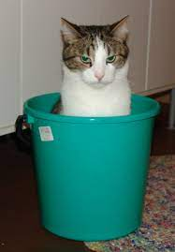
Notes:
Buckets make it easier to rationalize about people
Buckets make it so HR doesnt have to think as much.
Buckets are lazy.
Buckets completely miss the point.
<SMALL PAUSE>
A company is not a collection of robots.

Slide 9

Notes:
Its a collection of individuals

Slide 10

Notes:
with different strengths and weaknesses.
And being individuals is a good thing.
But companies still dont seem to understand this.
So they bucket us, sort us into groups.

Slide 11
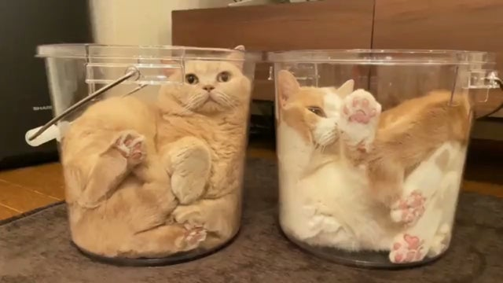
Notes:
And that's what "Years of Experience" is.
It's a bucket.
So that HR doesnt have to think about people.
They can just think about the buckets.
These buckets help HR determine your worth to the company.

Slide 12
WORTH
How much they should pay you?
How much responsibility the can place in you?
How much can they expect of you?
How much value do you add to the company?
Notes:
How much they should pay you?
How much responsibility can they place in you?
How much can they expect of you?
How much value do you add to the company?
But circling back to the Job Descriptions I brought up earlier...
These buckets dont actually answer any of these questions.
They only answer one question:

Slide 13
How long have you been sitting at a desk?
Notes:
How long have you been sitting at a desk.
<SHORT PAUSE>
It is entirely possible
To work in a company
For multiple years
Without doing anything more
Than occupying space.
Believe me.
<PAUSE>
So lets blow it up.

Slide 14

Notes:
Let us throw out the notion of "Years of Experience".
And let us instead imagine a better way to judge
a Software Engineer's "level".
And once we understand the leveling system
Then we can understand how to advance within it.
<SHORT PAUSE>
But before we can do that
We need to sidetrack into motivations.

Slide 15
Motivations
Notes:
What motivations drive Software Engineers to work.
And I want to be clear here…
This is not a comprehensive list of motivations
Just what I believe are the important ones.
All of us individuals are motivated in different ways.
Figure out yours.
<SHORT PAUSE>
Alright.
The first motivation is
Getting Paid.

Slide 16
Motivations
Getting Paid
Notes:
Lets face it, we work to get paid.
Yes, many of us would work even if we didnt get paid
Because we love what we do
But we most certainly would not be
working on whatever it is your company wants us to do.
we'd all be making video games.
<SHORT PAUSE>
Second
Technical Challenge

Slide 17
Motivations
Getting Paid
Technical Challenge
Notes:
There is nothing like overcoming a juicy problem.
And software engineers in particular seem to be a glutton for solving problems.
So we want to be challenged.
But not overwhelmed.
Something in the sweet spot that forces us to grow
without being completely over our heads.
<SHORT PAUSE>
Third,
Creative Opportunity

Slide 18
Motivations
Getting Paid
Technical Challenge
Creative Opportunity
Notes:
Software is as much an art as it is a science.
As such, there is a strong component of Creation in the work that we do.
Yet most companies already have the "plan" all mapped out,
and the chance to be creative is very micro-ized,
tiny little chances to name variables and classes.
As we grow, these small chances get bigger…
And the corresponding creative opportunities expand.
As we start to increase the scope of the systems we work on,
as we start to look at how the systems grow,
and work together,
and solve problems,
we get more and more chances to truly create.
Thus as we grow in our career we seek out greater opportunities
to be in a role that allows great chance to be creative.
<SHORT PAUSE>
Fourth
Influence

Slide 19
Motivations
Getting Paid
Technical Challenge
Creative Opportunity
Influence
Notes:
As you grow in your career
you will also seek out the opportunity
to wield influence within the company.
How much are my words being heard throughout the company?
How does that work I do impact others?
Some might call this Authority and Management
But there are a lot of ways to influence
without being the boss or acting bossy.
<SHORT PAUSE>
And Finally
Avoiding Hassle

Slide 20
Motivations
Getting Paid
Technical Challenge
Creative Opportunity
Influence
Avoiding Hassle
Notes:
Nobody wants to work in a company that sucks.
And nobody wants to go to that stupid
weekly all hands meeting every friday morning.
So whether or not we choose to admit it
One of our underlying motivations
Is to avoid work place stress...
Aka avoid hassle.
<SHORT PAUSE>
So these are
In my opinion

Slide 21
Motivations
Getting Paid
Technical Challenge
Creative Opportunity
Influence
Avoiding Hassle
Notes:
The motivations that we
as software engineers
look for in our work.
Again, not exhaustive,
not the same for everyone,
but I think it is a very good place to have
a common discussion around.
And we can measure these.

Slide 22
Motivations
😢
😃
Getting Paid
Technical Challenge
Creative Opportunity
Wielding Influence
Avoiding Hassle
0
10
Notes:
We can rate them from a 1 to 10
With 1 being Low and 10 being high.
For example,
For my current role
I serve as
Chief Architect and Lead Engineer
and this is how I rank these motivations…

Slide 23
Motivations
😢
😃
Getting Paid
8
Technical Challenge
4
Creative Opportunity
6
Wielding Influence
7
Avoiding Hassle
7
0
10
Notes:
I am very well paid,
I am not very challenged,
I am somewhat given the chance to be creative
I am somewhat influential in the company
and I am able to avoid a moderate amount of hassle.
Additionally, as we grow in our career
we expect these numbers to grow also.

Slide 24
Motivations
😢
😃
Getting Paid
9
Technical Challenge
8
Creative Opportunity
8
Wielding Influence
9
Avoiding Hassle
8
0
10
Notes:
I expect that as I move up in my career trajectory
I am going to see an increase
in Pay,
and Challenge,
and Creativity,
and Influence.
And as a company changes around us
we expect these numbers to change as well.

Slide 25
sadf
Motivations
😢
😃
Getting Paid
8
Technical Challenge
2
Creative Opportunity
3
Wielding Influence
6
Avoiding Hassle
1
0
10
Notes:
And not always for the better.
Over time Technical Challenge becomes less.
Over time Avoiding Hassle becomes harder.
Over time Influence will wax and wane.
And companies should be watching these changes.
When these number drop down to 1s and 2s
people get demotivated and start looking elsewhere.
<PAUSE>
So now that we have some baselines for motivations
we can look at how those motivations translate to levels.
For a Junior Software Engineer
We might expect something like this…

Slide 26
Motivation Expectations per Level
Getting Paid
Technical Challenge
Creative Opportunity
Wielding Influence
Avoiding Hassle
Junior Engineer
LOW
VERY HIGH
LOW
LOW
HIGH
Mid Engineer
Senior Engineer
Principal Engineer
Notes:
Low Pay
Low Creativity
Low Influence
Low Avoiding Hassle
But interestingly enough, high Challenge,
because, this is after all, usually the entry point
and there's a lot of learning to be done.
But as we progress up into the Mid level

Slide 27
Motivation Expectations per Level
Getting Paid
Technical Challenge
Creative Opportunity
Wielding Influence
Avoiding Hassle
Junior Engineer
LOW
VERY HIGH
LOW
LOW
HIGH
Mid Engineer
MEDIUM
LOW
LOW
LOW
HIGH
Senior Engineer
Principal Engineer
Notes:
We see that
Pay increases
Technical Challenge decreases as we become complacent
And everything else kind of coasts.
Until we step up in the Senior Role

Slide 28
Motivation Expectations per Level
Getting Paid
Technical Challenge
Creative Opportunity
Wielding Influence
Avoiding Hassle
Junior Engineer
LOW
VERY HIGH
LOW
LOW
HIGH
Mid Engineer
MEDIUM
LOW
LOW
LOW
HIGH
Senior Engineer
HIGH
MEDIUM
MEDIUM
LOW
MEDIUM
Principal Engineer
Notes:
Then we see
Pay raising again, of course,
Technical Challenge starts to rise as we start building things of greater scope
Creativity also raises with the chance to build with greater scope
But Avoiding Hassle becomes harder as you start getting sucked into more meetings.
Moving beyond senior continues this trend.

Slide 29
Motivation Expectations per Level
Getting Paid
Technical Challenge
Creative Opportunity
Wielding Influence
Avoiding Hassle
Junior Engineer
LOW
VERY HIGH
LOW
LOW
HIGH
Mid Engineer
MEDIUM
LOW
LOW
LOW
HIGH
Senior Engineer
HIGH
MEDIUM
MEDIUM
LOW
MEDIUM
Principal Engineer
VERY HIGH
HIGH
HIGH
MEDIUM
LOW
Notes:
We see that
Pay continues to raise,
Challenge and Creative Opportunity increase with the scope of the work we do,
We start to have more influence within the company,
But the non-stop assault of meeting and hassle increases greatly.
All this is to say

Slide 30
Motivation Expectations per Level
Getting Paid
Technical Challenge
Creative Opportunity
Wielding Influence
Avoiding Hassle
Junior Engineer
LOW
VERY HIGH
LOW
LOW
HIGH
Mid Engineer
MEDIUM
LOW
LOW
LOW
HIGH
Senior Engineer
HIGH
MEDIUM
MEDIUM
LOW
MEDIUM
Principal Engineer
VERY HIGH
HIGH
HIGH
MEDIUM
LOW
Notes:
That our levels are more than just
how many years we have been whacking a keyboard.
Levels identify the expectation of the
Pay we get
The challenges we face
The creativity we explore
The influence we wield
and the hassle we must surmount.
These, of course, fluxuate from job to job,
but generally you get the idea.
And to take it back to the Job Descriptions.

Slide 31
Motivation Expectations per Level
Getting Paid
Technical Challenge
Creative Opportunity
Wielding Influence
Avoiding Hassle
Junior Engineer
LOW
VERY HIGH
LOW
LOW
HIGH
0 to 2 Years
Mid Engineer
MEDIUM
LOW
LOW
LOW
HIGH
2 to 5 Years
Senior Engineer
HIGH
MEDIUM
MEDIUM
LOW
MEDIUM
5 to 10 Years
Principal Engineer
VERY HIGH
HIGH
HIGH
MEDIUM
LOW
10 to 20 Years
Notes:
These are the "Years of Experience" expectations
that correspond to these roles
Junior: 1 to 2 years
Mid: 2 to 5 years
Senior: 5 to 10 years
Principal: 10 to 20 years
As if this mystical Years of Experience number
can capture all the nuance of what we do.
As if occupying space for some magic period of time
Qualifies me to wield more influence in the company
or makes me more effective at being creative.
It's bunk.

Slide 32

Notes:
Junk Science.
Fake News.
And even if your company subscribes to this,
and I assure you they do,
HR does not magically promote you based on your
work anniversary.
"Wow, Kirill has been with us 5 years.
I guess he's a Senior Software Engineer now.
Better give him more money
and more influence in the company."
Just doesnt work that way.

Slide 33
Notes:
<PAUSE>
Alright,
So I am 30 slides or so in.
And All I've done is bitch about HR.
And I promised I was going to talk about

Slide 34
Notes:
how you, as a software engineer,
level-up your career.
If the magic "Years of Experience" number is worthless
what do you use instead?
Well, the answer to that sort of lies in our motivations.

Slide 35
Motivations
Getting Paid
Technical Challenge
Creative Opportunity
Wielding Influence
Avoiding Hassle
Notes:
If we take our motivations
and map them into things
that the company would value us for
we can begin to understand the best avenues
for us to grown along.
(Its not a perfect comparison, but bear with me...)
<SHORT PAUSE>
So first we map
Getting Paid into Knowledge

Slide 36
Motivations > Growth
Getting Paid
Knowledge
Technical Challenge
Creative Opportunity
Wielding Influence
Avoiding Hassle
Notes:
We are fundamentally knowledge workers.
This mean the knowledge we have
and the application of that knowledge
is what we are selling,
what we are getting paid for.
So the greater our knowledge,
And our application of that knowledge,
the more we get paid.
<SHORT PAUSE>
Second, we map
Technical Challenge into Tenacity.

Slide 37
Motivations > Growth
Getting Paid
Knowledge
Technical Challenge
Tenacity
Creative Opportunity
Wielding Influence
Avoiding Hassle
Notes:
The tenacity we bring to bear for our company,
the passion to dig into a problem and solve it,
no matter how hard that problem might be,
that is what makes us valuable.
Tenacity is the will to rise above our technical challenges.
<SHORT PAUSE>
Third, we map Creativity into Insight.

Slide 38
Motivations > Growth
Getting Paid
Knowledge
Technical Challenge
Tenacity
Creative Opportunity
Insight
Wielding Influence
Avoiding Hassle
Notes:
The opportunity to be creative in your work
takes many forms in a company.
But the value lies in your ability to provide
new insights and new innovations.
Insight and Innovation is the expression of your creativity.
<SHORT PAUSE>
Next, we map Influence into Leadership.

Slide 39
Motivations > Growth
Getting Paid
Knowledge
Technical Challenge
Tenacity
Creative Opportunity
Insight
Wielding Influence
Leadership
Avoiding Hassle
Notes:
Influence is earned, not rewarded,
and in order to earn it you must demonstrate it.
This seems kind of chicken and egg like,
but really there are lots of ways to lead
By demonstrating that you are a leader without authority.
<SHORT PAUSE>
Finally, we map Avoiding Hassle into Communication.

Slide 40
Motivations > Growth
Getting Paid
Knowledge
Technical Challenge
Tenacity
Creative Opportunity
Insight
Wielding Influence
Leadership
Avoiding Hassle
Communication
Notes:
90% of all hassle is actually
a breakdown in communication.
Its a failure by some party to communicate effectively.
So by being an effective communicator
you are actually striving to reduce the hassle
for yourself and others.
<PAUSE>
By mapping our motivations into

Slide 41
Motivations > Growth
Getting Paid
Knowledge
Technical Challenge
Tenacity
Creative Opportunity
Insight
Wielding Influence
Leadership
Avoiding Hassle
Communication
Notes:
actionable things we can do to improve,
we create a path forward and upward
and we can begin to see the ways
in which we can achieve greater success.
<SHORT PAUSE>
So now we know WHERE to grow,

Slide 42
Motivations > Growth
Getting Paid
Knowledge
Technical Challenge
Tenacity
Creative Opportunity
Insight
Wielding Influence
Leadership
Avoiding Hassle
Communication
Notes:
but the million dollar question
is HOW we do that.
How do we grow in each of these areas
to move us from junior to senior and beyond?
<PAUSE>
So we are now 43 slides in
And all I've done so far is set the stage.
You're all wondering where the meat is,
where's all the great advice?
Well get out those notebooks,
start those cameras rolling,
I'm about to advice bomb the hell out of this sucker.
<PAUSE>
We start with Knowledge and…

Slide 43
Knowledge
Always be open to learning new technology.
Notes:
Always be open to learning a new technology.
And this is one of those places I'm being super hypocritical
Because I'm a curmudgeon
and will never ever use React.
So don’t do like me,
be much more willing to embrace new tech.
Additionally…

Slide 44
Knowledge
Always be open to learning new technology.
Never be afraid to try a new way of doing something.
Notes:
Never be afraid to try a new way of doing something.
So this is different than learning a new technology.
Its about being open to new ways to think and explore.
If a co-worker suggest XYZ and you've never tried it
And you don’t see a massive reason not to
Give it a shot.
Invest in the coworkers idea
You will most certainly learn something.
In order to do this though, you must…

Slide 45
Knowledge
Always be open to learning new technology.
Never be afraid to try a new way of doing something.
Stay current via newsletters, podcasts, and meetups.
Notes:
Stay current via newsletters, podcasts, and meetups.
The best way you can increase your knowledge
is to always be staying current of the field.
I'm not saying you have to go out and learn
every new library or framework or whatever.
But know that they exist
Know why they exist.
Meetups like this one are great for this.
As are podcasts, blogs, newsletters, etc.
There's a bunch out there.
Find some.
<PAUSE>
On to Tenacity.

Slide 46
Tenacity
Demonstrate Tenacity by not giving up.
Notes:
Demonstrate Tenacity by not giving up.
When your manager is looking for volunteers
Jump on that shit.
Your chance to shine is here.
And then when faced with the problem,
Embrace it.
Dig into it.
This is why we do what we do people!
For the love of the Bugs!
BUT

Slide 47
Tenacity
Demonstrate Tenacity by not giving up.
But know when to ask for help.
Notes:
Know when to ask for help.
Asking for help is not a weakness
And, in fact, helps both you and your peers.
And your management takes notice of it
In a positive way.
So ask for that help.
And even more importantly…

Slide 48
Tenacity
Demonstrate Tenacity by not giving up.
But know when to ask for help.
Always be eager to help others, even if you dont know the answer.
Notes:
Always be eager to help others, even if you dont know the answer.
If you want others to help you,
you must be first willing to help them.
Demonstrate you are a team player.
And even if you don’t know the answer
Offer to help and work it through
or be a fly on the wall and watch others helping.
The point of Tenacity is to demonstrate an eagerness
to help the company solve problems.
<PAUSE>
Next up is Insight.

Slide 49
Insight
Never be afraid to suggest a different approach, even if everyone disagrees.
Notes:
Never be afraid to suggest a different approach,
even if everyone disagrees.
Insight is about seeing things differently
And being willing to take the risk of owning that difference.
Sometimes, you will be right.
Sometimes, you will be wrong.
Own that, and own it gracefully.
Along those lines…

Slide 50
Insight
Never be afraid to suggest a different approach, even if everyone disagrees.
Always try to look at the problem from a different angle.
Notes:
Always try to look at the problem from a different angle.
You wont ever even see a different approach
If you don’t look for one.
So ask yourself
is there a different way to tackle the problem?
A different technology or pattern
that might be better suited.
Don’t be afraid to take the time to think it through.
And once you have your alternate view…

Slide 51
Insight
Never be afraid to suggest a different approach, even if everyone disagrees.
Always try to look at the problem from a different angle.
Champion your ideas; no one else will.
Notes:
Champion your ideas; no one else will.
In your career,
you are the only person who is going to sell you.
you are your own marketing department.
your own PR Firm.
So put your ideas out there and then sell them.
And if you are wrong, you are wrong.
Admit it, be graceful about it,
and then commit to the better answer.
Ultimately…

Slide 52
Insight
Never be afraid to suggest a different approach, even if everyone disagrees.
Always try to look at the problem from a different angle.
Champion your ideas; no one else will.
Dont stay silent, challenge the status quo.
Notes:
Dont stay silent,
challenge the status quo,
and don’t be afraid to rock the boat.
So often in our industry
I see software engineers whom
sit on the sidelines
just quietly observing
never speaking up.
And I know our industry
tends to attract introverts
for whom this is the social norm.
But that behavior is not in your best interest.
It prevents others from seeing you,
It prevents others from seeing your ideas,
and it prevents you from another chance to learn and grow.
Its okay to put yourself out there
and its okay to make mistakes when you do.
<PAUSE>
Alright, on to Leadership…

Slide 53
Leadership
ALWAYS Help Others.
Notes:
ALWAYS Help Others.
I think I said this a few slides back
But it is worth repeating.
In my last few companies we've talked about
something called a Culture of Help.
The goal of the Culture of Help
is to make teams that work strongly together,
that rely on one another
to solve whatever it is the team is solving.
There is strength in this unity of the team.
And helping others build that strength
is the first step of being a good leader.
Being a good helper also means…

Slide 54
Leadership
ALWAYS Help Others.
Champion other people's ideas; and make sure they get the credit.
Notes:
Champion other people's ideas; and make sure they get the credit.
If you give or get help
and someone solves the problem
or comes up with a great idea,
help them get that idea or solution out there.
Support their work and they will support yours.
Great leaders raise everyone up around them
Not just themselves.
But you cannot help them if you don’t first…

Slide 55
Leadership
ALWAYS Help Others.
Champion other people's ideas; and make sure they get the credit.
Listen.
Notes:
Listen.
I know I just had a whole bunch of slides
Telling you to speak up.
Often.
But there is also a time to listen
And a good leader knows that.
And a great leader recognizes when other want to speak.
So encourage them
and listen to them.
Refine the collective thought process
Down to a solution that works for everyone.
And ultimately make a decision.
And once you have your decision.

Slide 56
Leadership
ALWAYS Help Others.
Champion other people's ideas; and make sure they get the credit.
Listen.
Take ownership.
Notes:
Take ownership.
So many times I have seen
A room full of software engineers
asked for a volunteer to do XYZ
and heard nothing but crickets.
If you want to advance your career,
take the chance.
And then run with it.
Become the expert on XYZ.
Make yourself the person everyone else seeks out
when ever XYZ is discussed.
Now, the down side of this is
you might end up owning something terrible.
That's okay.
Make it shine as best you can
and ultimately…

Slide 57
Leadership
ALWAYS Help Others.
Champion other people's ideas; and make sure they get the credit.
Listen.
Take ownership.
Own your shit.
Notes:
Own your shit.
Leaders take responsibility
and don’t deflect and blame others.
If the project you took ownership of sucks.
Own that.
Identify the suck.
Blame yourself for it.
Fix it if you can.
And then move on.
<PAUSE>
And last, but probably the most important area is Communication…

Slide 58
Communication
Be verbose.
Notes:
Be verbose.
We have a tendency in this industry
to be quiet or terse in our words.
We would rather work with code than write a paragraph of text.
That has to stop.
You CANNOT over communicate.
You cannot be too detailed in your documentation
Or in writing up that design document your boss asked for.
You must…

Slide 59
Communication
Be verbose.
Stop being afraid to write.
Notes:
Stop being afraid to write.
Don’t shy away from the English language.
Embrace it.
Practice it on the job. Seriously.
Write more emails or longer slack messages.
Add more documentation to your code.
Every chance you get to wield the proverbial pen
will make you a better writer.
And being a better writer
becomes infinitely more important
as you grow your career.
But communication is more than just writing, so…

Slide 60
Communication
Be verbose.
Write everything; design docs, documentation, missives.
Speak up.
Notes:
Speak up.
Be the person in the meeting everyone expects to talk.
BUT Don’t also don’t be an asshole about it.
Give others the space to talk too.
And don’t just talk to hear yourself speak.
Talk to add something to the conversation
or to reinforce a peer who is getting sidelined.
But you have to participate.
And speaking of participating
Another key aspect of communication is…

Slide 61
Communication
Be verbose.
Stop being afraid to write.
Speak up.
Get great at presenting and public speaking.
Notes:
Public Speaking.
Get great at presenting and public speaking.
The longer I have worked in this field,
the more senior my role,
the more time I spend in powerpoint.
That's the Absolute truth.
AND… I have just the thing to help you
get so much better at public speaking.
GIVE A TALK AT CHARMCITYJS
It super easy,
great practice,
very lower stakes,
and every single person in the room wants you to succeed.
Every single CCJS talk you give
is going to help you on your path forward.
I promise.
<pause>
And last but not least…

Slide 62
Communication
Be verbose.
Stop being afraid to write.
Speak up.
Get great at presenting and public speaking.
Make small talk.
Notes:
Make small talk.
I know all us introverts
would rather do anything else.
I know I would.
But being social is important.
Its about being a part of a team
Being a part of a community.
So take the time to make the small talk
to get to know your peers and bosses.
To attend the company outings
to connect with other people.
As human beings.
The heart of a great team
lies in the familiarity they have with one another.
And being social with your peers
is the key to that familiarity.
<PAUSE>

Slide 63
Insight
Never be afraid to suggest a different approach, even if everyone disagrees.
Always try to look at the problem from a different angle.
Champion your ideas; no one else will.
Dont stay silent, challenge the status quo.
Tenacity
Demonstrate Tenacity by not giving up.
But know when to ask for help.
Always be eager to help others, even if you dont know the answer.
Knowledge
Always be open to learning new technology.
Never be afraid to try a new way of doing something.
Stay current via newsletters, podcasts, and meetups.
Leadership
ALWAYS Help Others.
Champion other people's ideas; and make sure they get the credit.
Listen.
Take ownership.
Own your shit.
Communication
Be verbose.
Stop being afraid to write.
Speak up.
Get great at presenting and public speaking.
Make small talk.
Notes:
Alright.
Phew.
I've given you a lot of advice here.
Take it or not.
But I have worked for a very long time in this industry.
From small companies to big ones.
And I have done just about every job
from Intern to Director to Founder to CTO.
And everything I have talked about tonight
Has served me exceptionally well in my career.
Hopefully it will serve you as well.

Slide 64
Insight
Never be afraid to suggest a different approach, even if everyone disagrees.
Always try to look at the problem from a different angle.
Champion your ideas; no one else will.
Dont stay silent, challenge the status quo.
Tenacity
Demonstrate Tenacity by not giving up.
But know when to ask for help.
Always be eager to help others, even if you dont know the answer.
Knowledge
Always be open to learning new technology.
Never be afraid to try a new way of doing something.
Stay current via newsletters, podcasts, and meetups.
Leadership
ALWAYS Help Others.
Champion other people's ideas; and make sure they get the credit.
Listen.
Take ownership.
Own your shit.
Communication
Be verbose.
Stop being afraid to write.
Speak up.
Get great at presenting and public speaking.
Make small talk.
Notes:
To be clear
I am not saying Growing in any one of these channels alone
is going to get your promoted.
You need to embrace all of them
or at least a majority of them
To truly grow your career.
But its not a guaranteed promotion.
I cannot promise you that.
But what I can promise you is
that it will make you a more valuable job candidate.
that it will make you a more valuable employee.
and that it will lead you to a more rewarding career.

Slide 65
Insight
Never be afraid to suggest a different approach, even if everyone disagrees.
Always try to look at the problem from a different angle.
Champion your ideas; no one else will.
Dont stay silent, challenge the status quo.
Tenacity
Demonstrate Tenacity by not giving up.
But know when to ask for help.
Always be eager to help others, even if you dont know the answer.
Knowledge
Always be open to learning new technology.
Never be afraid to try a new way of doing something.
Stay current via newsletters, podcasts, and meetups.
Leadership
ALWAYS Help Others.
Champion other people's ideas; and make sure they get the credit.
Listen.
Take ownership.
Own your shit.
Communication
Be verbose.
Stop being afraid to write.
Speak up.
Get great at presenting and public speaking.
Make small talk.
Notes:
I'm not saying it wont be easy.
I'm not saying it wont have problems.
I am saying that its infinitely better
than waiting for HR to magically notice
you've been working for 5 years
and you are suddenly ready
for more pay and responsibility.
The world just doesn’t work like that.
So stop expecting it to.
And take charge of your career.

Slide 66
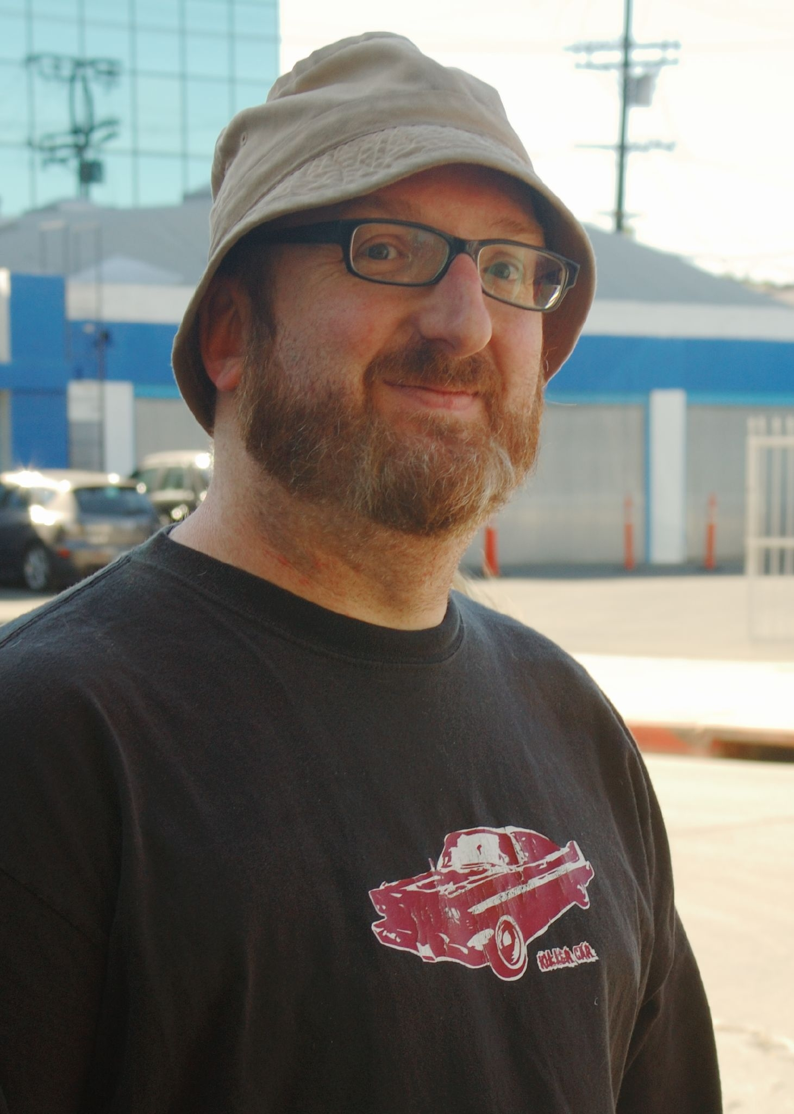




Glen R. Goodwin
arei.net
@areinet
github.com/arei
Notes:
Thank You.

