Slide 1

MűFi25 – Lecture 6.
Nonlinear equations
Fourier-transform numerical

Slide 2
Nonlinear equations – General Numerical Techniques
Numerical algorithms to programmed using any programming language :
Newton-Raphson method – Fast convergence near solutions, needs derivative of function to be calculated
Bisection Method – Slower than NR, but guaranteed to work if you bracket the root, linear equation solution is needed
Other methods to be used :
Graphing – Visualize where solutions exist (old method, was used before modern computers)
Numerical software solutions – Python (SciPy), MATLAB ( ☺ ) , Mathematica

Slide 3
Nonlinear equations – General Techniques
Other methods to be used :
Graphing – Visualize where solutions exist (old method, was used before modern computers) – using a mm-paper and old-school compass and ruler method for measuring
Numerical software solutions – Python (SciPy), MATLAB ( ☺ ) , Mathematica algorithmical implementation is not shown, only using parameters to be tuned (algorithm used has to be known by user!)

Slide 4

Problem 1. Projectile motion with air resistance
A projectile is launched at angle $θ$ with initial velocity $v_{0}$. With quadratic air resistance, the horizontal distance traveled satifies : $x=\frac{v_{0}^{2}\sin\left(2θ\right)}{g+k⋅v_{0}^{2}}$
Find the angle $θ$ that maximizes range! (when $k=0.01 m^{−1}, v_{0}=50\frac{m}{s}$and $g=9.8 m⋅s^{−2}$ )

Slide 5

Problem 1. Projectile motion with air resistance
Two competing effects
gravity pulls it down
air resistance slows it down (it is often ignored)
Classical projectile movement (no air resistance)
distance : $R=\frac{v_{0}^{2}\sin\left(2θ\right)}{g}$

Slide 6
Problem 1. Projectile motion with air resistance
A projectile is launched at angle $θ$ with initial velocity $v_{0}$. With quadratic air resistance, the horizontal distance traveled satifies : $x=\frac{v_{0}^{2}\sin\left(2θ\right)}{g+k⋅v_{0}^{2}}$
Find the angle $θ$ that maximizes range! (when $k=0.01 m^{−1}, v_{0}=50\frac{m}{s}$and $g=9.8 m⋅s^{−2}$ )

Slide 7

Problem 2. Cubic Equation from Energy Conservation
In a certain physical system (vibrating system, multiple oscillators coupled), energy conservation leads to : $x^{3}−6x^{2}+11⋅x −6=0$ where x represents a dimensionless energy parameter. Find all real solutions!
Plot solution and show where they are!
Hint : Each solution might represent different equilibrium states! In this case the solutions are different frequency-like solutions of an oscillating mode.
Interestingly, if we include higher-order air resistance corrections to the projectile range formula, we might get a cubic equation relating the launch angle to the range!

Slide 8

Problem 3. Real gas – Van der Waals gas, Solving for Volume
For a real gas or Van der Waals gas, solve for molar volume V : $\left(P+\frac{a}{V^{2}}\right)⋅\left(V −b\right)=R⋅T$
Given $P=10 atm, T=300 K, R=0.08206\frac{L⋅atm}{mol⋅K}, a=1.37\frac{atm⋅L^{2}}{mol^{2}} b=0.0318\frac{L}{mol}$
Compare solution with ideal gas solution of 2.46 L/mol !

Slide 9
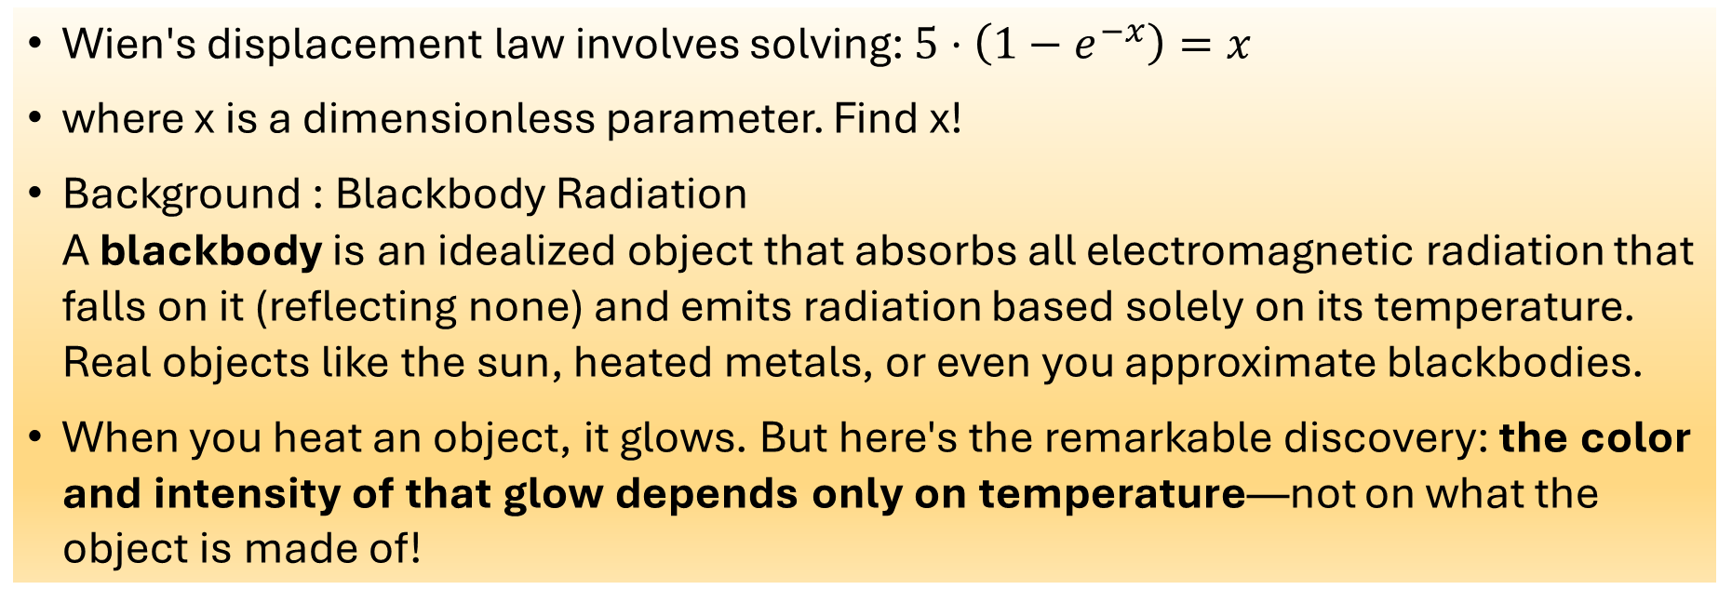
Problem 4. Transcendental Equation / Blackbody Radiaiton
Wien's displacement law involves solving: $5⋅\left(1−e^{−x}\right)=x$
where x is a dimensionless parameter. Find x!
Background : Blackbody Radiation A blackbody is an idealized object that absorbs all electromagnetic radiation that falls on it (reflecting none) and emits radiation based solely on its temperature. Real objects like the sun, heated metals, or even you approximate blackbodies.
When you heat an object, it glows. But here's the remarkable discovery: the color and intensity of that glow depends only on temperature—not on what the object is made of!

Slide 10

Problem 4. Transcendental Equation / Blackbody Radiaiton [Background]
In 1900, Max Planck discovered that electromagnetic energy is quantized (comes in packets called photons). His law describes the intensity of radiation at different wavelengths: $I\left(λ, T\right)=\frac{2hc^{2}}{λ^{5}}⋅\frac{1}{e^{\frac{hc}{λk_{B}T}}−1}$
where h is Planck’s constant, $k_{B}$ is Boltzmann’s constant, T is temperature and $λ$ is wavelength of the light.
Wien’s Displacement Law (key observation): as temperature increases, the peak of the radiation spectrum shifts to shorter wavelengths (higher frequencies, bluer color)

Slide 11

Problem 4. Transcendental Equation / Blackbody Radiaiton [Background]
Wien’s Displacement Law : $λ_{\left\{max\right\}}⋅T=b$ where $b≈2.898⋅{10}^{−3} m⋅K$ is Wien’s displacement constant. (As temperature doubles, the peak wavelength is cut in half)
Find where Planck’s law has its maximum !
Take derivative and set it to zero, and you let $x=\frac{hc}{λk_{B}T}$ so we get $x+5=5⋅e^{x}$
After solution substitute it back and calculate wavelength, to get constant b!

Slide 12

Problem 5. Coupled Non-Linear System / Chemical equilibrium
Chemical reaction with two substances (A and B) that interact with each other and reaches a stable state.
The amounts of A and B present at equilibrium are determined by conservation laws and equilibrium constants.
$x^{2}+2x⋅y=4$ is a conservation law
$y^{2}−2x⋅y=1$ is another conservation law

Slide 13

Problem 6. Saturation in Magnetism
The magnetization of a ferromagnetic material follows the Langevin equation : $M=M_{s}⋅\coth\left(x\right)−\frac{1}{x}$
where $x=\frac{μ_{0}m B}{k_{B}T}$ is a dimensionless parameter. For a specific set of conditions, x satisfies $x=2⋅tanh⁡(3x)$
Find x!

Slide 14

Problem 6. Saturation in Magnetism
it deals with ferromagnetic materials and how they respond to magnetic field
When a magnetic field is applied to a ferromagnetic material (like iron), the material becomes magnetized. However, the magnetization doesn’t increase linearly with the field, it saturates. No matter how strong you make the field, the magnetization levels off at a maximum value ($M_{s},$the saturation magnetization)
We have to solve $x=2⋅tanh⁡(3x)$ , $x=\frac{μ_{0}m B}{k_{B}T}$ where m is magnetic moment of individual atoms, B is magnetic field applied, T is temperature, $k_{B}$ Boltzmann constant.

Slide 15
Problem 6. Saturation in Magnetism
What equation means :
The tendency of magnetic moments to align (with external field, pulling them one direction)
The thermal chaos, that randomizes their orientation (thermal energy fighting the alignment)
factors 2 and 3 are related to interactions between magnetic moments

Slide 16

Problem 6. Saturation in Magnetism
Physical meaning of the solution :
if x is small – weak field or high temperature – the thermal energy dominates, so few moments align, The magnetization is small and proportional to B
if x is large – strong field or low temperature – thermal chaos is overcome, and most moments align. The magnetization approaches saturation $(M≈M_{s})$

Slide 17
Nonlinear circuits 1.
diode as a nonlinear (resistive) element

