Slide 1
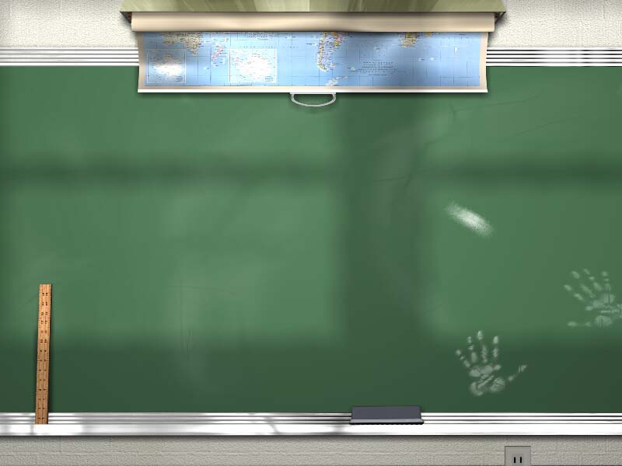
Ruby Development 201
Jason Noble
http://www.jasonnoble.org

Slide 2


Slide 3
Why Pair?
Increase Brainpower
Use both sides of your brain
  One person’s focus is coding
  One person’s focus is design, todos, etc
More focused, less interruptions
Write better code by consistently following best practices

Slide 4
Driver and Navigator
Driver
  Person typing, writing method/test, etc
Navigator
  Keep track of overall design, what’s next, tests needed?

Slide 5
Pairing Rules
Talk often, explain things, ask questions
Switch driver/navigator roles often
  Ping/Pong - One writes the test, the other writes the code

Slide 6
Driver
Think out loud as you code
  Say what you’re planning
Listen to navigator’s input
Concentrate on writing good code, let the navigator think about design issues

Slide 7
Navigator
Ignore little mistakes (missing ], etc)
Think about what tests to write
Can the code be better? Use different methods?
Can the design be better?
Think of what’s next and have suggestions ready

Slide 8
Navigator (Cont.)
Find an answer to a question while the driver continues
If finding the answer takes more than a minute, the driver should help

Slide 9
Tips to consider
Collaborate, don’t critique
Switch navigator/driver role frequently
May be uncomfortable at first
Over time you will become more productive

Slide 10
Tools used for tonight’s class
Git
Rspec / BDD
Ruby
Rock
Paper
Scissors

Slide 11
Rock Paper Scissors - Players
Each player can play one of three hands
  Rock
  Paper
  Scissors

Slide 12
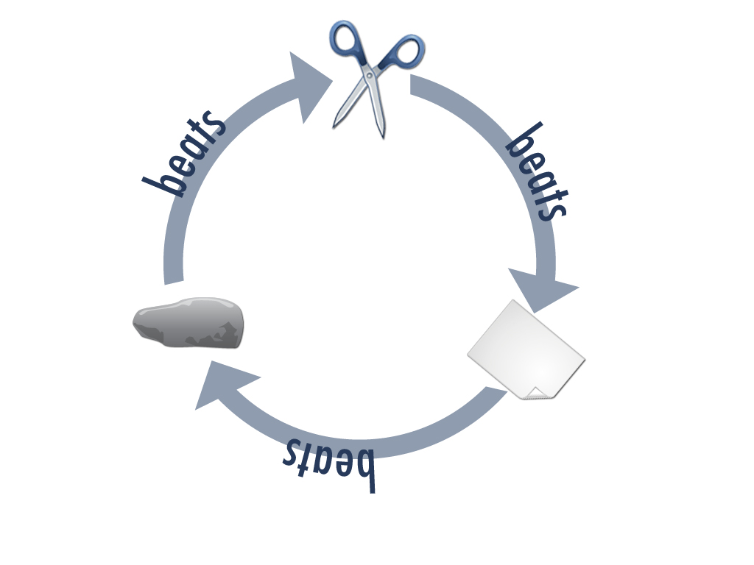
Rock Paper Scissors - The Game

Slide 13
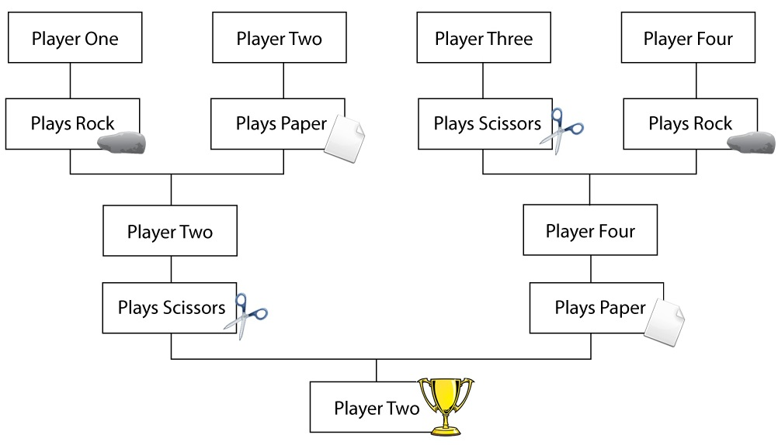
Rock Paper Scissors Tournament

Slide 14
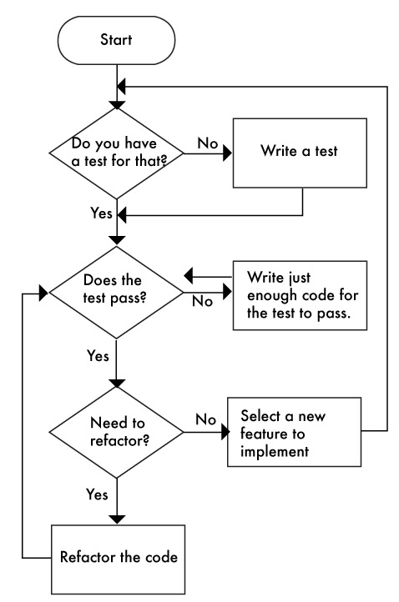
BDD Programming Flowchart
Source: http://pairprogrammingbot.com

Slide 15

Let’s Get Started

Slide 16
Credits
Images by Jacklyn Burgan http://playfulpixel.com
Rein Henrichs - Original Code Idea
Introduction to Pair Programming, version 2
http://www.youtube.com/watch?v=rG_U12uqRhE

