Slide 1

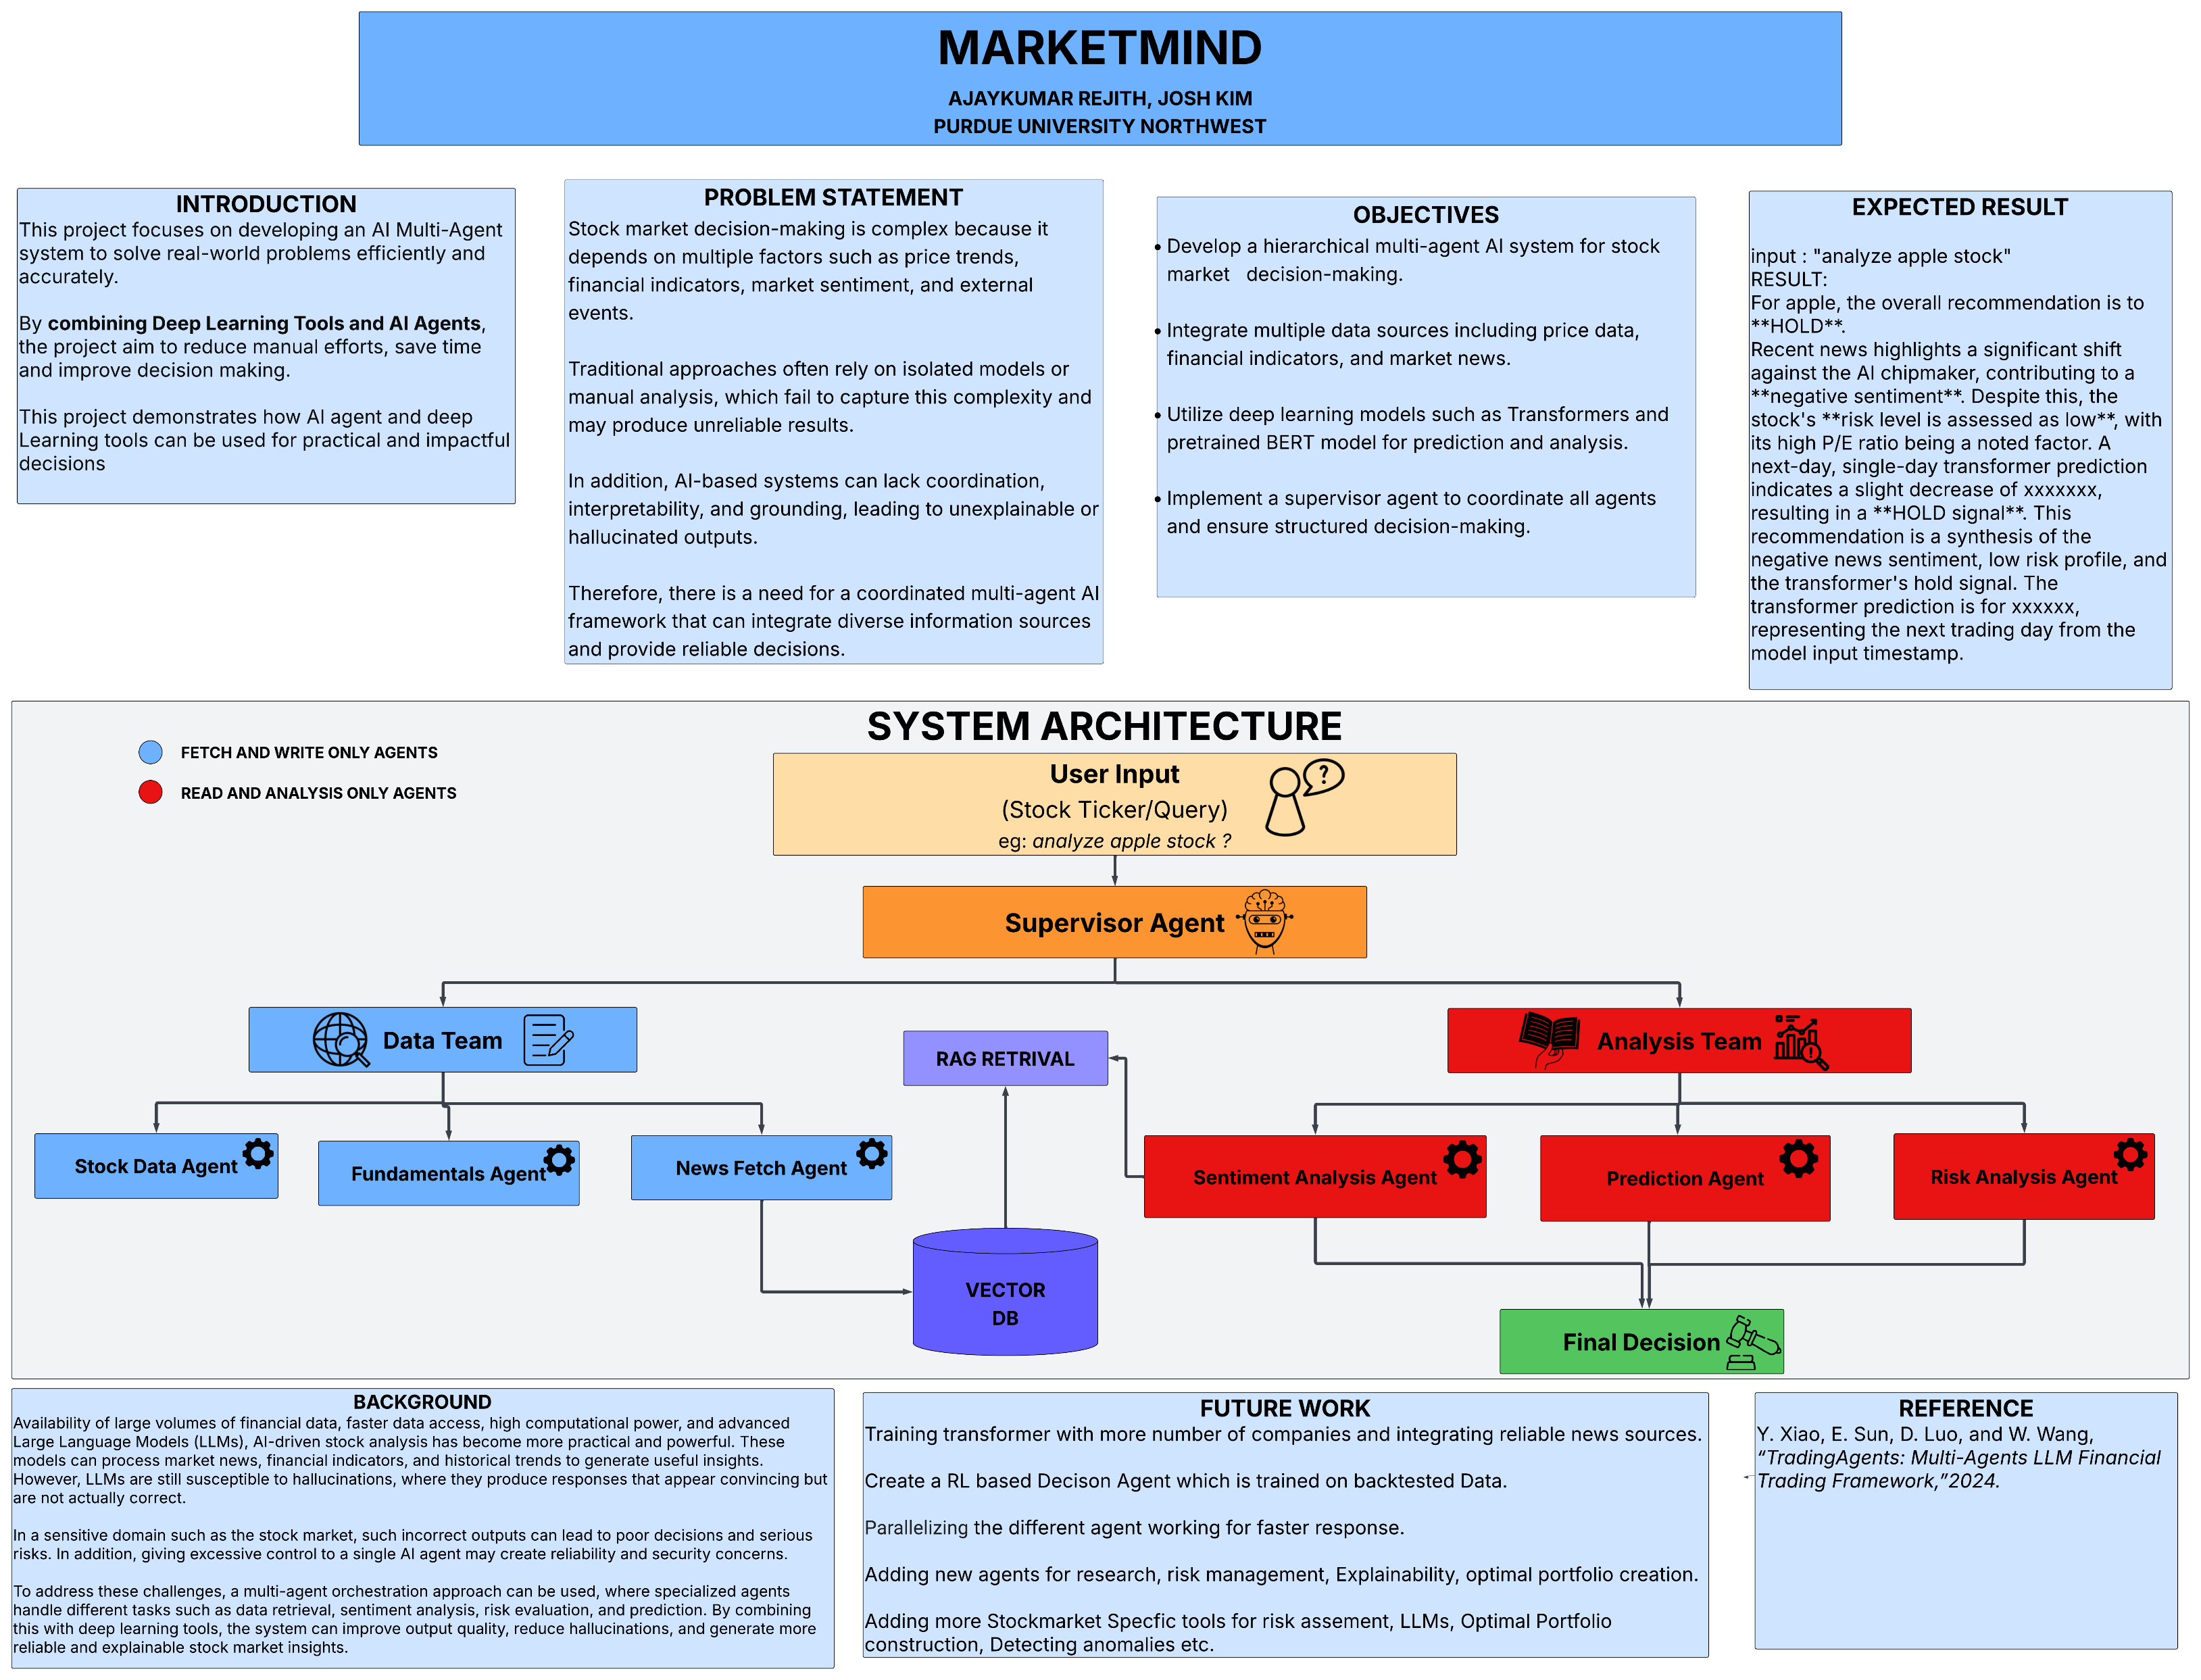
MarketMind: Multi-Agent AI
Engineering Technology
Department of Engineering Technology
Background
Approach
Results
.
.

