Slide 1
Diabetes Dynamics: A Data Analytics Approach for Uncovering Trends and Guiding Health Interventions
Team 6
Akhil Arekatika
Raghu Manjunatha
Ritesh Somashekar
Dr. Eddy Zhang
AIT 614: Big Data Essentials
George Mason University

Slide 2
Introduction
Our project aims to investigate the multifaceted nature of diabetes risk factors and their impact on public health. Diabetes is a prevalent and complex chronic condition with significant implications for individuals and healthcare systems worldwide. By delving into the various health indicators, lifestyle factors, and socio-demographic variables associated with diabetes, we seek to enhance our understanding of this disease and inform targeted interventions for prevention and management.

Slide 3
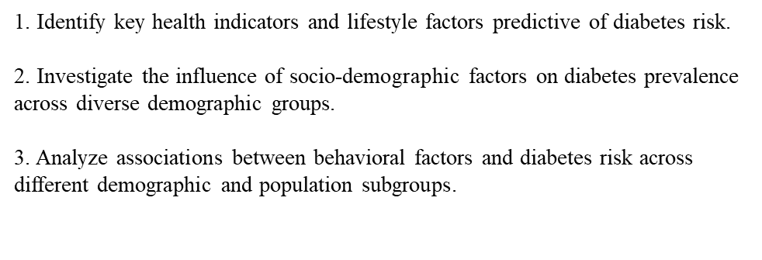
Objectives

Slide 4
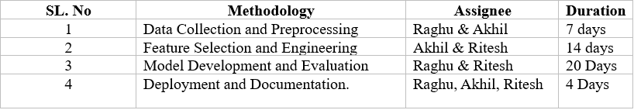
Timeline

Slide 5
Dataset
Diabetes_012: Binary variable indicating diabetes status (0 = No, 1 = Yes)
HighBP: Binary variable for high blood pressure (0 = No, 1 = Yes)
HighChol: Binary variable for high cholesterol (0 = No, 1 = Yes)
CholCheck: Binary variable indicating cholesterol check (0 = No, 1 = Yes)
BMI: Body Mass Index (numeric)
Smoker: Binary variable for smoking status (0 = Non-smoker, 1 = Smoker)
Stroke: Binary variable indicating stroke history (0 = No, 1 = Yes)
HeartDiseaseorAttack: Binary variable indicating heart disease or heart attack history (0 = No, 1 = Yes)
PhysActivity: Binary variable for physical activity level (0 = Low, 1 = High)
Fruits: Frequency of fruit consumption (numeric)
Veggies: Frequency of vegetable consumption (numeric)
HvyAlcoholConsump: Binary variable for heavy alcohol consumption (0 = No, 1 = Yes)
AnyHealthcare: Binary variable indicating access to healthcare services (0 = No, 1 = Yes)
NoDocbcCost: Binary variable indicating healthcare access without out-of-pocket cost (0 = No, 1 = Yes)
GenHlth: General health perception (numeric)
MentHlth: Mental health perception (numeric)
PhysHlth: Physical health perception (numeric)
DiffWalk: Difficulty in walking (numeric)
Sex: Gender (0 = Female, 1 = Male)
Age: Age of the individual (numeric)
Education: Level of education (numeric)
Income: Household income (numeric)

Slide 6
Technology Used
Programming Languages
Frameworks
Python , SQL
PySpark, Spark Mllib
Big Data platform
NoSQL Database
Databricks
Databricks DBFS

Slide 7
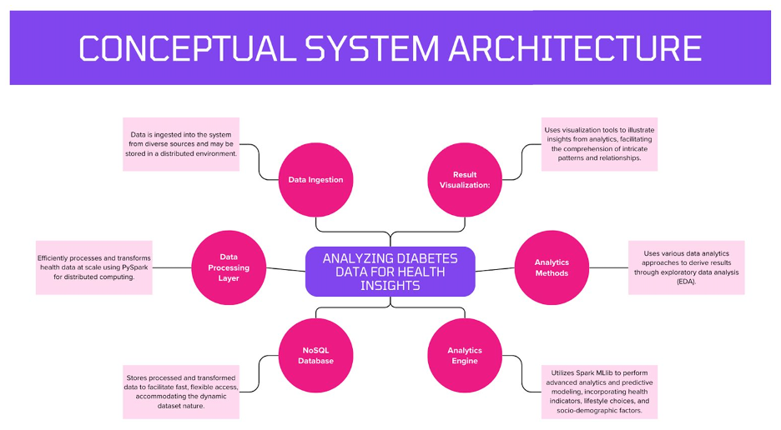

Slide 8
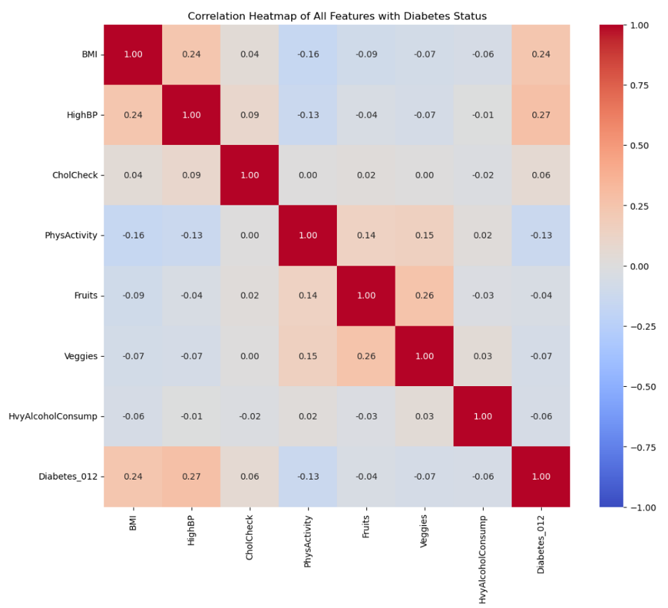
Correlation coefficients and their relationship with predicting the diabetes factor

Slide 9
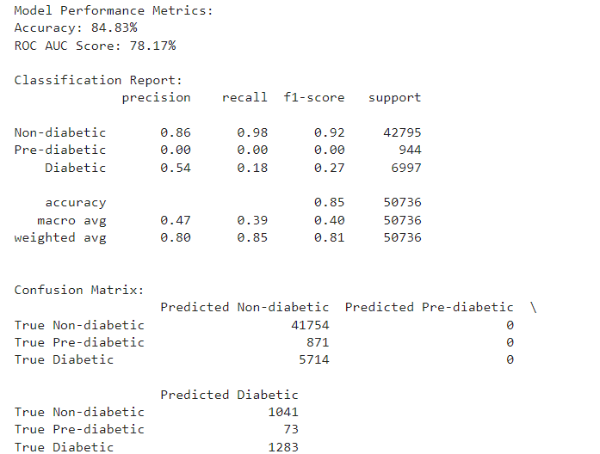
Results from Logistic Regression Models
Notes:
Algorithm: This column lists the names of the machine learning algorithms used for classification, namely Logistic Regression, Decision Tree, Random Forest, and Support Vector Machine (SVM). Accuracy: Accuracy represents the proportion of correctly classified instances out of the total instances. It is calculated as (TP + TN) / (TP + FP + TN + FN). Precision: Precision measures the proportion of true positive predictions out of all positive predictions made by the model. It is calculated as TP / (TP + FP). Recall: Recall, also known as sensitivity or true positive rate, measures the proportion of true positive predictions out of all actual positive instances in the data. It is calculated as TP / (TP + FN). F1 Score: The F1 score is the harmonic mean of precision and recall. It provides a balance between precision and recall and is useful when classes are imbalanced. It is calculated as 2 * (precision * recall) / (precision + recall). ROC AUC: ROC AUC (Receiver Operating Characteristic Area Under the Curve) is a performance metric for binary classification models. It represents the area under the ROC curve, which plots the true positive rate against the false positive rate at various threshold settings.

Slide 10
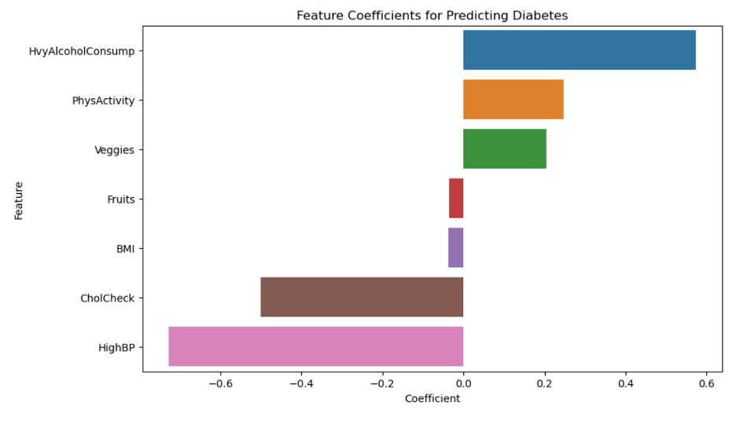
Which specific health indicators and lifestyle factors demonstrate the highest predictive power for identifying individuals at risk of developing diabetes?

Slide 11
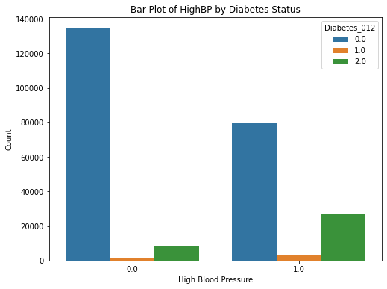
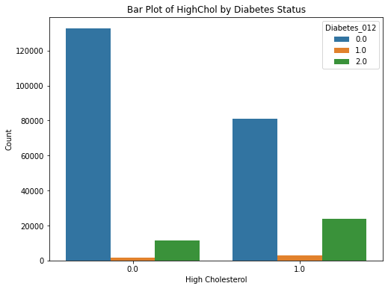
Which specific health indicators and lifestyle factors demonstrate the highest predictive power for identifying individuals at risk of developing diabetes?

Slide 12
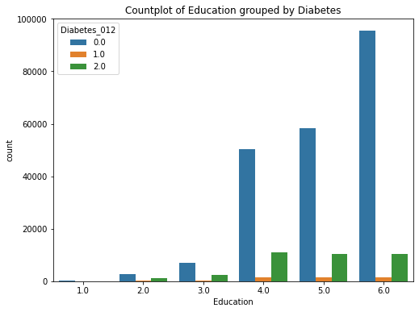
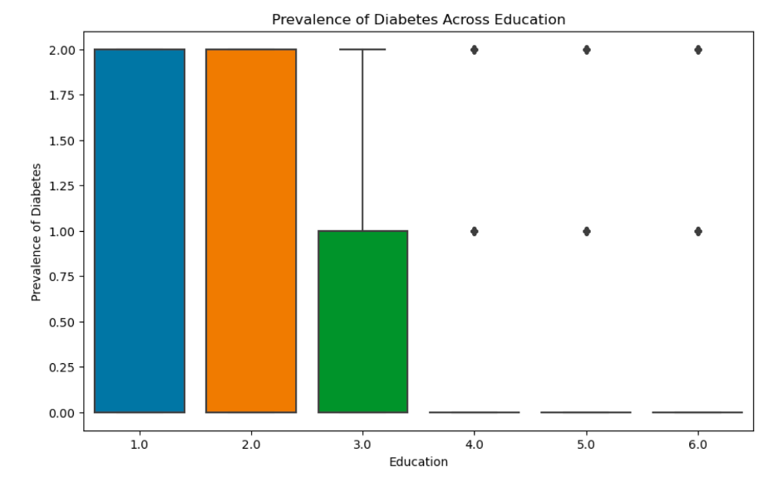
How do socio-demographic factors influence the prevalence of diabetes across diverse demographic groups, and are there variations in their impact among different population subsets?

Slide 13
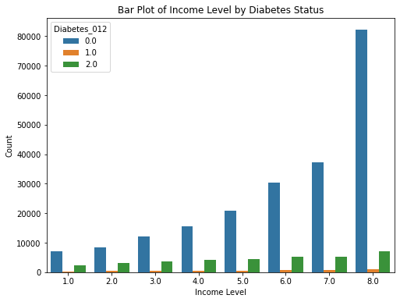
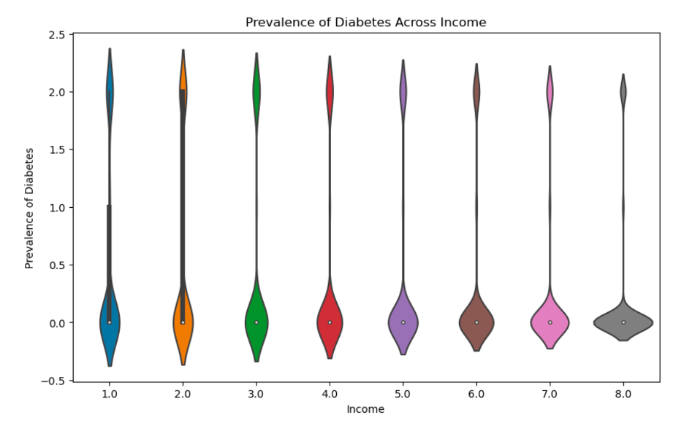
How do socio-demographic factors influence the prevalence of diabetes across diverse demographic groups, and are there variations in their impact among different population subsets?

Slide 14
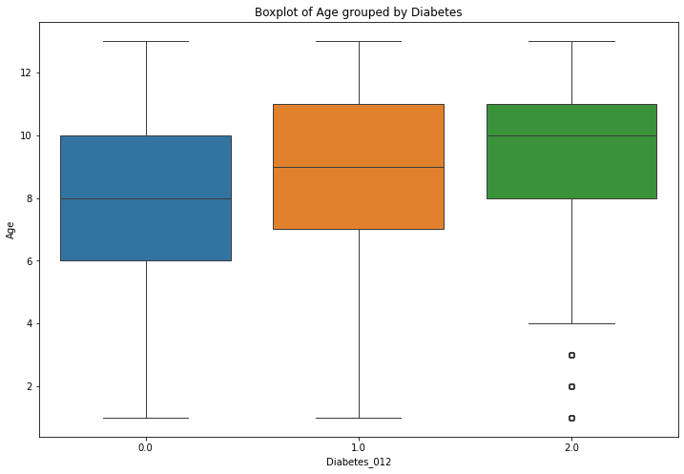
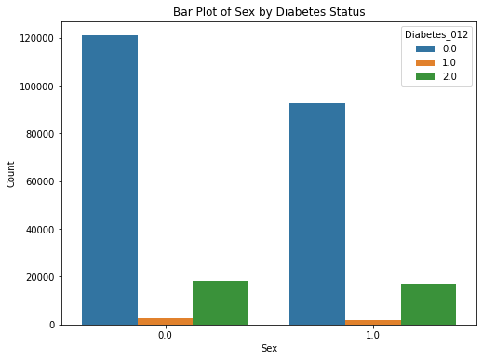
How do socio-demographic factors influence the prevalence of diabetes across diverse demographic groups, and are there variations in their impact among different population subsets?

Slide 15
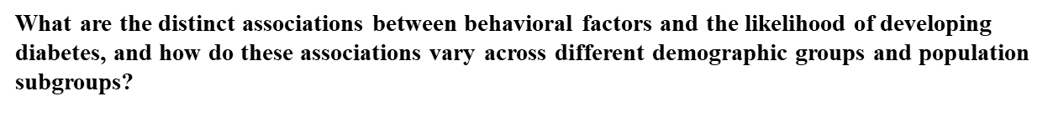
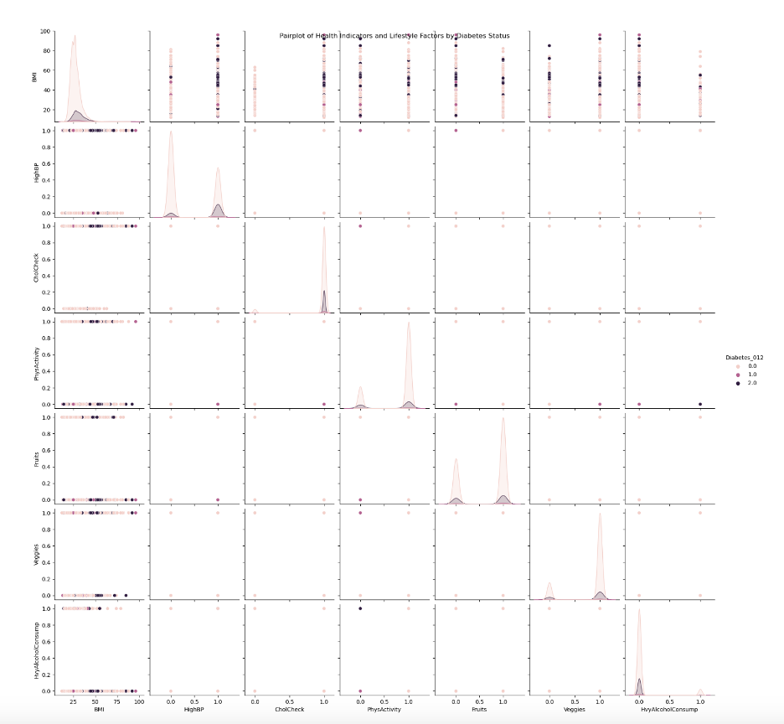

Slide 16
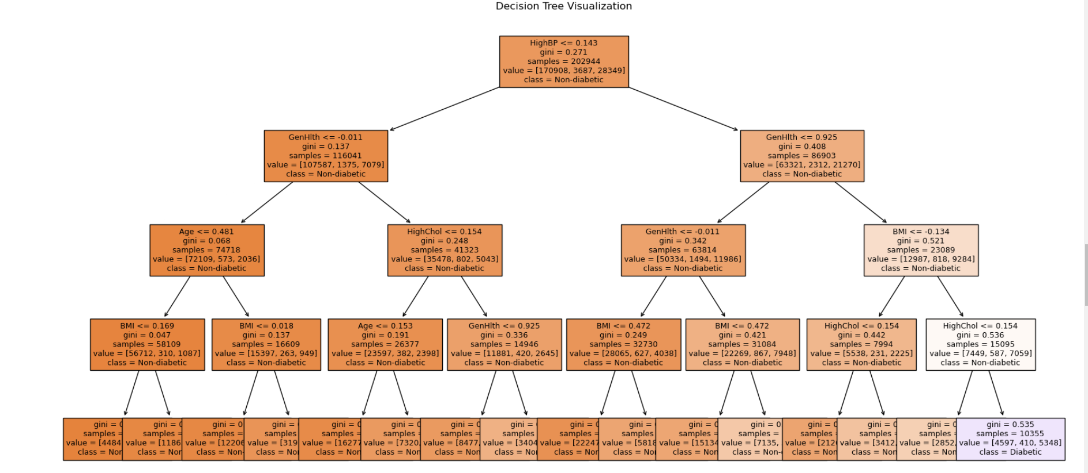

Slide 17
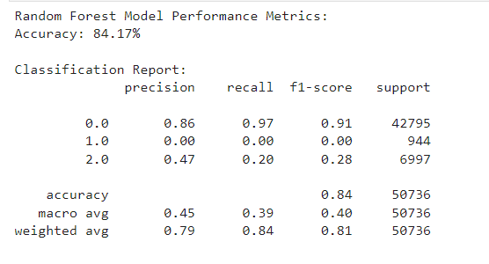
Random Forest Classifier Accuracy Evaluation

Slide 18
Conclusion & Lessons Learnt
In summary, this project has made significant strides in addressing the intricate challenges of diabetes management and prevention through the application of data analytics. By leveraging extensive datasets and advanced algorithms, valuable insights into diabetes risk factors and predictive modeling have been unearthed, laying the groundwork for more effective healthcare interventions. The project's emphasis on user needs, coupled with robust data quality assurance and innovative system architecture, highlights its commitment to delivering tangible solutions for healthcare stakeholders.
Throughout the project, several key lessons have emerged. Interdisciplinary collaboration has proven essential, emphasizing the importance of aligning technical solutions with clinical needs through cooperation between healthcare professionals, data scientists, and technology experts. Continuous model refinement and risk management strategies have been vital in addressing challenges such as model overfitting and underfitting, ensuring the accuracy and relevance of predictive models in real-world healthcare contexts. Effective communication and engagement with end-users have been critical, facilitating feedback gathering and solution tailoring to meet user needs effectively. Furthermore, ethical considerations surrounding healthcare data privacy, consent, and security have underscored the importance of ethical practices throughout the project lifecycle.

Slide 19
Future Work & Github Repo
Looking ahead, several avenues for future work have been identified. Integration of real-time data streams from wearable devices and electronic health records presents an opportunity to enhance the timeliness and relevance of predictive models, enabling proactive healthcare interventions. Longitudinal studies tracking individuals over time could provide deeper insights into disease progression and intervention effectiveness, informing personalized healthcare strategies. Additionally, the development of interpretable machine learning models could enhance trust among healthcare providers and facilitate better decision-making in clinical practice. Lastly, the adaptation and extension of the project's data analytics framework to address other chronic diseases offer potential for broader impact in public health initiatives.
Github Repo - https://github.com/RaghuManjunatha/Diabetes-Dynamics/settings

Slide 20
Acknowledgement & Source
We extend our heartfelt gratitude to Professor Eddy Zhang, PhD, for his invaluable guidance and unwavering support throughout this project. We also acknowledge the faculty, TA and staff of George Mason University, particularly the AIT 614: Big Data Essentials program, for providing the necessary resources and platform. Special thanks to our team members, for their dedication and collaboration. Additionally, we appreciate the organizations that provided access to datasets, enabling comprehensive analyses.
Source –
[1] Diabetes Health Indicators Dataset. (2021b, November 8). Kaggle. https://www.kaggle.com/datasets/alexteboul/diabetes-health-indicators-dataset

Slide 21
References
[1] What is Diabetes? (2023, September 5). Centers for Disease Control and
  Prevention.
  https://www.cdc.gov/diabetes/basics/diabetes.html
[2] National Diabetes Statistics Report | Diabetes | CDC. (n.d.).
  https://www.cdc.gov/diabetes/data/statistics-report/index.html#print
[3] G. N. Kulkarni, S. Ambesange, A. Vijayalaxmi and A. Sahoo, "Comparision of
  diabetic prediction AutoML model with customized model," 2021 International Conference on Artificial Intelligenceand Smart Systems (ICAIS), Coimbatore, India, 2021, pp. 842-847, doi: 10.1109/ICAIS50930.2021.9395775.
[4] S. Parveen, P. Patre and J. Minj, "An Improved Technique for Diabeties
  Prediction By Combining Feature Selection Techniques And BFGS Optimization Algorithm With Weight Constrained Neural Network," 2021 International Conference on Smart Generation Computing, Communication and Networking (SMART GENCON), Pune, India, 2021, pp. 1-4, doi: 10.1109/SMARTGENCON51891.2021.9645892.

