Slide 1
What does it take to find a job in tech?
Gilberto Arellano
Student ID: 1801074
CPSC 392, Fall 2022
Chapman University

Slide 2
Introduction
For the data in this presentation, we are defining the “tech” industry as those seeking jobs in software and/or data science. Despite the high-demand, it is a competitive field due to the high-salary and the technical skills required to find a job. These are the questions we are trying to answer:
How relevant is your education?
Which is the best medium to reach an employer? (Referrals, online-job boards, recruiters, campus recruitment?)
What are the characteristics needed to find a job?
What are the type of candidates landing the highest paid ?

Slide 3
Variables
Gender
Age
Annual Salary
Formal Education
Employer Search Method
Employment Status
Models
Logistic Regression
Regularization (Lasso/Ridge)
Clustering, Gaussian Mixture

Slide 4
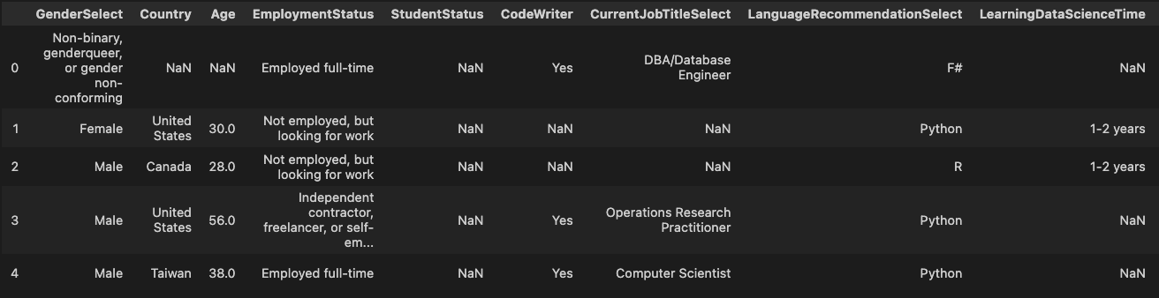
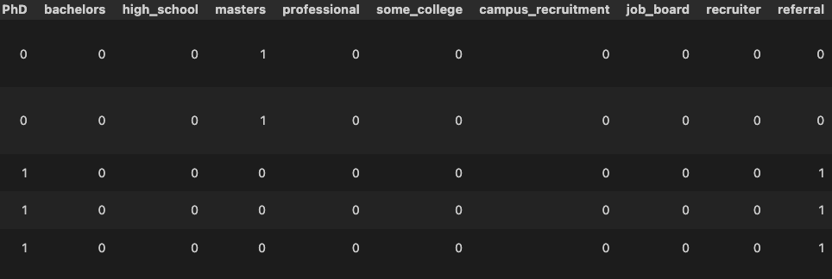
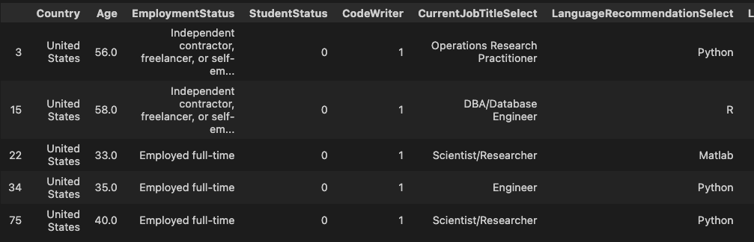
Data Cleanup, Before
Data Cleanup, After

Slide 5
Results Analysis
Subtitle

Slide 6
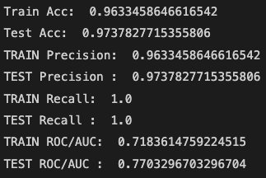
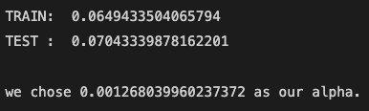
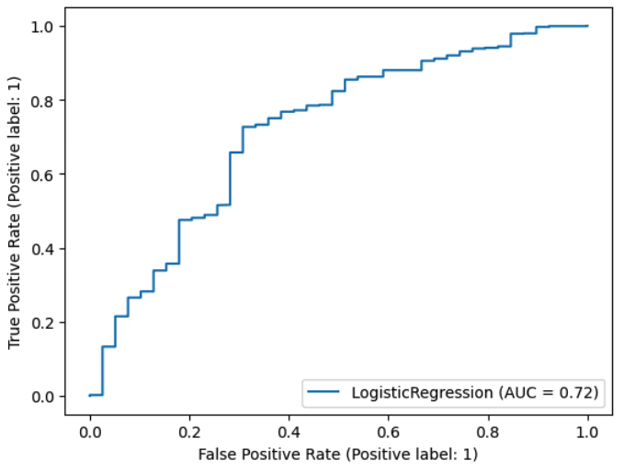
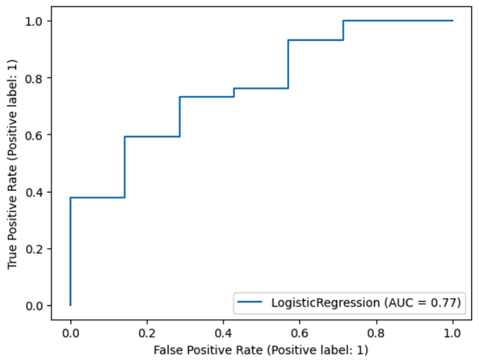
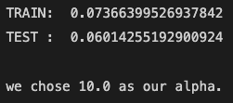
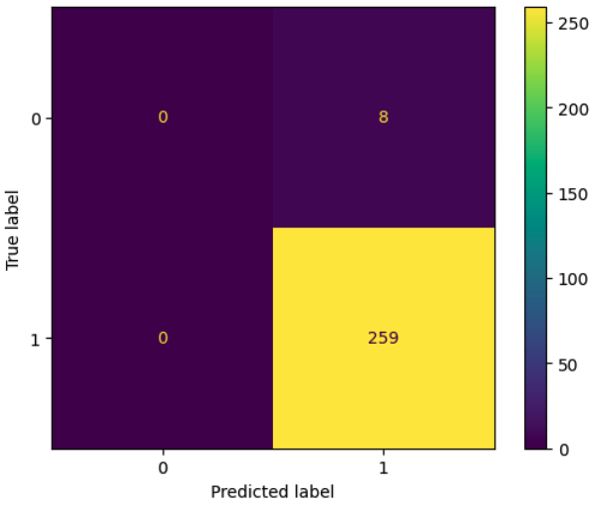
Logistic Regression
Lasso/Ridge
Lasso
Ridge
Notes:
A high accuracy but a low AUC can can occur when the model is correctly . This can happen when the model is heavily skewed towards one class, and is not able to accurately predict the other class. In this situation, the model may have a high overall accuracy because it is predicting the majority class most of the time, but its AUC will be low because it is not able to accurately distinguish between the two classes

Slide 7
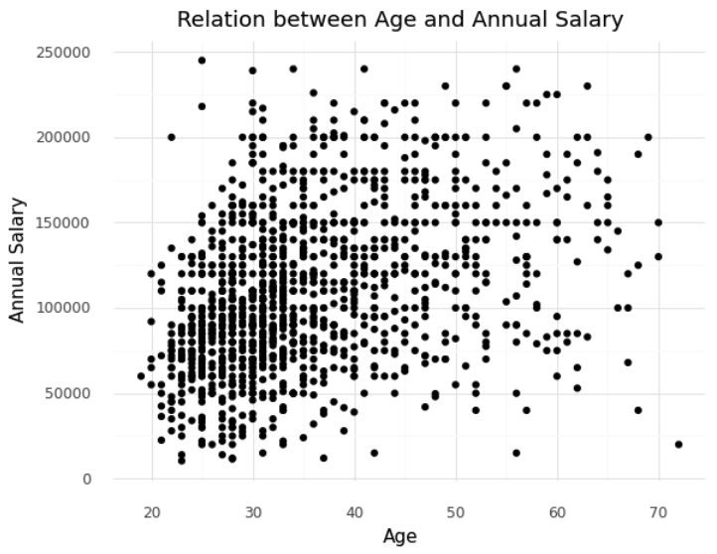
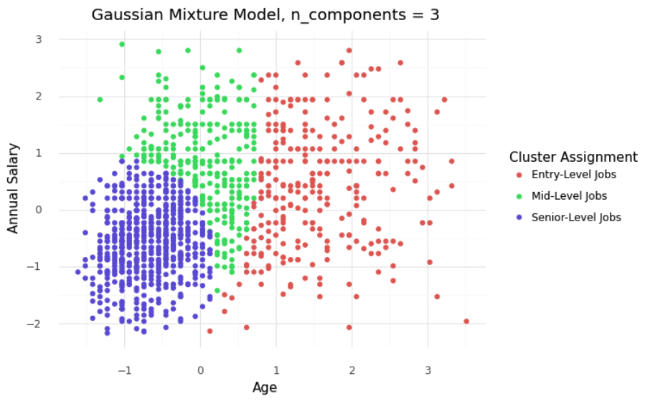
Clustering, Gaussian Mixture
Notes:
It is a measure of how well each point in a cluster is classified, based on the average distance between that point and all other points in the same cluster, and the average distance between that point and all other points in the nearest neighboring cluster. A high silhouette score indicates that points in the same cluster are similar to each other, and points in different clusters are dissimilar. This is because in our data set

