Slide 1
ARENA CLUB × MONSTER ENERGY
OFFICIAL HYDRATION PARTNERSHIP PROPOSAL
ARENA Club — Association of Recreational Esports and Athletics, IIIT Bhopal
[Fest Name / Season] [Year]
Header: ARENA CLUB × MONSTER ENERGY — Footer: Sponsorship Prospectus | IIIT Bhopal | Page 1

Slide 2


Why IIIT Bhopal
IIIT Bhopal presents a focused campus ecosystem with relatively few large, highly active student clubs. That concentration reduces fragmentation of attention and creates meaningful opportunities for brand-led engagement across sports and esports. For a strategic partner, this is an opportunity to build early, recognizable campus association.
Key message: High potential. Focused campus ecosystem.
01 FOCUSED CAMPUS ECOSYSTEM
02 SPORTS & ESPORTS POTENTIAL
03 STUDENT ENGAGEMENT
04 BRAND-BUILDING OPPORTUNITY
FOCUSED CAMPUS →STUDENT ENGAGEMENT → SPORTS + ESPORTS → BRAND ASSOCIATION

Slide 3
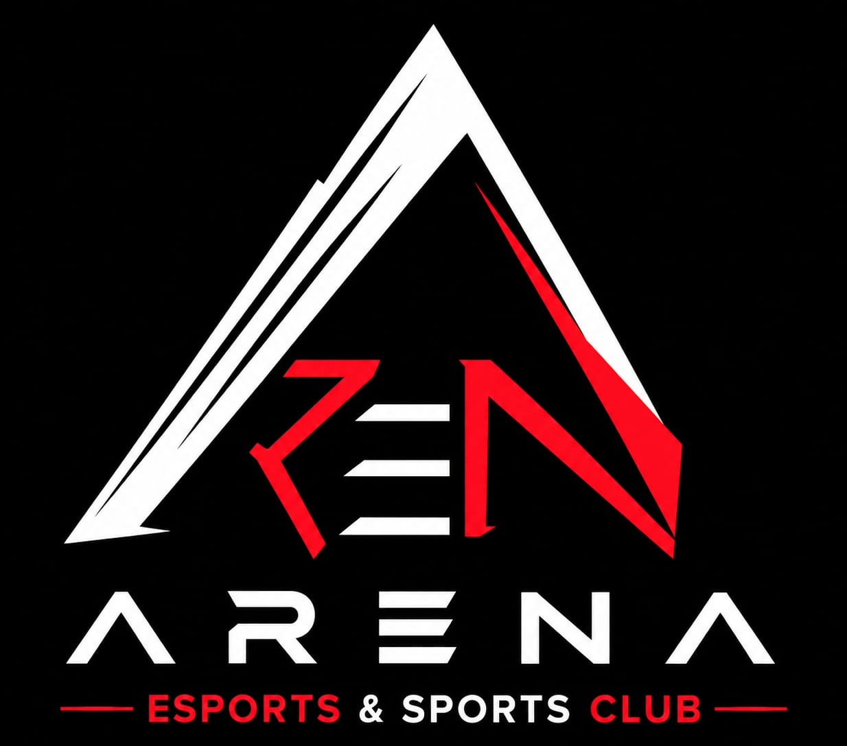

Why ARENA
IIIT Bhopal's Sports & Esports Platform
ARENA is IIIT Bhopal's official sports and esports club. It manages both physical sports and esports activities and is associated with the Sports Secretary / institute sports administration. ARENA oversees registrations, logistics, on-ground execution and digital promotion for its events and teams.
1
2
3
SPORTS
ESPORTS
EXECUTION
Physical sporting activities
Competitive gaming ecosystem
Registration • Logistics • Promotion • On-ground execution
Core positioning: One platform connecting physical sports, esports and institute-level sporting activity.

Slide 4
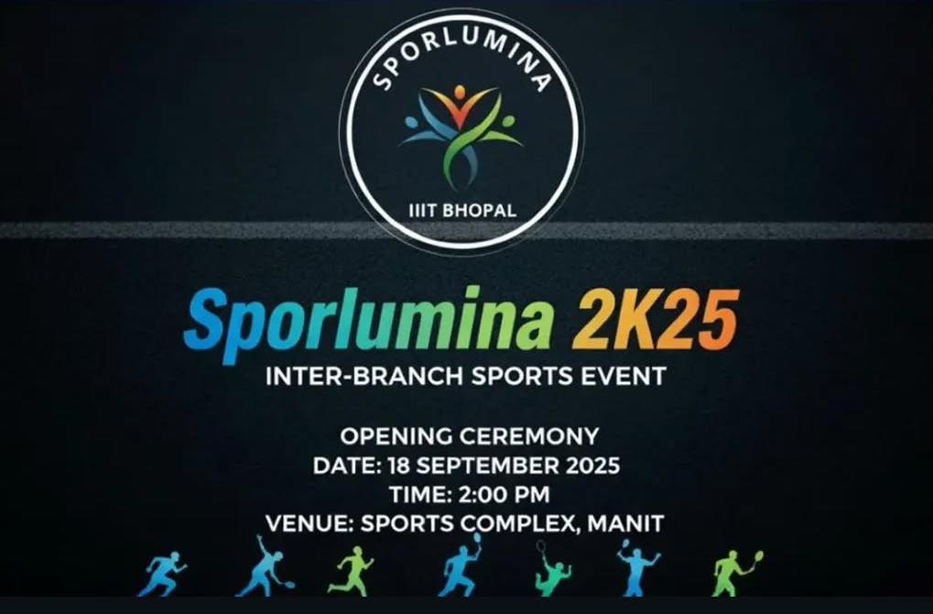


Sporlumina
Inter-Branch Sports & Esports Meet
Event profile
Format: Multi-day
Scope: Sports + Esports
Audience: Students / Participants
Activation: On-ground + Digital
[X+ PARTICIPANTS] • [X+ FOOTFALL] • [X SPORTS] • [X ESPORTS TITLES] • [X DAYS]
Sporlumina is ARENA's flagship, highest-footfall event of the year (as described in the prospectus).
Sponsorship relevance: High-frequency on-ground visibility across a multi-day flagship event.

Slide 5
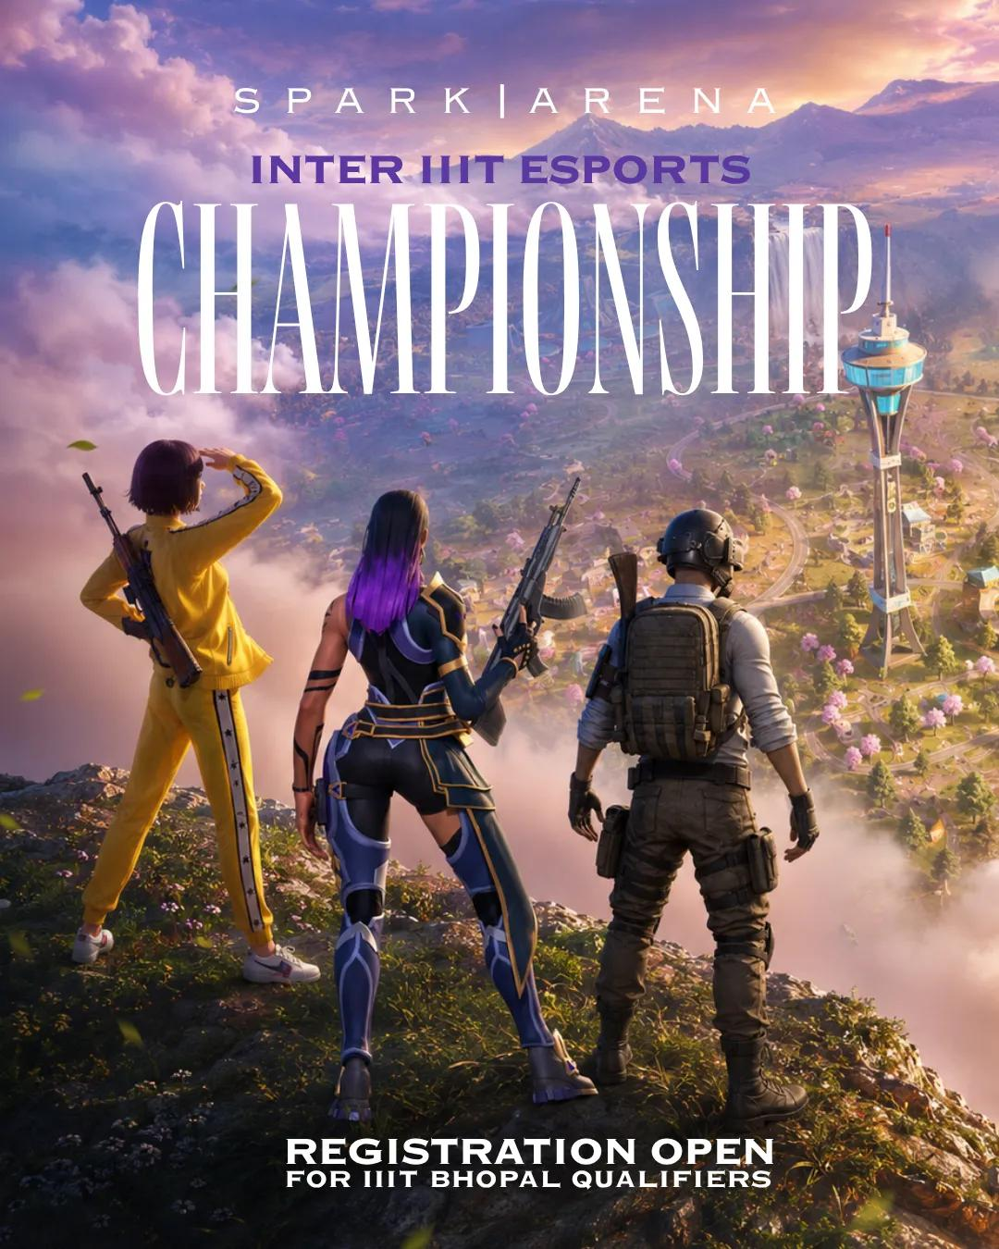
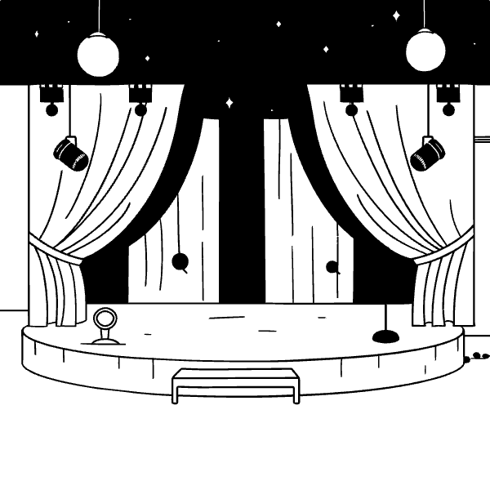
IEC
Inter-Branch Esports Championship (co-hosted with SPARK)
Dedicated esports championship with online registration and structured tournament brackets. IEC delivers a concentrated, digitally engaged student audience — a strategic fit for an energy-drink brand seeking gaming-first activations.
[X+ PARTICIPANTS] • [X+ TEAMS] • [X GAMES / TITLES] • [X+ ONLINE REACH]
1
2
Format
Audience
Online registration • Bracketed competition
Digitally engaged, competition-driven
Key message: Built for a digitally engaged gaming audience.

Slide 6
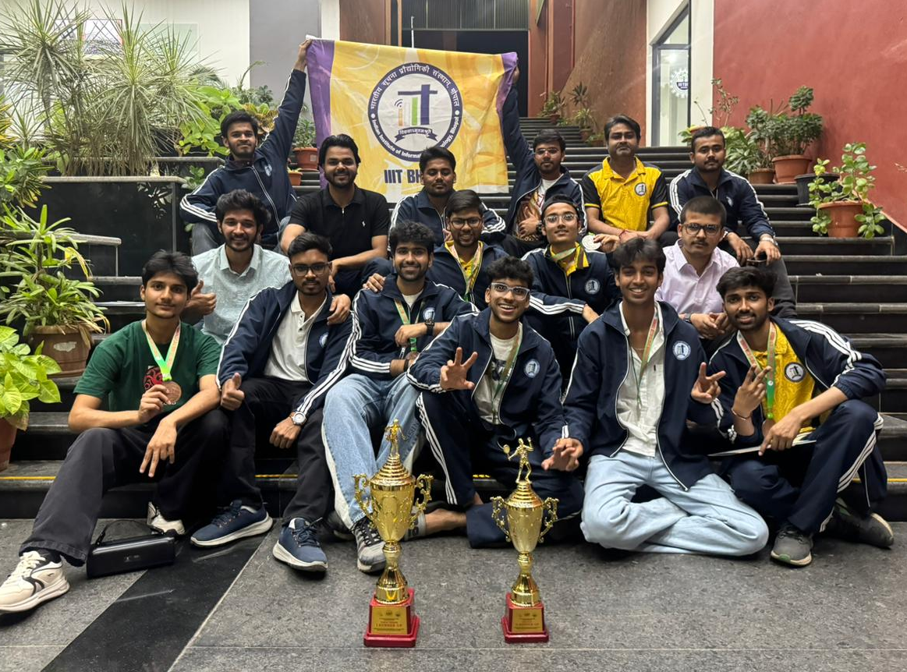

Inter-IIIT Sports Meet
IIIT Bhopal's National Sports Contingent
The Inter-IIIT Sports Meet is an annual national-level sports meet among IIITs where hosting rotates between member institutes. ARENA organizes and fields IIIT Bhopal's official contingent — handling selection, training, team kits and travel. Sponsorship can extend to kit branding, promotion and travel support tied to the contingent.
[X ATHLETES] • [X SPORTS] • [X MEDALS / RESULTS] • [HOST INSTITUTE] • [YEAR]
Key message: Extending visibility from campus to a national inter-IIIT sporting platform.

Slide 7
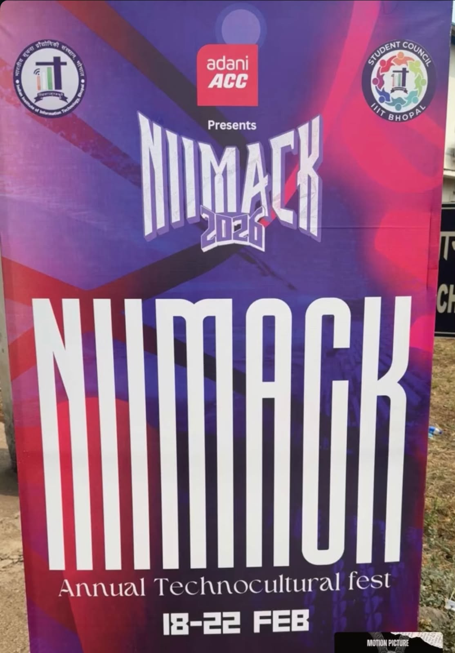

NIMACK
Flagship Cultural Event of IIIT Bhopal
Event profile
Event: NIMACK
Position: Flagship cultural event of IIIT Bhopal
Audience: Campus-wide student community
Scale: [X+ ATTENDEES] • [X DAYS] • [X+ DIGITAL REACH]

Slide 8
Why Partner with ARENA
Partnership pillars drawn from the prospectus — presented as strategic benefits for an Official Hydration Partner.
01 DIRECT PHYSICAL-ACTIVITY AUDIENCE
Athletes and esports players are a highly relevant audience for energy drinks.
02 MULTI-EVENT, MULTI-MONTH VISIBILITY
Sporlumina, IEC and the Inter-IIIT contingent across the academic year.
03 ON-GROUND ACTIVATION
Stalls, sampling and product-placement opportunities.
04 DIGITAL + PHYSICAL BRAND VISIBILITY
Registration platforms, event flexes, merchandise and social promotion.
05 CATEGORY EXCLUSIVITY
Potential exclusive energy-drink category rights, subject to confirmation.

Slide 9
The Proposed Partnership
OFFICIAL HYDRATION PARTNER — Coverage: SPORLUMINA + IEC + INTER-IIIT CONTINGENT
Benefit | Official Hydration Partner
Exclusive category rights | ✓
Logo on event flexes, banners and stage backdrops | ✓
Branded hydration stations / stalls | ✓
Logo on registration site, certificates and trophies | ✓
Branding on contingent kit and travel gear | ✓
Social-media promotion & ceremony mentions | ✓
Sampling and product placement rights | ✓
Right of first refusal | ✓
Proposed partnership value: [₹X CASH / PRODUCT CONTRIBUTION / HYBRID DEAL]

Slide 10
Past Events & Associations
Reference items from the prospectus (use actual names if provided). If not available, placeholders are used below.
BGMI TOURNAMENT
MONSTER X NODWIN
IEC
IIIT NETWORK
Let's talk
“We'd welcome the opportunity to walk your team through this proposal and tailor the partnership to Monster's activation goals.”
Contact: [NAME] • [ROLE] • [PHONE] • [EMAIL]
ARENA Club IIIT Bhopal
ARENA CLUB × MONSTER ENERGY — OFFICIAL HYDRATION PARTNERSHIP

Slide 11


Next Steps
01
1. Introductory meeting
Align on objectives and scope.
02
2. Activation plan
Detail on-ground, sampling and digital deliverables.
03
3. Commercial terms
Header: ARENA CLUB × MONSTER ENERGY — Footer: Sponsorship Prospectus | IIIT Bhopal | Page 10
Finalize cash / product / hybrid contribution.
04
Closing line: We look forward to discussing how Monster Energy can become ARENA's Official Hydration Partner and unlock year‑round campus moments.
4. Implementation timeline
Confirm dates, logistics and approvals.

