Slide 1
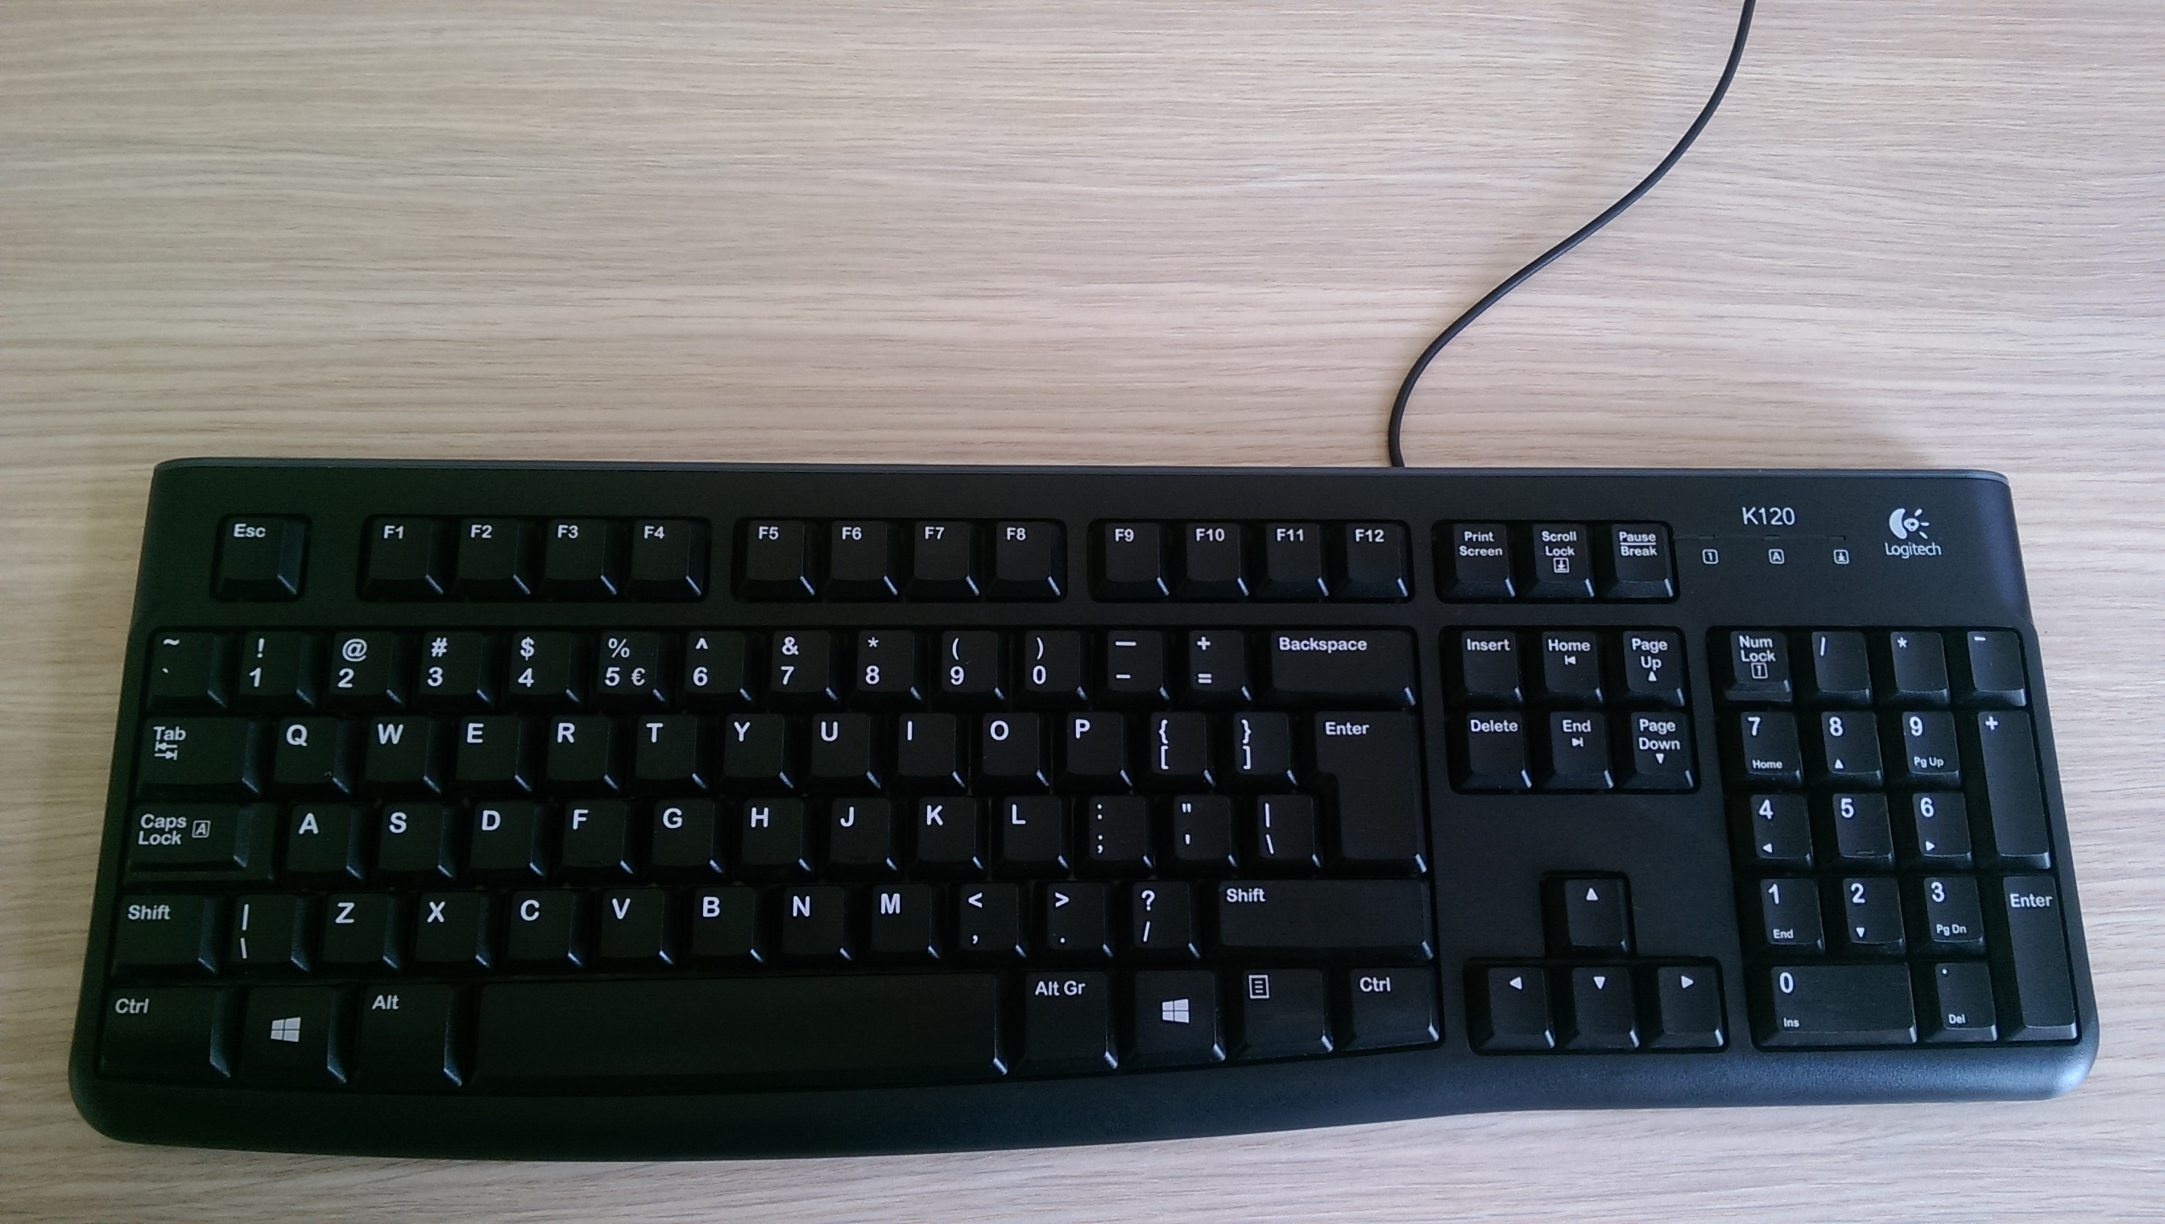


Movement
Weapons
Menus etc.
Teamplay messages
W: Forward
A: Strafe left
S: Back
D: Strafe right
Space: Jump
2: Shotgun or Axe (if out of ammo)
3: Super Shotgun or Shotgun
4: Super Nailgun or Nailgun
Q: Grenade Launcher
E: Rocket Launcher
Mouse 1: Attack
Mouse 2: Lightning Gun
ESC: Menu Tilde: Toggle console
F5: Toggle ready Enter: Chat
F6: Break Y: Team chat
F7: Join U: QTV observer-to-game chat
F8: Observe Tab: Show scores
F9: Server browser
F12: Screenshot
1: Quad over F1: Get quad
5: Enemy powerup F2: Get pent
R: Point at item F3: Quad delayed <secs>
T: Location is lost F4: Pent delayed <secs>
F: Location is safe MWHEEL: Set delay time
G: Help needed at location Shift: Status report
C: Coming from location CTRL: Took item
V: Replace me at location
Get the game on nquake.com

