Slide 1
dropwizard
overview

Slide 2
Dropwizard is a Java framework for developing high-performance, RESTful web services.
Dropwizard - Highlights:
Allows you to build one jar, that contains all needed dependencies
Simple & Lightweight
Quick and easy to get a new http service going
Easy Test, Deployment and Management
Quick start up time of the app

Slide 3
Dropwizard Core
Jetty - HTTP-server
Jersey - RESTful web framework
Jackson - JSON library
Metrics - application metrics
Guava - google lib
Logback - logging framework
Hibernate Validator - the reference implementation of the Java Bean Validation standard

Slide 4
Performance

Slide 5
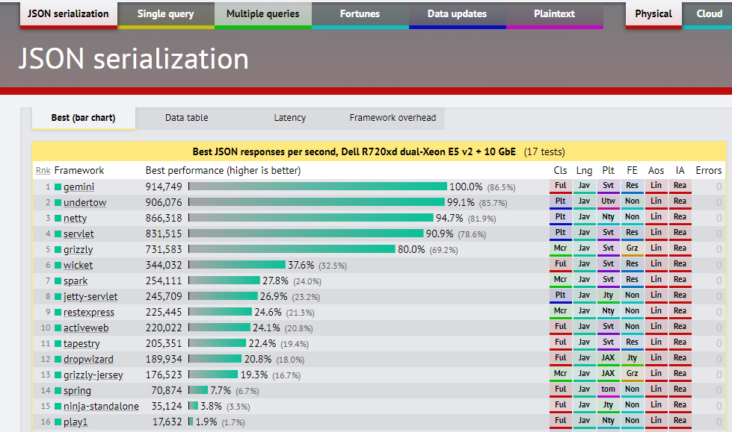
https://www.techempower.com/benchmarks/#section=data-r9&hw=ph&test=json&l=hra0e7

Slide 6
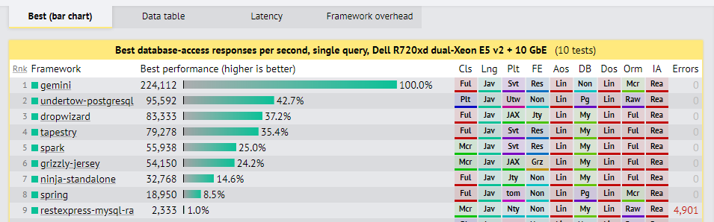
https://www.techempower.com/benchmarks/#section=data-r9&hw=ph&test=db&l=hra0e7&f=2ups-35s-0-0-0-0-0-0

Slide 7
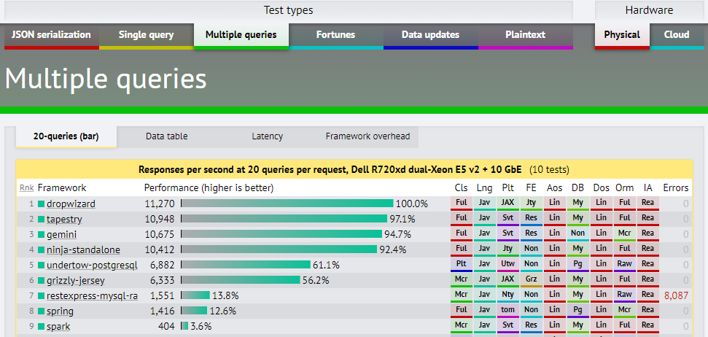
https://www.techempower.com/benchmarks/#section=data-r9&hw=ph&test=query&l=hra0e7&f=2ups-35s-0-0-0-0-0-0

Slide 8
How to start?

Slide 9
Project organization
com.example.myapplication:
api: Representations. Request and response bodies.
cli: Commands
client: Client code that accesses external HTTP services.
core: Domain implementation; where objects not used in the API such as POJOs, validations, crypto, etc, reside.
jdbi: Database access classes
health: Health Checks
resources: Resources
MyApplication: The application class
MyApplicationConfiguration: configuration class

Slide 10
Configuration class and Config mapping - These parameters are specified in a YAML configuration file which is deserialized to an instance of your application’s configuration class and validated.
package com.wiza.config; import com.fasterxml.jackson.annotation.JsonProperty; import io.dropwizard.Configuration; import org.hibernate.validator.constraints.NotEmpty; public class AppConfig extends Configuration { @NotEmpty private String template; @NotEmpty private String defaultName = "Stranger"; @JsonProperty public String getTemplate() { return template; } @JsonProperty public void setTemplate(String template) { this.template = template; } @JsonProperty public String getDefaultName() { return defaultName; } @JsonProperty public void setDefaultName(String name) { this.defaultName = name; } }
template: Hello, %s! defaultName: Renat

