Slide 1
Dropwizard and spring boot
review and comparison

Slide 2
Dropwizard is a Java framework for developing high-performance, RESTful web services.
Dropwizard - Highlights:
Allows you to build one jar, that contains all needed dependencies (application has one main program which starts the jetty container)
Simple & Lightweight
Quick and easy to get a new http service going
Easy Test, Deployment and Management
Quick Project Bootstrap

Slide 3
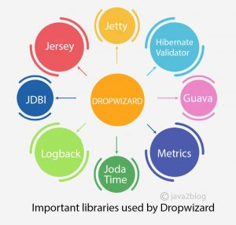
Dropwizard Core
Jetty – Standalone HTTP-server
Jersey – RESTful web framework
Jackson – JSON prcessing
Metrics – application metrics
Google Guava – utilities
Logback & SLF4J – logging framework
Liquibase – database migrations
JDBI, Hibernate – database access
Hibernate Validator – the reference implementation of the Java Bean Validation standard
Joda Time, Freemaker, Mustache, Jersey Client

Slide 4
Deployment
Build executable fat JAR
Run database migration (if any)
Start application (embedded Jetty server)
usage: java -jar some_service.jar [-h] [-v] {server, check, db} ...
positional arguments:
{server, check, db} available commands
named arguments:
-h, --help show this help message and exit
-v, --version show the application version and exit

Slide 5
Bootstrap
Start up$ java –jar app.java server config.yml
Jetty HTTP
server
Application port
Admin port
HttpServlet:
Controllers scan, providers
AdminServlet: Healthchecks,
Metrics,
Tasks

Slide 6
Performance

Slide 7
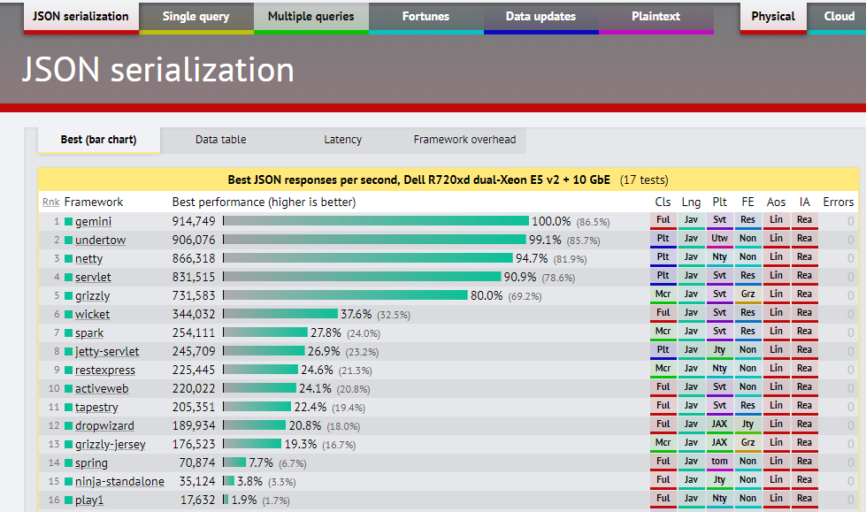
https://www.techempower.com/benchmarks/#section=data-r9&hw=ph&test=json&l=hra0e7

Slide 8
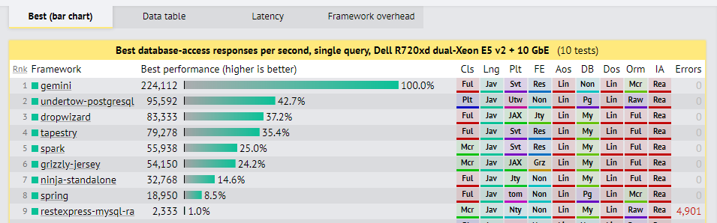
https://www.techempower.com/benchmarks/#section=data-r9&hw=ph&test=db&l=hra0e7&f=2ups-35s-0-0-0-0-0-0

Slide 9
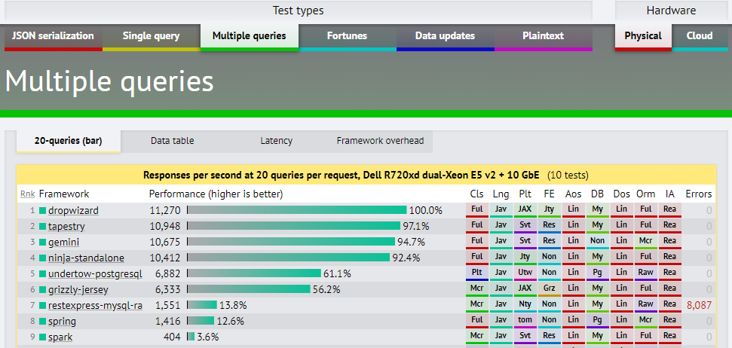
https://www.techempower.com/benchmarks/#section=data-r9&hw=ph&test=query&l=hra0e7&f=2ups-35s-0-0-0-0-0-0

Slide 10
others
Best fortunes (db -> json -> html) responses per second, Dell R440 Xeon Gold + 10 GbE(54 tests):
Vertx, 336 138
Dropwizard 46 349
Spring 30 990
https://www.techempower.com/benchmarks/#section=data-r17&hw=ph&test=fortune&l=hra0e7-0&f=2usnh1-35s-0-0-0-0-0-0-0
Best plaintext responses per second, Dell R440 Xeon Gold + 10 GbE(57 tests)
Wizzardo-http 7 026 401
Dropwizard 236 960
Spring 158 808
https://www.techempower.com/benchmarks/#section=data-r17&hw=ph&test=plaintext&l=hra0e7-0&f=2usnh1-35s-0-0-0-0-0-0-0
Responses per second at 20 updates (update db) per request, Dell R440 Xeon Gold + 10 GbE(38 tests)
Vertx 18 272
Dropwizard 8 360
Spring 2 913
https://www.techempower.com/benchmarks/#section=data-r17&hw=ph&test=update&l=hra0e7-0&f=2usnh1-35s-0-0-0-0-0-0-0

Slide 11
How to start?

Slide 12
Project organization
com.example.myapplication:
api: Representations. Request and response bodies.
cli: Commands
client: Client code that accesses external HTTP services.
core: Domain implementation; where objects not used in the API such as POJOs, validations, crypto, etc, reside.
jdbi: Database access classes
health: Health Checks
resources: Resources
MyApplication: The application class
MyApplicationConfiguration: configuration class

Slide 13
Configuration class and Config mapping - These parameters are specified in a YAML configuration file which is deserialized to an instance of your application’s configuration class and validated.
template: Hello, %s! defaultName: defName server: applicationConnectors: - type: http port: 9000 adminConnectors: - type: http port: 9001 database: driverClass: com.mysql.jdbc.Driver user: root password: qweQWE123!@# url: jdbc:mysql://localhost:3306/appcenter?allowMultiQueries=true validationQuery: "/* Health Check */ SELECT 1"
@Data
public class AppConfig extends Configuration {
@NotEmpty private String template; @NotEmpty private String defaultName = "AppConfigDefaultName";
@Valid @NotNull private DataSourceFactory database = new DataSourceFactory(); }

Slide 14
Spring configuration
@Data @Validated //@PropertySource("classpath:my.properties") @Component public class GlobalProperties { @Value("${thread-pool}") private int threadPool; @Value("${email}") private String email; }
server.port = 8081 email = test@hp.com thread-pool = 10
@Data @Configuration @EnableConfigurationProperties @ConfigurationProperties @Validated @PropertySource("classpath:yml.properties") public class YAMLConfig { private String name; private String environment; private List<String> servers
= new ArrayList<>();
@Max(5) private Integer somenumber; // standard getters and setters }
spring: profiles: test name: test-YAML environment: test somenumber: 100 servers: - www.abc.test.com - www.xyz.test.com

Slide 15
Application class
public class App extends Application<AppConfig> { public static void main(String[] args) throws Exception { new App().run(args); // path to yaml config } @Override public String getName() { return "the-app"; } @Override public void initialize(Bootstrap<AppConfig> bootstrap)
{ // bundles } @Override public void run(AppConfig configuration, Environment environment) { // set up environment
}
}

Slide 16
Application class - bundles
Bundles is re-usable functionality
Examples:
Database migrations bundle
Hibernate bundle
Assets bundle

Slide 17
Initialize – add a migration bundle
@Override public void initialize(Bootstrap<AppConfig> bootstrap) { bootstrap.addBundle(new MigrationsBundle<AppConfig>() { @Override public DataSourceFactory getDataSourceFactory(AppConfig configuration) { return configuration.getDatabase(); // data source factory } });
}

Slide 18
Liquibase migration
<?xml version="1.0" encoding="UTF-8"?> <databaseChangeLog xmlns="http://www.liquibase.org/xml/ns/dbchangelog" xmlns:xsi="http://www.w3.org/2001/XMLSchema-instance" xsi:schemaLocation="http://www.liquibase.org/xml/ns/dbchangelog http://www.liquibase.org/xml/ns/dbchangelog/dbchangelog-3.1.xsd"> <changeSet id="1" author="renat"> <createTable tableName="people"> <column name="id" type="bigint" autoIncrement="true"> <constraints primaryKey="true" nullable="false"/> </column> <column name="fullName" type="varchar(255)"> <constraints nullable="false"/> </column> <column name="jobTitle" type="varchar(255)"/> </createTable> </changeSet> </databaseChangeLog>
src/main/resources/migratinos.xml

Slide 19
Application class – environment
@Override public void run(AppConfig configuration, Environment environment) { // create a new DBIFactory final DBIFactory factory = new DBIFactory(); final DBI jdbi = factory.build(environment, configuration.getDatabase(), "mysql"); // DataSourceFactory // create daos final UserDAO userDAO = jdbi.onDemand(UserDAO.class); // create controllers final IndexController controller = new IndexController( configuration.getTemplate(), configuration.getDefaultName(), configuration.getPortConfig().getServerPort()); final UserController userController = new UserController(userDAO); // create health checks final TemplateHealthCheck healthCheck = new TemplateHealthCheck(configuration.getTemplate()); // set up environment environment.healthChecks().register("template", healthCheck); environment.jersey().register(controller); environment.jersey().register(userController); }

Slide 20
Spring boot application
@SpringBootApplication public class Application { public static void main(String[] args) { SpringApplication.run(BoottApplication.class, args); } }
Migration:
spring.liquibase.change-log=classpath:db/liquibase-changelog.xml
Database settings:
spring.jpa.hibernate.ddl-auto=none spring.datasource.url=jdbc:mysql://localhost:3306/appcenter?useLegacyDatetimeCode=false&serverTimezone=UTC spring.datasource.username=root spring.datasource.password=qweQWE123!@#

Slide 21
Health checks
Runtime test of behavior, initialization happens in the run method
public class TemplateHealthCheck extends HealthCheck { private final String template; public TemplateHealthCheck(String template) { this.template = template; } @Override protected Result check() throws Exception { final String saying = String.format(template, "TEST"); if (!saying.contains("TEST")) { return Result.unhealthy("template doesn't include a name"); } return Result.healthy(); } }

Slide 22
Representation

Slide 23
Representation (Pojo)
@Entity @Table(name = "people") public class PeopleTable { @Id @Column(name = "id", nullable = false) @NotNull @JsonProperty private Integer id; @Column(name = "fullName") @NotNull @JsonProperty private String fullName; @Column(name = "jobTitle") @NotNull @JsonProperty private String jobTitle;

Slide 24
Representation (advanced json)
@JsonSnakeCase public class Person { private final String firstName; @JsonCreator public Person(@JsonProperty String firstName) { this.firstName = firstName; } @JsonProperty public String getFirstName() { return firstName; } }
{
"first_name":"camelCaseTo_snake_case“
}

Slide 25
DAO (Hibernate)
DAO (JDBI)
public class PeopleDAO extends AbstractDAO<PeopleTable> { public PeopleDAO(SessionFactory factory) { super(factory); } public PeopleTable findById(Integer id) { return get(id); } public void create(PeopleTable peopleTable) { persist(peopleTable); } public List<PeopleTable> findAll() { return list(
namedQuery("com.wiza.representation.PeopleTable.findAll")); } }
public interface UserDAO { @SqlQuery("select id from user_info where user_email = :email") Integer getUserIdByEmail(@Bind("email") String email); }
SPRING DATA JPA
public
interface PeopleRepository
extends
CrudRepository<People, Integer>
{ }

Slide 26
Resource classes (controller)
Supports JAX-RS, @GET, @POST, @UnitOfWork, @Path Dropwizard adds some additional features:
Validation with @Valid
Metrics supports @Timed
@Path("/user") @Produces(MediaType.APPLICATION_JSON) public class UserController { UserDAO userDAO; private final AtomicLong counter = new AtomicLong(); public UserController(UserDAO userDAO) { this.userDAO = userDAO; } @GET @Timed @UnitOfWork public MessageDto getId(@QueryParam("email") Optional<String> email) { Integer userId = userDAO.getUserIdByEmail(email.orElse("renat.ashirbakiev@hp.com")); return new MessageDto(userId.toString(), counter.getAndIncrement()); } }

Slide 27
Resources (controllers) – Error handling
If your resource class unintentionally throws an exception, Dropwizard will log that exception under the ERROR level (including stack traces) and return a terse, safe application/json 500 Internal Server Error response
ExceptionMapper allows take exceptions that your resources may throw and map them to appropriate responses.
public class IllegalArgumentExceptionMapper implements ExceptionMapper<IllegalArgumentException> { private final Meter exceptions; public IllegalArgumentExceptionMapper(MetricRegistry metrics) { exceptions = metrics.meter(name(getClass(), "exceptions")); } @Override public Response toResponse(IllegalArgumentException e) { exceptions.mark(); return Response.status(Response.Status.BAD_REQUEST) .header(“some_header", "true") .type(MediaType.APPLICATION_JSON_TYPE) .entity(new ErrorMessage(Response.Status.BAD_REQUEST.getStatusCode(), "You passed an illegal argument! Watch out!")) .build(); } }
environment.jersey().register(new IllegalArgumentExceptionMapper(environment.metrics()));

Slide 28
Spring error handling
@ControllerAdvice public class AppExceptionHandler extends ResponseEntityExceptionHandler
{ @ExceptionHandler({IllegalArgumentException.class}) public ResponseEntity<Object> handleIllegalArgumentException(
Exception ex,
WebRequest request)
{ return new ResponseEntity<Object>(
"Illegal argument" ,
new HttpHeaders(),
HttpStatus.BAD_REQUEST); } }

Slide 29
Resources (controllers) – Jersey filters
There might be cases when you want to filter out requests or modify them before they reach your controllers.
@Provider public class DateNotSpecifiedFilter implements ContainerRequestFilter { @Override public void filter(ContainerRequestContext requestContext) throws IOException { String dateHeader = requestContext.getHeaderString(HttpHeaders.DATE); if (dateHeader == null) { throw new CommonException("Date Header was not specified"); } } }
Another way to create filters is by creating servlet filters.
Special annotation should be used in order to filter specific endpoints.

Slide 30
Spring boot filter
@Component @Order(1) public class RequestResponseLoggingFilter implements Filter { @Override public void doFilter(final ServletRequest request, final ServletResponse response, final FilterChain chain) throws IOException, ServletException { HttpServletRequest req = (HttpServletRequest) request; HttpServletResponse res = (HttpServletResponse) response; LOG.info("Logging Request {} : {}", req.getMethod(), req.getRequestURI()); chain.doFilter(request, response); LOG.info("Logging Response :{}", res.getContentType()); } }
Filter for group of endpoints
@Bean
public FilterRegistrationBean<RequestResponseLoggingFilter> loggingFilter(){
FilterRegistrationBean<RequestResponseLoggingFilter> registrationBean
= new FilterRegistrationBean<>();
registrationBean.setFilter(new RequestResponseLoggingFilter());
registrationBean.addUrlPatterns("/users/*");
return registrationBean;
}

Slide 31
validation

Slide 32
Resources (controllers) – validators
@GET public String validate(@NotEmpty @QueryParam("v") String v) { return "Got: " + v; }
V == null
422: {"errors":["query param v may not be empty"]}
@PUT public Person person(@NotNull @Valid Person person) { return person; }
Person == null
422: {"errors": ["The request body may not be null"]}
public class Person { @NotNull private String firstName; public Person() { } public String getFirstName() { return firstName; } public void setFirstName(String firstName) { this.firstName = firstName; }
}
firstName == null
422: {"errors": [“firstName may not be null“]}

Slide 33
VALUE Constrains (validations)
@GET @Path("params") public String getBean(@Valid @BeanParam MyBeanParams params) { return params.getField(); } public static class MyBeanParams { @NotEmpty private String field; public String getField() { return field; } @QueryParam("foo") public void setField(String field) { this.field = Strings.nullToEmpty(field).trim(); } }
@GET @Path("/max") public Integer max(@QueryParam("m") @Max(256) Integer m) { return m; }
@GET @Path("len") public String len(@QueryParam("l") @Length(max = 5) String len) { return len; }
@GET @Path("oneof") public String oneOf(@QueryParam("e") @OneOf(value = {"in", "out"}, ignoreCase = true, ignoreWhitespace = true) String in) { return in; }

Slide 34
Annotations in representation class
@NotNull private Integer id; @NotBlank @Length(min=2, max=255) private String firstName; @NotBlank @Length(min=2, max=255) private String lastName; @Pattern(regexp=".+@.+\\.[a-z]+") private String email;

Slide 35
List of validators
Hibernate:
@AssertFalse
@AssertTrue
@DecimalMax(value=,inclusive=)
@DecimalMin(value=,inclusive=)
@Digits(integer=,fraction=)
@Future
@Max(value=)
@Min(value=)
@NotNull
@Null
@Past
@Pattern(regex=,flag=)
@Size(min=, max=)
@Valid
@CreditCardNumber(ignoreNonDigitCharacters=)
@EAN
@Email
@Length(min=,max=)
@LuhnCheck(startIndex=,endIndex=,checkDigitIndex=,ignoreNonDigitCharacters=)
@Mod10Check(multiplier=,weight=,startIndex=,endIndex=,checkDigitIndex=,ignoreNonDigitCharacters=)
Spring:
DecimalMax
DecimalMin
Digits
Email
Future
FutureOrPresent
Max
Min
Negative
NegativeOrZero
NotBlank
NotEmpty
NotNull
Null
Past
PastOrPresent
Pattern
Positive
PositiveOrZero
Dropwizard:
SizeRange
PortRange
OneOf
MixSize
MinDuration
MaxSize
MaxDuration
@NotBlank
@NotEmpty
@Range(min=,max=)
@SafeHtml
@ScriptAssert
@URL
@Mod11Check

Slide 36
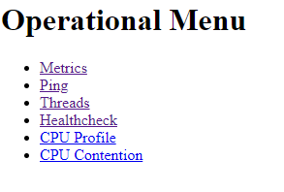
Application checking
Spring actuators:
http://localhost:8081/actuator http://localhost:8081/actuator/auditevents http://localhost:8081/actuator/beans http://localhost:8081/actuator/caches/{cache} http://localhost:8081/actuator/caches http://localhost:8081/actuator/health http://localhost:8081/actuator/health/{component}/{instance} http://localhost:8081/actuator/health/{component} http://localhost:8081/actuator/conditions http://localhost:8081/actuator/configprops http://localhost:8081/actuator/env http://localhost:8081/actuator/env/{toMatch} http://localhost:8081/actuator/info http://localhost:8081/actuator/liquibase http://localhost:8081/actuator/loggers http://localhost:8081/actuator/loggers/{name} http://localhost:8081/actuator/heapdump http://localhost:8081/actuator/threaddump http://localhost:8081/actuator/metrics/{requiredMetricName} http://localhost:8081/actuator/metrics http://localhost:8081/actuator/scheduledtasks http://localhost:8081/actuator/httptrace http://localhost:8081/actuator/mappings
Works on admin port
/
/ping
/healthcheck
/metrics
/threads

Slide 37
Other featureS
1. Environment variables – dropwizard-configuration module provides the capabilities to substitute configuration settings
with the value of environment variables
2. SSL support is built into Dropwizard
3. Managed objects –ties object’s lifecycle to that of the application’s HTTP server (before the server starts, the start() method
is called, after the server has stopped the stop() method is called).
4. Commands – are basic actions which Dropwizard runs based on the arguments provided on the command line
(server, db migrate)
5. Task – is a run-time action your application provides access to on the administrative port via HTTP.
6. Logging – Dropwizard can log to console, file ans syslog. DEBUG, INFO, WARN, ERROR could be written to different output.
The output can be in JSON format.
7. Testing Applications - all of Dropwizard’s APIs are designed with testability
8. Dropwizard client
9. Proxy Authentication
10. Dropwizard Authentication – provides authentication using either HTTP Basic Authentication or OAuth2 bearer tokens.
11. Dropwizard Forms - module provides you with a support for multi-part forms Jersey.
12. Dropwizard validation – NotNull, UnwrapValidatedValue, Max, DefaultValue, BeanParam, one of, ValidationMethod, Length
13. Dropwizard Views – dropwizard-views-mustache & dropwizard-views-freemarker modules provide you with simple,
fast HTML views.
14. Dropwizard & Scala
15. Testing Dropwizard – provides you with some handy classes for testing your representation classes and resource classes.
It also provides a JUnit rule for full-stack testing of your entire app

Slide 38
Logging
logging: # The default level of all loggers. Can be OFF, ERROR, WARN, INFO, DEBUG, TRACE, or ALL. level: ALL appenders: - type: file # syslog, console currentLogFilename: ./logs/example-sql.log archivedLogFilenamePattern: ./logs/example-sql-%d.log.gz archivedFileCount: 5

Slide 39
Console logging
By default, Dropwizard applications log INFO and higher to STDOUT. You can configure this by editing the logging section of your YAML configuration file:
logging: appenders: - type: console threshold: WARN target: stderr

Slide 40
Syslog logging
logging: appenders: - type: syslog # The hostname of the syslog server to which statements will be sent. # N.B.: If this is the local host, the local syslog instance will need to be configured to # listen on an inet socket, not just a Unix socket. host: localhost # The syslog facility to which statements will be sent. facility: local0

Slide 41
Combine any number of different appenders
logging: # Permit DEBUG, INFO, WARN and ERROR messages to be logged by appenders. level: DEBUG appenders: # Log warnings and errors to stderr - type: console threshold: WARN target: stderr # Log info, warnings and errors to our apps' main log. # Rolled over daily and retained for 5 days. - type: file threshold: INFO currentLogFilename: ./logs/example.log archivedLogFilenamePattern: ./logs/example-%d.log.gz archivedFileCount: 5 # Log debug messages, info, warnings and errors to our apps' debug log. # Rolled over hourly and retained for 6 hours - type: file threshold: DEBUG currentLogFilename: ./logs/debug.log archivedLogFilenamePattern: ./logs/debug-%d{yyyy-MM-dd-hh}.log.gz archivedFileCount: 6

Slide 42
Json Log format
{ "level":"INFO", "logger":"io.dropwizard.setup.AdminEnvironment", "thread":"main", "message":"tasks = \r\n\r\n POST /tasks/log-level (io.dropwizard.servlets.tasks.LogConfigurationTask)\r\n POST /tasks/gc (io.dropwizard.servlets.tasks.GarbageCollectionTask)\r\n", "timestamp":1541062017925 }
{ "level":"INFO", "logger":"org.eclipse.jetty.server.handler.ContextHandler", "thread":"main", "message":"Started i.d.j.MutableServletContextHandler@2b9ecd05{/,null,AVAILABLE}", "timestamp":1541062017931 }
logging: appenders: - type: console layout: type: json

Slide 43
Access log
server: rootPath: /api/ applicationConnectors: - type: http port: 9000 adminConnectors: - type: http port: 9001 requestLog: appenders: - type: console layout: type: access-json
{ "method":"GET", "userAgent":"Mozilla/5.0 (Windows NT 10.0; Win64; x64) AppleWebKit/537.36 (KHTML, like Gecko) Chrome/70.0.3538.77 Safari/537.36", "uri":"/api/user", "requestTime":14, "protocol":"HTTP/1.1", "contentLength":22, "remoteAddress":"0:0:0:0:0:0:0:1", "timestamp":1541062167713, "status":200 }

Slide 44
Logging filters
• Only log requests that have large bodies
• Only log requests that are slow
• Only log requests that resulted in a non-2xx status code
• Exclude requests that contain sensitive information in the URL
• Exclude healthcheck requests
server: requestLog: appenders: - type: console filterFactories: - type: secret-filter-factory

Slide 45
Spring boot logging
<?xml version="1.0" encoding="UTF-8"?> <configuration> <property name="LOGS" value="./logs" /> <appender name="Console" class="ch.qos.logback.core.ConsoleAppender"> <layout class="ch.qos.logback.classic.PatternLayout"> <Pattern> %black(%d{ISO8601}) %highlight(%-5level) [%blue(%t)] %yellow(%C{1.}): %msg%n%throwable </Pattern> </layout> </appender> <appender name="RollingFile" class="ch.qos.logback.core.rolling.RollingFileAppender"> <file>${LOGS}/spring-boot-logger.log</file> <encoder class="ch.qos.logback.classic.encoder.PatternLayoutEncoder"> <Pattern>%d %p %C{1.} [%t] %m%n</Pattern> </encoder> <rollingPolicy class="ch.qos.logback.core.rolling.TimeBasedRollingPolicy"> <!-- rollover daily and when the file reaches 10 MegaBytes --> <fileNamePattern>${LOGS}/archived/spring-boot-logger-%d{yyyy-MM-dd}.%i.log </fileNamePattern> <timeBasedFileNamingAndTriggeringPolicy class="ch.qos.logback.core.rolling.SizeAndTimeBasedFNATP"> <maxFileSize>10MB</maxFileSize> </timeBasedFileNamingAndTriggeringPolicy> </rollingPolicy> </appender> <!-- LOG everything at INFO level --> <root level="info"> <appender-ref ref="RollingFile" /> <appender-ref ref="Console" /> </root> <!-- LOG "com.baeldung*" at TRACE level --> <logger name="com.baeldung" level="trace" additivity="false"> <appender-ref ref="RollingFile" /> <appender-ref ref="Console" /> </logger> </configuration>

Slide 46
Dropwizard and spring views

Slide 47
Dropwizard supports:
Mustache
FreeMaker
Spring supports:
Jsp
FreeMaker
Thymeleaf
Groovy
Jade
JMustache
Spring Boot will provide auto-configuration for
FreeMaker, Thymeleaf, Groovy

Slide 48
<dependency> <groupId>io.dropwizard</groupId> <artifactId>dropwizard-views-freemarker</artifactId> <version>${dropwizard.version}</version> </dependency>
bootstrap.addBundle(new ViewBundle<AppConfig>() { @Override public Map<String, Map<String, String>> getViewConfiguration(AppConfig config) { return config.getViewRendererConfiguration(); } });
views: freemarker: strict_syntax: true mustache: cache: false
public class PersonView extends View { private final Person person; public PersonView(Person person) { super("person.ftl"); this.person = person; } public Person getPerson() { return person; } }
<#-- @ftlvariable name="" type="com.wiza.view.PersonView" --> <html> <body> <!-- calls getPerson().getName() and sanitizes it --> <h1>Hello, ${person.firstName}!</h1> </body> </html>
@GET public Person get() { Person person = new Person(); person.setFirstName("firstName"); return person; }
Spring, Thymeleaf:
Thymeleaf
<!DOCTYPE HTML> <html xmlns:th="http://www.thymeleaf.org"> <head> <title>Getting Started: Serving Web Content</title> <meta http-equiv="Content-Type" content="text/html; charset=UTF-8" /> </head> <body> <p th:text="'Hello, ' + ${name} + '!'" /> </body> </html>
@Controller public class GreetingController { @GetMapping("/greeting") public String greeting(@RequestParam(name = "name", required = false, defaultValue = "World") String name, Model model) { model.addAttribute("name", name); return "greeting"; } }
<dependency>
<groupId>
org.springframework.boot
</groupId>
<artifactId>
spring-boot-starter-thymeleaf
</artifactId> </dependency>

Slide 49
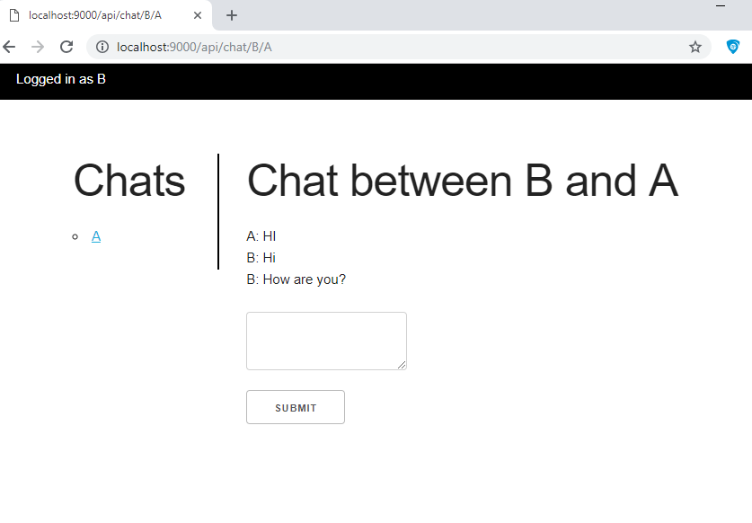
Mustache view
<!DOCTYPE html> <html> <head> <link rel="stylesheet" href="/assets/css/skeleton.css"/> <link rel="stylesheet" href="/assets/css/main.css"/> </head> <body> <div class="top"> <div class="user">Logged in as {{currentUser}}</div> </div> <div class="container"> <row> <div class = "three columns"> <h1>Chats</h1> <ul> {{#chats}}<li><a href="/api/chat/{{userOne}}/{{userTwo}}">{{userTwo}}</a></li>{{/chats}} </ul> </div> <div class = "nine columns"> {{#currentChat}} <h1>Chat between {{currentUser}} and {{otherUser}}</h1> {{#chat}} {{.}}<br/> {{/chat}} <br> <form method="post" action="/api/chat/{{currentUser}}/{{otherUser}}"> <textarea name="message"></textarea> <br/><button>Submit</button> </form> {{/currentChat}} </div> </row> </div> </body> </html>

Slide 50
Dropwizard and spring testing

Slide 51
unit tests for serializing and deserializing representation classes to and from JSON
public class Person { @NotNull private String firstName; public Person() { } public String getFirstName() { return firstName; } public void setFirstName(String firstName) { this.firstName = firstName; } }
public class PersonTest { private static final ObjectMapper MAPPER = Jackson.newObjectMapper(); @Test public void serializesToJSON() throws Exception { final Person person = new Person(); person.setFirstName("hp"); final String expected = MAPPER.writeValueAsString( MAPPER.readValue(fixture("fixtures/person.json"), Person.class)); assertThat(MAPPER.writeValueAsString(person)).isEqualTo(expected); } }
CTRL + F + T
@Test public void deserializesFromJSON() throws Exception { final Person person = new Person(); person.setFirstName("hp");
assertThat(MAPPER.readValue(fixture("fixtures/person.json"), Person.class)) .isEqualTo(person); }

Slide 52
@RunWith(SpringRunner.class) @JsonTest public class JsonSDTest { private static People details = new People(); static { details.setId(1); details.setFullName("hp"); details.setJobTitle("hp_test"); } @Autowired private JacksonTester<People> json; @Test public void testSerialize() throws Exception { Resource resource = new ClassPathResource("json/people.json"); String json = null; try { json = StreamUtils.copyToString( resource.getInputStream(), Charset.defaultCharset()); } catch (IOException e) { e.printStackTrace(); } assertThat(this.json.write(details)).isEqualToJson(json); } @Test public void testDeserialize() throws Exception { Resource resource = new ClassPathResource("json/people.json"); String json = StreamUtils.copyToString( resource.getInputStream(), Charset.defaultCharset()); assertThat(this.json.parse(json)) .isEqualTo(details); } }

Slide 53
Testing controllers (resources)
// loads a given controller instance in an in-memory Jersey server @ClassRule public static final ResourceTestRule resources = ResourceTestRule.builder() .addResource(new UserController(dao)) .build();
@Test public void testGetIdMethod() { MessageDto expectedMessageDto = new MessageDto(String.valueOf(returnedValue), Long.valueOf(returnedValue)); assertThat(resources.target("/user") .queryParam("email", emailToPath) .request().get(MessageDto.class)) .isEqualTo(expectedMessageDto); verify(dao).getUserIdByEmail(emailToPath); }
Another test container
@ClassRule public static final ResourceTestRule RULE = ResourceTestRule.builder() .setTestContainerFactory(new GrizzlyWebTestContainerFactory()) .addResource(new ExampleController()) .build();

Slide 54
Integration testing
public class IntegrationTest { @ClassRule public static final DropwizardAppRule<AppConfig> RULE = new DropwizardAppRule<AppConfig>(App.class, ResourceHelpers.resourceFilePath("test.yml")); @Test public void firstIntegrationTest() { Client client = new JerseyClientBuilder(RULE.getEnvironment()).build("test client"); String response = client.target( String.format("http://localhost:%d/api/validator/max?m=100", RULE.getLocalPort())) .request() .get(String.class); assertThat(response).isEqualTo("100"); } }

Slide 55
@RunWith(SpringRunner.class) @SpringBootTest(webEnvironment = SpringBootTest.WebEnvironment.RANDOM_PORT) // to start the server with a random port public class ApplicationTest { @Autowired private GController controller; @LocalServerPort private int port; @Autowired private TestRestTemplate restTemplate; @Test public void contextLoads() throws Exception { assertThat(controller).isNotNull(); } @Test public void greetingShouldReturnDefaultMessage() throws Exception { assertThat(this.restTemplate.getForObject("http://localhost:" + port + "/greeting", String.class)).contains("hp"); } }

Slide 56
Testing client implementations
public class ValidatorControllerTest { @ClassRule public static final DropwizardClientRule dropwizard = new DropwizardClientRule(new ValidatorController()); @Test public void checkMaxConstrains() throws IOException { final URL url = new URL(dropwizard.baseUri() + "/validator/max?m=100"); final String response = new BufferedReader(new InputStreamReader(url.openStream())).readLine(); assertEquals("100", response); } }
The DropwizardClientRule takes care of:
Creating a simple default configuration.
Creating a simplistic application.
Adding a dummy health check to the application to suppress the startup warning.
Adding your JAX-RS resources (test doubles) to the Dropwizard application.
Choosing a free random port number (important for running tests in parallel).

Slide 57
Testing Database Interactions
public class DatabaseTest { @Rule public DAOTestRule database = DAOTestRule.newBuilder().addEntityClass(PeopleTable.class).build(); private PeopleDAO peopleDAO; @Before public void setUp() { peopleDAO = new PeopleDAO(database.getSessionFactory()); } @Test public void createsFoo() { Integer userId = 1123; PeopleTable peopleTable = new PeopleTable(); peopleTable.setId(userId); peopleTable.setFullName("MrR"); peopleTable.setJobTitle("developer"); PeopleTable result = database.inTransaction(() -> { peopleDAO.create(peopleTable); return peopleDAO.findById(userId); }); assertEquals(result, peopleTable); } }
@RunWith(SpringRunner.class) @DataJpaTest public class DatabaseInteractionTest { @Autowired private TestEntityManager entityManager; @Autowired private PeopleRepository peopleRepository; @Test public void findsUserByEmail() { People people = new People(); people.setId(1); people.setJobTitle("title"); people.setFullName("name"); entityManager.persist(people); assertEquals(people, peopleRepository.findById(1).orElse(null)); } }

Slide 58
Testing Configurations
public class YamlConfigTest { private final ObjectMapper objectMapper = Jackson.newObjectMapper(); private final Validator validator = Validators.newValidator(); private final YamlConfigurationFactory<PortConfig> factory = new YamlConfigurationFactory<>(PortConfig.class, validator, objectMapper, "ports"); @Test public void testPortConfig() throws Exception { final File yml = new File(ResourceHelpers.resourceFilePath("yaml/portconfig.yml")); PortConfig pc = factory.build(yml); assertThat(pc).isInstanceOf(PortConfig.class); assertThat(pc.getServerPort()).isEqualTo(8000); } }

Slide 59
Conclusion
REST supports – frameworks are quit similar.
DI supports – Dropwizard (DW) has only community version dropwizard-guice, but SpringBoot (SB) version works better.
Persistence supports – DW is tightly coupled with Hibernate and JPA specification is not possible.
Transaction supports – DW use @UnitOfWork annotation and it can be applied only to methods in REST classes.
In SB @Transactional annotation can be applied on any method or class (not only endpoints).
Configuration management – DW has not built-in functionality to support multiple environment configs in one file.
SB has its own solution Spring Profiles.
Metrics – SB provides only basic metrics and stats. SB suggest using DW metrics package for any advanced measurements.
Supports – SB is sponsored by Pivotal. DW is community.

