Slide 1
dropwizard
overview

Slide 2
Dropwizard is a Java framework for developing high-performance, RESTful web services.
Dropwizard - Highlights:
Allows you to build one jar, that contains all needed dependencies (application has one main program which starts the jetty container)
Simple & Lightweight
Quick and easy to get a new http service going
Easy Test, Deployment and Management
Quick Project Bootstrap

Slide 3
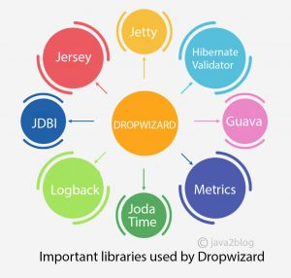
Dropwizard Core
Jetty – Standalone HTTP-server
Jersey – RESTful web framework
Jackson – JSON prcessing
Metrics – application metrics
Google Guava – utilities
Logback & SLF4J – logging framework
Liquibase – database migrations
JDBI, Hibernate – database access
Hibernate Validator – the reference implementation of the Java Bean Validation standard
Joda Time, Freemaker, Mustache, Jersey Client

Slide 4
Performance

Slide 5
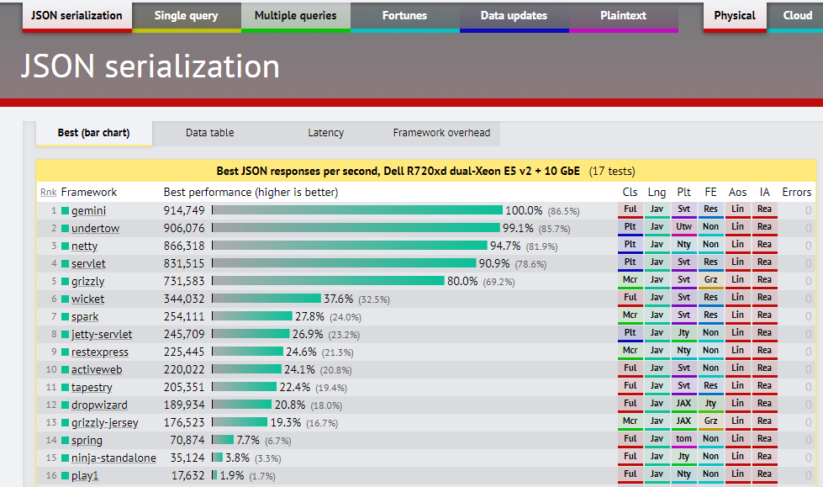
https://www.techempower.com/benchmarks/#section=data-r9&hw=ph&test=json&l=hra0e7

Slide 6
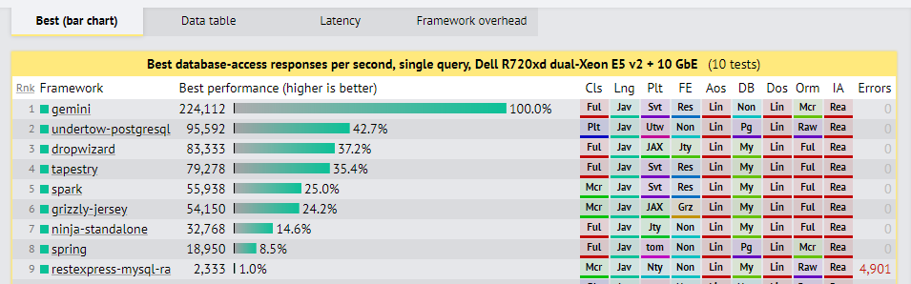
https://www.techempower.com/benchmarks/#section=data-r9&hw=ph&test=db&l=hra0e7&f=2ups-35s-0-0-0-0-0-0

Slide 7
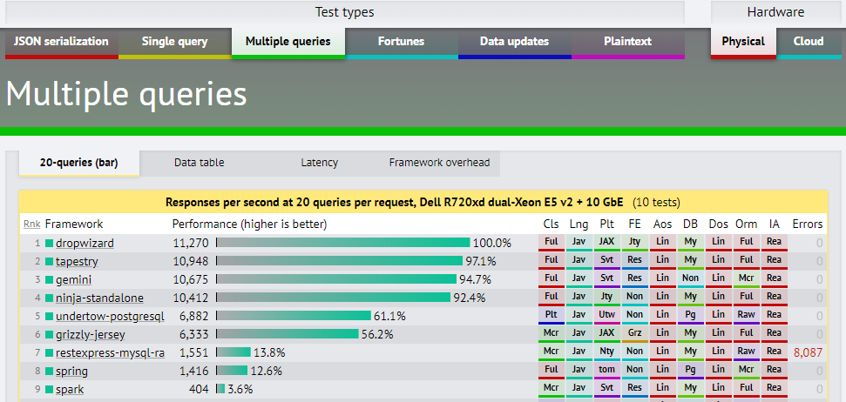
https://www.techempower.com/benchmarks/#section=data-r9&hw=ph&test=query&l=hra0e7&f=2ups-35s-0-0-0-0-0-0

Slide 8
How to start?

Slide 9
Project organization
com.example.myapplication:
api: Representations. Request and response bodies.
cli: Commands
client: Client code that accesses external HTTP services.
core: Domain implementation; where objects not used in the API such as POJOs, validations, crypto, etc, reside.
jdbi: Database access classes
health: Health Checks
resources: Resources
MyApplication: The application class
MyApplicationConfiguration: configuration class

Slide 10
Configuration class and Config mapping - These parameters are specified in a YAML configuration file which is deserialized to an instance of your application’s configuration class and validated.
public class AppConfig extends Configuration { @NotEmpty private String template; @NotEmpty private String defaultName = "AppConfigDefaultName";
@Valid @NotNull @JsonProperty private DataSourceFactory database = new DataSourceFactory(); @JsonProperty public String getTemplate() { return template; } @JsonProperty public void setTemplate(String template) { this.template = template; } @JsonProperty public String getDefaultName() { return defaultName; } @JsonProperty public void setDefaultName(String name) { this.defaultName = name; } }
template: Hello, %s! defaultName: defName server: applicationConnectors: - type: http port: 9000 adminConnectors: - type: http port: 9001 database: driverClass: com.mysql.jdbc.Driver user: root password: qweQWE123!@# url: jdbc:mysql://localhost:3306/appcenter?allowMultiQueries=true validationQuery: "/* Health Check */ SELECT 1"

Slide 11
Application class
public class App extends Application<AppConfig> { public static void main(String[] args) throws Exception { new App().run(args); // path to yaml config } @Override public String getName() { return "the-app"; } @Override public void initialize(Bootstrap<AppConfig> bootstrap)
{ // bundles } @Override public void run(AppConfig configuration, Environment environment) { // set up environment
}
}

Slide 12
Application class - bundles
Bundles is re-usable functionality
Examples:
Database migrations bundle
Hibernate bundle

Slide 13
Initialize – add a migration bundle
@Override public void initialize(Bootstrap<AppConfig> bootstrap) { bootstrap.addBundle(new MigrationsBundle<AppConfig>() { @Override public DataSourceFactory getDataSourceFactory(AppConfig configuration) { return configuration.getDatabase(); // data source factory } });
}

Slide 14
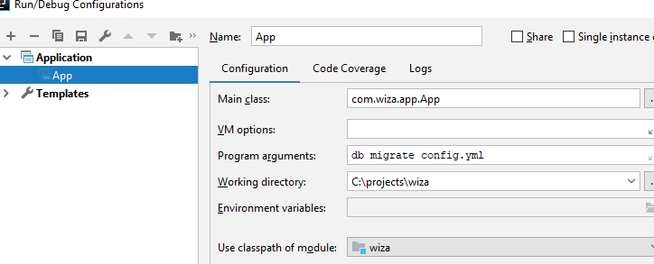
Liquibase migration
<?xml version="1.0" encoding="UTF-8"?> <databaseChangeLog xmlns="http://www.liquibase.org/xml/ns/dbchangelog" xmlns:xsi="http://www.w3.org/2001/XMLSchema-instance" xsi:schemaLocation="http://www.liquibase.org/xml/ns/dbchangelog http://www.liquibase.org/xml/ns/dbchangelog/dbchangelog-3.1.xsd"> <changeSet id="1" author="renat"> <createTable tableName="people"> <column name="id" type="bigint" autoIncrement="true"> <constraints primaryKey="true" nullable="false"/> </column> <column name="fullName" type="varchar(255)"> <constraints nullable="false"/> </column> <column name="jobTitle" type="varchar(255)"/> </createTable> </changeSet> </databaseChangeLog>
src/main/resources/migratinos.xml

Slide 15
Application class – environment
@Override public void run(AppConfig configuration, Environment environment) { // create a new DBIFactory final DBIFactory factory = new DBIFactory(); final DBI jdbi = factory.build(environment, configuration.getDatabase(), "mysql"); // DataSourceFactory // create daos final UserDAO userDAO = jdbi.onDemand(UserDAO.class); // create controllers final IndexController controller = new IndexController( configuration.getTemplate(), configuration.getDefaultName(), configuration.getPortConfig().getServerPort()); final UserController userController = new UserController(userDAO); // create health checks final TemplateHealthCheck healthCheck = new TemplateHealthCheck(configuration.getTemplate()); // set up environment environment.healthChecks().register("template", healthCheck); environment.jersey().register(controller); environment.jersey().register(userController); }

Slide 16
Health checks
Runtime test of behavior
public class TemplateHealthCheck extends HealthCheck { private final String template; public TemplateHealthCheck(String template) { this.template = template; } @Override protected Result check() throws Exception { final String saying = String.format(template, "TEST"); if (!saying.contains("TEST")) { return Result.unhealthy("template doesn't include a name"); } return Result.healthy(); } }

Slide 17
Representation (Pojo)
@Entity @Table(name = "people") public class PeopleTable { @Id @Column(name = "id", nullable = false) @NotNull @JsonProperty private Integer id; @Column(name = "fullName") @NotNull @JsonProperty private String fullName; @Column(name = "jobTitle") @NotNull @JsonProperty private String jobTitle;

Slide 18
DAO (Hibernate)
DAO (JDBI)
public class PeopleDAO extends AbstractDAO<PeopleTable> { public PeopleDAO(SessionFactory factory) { super(factory); } public PeopleTable findById(Integer id) { return get(id); } public void create(PeopleTable peopleTable) { persist(peopleTable); } public List<PeopleTable> findAll() { return list(namedQuery("com.wiza.representation.PeopleTable.findAll")); } }
public interface UserDAO { @SqlQuery("select id from user_info where user_email = :email") Integer getUserIdByEmail(@Bind("email") String email); }

Slide 19
Resource classes (controller)
Supports JAX-RS, @GET, @POST, @UnitOfWork, @Path Dropwizard adds some additional features:
Validation with @Valid
Metrics supports @Timed
@Path("/user") @Produces(MediaType.APPLICATION_JSON) public class UserController { UserDAO userDAO; private final AtomicLong counter = new AtomicLong(); public UserController(UserDAO userDAO) { this.userDAO = userDAO; } @GET @Timed @UnitOfWork public MessageDto getId(@QueryParam("email") Optional<String> email) { Integer userId = userDAO.getUserIdByEmail(email.orElse("renat.ashirbakiev@hp.com")); return new MessageDto(userId.toString(), counter.getAndIncrement()); } }

Slide 20
Deployment
Build executable fat JAR
Run database migration (if any)
Start application (embedded Jetty server)
usage: java -jar some_service.jar [-h] [-v] {server,check,db} ...
positional arguments:
{server,check,db} available commands
named arguments:
-h, --help show this help message and exit
-v, --version show the application version and exit

Slide 21
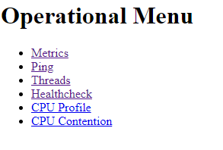
Application checking
Works on admin port
/
/ping
/healthcheck
/metrics
/threads

Slide 22
Other feature
Environment variables – dropwizard-configuration module provides the capabilities to substitute configuration settings
with the value of environment variables
2.

