Slide 1
5
2
4
5

Slide 2
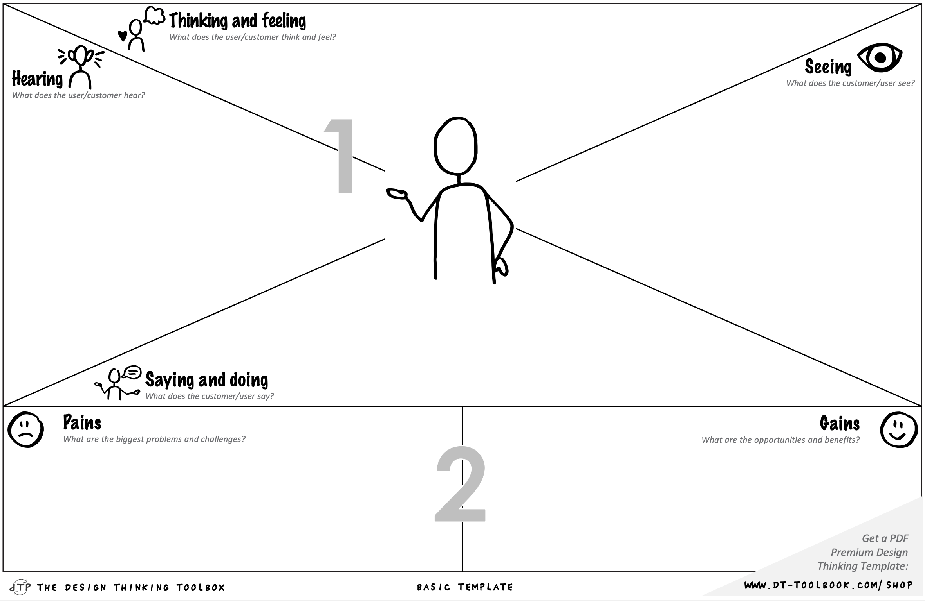
Classmates asking the same questions repeatedly in group chats
Long email threads with administrative staff
Scattered announcements across multiple channels (UM website, Student Portal, Canvas, MyUM, faculty pages)
"Did you check the website?" "Which website?"
Friends complaining: "I can't find the exam schedule anywhere"
Professors saying: "All information is available online"
Study advisors: "You should have found that on Canvas/the portal"
Sarah
2nd-year BA DS Student
"I've checked three different places and got three different answers”
Sends emails to administrative offices for basic questions
Frustrated by wasting time searching across multiple platforms
Anxious about missing important deadlines or information
Embarrassed to ask "simple" questions again
Values time efficiency for studying instead of searching
Wants to feel in control and informed
Seeks clarity and peace of mind

Slide 3
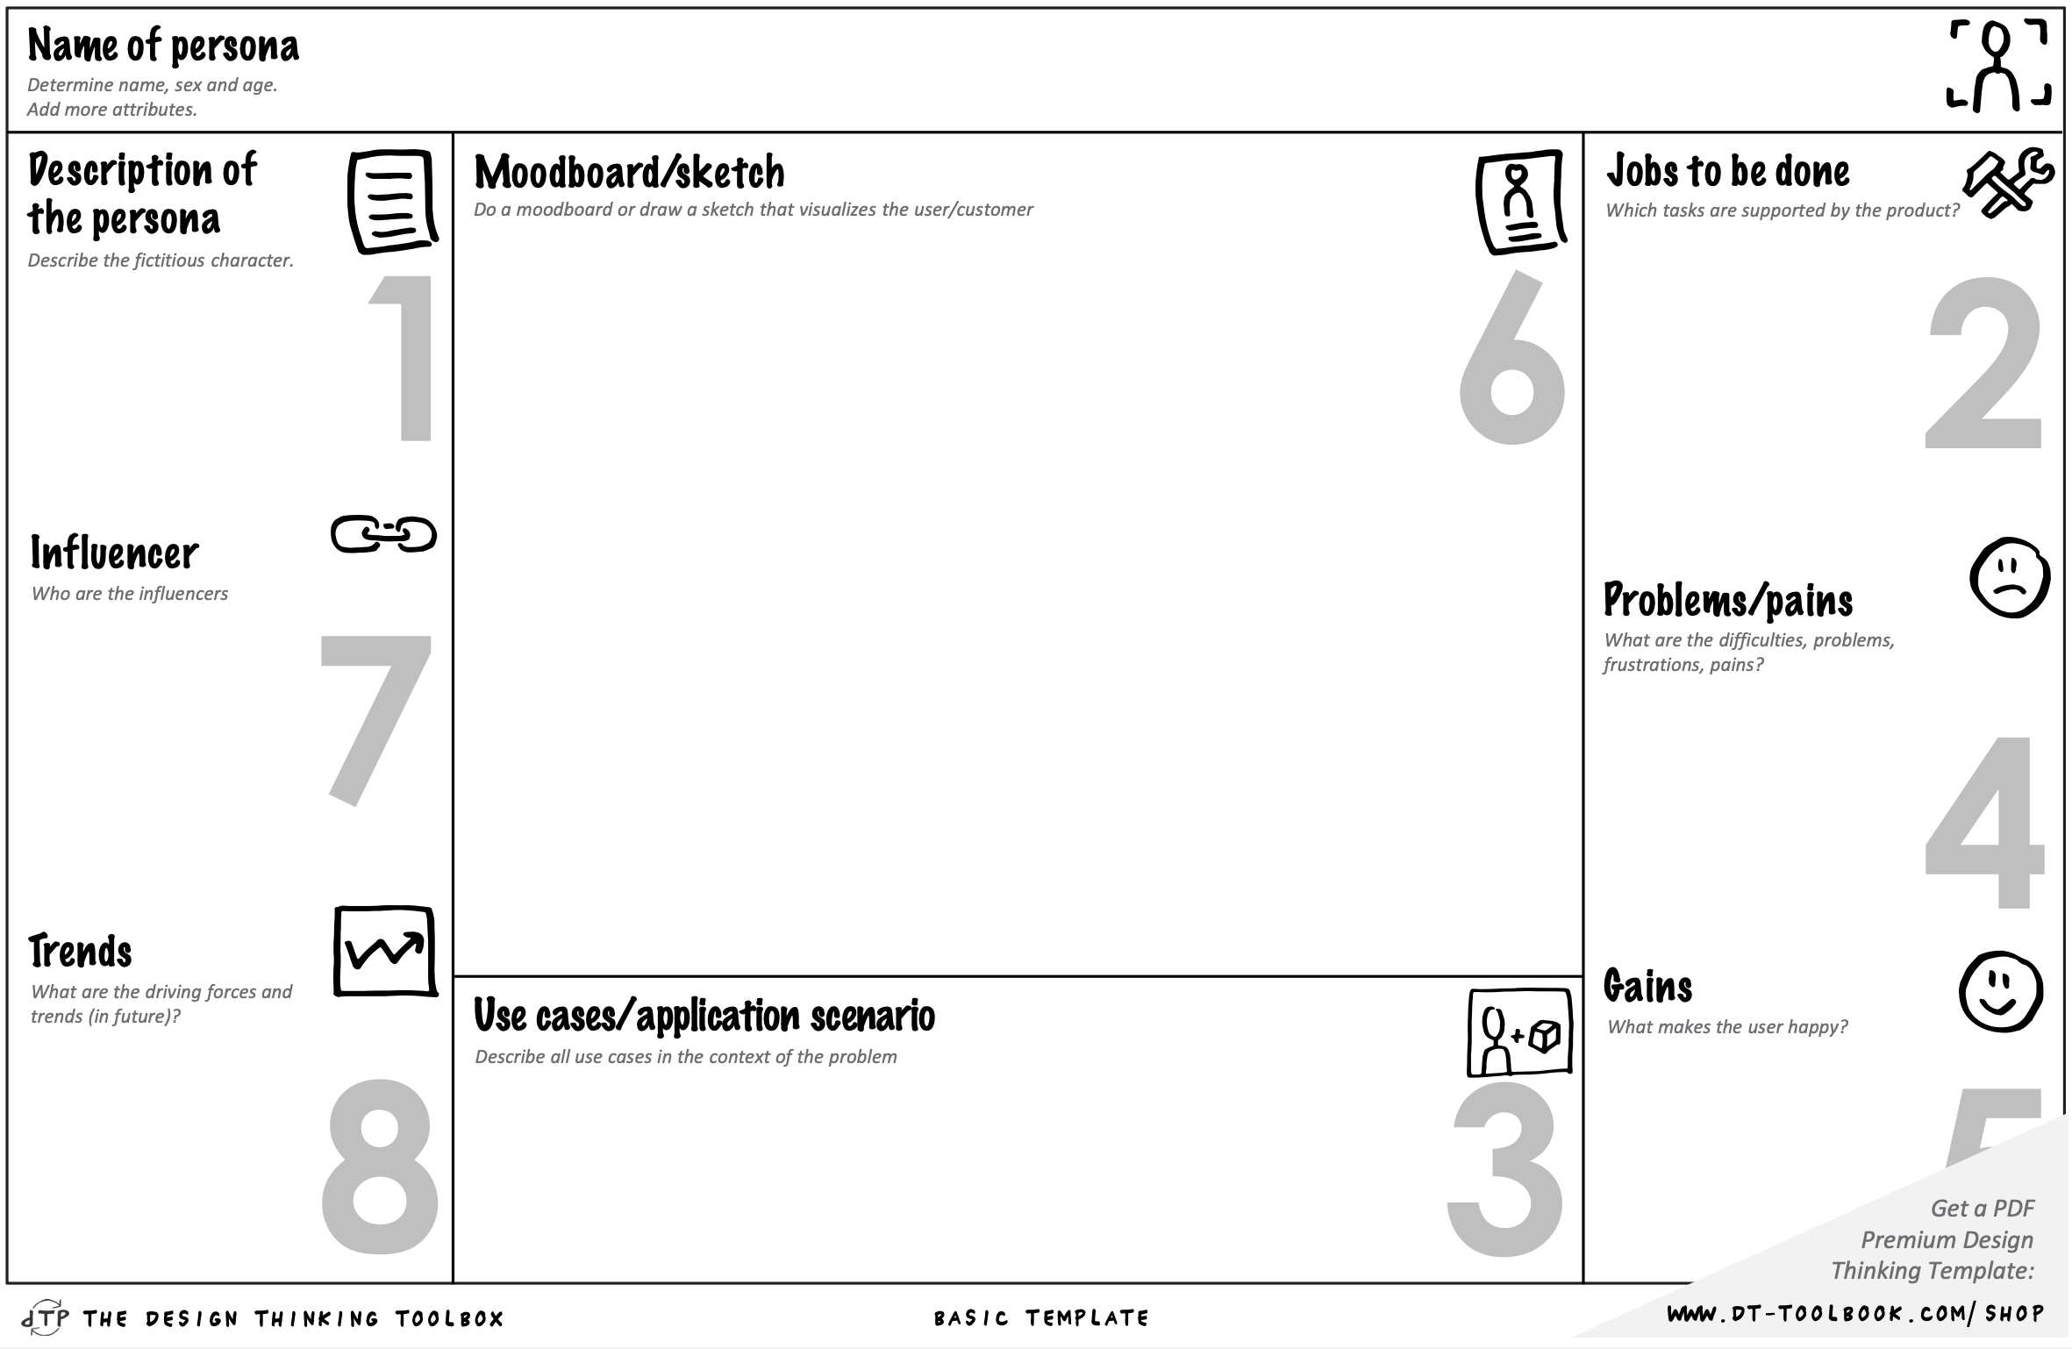

Emma Chen - Age: 21
Completed undergraduate degree in Singapore where information was centralized in one student portal
Active user of AI tools like ChatGPT for study support
Program: Ma GS, 1st year
Nationality: Singapore
Living Situation: Shared apartment in Maastricht
Tech Proficiency: High (daily smartphone user, comfortable with apps)
Languages: English (fluent), Mandarin (native), Dutch (basic/learning)
Difficulty determining if information is up-to-date
Platform-hopping is exhausting
Emma moved to Maastricht 4 months ago for her master's degree. As an international student, she's navigating not just academic requirements but also visa regulations, housing procedures, and Dutch bureaucracy.
Stay compliant with visa and residence permit requirements
Access student services (healthcare, counseling, career support)

Slide 4
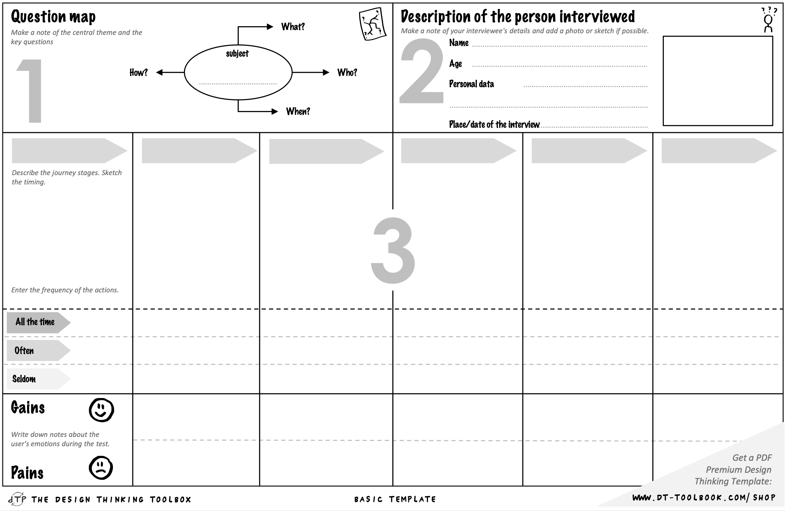
Peter
1st year BA DS
Lisa needs to find the deadline for course registration for Period 3
1 - Awareness
2 – Initial Search
3 – Frustration
4 – Seeking help
5 – Resolution
Remembers professor mentioned registration
Checks email for announcements
Opens UM website
Searches "course registration
Clicks on 3-4 different links
Tries Student Portal login
Checks Canvas announcements
Finds conflicting dates on different platforms
Posts in class WhatsApp group
Waits for responses
Emails study advisor
Waits 24-48 hours for response |
Receives email from student advisor (2 days
Gets the correct deadline
Shares with classmates who had same question
😮‍💨 Relieved but exhausted, residual frustration
😊 Neutral, slightly concerned
😕 Confused, slightly frustrated
😤 Frustrated, anxious, overwhelmed
😰 Anxious, embarrassed, stressed

Slide 5
