Slide 1
Lab meeting 5/28/13

Slide 2
Questions
What are the spatiotemporal dynamics involved in repetition task?
What role does each region play during task?
How does activity differ by word type?

Slide 3
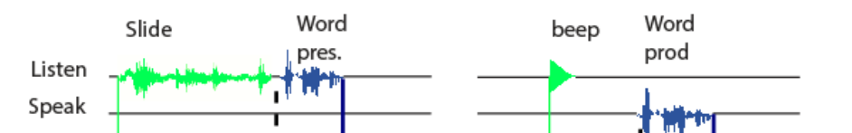
Experimental Design
28 real words presented by speakers (vary by length, frequency, and articulatory difficulty)
2 second delay
Go Cue
Subject repeat word

Slide 4
Schematic of repetition
spectro-temporal
Ear/primary auditory cortex
phonetic
semantic
lexical
pSTG
storage/buffering
IPL
phonological encoding
motor planning
vPMC/pars opercula
articulation

Slide 5
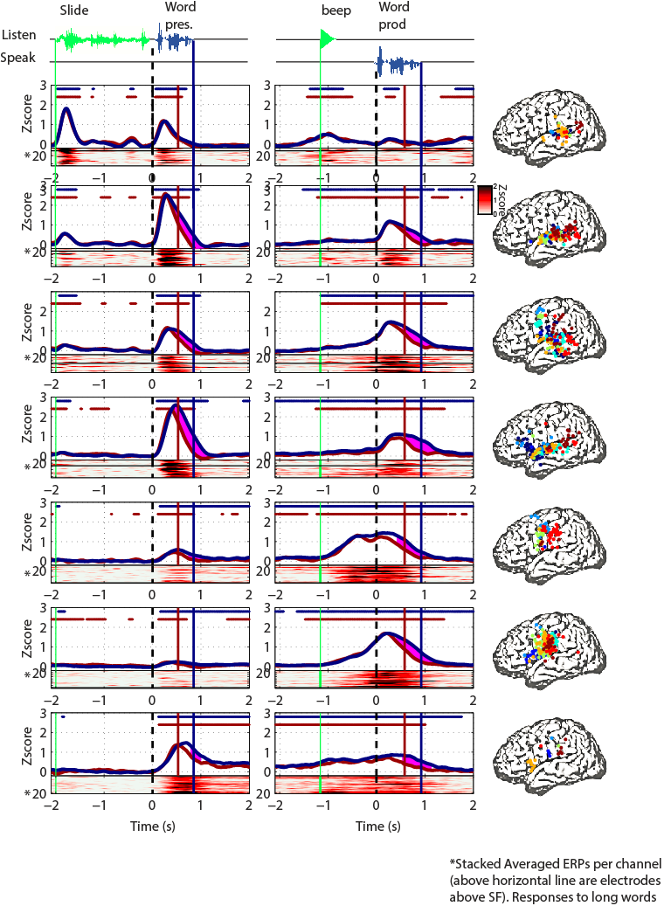

Average Electrode ERPs
1
2
3
4
5
6
7

Slide 6
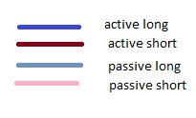
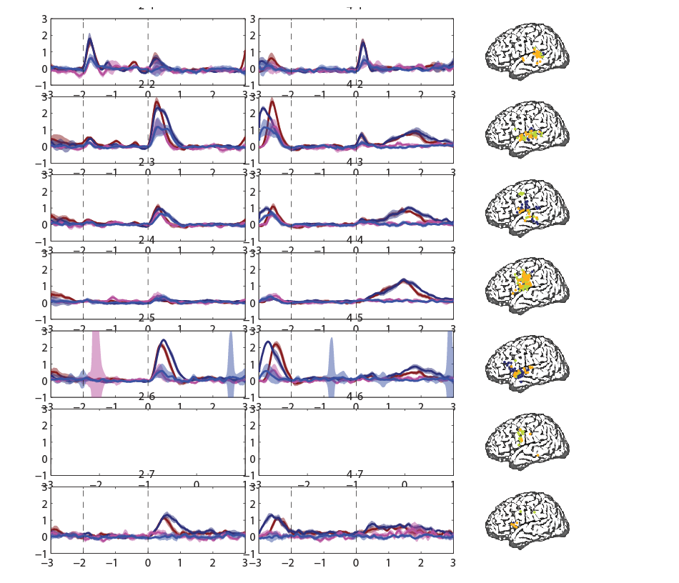
Active vs passive
Word
start
Word
end
slide
cue
1
2
3
4
5
6
7

Slide 7
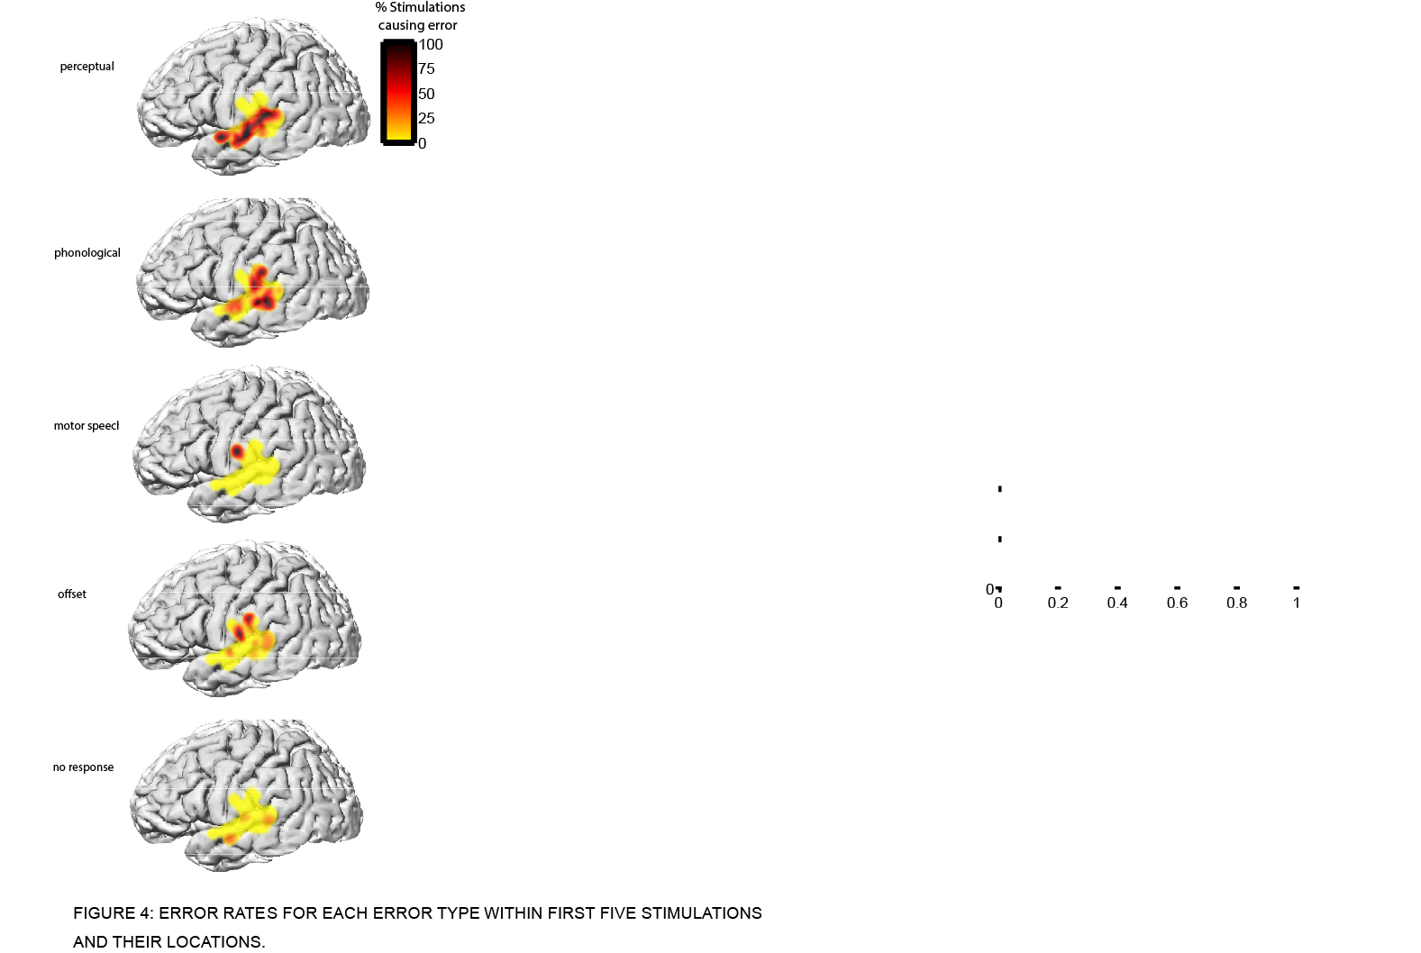
Error category | Criteria | Example
No response (nr) | No verbal response
Perceptual (per) | Patient appear­­­s to have not "heard" the target word | "huh", "what", "I don't know", "can you repeat that?"
Phonological (ph) | Addition, deletion, substitution, or transposition of phonemes of the target word | "de" for debate, "opti" for optimism, "caterpilly" for caterpillar, "fedometer" for speedometer
Offset (off) | Delay in response until stimulation is terminated | "say...delivery" [stimulation offset] → "delivery"
Motor speech (ms) | Phonologically correct, but the phonetic quality is altered (i.e., slurred or distorted) | "prosperity" [slurred]
Real word substitution (rws) | Response word that is not the target word | "declaration" for decoration

Slide 8
1. pSTG
Word
start
Prod
start
slide
cue
Short E Vs
Long E
Long E Vs
Long D
Long F Vs
Long I
Word
start
Word
end
slide
cue
Active Vs
Passive

Slide 9
2. STG
Word
start
Prod
start
slide
cue
Short E Vs
Long E
Long E Vs
Long D
Long F Vs
Long I
Word
start
Word
end
slide
cue
Active Vs
Passive

Slide 10
3.
Word
start
Prod
start
slide
cue
Short E Vs
Long E
Long E Vs
Long D
Long F Vs
Long I
Word
start
Word
end
slide
cue
Active Vs
Passive

Slide 11
4. Motor
Word
start
Prod
start
slide
cue
Short E Vs
Long E
Long E Vs
Long D
Long F Vs
Long I
Word
start
Word
end
slide
cue
Active Vs
Passive

Slide 12
5. Broca/aSTG
Word
start
Prod
start
slide
cue
Short E Vs
Long E
Long E Vs
Long D
Long F Vs
Long I
Word
start
Word
end
slide
cue
Active Vs
Passive

Slide 13
6. Dorsal CS
Word
start
Prod
start
slide
cue
Short E Vs
Long E
Long E Vs
Long D
Long F Vs
Long I

Slide 14
7. Delay
Word
start
Prod
start
slide
cue
Short E Vs
Long E
Long E Vs
Long D
Long F Vs
Long I
Word
start
Word
end
slide
cue
Active Vs
Passive

Slide 15
Appendix

Slide 16
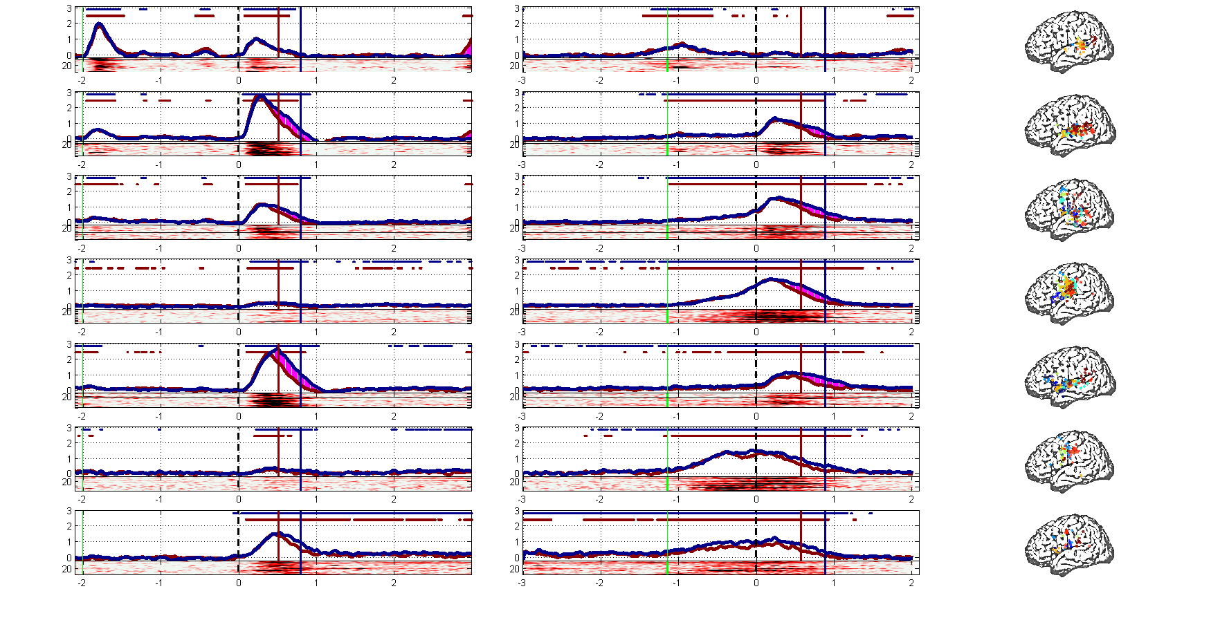
Se vs le

Slide 17
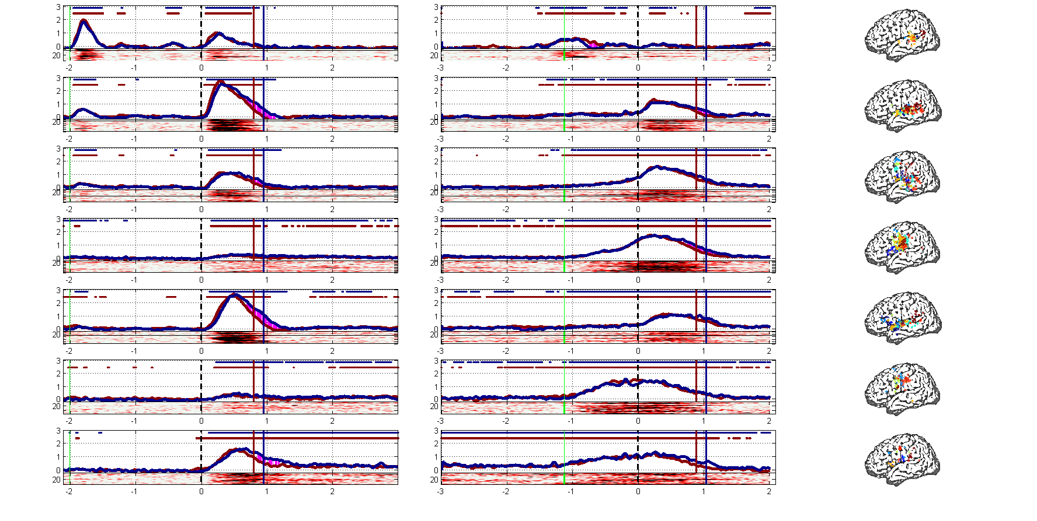
Le vs ld

Slide 18
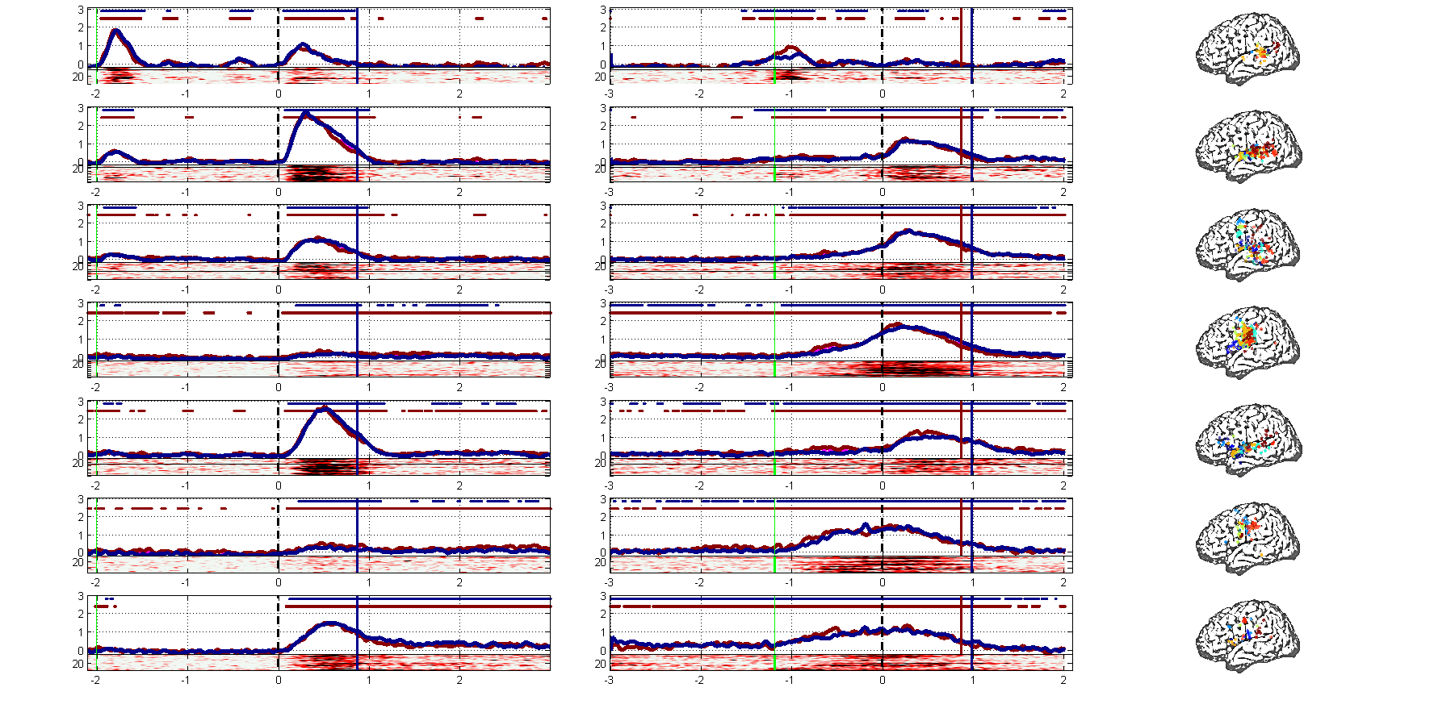
Lf vs li

Slide 19
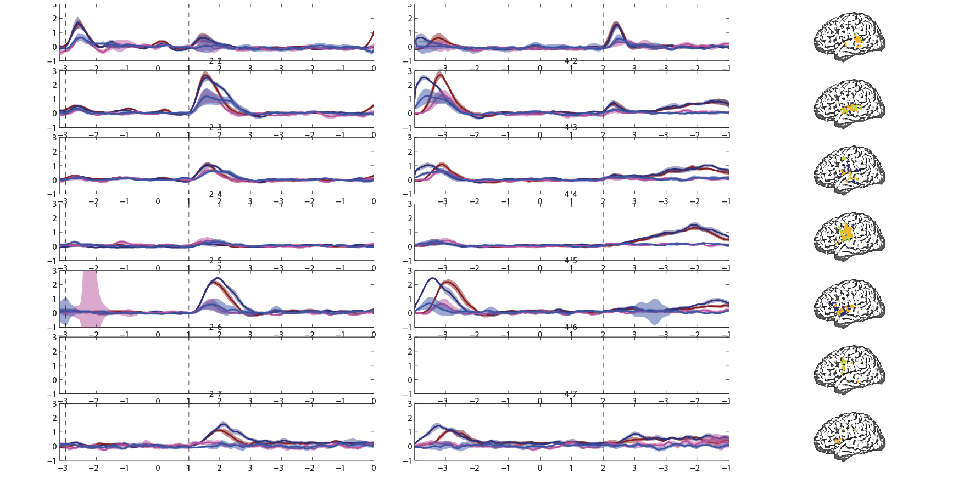

Slide 20
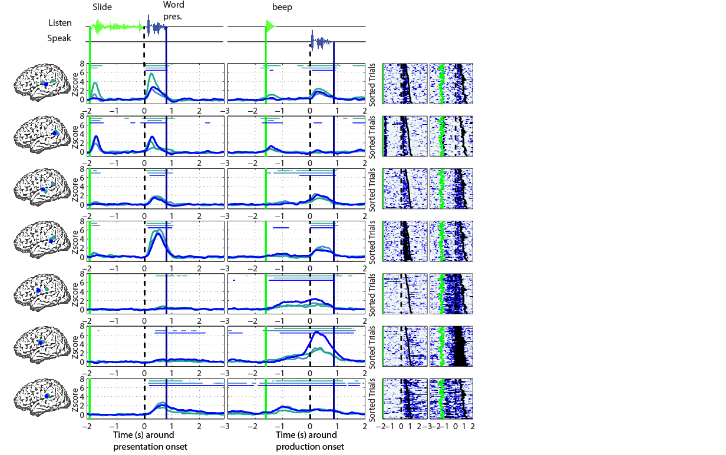

Slide 21
