Slide 2
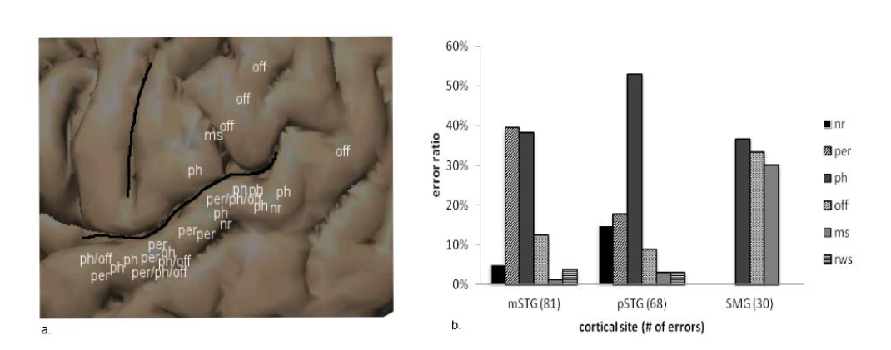
Error type by location
Figure 4: a. Enlarged view of the posterior perisylvian cortex. Black lines demarcate the Sylvian fissure (horizontally) and the central sulcus (vertically). Individual repetition sites labeled according to their most prominent error type: perceptual (per), phonological (ph), no response (NR), offset (off), motor speech (ms). Sites with equal distributions of error types are labeled with multiple abbreviations (e.g., ph/off indicates an equal and prominent distribution of phonological and offset errors at that site).b. Ratio of error type according to cortical site. The numbers in parentheses equal the total number of errors in each region. Error codes: NR = no response; per = perceptual; ph = phonological; off = offset; ms = motor speech; rws = real word substitution

Slide 3
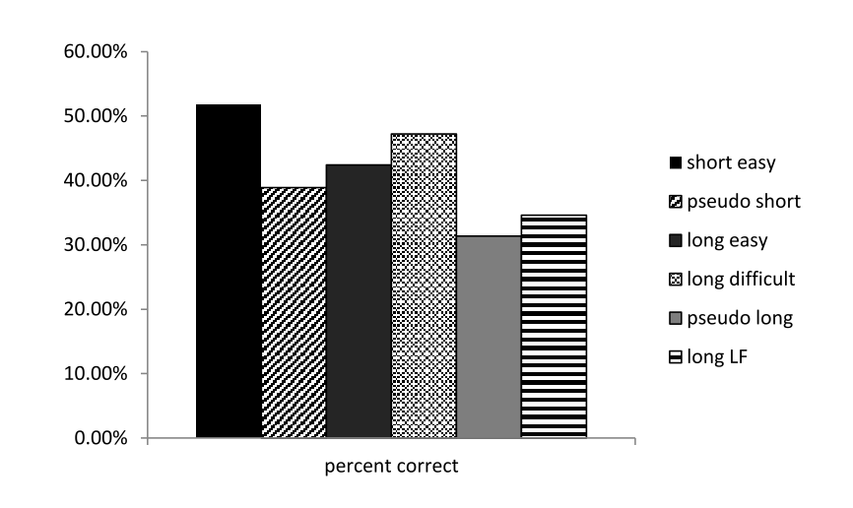
Error rate by word type
Figure 5: Percent correct according to word type. Short easy = two-syllable words, easy to articulate words; pseudo short = two-syllable pseudowords; long easy = four-syllable, easy to articulate words; long difficult = four-syllable, difficult to articulate words; pseudo long = four- syllable pseudowords; long LF = three and four-syllable low frequency words

Slide 4
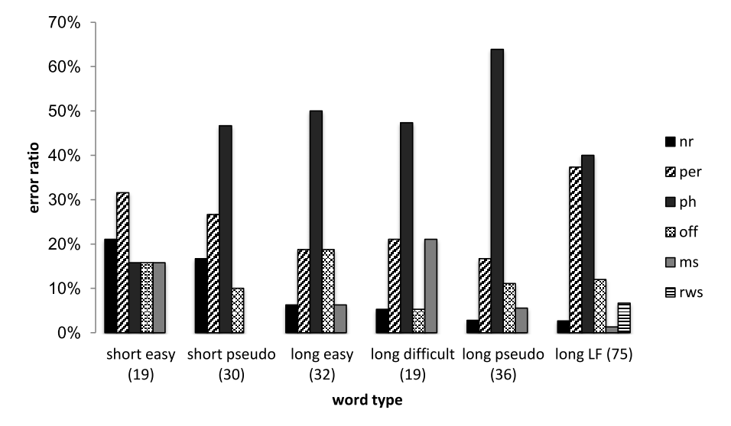
Error type by word type
Figure 6: Ratio of types of errors according to word type. Error codes: NR = no response; per = perceptual; ph = phonological; off = offset; ms = motor speech; rws = real word substitution

Slide 5
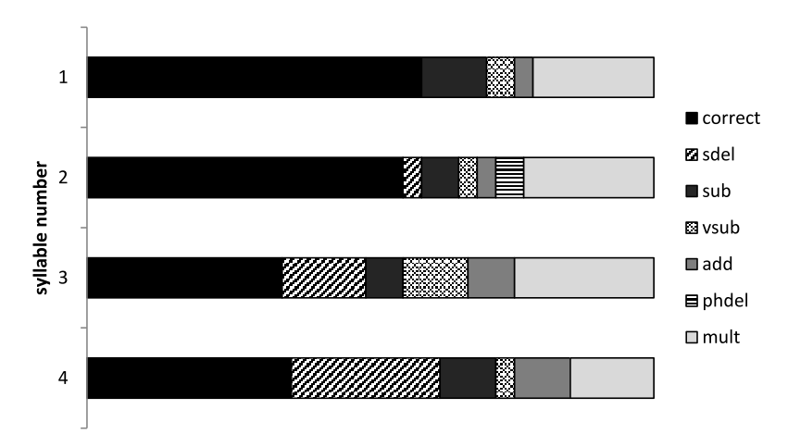
Phonological Error type by Syllable
Figure 7: Proportion of error types per syllable of four-syllable phonological errors. Each horizontal bar represents a syllable. correct = target syllable; sdel = syllable deletion; sub = substitution of consonant phoneme; vsub = substitution of the vowel; add = addition of a phoneme; phdel = deletion of a phoneme; mult = multiple errors per syllable or alteration of both consonant and vowel within a syllable

