Slide 1
Processes involved in perception and production during single word repetition

Slide 2
Questions
What are the spatiotemporal dynamics of cortical networks during word repetition task?
Which regions are crucial for perception, short term memory, and production?

Slide 3
Schematic of repetition
spectro-temporal
Ear/primary auditory cortex
phonetic
semantic
lexical
pSTG
storage/buffering
IPL
phonological encoding
motor planning
vPMC/pars opercula
articulation

Slide 4
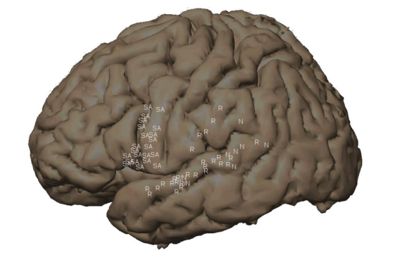
Regions of interest from stimulation
mSTG - perceptual & phonetic errors
pSTG -phonetic errors
aSTG
STS
IFG -speech arrest
dSMC -vocalization
SMG -motor speech
vPMC -speech arrest
Source: Miranda

Slide 5
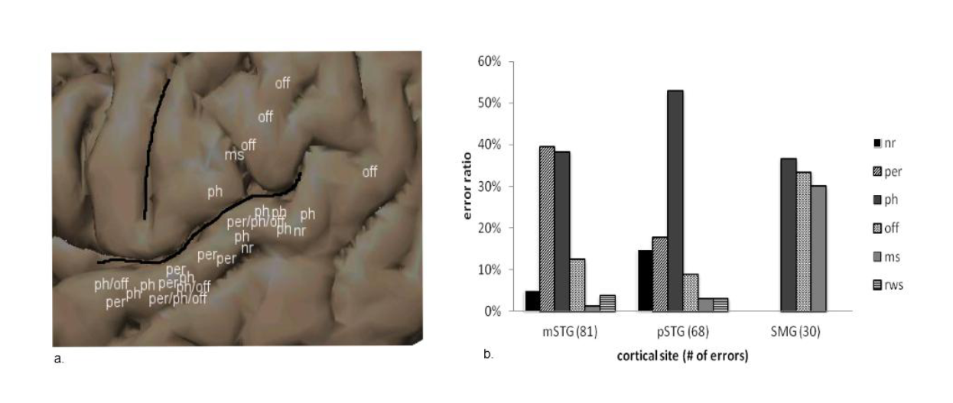
Cortical Stimulation Results (No Delay)
mSTG: perceptual & phonological errors
pSTG: mostly phonological errors
SMG: offset, motor speech, phonological
Source: Miranda, 2012!
Notes:
Phonological errors from mSTG and pSTG are behaviorally the same
The dominance of pSTG by phonetic errors is particularly striking
Of note, the motor speech errors on SMG are all accounted for by one patient (patient 38).

Slide 6
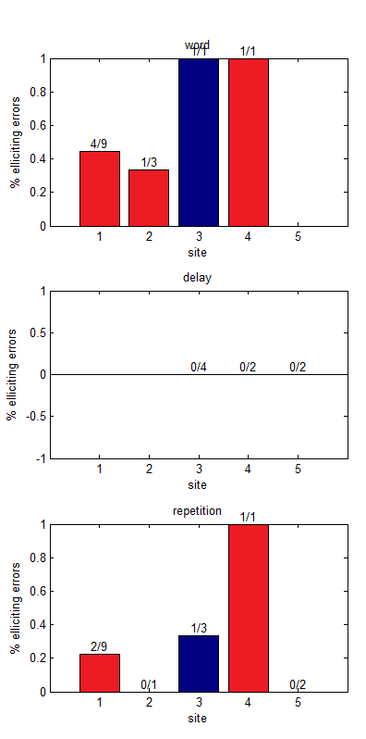
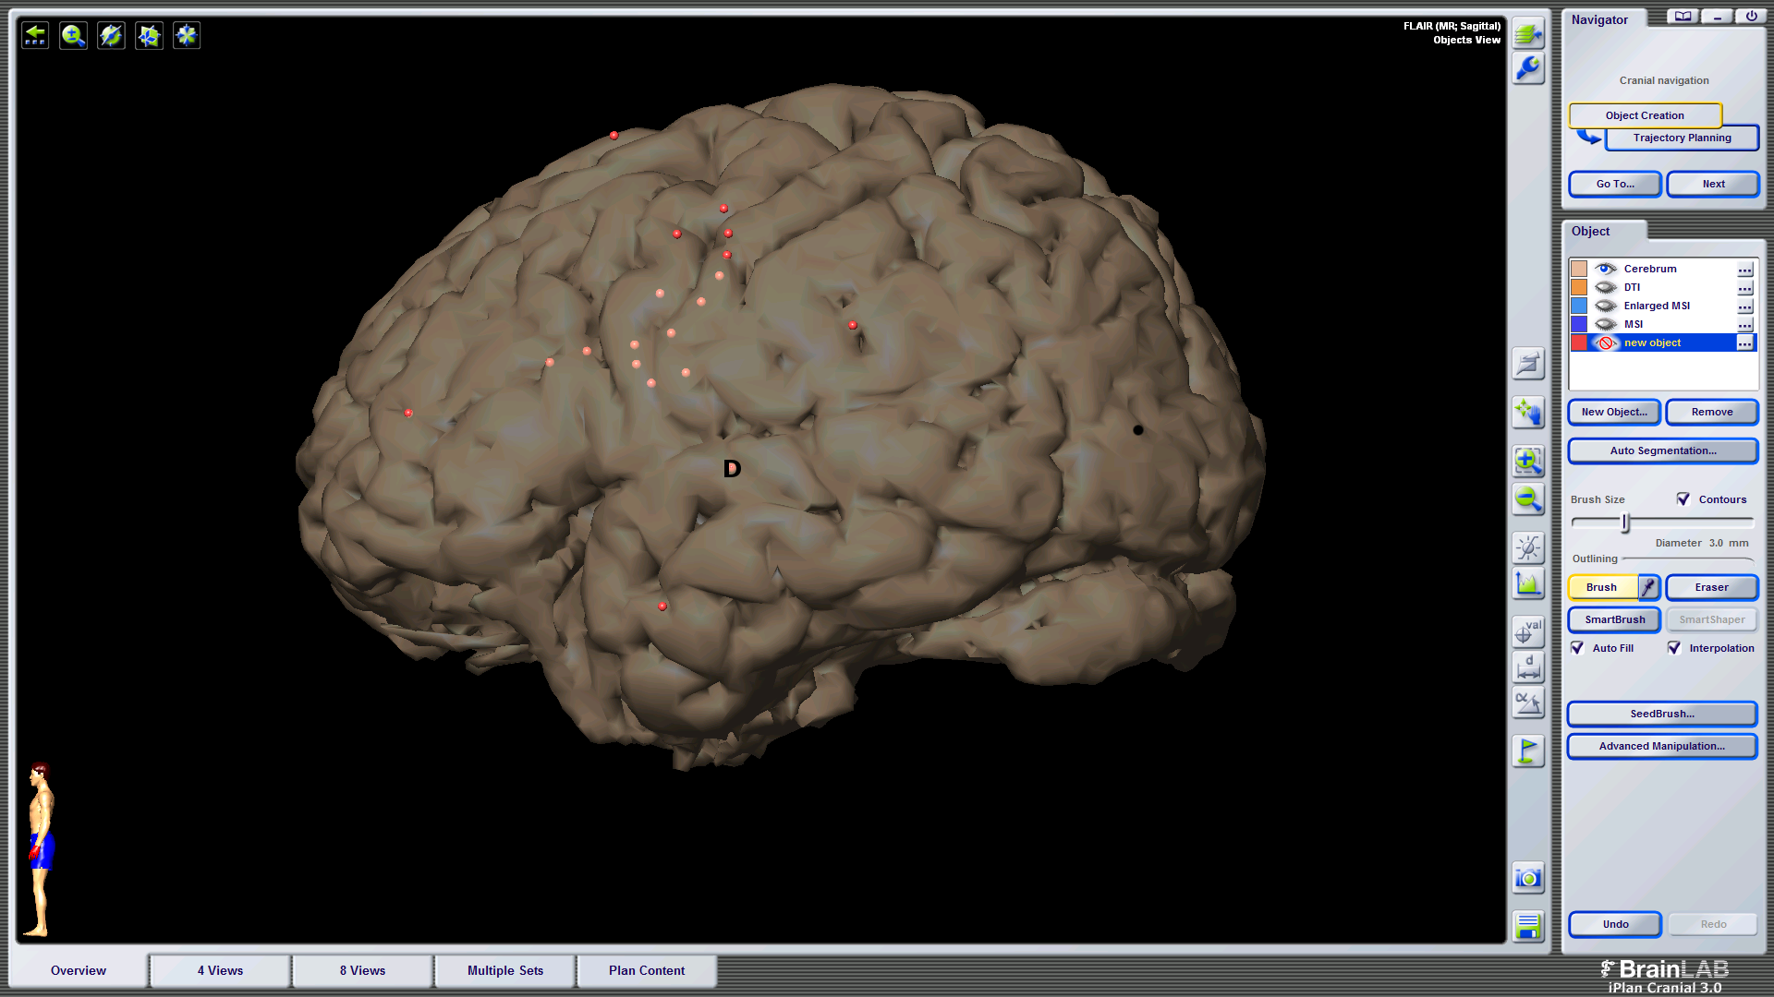
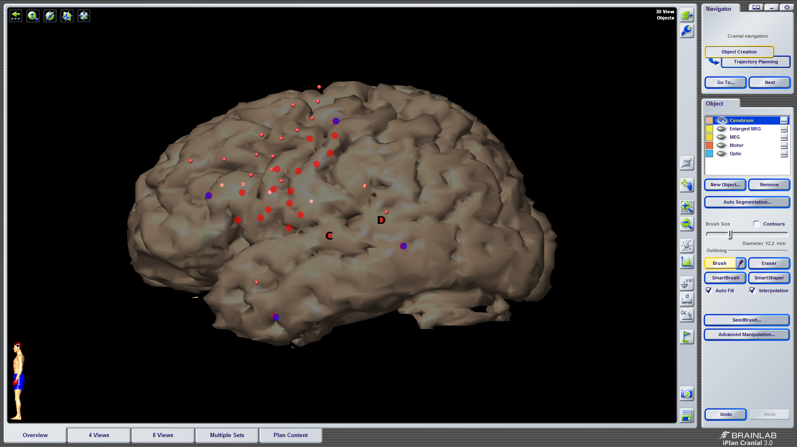
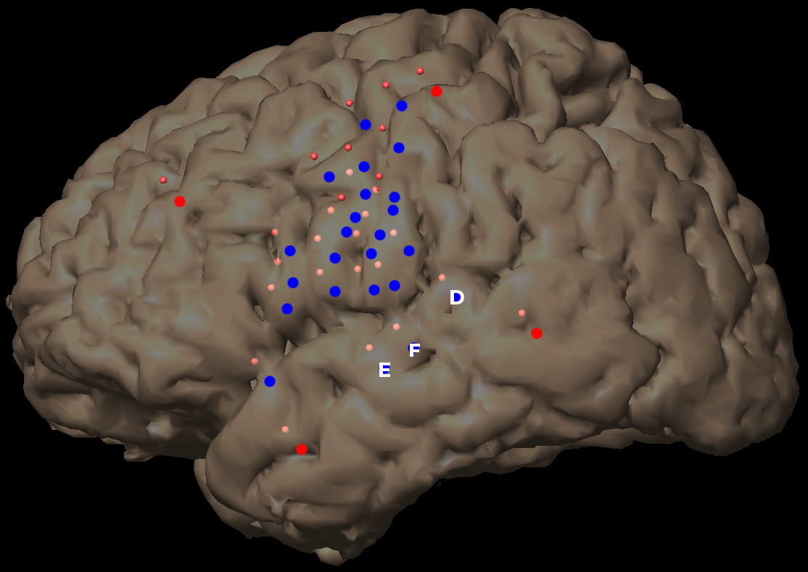
Stimulation error rates (with Delay)

Slide 7
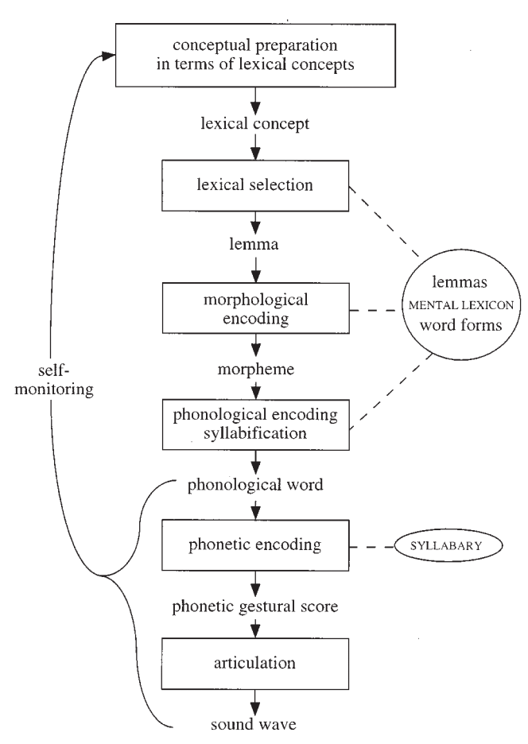
Model of lexical access in speech production*
*Levelt

Slide 8
Dual Stream Model*
Bilateral
Ventral
Dorsal
Left Spt maps acoustic to articulatory; phonological store in STG
Left pSTG is phonological store
Based on conduction aphasia
Projects to frontal/pre-motor regions
*Hickok and Poeppel

Slide 9
Conduction aphasia
frequent phonemic paraphasias
impaired verbatim repetition- short term memory
naming difficulties- responsive to cuing
Self-monitoring- relatively spared auditory comprehension
Linked to articulatory planning load

Slide 10
Working memory
Phonological Loop*
Processes involved in speech production recruited for subvocal rehearsal (pSTG, SMG)**
* Baddeley
**Buchsbaum

Slide 11
Non-dominant Hemisphere
Dual stream model: speech perception bilateral
Aphasics recruit non-dominant Broca’s and Wernicke’s areas*
*Ohyama

Slide 12
No stim effects during delay– where is phonological store?
Are phonetic errors due to feedback or altered code to motor regions?
Do behaviorally similar errors during perception and production differ?
Why does stimulation of left hemisphere cause perceptual errors?

Slide 13
Presentation
Production

Slide 14
mSTG
pSTG

